Slide 1
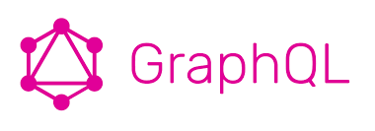
GRAPHQL
GraphQL

Slide 2
What is GraphQL ?
GraphQL is a query language
GraphQL is an open source server-side technology
which was developed by Facebook to optimize RESTful API calls
It is an execution engine and a data query language.
Concepts of GraphQL −
1. Implement GraphQL API using GraphQL Server
2. Test GraphQL API using GraphiQL
3. Client applications to consume the API

Slide 3
Advantages of GraphQL
1. Ask for what you want − and get it
- Send a GraphQL query to your API and get exactly what you need.
- GraphQL queries always return predictable results.
- Applications using GraphQL are fast and stable.
Example :
1. Consider a business object ViewProfile with the attributes MatriId, firstName, lastName and LastCommunication.
2. Suppose a mobile application needs to fetch only the firstName and MatriId.
3. If we design a REST endpoint like /api/v1/viewprofile, it will end up fetching data for all the fields for a ViewProfile object.
This problem can be solved by using GraphQL.

Slide 4
Consider the GraphQL query given below −
{
ViewProfile {
MatriId
firstName
}
}
This will return values only for the MatriId and firstname fields.
{
"data": {
"viewprofile": [
{
"MatriId": "M1001",
"firstName": "durai"
},
{
"MatriId": "M1002",
"firstName": "Sathrak"
}
]
}
}

Slide 5
2. Get many resources in a single request
- GraphQL APIs fetch all the data your application need in a single request.
- Applications using GraphQL can be quick even on slow mobile network connections.
Example :
1. Consider one more business object, Communication which has the attributes: name and location.
2. The ViewProfile business object has an association relationship with the Communication object.
3. If we were to use a REST API in order to fetch the details of ViewProfile and their Communication, we will end up making two requests to the server like /api/v1/ViewProfile and /api/v1/Communication.
4. So mobile applications are forced to make multiple calls to the server to get the desired data.
Mobile application can fetch details for both Student and College objects in a single request by using GraphQL.

Slide 6
The following is a GraphQL query to fetch data −
{
viewprofile{
MatriId
firstName
lastName
communication{
name
location
}
}
}
The output of the above query contains exactly those fields we have requested for as shown below −
{
"data": {
"viewprofile": [
{
"MatriId": "M1001",
"firstName": "Mohtashim",
"lastName": "Mohammad",
"communication": {
"name": "CUSAT",
"location": "Kerala"
}
},
{
"MatriId": "M1003",
"firstName": "Kiran",
"lastName": "Panigrahi",
"communication": {
"name": "AMU",
"location": "Uttar Pradesh"
}
}
]
}
}

Slide 7
3. Describe what’s possible with a type system
- GraphQL is strongly typed and the queries are based on fields and their associated data types.
- If there is type mismatch in a GraphQL query, server applications return clear and helpful error messages.
Example :
viewprofile and communication data types is given below −
type Query {
viewprofile:[View]
}
type View {
MatriId:ID!
firstName:String
lastName:String
fullName:String
communication:CMC
}
type CMC {
name:String
location:String
rating:Float
}

Slide 8
4. Move faster with powerful developer tools
- GraphQL provides rich developer tools for documentation and testing queries.
- GraphiQL is an excellent tool which generates documentation of the query and its schema.
How to Build a GraphQL server with Nodejs
Create a Project Folder "graphqlServer"
Create package.json and Install the Dependencies
npm install express
Install GraphQL using the following command. We will be installing graphql and graphql for express.
npm install express-graphql graphql
GraphQL - Architecture
> GraphQL server with connected database
> GraphQL server that integrates existing systems
> Hybrid approach

Slide 9
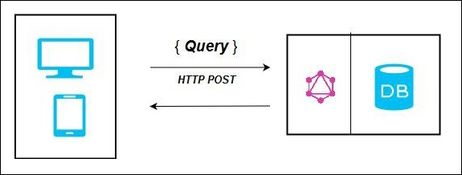
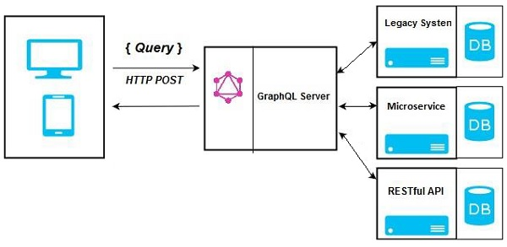
GraphQL - Architecture
GraphQL Server with Connected Database
GraphQL Server Integrating Existing Systems

Slide 10
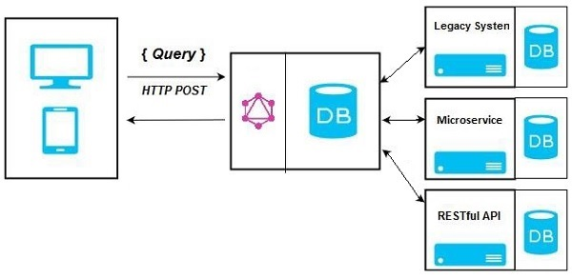
Hybrid Approach
It will either retrieve data from connected database or from the integrated API’s.

Slide 11
GraphQL - Type System
> GraphQL is a strongly typed language.
> Type System defines various data types that can be used in a GraphQL application.
Types & Description
1. Scalar Type
Stores a single value
Int − Signed 32-bit Integer
Float − Signed double precision floating point value
String − UTF - 8-character sequence
Boolean − True or false
ID − A unique identifier
The syntax for defining a scalar type is as follows −
field: data_type
Firstname: String

Slide 12
2. Object Type :
Fetch a group of fields. Each field inside an object type maps to another type, thereby allowing nested types.
Define an object type
type Viewprofile {
stud_id:ID
firstname: String
age: Int
score:Float
}
Defining a GraphQL schema
type Query
{
viewprofile:[Viewprofile]
}
3. Query Type :
A GraphQL query is used to fetch data. GraphQL uses the Schema Definition Language (SDL) to define a Query.
The syntax for defining a Query is as given below −
type Query {
field1: data_type
field2:data_type
field2(param1:data_type,param2:data_type,...paramN:data_type):data_type
}

Slide 13
4. Mutation Type :
Mutations are operations sent to the server to create, update or delete data. These are analogous to the PUT, POST, PATCH and DELETE verbs to call REST-based APIs.
For example,
type Mutation {
ViewprofileAdd(firstName: String, lastName: String): ViewProfile
}
5. Non-Nullable Type :
Exclamation mark (!) can be appended to a type
type ViewProfile {
MatriId:ID!
firstName:String
lastName:String
fullName:String
Communication:Communication
}
6. Enum Type :
An Enum is similar to a scalar type.
7. List Type:
Lists can be used to represent an array of values of specific type.
type Query {
todos: [String]
}

Slide 14
GraphQL - Schema
1. Schema is at the core of any GraphQL server implementation.
2. The root of the schema will be Query type.
Example :- query has two fields − Communication and viewprofile that returns String and a list of viewprofile respectively.
var SchemaType = `
type Query {
communication(ID: String!,VIEWEDID: String!,APPTYPE: String!):Communications
viewprofile(ID: String!,VIEWEDID: String!,APPTYPE: String!): viewprofiles
}
type viewprofiles {
RESPONSECODE: Int
ERRCODE: Int
PROFILEDET:ProfileDet
}
type ProfileDet{
VPFLAG : Int
WEBNOTIFICATION : Int
}
type Communications {
RESPONSECODE : Int
ERRCODE : Int
CMCFLAG : Int
}
}`

Slide 15
GraphQL - Resolver
GraphQL – Resolver
Resolver is a collection of functions that generate response for a GraphQL query.
var resolver = {
viewprofile(args){
return this.api.get('/view',{params:args}).then(res => res.data)
},
communication(args){
return this.comapi.get('/cmc',{params:args}).then(res => res.data);
}
};

Slide 16
GraphQL - Query
GraphQL - Query
var query = {
"viewprofile":`{
ERRCODE,
RESPONSECODE,
PROFILEDET
}`,
"communication":`{
ERRCODE,
RESPONSECODE,
CMCFLAG,
COMMUNICATIONACTION
}`
};
GraphQL -
graphql(schemaType, query, resolvers).then((response) => {
res.send(response);
next();
});

Slide 17
GRAPHQL - DEMO
http://192.168.20.69:4000/graphql

Slide 18
Thanks

