Slide 1
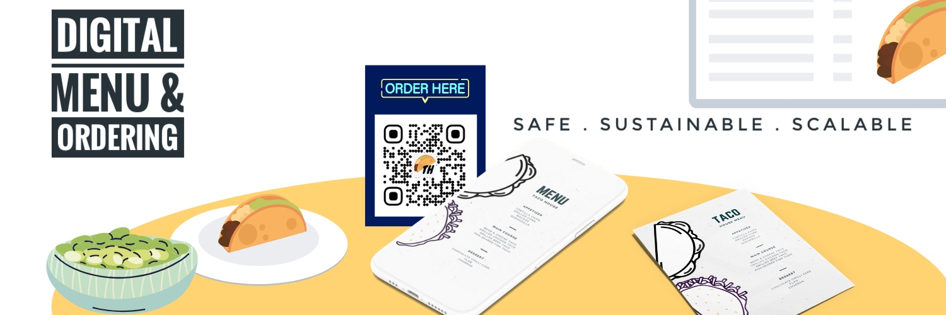

Slide 2
Team 18
Humble pixies
Team Members
Sathu Tarimela, Ashwini Reddy, Mounika Thotakura, Rishmitha

Slide 3

Storyline
Since early 2020, we have witnessed the spread of Coronavirus across the world. Its impact has been so huge that it has redefined the way of living for every individual.
The Food & Beverage industry has been one of the most affected due to the pandemic.
We’d like to propose a digital solution in the form of an app to provide a secure dining experience to customers by enabling customers to view the menu of a restaurant by just scanning a QR code at their table and being able to order food at their convenience.

Slide 4
Problem Statement
Going by the recent positive developments, the downward trend in recorded positive cases has encouraged governments to let their businesses open up with limited capacities and utmost precautions. The Food & Beverage industry has been one of the most affected due to the pandemic. Especially, restaurants whose business model is majorly designed around dine in concept had seen losses due to drop in daily customer footfall.
Although, recommencing of restaurants comes as a huge relief to both owners and customers. Restaurants are expected to maintain few standards that’ll limit the spread of infections. Infact, CDC (Centers for Disease Control and Prevention) suggests minimizing the use of reusable physical menus in the restaurants. For the same reason, dine in businesses have been looking for effective and efficient ways to limit physical contact throughout the dine in process.

Slide 5
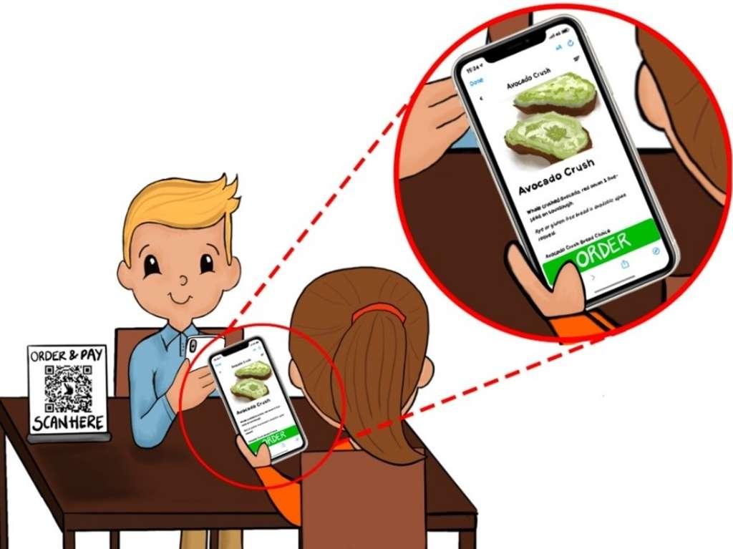
Proposed Solution
We have proposed to develop a digital solution in the form of an app to provide a secure dining experience to customers by enabling customers to view the menu of a restaurant by just scanning a QR code at their table and being able to order food at their convenience. As an addition to the main feature mentioned above, app users would also be able to access the list of restaurants available in and around a zip code in the US regions.

Slide 6
Features
RESTAURANTS PERSPECTIVE
Maintaining minimal contact has not just become an imposed guideline for restaurants, rather, a welcomed norm. Having a QR code approach to menus and ordering is definitely going to achieve that goal. This would also cost less when compared to having disposable menus or heavy backlit menu boards. Enabling customers to order through the app would also decrease the number of on duty staff in the restaurant. Our solution enables flexibility to restaurants to easily tweak their menus whenever there are changes.
CUSTOMERS PERSPECTIVE
Most important advantage of having digital menus is to limit the number of things a customer might require to touch in a restaurant. This would make the whole dining experience safer. This approach would also reduce the possibility of miscommunication and increase the flexibility when placing the order.

Slide 7
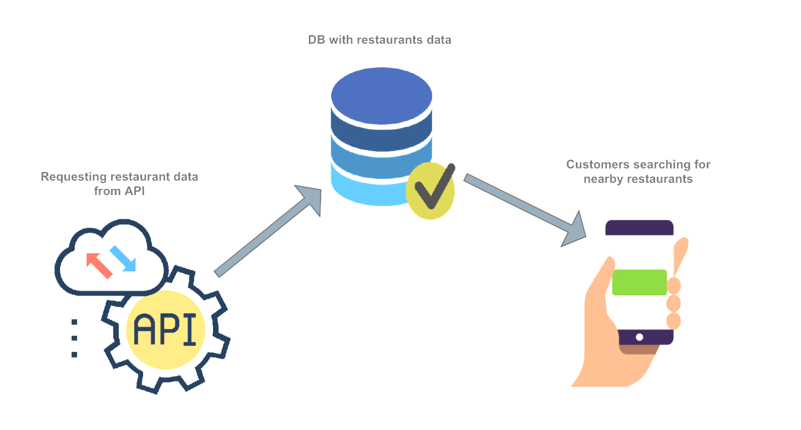
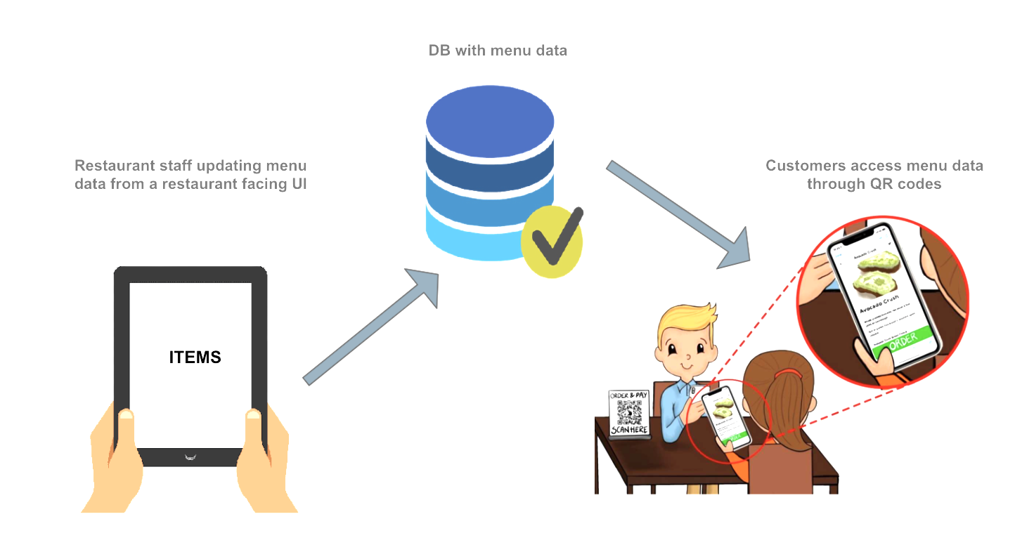
Data & its details
FOURSQUARE - Nearby restaurants data
Few of the many attributes their schema holds are latitude/longitude information, address, telephone number, social media links, rating, price, popularity score etc.
ALLMENUS.COM - Restaurant menu data
The menu data contains items along with their ingredients under various food headers (Salads, Hot dishes) along with their prices.

Slide 8
Tech Stack
MongoDB
Express.js
Angular
Node.js

Slide 9
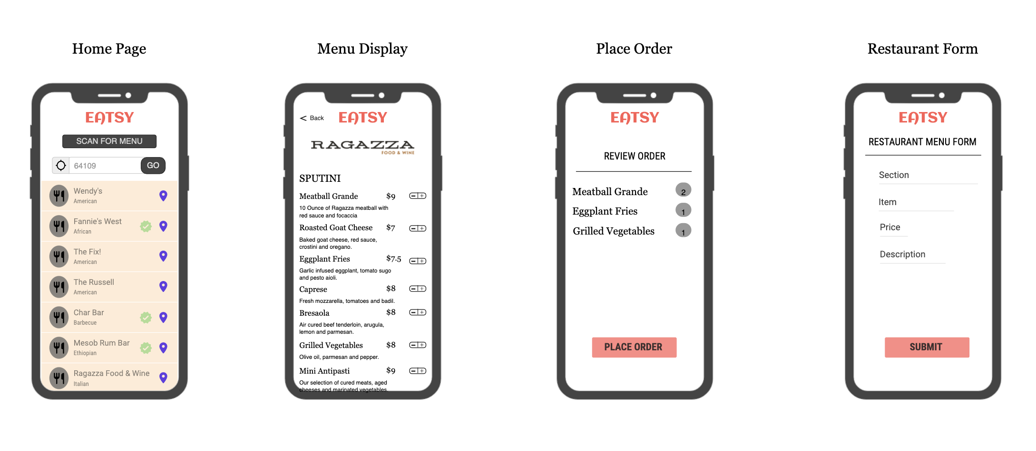
Initial UI design

Slide 10
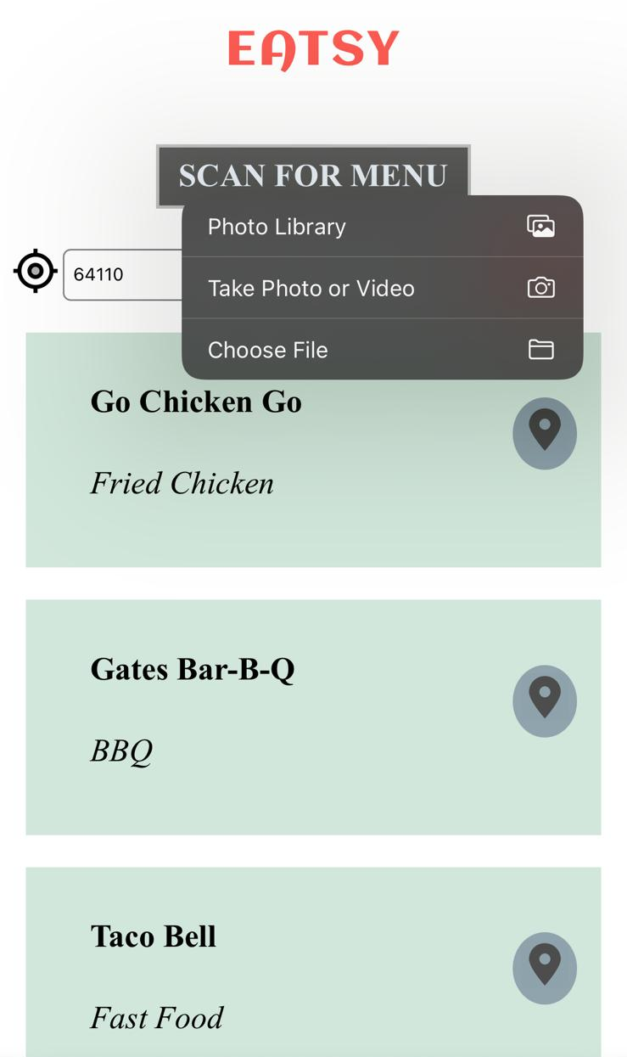
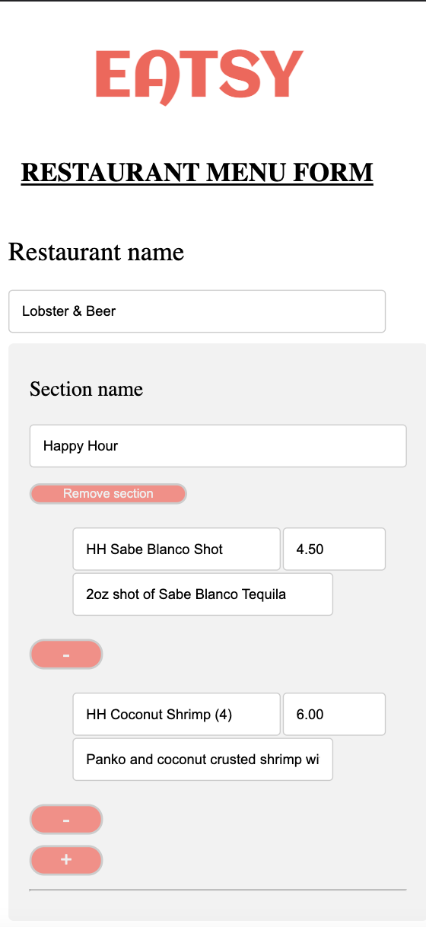
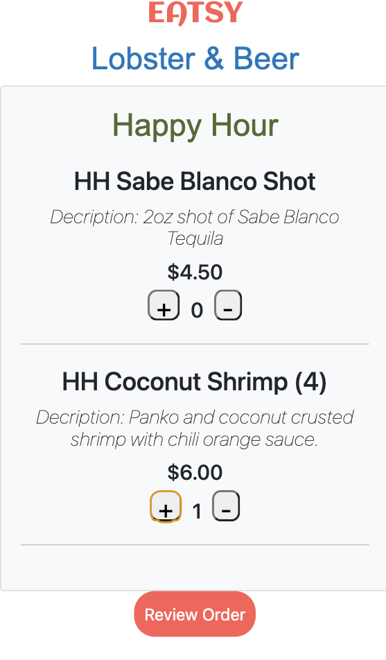
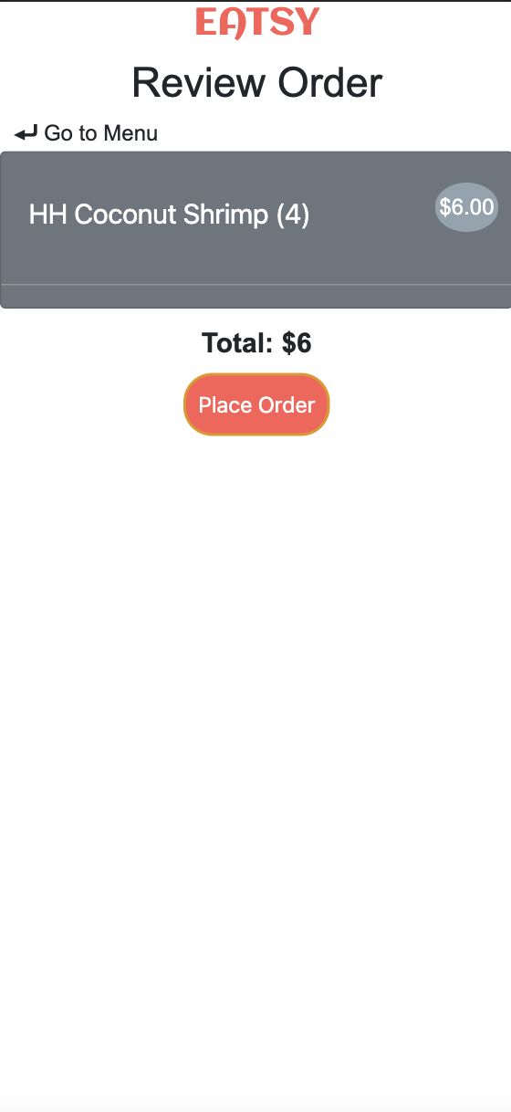
Implementation Outcome
Home Page
Menu Display
Place Order
Restaurant Form

Slide 11
REFERENCES
(Harvard reference style)
Monika Adarsh (2020) . Restaurant menus: disposable, digital, QR code — post COVID [https://medium.com/@monikaadarsh/disposable-menus-digital-menus-qr-code-menus-comparing-solutions-for-restaurants-post-covid-db227ac00d0b]
Centers for Disease Control and Prevention (2021) . Considerations for Restaurant and Bar Operators [https://www.cdc.gov/coronavirus/2019-ncov/community/organizations/business-employers/bars-restaurants.html]
Foursquare (2020) Documentation. Available at: https://developer.foursquare.com/docs/places-api/ (Accessed: Oct 2, 2021 )
Allmenus.com (2020) Available at: https://www.allmenus.com/ (Accessed: Oct 2, 2021 )
Qrcode-monkey.com Available at: https://www.qrcode-monkey.com/ (Accessed: Oct 3, 2021 )

Slide 12
THANK YOU

