Slide 1


INFORMATION RETRIEVAL Assignment-1: Stack Overflow Dataset
Teammates: Sai Sathvick Chirakala
Maitreyi Naik
Nikhila Ratakonda
Instructor: Dr. Fang Jin

Slide 2
Contents
Dataset Introduction
Defining query
Term frequency and Inverse document frequency
Tf-idf score
Visualization of tf-idf
Cosine similarity
Word cloud

Slide 3
1. Dataset Introduction
A Stackoverflow dataset is taken, which is a little noisy.
Stackoverflow-data-idf.json file has 20000 questions posted and 19 columns.
19 columns include post title, body, tags, dates and other media.
After preprocessing the data, total terms left are 666637.

Slide 4
2. Query
Variabl
Python
Color
String
Java
Framework
Ajax
Git
Help
Null
File
Stopwords: I, according, almost, already, always.

Slide 5
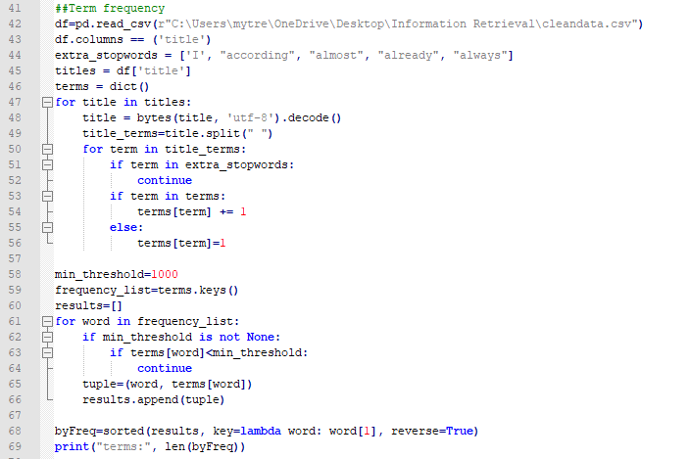
3. Term Frequency

Slide 6
IDF
Variabl | 7.896572202700973
Python | 7.156172137290483
Color | 7.381722428635257
String | 5.551360293245164
Java | 7.08206416513676
Framework | 7.800529153680996
Ajax | 7.815289569264116
Git | 8.030103595325496
Help | 5.585555017988336
Null | 7.1504194848010325
File | 4.984484546021622

Slide 7
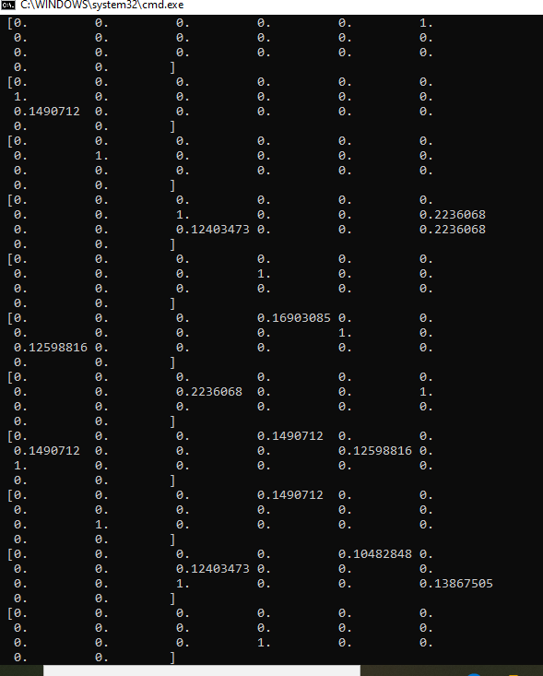
4. Tf-idf Score

Slide 8
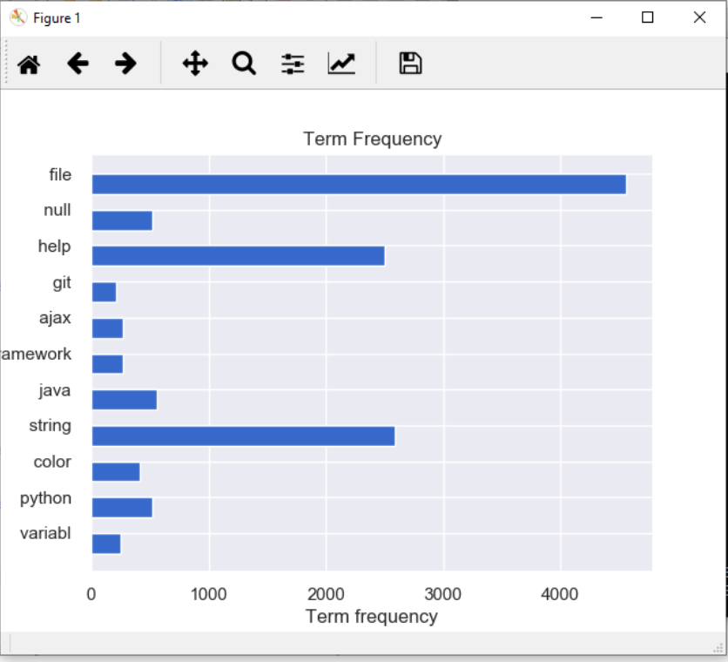
5. Visualization of tf-idf score

Slide 9
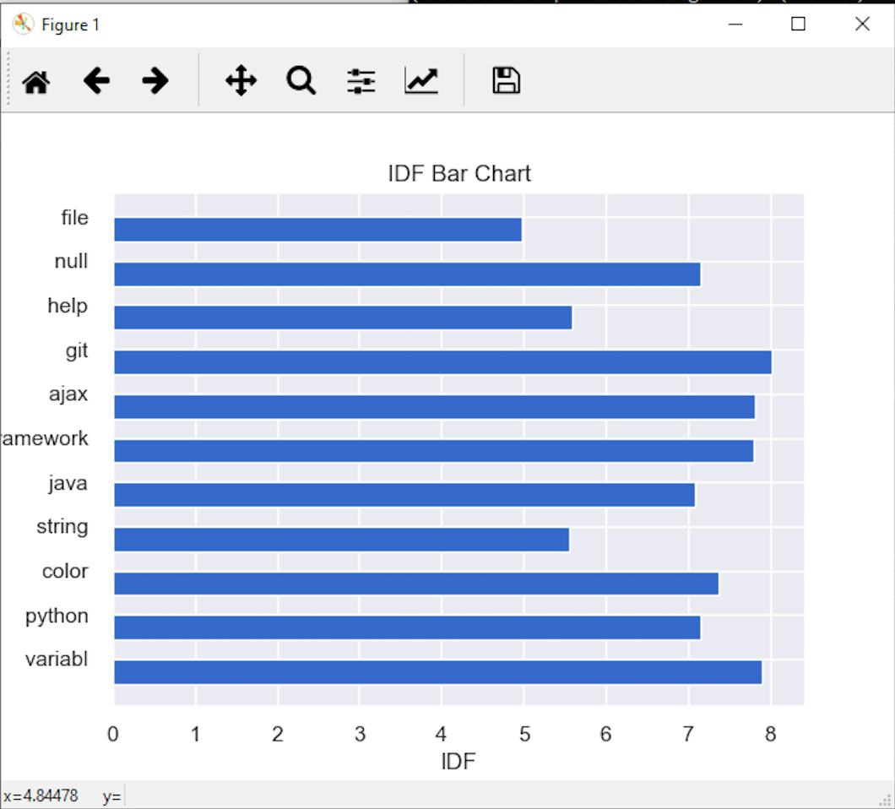

Slide 10
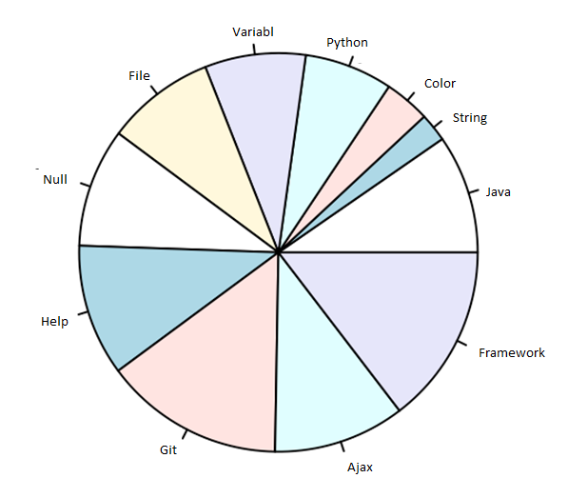

Slide 11
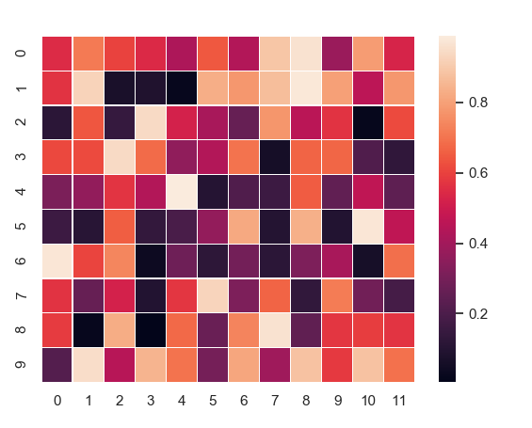
6. Vector space heat map

Slide 12
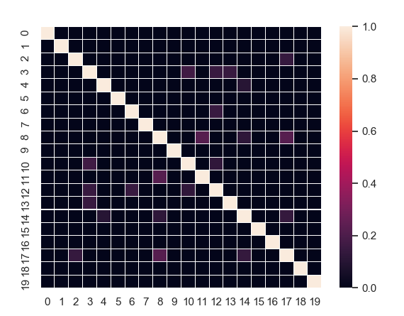
7. Cosine similarity

Slide 13
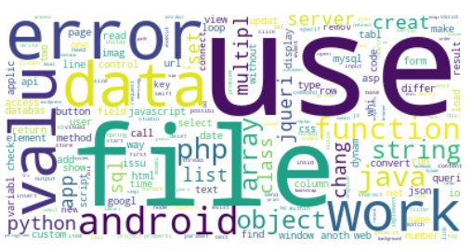
8. Word Cloud

Slide 14


