Slide 1
INFORMATION RETRIEVAL Project-1: Crime Reports
Team: Sai Sathvick Chirakala
Maitreyi Naik
Nikhila Ratakonda

Slide 2
Contents
Data set introduction
Defining query
Term frequency and inverse document frequency
Tf-idf score
Visualization of tf-idf
Cosine similarity
Word cloud

Slide 3
Dataset Introduction
This dataset has formals complaints filed by the citizens of the US.
Approximately 60 files of data was collected, having approximately 300000 number of reports filed.
Around 10000 terms remained after filtering, stemming, removing stop words and tokenizing.

Slide 4
Defining query
Queries taken are:
Kill, miss, kidnap, crime, shoot, death, victim, police, murder, suspect, blood.
9791 terms were left out with the query terms.

Slide 5
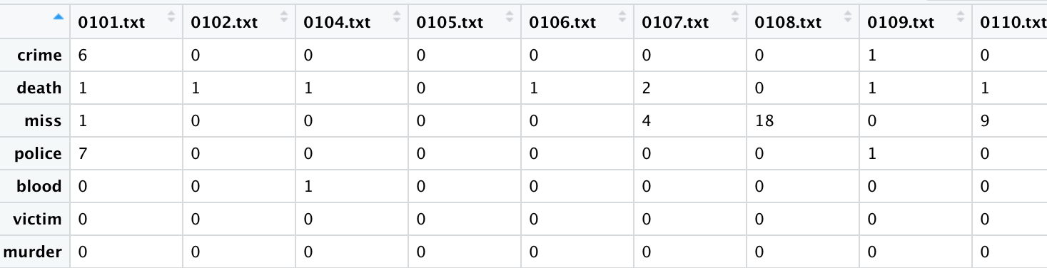
Term frequency

Slide 6
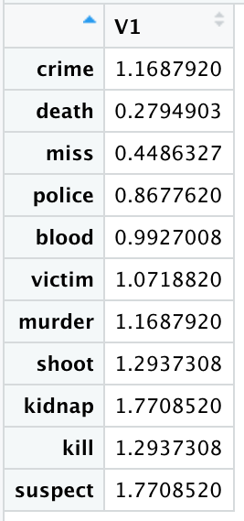
Inverse document frequency

Slide 7
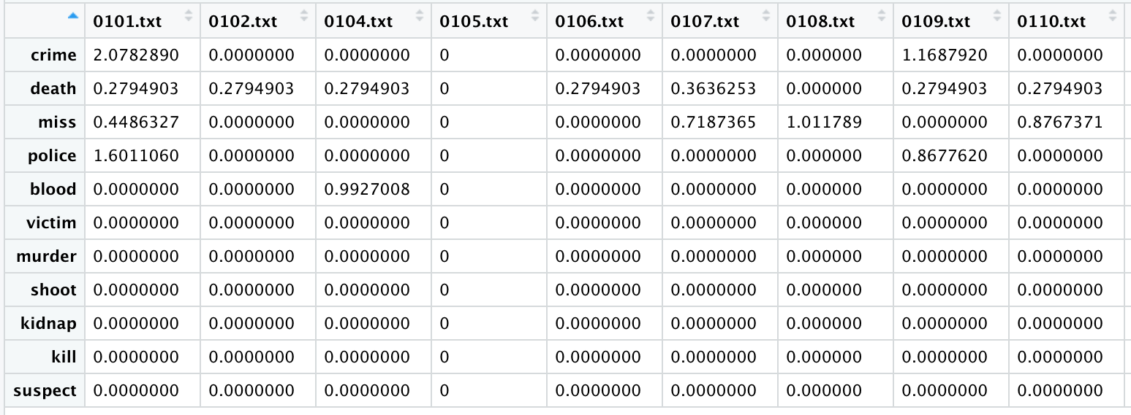
Tf-idf score

Slide 8
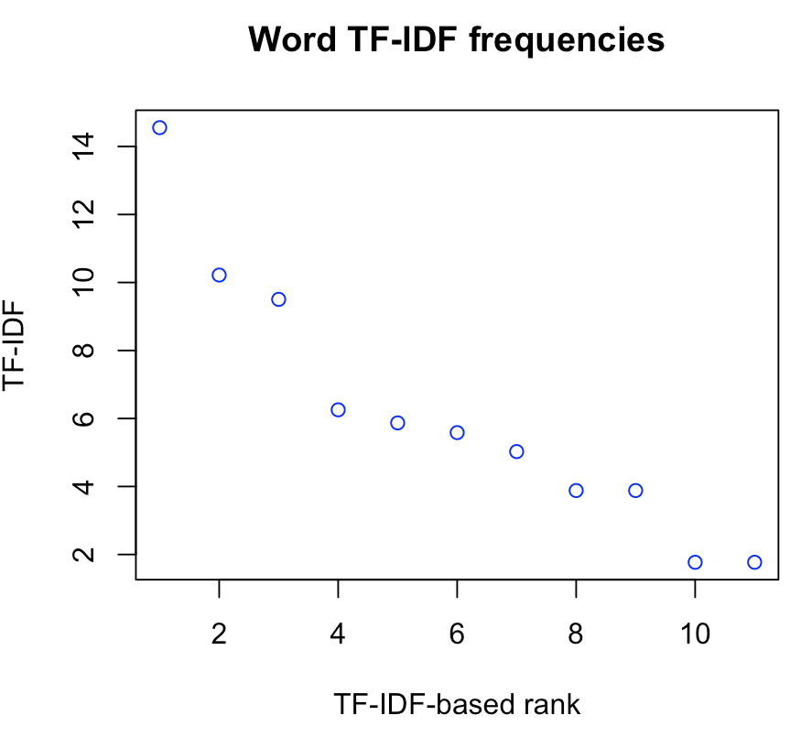
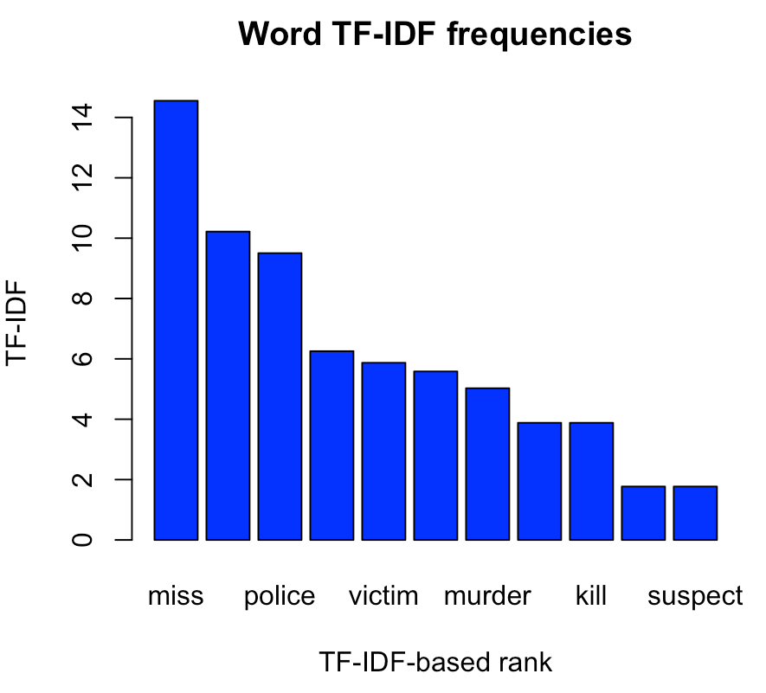
Visualization of tf-idf

Slide 9
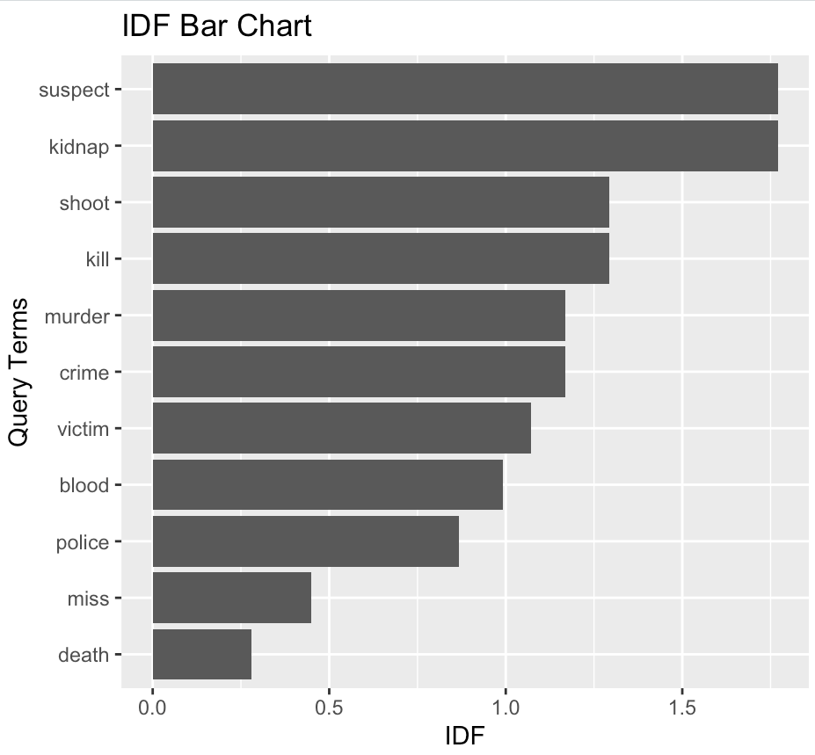
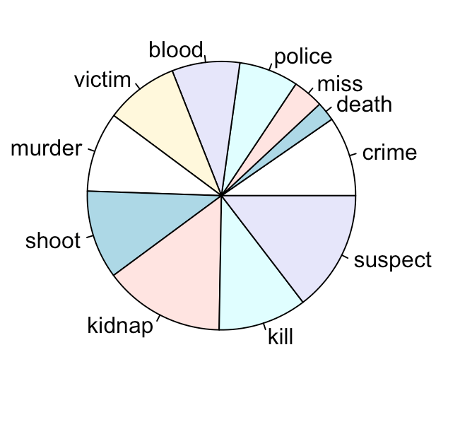

Slide 10
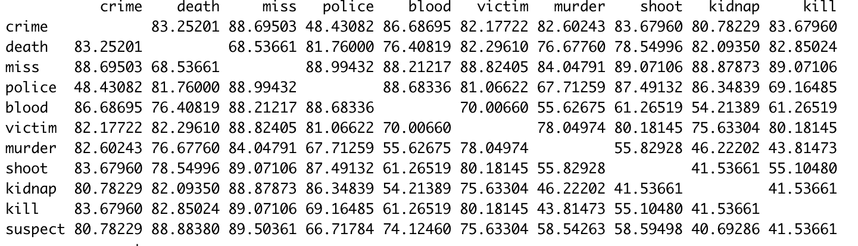
Cosine similarity

Slide 11
Comparison based on cosine similarity

Slide 12
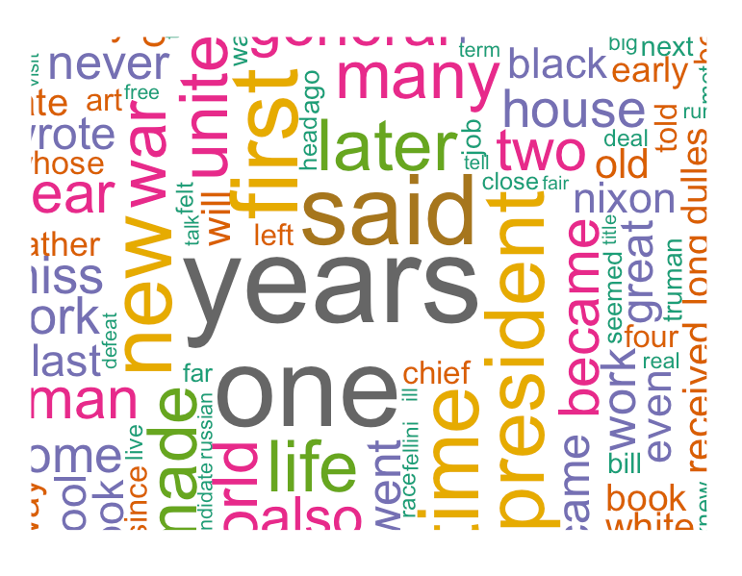
Word cloud

Slide 13


