Slide 1
MODULE 2
Ramya K
AIML Dept, DSCE.

Slide 2
CHAPTER 4-CLOUD COMPUTING ARCHITECTURE
.

Slide 3
4.1 INTRODUCTION
Utility-oriented data centers are the first outcome of cloud computing, and they serve as the infrastructure through which the services are implemented and delivered.
Any cloud service, whether virtual hardware, development platform, or application software, relies on a distributed infrastructure owned by the provider or rented from a third party.
Clouds are built by relying on one or more datacenters. In most cases hardware resources are virtualized to provide isolation of workloads and to best exploit the infrastructure.
Cloud computing is a utility-oriented and Internet-centric way of delivering IT services on demand. These services cover the entire computing stack: from the hardware infrastructure packaged as a set of virtual machines to software services such as development platforms and distributed applications.

Slide 4
4.2 The cloud reference model
Cloud computing supports any IT service that can be consumed as a utility and delivered through a network, most likely the Internet. Such characterization includes quite different aspects: infrastructure, development platforms, application and services.
4.2.1 Architecture
It is possible to organize all the concrete realizations of cloud computing into a layered view covering the entire stack (figure next slide), from hardware appliances to software systems.
* This layer is implemented using a datacenter in which hundreds and thousands of nodes are stacked together.
* Cloud infrastructure can be heterogeneous in nature because a variety of resources.
* Database systems and other storage services can also be part of the infrastructure.

Slide 5
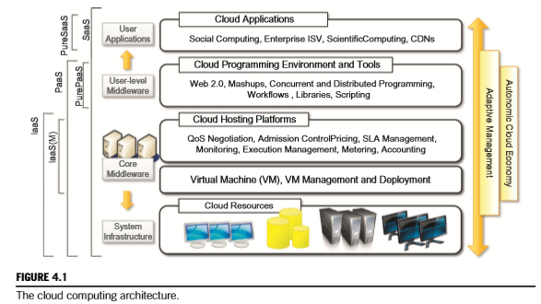
4.2 The cloud reference model
Cloud Computing Architecture

Slide 6
4.2 The cloud reference model
* The physical infrastructure is managed by the core middleware, the objectives of which are to provide an appropriate runtime environment for applications and to best utilize resources.
* At the bottom of the stack, virtualization technologies are used to guarantee runtime environment customization, application isolation, sandboxing, and quality of service.
* Hardware virtualization is most commonly used at this level. Hypervisors manage the pool of resources and expose the distributed infrastructure as a collection of virtual machines.
* By using virtual machine technology it is possible to finely partition the hardware resources such as CPU and memory and to virtualize specific devices, thus meeting the requirements of users and applications.

Slide 7
4.2 The cloud reference model
* Programming-level virtualization helps in creating a portable runtime environment where applications can be run and controlled.
* This scenario generally implies that applications hosted in the cloud be developed with a specific technology or a programming language, such as Java, .NET, or Python.
* Infrastructure management is the key function of core middleware, which supports capabilities such as
negotiation of the quality of service,
admission control,
execution management and
monitoring, accounting, and
billing.

Slide 8
4.2 The cloud reference model
The combination of cloud hosting platforms and resources is generally classified as a Infrastructure-as-a-Service (IaaS) solution.
We can organize the different examples of IaaS into two categories:
* Some of them provide both the management layer and the physical infrastructure;
* Others provide only the management layer (IaaS (M)). In this second case, the management layer is often integrated with other IaaS solutions that provide physical infrastructure and adds value to them.
IaaS solutions are suitable for designing the system infrastructure but provide limited services to build applications.
PaaS- Users develop their applications specifically for the cloud by using the API exposed at the user-level middleware.
This approach is also known as Platform-as-a-Service (PaaS) because the service offered to the user is a development platform rather than an infrastructure

Slide 9
4.2 The cloud reference model
* PaaS solutions generally include the infrastructure as well, which is bundled as part of the service provided to users.
* In the case of Pure PaaS, only the user-level middleware is offered, and it has to be complemented with a virtual or physical infrastructure.
SaaS- Web-based applications that rely on the cloud to provide service to end users. * The horsepower of the cloud provided by IaaS and PaaS solutions allows independent software vendors to deliver their application services over the Internet.
* SaaS implementations should feature adaptively change and expose an autonomic behavior automatically, whereas PaaS and IaaS generally provide this functionality as a part of the API exposed to users.

Slide 10
4.2 The cloud reference model
Everything as a Service (XaaS) is one of the most important elements of cloud computing:
* Cloud services from different providers can be combined to provide a completely integrated solution covering all the computing stack of a system.
* IaaS providers can offer the bare metal in terms of virtual machines where PaaS solutions are deployed.
When there is no need for a PaaS layer, it is possible to directly customize the virtual infrastructure with the software stack needed to run applications.
Cloud computing an interesting option for reducing startups’ capital investment in IT, allowing them to quickly commercialize their ideas and grow their infrastructure according to their revenues.

Slide 11
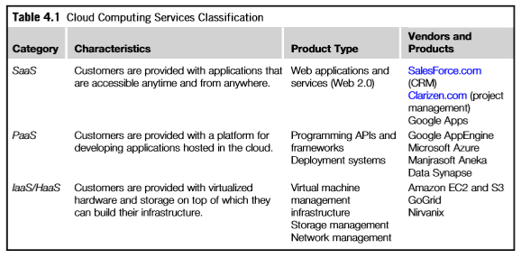
4.2 The cloud reference model
Cloud Computing Services Classification:

Slide 12
4.2.2 Infrastructure- and hardware-as-a-service
Infrastructure- and Hardware-as-a-Service (IaaS/HaaS) solutions are the most popular and developed market segment of cloud computing.
They deliver customizable infrastructure on demand. IaaS offering range from single servers to entire infrastructures, including network devices, load balancers, and database and Web servers.
The main technology used to deliver and implement these solutions is hardware virtualization: one or more virtual machines opportunely configured and interconnected define the distributed system on top of which applications are installed and deployed
IaaS/HaaS solutions bring all the benefits of hardware virtualization:
workload partitioning,
application isolation,
sandboxing, and
hardware tuning.

Slide 13
4.2.2 Infrastructure- and hardware-as-a-service
From the perspective of the customer it reduces the administration and maintenance cost as well as the capital costs allocated to purchase hardware.
At the same time, users can take advantage of the full customization offered by virtualization to deploy their infrastructure in the cloud.
Virtual machines come with only the selected operating system installed and the system can be configured with all the required packages and applications.
Other solutions provide prepackaged system images that already contain the software stack required for the most common uses: Web servers, database servers, or LAMP stacks.
Additional services can be provided: SLA resource-based allocation, workload management, support for infrastructure design through advanced Web interfaces, and the ability to integrate third-party IaaS solutions.

Slide 14
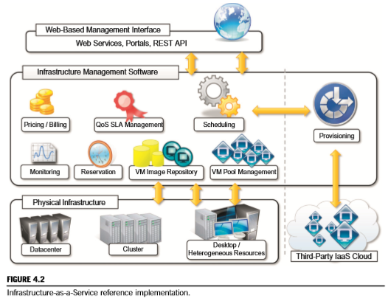
4.2.2 Infrastructure- and hardware-as-a-service
Figure provides an overall view of the components forming an Infrastructure-as-a-Service solution

Slide 15
4.2.2 Infrastructure- and hardware-as-a-service
It is possible to distinguish three principal layers:
->the physical infrastructure,
->the software management infrastructure, and
->the user interface.
1. User interface : It provides access to the services exposed by the software management infrastructure.
Such an interface is generally based on Web 2.0 technologies: Web services, RESTful APIs, and mash-ups. These technologies allow either applications or final users to access the services.
Web services and RESTful APIs allow programs to interact with the service without human intervention

Slide 16
4.2.2 Infrastructure- and hardware-as-a-service
2. Infrastructure management software layer.
The core features of an IaaS solution are implemented in the infrastructure management software layer.
In particular, management of the virtual machines is the most important function performed by this layer. A central role is played by the scheduler, which is in charge of allocating the execution of virtual machine instances.
The scheduler interacts with the other components that perform a variety of tasks:
The pricing and billing component takes care of the cost of executing each virtual machine instance and maintains data that will be used to charge the user.
The monitoring component tracks the execution of each virtual machine instance and maintains data required for reporting and analyzing the performance of the system
The reservation component stores the information of all the virtual machine instances that have been executed or that will be executed in the future.

Slide 17
4.2.2 Infrastructure- and hardware-as-a-service
A QoS/SLA management component will maintain a repository of all the SLAs made with the users; together with the monitoring component.
The VM repository component provides a catalog of virtual machine images that users can use to create virtual instances.
A VM pool manager component is responsible for keeping track of all the live instances.
If the system supports the integration of additional resources belonging to a third-party IaaS provider, a provisioning component interacts with the scheduler to provide a virtual machine instance.
3. Physical infrastructure: The bottom layer is composed of the physical infrastructure, on top of which the management layer operates
A cloud infrastructure developed in house, in a small or medium-sized enterprise or within a university department, will most likely rely on a cluster

Slide 18
4.2.2 Infrastructure- and hardware-as-a-service
It is also possible to consider a heterogeneous environment where different types of resources—PCs, workstations, and clusters—can be aggregated.
In the case of complete IaaS solutions, all three levels are offered as service.
This is generally the case with public clouds vendors such as Amazon, GoGrid, Joyent, Rightscale, Terremark, Rackspace, ElasticHosts, and Flexiscale, which own large datacenters and give access to their computing infrastructures using an IaaS approach.
Other solutions instead cover only the user interface and the infrastructure software management layers.
They need to provide credentials to access third-party IaaS providers or to own a private infrastructure in which the management software is installed. This is the case with Enomaly, Elastra, Eucalyptus, OpenNebula, and specific IaaS (M) solutions from VMware, IBM, and Microsoft.

Slide 19
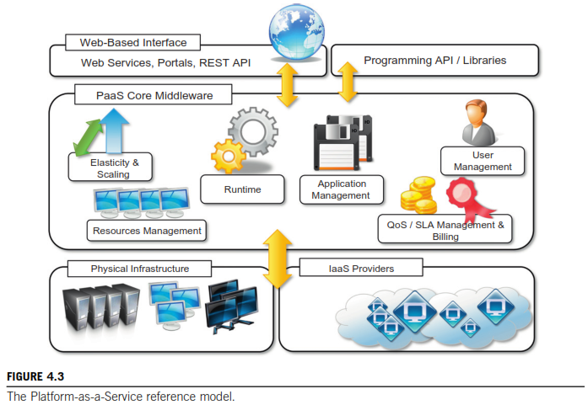
4.2.3 Platform as a service
Platform-as-a-Service (PaaS) solutions provide a development and deployment platform for running applications in the cloud.
They constitute the middleware on top of which applications are built. A general overview of the features characterizing the PaaS approach is given in Figure 4.3.

Slide 20
4.2.3 Platform as a service
Application management is the core functionality of the middleware.
PaaS implementations provide applications with a runtime environment and do not expose any service for managing the underlying infrastructure.
They automate the process of deploying applications to the infrastructure, configuring application components, provisioning and configuring supporting technologies such as load balancers and databases, and managing system change based on policies set by the user.
Developers design their systems in terms of applications and are not concerned with hardware (physical or virtual), operating systems, and other low-level services
The core middleware is in charge of managing the resources and scaling applications on demand or automatically, according to the commitments made with users.\
The specific development model decided for applications determines the interface exposed to the user.
Other implementations of the PaaS model provide a complete object model for representing an application and provide a programming language-based approach.

Slide 21
4.2.3 Platform as a service
Developers generally have the full power of programming languages such as Java, .NET, Python, or Ruby, with some restrictions to provide better scalability and security.
PaaS solutions can offer middleware for developing applications together with the infrastructure or simply provide users with the software that is installed on the user premises.
In the first case, the PaaS provider also owns large datacenters where applications are executed; in the second case, referred to in this book as Pure PaaS.

Slide 22
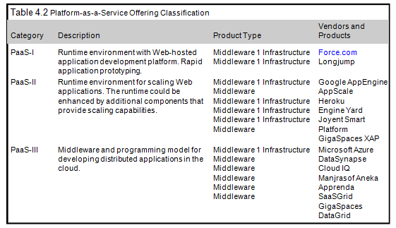
4.2.3 Platform as a service
Table 4.2 provides a classification of the most popular PaaS implementations. It is possible to organize the various solutions into three wide categories: PaaS-I, PaaS-II, and PaaS-III.

Slide 23
4.2.3 Platform as a service
PaaS-I: The first category(PaaS-I) identifies PaaS implementations that completely follow the cloud computing style for application development and deployment.
They offer an integrated development environment hosted within the Web browser where applications are designed, developed, composed, and deployed.
Ex: Force.com and Longjump. Both deliver as platforms the combination of middleware and infrastructure.
PaaS-II: we can list all those solutions that are focused on providing a scalable infrastructure for Web application, mostly websites.
In this case, developers generally use the providers’ APIs, which are built on top of industrial runtimes, to develop applications
ex: Google AppEngine is the most popular product in this category
It provides a scalable runtime based on the Java and Python programming languages
.Joyent Smart Platform provides a similar approach to Google AppEngine. A different approach is taken by Heroku and Engine Yard, which provide scalability support for Ruby- and Ruby on Rails-based Websites

Slide 24
4.2.3 Platform as a service
PaaS-III: The third category consists of all those solutions that provide a cloud programming platform for any kind of application, not only Web applications.
Among these, the most popular is Microsoft Windows Azure, which provides a comprehensive framework for building service-oriented cloud applications on top of the .NET technology, hosted on Microsoft’s datacenters.
Other solutions in the same category, such as Manjrasoft Aneka, Apprenda SaaSGrid, Appistry Cloud IQ Platform, DataSynapse, and GigaSpaces DataGrid, provide only middleware with different services.
Essential characteristics that identify a PaaS solution:
Runtime framework: This framework represents the “software stack” of the PaaS model.
The runtime framework executes end-user code according to the policies set by the user and the provider.

Slide 25
4.2.3 Platform as a service
Essential characteristics that identify a PaaS solution(contd)
Abstraction: PaaS solutions are distinguished by the higher level of abstraction that they provide.
*In the case of IaaS solutions the focus is on delivering “raw” access to virtual or physical infrastructure, in the case of PaaS the focus is on the applications the cloud must support.
*This means that PaaS solutions offer a way to deploy and manage applications on the cloud rather than a bunch of virtual machines on top of which the IT infrastructure is built and configured.
Automation: PaaS environments automate the process of deploying applications to the infrastructure, scaling them by provisioning additional resources when needed.
*This process is performed automatically and according to the SLA made between the customers and the provider.
*This feature is normally not native in IaaS solutions, which only provide ways to provision more resources.

Slide 26
4.2.3 Platform as a service
Essential characteristics that identify a PaaS solution(contd)
Cloud services: PaaS offerings provide developers and architects with services and APIs, helping them to simplify the creation and delivery of elastic and highly available cloud applications.
Generally include specific components for developing applications, advanced services for application monitoring, management, and reporting.
Another essential component for a PaaS-based approach is the ability to integrate third-party cloud services offered from other vendors by leveraging service-oriented architecture.

Slide 27
4.2.4 Software as a service
Software-as-a-Service (SaaS) is a software delivery model that provides access to applications through the Internet as a Web-based service.
It provides a means to free users from complex hardware and software management by offloading such tasks to third parties, which build applications accessible to multiple users through a Web browser.
This requirement characterizes SaaS as a “one-to-many” software delivery model, whereby an application is shared across multiple users.
This is the case of CRM3 and ERP4 applications that constitute common needs for almost all enterprises, from small to medium-sized and large business.
The acronym SaaS was then coined in 2001 by the Software Information & Industry Association (SIIA) [32] with the following connotation:
In the software as a service model, the application, or service, is deployed from a centralized datacenter across a network—Internet, Intranet, LAN, or VPN—providing access and use on a recurring fee basis. Users “rent,” “subscribe to,” “are assigned,” or “are granted access to” the applications from a central provider.

Slide 28
4.2.4 Software as a service
The analysis carried out by SIIA was mainly oriented to cover application service providers (ASPs) and all their variations, which capture the concept of software applications consumed as a service in a broader sense. ASPs already had some of the core characteristics of SaaS:
The product sold to customer is application access.
The application is centrally managed.
The service delivered is one-to-many.
The service delivered is an integrated solution delivered on the contract, which means provided as promised.
These opportunities eventually evolved into a more flexible model to deliver applications as a service: the SaaS model.
ASPs provided access to packaged software solutions that addressed the needs of a variety of customers. Later became inconvenient when the cost of customizations and speciali-zations increased.

Slide 29
4.2.4 Software as a service
The SaaS approach introduces a more flexible way of delivering application services that are fully customizable by the user by integrating new services, injecting their own components, and designing the application and information workflows.
Possible with the support of Web 2.0 technologies, which allowed turning the Web browser into a full-featured interface, able even to support application composition and development.
the SaaS approach lays on top of the cloud computing stack. It fits into the cloud computing vision expressed by the XaaS acronym, Everything-as-a-Service; and with SaaS, applications are delivered as a service.The benefits delivered at that stage were the following:
* Software cost reduction and total cost of ownership (TCO) were paramount
* Service-level improvements
* Rapid implementation
* Standalone and configurable applications
* Rudimentary application and data integration
* Subscription and pay-as-you-go (PAYG) pricing

Slide 30
4.2.4 Software as a service
In particular, SaaS 2.0 is focused on providing a more robust infrastructure and application plat-forms driven by SLAs.
Software-as-a-Service applications can serve different needs. CRM, ERP, and social networking applications are definitely the most popular ones. SalesForce.com is probably the most successful and popular example of a CRM service.
It provides a wide range of services for applications: customer relationship and human resource management, enterprise resource planning, and many other features.
SalesForce.com builds on top of the Force.com platform, which provides a fully featured environment for building applications. It offers either a programming language or a visual environment to arrange components together for building applications.
In particular, through AppExchange customers can publish, search, and integrate new services and features into their existing applications.

Slide 31
4.2.4 Software as a service
Similar solutions are offered by NetSuite and RightNow.
*NetSuite is an integrated software business suite featuring financials, CRM, inventory, and ecommerce functionalities integrated all together.
*RightNow is customer experience-centered SaaS application that integrates together different features, from chat to Web communities, to support the common activity of an enterprise.
Another important class of popular SaaS applications comprises social networking applications such as Facebook and professional networking sites such as LinkedIn.
Office automation applications are also an important representative for SaaS applications: Google Documents and Zoho Office are examples of Web-based applications that aim to address all user needs for documents, spreadsheets, and presentation management
They offer a Web-based interface for creating, managing, and modifying documents that can be easily shared among users and made accessible from anywhere.

Slide 32
4.3 Types of clouds
Clouds constitute the primary outcome of cloud computing. They are a type of parallel and distributed system harnessing physical and virtual computers presented as a unified computing resource.
It is then possible to differentiate four different types of cloud:
Public clouds: The cloud is open to the wider public.
• Private clouds: The cloud is implemented within the private premises of an institution and generally made accessible to the members of the institution or a subset of them.
• Hybrid or heterogeneous clouds: The cloud is a combination of the two previous solutions and most likely identifies a private cloud that has been augmented with resources or services hosted in a public cloud.
• Community clouds: The cloud is characterized by a multi-administrative domain involving different deployment models (public, private, and hybrid), and it is specifically designed to address the needs of a specific industry.

Slide 33
4.3 Types of clouds
4.3.1 Public clouds
Public clouds constitute the first expression of cloud computing. They are a realization of the canonical view of cloud computing in which the services offered are made available to anyone, from anywhere, and at any time through the Internet.
They are a distributed system, most likely composed of one or more datacenters connected together.
Public clouds were the first class of cloud that were implemented and offered.
They offer solutions for minimizing IT infrastructure costs and serve as a viable option for handling peak loads on the local infrastructure.
Interesting option for small enterprises, which are able to start their businesses without large up-front investments .
A fundamental characteristic of public clouds is multitenancy. A public cloud is meant to serve a multitude of users, not a single customer. Any customer requires a virtual computing environment that is separated, and most likely isolated, from other users

Slide 34
4.3 Types of clouds
4.3.1 Public clouds(contd)
QoS management is a very important aspect of public clouds. A significant portion of the software infrastructure is devoted to monitoring the cloud resources, to bill them according to the contract made with the user, and to keep a complete history of cloud usage for each customer.
A public cloud can offer any kind of service: infrastructure, platform, or applications. For example,
* Amazon EC2 is a public cloud that provides infrastructure as a service;
* Google AppEngine is a public cloud that provides an application development platform as a service; and
* SalesForce.com is a public cloud that provides software as a service.
Public clouds can be geographically dispersed datacenters.
For example, Amazon Web Services has datacenters installed in the United States, Europe, Singapore, and Australia; they allow their customers to choose between three different regions: us-west-1, us-east-1, or eu-west-1

Slide 35
4.3 Types of clouds
4.3.2 Private clouds
Public clouds are a viable option to cut IT costs and reduce capital expenses, but they are not applicable in all scenarios.
Institutions such as government and military agencies will not consider public clouds as an option for processing or storing their sensitive data. The risk of a breach in the security infrastructure of the provider could expose such information to others;
According to the specific location of data, some sensitive information can be made accessible to government agencies or even considered outside the law if processed with specific cryptographic techniques.
For example, the USA PATRIOT Act5 provides its government and other agencies with virtually limitless powers to access information
Private clouds are virtual distributed systems that rely on a private infrastructure
Private clouds have the advantage of keeping the core business operations in-house by relying on the existing IT infrastructure and reducing the burden of maintaining it once the cloud has been set up.

Slide 36
4.3 Types of clouds
4.3.2 Private clouds(contd)
In private clouds there is the possibility of testing applications and systems at a comparatively lower price rather than public clouds.
Key advantages of using a private cloud computing infrastructure:
* Customer information protection. Few provide satisfactory disclosure and few provide warranties about the specific level of security put in place on their systems.
->In-house security is easier to maintain and rely on.
* Infrastructure ensuring SLAs. Quality of service implies specific operations such as appropriate clustering and failover
data replication,
system monitoring and maintenance,
disaster recovery, and other uptime services can be commensurate to the application needs.
->Although public cloud vendors provide some of these features, not all of them are available as needed.

Slide 37
4.3 Types of clouds
4.3.2 Private clouds(contd)
* Compliance with standard procedures and operations- If organizations are subject to third-party compliance standards, specific procedures have to be put in place when deploying and executing applications.
-> This could be not possible in the case of the virtual public infrastructure.
Private clouds can be implemented on more heterogeneous hardware: They generally rely on the existing IT infrastructure already deployed on the private premises.
This could be a datacenter, a cluster, an enterprise desktop grid, or a combination of them.
Figure(next slide) explanation: At the bottom layer of the software stack, virtual machine technologies such as Xen, KVM, and VMware serve as the foundations of the cloud.
Virtual machine management technologies such as VMware vCloud, Eucalyptus [37], and OpenNebula can be used to control the virtual infrastructure and provide an IaaS solution.

Slide 38
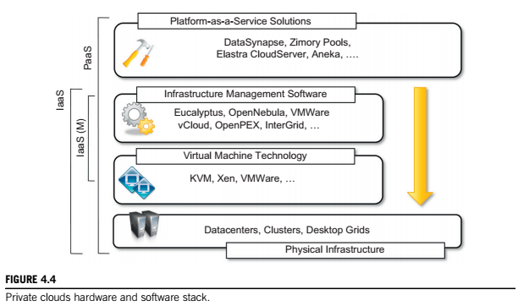
.
4.3.2 Private clouds(contd)
VMware vCloud is a proprietary solution, but Eucalyptus provides full compatibility with Amazon Web Services interfaces and supports VM technologies Xen, KVM, and VMware.
Like Eucalyptus, OpenNebula is an open-source solution for virtual infrastructure management that supports KVM, Xen, and VMware, which has been designed to easily integrate third-party IaaS providers.

Slide 39
.
4.3.2 Private clouds(contd)
OpenPEX is Web-based system that allows the reservation of virtual machine instances and is designed to support different back ends.
InterGrid also allowing the reservation of virtual machine instances and managing multi- administrative domain clouds.
DataSynapse is a global provider of application virtualization software. It provides a flexible environment for building private clouds on top of datacenters.
Elastra Cloud Server is a platform for easily configuring and deploying distributed application infrastructures on clouds.
Zimory provides a software infrastructure layer that automates the use of resource pools based on Xen, KVM, and VMware virtualization technologies.
Aneka is a software development platform that can be used to deploy a cloud infrastructure on top of heterogeneous hardware: datacenters, clusters, and desktop grids.
It supports the execution of distributed applications with different programming models:
bag of tasks, MapReduce, and others.

Slide 40
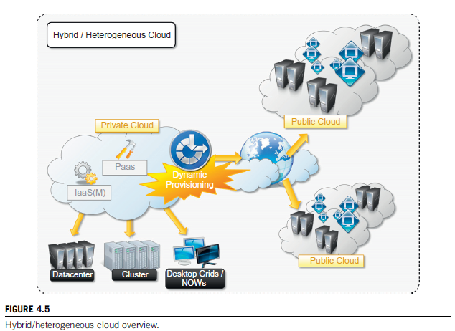
.
4.3.3 Hybrid clouds
Public clouds - suffer from security threats and administrative pitfalls.
Private clouds - inability to scale on demand and to efficiently address peak loads.
A hybrid solution -taking advantage of the best of the private and public worlds

Slide 41
.
4.3.3 Hybrid clouds(contd)
Public clouds - suffer from security threats and administrative pitfalls.
Private clouds - inability to scale on demand and to efficiently address peak loads.
A hybrid solution -taking advantage of the best of the private and public worlds.
Hybrid clouds allow enterprises to exploit existing IT infrastructures, maintain sensitive information within the premises, and naturally grow and shrink by provisioning external resources and releasing them when they’re no longer needed.
It is a heterogeneous distributed system resulting from a private cloud that integrates additional services or resources from one or more public clouds. So they are also called Heterogeneous Clouds

Slide 42
4.3.4 Community clouds
Community clouds are distributed systems created by integrating the services of different clouds to address the specific needs of an industry, a community, or a business sector.
The National Institute of Standards and Technologies (NIST) [43] characterizes community clouds as follows:
“The infrastructure is shared by several organizations and supports a specific community that has shared concerns (e.g., mission, security requirements, policy, and compliance considerations). It may be managed by the organizations or a third party and may exist on premise or off premise.”
The users of a specific community cloud fall into a well-identified community, sharing the same concerns or needs; they can be government bodies, industries, or even simple users, but all of them focus on the same issues for their interaction with the cloud.
This is a different scenario than public clouds, which serve a multitude of users with different needs.
Also different from private clouds, where the services are generally delivered within the institution that owns the cloud.

Slide 43
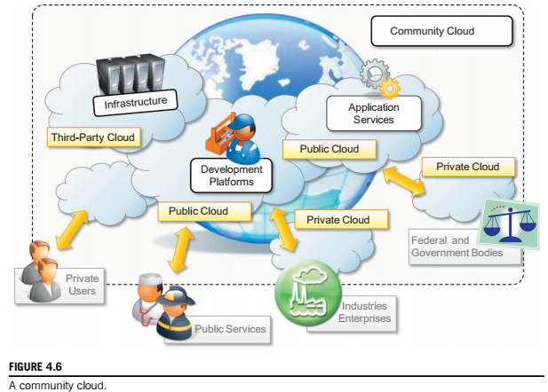
4.3.4 Community clouds
From an architectural point of view, a community cloud is most likely implemented over multiple administrative domains. Think of it as a public cloud environment, but with set levels of security, privacy, and even regulatory compliance of a private cloud.

Slide 44
4.3.4 Community clouds
This means that different organizations such as government bodies,private enterprises, research organizations, and even public virtual infrastructure providers contribute with their resources to build the cloud infrastructure.
Candidate sectors for community clouds are as follows:
1.Media industry. In the media industry, companies are looking for low-cost, agile, and simple solutions to improve the efficiency of content production.
Community clouds can provide a shared environment where services can facilitate business-to-business collaboration and offer the horsepower in terms of aggregate bandwidth, CPU, and storage required to efficiently support media production.
2.Healthcare industry. In the healthcare industry, community clouds can provide a global platform on which to share information and knowledge without revealing sensitive data maintained within the private infrastructure.
The naturally hybrid deployment model of community clouds can easily support the storing of patient-related data in a private cloud while using the shared infrastructure for noncritical services and automating processes within hospitals.

Slide 45
4.3.4 Community clouds
3.Energy and other core industries. In these sectors, community clouds can bundle the comprehensive set of solutions that together vertically address management, deployment, and orchestration of services and operations.
4.Public sector. Legal and political restrictions in the public sector can limit the adoption of public cloud offerings.
Moreover, governmental processes involve several institutions and agencies and are aimed at providing strategic solutions at local, national, and international administrative levels.
They involve business-to-administration, citizen-to-administration, and possibly business-to-business processes. Some examples include invoice approval, infrastructure planning, and public hearings.
5.Scientific research. Science clouds are an interesting example of community clouds. In this case, the common interest driving different organizations sharing a large distributed infrastructure is scientific computing.

Slide 46
4.3.4 Community clouds
The benefits of these community clouds are the following:
• Openness. By removing the dependency on cloud vendors, community clouds are open systems in which fair competition between different solutions can happen.
• Community. Being based on a collective that provides resources and services, the infrastructure turns out to be more scalable because the system can grow simply by expanding its user base.
• Graceful failures. Since there is no single provider or vendor in control of the infrastructure,there is no single point of failure.
• Convenience and control. Within a community cloud there is no conflict between convenience and control because the cloud is shared and owned by the community, which makes all the decisions through a collective democratic process.
• Environmental sustainability. The community cloud is supposed to have a smaller carbon footprint because it harnesses underutilized resources. Moreover, these clouds tend to be more organic by growing and shrinking in a symbiotic relationship to support the demand of the community, which in turn sustains it.

Slide 47
4.4 Economics of the cloud
The main drivers of cloud computing are economy of scale and simplicity of software delivery and its operation. In fact, the biggest benefit of this phenomenon is financial: the pay-as-you-go model offered by cloud providers.
In particular, cloud computing allows:
* Reducing the capital costs associated to the IT infrastructure
* Eliminating the depreciation or lifetime costs associated with IT capital assets
* Replacing software licensing with subscriptions
* Cutting the maintenance and administrative costs of IT resources
A capital cost is the cost occurred in purchasing an asset that is useful in the production of goods or the rendering of services. Capital costs are one-time expenses that are generally paid up front and that will contribute over the long term to generate profit.

Slide 48
4.4 Economics of the cloud
Enterprise will definitely have an IT department that is used to automate many of the activities that are performed within the enterprise: payroll, customer relationship management, enterprise resource planning, tracking and inventory of products, and others.
In the case of IT capital costs, the depreciation costs are represented by the loss of value of the hardware over time and the aging of software products that need to be replaced because new features are required.
Many enterprises own a small or medium-sized datacenter that introduces several operational costs in terms of maintenance, electricity, and cooling.Moreover, other costs are triggered by the purchase of potentially expensive software. With cloud computing these costs are significantly reduced or simply disappear according to its penetration.
Cloud computing also introduces reductions in administrative and maintenance costs leverage
In the case of a small startup, it is possible to completely leverage the cloud for many aspects, such as:
IT infrastructure
Software development
CRM and ERP

Slide 49
4.4 Economics of the cloud
In terms of the pricing models introduced by cloud computing, we can distinguish three different strategies that are adopted by the providers:
• Tiered pricing. In this model, cloud services are offered in several tiers, each of which offers a fixed computing specification and SLA at a specific price per unit of time. This model is used by Amazon for pricing the EC2 service, which makes available different server configurations in terms of computing capacity (CPU type and speed, memory) that have different costs per hour.
• Per-unit pricing. This model is more suitable to cases where the principal source of revenue for the cloud provider is determined in terms of units of specific services, such as data transfer and memory allocation. In this scenario customers can configure their systems more efficiently according to the application needs. This model is used, for example, by GoGrid, which makes customers pay according to RAM/hour units for the servers deployed in the GoGrid cloud.
• Subscription-based pricing. This is the model used mostly by SaaS providers in which users pay a periodic subscription fee for use of the software or the specific component services that are integrated in their applications.
4.5 Open Challenges- Refer Assignment Note book

Slide 50
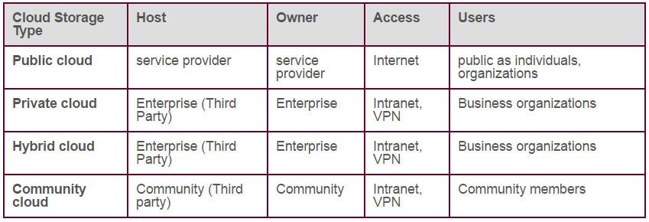
4.3.4 Community clouds

Slide 51
Open Challenges (Cloud Definition)
The NIST (National Institute of Standards and Technology) definition of cloud computing is widely accepted and serves as a comprehensive formalization of the concept.
It defines cloud computing based on five essential characteristics:
on-demand self-service
broad network access
resource pooling
rapid elasticity
and measured service.
Additionally, it categorizes cloud services into Software as a Service (SaaS), Platform as a Service (PaaS), and Infrastructure as a Service (IaaS), and classifies deployment models as public, private, community, and hybrid clouds.

Slide 52
Cloud Definition
There are alternative taxonomies and classifications for cloud services.
For example, David Linthicum offers a more detailed classification that includes ten different classes, which is better suited for understanding cloud computing within enterprises.
Another approach, taken by the University of California, Santa Barbara (UCSB), focuses on defining an ontology for cloud computing.
This ontology dissects the concept of a cloud into five main layers:
applications
software environments
software infrastructure
software kernel, and hardware.
Each layer addresses the needs of different user classes within the cloud computing community and builds on the underlying layers.

Slide 53
Cloud Interoperability and Standards
Cloud computing is like a utility service, providing IT infrastructure and applications on-demand, similar to how we access electricity or water.
However, for cloud computing to work smoothly, it's crucial to have standards and compatibility between different cloud solutions.
One big problem is "vendor lock-in."
This happens when a customer gets stuck with a particular cloud provider's solution and finds it hard to switch to another provider's solution.
This might be because the customer wants a better solution or because the original provider can no longer provide the needed service.
Switching in such cases is often costly and time-consuming.

Slide 54
Cloud Interoperability and Standards
Several organizations, like the Cloud Computing Interoperability Forum (CCIF), the Open Cloud Consortium, and the DMTF Cloud Standards Incubator, are leading this effort.
Most of these standardization efforts focus on the lower levels of cloud computing, especially Infrastructure as a Service (IaaS).
In IaaS, a major reason for vendor lock-in is the use of different formats for virtual machines. Efforts to make virtual machine formats compatible among different providers, like the Open Virtualization Format (OVF), aim to improve compatibility.

Slide 55
Scalability and Fault Tolerance
Cloud computing offers the ability to scale resources on demand, which is one of its most attractive features.
This means that businesses can easily increase their computing power and storage capacity beyond what their in-house IT infrastructure can handle, whether it's for infrastructure (like servers and storage) or application services.
Cloud middleware manages a vast number of resources and users, all relying on the cloud to access computing power they couldn't afford or manage on their own premises.
However, managing these resources comes with administrative and maintenance costs. These costs are real for cloud service providers who develop, manage, and maintain the cloud infrastructure.

Slide 56
Scalability and Fault Tolerance
The goal is to design highly scalable and fault-tolerant systems that are easy to manage and also provide competitive performance.
This means building systems that can automatically handle increases in workload, redistribute tasks in case of failures, and recover quickly from any disruptions.
Additionally, these systems need to be manageable by administrators and offer good performance to users.

Slide 57
Security, Trust and Privacy
Security, trust, and privacy are significant concerns preventing widespread adoption of cloud computing.
While traditional cryptographic technologies are used to safeguard data and prevent unauthorized access, the extensive use of virtualization technologies in cloud environments introduces new vulnerabilities.
For example, sensitive data processed by applications hosted in the cloud might be stored securely using advanced encryption techniques.
However, these data must be decrypted by the legitimate application to be processed.
In a managed virtual environment, the virtual machine manager may have access to the application's memory pages, potentially compromising the confidentiality of the data.
This lack of control over the execution environment of applications in the cloud creates new opportunities for security threats.

Slide 58
Security, Trust and Privacy
The challenges in this area involve developing secure and trustworthy systems from multiple perspectives: technical, social, and legal.
This includes ensuring robust technical security measures, establishing clear legal frameworks for data protection and privacy, and fostering a culture of trust among users and providers.
Addressing these challenges is essential for enhancing security, trust, and privacy in cloud computing environments and facilitating their widespread adoption.

Slide 59
Organizational Aspects
Cloud computing fundamentally changes how IT services are consumed and managed.
It provides storage, computing power, network infrastructure, and applications as metered services over the Internet.
This introduces a new billing model for IT departments, which requires a certain level of cultural and organizational process maturity.
In particular, the widespread adoption of cloud computing necessitates significant changes to business processes and organizational boundaries.

Slide 60
Organizational Aspects
This prompts several important questions about the role of the IT department in this new scenario:
What is the new role of the IT department in an enterprise that completely or significantly relies on the cloud?
How will the compliance department perform its activity when there is a considerable lack of control over application workflows?
What are the implications (political, legal, etc.) for organizations that lose control over some aspects of their services?
What will be the perception of the end users of such services?
One of the major advantages of moving IT infrastructure and services to the cloud is to reduce or completely remove the costs related to maintenance and support.

Slide 61
END OF CHAPTER 4
.

Slide 62
CHAPTER 5
Cloud Application Programming and
the Aneka Platform
.

Slide 63
5.1 Framework overview
Aneka is a software platform for developing cloud computing applications.
It allows harnessing of disparate computing resources and managing them into a unique virtual domain—the Aneka Cloud—in which applications are executed.
According to the Cloud Computing Reference Model ,it is a pure PaaS solution for cloud computing.
Aneka is a cloud middleware product that can be deployed on a heterogeneous set of resources:
a network of computers,
a multicore server,
datacenters,
virtual cloud infrastructures, or
a mixture of these.
The framework provides both middleware for managing and scaling distributed applications and an extensible set of APIs for developing them.

Slide 64
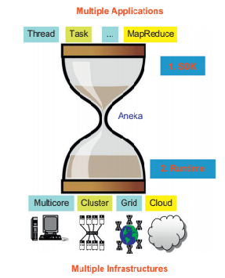
5.1 Framework overview
One of Aneka’s key advantages- its extensible set of APIs associated with different types of programming models—such as Task, Thread, and MapReduce
—used for developing distributed applications, integrating new capabilities into the cloud, and supporting different types of cloud deployment models: public, private, and hybrid (see Figure)

Slide 65
5.1 Framework overview
Figure 5.2 provides a complete overview of the components of the Aneka framework. The core infrastructure of the system allows the framework to be deployed over different platforms and operating systems.
Aneka container, which is installed on each node and constitutes the basic building block of the middleware.
A collection of interconnected containers constitute the Aneka Cloud: a single domain in which services are made available to users and developers.
The container features three different classes of services: Fabric Services, Foundation Services, and Execution Services.
These take care of infrastructure management, supporting services for the Aneka Cloud, and application management and execution, respectively.
These services are made available to developers and administrators by means of the application management and development layer, which includes
* interfaces and APIs for developing cloud applications and
* management tools and interfaces for controlling Aneka Clouds.

Slide 66
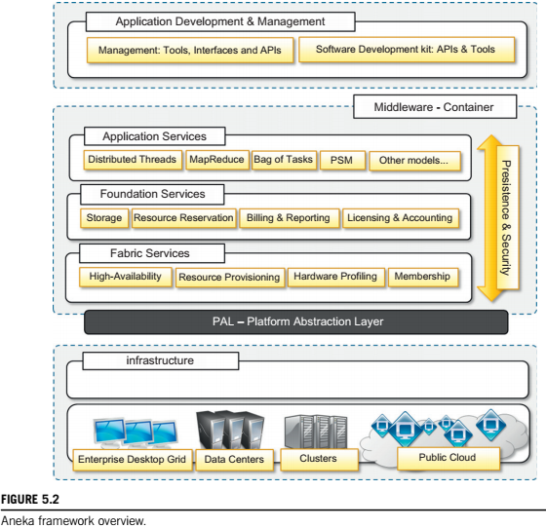
.
.

Slide 67
5.1 Framework overview
Aneka implements a service-oriented architecture (SOA), and services are the fundamental components of an Aneka Cloud.
Services operate at container level and, except for the PAL, they provide developers, users, and administrators with all features offered by the framework.
Services also constitute the extension and customization point of Aneka Clouds:
1. The infrastructure allows for the integration of new services or replacement of the existing ones with a different implementation.
2.The framework includes the
basic services for infrastructure and node management,
application execution,
accounting, and
system monitoring;
existing services can be extended and new features can be added to the cloud by dynamically plugging new ones into the container.

Slide 68
5.1 Framework overview
Aneka services involve:
• Elasticity and scaling. By means of the dynamic provisioning service, Aneka supports dynamically upsizing and downsizing of the infrastructure available for applications.
• Runtime management. The runtime machinery is responsible for keeping the infrastructure up and running and serves as a hosting environment for services. (achieve through container)
• Resource management. Aneka is an elastic infrastructure in which resources are added and removed dynamically according to application needs and user requirements.
To provide QoS-based execution, the system not only allows dynamic provisioning but also provides capabilities for reserving nodes for exclusive use by specific applications.
• Application management. A specific subset of services is devoted to managing applications. These services include scheduling, execution, monitoring, and storage management.

Slide 69
5.1 Framework overview
User management. Aneka is a multitenant distributed environment in which multiple
applications, potentially belonging to different users, are executed.
* The framework provides an extensible user system via which it is possible to define users, groups, and permissions. The services devoted to user management build up the security infrastructure of the system.
• QoS/SLA management and billing. Within a cloud environment, application execution is metered and billed.
* Aneka provides a collection of services that coordinate together to take into account the usage of resources by each application and to bill the owning user accordingly.

Slide 70
5.2 Anatomy of the Aneka container
The services installed in the Aneka container can be classified into three major categories:
• Fabric Services
• Foundation Services
• Application Services
The services stack resides on top of the Platform Abstraction Layer (PAL), representing the interface to the underlying operating system and hardware.
5.2.1 From the ground up: the platform abstraction layer
The core infrastructure of the system is based on the .NET technology and allows the Aneka container to be portable over different platforms and OS.
Any platform featuring an ECMA-334 and ECMA-335 compatible environment can host and run an instance of the Aneka container.
The Common Language Infrastructure (CLI), which is the specification introduced in the ECMA-334 standard, defines a common runtime environment (for executing programs) but does not provide any interface.

Slide 71
5.2.1 From the ground up: the platform abstraction layer
Moreover, each OS has a different file system organization and stores that information differently.
The Platform Abstraction Layer (PAL) addresses this heterogeneity and provides the container with a uniform interface for accessing the relevant hardware and operating system information.
The PAL is responsible for detecting the supported hosting environment(detection engine)
The PAL provides the following features:
• Uniform and platform-independent implementation interface for accessing the hosting platform
• Uniform access to extended and additional properties of the hosting platform
• Uniform and platform-independent access to remote nodes
• Uniform and platform-independent management interfaces
The PAL is a small layer of software that comprises a detection engine, which automatically configures the container at boot time.

Slide 72
5.2.1 From the ground up: the platform abstraction layer
The collectible data that are exposed by the PAL are the following:
• Number of cores, frequency, and CPU usage
• Memory size and usage
• Aggregate available disk space
• Network addresses and devices attached to the node

Slide 73
5.2.2 Fabric services
Fabric Services define the lowest level of the software stack representing the Aneka Container.
They provide access to the resource-provisioning subsystem and to the monitoring facilities implemented in Aneka.
Resource-provisioning services- dynamically providing new nodes on demand by relying on virtualization technologies,
Monitoring services - allow for hardware profiling and implement a basic monitoring infrastructure that can be used by all the services installed in the container.
5.2.2.1 Profiling and monitoring
Profiling and monitoring services are mostly exposed through the
* Heartbeat- makes available the information that is collected through the PAL
* Monitoring, and Reporting Services - implement a generic infrastructure for monitoring the activity of any service in the Aneka Cloud.

Slide 74
5.2.2 Fabric services
Heartbeat: The Heartbeat Service periodically collects the dynamic performance information about the node and publishes this information to the membership service in the Aneka Cloud.
* These data are collected by the index node of the Cloud, which makes them available for services such as reservations and scheduling.
* Basic information about memory, disk space, CPU, and operating system is collected.
A specific component, called Node Resolver, is in charge of collecting these data and making them available to the Heartbeat Service.
Reporting and Monitoring Services. The Reporting Service manages the store for monitored data and makes them accessible to other services or external applications for analysis purposes.
* On each node, an instance of the Monitoring Service acts as a gateway to the Reporting Service and forwards to it all the monitored data that has been collected on the node. Any service that wants to publish monitoring data can leverage the local monitoring service.

Slide 75
5.2.2 Fabric services
Currently several built-in services provide information through this channel:
* The Membership Catalogue tracks the performance information of nodes.
* The Execution Service monitors several time intervals for the execution of jobs.
* The Scheduling Service tracks the state transitions of jobs.
* The Storage Service monitors and makes available information about data transfer, such as upload and download times, filenames, and sizes.
* The Resource Provisioning Service tracks the provisioning and lifetime information of virtual nodes.
5.2.2.2 Resource management
Resource management is another fundamental feature of Aneka Clouds. It comprises several tasks: resource membership, resource reservation, and resource provisioning.
Aneka provides a collection of services that are in charge of managing resources.
These are the Index Service (or Membership Catalogue), Reservation Service, and Resource Provisioning Service

Slide 76
5.2.2 Fabric services
The Membership Catalogue –
* keeps track of the basic node information for all the nodes that are connected or disconnected.
* implements the basic services of a directory service, allowing the search for services using attributes such as names and nodes.
* During container startup, each instance publishes its information to the Membership Catalogue and updates it constantly during its lifetime.
* Services and external applications can query the membership catalogue to discover the available services and interact with them.
* collector of the dynamic performance data of each node, which are then sent to the local monitoring service.
Resource provisioning –
* allows the integration and management of virtual resources leased from IaaS providers into the Aneka Cloud.
* changes the structure of the Aneka Cloud by allowing it to scale up and down according to different needs: handling node failures, ensuring the quality of service for applications, or maintaining a constant performance and throughput of the Cloud

Slide 77
5.2.3 Foundation services
Foundation Services are related to the logical management of the distributed system built on top of the infrastructure and provide supporting services for the execution of distributed applications.
All the supported programming models can integrate with and leverage these services to provide advanced and comprehensive application management. These services cover:
* Storage management for applications
* Accounting, billing, and resource pricing
* Resource reservation
Foundation Services provide a uniform approach to managing distributed applications and allow developers to concentrate only on the logic that distinguishes a specific programming model from the others.
Together with the Fabric Services, Foundation Services constitute the core of the Aneka middleware.
These services are mostly consumed by the execution services and Management Consoles. External applications can leverage the exposed capabilities for providing advanced application management.

Slide 78
5.2.3 Foundation services
5.2.3.1 Storage management
File/Data transfer management is an important aspect of any distributed system, even in computing clouds(data persisted and moved in the format of files).
Aneka offers two different facilities for storage management: Centralized file storage and Distributed file system.
A Centralized File Storage- used for the execution of compute-intensive applications (appln require powerful processors and do not have high demands in terms of storage, used to store small files that are easily transferred from one node to another..applicable for a centralized storage node, or a pool of storage nodes)
*It consitutes Aneka’s data-staging facilities- It provides distributed applications with the basic file transfer facility and abstracts the use of a specific protocol (FTP)to end users
* To support different protocols, the system introduces file channel components: a file channel controller and a file channel handler.

Slide 79
5.2.3 Foundation services
5.2.3.1 Storage management(contd)
* The file channel controller constitutes the server component of the channel, where files are stored and made available; the file channel handler represents the client component, which is used by user applications or other components of the system to upload, download, or browse files
* The storage service uses the configured file channel factory to first create the server component that will manage the storage and then create the client component on demand.
* File Channel Abstraction is the ability to chain two different channels to move files by using two different protocols. For example, an output file should store in S3 bucket. worker node -> Storage Service (using the internal FTP protocol) -> S3 (by the FTP channel controller)
Distributed File System -for the execution of data-intensive applications( appln are characterized by large data files (gigabytes or terabytes), and the processing power required by tasks does not constitute a performance bottleneck. Applicable for a distributed file system )

Slide 80
5.2.3 Foundation services
5.2.3.1 Storage management(contd)
* The reference model for the distributed file system is the Google File System.
* The architecture of the file system is based on a master node, which contains a global map of the file system and keeps track of the status of all the storage nodes, and a pool of chunk servers, which provide distributed storage space in which to store files.
* Files are logically organized into a directory structure.Each file is organized as a collection of chunks that are all of the same size. File chunks are assigned unique IDs and stored on different servers, eventually replicated to provide high availability and failure tolerance.
* the only programming model that makes use of the distributed file system is MapReduce
5.2.3.2 Accounting, billing, and resource pricing
Accounting Services keep track of the status of applications. The collected information provides a detailed breakdown of the distributed infrastructure usage and is vital for the proper management of resources.

Slide 81
5.2.3 Foundation services
5.2.3.2 Accounting, billing, and resource pricing(contd)
Billing is another important feature of accounting. Aneka is a multitenant cloud programming platform. Aneka Billing Service provides detailed information about each user’s usage of resources, with the associated costs. Each resource can be priced differently according to the set of services that are available.
The accounting model provides an integrated view of budget spent for each application, a summary view of the costs associated to a specific user, and the detailed information about the execution cost of each job
Difference b/w Accounting Service and the Reporting Service.
Accounting- Keeps track of the information that is related to application execution, such as the distribution of jobs among the available resources, the timing of each of job, and the associated cost.
Reporting -makes available the information collected from the monitoring services for accounting purposes: storage utilization and CPU performance.

Slide 82
5.2.3 Foundation services
5.2.3.3 Resource reservation
Resource Reservation supports the execution of distributed applications and allows for reserving resources for exclusive use by specific applications.
Resource reservation is built out of two different kinds of services:
1.Resource Reservation- It keeps track of all the reserved time slots in the Aneka Cloud and provides a unified view of the system.
2. Allocation Service. It is installed on each node that features execution ser-vices and manages the database of information regarding the allocated slots on the local node.
At the moment, the framework supports three different implementations:
1.Basic Reservation. Features the basic capability to reserve execution slots on nodes and implements the alternate offers protocol, which provides alternative options in case the initial reservation requests cannot be satisfied.
2.Libra Reservation. Represents a variation of the previous implementation that features the ability to price nodes differently according to their hardware capabilities.
3.Relay Reservation. Constitutes a very thin implementation that allows a resource broker to reserve nodes in Aneka Clouds and control the logic with which these nodes are reserved. This implementation is useful in integration scenarios in which Aneka operates in an intercloud environment.

Slide 83
5.2.4 Application services
Application Services manage the execution of applications and constitute a layer that differentiates according to the specific programming model used for developing distributed applications on top of Aneka.
It is possible to identify two major types of activities that are common across all the supported models: scheduling and execution.
5.2.4.1 Scheduling
Scheduling Services are in charge of planning the execution of distributed applications on top of Aneka and governing the allocation of jobs composing an application to nodes. They also constitute the integration point with several other Foundation and Fabric Services, such as the Resource Provisioning Service, the Reservation Service, the Accounting Service, and the Reporting Service. Common tasks that are performed by the scheduling component are the following:
Job to node mapping
Rescheduling of failed jobs
Job status monitoring
Application status monitoring

Slide 84
5.2.4 Application services
5.2.4.1 Scheduling (contd)
Aneka does not provide a centralized scheduling engine.
Different scheduling engines for different models gives great freedom in implementing scheduling and resource allocation strategies .
common situations that have to be appropriately managed are the following: multiple jobs sent to the same node at the same time; jobs without reservations sent to reserved nodes; and jobs sent to nodes where the required services are not installed.
Aneka’s Foundation Services provide sufficient information to avoid these cases.
it is possible to enforce that only one job per programming model is run on each node at any given time, but the execution of applications is not mutually exclusive unless Resource Reservation is used.
5.2.4.2 Execution
Execution Services control the execution of single jobs that compose applications.

Slide 85
5.2.4 Application services
They are in charge of setting up the runtime environment hosting the execution of jobs. As happens for the scheduling services, each programming model has its own requirements, but it is possible to identify some common operations that apply across all the range of supported models:
*Unpacking the jobs received from the scheduler
*Retrieval of input files required for job execution
*Sandboxed execution of jobs
*Submission of output files at the end of execution
*Execution failure management (i.e., capturing sufficient contextual information useful to identify the nature of the failure)
*Performance monitoring
` *Packing jobs and sending them back to the scheduler
Execution Services handle less information and are required to integrate themselves only with the Storage Service and the local Allocation and Monitoring Services.
Application Services constitute the runtime support of the programming model in the Aneka Cloud

Slide 86
5.2.4 Application services
Currently there are several supported models:
1. Task Model. This model provides the support for the independent “bag of tasks” applications and many computing tasks. In this model, an application is modeled as a collection of tasks that are independent from each other and whose execution can be sequenced in any order.
2.Thread Model. This model provides an extension to the classical multithreaded programming to a distributed infrastructure and uses the abstraction of Thread to wrap a method that is executed remotely.
3.MapReduce Model. This is an implementation of MapReduce as proposed by Google on top of Aneka.
4.Parameter Sweep Model. This model is a specialization of the Task Model for applications that can be described by a template task whose instances are created by generating different combinations of parameters, which identify a specific point into the domain of interest.
Other programming models Dataflow Model, the Message-Passing Interface, and the Actor Model developed for internal use.

Slide 87
END OF CHAPTER 5 (MODULE 2)

