Slide 1

Credit Card Fraud Detection

Slide 2

Dhathri Bathini
Vijaya Deepika Buddhiraju
Rehonoma Hasan Jahin
Sathvik Maridasana Nagaraj

Slide 3
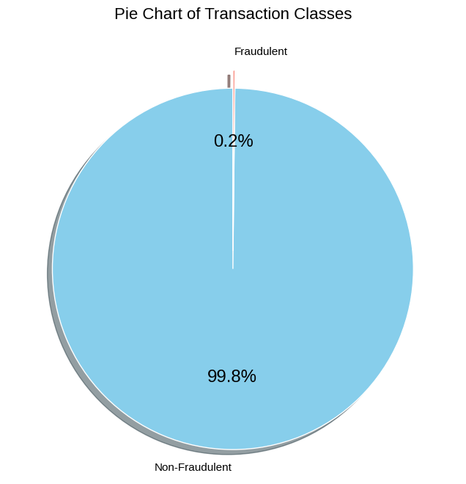
Introduction
Objectives -
The aim of the project is to check which machine learning model is the best to identifying and flag the fraudulent transactions in real-time.
Data Description -
The dataset was sourced from Kaggle.
Columns: 31
Rows: 284807
V1 to V28: PCA variables

Slide 4
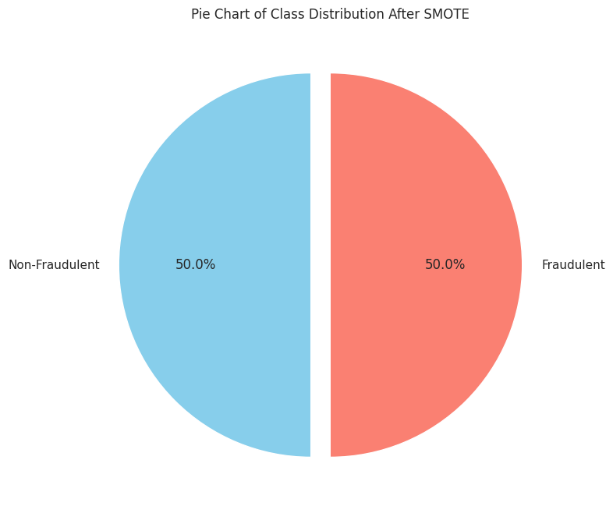
Data Preprocessing
Splitting data: The dataset was divided into training (70%) and testing (30%) set.
Data normalisation: Features were scaled using StandardScaler to ensure that the model inputs have mean zero and variance one.
SMOTE: Synthetic Minority Over-sampling Technique (SMOTE) was applied to the training set to balance the classes by generating synthetic samples.
Null values: The dataset was checked for null values, and no missing data was found, eliminating the need for imputation.
Libraries: Utilized Python libraries including pandas for data manipulation, numpy for numerical operations, sklearn for modeling and metrics, and imblearn for applying SMOTE.

Slide 5

Model selection
Support Vector Machines (SVM):
Effective in high-dimensional spaces, typical of credit card transaction data.
Based on margin maximization, useful for achieving clear separation between classes using hyperplanes.
Decision Tree:
Easy to understand and interpret, facilitating transparency in decision-making.
Capable of handling non-linear relationships between features, useful for identifying complex fraudulent patterns.
Logistic Regression:
Provides probabilities for outcomes, offering a nuanced assessment of transaction risk.
Performs well in binary classification tasks, even with imbalanced datasets, by adjusting class weights or thresholds.
K-Nearest Neighbors (KNN):
Simple, instance-based learning algorithm effective in capturing data patterns without assuming a specific model structure.
Can handle nonlinear decision boundaries, useful in fraud detection where such boundaries are common.

Slide 6
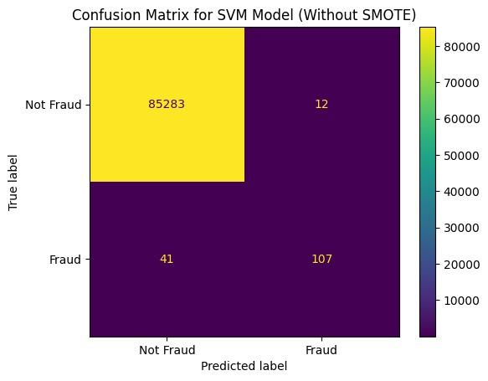
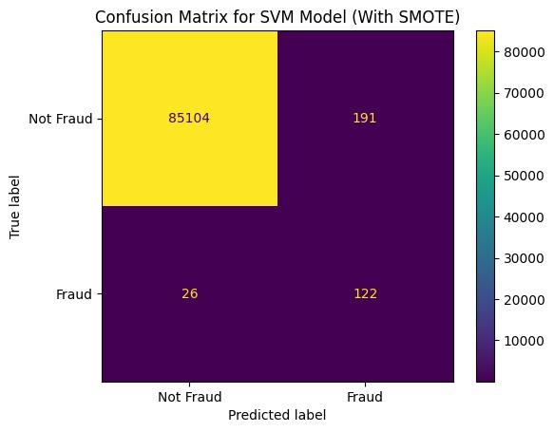
SVM

Slide 7
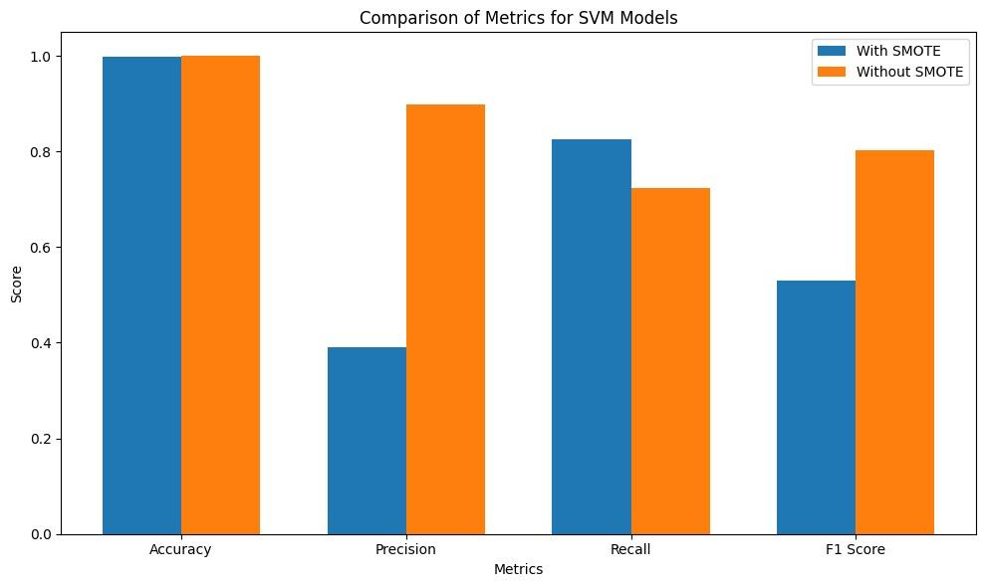
SVM

Slide 8
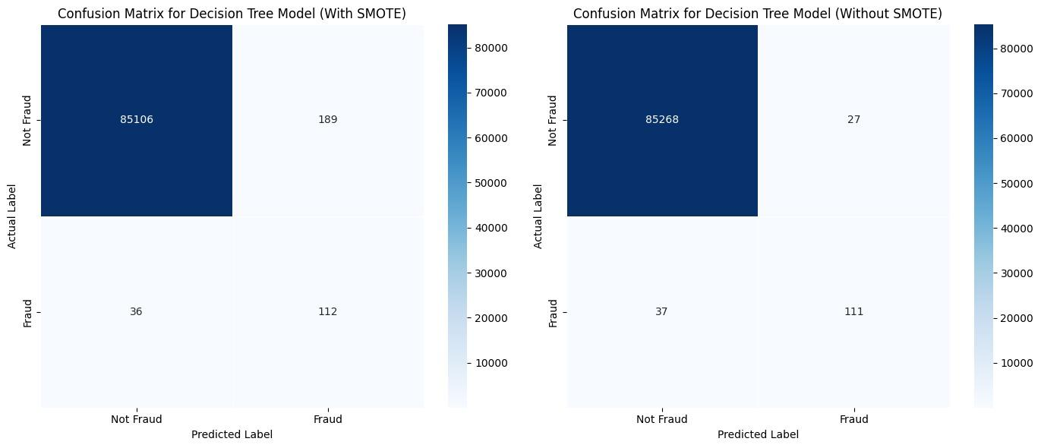
Decision Tree

Slide 9
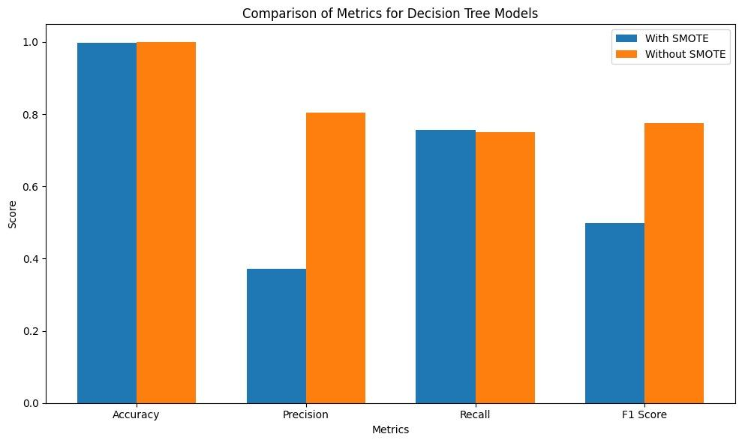
Decision Tree

Slide 10
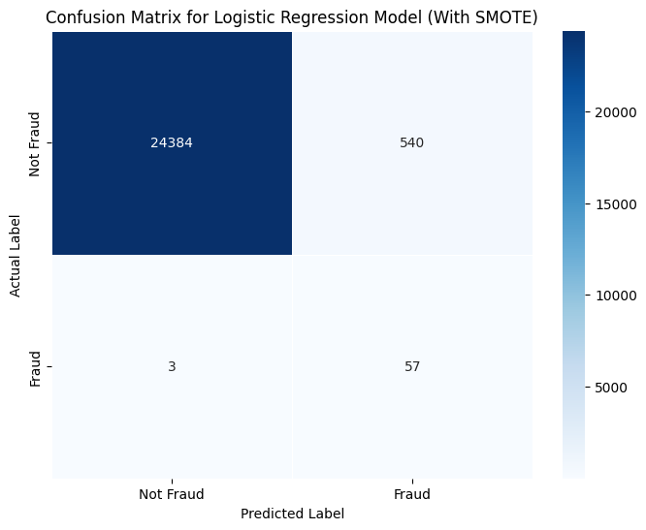

Logistic Regression

Slide 11
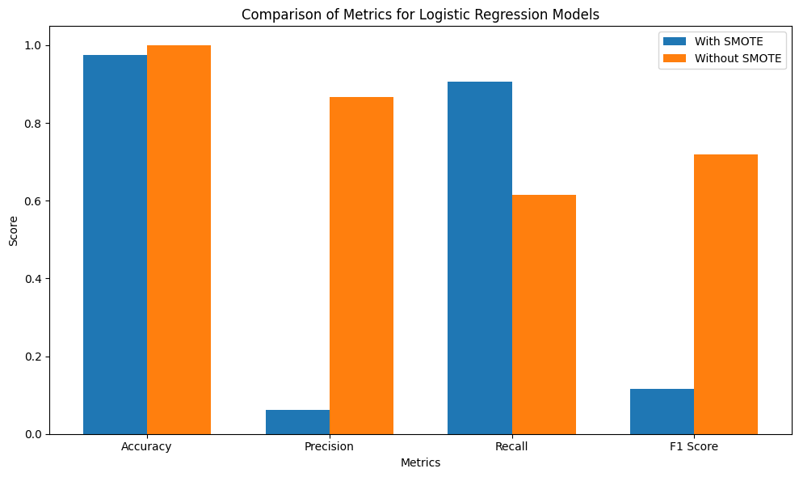
Logistic Regression

Slide 12
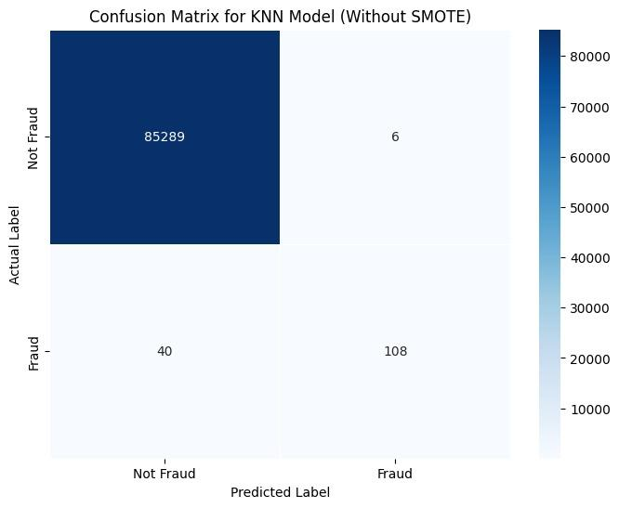

KNN

Slide 13
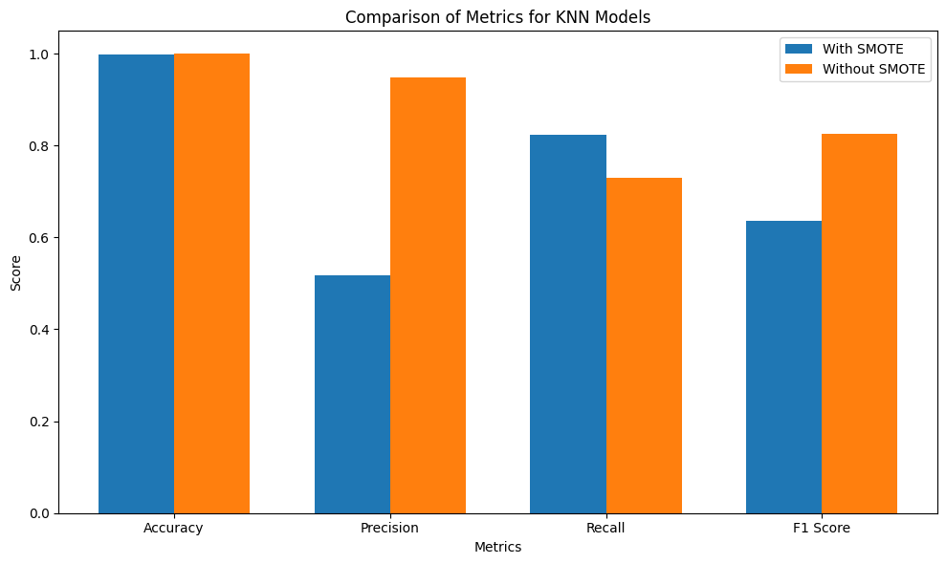
KNN

Slide 14
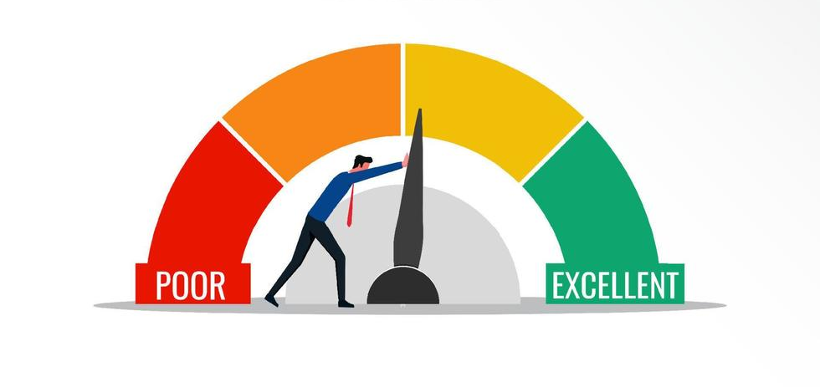
Performance Metrics
Model | SMOTE | Accuracy | Precision | Recall | F1-score
SVM | With | 0.997460 | 0.389763 | 0.824324 | 0.529284
 | Without | 0.999379 | 0.899159 | 0.722972 | 0.801498
Decision Tree | With | 0.997367 | 0.372093 | 0.756757 | 0.498886
 | Without | 0.999251 | 0.804348 | 0.75 | 0.776224
Logistic Regression | With | 0.975913 | 0.061524 | 0.905405 | 0.115219
 | Without | 0.999169 | 0.866666 | 0.614864 | 0.719367
KNN | With | 0.998361 | 0.516949 | 0.824324 | 0.635416
 | Without | 0.999461 | 0.947368 | 0.729729 | 0.824427

Slide 15
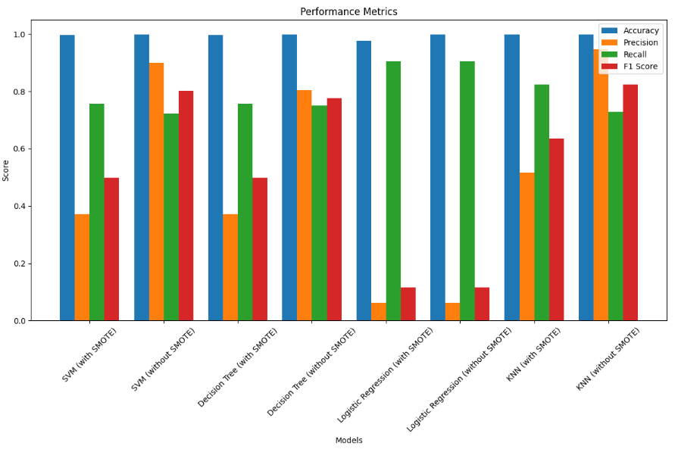
Results

Slide 16
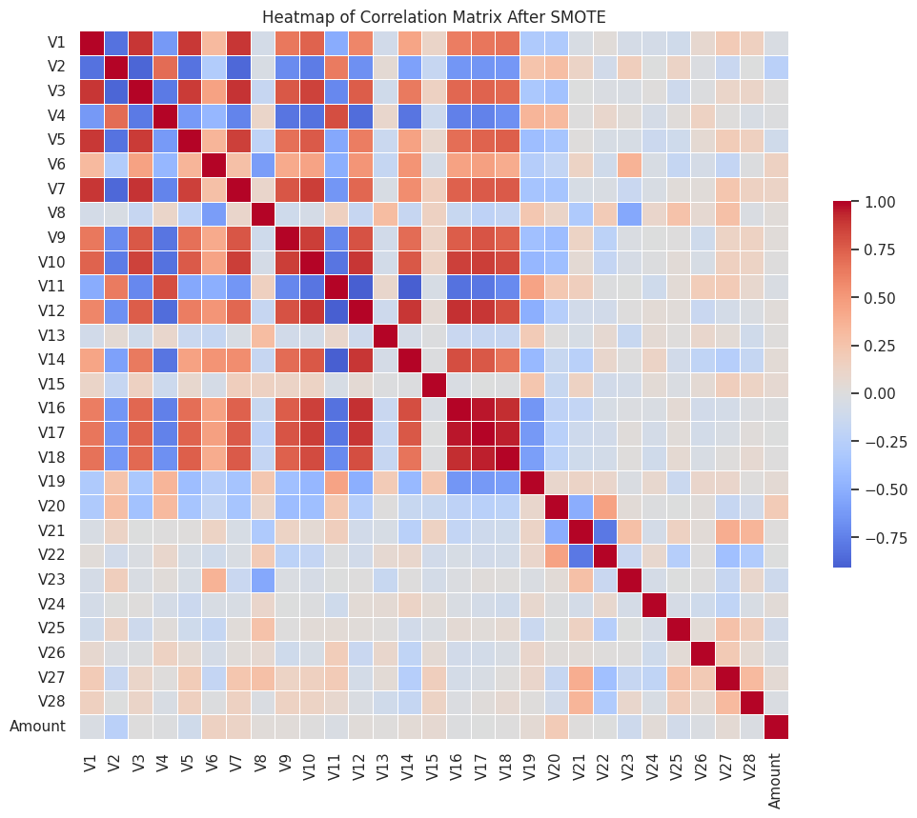
Challenges with SMOTE
Increased Collinearity
Undermined Indepence
Poor Generalization

Slide 17
Best Performing Model
KNN (without SMOTE) stands out with the highest F1 score, which suggests a strong balance between precision and recall. This model minimizes false positives while still capturing a substantial proportion.
KNN (without SMOTE), with its high precision and good recall ensures that fewer legitimate transactions are mistakenly flagged as fraudulent while still maintaining a robust detection rate for actual fraud.

Slide 18

Limitations
The project encountered a constraint due to the imbalance present in the dataset, which raised the potential for overfitting and inherent biases.
Encountered uncertainty regarding the efficacy of SMOTE in achieving data balance, adding to the challenges faced in the analysis.
SMOTE generated extensive correlation between the variables as the variables V1 to V28 were already derived via PCA.

Slide 19

Future work
Advanced Over-sampling Techniques: Beyond SMOTE, explore variants like Borderline-SMOTE or ADASYN, which focus on generating synthetic samples near the borderline of decision classes, potentially improving decision boundaries.
Under-sampling Methods: Implement techniques such as Cluster Centroids or Tomek Links to reduce the number of instances from the majority class, making the dataset more manageable and less biased.
Cost-sensitive Learning: Employ models that integrate the cost associated with misclassifications, particularly emphasizing the high cost of missing a fraudulent transaction.

Slide 20
THANK YOU!
Questions?

