Slide 1





Life Expectancy Prediction

Slide 2
Objectives
Development of Life Expectancy Prediction Model for individuals aiming to estimate their life expectancy based on various factors. The model will provide an estimate of life expectancy ranging from low to high, assisting individuals in understanding their potential lifespan.
Benefits
Predict the Life Expectancy based on the given parameters.
Provides insights about the factors affecting life expectancy.
Establishes relationships between the parameters and life expectancy.
Provides estimated life expectancy values to assist individuals in understanding their potential lifespan.

Slide 3
Data Sharing Agreement
Sample File Name: life expectancy data.csv
Cleaned Data File Name: life expectancy.ipynb
Number of Columns: 21
Number of Rows: 2938
Columns Name: Year, Status, Adult Mortality, Alcohol, Hepatitis B, Measles, BMI, Under-five deaths, Polio, Total expenditure, Diphtheria, HIV/AIDS, GDP, Population, Thinness 1-19 years, Income composition of resources, Schooling
Columns Datatype: int64, float64

Slide 4
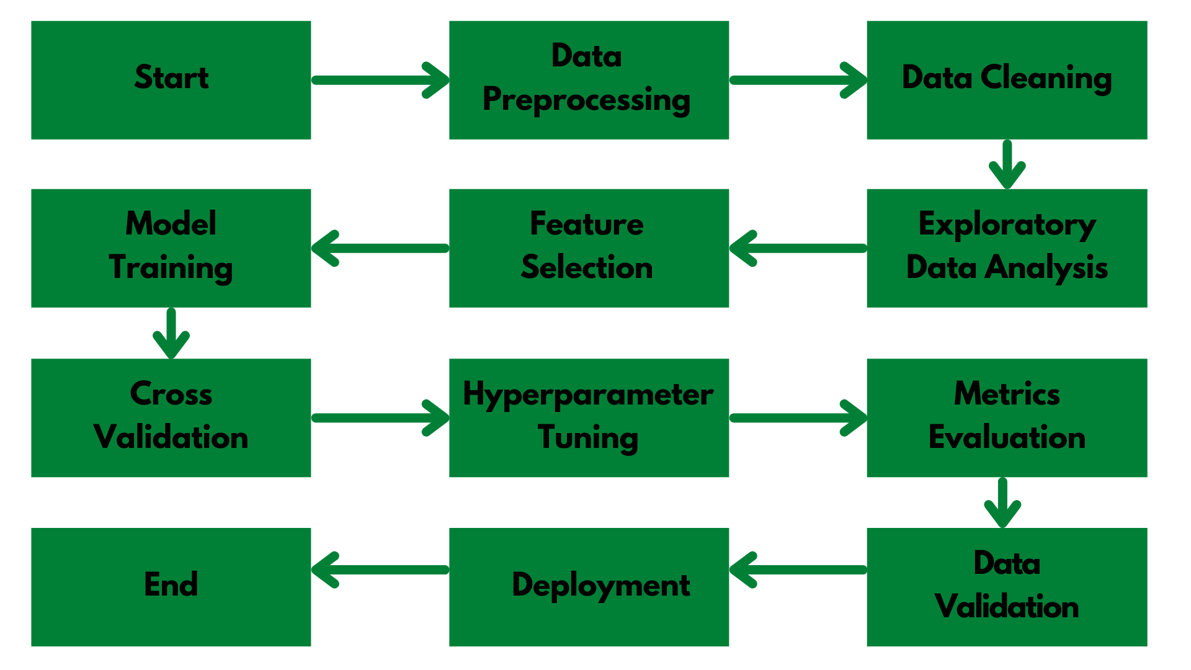
Architecture

Slide 5
Step 1: Data Preprocessing and EDA
Raw data contains 16 columns: Gender, Age, Smoking, Alcohol Consumption, Physical Activity, BMI, Life Expectancy, and others.
We used the DataPrep module to perform exploratory data analysis (EDA) on the dataset.
During the analysis, we found that the dataset has missing data, with certain features like smoking and alcohol consumption having relatively high percentages of missing values.
We handled the missing data appropriately by either imputing or removing the missing values.
To focus on the relevant parameters for predicting life expectancy, we selected important features and dropped unnecessary columns.
We removed any non-contributing factors and features that were not dependent on life expectancy, such as specific dates or irrelevant demographic information.
Additionally, we performed data transformations and feature engineering to enhance the predictive power of the model.
This involved encoding categorical variables, normalizing numerical features, and exploring relationships between different variables.

Slide 6
Step 2: Linear Regression
In the life expectancy prediction project, a linear regression model was implemented to examine the linear relationship between various features and life expectancy.
The dataset included features such as gender, age, smoking, alcohol consumption, physical activity, and BMI (Body Mass Index), with the target variable being life expectancy.
By applying linear regression, the model estimated the coefficients for each feature, indicating the strength and direction of their linear relationship with life expectancy.
These coefficients provided insights into how changes in each feature affected the predicted life expectancy.
Through analysis, it was observed that certain features exhibited significant linear relationships with life expectancy.
For example, the coefficient for physical activity might indicate that an increase in physical activity is associated with an increase in life expectancy.

Slide 7
Similarly, the coefficients for age, BMI, and smoking could reveal the impact of these factors on life expectancy.
The linear regression model allowed for quantifying the impact of each feature on life expectancy, providing a valuable understanding of the relationships between the variables.
This information could be used to identify significant predictors and further refine the predictive model.

Slide 8
Prediction and Deployment
Once the data is prepared, it is fed into the loaded linear regression model. The model applies the learned coefficients to the input features and calculates the predicted life expectancy.
The predicted life expectancy is obtained from the model and can be displayed to the user. This can be done by updating the web page with the predicted value or by presenting it in a user-friendly format.
Flask application was developed to provide a user interface for predicting life expectancy based on the given features.
The Flask framework was used to handle the backend logic and routing, while HTML and CSS were used to design and structure the frontend interface.
The Flask app allowed users to input the relevant feature values through a form or user interface.

Slide 9
These inputs were then passed to the deployed linear regression model, which calculated and returned the predicted life expectancy.
The predicted value was then displayed to the user on the webpage.
To make the Flask app accessible to users, it was deployed on the Render platform.
Render provides hosting and deployment services for web applications, allowing them to be accessible over the internet.
By deploying the Flask app on Render, users could access the life expectancy prediction functionality through a web browser.
The HTML and CSS files were used to customize the appearance and layout of the web page, ensuring a visually appealing and user-friendly interface. CSS styles were applied to create a consistent design and improve the overall user experience.

Slide 10
Frequent Q&A
Q) What is the source of the data?
Data was provided by VIEH Group
Q) What is the complete flow of your project?
Refer to slide no 4 for better understanding.
Q) What techniques were you using for data pre-processing?
In data pre processing, we analyzed the data, found the important features, and based on the domain knowledge, we eliminated the unnecessary columns. We also tried to fill missing Values with random imputation technique.

Slide 11
Frequent Q&A
Q) What are the different stages of deployment?
Development: We develop our Flask application using HTML, CSS, and Python. This involves writing code, designing the user interface, and implementing the necessary functionality.
Testing: We perform thorough testing of your Flask app to ensure that it functions correctly, handles different scenarios, and provides accurate predictions. This stage helps identify and fix any issues or bugs in the application.
Deployment: Once our Flask app passes the testing phase, we deploy it to the Render platform. This involves configuring the necessary settings, uploading our code, and ensuring that the application is running properly on the server.
Prediction: After the deployment, users can access our Flask app through a web interface. They can input the relevant parameters or data, and the app will use the trained linear regression model to make predictions on life expectancy. The predicted results are displayed to the users.
Monitoring and Maintenance: Once the application is live, it's important to continuously monitor its performance, address any issues that may arise, and provide regular updates or maintenance as needed. This ensures that the app remains functional, accurate, and reliable for users.

