Slide 1
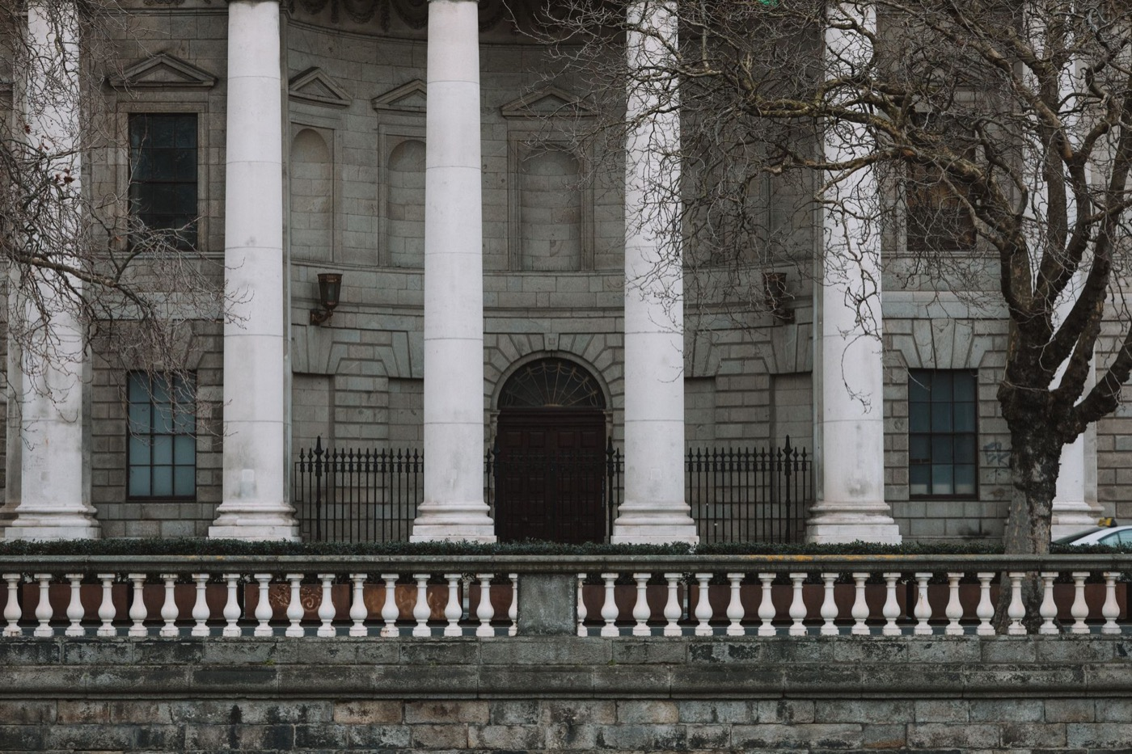
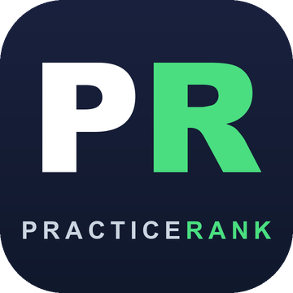
SEO & AI-Search
Growth Strategy
Prepared for Parian Lawyers · Carrollton, Georgia
Personal Injury Law Firm
PracticeRank · practicerank.ai

Slide 2
WHO YOU'RE WORKING WITH
Meet Your Team
D
Dan Toone
K
Kody Doherty
Client Relations Manager
Chief Technology Officer
Your dedicated day-to-day point of contact. Dan keeps you informed, coordinates approvals, and makes sure every deliverable ships on time — so you always know exactly what's happening and what's next.
Leads the technical SEO, automation, and AI-search engineering behind your growth — the systems that get you found across Google, Maps, and AI assistants.
practicerank.ai
02

Slide 3
WHY THIS MATTERS
How Customers Find You Has Changed
People don't just “Google it” anymore. They search Google, tap the Maps 3-pack, and increasingly ask AI assistants for a recommendation. Winning today means showing up in all of them.
Google Search
Google & Apple Maps
AI Assistants
Organic rankings for the searches that bring you customers
The local 3-pack — where most “near me” clicks go
ChatGPT, Gemini, Perplexity & Google AI recommending you
practicerank.ai
03

Slide 4
OUR METHOD
A Well-Rounded Approach — Every Signal Covered
Technical SEO
On-Page SEO
Schema / Structured Data
Local SEO & Google Profile
Content & Authority
AI-Search (AEO)
Reviews & Reputation
Conversion & UX
We don't do one thing well — we cover every signal Google and AI engines use to find, trust, and recommend you.
practicerank.ai
04

Slide 5
THE PROBLEMS WE SOLVE
What We Fix
✗ Invisible in “near me” searches
✗ Site doesn't tell Google what you do
→ Local SEO + Google Business Profile + city/neighborhood pages
→ Keyword-rich service pages + complete schema markup
✗ Not showing up in AI answers
✗ Thin or off-target content
→ llms.txt, structured data & AI-readable content (AEO)
→ Buyer-intent content + a focused blog strategy
✗ Low domain authority
✗ Few or aging reviews
→ A few HIGH-value local backlinks + citation cleanup
→ Automated review engine + reputation management
practicerank.ai
05

Slide 6
THE OPPORTUNITY
Where Parian Lawyers Stands Today
You've already built a strong local reputation — the opportunity is turning it into search and AI dominance.
Parian Lawyers
your top local rivals
Gap
Google reviews
162 · 4.9★
83–148
You lead
Domain Authority
29
single digits (most)
You lead
AI search visibility
0 of 68 queries
—
Biggest gap
Google · Moz · AI-visibility scan, June 2026
practicerank.ai
06

Slide 7
AUTHORITY
Domain Authority — and Why ~30 Is the Goal
Domain Authority (0–100) is a trust score for your website — built mostly from quality backlinks. The higher it climbs, the easier everything else ranks.
YOUR TARGET ~30
Parian Lawyers
29
Most local firms sit in the single digits to low teens. You're already at 29 — basically the ~30 sweet spot that beats nearly every local competitor. So authority isn't your gap; AI-search visibility is. We protect this lead and turn it into more rankings and AI recommendations.
Domain Authority — Moz, June 2026 · Backlinks are the #1 lever for raising Domain Authority.
practicerank.ai
07

Slide 8

NEXT STEPS · 1 OF 2
Building Authority — Citations & Backlinks
Quality over volume: the work that raises your Domain Authority toward ~30 and gets you cited by AI.
— Aggressive local citation building + NAP cleanup across the directories that matter
— “Best Injury Lawyer in West Georgia” comparison placements — rank for high-intent searches AND get cited by AI
— High-authority backlinks from real, locally-relevant sites — no spam, no risky tactics
— Local press, partner & supplier links for authoritative mentions
— A steady monthly cadence — compounding authority that competitors can't shortcut
practicerank.ai
08

Slide 9

NEXT STEPS · 2 OF 2
Content & Blog — Capture Ready-to-Buy Searches
Shift from curiosity content to buyer-intent content that brings customers through the door.
— Target real transactional searches from your Google data, like "car accident lawyer Carrollton GA", "personal injury attorney near me"
— Expand & refresh landing pages as we find new demand
— 2–4 new posts per month on high-intent topics, refreshed to keep ranking
— FAQ content structured for Google snippets and AI answers
practicerank.ai
09

Slide 10
THE PLAN
Your 90-Day Roadmap
Month 1 ✓
Month 2
Month 3
Technical foundation, Google Business Profile, homepage rebuild, service & location landing pages
Authority backlinks (raise Domain Authority), on-page depth, content cadence
Authority push, review growth, measure & iterate
Goal: Top-3 Map Pack + AI recommendations for your core injury keywords within 6 months — backed by our 90-day score guarantee.
practicerank.ai
10

Slide 11
YOUR OPTIONS
Three Ways to Grow
RECOMMENDED
Optimize
Grow
Dominate
The Foundation
The Growth Engine
Market Domination
$1,500/mo
$2,500/mo
$3,500/mo
✓ Local SEO + AI-search foundation
✓ 100 local citations + Google Business Profile
✓ 2 content + 1 backlink / mo
✓ Review funnel + monthly report
✓ Everything in Optimize, plus:
✓ New site on our fast managed platform
✓ 4 content + 2 backlinks / mo
✓ Practice-area + city pages, keyword tracking
✓ Everything in Grow, plus:
✓ 4 high-authority backlinks / mo
✓ “Best injury lawyer in West GA” comparison placements
✓ Aggressive citations + AI authority
Pricing tailored to your market. · Month-to-month, no long-term contracts. · Backed by our 90-day guarantee.
practicerank.ai
11

Slide 12
OUR PROMISE
The 90-Day Results-or-Refund Guarantee
If your PracticeRank Score doesn't improve by 20+ points in 90 days, we refund your monthly fees — and you keep everything we built. Month-to-month. No long-term contracts.

Slide 13
Let's grow your visibility.
Found everywhere your customers search — Google, Maps, and AI.
Dan Toone · Client Relations Manager
Kody Doherty · Chief Technology Officer
practicerank.ai · kdoherty@practicerank.ai

