Slide 1

Indian Career League
A Discord Bot
By students of ISE, BMSCE 2022
Saurabh Agarwal
Sathvik KP
Varsha Ryali

Slide 2
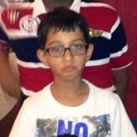
Let’s Talk About Sridhar
He’s a 13 year old boy who goes to school in DPS, Bangalore. He has an older sister who is an Engineer. He loves to play video games and sketch.
This picture was taken seconds after someone asked him “So, what do you want to be when you grow up?”.
He knows it’s easy to dream but he finds it difficult to match his dreams with sustainability.
And most importantly, he lacks awareness of career options and he has questions that are left unanswered.

Slide 3
Problem Definiton
93% of students are unaware of more than seven career options.
An aware population could minimize unemployment. Productive and motivated workers could do wonders for a sustainable future.

Slide 4
01
02
03
04
Research on career exploration in India. Aptitude tests and information of popular fields is collected.
Exploration of available platforms that tackle the same problem statement.
Conversations with present students and understanding their dilemmas. Their opinions and feedback of the present situation was noted.
Conversations with enrolled students to understand what they would do differently. This part of research helped us recruit mentors for our product.

Slide 5
IDEATE
Could track social media activity and suggest routes to take career path
Have a medium to sign up for several seminars conducted by people from different career backgrounds.
Have an article in the school newspaper that talks about a new career everyday, say a day in the life of an astronaut.
Career day where parents take the all the students of a class to their workplaces.
An app/ website that matches student profiles to mentors who can advice on the fields of interest. Consists of a feed that loads exciting information about fields the student has subscribed to and also gives clearer insight on admission procedures for dream colleges

Slide 6
OUR IMPLEMENTED IDEA
Senior connect- connects students to their alumni. This could serve as comfortable advice.
Google extension that can direct children to the inspiring part of the internet, based on interests.
Adding moral sciences and exploration to the curriculum
Discord has 155 million users a day. Most of them young.
Design a career-centric bot that helps users:
a. Take a test to identify strengths to determine the ideal career options.
b. Explore the variety of fields
c. Specifies skill-set and routes necessary to score a job in the field.
d. Find mentors for each field who are pursuing careers and are available to give advice.

Slide 7
Product testing & walk-through
Technology used: Node js dependencies {discord.js, MongoDB, Mongoose}, MongoDB Atlas.
Make sure you have “Manage Server” permissions on the server that you want to add the bot to.

Slide 8
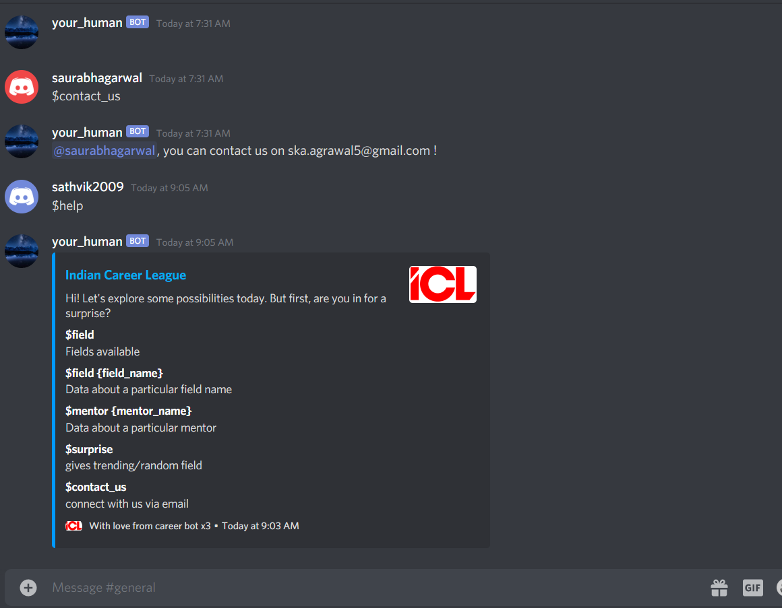
Step 1
$help to view all the commands offered by the bot and how they can help you.

Slide 9
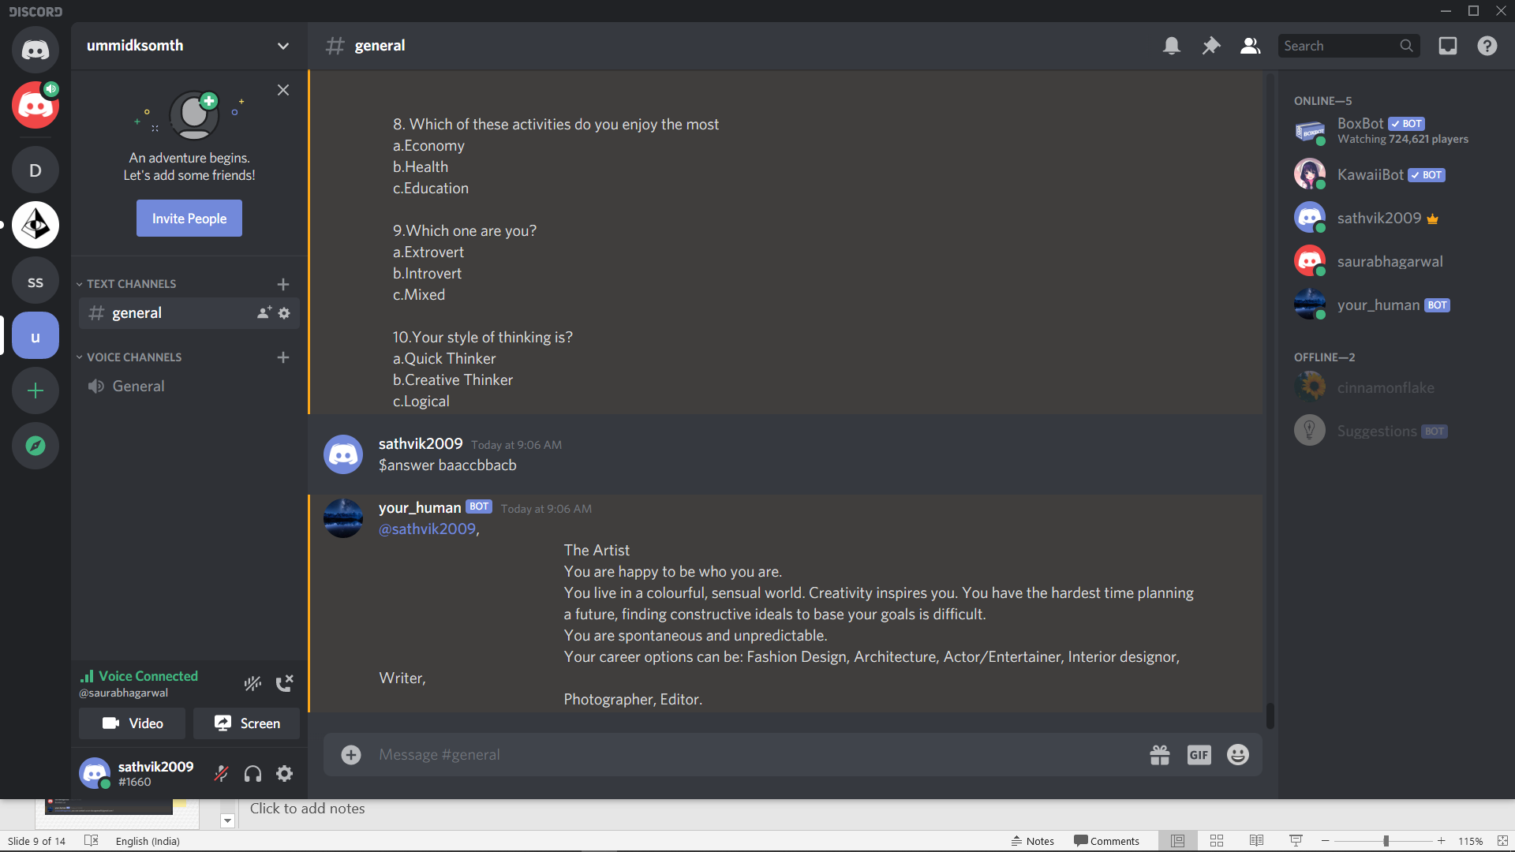
Step 2
$surprise which leads you to a quiz!
This quiz will return potential career options based off your result to make your exploration more meaningful.

Slide 10
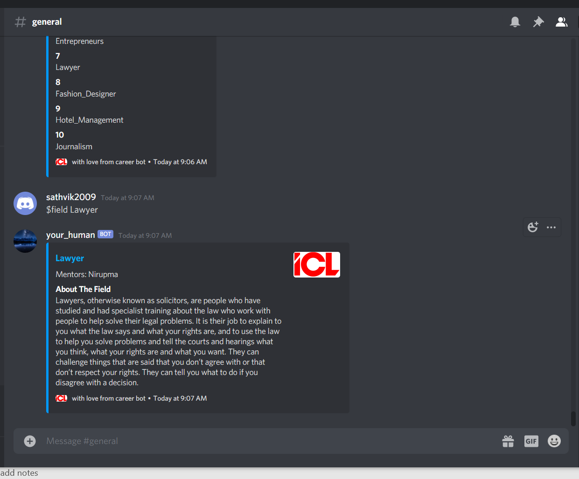
Step 3
$field will list all the fields our product can ensure mentorship for. It will also broaden the perspective of the user.
$field {field_name} will display a short intro about the field and the skill-sets required to professionally pursue it.
Additionally, it will display the names of the mentors associated to it.

Slide 11
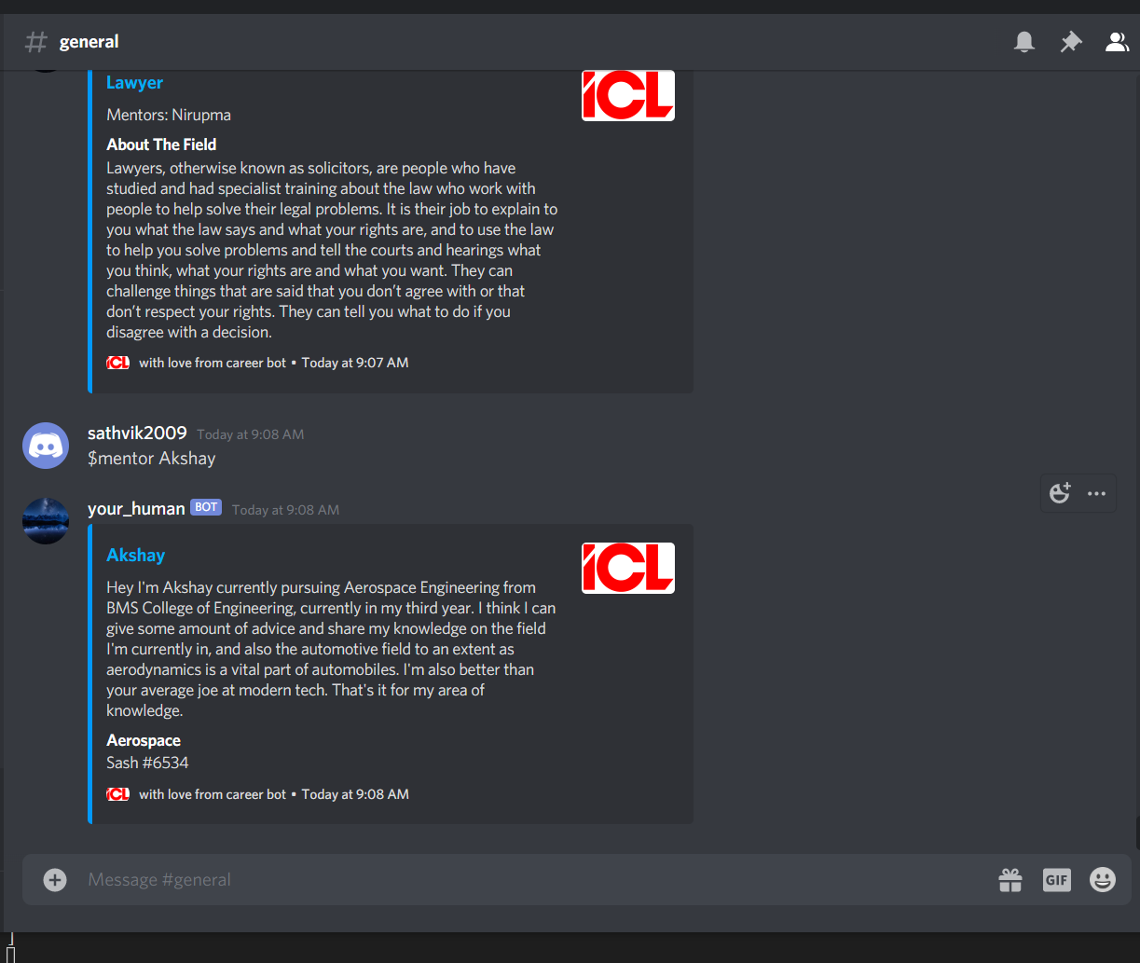
Step 4
After the exploration of fields, the user would narrow down a few areas of interest. They have the liberty to contact people in the field if they wish to seek advice.
$mentor {mentor_name} will display a short message from the mentor to the user. Their area of expertise, route to present and discord id. This id can be used for further communication.

Slide 12
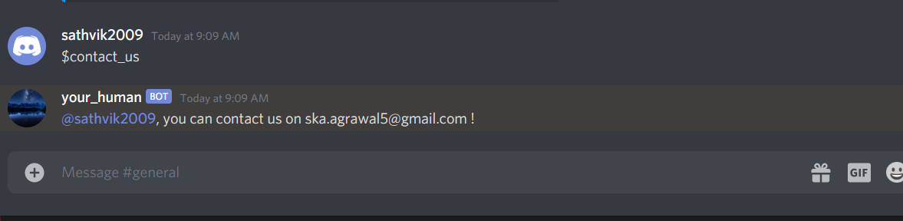
Step 5
And finally, $contact_us is used to send feedback to us! We really enjoyed making this and we’re subject to criticism. And we wish we had such a platform growing up.

Slide 13
In Conclusion…
Sridhar would be profited by using this bot in one of his million discord servers. He will turn out just a bit wiser than before, and maybe – just maybe- be motivated to pave himself a path to a future he will shine in.
And to us, nothing seems more sustainable than a happy and working nation.
Github https://github.com/sathvik09/career_bot.git

