Slide 1

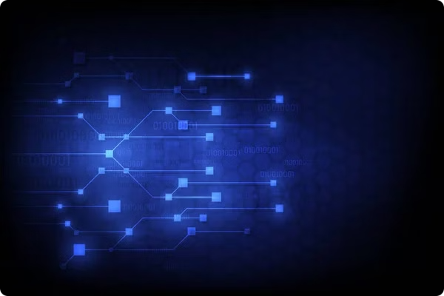
Blockchain and NFTs: A Transformative Journey
Blockchain and Non-Fungible Tokens (NFTs) are two revolutionary technologies that are rapidly transforming industries across the globe. From finance to art, these innovative solutions are disrupting the status quo and unlocking new possibilities. In this presentation, we will embark on an in-depth exploration of the fundamentals of blockchain, the rise and applications of NFTs, and the powerful synergies that emerge when these technologies converge.

Slide 2


Understanding Blockchain: The Basics
1
Decentralized Ledger
2
Cryptographic Security
3
Peer-to-Peer Network
Blockchain is a decentralized, distributed digital ledger that records transactions across many computers in a network. This decentralized structure ensures the integrity and transparency of data, as it cannot be altered by a single entity.
Blockchain utilizes advanced cryptography to secure transactions and ensure the authenticity of the data. Each block in the chain is linked to the previous one, creating an unbreakable chain of trust.
Blockchain operates on a peer-to-peer network, where participants can directly interact with each other without the need for a central authority. This decentralized structure promotes transparency, efficiency, and resilience.

Slide 3
Blockchain: Key Features and Benefits
Immutability
Transparency
Efficiency
Blockchain's distributed ledger ensures that once a transaction is recorded, it cannot be altered or deleted, providing an immutable and transparent record of all activities.
The decentralized nature of blockchain means that all participants in the network have access to the same information, fostering transparency and accountability.
Blockchain eliminates the need for intermediaries, streamlining processes and reducing bureaucratic delays, ultimately leading to increased efficiency and cost savings.

Slide 4

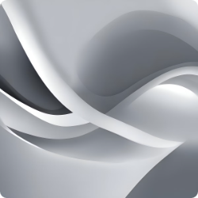
Blockchain: Real-World Applications
Finance
Supply Chain Management
Blockchain has revolutionized the financial industry, enabling secure and transparent transactions, decentralized finance (DeFi), and cross-border payments.
Blockchain enhances supply chain traceability, streamlines logistics, and improves transparency, ensuring the authenticity and integrity of products.
Healthcare
Energy
Blockchain-based solutions are transforming the healthcare industry, enabling secure and decentralized patient data management, clinical trials, and pharmaceutical supply chain tracking.
Blockchain is being utilized in the energy sector to facilitate peer-to-peer energy trading, grid management, and the integration of renewable energy sources.

Slide 5

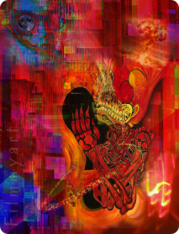
Introduction to NFTs: What are they?
1
Unique Digital Assets
2
Proof of Ownership
3
Blockchain-Based
NFTs, or Non-Fungible Tokens, are unique digital assets that are stored on a blockchain. They can represent a wide range of digital items, including artwork, collectibles, virtual real estate, and even audio or video content.
NFTs provide a secure and transparent way to establish ownership and authenticity of digital items. Each NFT is unique and cannot be replicated or exchanged for an equivalent item, making them valuable and desirable.
NFTs are built on blockchain technology, which ensures the integrity and traceability of the digital assets. This blockchain-based approach allows for the secure trading, buying, and selling of unique digital items.

Slide 6
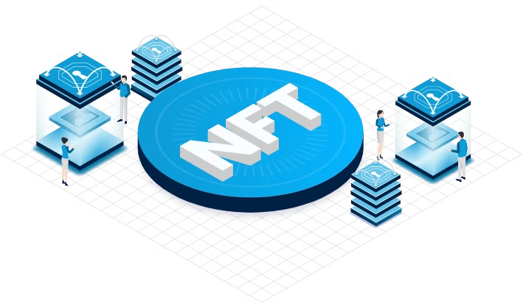
The Rise of NFTs: Driving Factors
1
Digital Scarcity
NFTs introduce the concept of digital scarcity, where unique digital items can be created and traded, much like physical collectibles. This scarcity drives demand and increases the perceived value of these digital assets.
2
Creator Empowerment
NFTs empower digital creators by allowing them to monetize their work and retain ownership and control over their creations. This has led to a surge of interest and adoption in the art, music, and gaming industries.
3
Mainstream Adoption
The recent mainstream adoption of NFTs, driven by high-profile sales and celebrity involvement, has further fueled the growth and interest in this new digital asset class, attracting both investors and enthusiasts.

Slide 7
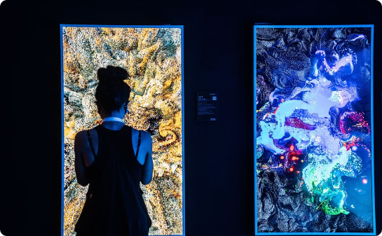
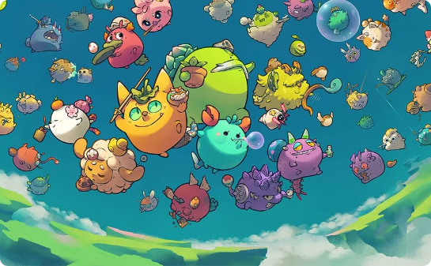
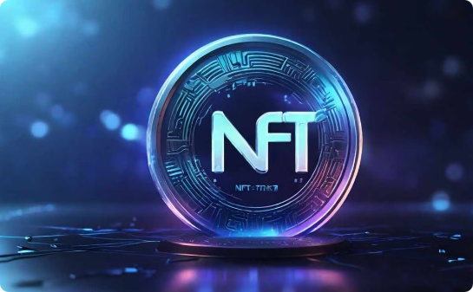
NFTs: Use Cases and Applications
Digital Art and Collectibles
Gaming and Virtual Items
Music and Royalties
NFTs have revolutionized the digital art market, allowing artists to sell their unique digital creations and establish provenance and ownership. Collectors can now invest in and trade these one-of-a-kind digital assets.
NFTs have found a strong foothold in the gaming industry, where they are used to represent unique in-game items, avatars, and even virtual real estate. These NFTs can be bought, sold, and traded, creating new revenue streams for game developers and player-driven economies.
Musicians and content creators are leveraging NFTs to sell unique digital content, such as limited edition album artwork, exclusive performances, or even fractional ownership of their work. This enables them to connect directly with fans and monetize their creations.

Slide 8




NFTs: Opportunities and Challenges
Growth Potential
Monetization Opportunities
Regulatory Challenges
Environmental Concerns
The NFT market is still in its early stages, with significant room for growth and innovation in various industries. As more mainstream adoption occurs, the opportunities for NFTs to transform industries will continue to expand.
NFTs provide new avenues for creators, artists, and businesses to monetize their digital assets and intellectual property. This can lead to increased revenue streams and the creation of new business models.
As the NFT market grows, there are concerns around regulatory frameworks, taxation, and legal considerations that need to be addressed to ensure the long-term stability and adoption of this technology.
The energy-intensive nature of some blockchain networks used to create and trade NFTs has raised concerns about the environmental impact of this technology, which will need to be addressed through more sustainable solutions.

Slide 9


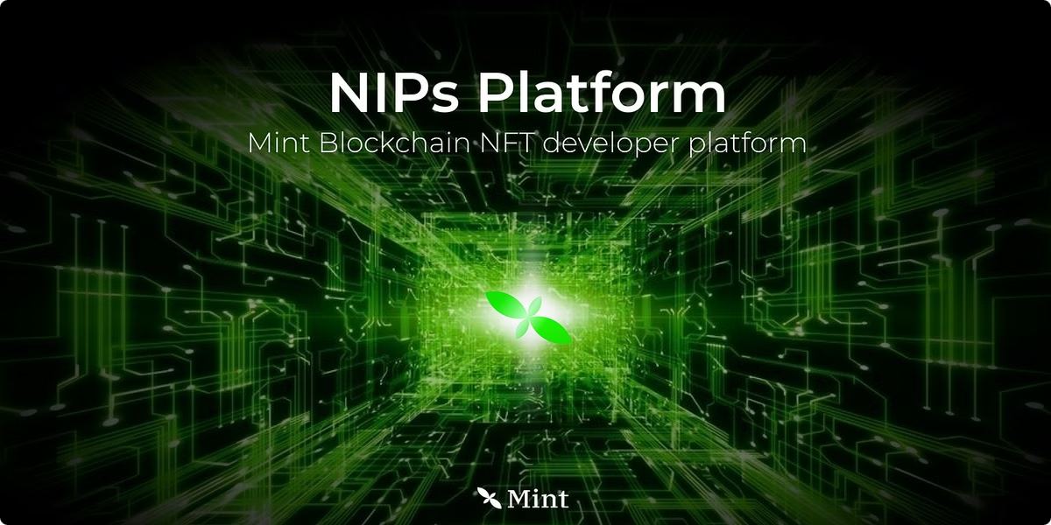


Integrating Blockchain and NFTs
Secure Transaction Records
Blockchain's immutable ledger provides a secure and transparent record of all NFT transactions, ensuring the authenticity and traceability of digital assets.
Decentralized Ownership
The decentralized nature of blockchain allows for the direct ownership and transfer of NFTs without the need for intermediaries, empowering users and creators.
Interoperability
The integration of blockchain and NFTs enables the development of interoperable platforms and ecosystems, where digital assets can be seamlessly exchanged and used across different applications.

Slide 10
The Future of Blockchain and NFTs
Mainstream Adoption
As blockchain and NFT technologies mature, they are poised to see widespread adoption across various industries, transforming how we interact with and value digital assets.
Interoperability and Scalability
Advancements in blockchain protocols and the development of cross-chain solutions will enhance the interoperability and scalability of NFT ecosystems, enabling seamless integration and broader use cases.
New Business Models
The intersection of blockchain and NFTs will continue to give rise to innovative business models, allowing creators, artists, and businesses to unlock new revenue streams and market opportunities.
Societal Impact
As these technologies become more deeply integrated into our lives, they have the potential to revolutionize how we own, transfer, and interact with digital assets, with far-reaching societal implications.

