Slide 1
Design patterns in PlantUML
Class-diagram parsing, rendering and controlled evolution
23CSE455 · Team A17 · 11 October 2026
Sathvik Pasuvula · P Sai Satvik Chowdary

Slide 2
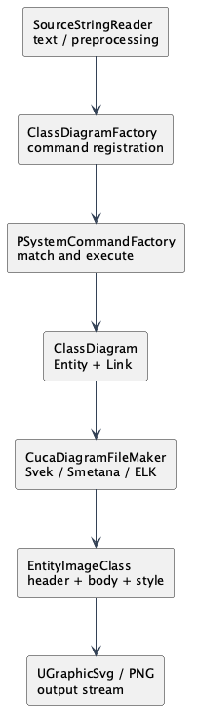
The path from text to SVG
class Order
class Customer
Order --> Customer
The parser selects command objects. They construct Entity and Link objects in ClassDiagram. A layout backend returns a TextBlock, which the exporter draws to SVG or PNG.
A17 · PlantUML v1.2026.8 · 2/7

Slide 3
Five source-verified collaborations
Command
Factory Method
Strategy
Composite
Adapter
Class command dispatch
ClassDiagram product creation
Layout backend selection
Text-block composition
VizJs stream conversion
A17 · PlantUML v1.2026.8 · 3/7

Slide 4
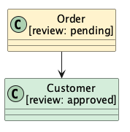
Three implemented changes
CH01 Review status
CH02 Review palette
CH03 SVG attribute
[review=pending] appears in the class header.
Pastel and mono are selectable fill policies.
Enabled SVG exports data-review-status.
A17 · PlantUML v1.2026.8 · 4/7

Slide 5
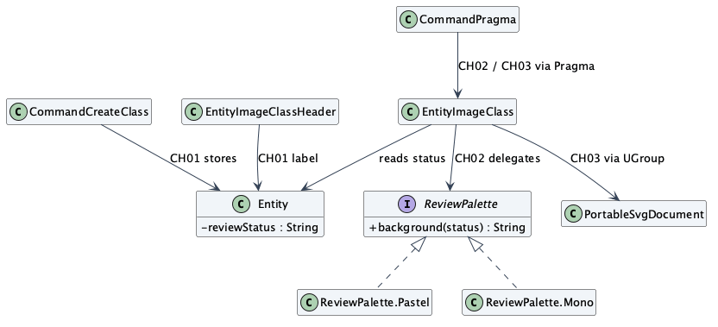
The SVG serializer was a real extension point
The first metadata patch reached UGroup but produced no attribute. PortableSvgDocument accepts only named keys; adding the new key fixed the failing integration check.
A17 · PlantUML v1.2026.8 · 5/7

Slide 6
Equivalent behavior in four languages
16 shared cases passed in each language
Java 106 LOC 27.206 ms
Python 101 LOC 16.827 ms
JavaScript 97 LOC 21.728 ms
C++ 156 LOC 2.279 ms
Median of five fresh processes after one warm-up. Startup and input/output are included; compilation is excluded.
A17 · PlantUML v1.2026.8 · 6/7

Slide 7
Verification and submission status
20 / 20
Final PlantUML integration checks passed
3,177 passed · 2 failed · 12 skipped (XML)
The console reports 10 skipped; XML includes two more skipped entries in both trees. The same Picoweb tests fail. Human review, faculty approval and repository upload remain to be recorded.
Source: pinned PlantUML commit 149874a1bb2b64c42889d7178cb89f6647ac14bc; report and evidence in A17.
A17 · PlantUML v1.2026.8 · 7/7

