Slide 1
Airline Data Challenge
Presented by: Sathvika Anugu Purpose: Showcase data-driven route analysis, quality control, and investment recommendations.

Slide 2
Agenda
Project Overview
Key Data Fields & Metrics
Data Quality Insights
Top Routes & Profitability
Visual Analytics
KPIs & Recommendations
Technical Workflow
Q&A

Slide 3
Project Objectives
Maximize profitability by identifying top-performing routes and top routes to invest
Ensure data integrity through quality checks
Generate investment recommendations based on analytics
Establish KPIs to track future performance

Slide 4
Key Derived Metrics
AIRPORT_COST = ORIGIN_FEE + DEST_FEE
DELAY_COST = DELAY_MINUTES × cost/min
TOTAL_COST = delay + mileage + fees
TOTAL_REVENUE = TICKET_REVENUE + BAGGAGE_REVENUE
PROFIT = TOTAL_REVENUE − TOTAL_COST

Slide 5
Data Quality Issues:
“Any model is only as good as its data, so I focused on four quality issues:
Missing delay or airtime data – I dropped these to avoid skewed delay/cost estimates, though I stayed aware of bias toward better flights.
Invalid occupancy rates – I filtered for realistic values between 0 and 1 to get valid passenger insights.
Route directionality – I treated each leg of a route separately; e.g., JFK→LAX isn’t automatically the same as LAX→JFK.
Delay outliers – I removed extreme delays using z-scores (±3σ) so costs reflect reliable patterns. These steps keep the analytics sound and the results actionable.”

Slide 6
Cost and Revenue Assumptions:
Costs:
$9.18 per mile (Fuel, Maintenance, Depreciation, etc.)
Airport fees: $5,000 (medium) / $10,000 (large) per landing → 2 charges per round trip
Delay cost: First 15 min free; $75/min after for both departures & arrivals
Revenue:
200-seat plane × occupancy rate (from Flights data)
Baggage: 50% passengers × $35/leg = $70/round trip
Ticket prices constant year-round (no seasonal variation)

Slide 7
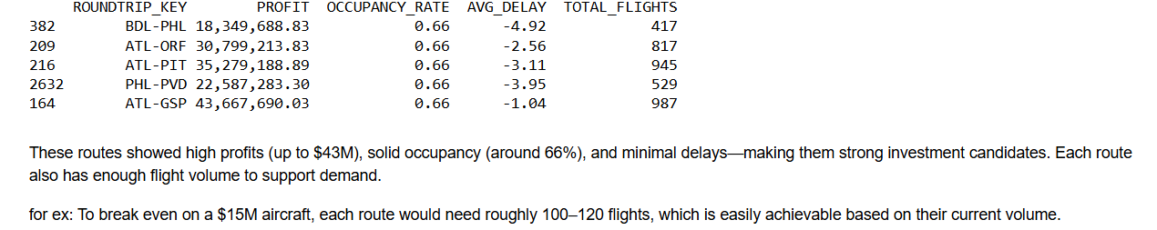
Top 5 Investment Routes
ATL–GSP – highest profit, punctual, frequent
ATL–PIT – busy hub, strong ROI
ATL–ORF – solid revenue with on-time performance
PHL–PVD – efficient, profitable
BDL–PHL – low volume but high reliability and margins

Slide 8
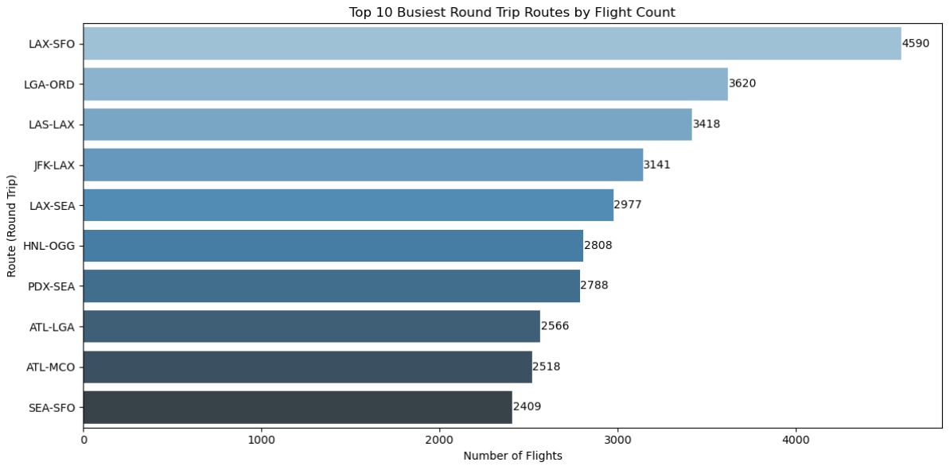
Most Busiest Round-Trips (Top 10)
Identifies consistently high-demand routes
Serves as baseline for scheduling decisions

Slide 9
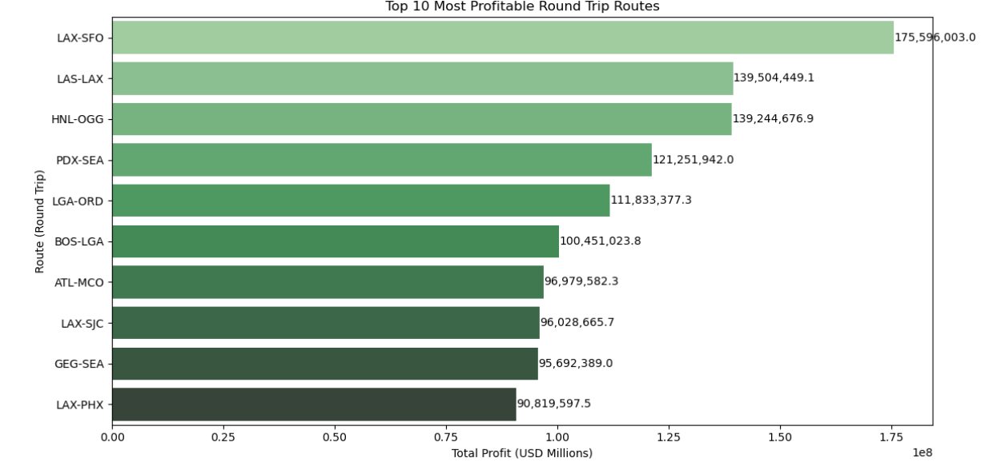
Most Profitable Round-Trips (Top 10)
Highlights high net-income routes
Reveals volume-profit disconnect.

Slide 10
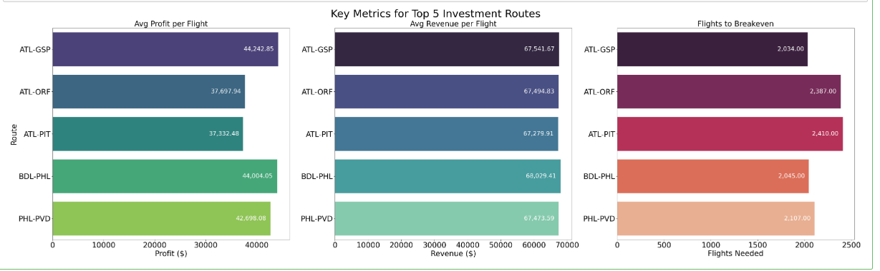
Composite Analysis — Top 5
Evaluates financial drivers
Shows cost considerations despite high revenue

Slide 11
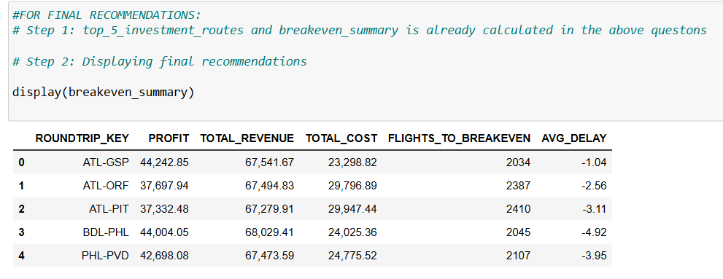
Breakeven Summary:

Slide 12
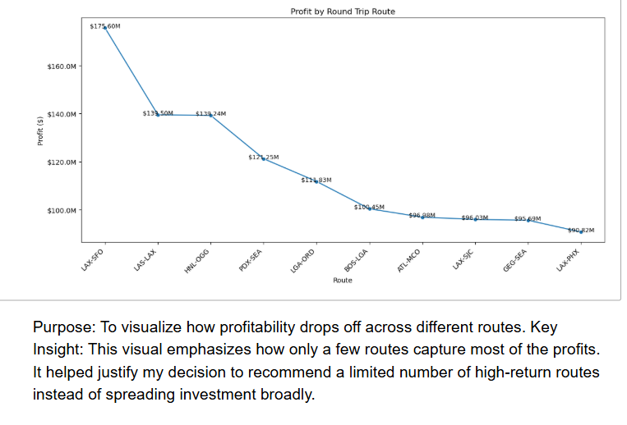
Other Visualizations
Line chart:

Slide 13
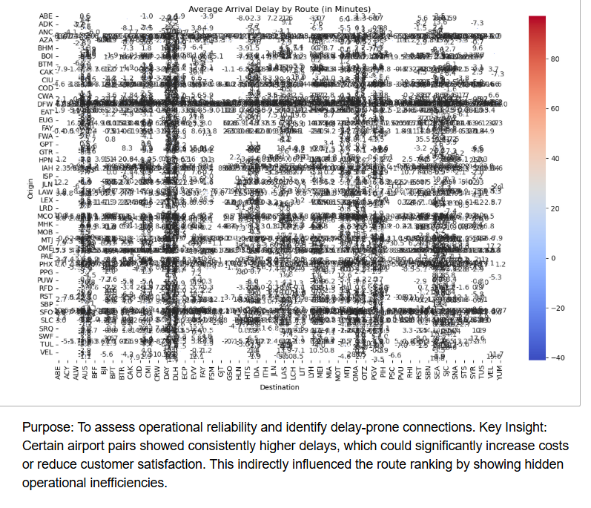
Heatmap

Slide 14
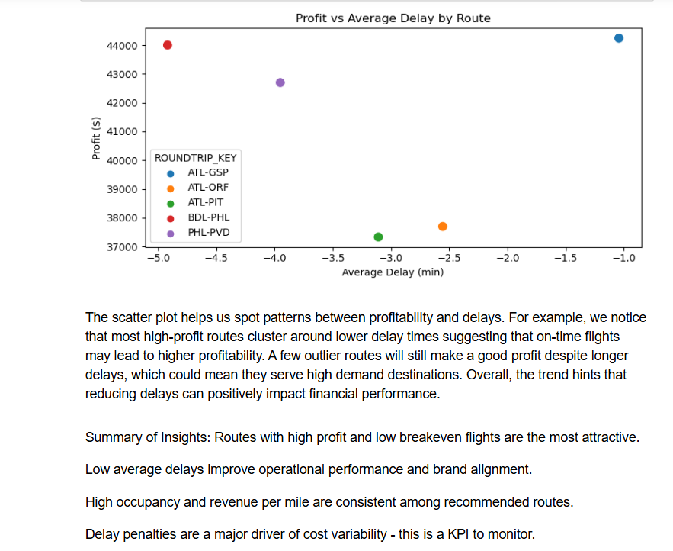
Scatter plot

Slide 15
Final Summary & recommended KPIs
My Key Conclusions:
a) High flight volume does not always correlate with high profit.
b) Delay trends and cost structures are critical in route evaluation—not just ticket revenue.
c) Only a handful of routes deliver disproportionately higher ROI, and they should be prioritized.
Net Profit per Route: Monitor route profitability over time
Flights to Breakeven: Know how many flights to recover aircraft cost
Delay Frequency & Avg Delay: Identify cost-heavy or inefficient routes
Load Factor (Occupancy): Measure how full and efficient flights are
Ancillary Revenue per Passenger: Track extra income like baggage fees

Slide 16
Suggested Improvements
Trim outliers in all numeric fields
Use median and IQR alongside means
Adjust for seasonality & day-of-week effects
Normalize profitability per flight and mile
Account for aircraft type and cost
Validate data quality
Run “what-if” sensitivity analyses

Slide 17
Technical Workflow
1)Clean datasets -> flights_df, airport_df, tickets_df etc.
2)Join airport data -> flights_enriched
3)Compute financials and concatenated it with flights_enriched
4)Run route summaries:
a) busiest
b) profitable
c) investment
d) breakeven
5)Passed each output to its respective plot function in matplotlib and seaborn and made other visualisations for analysis and insights in the python code file.

Slide 18
Summary & Final Recommendations
Volume isn’t always profit — focus on ROI
Delay/cost structure are critical for evaluation
Invest in top‑5 high-ROI routes(top 5 investment routes)
Implement KPIs, monitor variance, test assumptions
Continue data validation, seasonal adjustment, and sensitivity testing

Slide 19
Q&A
Thank you!
Open to any questions or deeper dives

