Slide 1
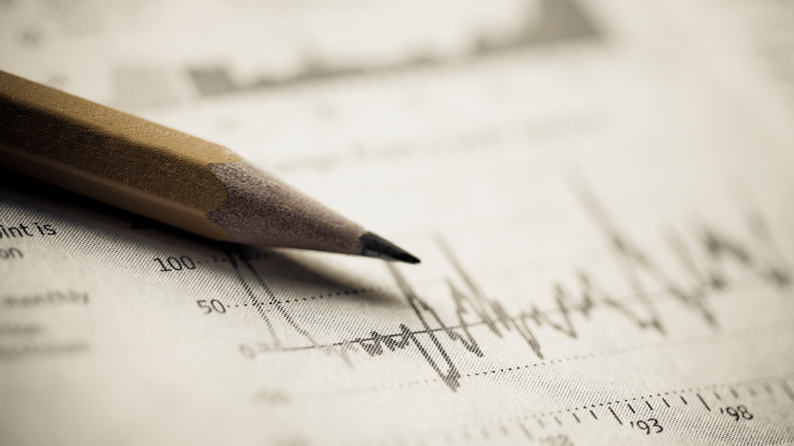

Inventory Analysis on Spirit Stock.
Presented by:
Sumit Ghosh.
Pravallika Jammula.
YEllAvula Lakshmi SaAthvika.

Slide 2
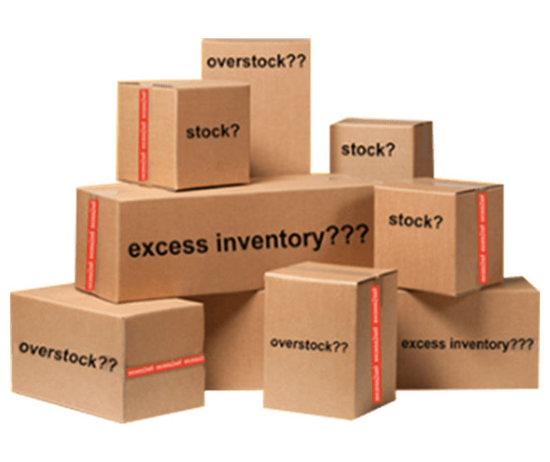
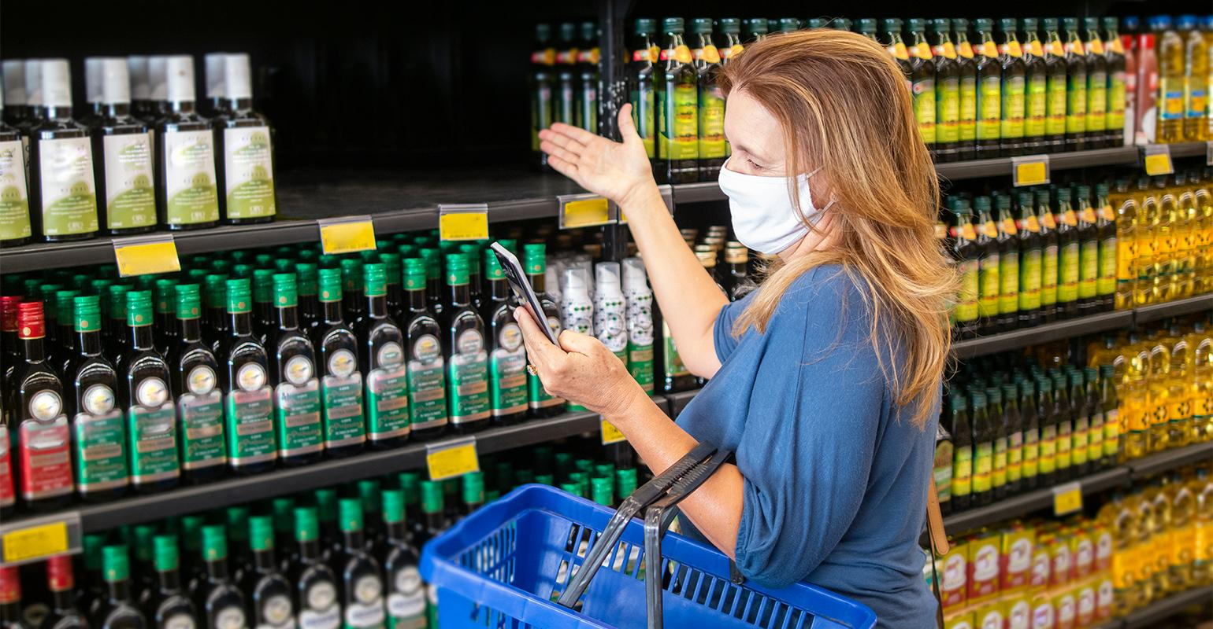
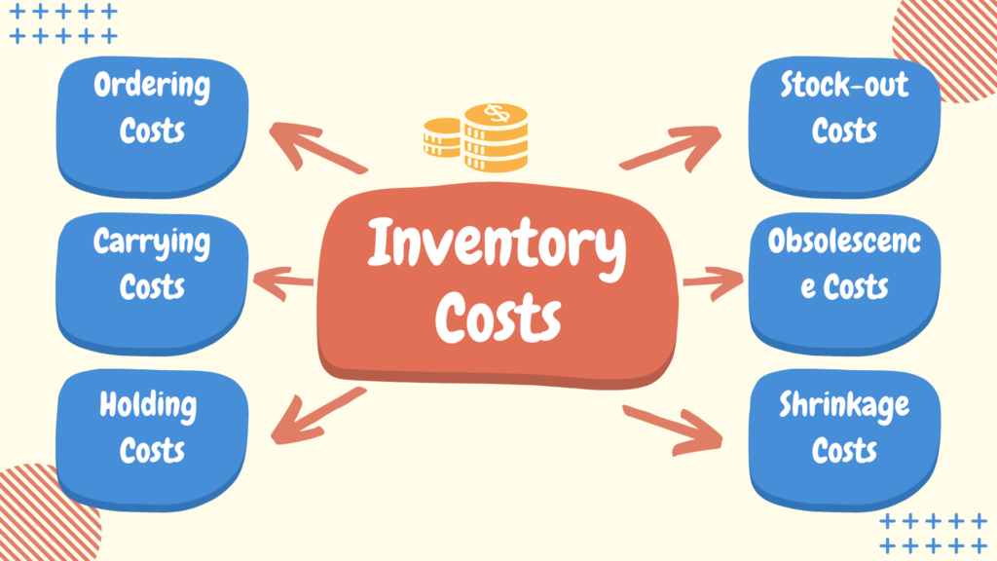
Pain Addressed
Inaccurate stock levels like
excess inventory.
Stock-outs leads to customer
Dissatisfaction.
High Inventory Costs from
Inaccuracies.

Slide 3

Proposed Solution
AI Process Improvement- Bottlenecks
ML Demand Forecasting
Predictive Maintenance AI- Analysis Report
ML EOQ Optimization- logistics and carry cost

Slide 4
Conceptualization and Justification
Input
Model
output
Inventory Stock Datasets
ML Algorithms
Stock Analysis & Prediction
Through DBMS like SQL
Use of Fast API, Python, Statistics

Slide 5
Target Market & Value Proportion
Value Proportion
Vendor Relation Boost
cost-efficient Pricing
Smart Classification
Target Market
Beverage Industry
Cost Saver

Slide 6
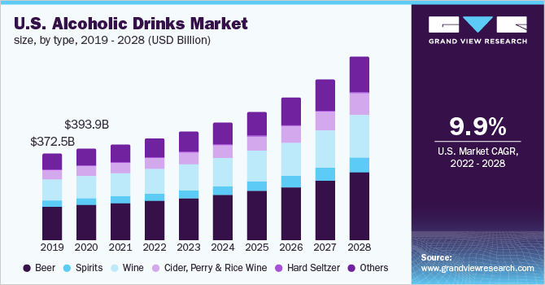
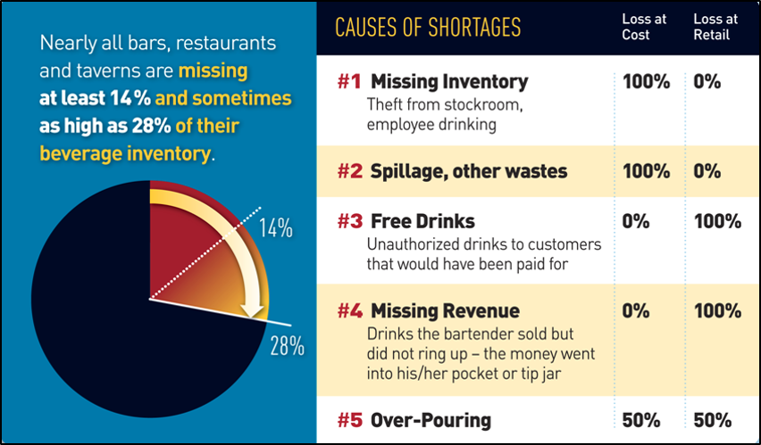
Market Research

Slide 7
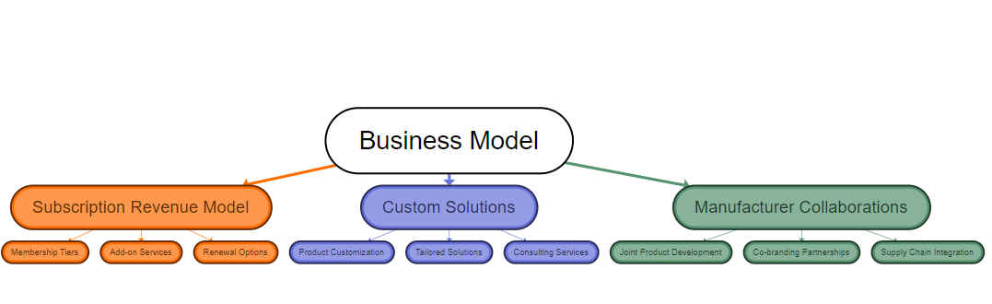
Business Model

Slide 8
Development Plan
1. Planning & Research on Project
2. Design & Architecture
3. Development of the Project
4. Testing & Deployment
5. Monitor and Review

Slide 9

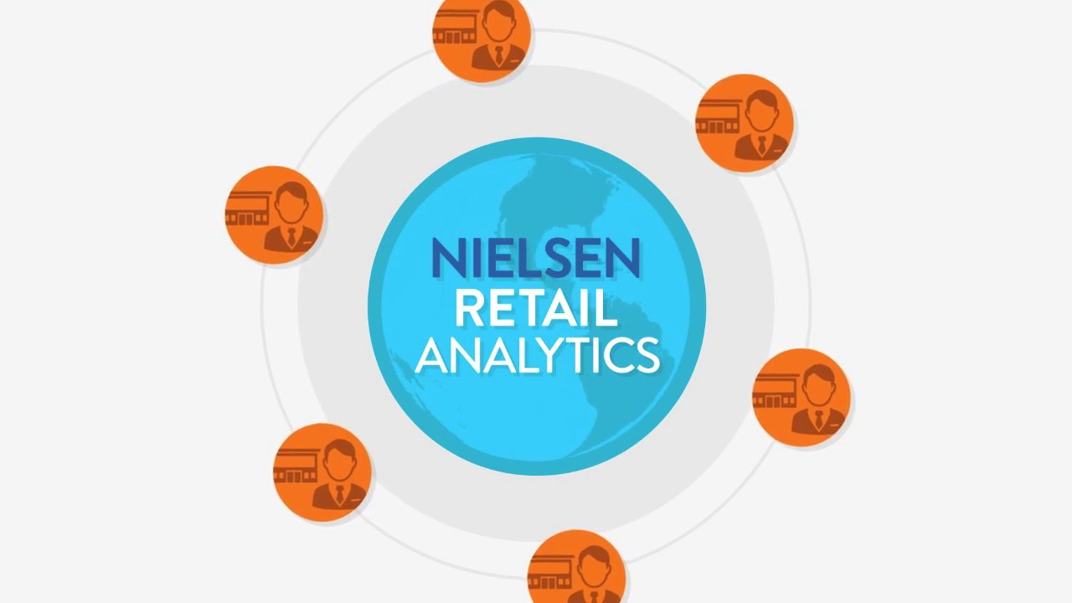



Current Offerings

Slide 10
Team Members Expertise and Contribution
Sumit Ghosh- Backend implementation using python and ML.
Pravallika Jammula- Full Stack Developer.
Yellavula Lakshmi Saathvika- User Interface Design and testing.

Slide 11

Collaborative Tools
GitHub for code repository and version control.
Python and SQL for coding.
FastAPI For Model API Creation
Office For PPT, data store, and Documentation
.
WhatsApp For communication and File sharing

Slide 12
References
https://www.kaggle.com/datasets/bhanupratapbiswas/inventory-analysis-case-study
https://www.netsuite.com/portal/resource/articles/inventory-management/inventory.shtml
https://www.fcbco.com/blog/the-state-of-inventory-and-its-impacts
https://www.sculpturehospitality.com/blog/70-of-bar-losses-are-at-retail-value-inventory-control
https://www.grandviewresearch.com/industry-analysis/alcoholic-drinks-market-report
https://cashflowinventory.com/blog/inventory-cost/
https://www.google.com/url?sa=i&url=https%3A%2F%2Fwww.supermarketnews.com%2Fissues-trends%2Fconsumers-say-1-5-items-they-want-buy-out-stock-their-local-retailer&psig=AOvVaw0i0BWSaA9XbBHLkURHH35w&ust=1708039086519000&source=images&cd=vfe&opi=89978449&ved=0CBMQjhxqFwoTCIiuqcn7q4QDFQAAAAAdAAAAABAD

Slide 13


