Slide 1
AI-Powered Career Guidance Tool
Sathvika Muthyala
U01912787

Slide 2
Brief Overview
This project is an AI-powered career guidance system designed to help users make informed career decisions using machine learning, NLP, and AI-driven insights. It provides:
Skill-Job Matching – Analyzes user skills and compares them with job role requirements using NLP.
AI Chatbot for Career Advice – A conversational assistant powered by Hugging Face API to answer career-related queries.
Salary Estimation – Predicts expected salary based on skills, experience, and job market trends.
Skill Gap Analysis – Identifies missing skills and provides personalized learning recommendations.
Company-Specific Skill Recommendations – Lists the most relevant skills required for specific companies and job roles.
Job Market Trends – Tracks in-demand skills, job postings over time, and geographic job distribution using data visualization.
Skill Progress Tracker – Allows users to monitor their progress in acquiring necessary skills for a specific job role.
Job Alerts Subscription – Users can subscribe to get real-time job alerts and updates on industry trends.
The system leverages TF-IDF, cosine similarity, spaCy NLP, machine learning models, and data visualization tools to generate accurate and data-driven career recommendations.

Slide 3
Data Sources
The project uses a job listings dataset originally sourced from Kaggle. However, the dataset was insufficient, so additional data was gathered through research and manual data collection.
Challenges faced:
- LinkedIn web scraping was restricted due to security limitations
- Alternative sources like company career pages and job boards were used to enrich the dataset
- The final dataset includes job roles, required skills, salaries, locations, and company-specific requirements.

Slide 4
Tech Stack
Frontend & Dashboard: Streamlit
NLP: spaCy, NLTK, Hugging Face Transformers
Visualization: Plotly, Seaborn, Matplotlib
Data Handling: Pandas
ML Integration: TF-IDF, Cosine Similarity
Environment: Python, .env, Hugging Face API

Slide 5
Exploratory Data Analysis (EDA)
Data overview
Rows: n jobs
Key Columns: Job_Title, Required_Skills, Total_Compensation, Company, Posting_Date, Location
Key Insights:
No major missing data in key fields
Most demanded job roles: Data Scientist, Software Engineer, etc.
Highest average compensation for Machine Learning Engineer
Job postings peaked in certain months, indicating seasonal hiring trends
Most jobs located in San Francisco, New York, and Seattle
Visuals:
Salary Distribution Box Plot
Job Trends Line Graph
Skills in Demand Bar Chart
Heatmap of Missing Values

Slide 6
Skill Gap Analysis Flow
User inputs current skills
System calculates Cosine Similarity with job role skills
Displays:
Match Score
Missing Skills
Recommended Resources
Predicted Salary
Company-specific skills

Slide 7
AI Chatbot Integration
Built using Hugging Face Inference API
Allows natural language questions
Example: “What skills are required for an ML Engineer at Google?” → Real-time AI answer

Slide 8
User Progress Tracker
Users can mark skills as In Progress or Completed
Visual skill completion bar
Personalized progress feedback

Slide 9
Future Enhancements
Resume parsing and personalized feedback
Real-time job API integration
Skill-building roadmaps with timelines
Recommendation engine for job switching

Slide 10
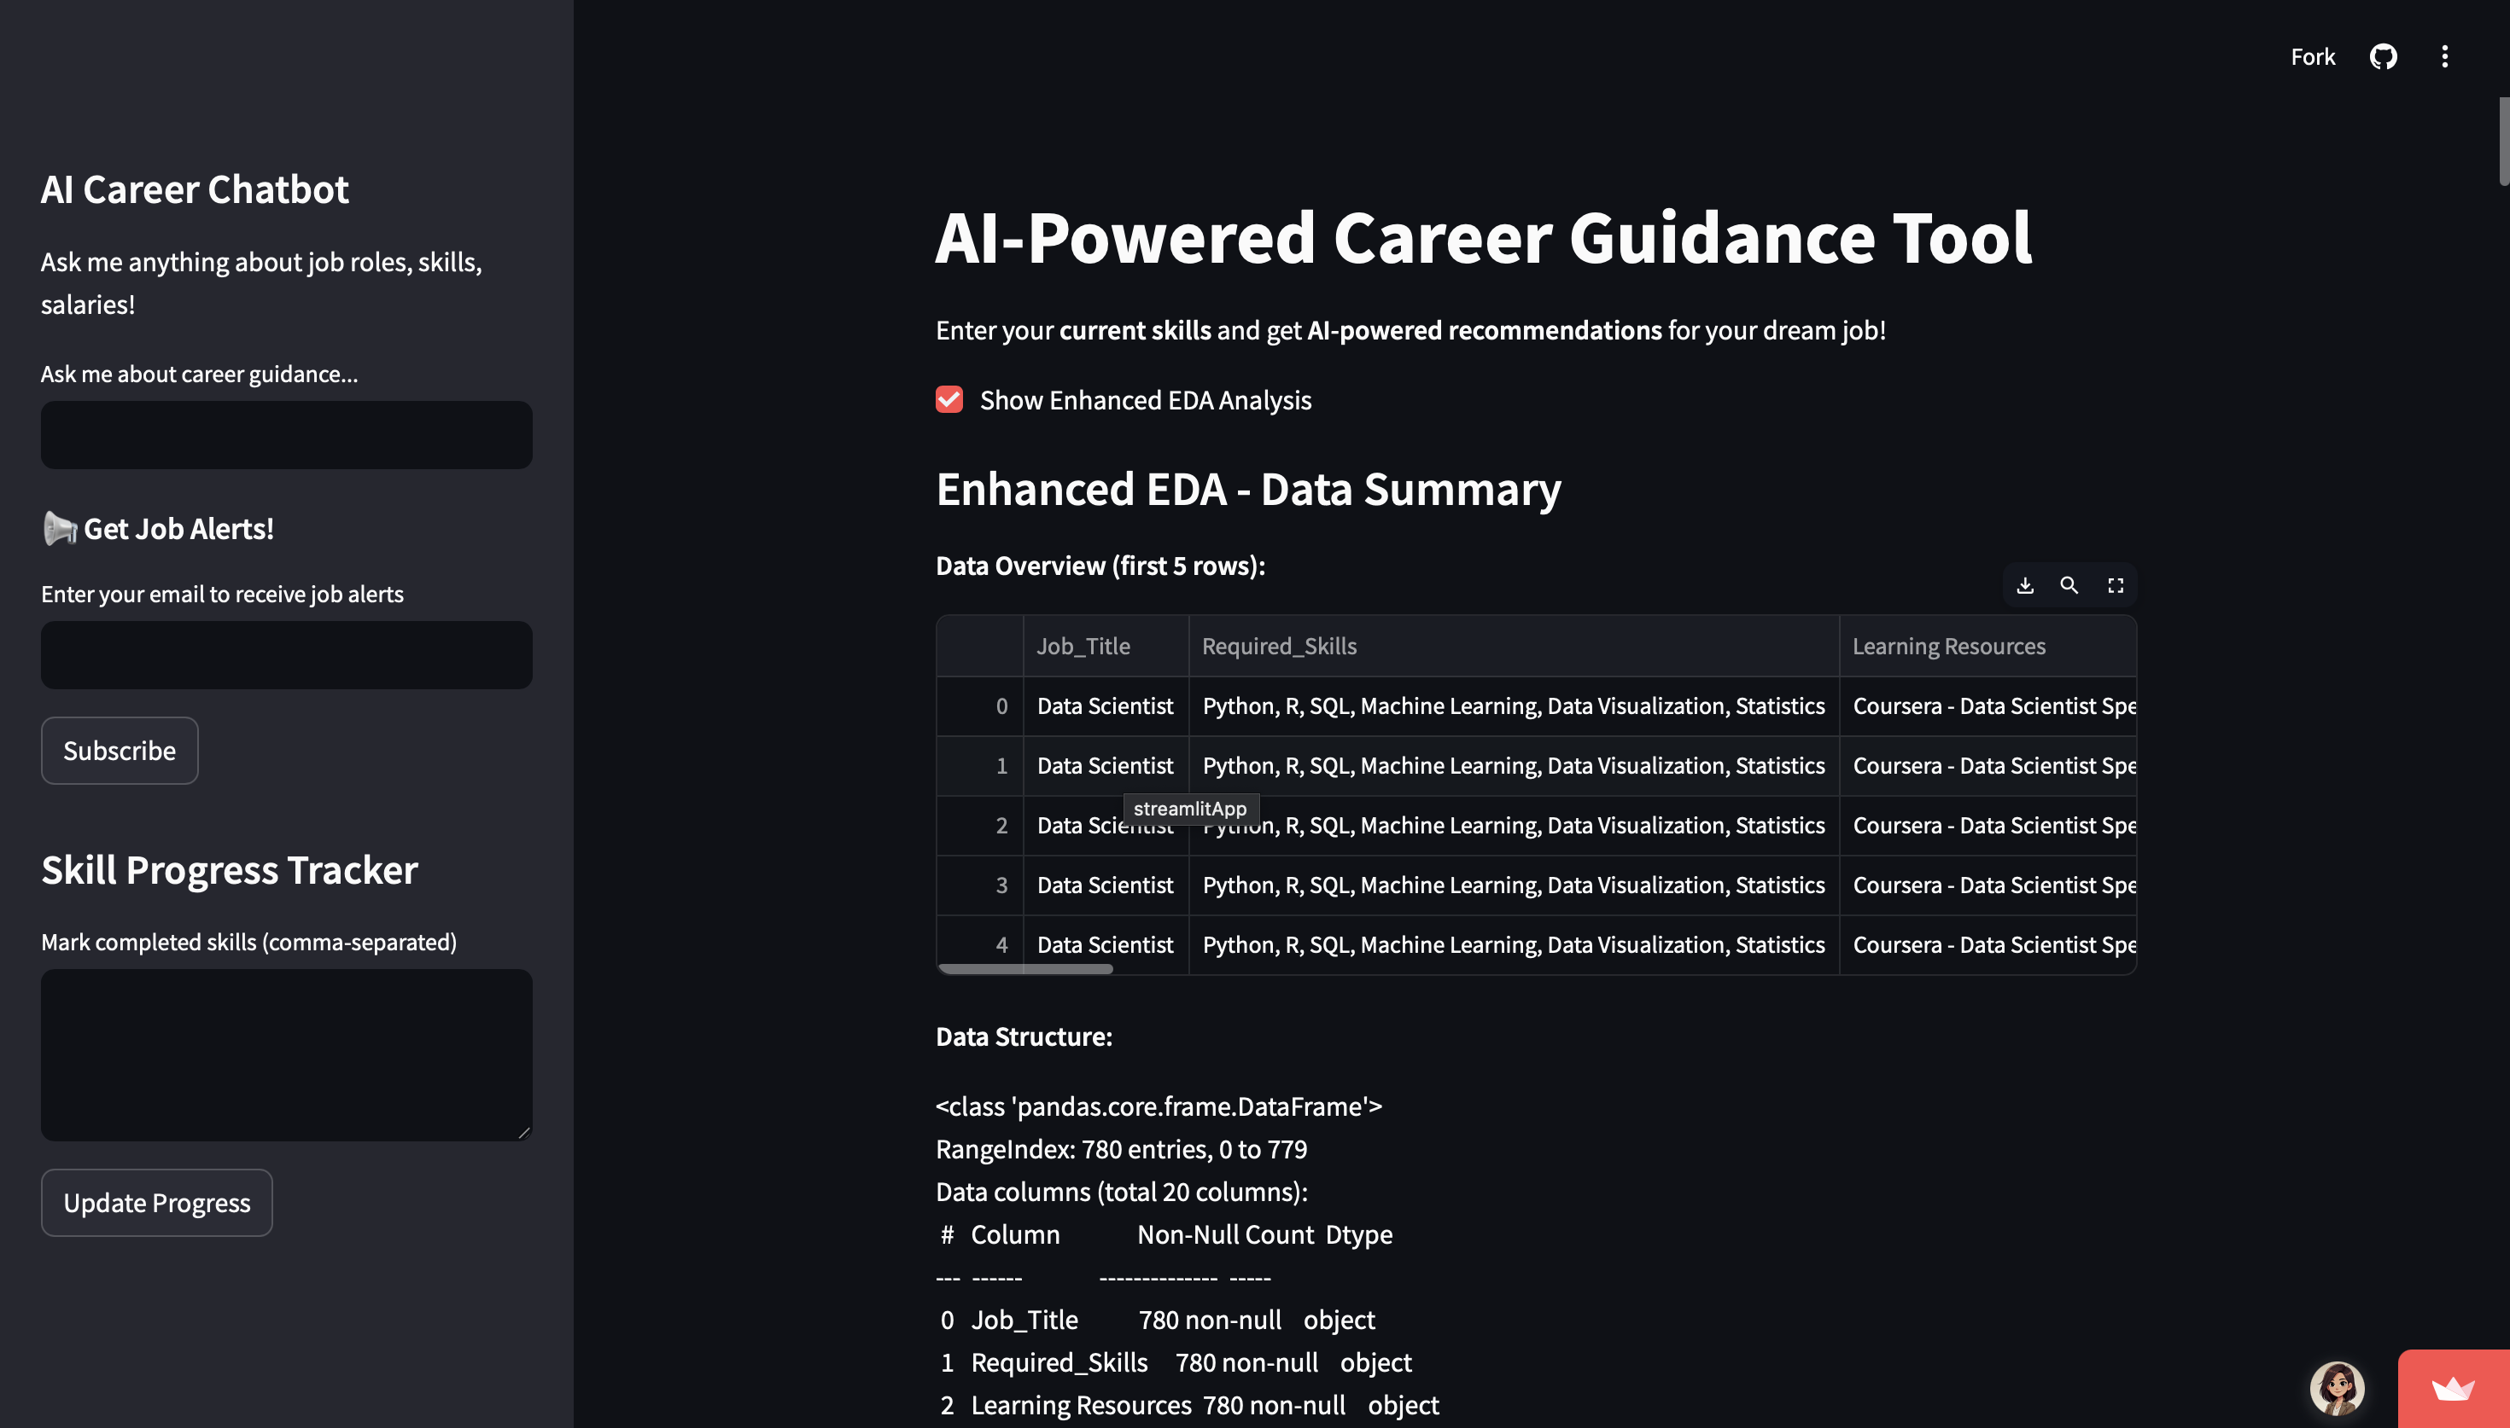
Tool Images For Reference

Slide 11
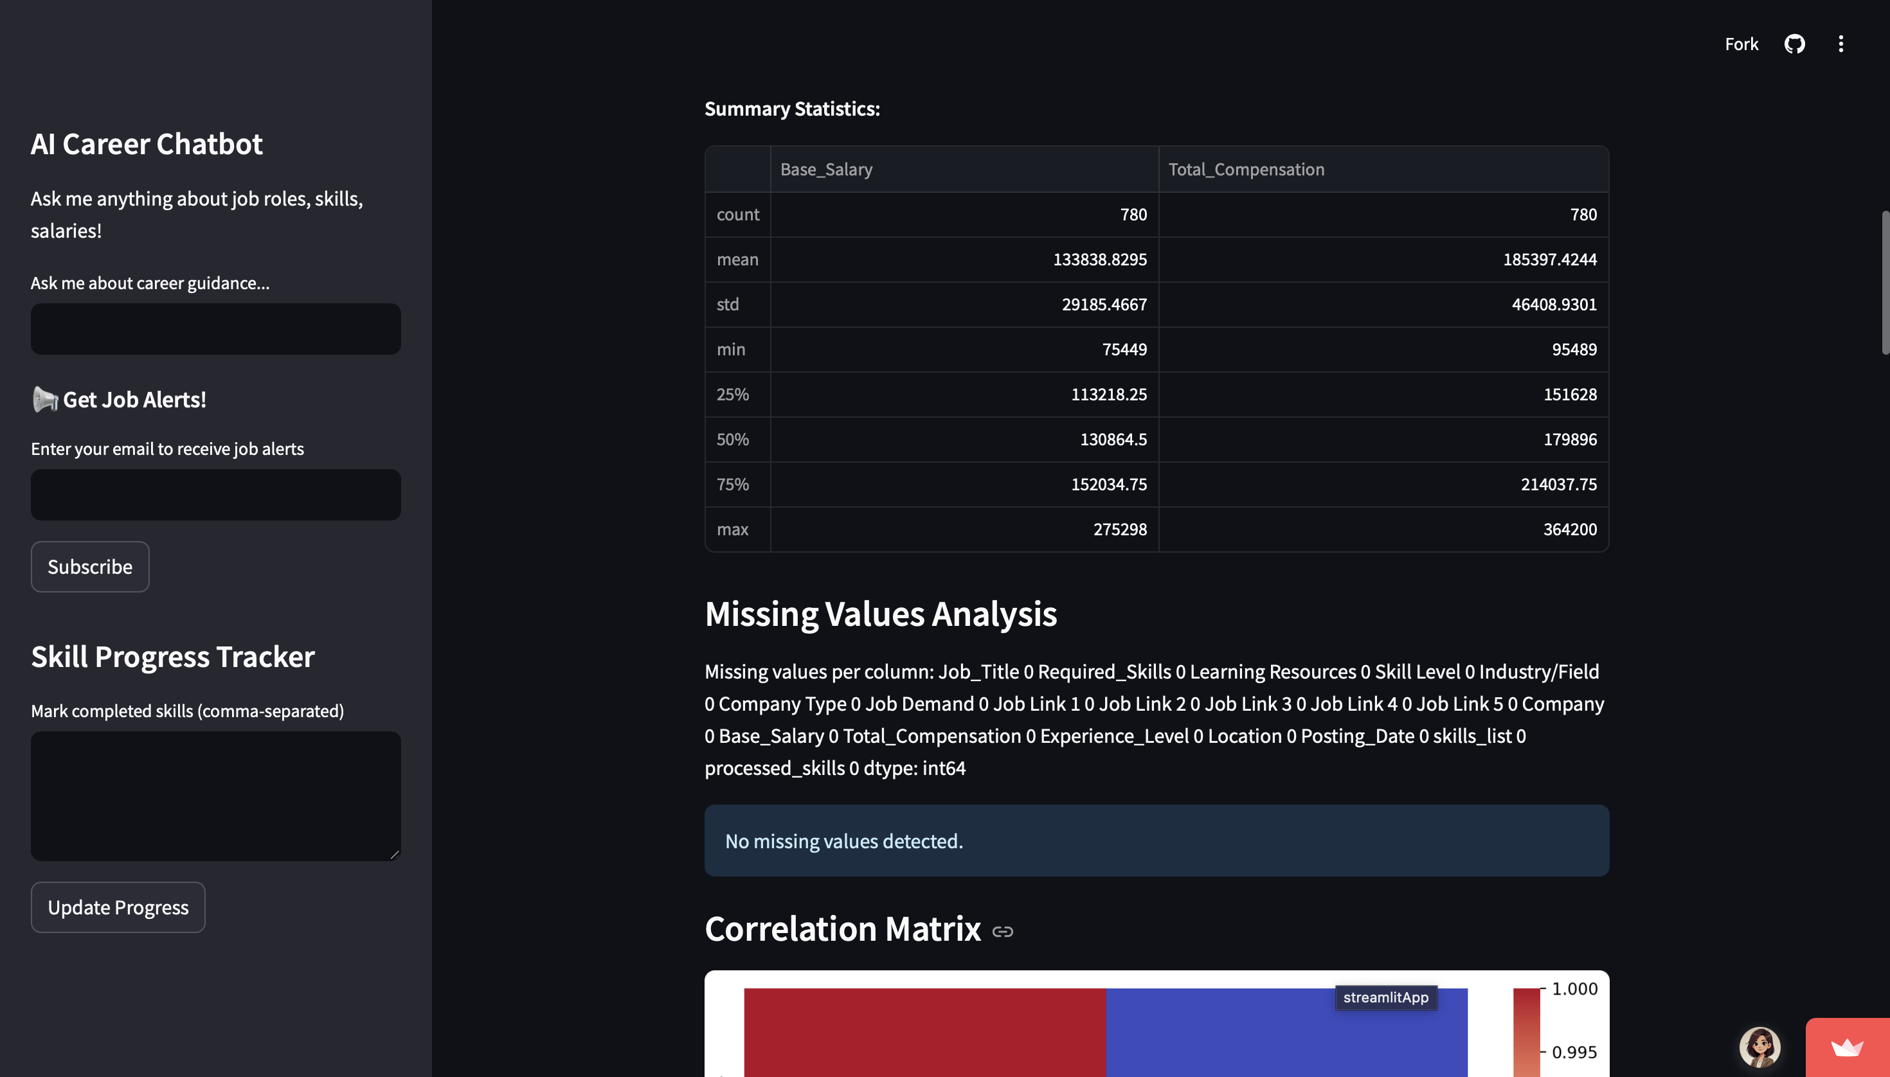

Slide 12
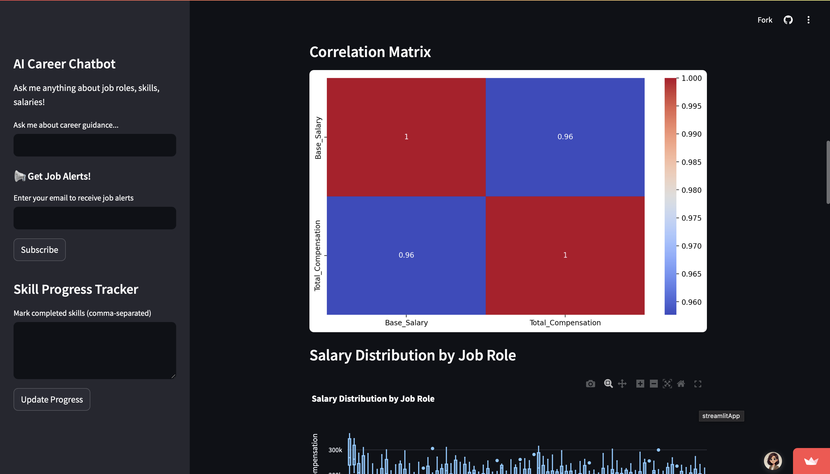

Slide 13
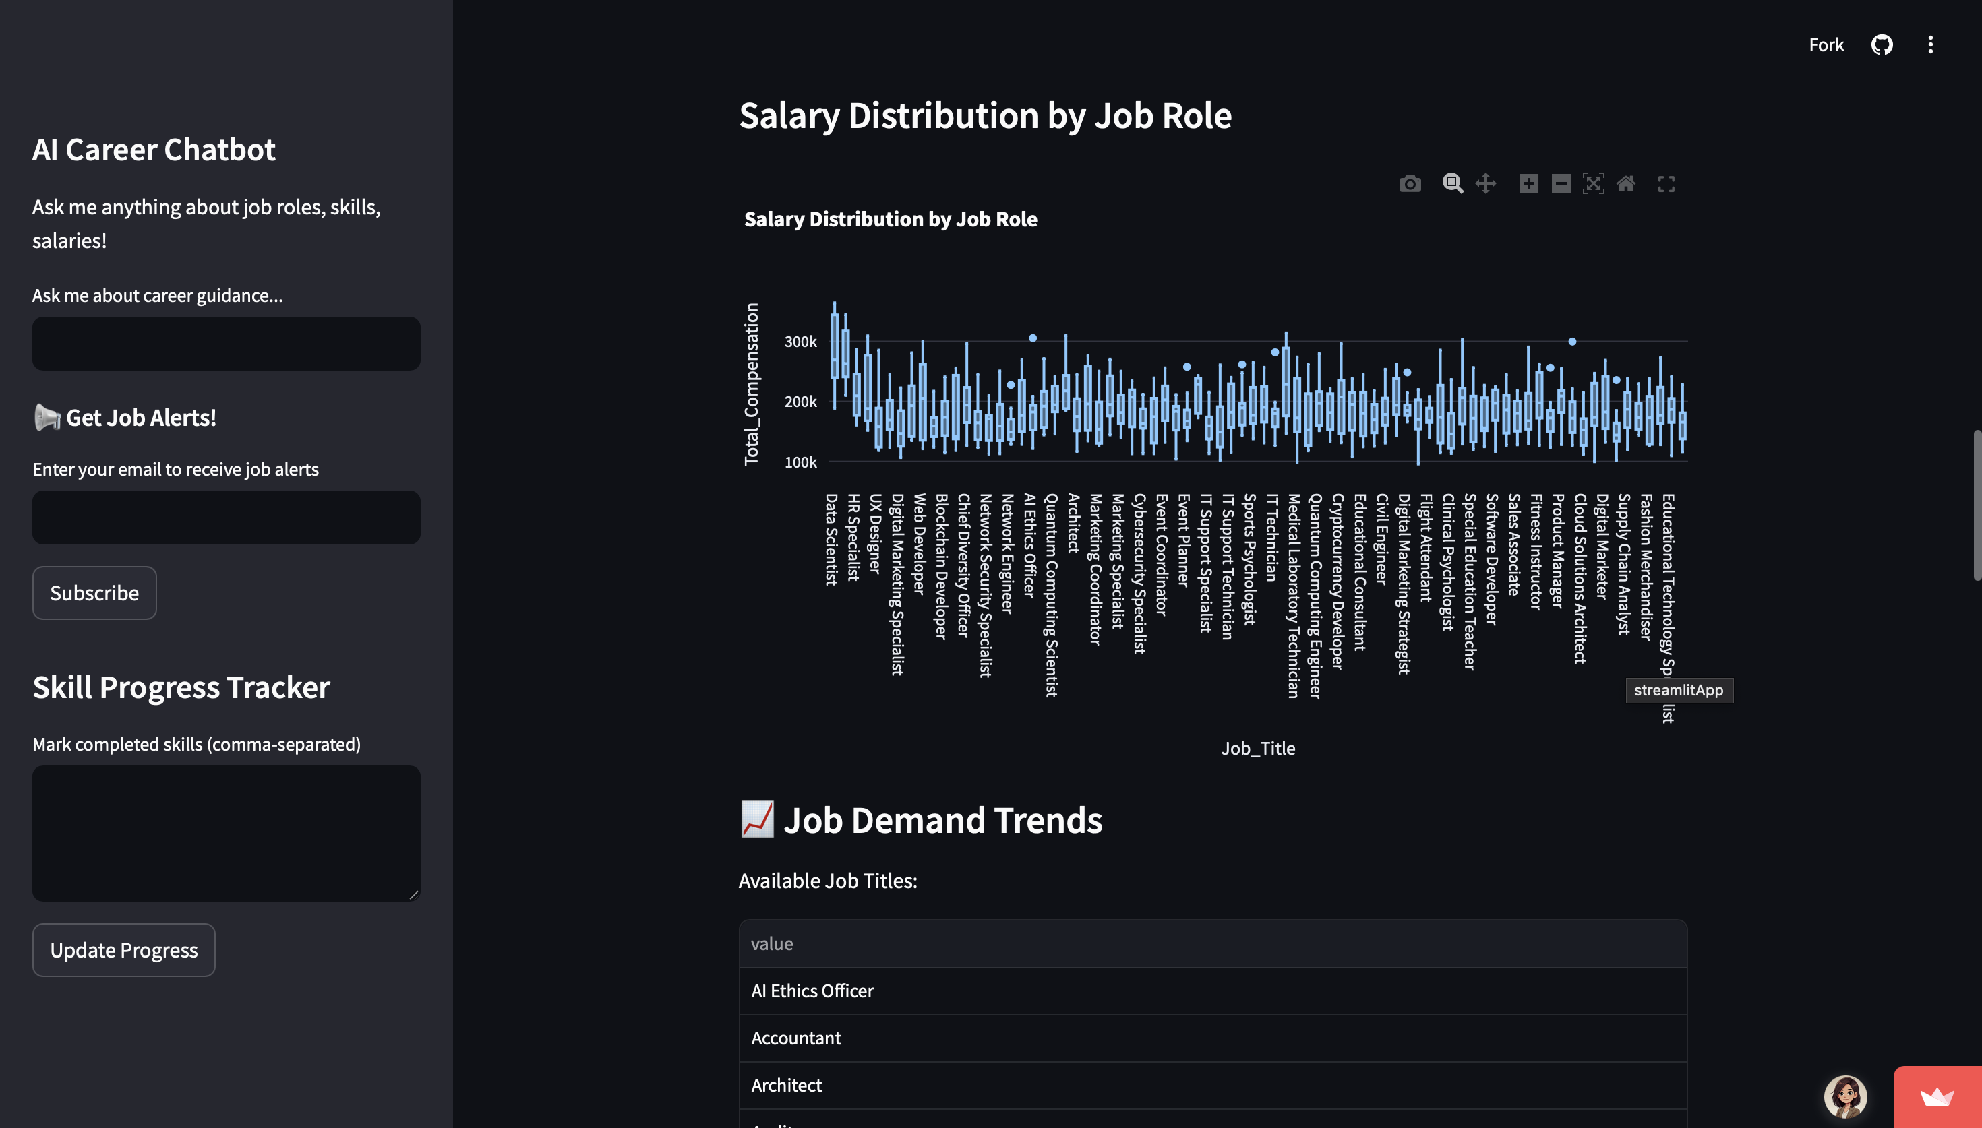

Slide 14
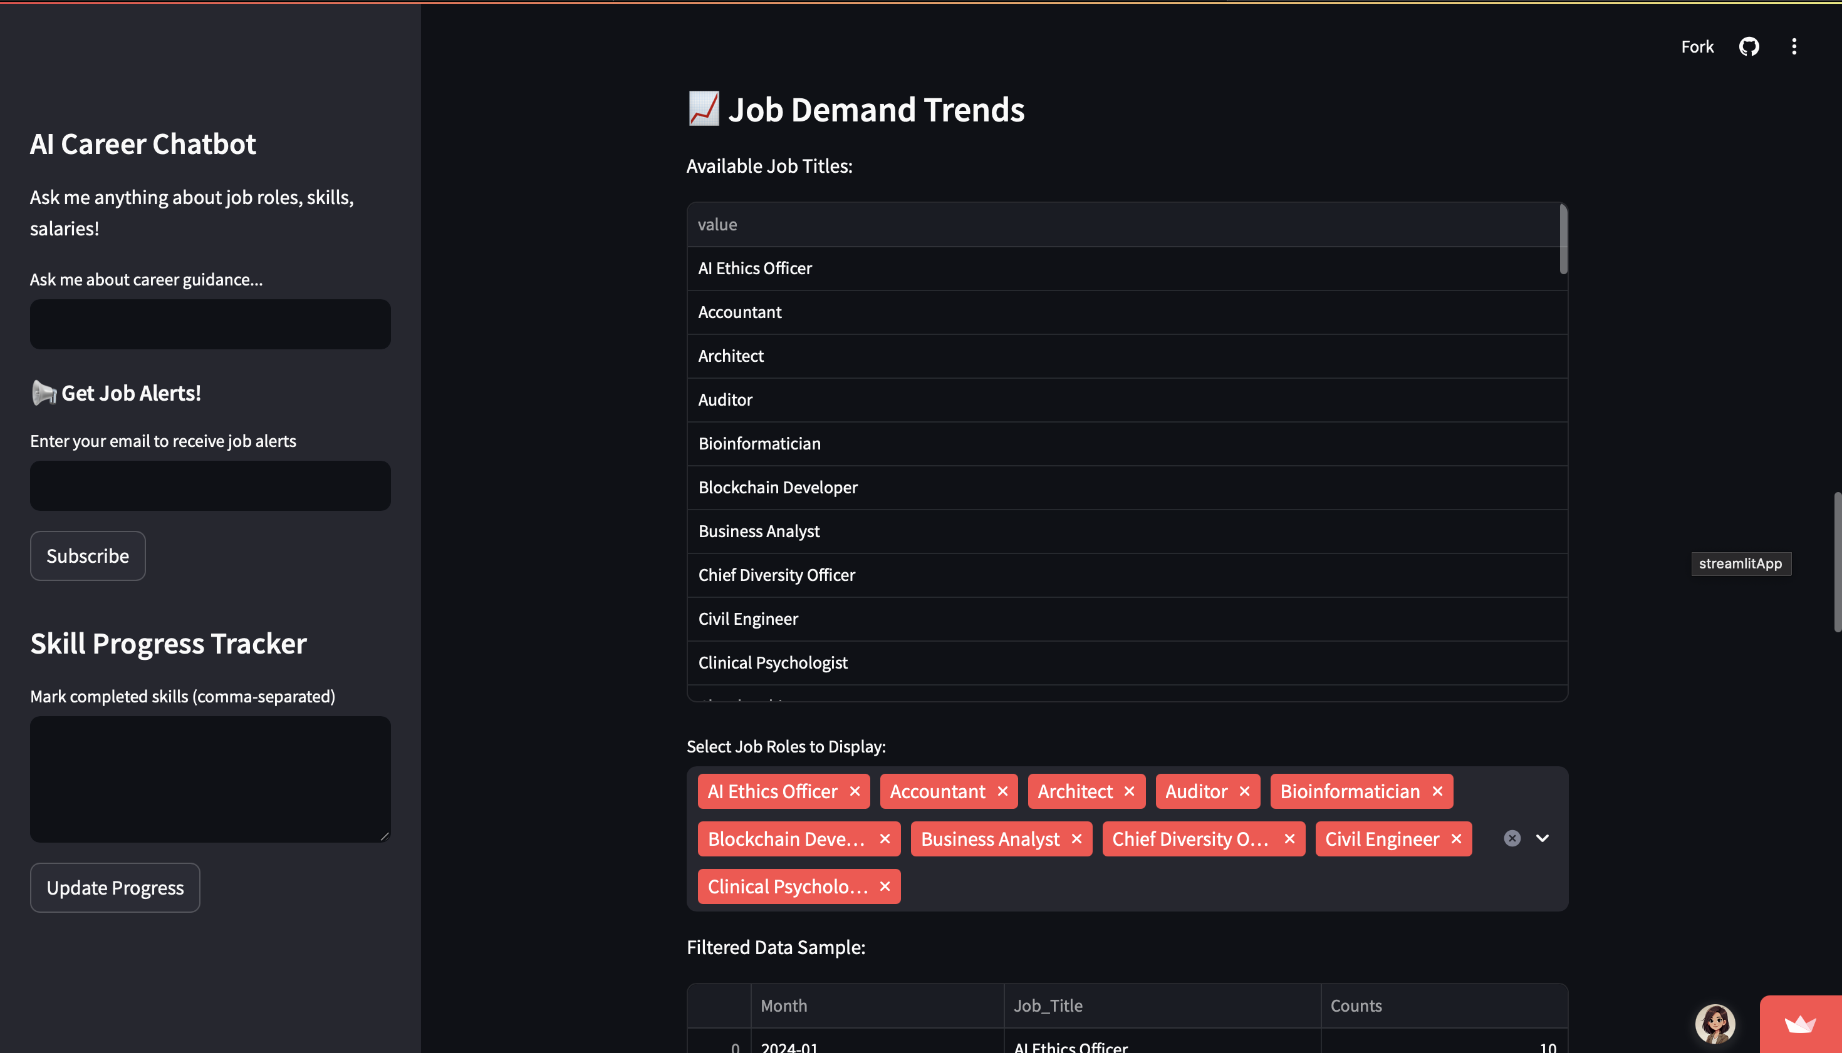

Slide 15
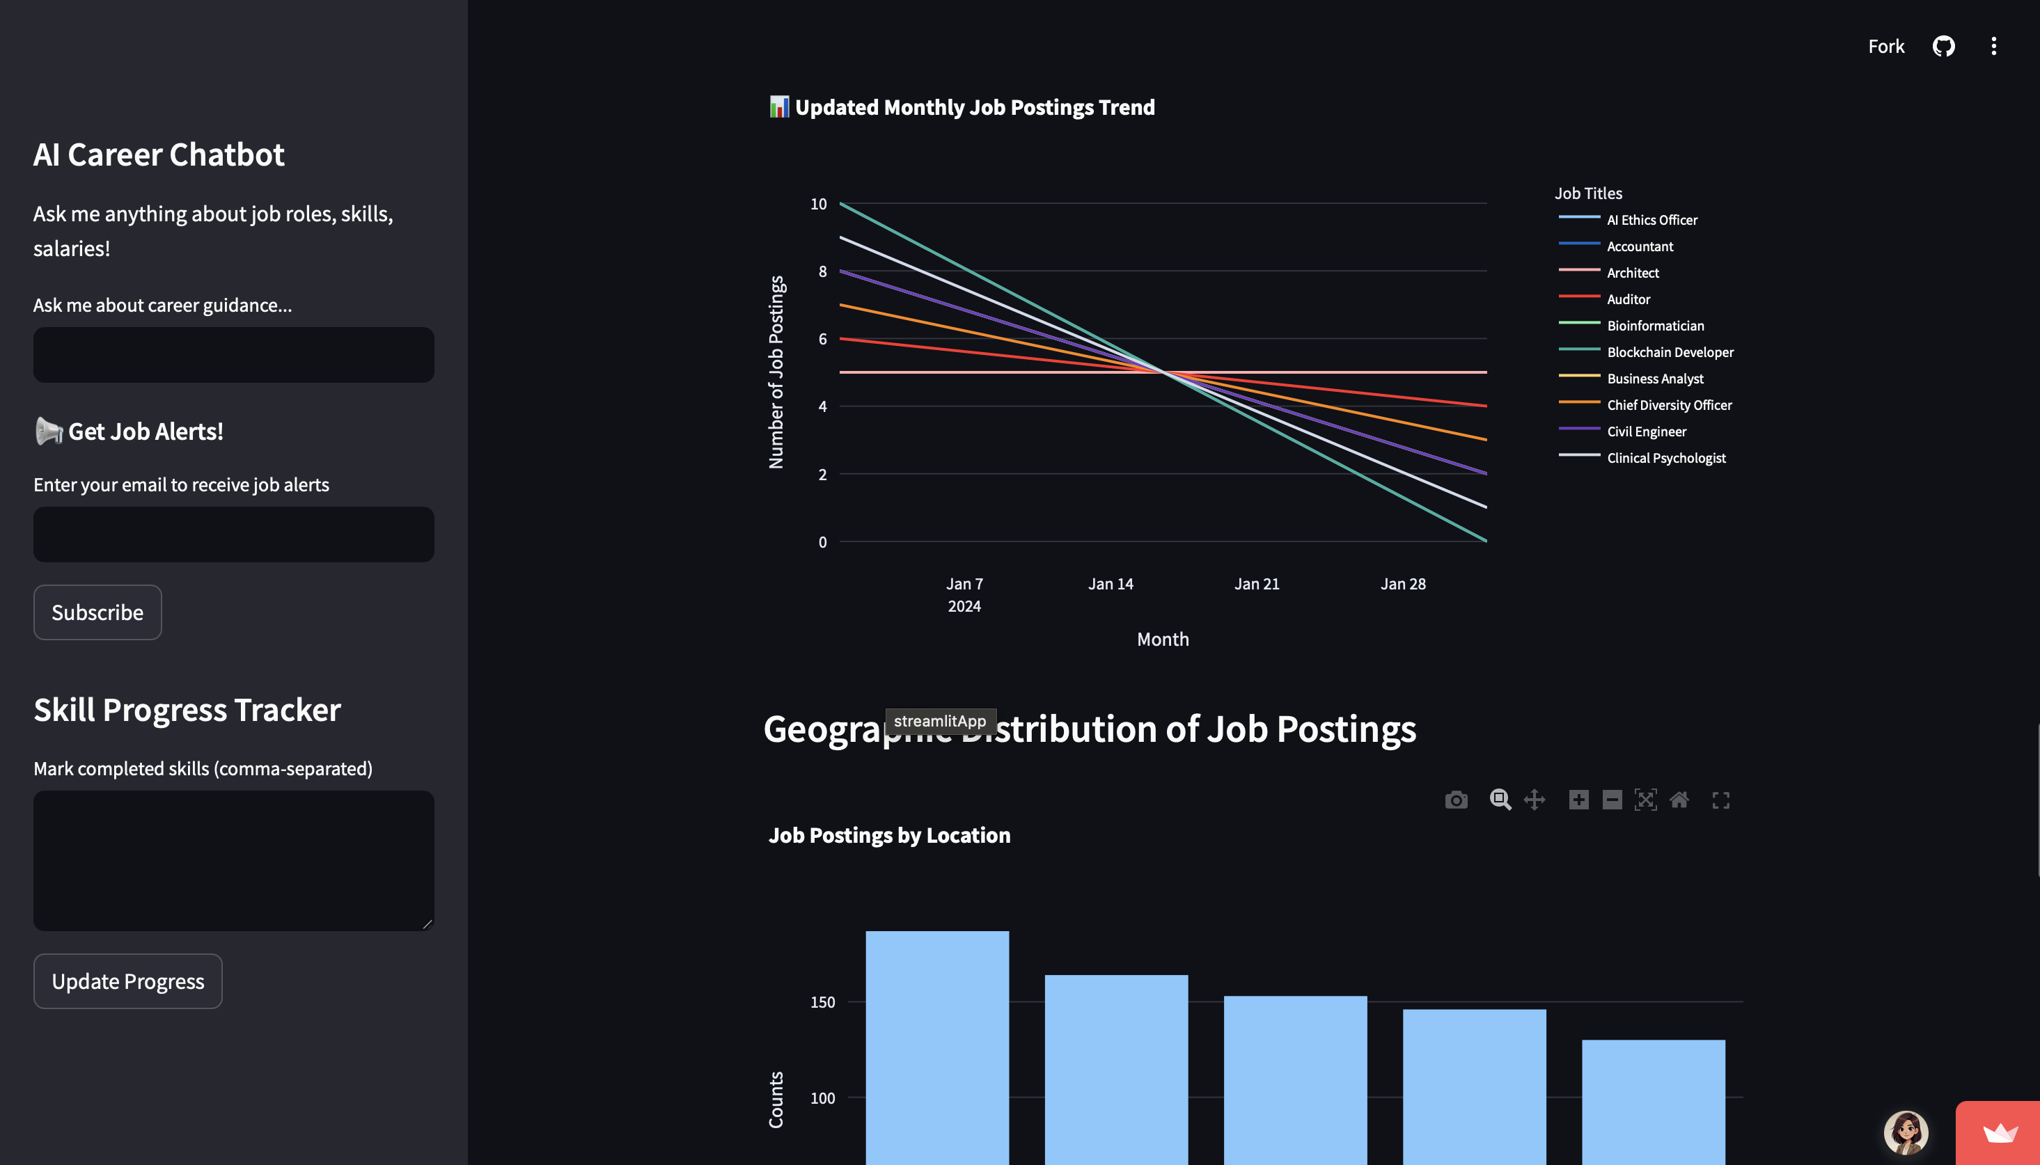

Slide 16
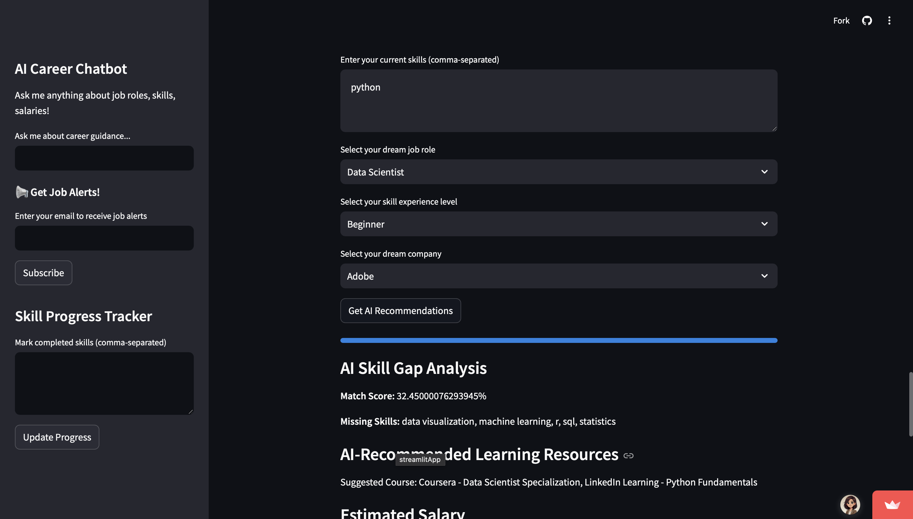

Slide 17
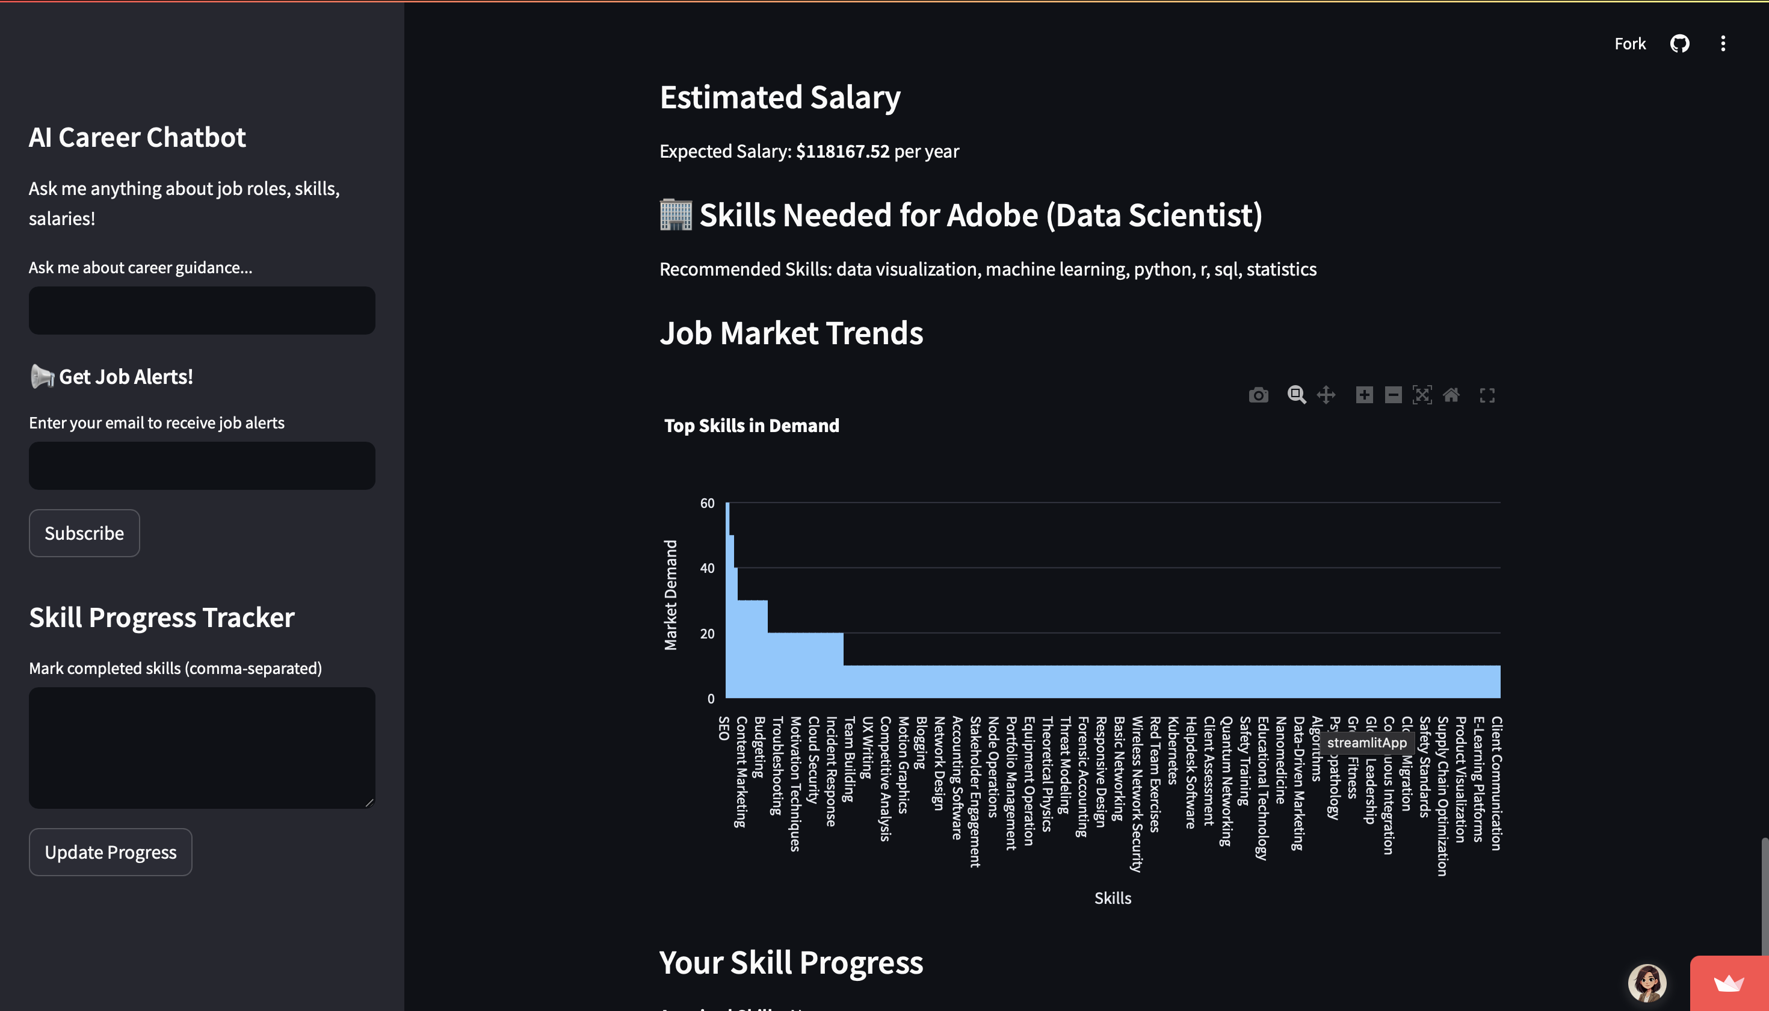

Slide 18
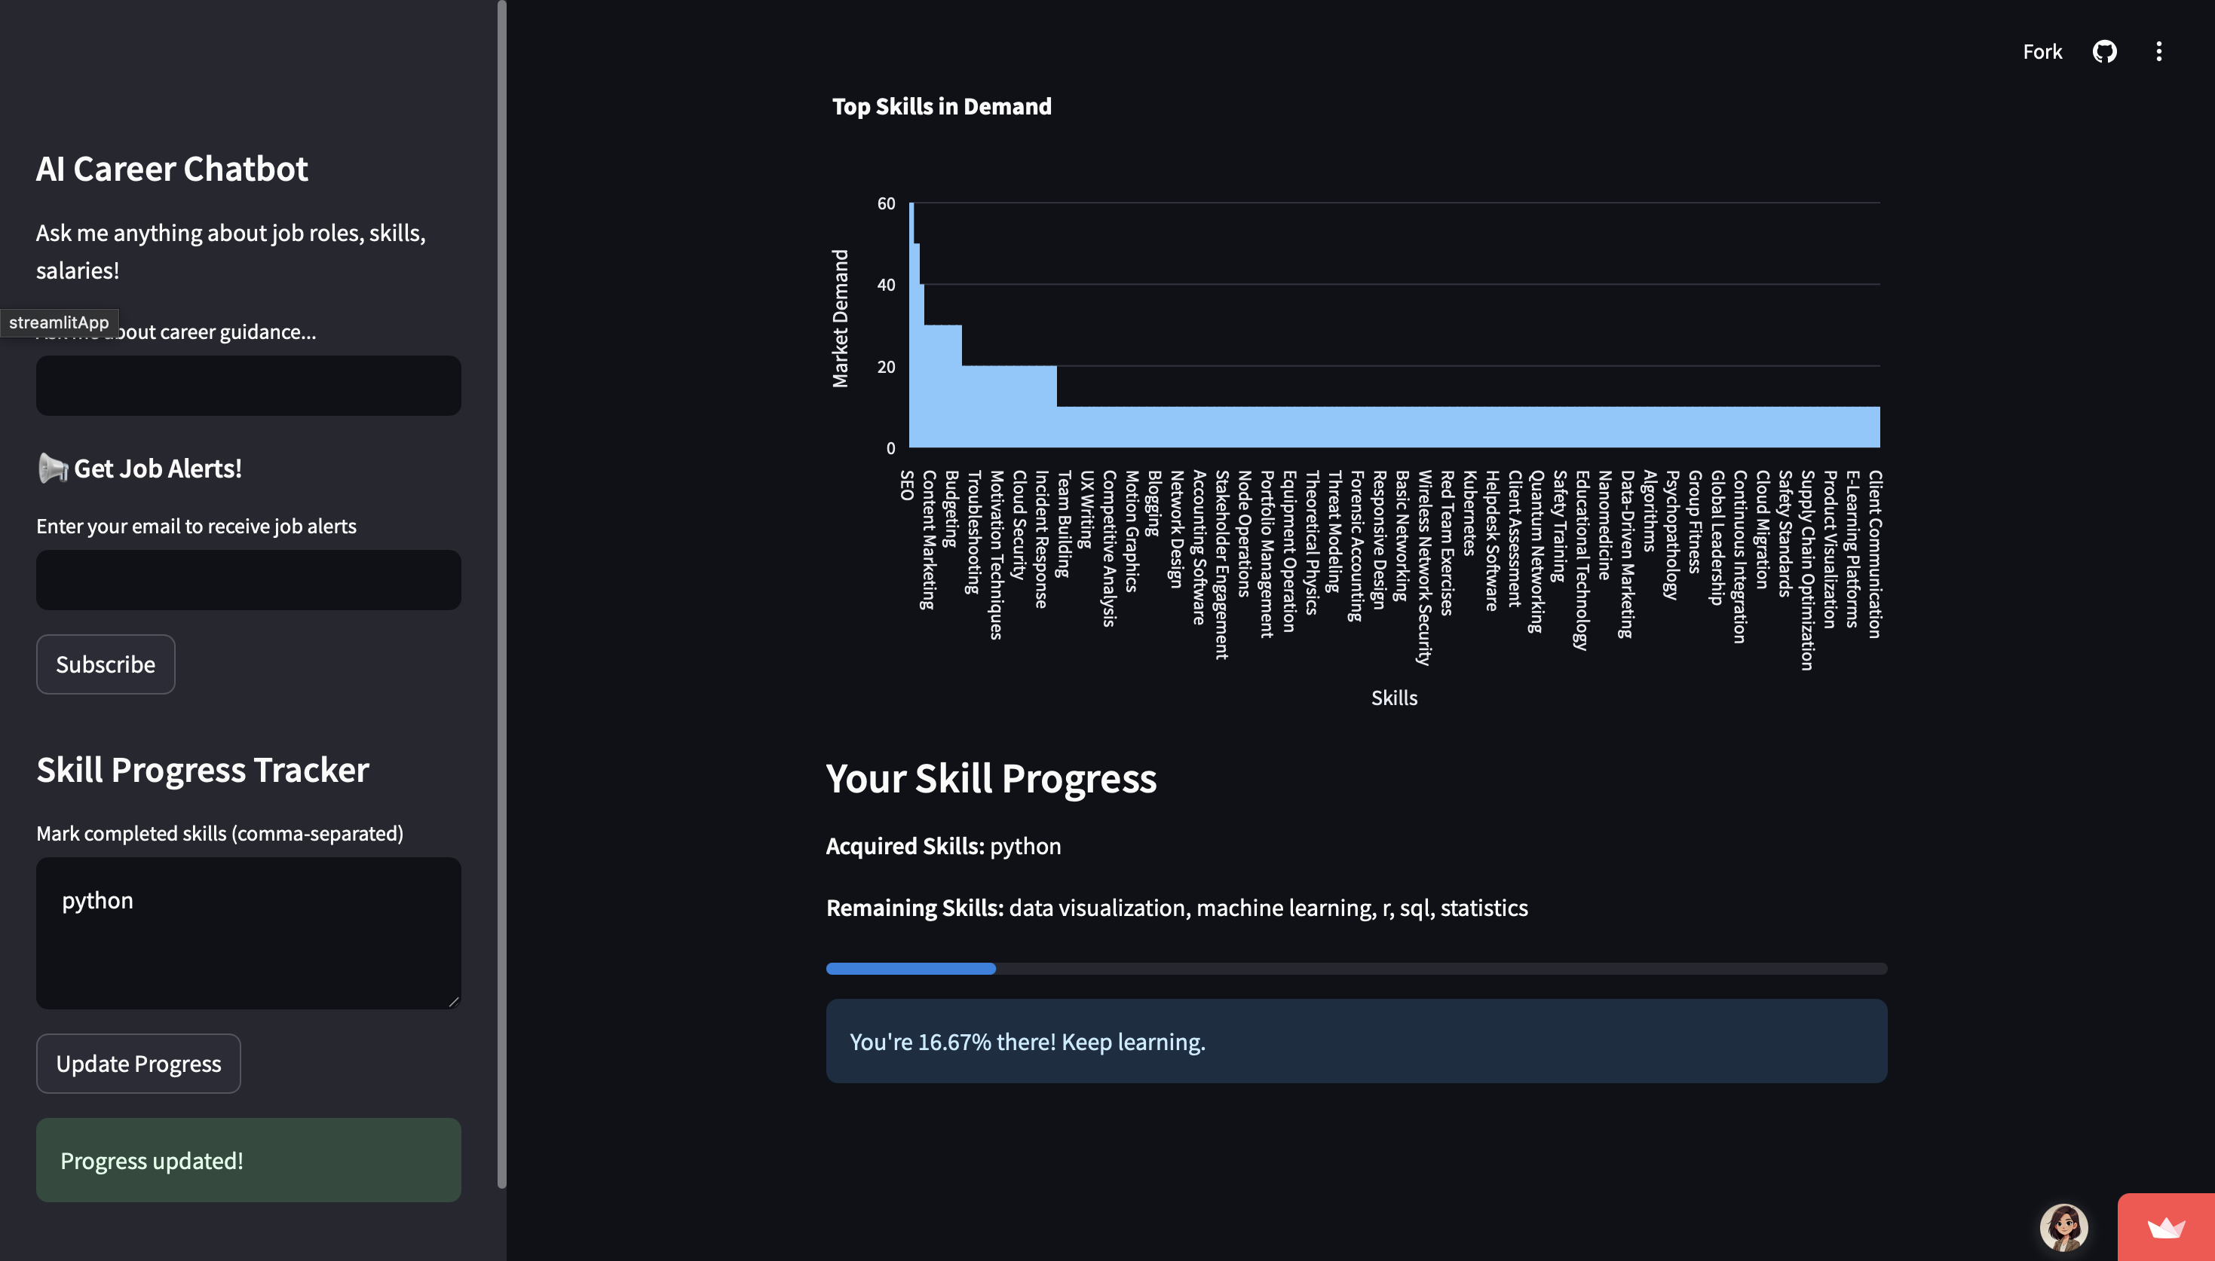

Slide 19
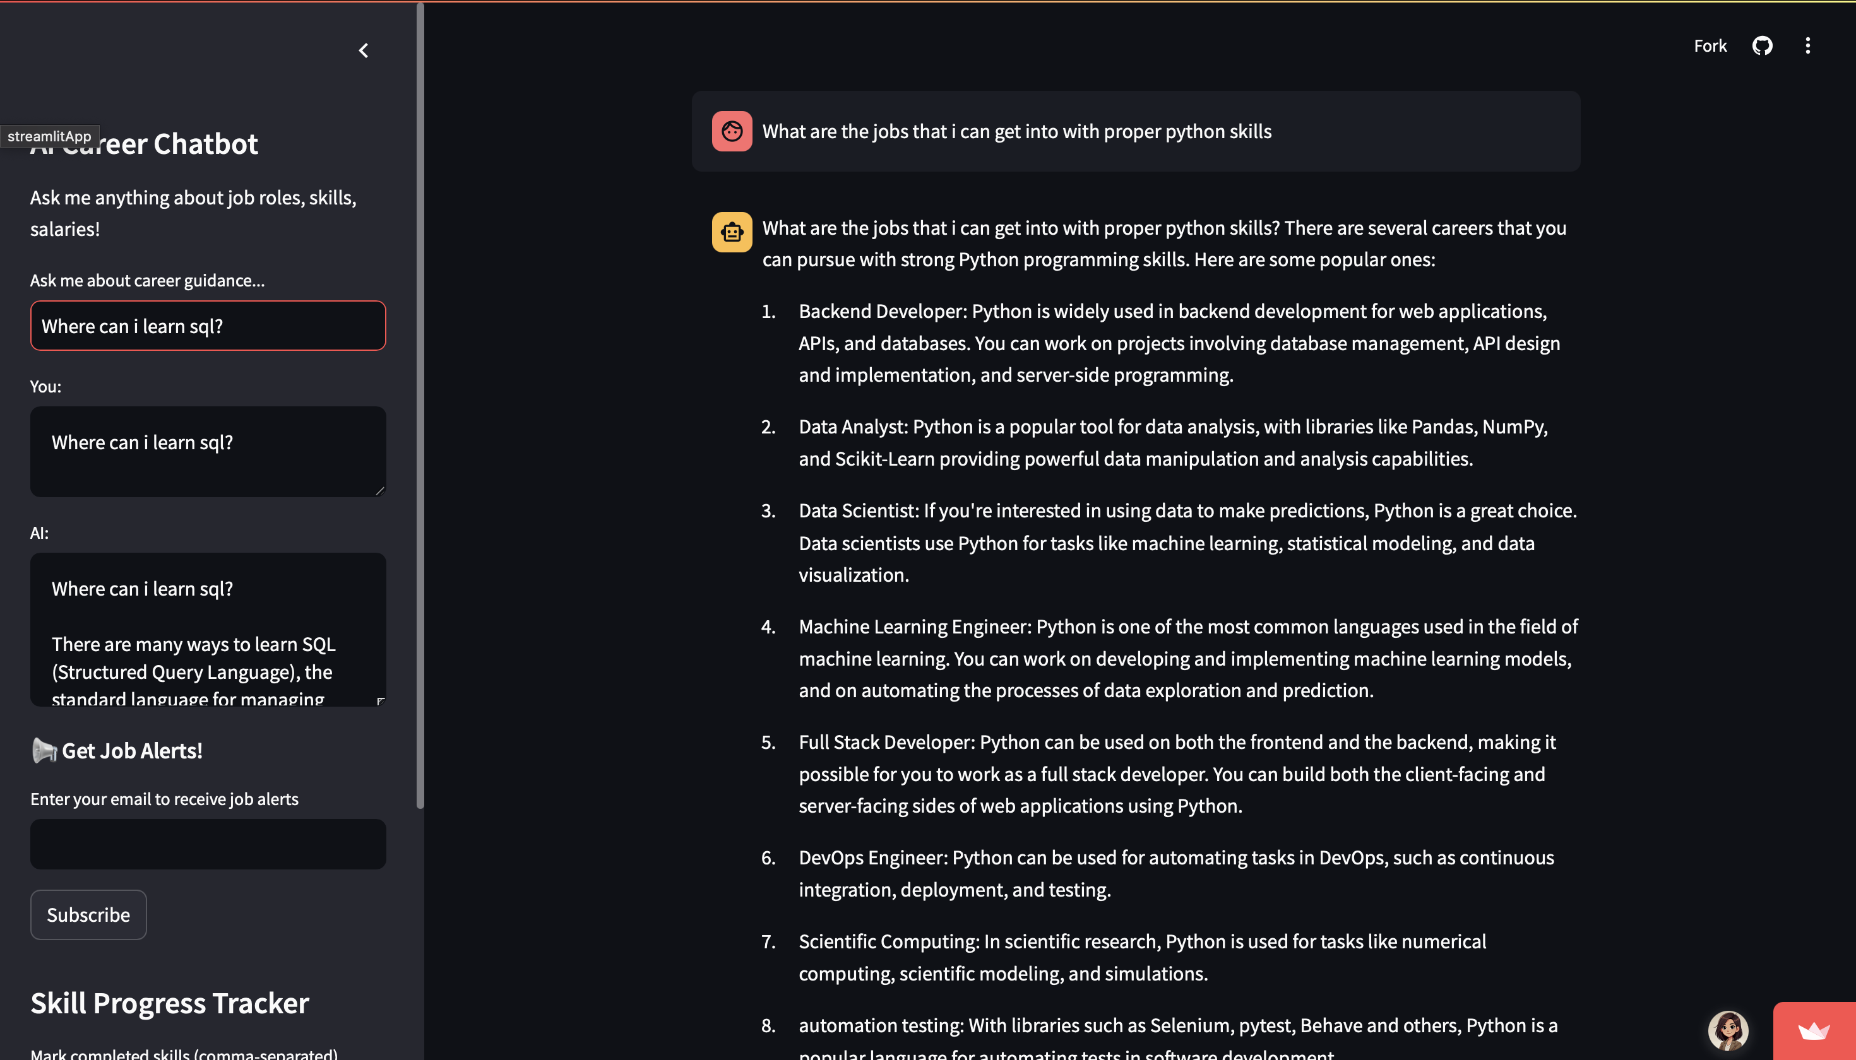

Slide 20
Thank You

