Slide 1
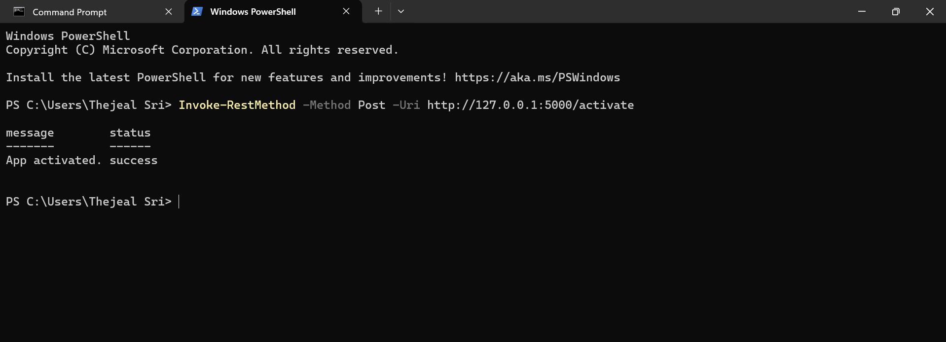
APP ACTIVATION

Slide 2
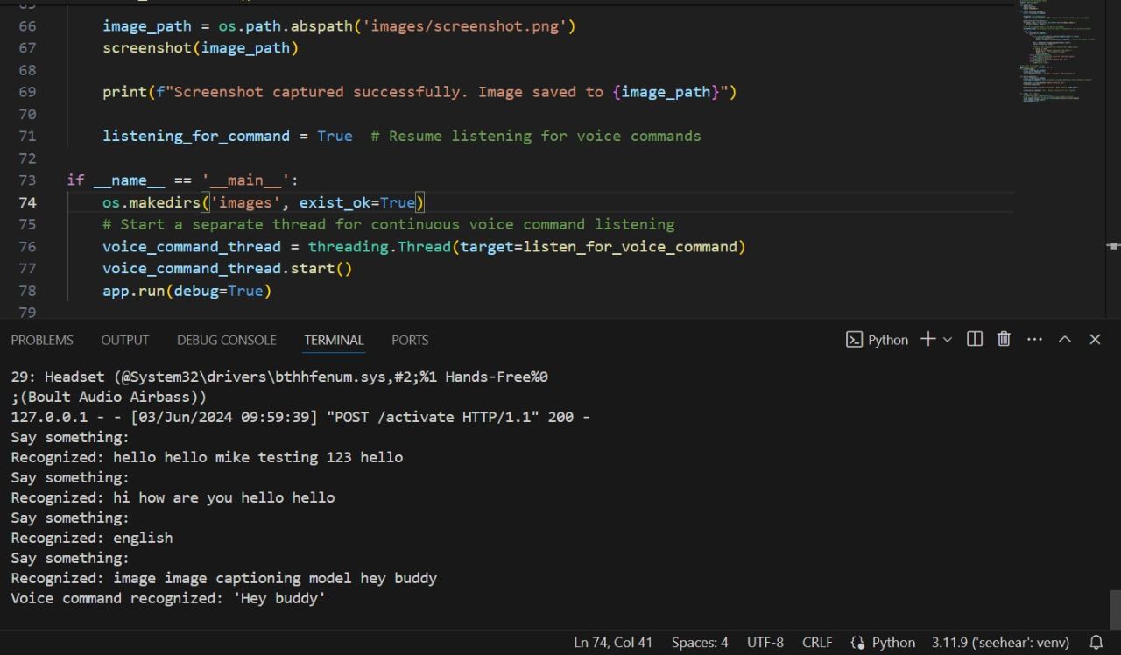
VOICE RECOGNITION

Slide 3
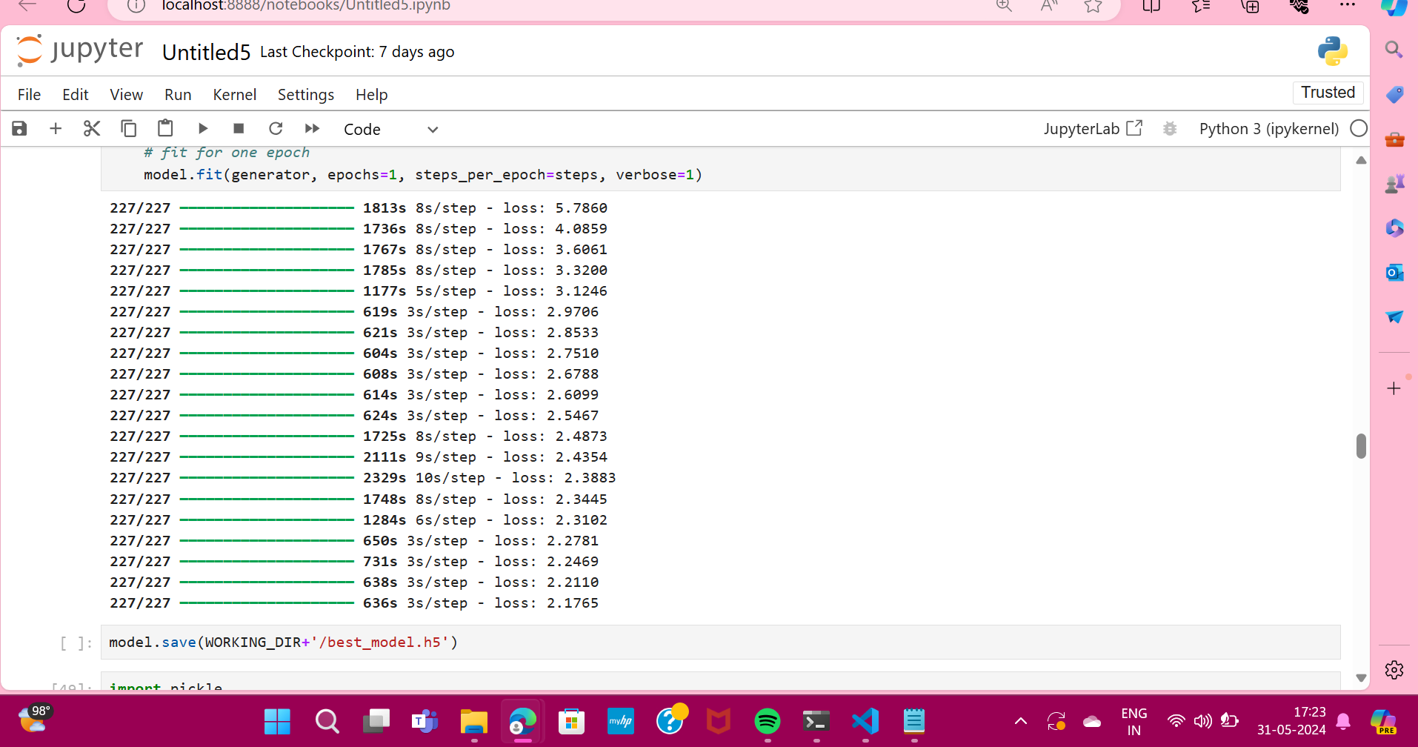
EPOCH GENERATION

Slide 4
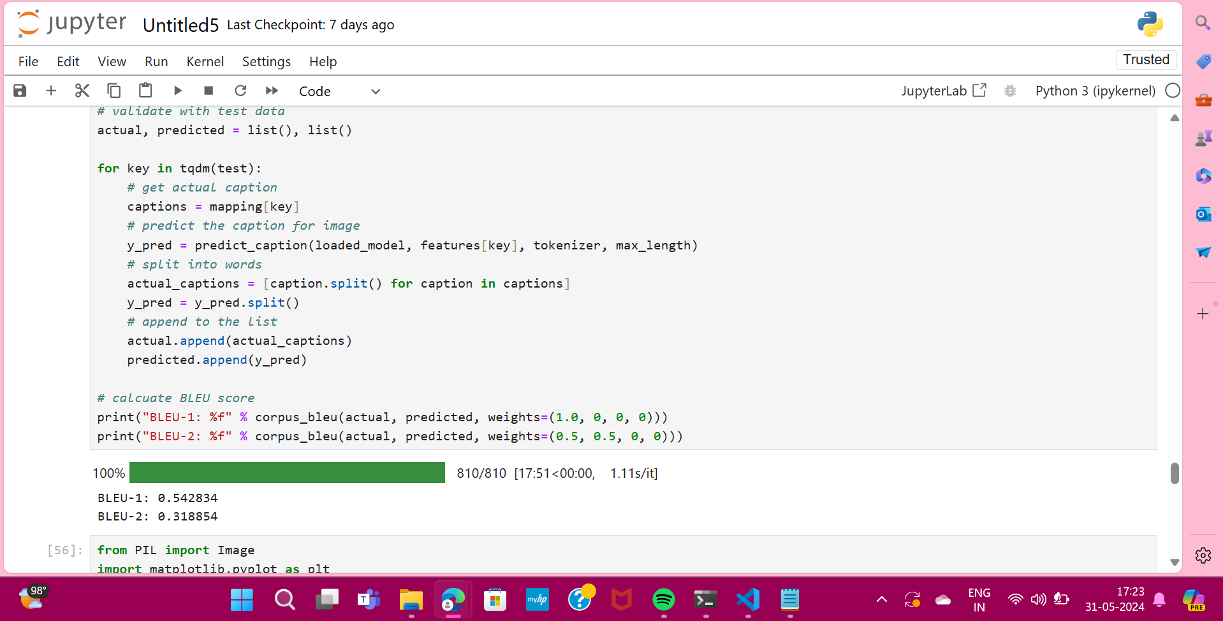
BLEU SCORES

Slide 5
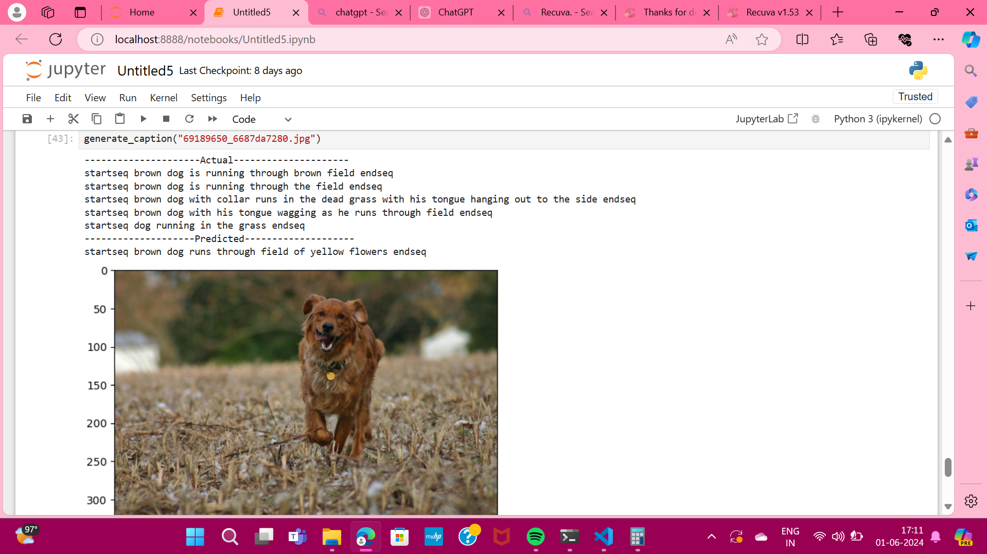
CAPTION GENERATION

Slide 6
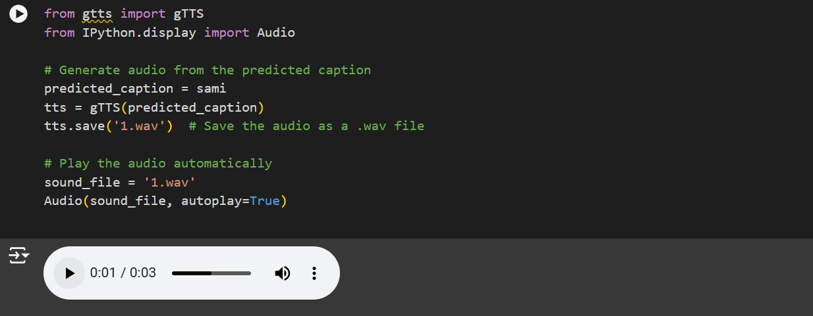
AUDIO CONVERSION

