Slide 1
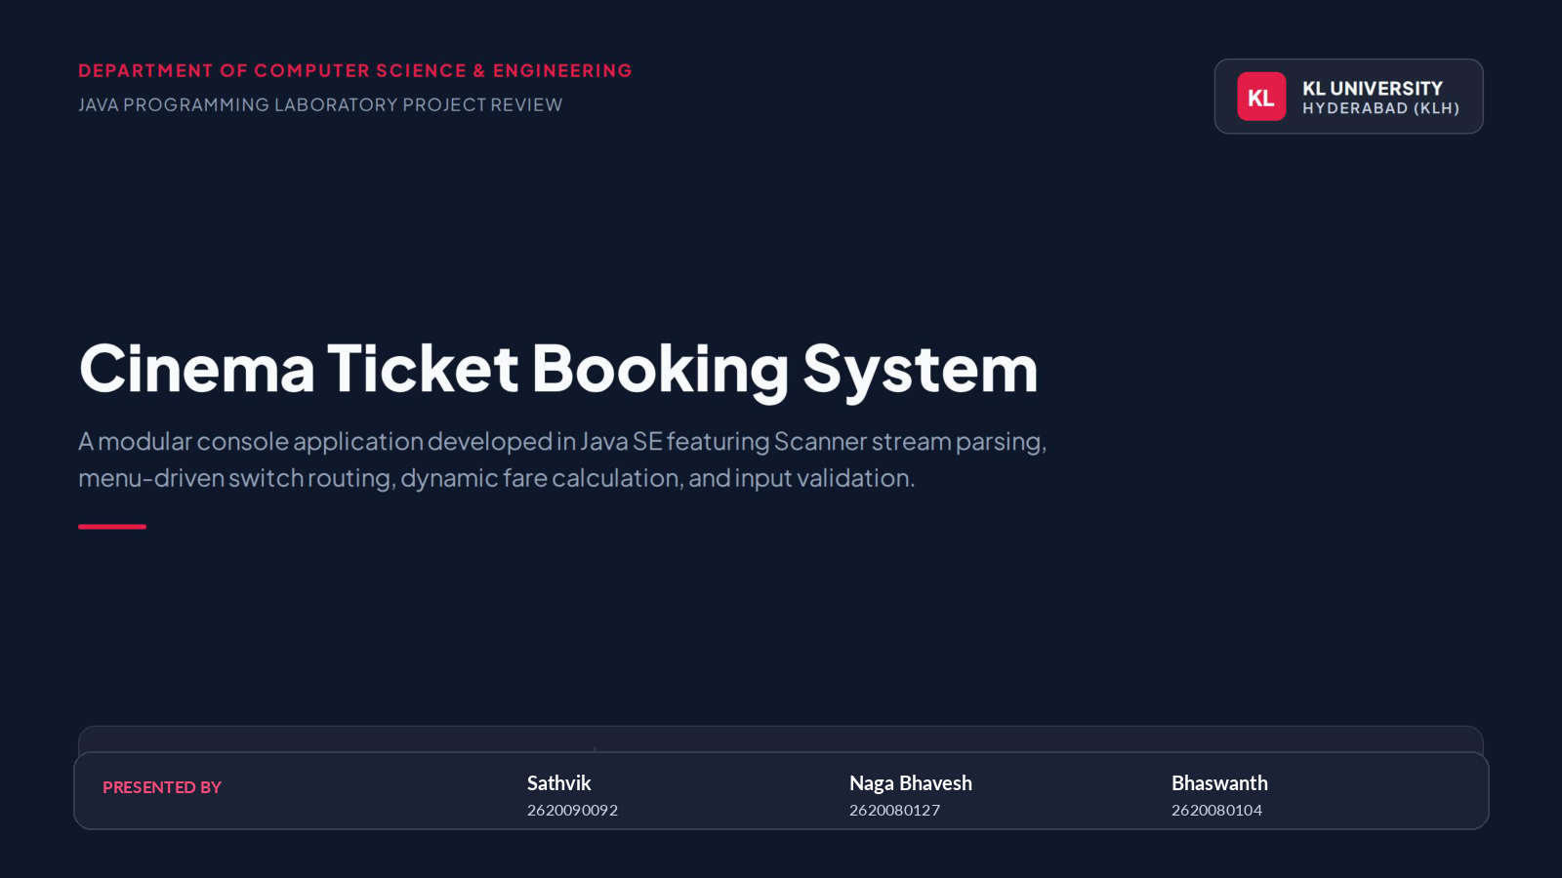

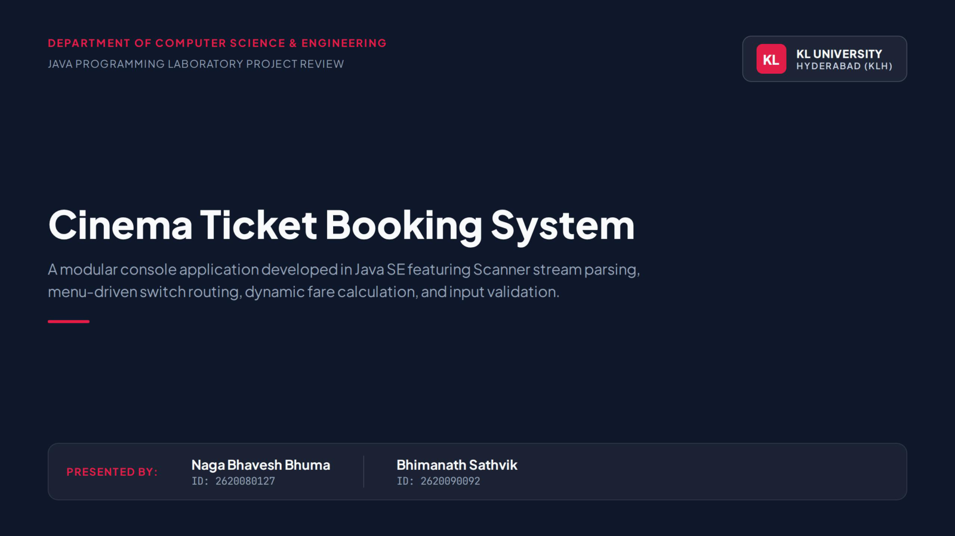

Slide 2
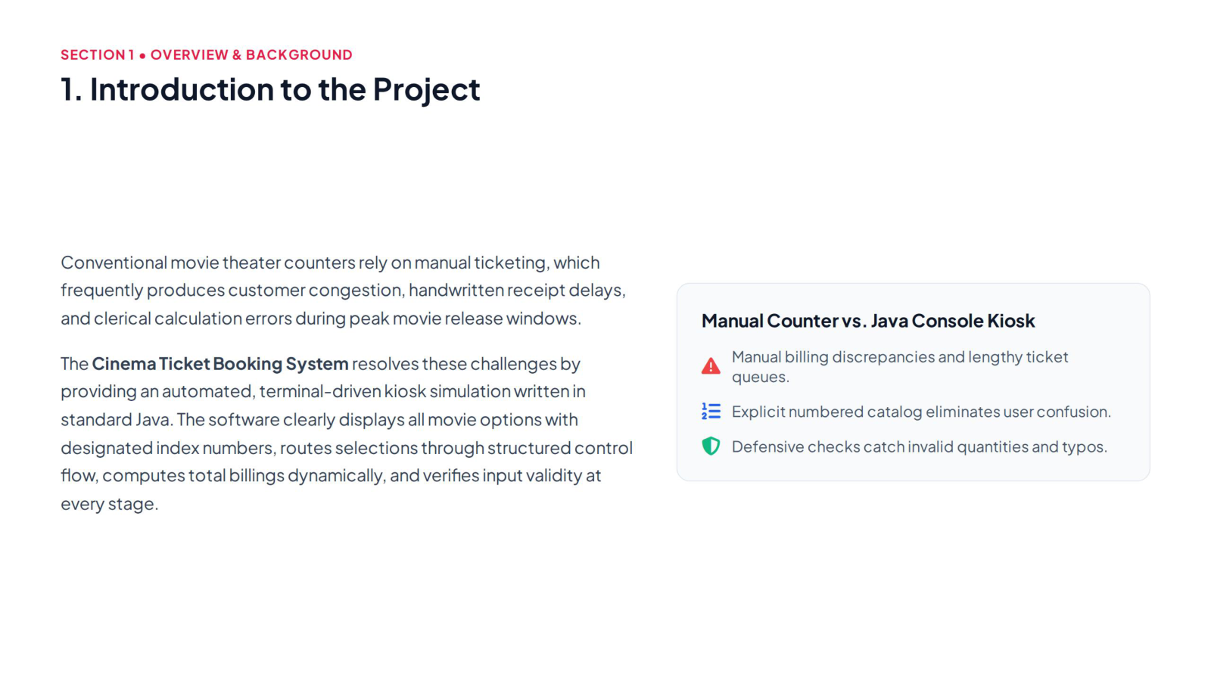
SECTION 1 • OVERVIEW & BACKGROUND
SECTION 1 • OVERVIEW & BACKGROUND
1. Introduction to the Project
1. Introduction to the Project

Slide 3
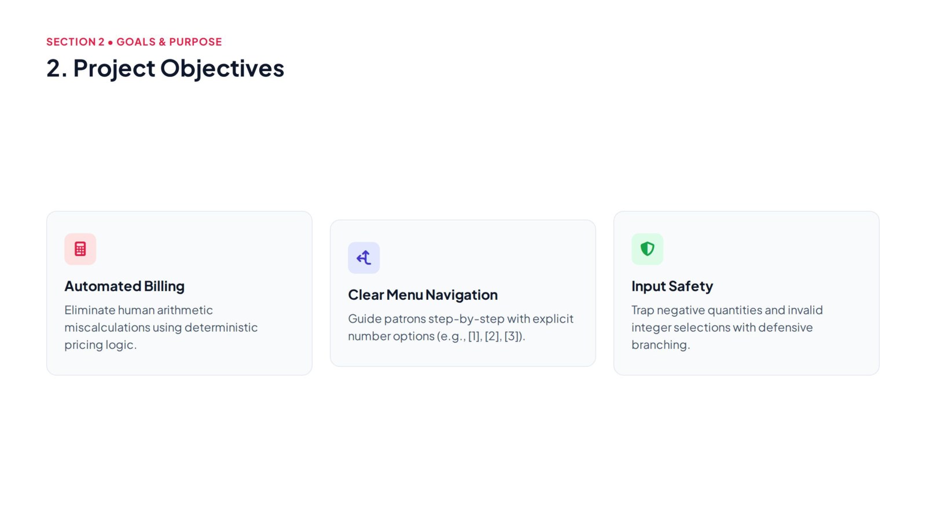
SECTION 2 • GOALS & PURPOSE
SECTION 2 • GOALS & PURPOSE
2. Project Objectives
2. Project Objectives

Slide 4
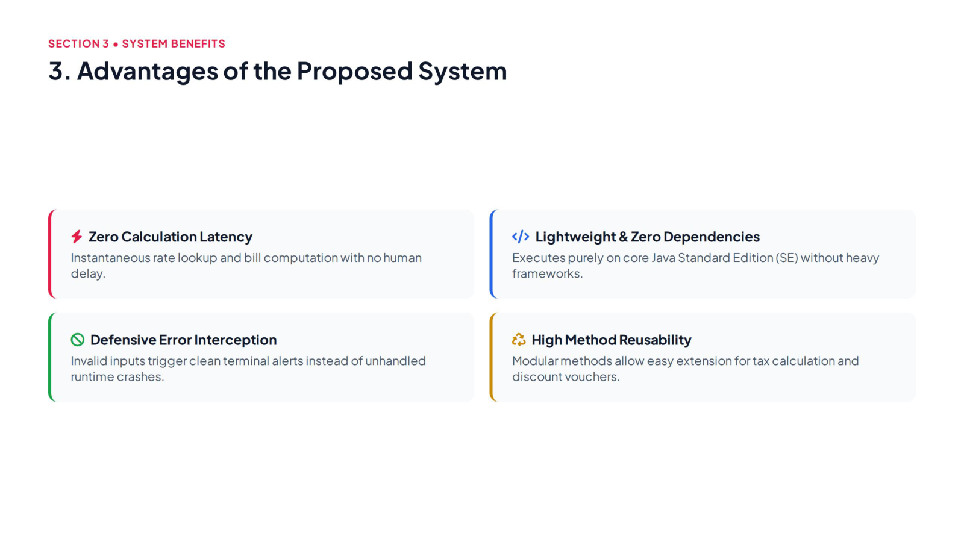
SECTION 3 • SYSTEM BENEFITS
SECTION 3 • SYSTEM BENEFITS
3. Advantages of the Proposed System
3. Advantages of the Proposed System

Slide 5
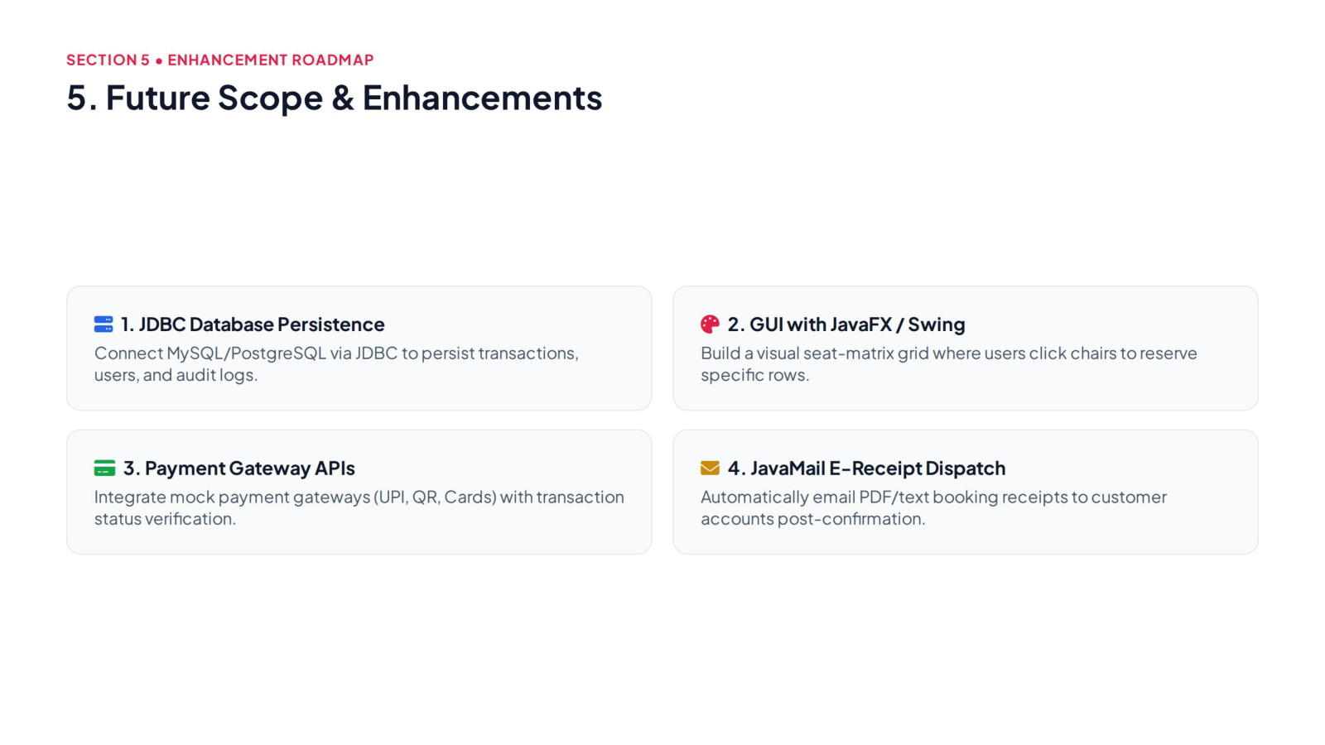
SECTION 4 • ENHANCEMENT ROADMAP
SECTION 4 • ENHANCEMENT ROADMAP
4. Future Scope & Enhancements
4. Future Scope & Enhancements

Slide 6
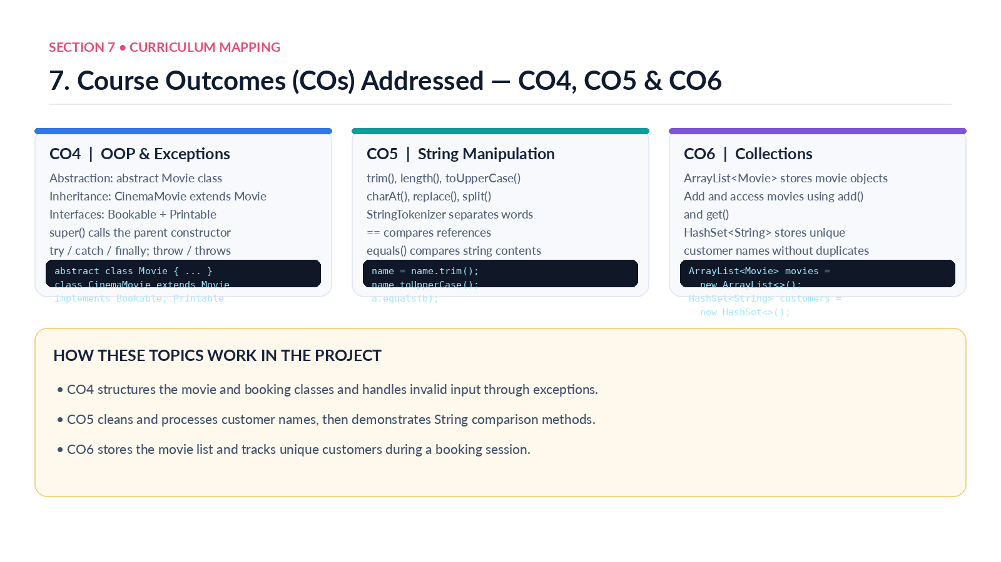
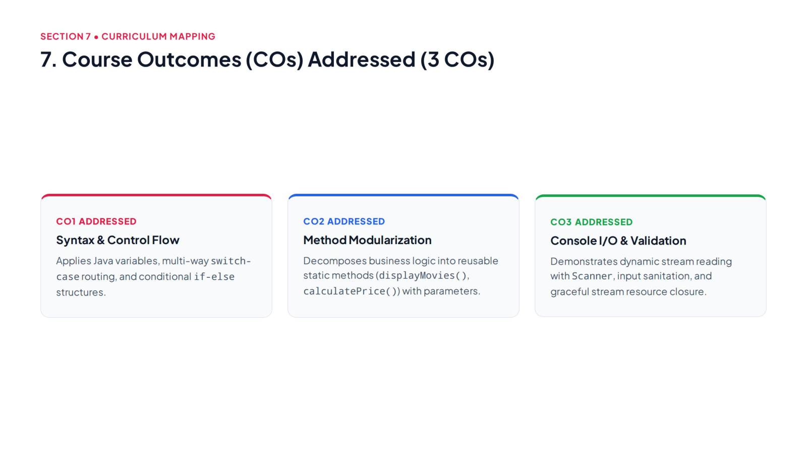
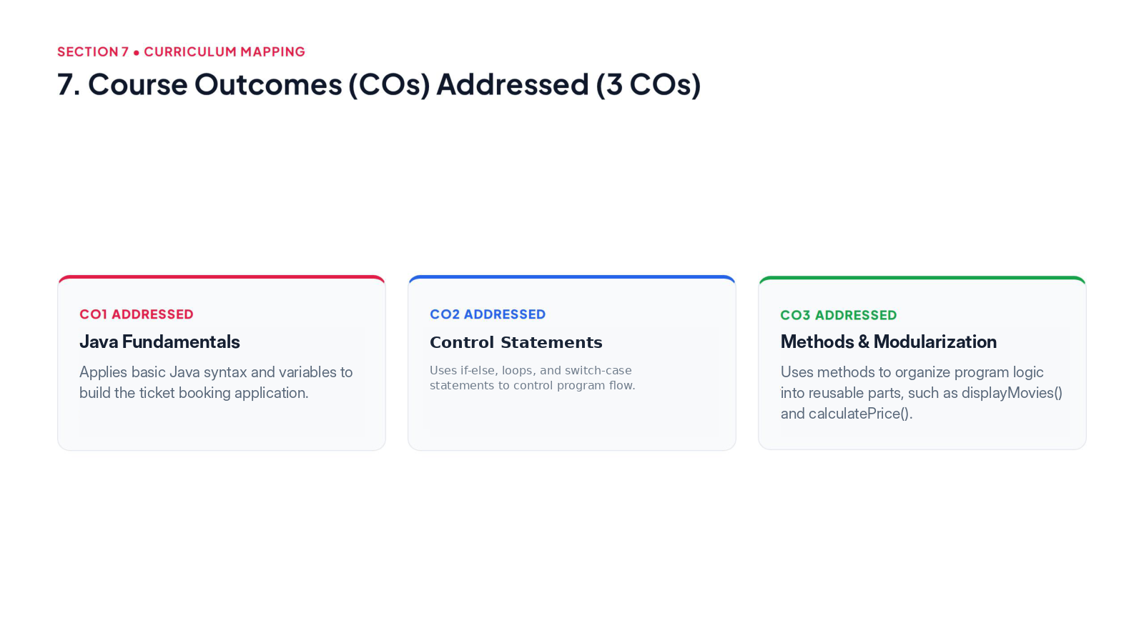
SECTION 5 • CURRICULUM MAPPING
SECTION 5 • CURRICULUM MAPPING
5. Course Outcomes (COs) Addressed — CO4, CO5 & CO6
5. Course Outcomes (COs) Addressed

Slide 7
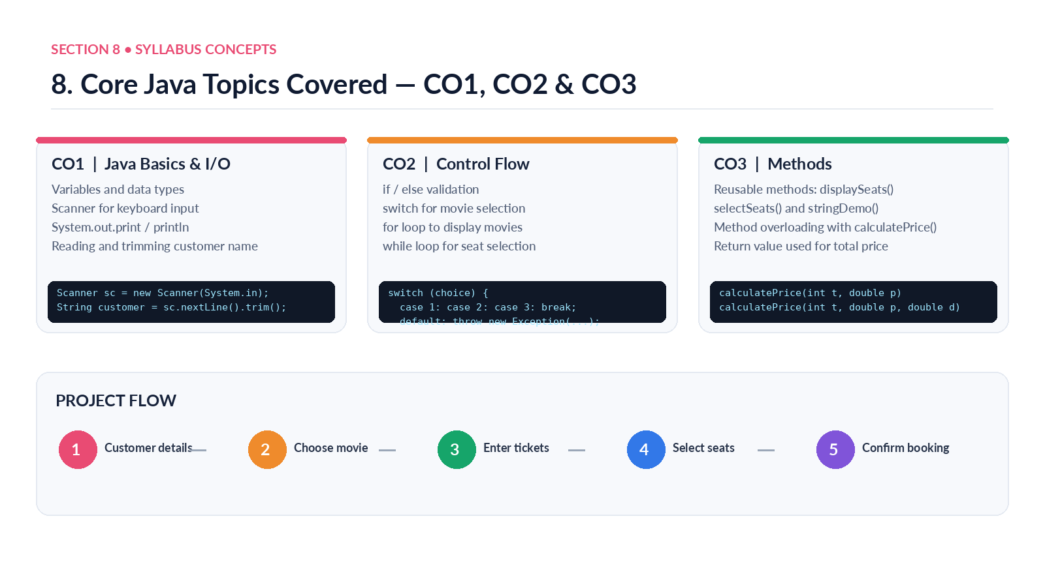
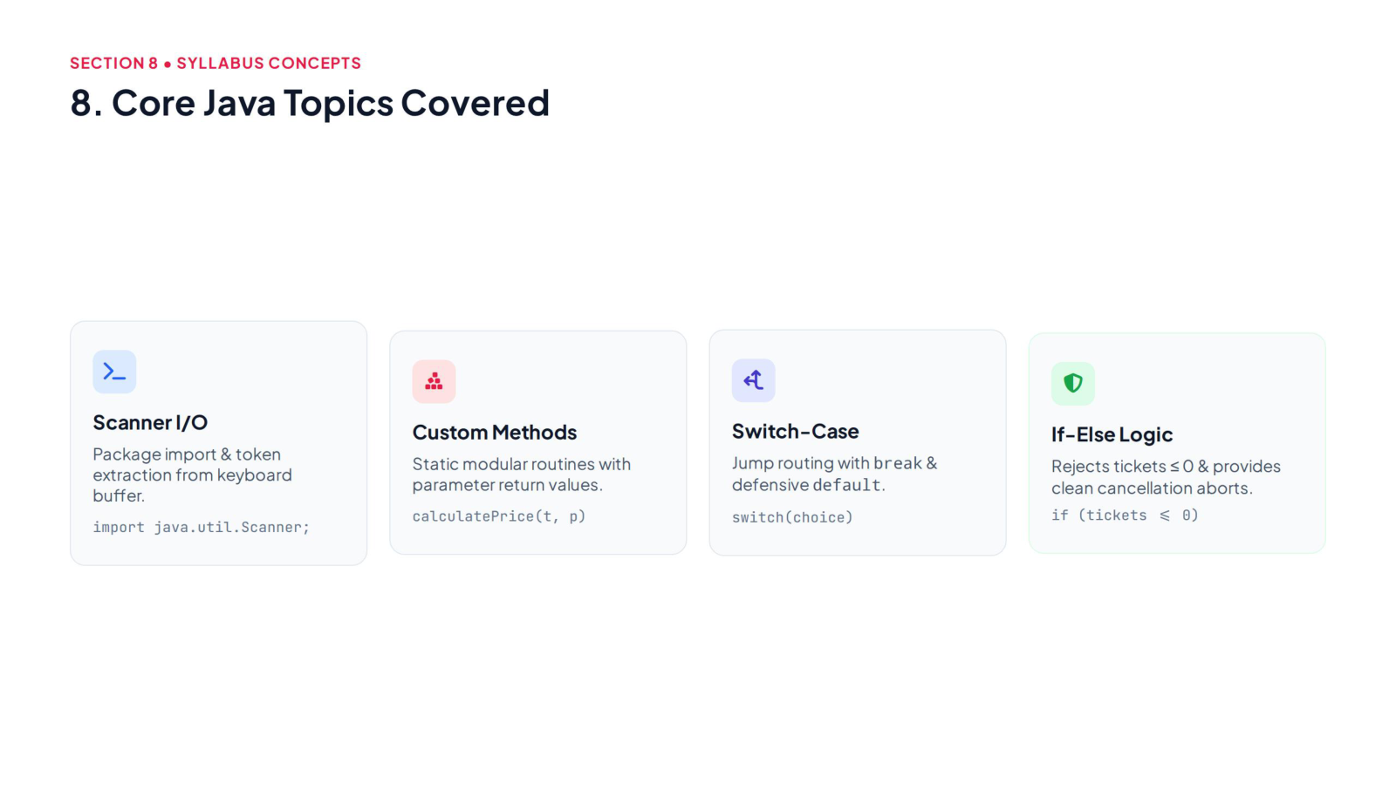
SECTION 6 • SYLLABUS CONCEPTS
SECTION 6 • SYLLABUS CONCEPTS
SECTION 5 • CURRICULUM MAPPING
6. Core Java Topics Covered — CO1, CO2 & CO3
6. Core Java Topics Covered
5. Course Outcomes (COs) Addressed

Slide 8
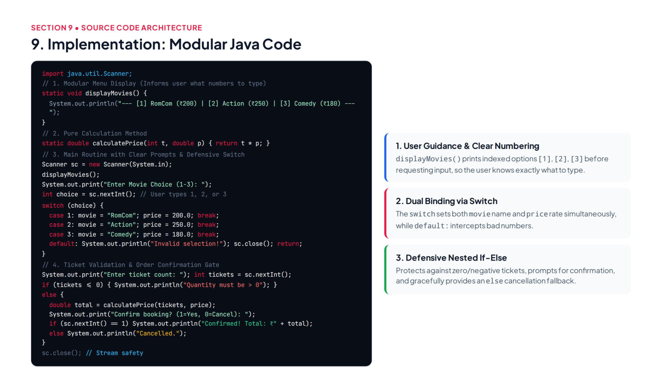
SECTION 7 • SOURCE CODE ARCHITECTURE
SECTION 7 • SOURCE CODE ARCHITECTURE
SECTION 6 • SYLLABUS CONCEPTS
7. Implementation: Modular Java Code
7. Implementation: Modular Java Code
6. Core Java Topics Covered

Slide 9
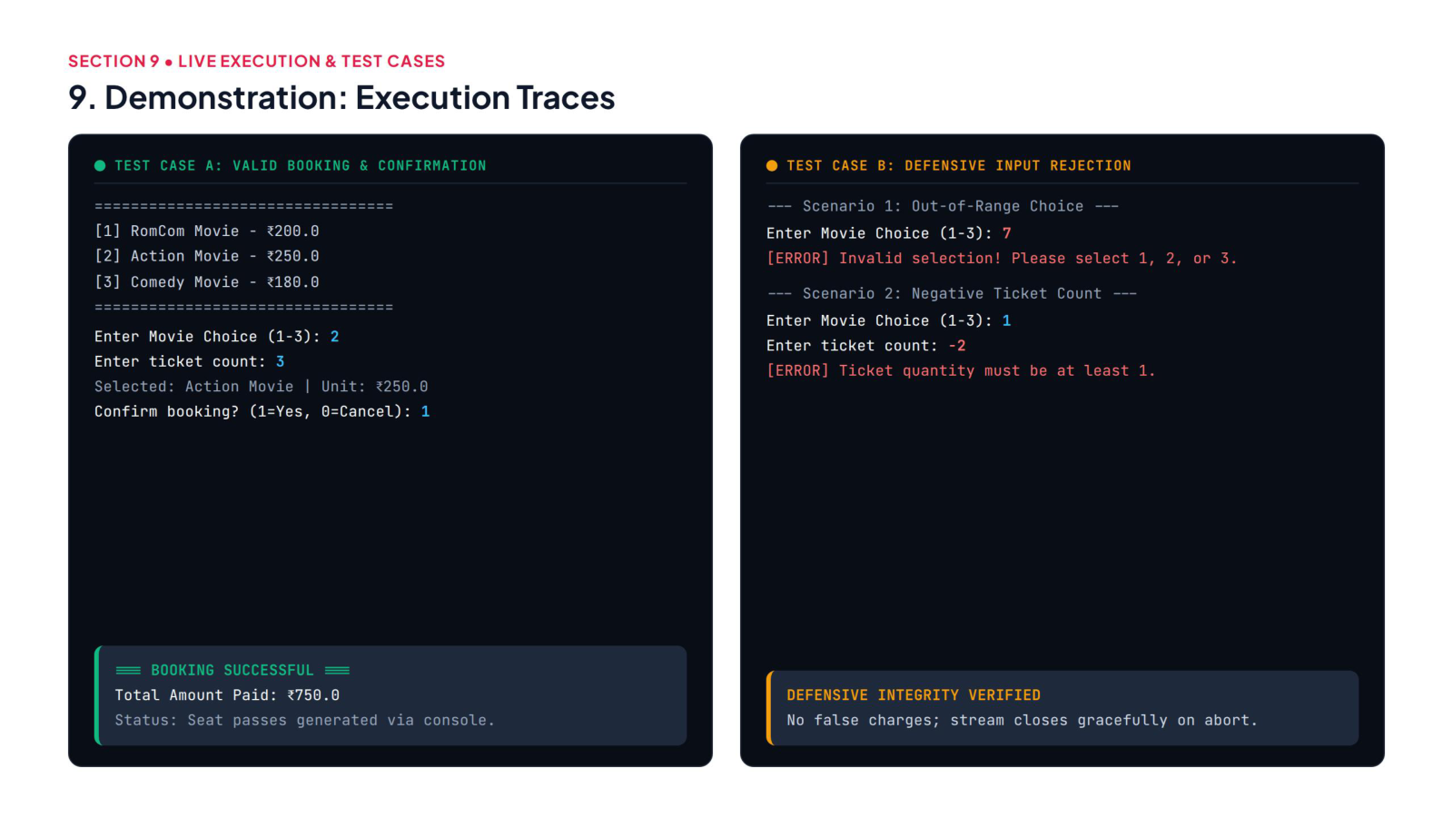
SECTION 8 • LIVE EXECUTION & TEST CASES
SECTION 8 • LIVE EXECUTION & TEST CASES
8. Demonstration: Execution Traces
8. Demonstration: Execution Traces

Slide 10
