Slide 2

Introduction
This project aims to examine airline flight data, using statistical analysis
Impact of weather in pricing
Role of holiday season
Impact of advance booking on ticket price
Effect of in-flight amenities on ticket price
Relationship between luggage allowance and price
Notes:
Project Overview:
This project analyzes airline flight data to uncover patterns and relationships using statistical methods. The primary aim is to understand factors influencing ticket pricing.
Key Areas of Analysis:
Impact of Weather on Pricing: Examining whether weather conditions significantly affect ticket prices.
Role of Holiday Season: Assessing if ticket prices increase during holiday periods due to demand surges.
Impact of Advance Booking: Investigating whether the number of days booked in advance influences ticket prices.
Effect of In-Flight Amenities: Evaluating the contribution of amenities like meals, Wi-Fi, and entertainment to ticket pricing.
Relationship Between Luggage Allowance and Price: Exploring if varying luggage allowances affect ticket prices.
Approach: Using statistical metrics like p-values, F-statistics, this project aims to draw conclusions about the significance and strength of these relationships

Slide 3
Hypothesis Questions
Do weather conditions affect flight ticket prices?
Does the holiday season have high ticket prices?
Does advance booking yield lower prices?
How do in-flight add-ons ( like meals, Wi-Fi, and entertainment) affect the price?
Does luggage allowance have a relationship with the price of the ticket?

Slide 4
Weather Conditions and Ticket Prices
Hypothesis:
Null (H₀): Weather conditions has no effect on ticket prices.
Alternative (H₁): Weather conditions affect ticket prices.
ANOVA Results :
P-value : 0.73
F-statistic: 0.4283
Conclusion:
We do not reject null Hypothesis (H₀)
Notes:
Hypothesis:
The null hypothesis (H₀) assumes no effect of weather on ticket prices, while the alternative (H₁) suggests an effect.
ANOVA Results:
P-value (0.73): Much larger than 0.05, meaning there’s no strong evidence against H₀.
F-statistic (0.4283): Indicates minimal variance explained by weather.
Conclusion:
We fail to reject H₀. Weather conditions do not significantly affect ticket prices based on this analysis.

Slide 5
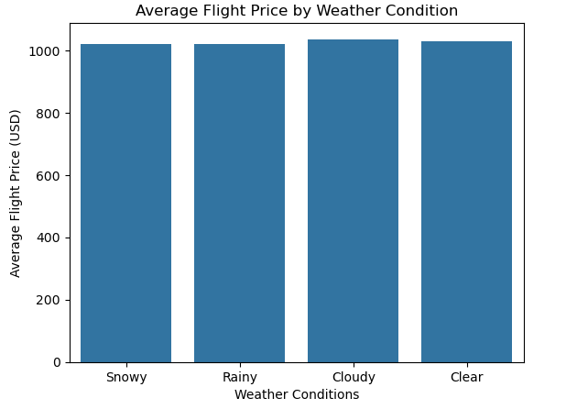
Weather Conditions and Ticket Prices
Weather conditions do not affect flight prices

Slide 6
Holiday season and ticket price
Hypothesis:
ANOVA Results :
Conclusion:
Null (H₀): Holiday season does not affect ticket price.
Alternative (H₁): Holiday season affects ticket prices.
p-value : 0.042
F-statistic : 4.126
Reject the null hypothesis (H₀), since p-value is less than significant level.
Notes:
Hypothesis:
Null Hypothesis (H₀): Holiday season has no impact on ticket prices.
Alternative Hypothesis (H₁): Holiday season affects ticket prices.
ANOVA Results:
P-value (0.042): This is less than 0.05, indicating significant evidence against H₀.
F-statistic (4.126): Suggests variance in ticket prices can be attributed to holiday season effects.
Conclusion:
We reject H₀, concluding that the holiday season significantly impacts ticket prices.

Slide 7
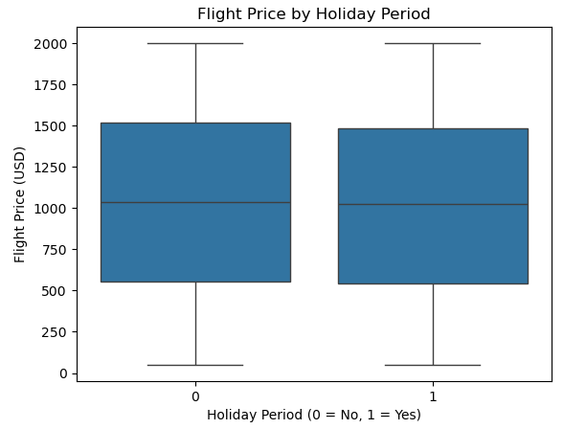
Holiday season and ticket price
Ticket prices are higher during holiday season

Slide 8
Advance booking and ticket prices
Hypothesis:
Regression :
Conclusion:
Do not reject null hypothesis (H₀) , since p-value is not less than significance level.
Null (H₀): Advance booking days have no effect on ticket price. Alternative (H₁): Advance booking days affect ticket prices.
R-squared: 0.000 p-value: 0.884
Notes:
Hypothesis:
Null Hypothesis (H₀): Advance booking days do not affect ticket prices.
Alternative Hypothesis (H₁): Advance booking days affect ticket prices.
Results:
R-squared (0.000): Indicates no variance in ticket prices is explained by advance booking days.
P-value (0.884): Much greater than 0.05, providing no evidence to reject H₀.
Conclusion:
We do not reject H₀. Advance booking days have no significant effect on ticket prices based on this analysis.

Slide 9
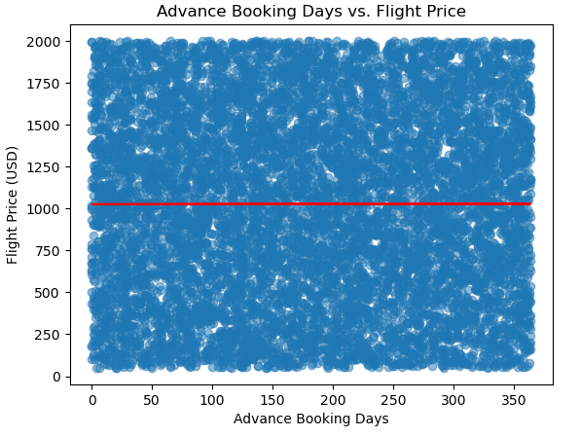
Advance booking and ticket prices
Advance booking has no significant affect on flight prices

Slide 10
In-flight add-ons and ticket prices
Hypothesis
Regression
Conclusion:
Do not reject null hypothesis (H₀)
Null (H₀): In-flight add-ons do not affect on ticket prices. Alternative (H₁): In-flight add-ons affect ticket prices.
p-value: Meal Included: 0.335 Wifi Available: 0.973 InFlight Entertainment: 0.808
Notes:
Hypothesis:
Null Hypothesis (H₀): In-flight add-ons (meal, Wi-Fi, or entertainment) do not affect ticket prices.
Alternative Hypothesis (H₁): In-flight add-ons affect ticket prices.
Results:
P-values:
Meal Included: 0.335
Wi-Fi Available: 0.973
In-Flight Entertainment: 0.808 All p-values are significantly greater than 0.05, indicating no evidence to reject H₀.
Conclusion:
We do not reject H₀. There is no significant effect of in-flight add-ons on ticket prices in this analysis.

Slide 11
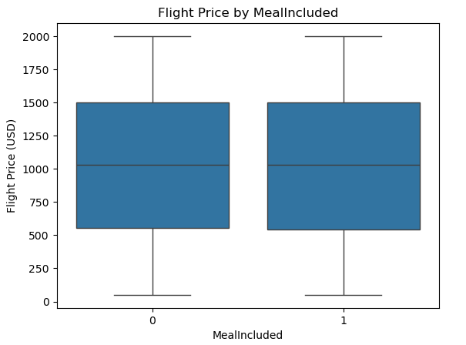
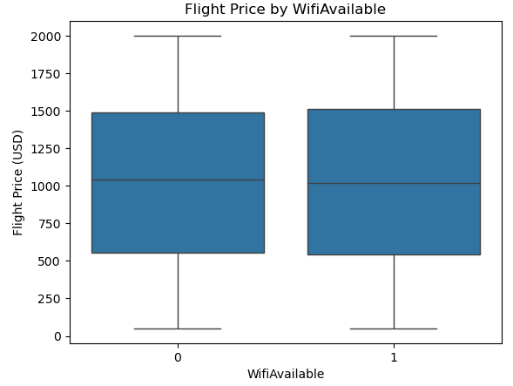
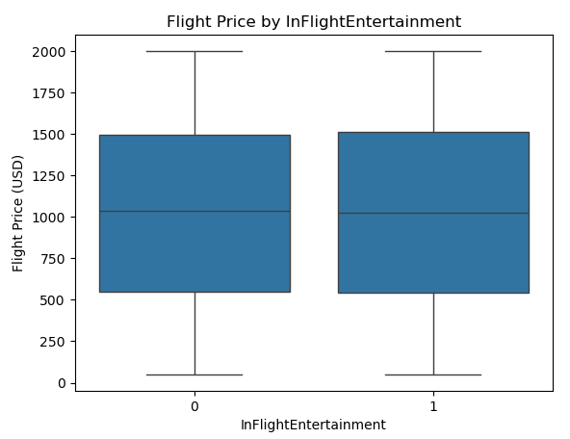
In-flight add-ons and ticket prices

Slide 12
Luggage Allowance and Ticket Prices
Hypothesis
Regression
Conclusion:
Do not reject null hypothesis (H₀)
Null (H₀): Luggage allowance has no effect on ticket prices. Alternative (H₁): Luggage allowance affects ticket prices.
R-squared: 0.000 p-value: 0.123
Notes:
Hypothesis:
Null Hypothesis (H₀): Luggage allowance has no effect on ticket prices.
Alternative Hypothesis (H₁): Luggage allowance affects ticket prices.
Results:
R-squared (0.000): Indicates luggage allowance explains no variance in ticket prices.
P-value (0.123): Greater than 0.05, showing insufficient evidence to reject H₀.
Conclusion:
We do not reject H₀. Luggage allowance does not significantly affect ticket prices based on this analysis.

Slide 13
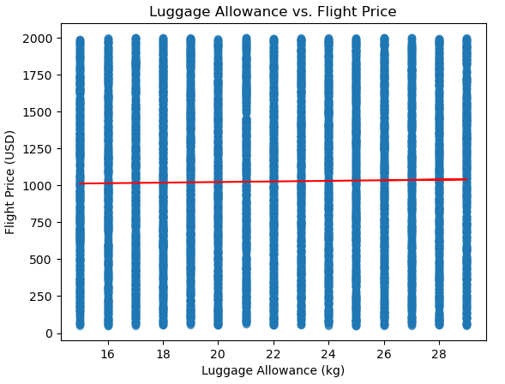
Luggage Allowance and Ticket Prices
Luggage allowance does not affect flight ticket prices.

Slide 14
Summary of Results
Variable | Results
Weather Conditions | No effect on ticket prices
Holiday Season | Significant increase in prices
Advance Booking | No effect on ticket prices
In-Flight Add-Ons | No effect on ticket prices
Luggage Allowance | No effect on ticket prices
Notes:
Weather Conditions:
Conclusion: No effect on ticket prices (Hypothesis Rejected).
Implication for Airlines: Weather does not significantly drive pricing, suggesting pricing is unaffected by external operational challenges.
Holiday Season:
Conclusion: Ticket prices are significantly higher during holiday periods (Hypothesis Accepted).
Implication for Airlines: Focus on holiday seasons as key revenue-generating periods. Airlines can implement dynamic pricing and promotions to maximize profitability.
Advance Booking:
Conclusion: No evidence that advance booking lowers ticket prices (Hypothesis Rejected).
Implication for Airlines: Reevaluate traditional assumptions around advance booking and investigate other factors influencing early ticket purchases.
In-Flight Add-Ons:
Conclusion: No significant effect on ticket prices (Hypothesis Rejected).
Implication for Airlines: In-flight services are not a direct driver of ticket price variability, but they may influence customer experience and brand loyalty.
Luggage Allowance:
Conclusion: No significant effect on ticket prices (Hypothesis Rejected).
Implication for Airlines: Luggage allowance is not a key determinant of ticket pricing, but it may serve as a value-add for premium services.

Slide 15

Thank You

