Slide 1
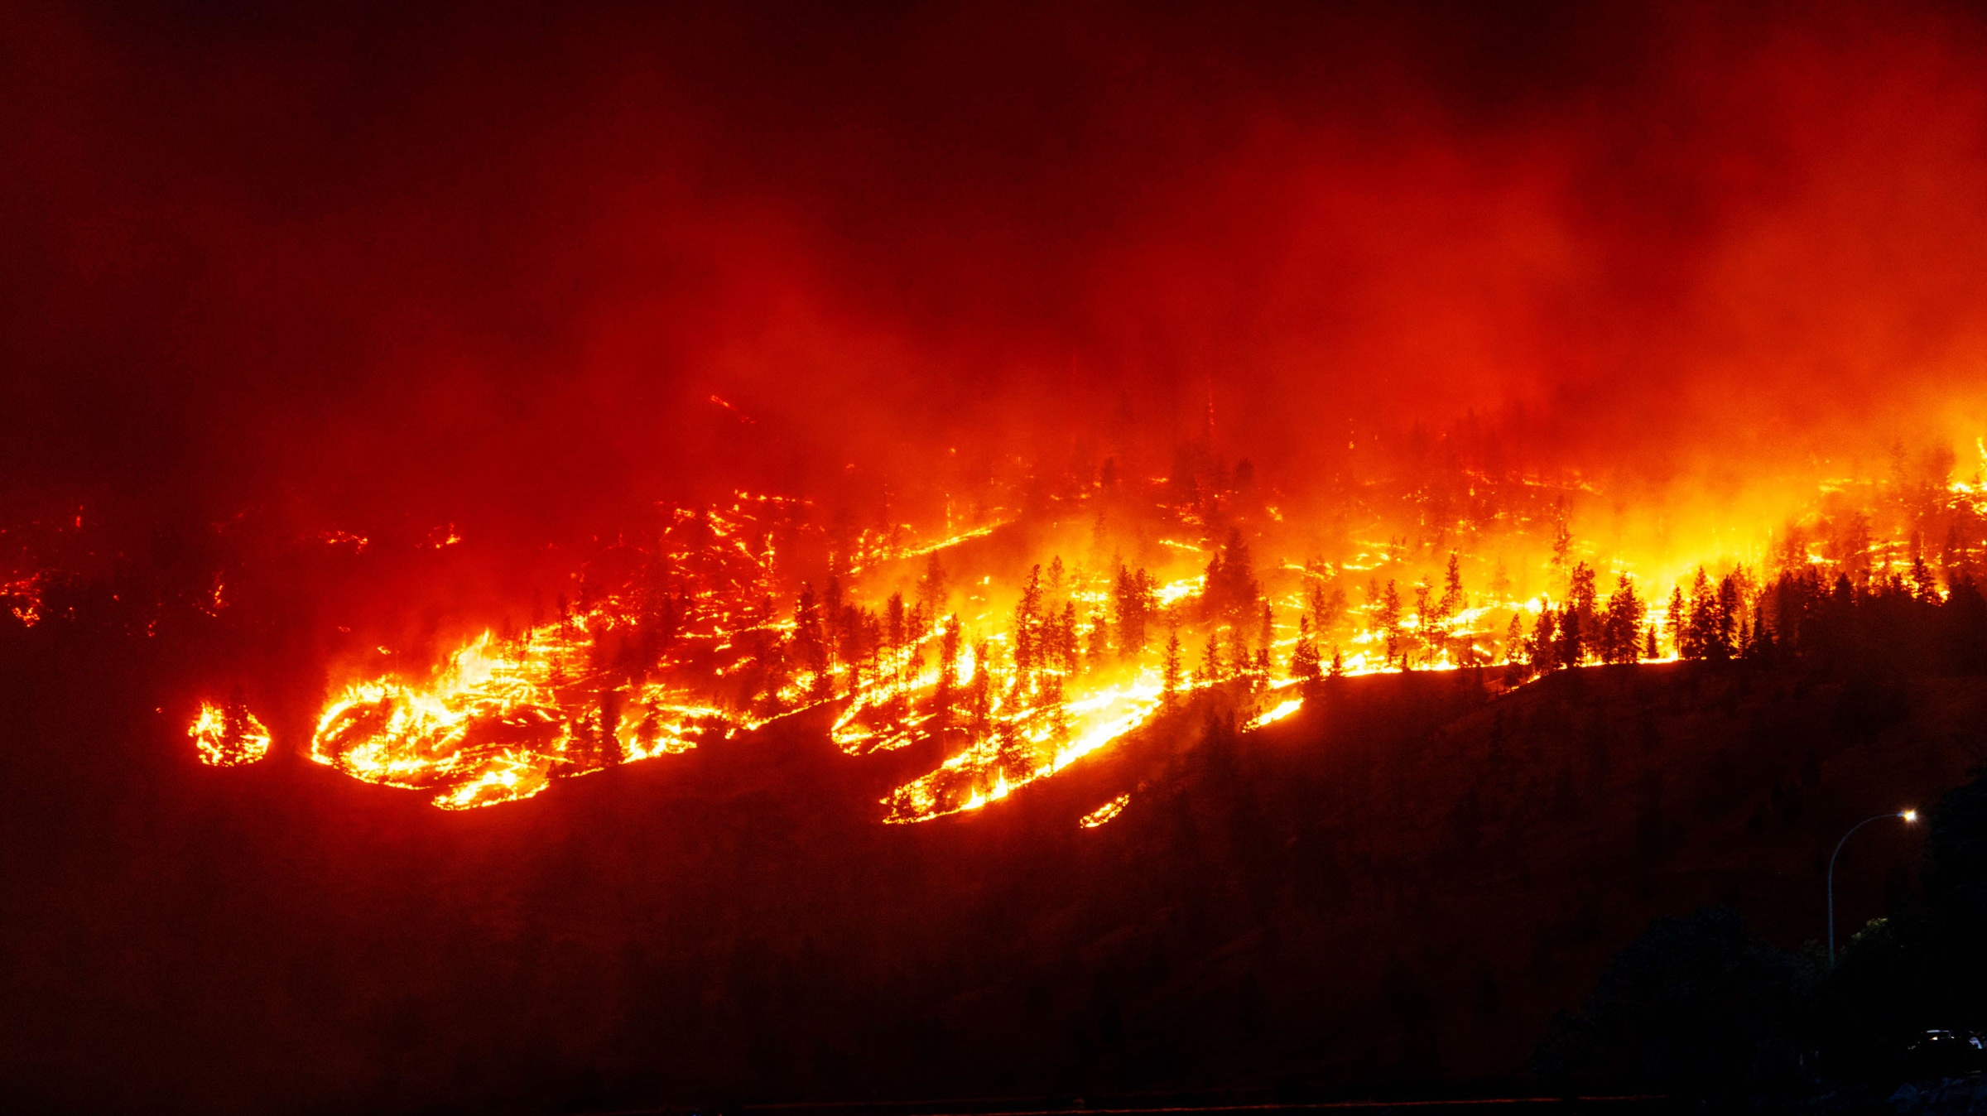
Harnessing Canadian Wildfire Data
Protecting Lives, Economy and Ecosystems
Image source: https://images.app.goo.gl/rbqEAxcwGeLUvPb7A

Slide 2
Why this matters?
Harnessing Wildfire data to make smarter prevention strategies which protect lives and ecosystems.
Improved Safety
Preserved Ecosystems
Economic Stability

Slide 3
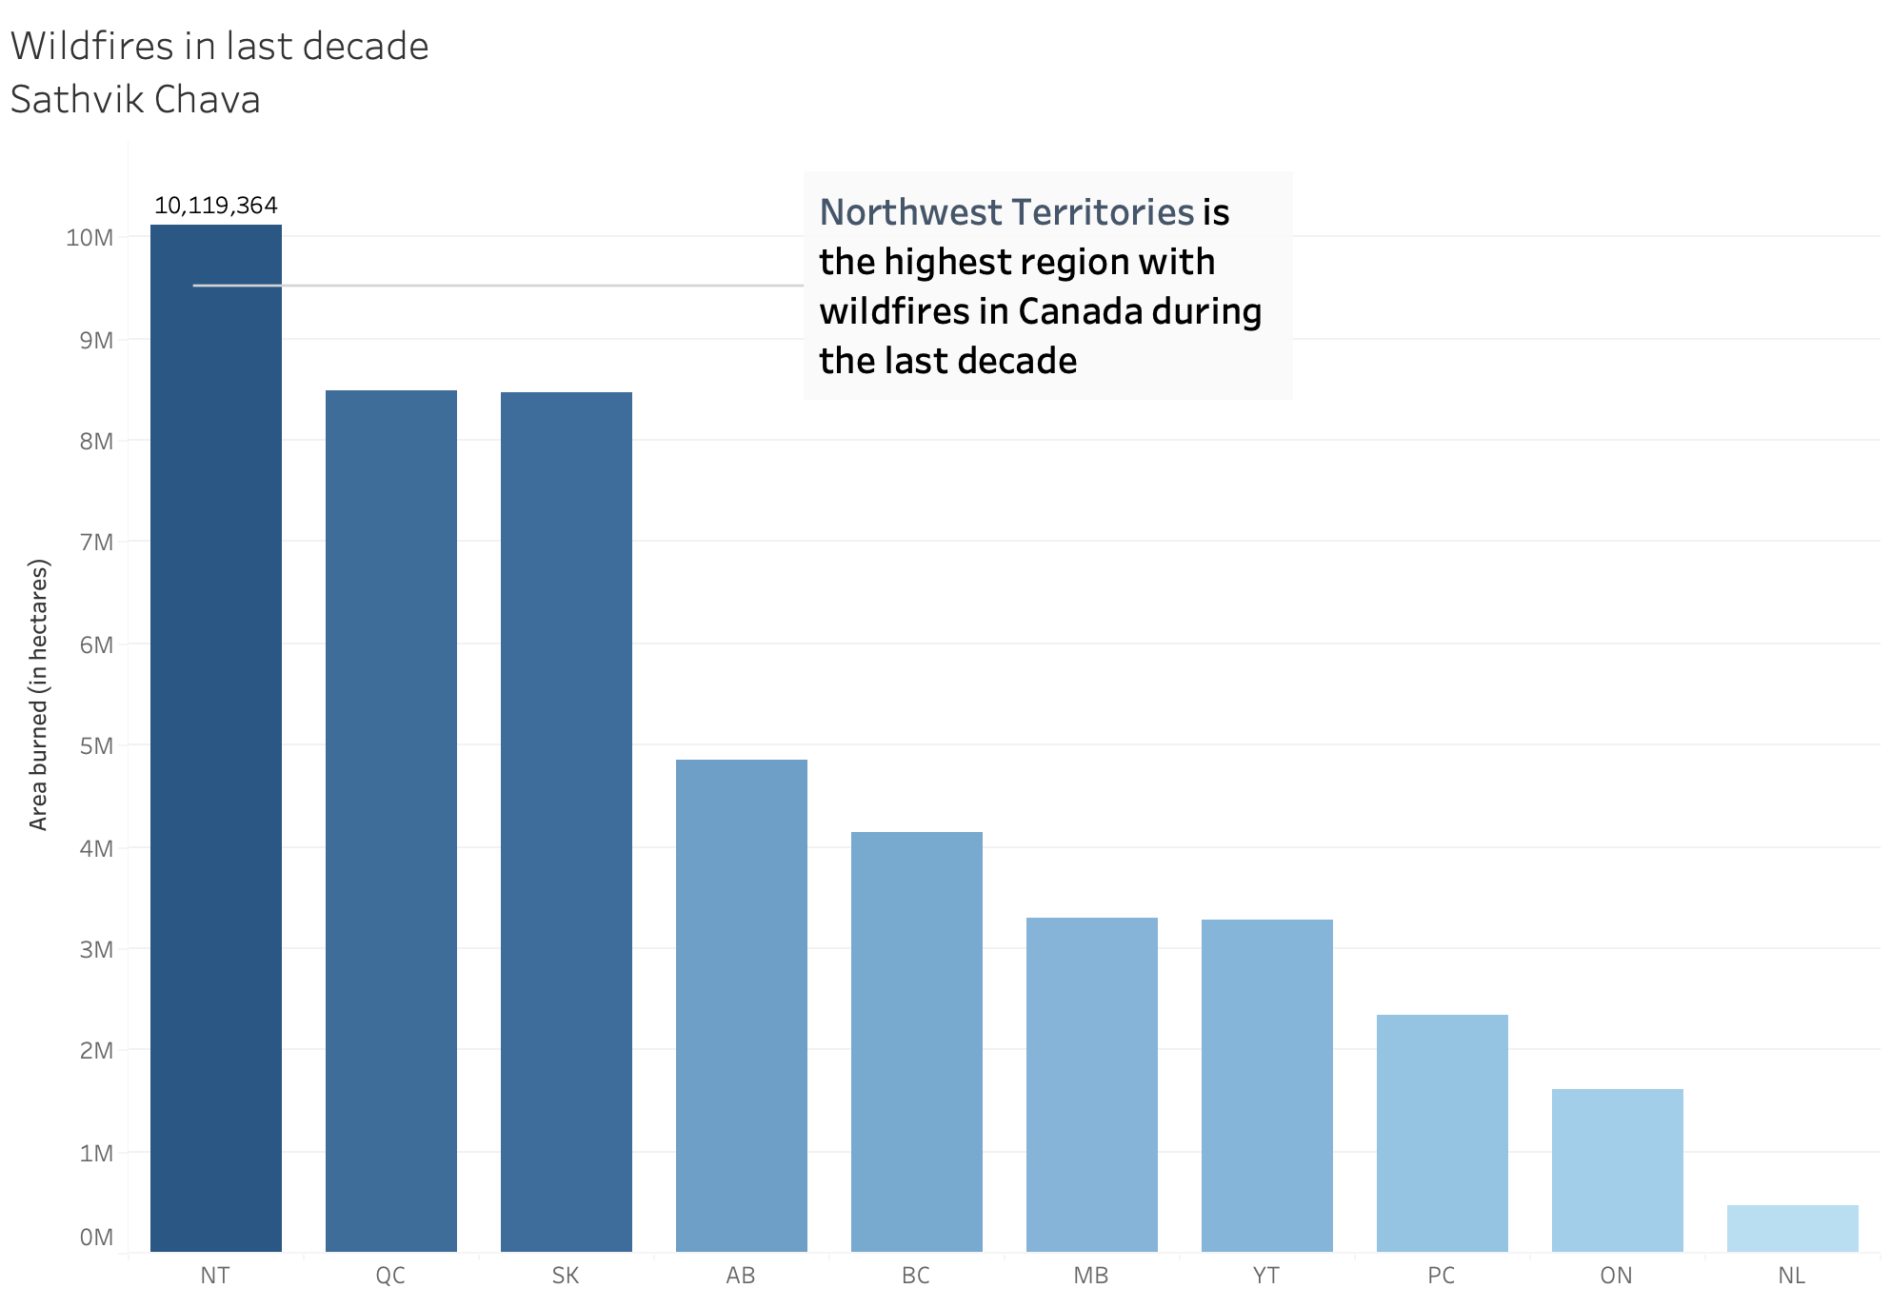
Northwest Territories leads in Area burned
NT is ahead of Quebec (QC) and Saskatchewan (SK)
NT is a critical focus area for wildfire prevention

Slide 4
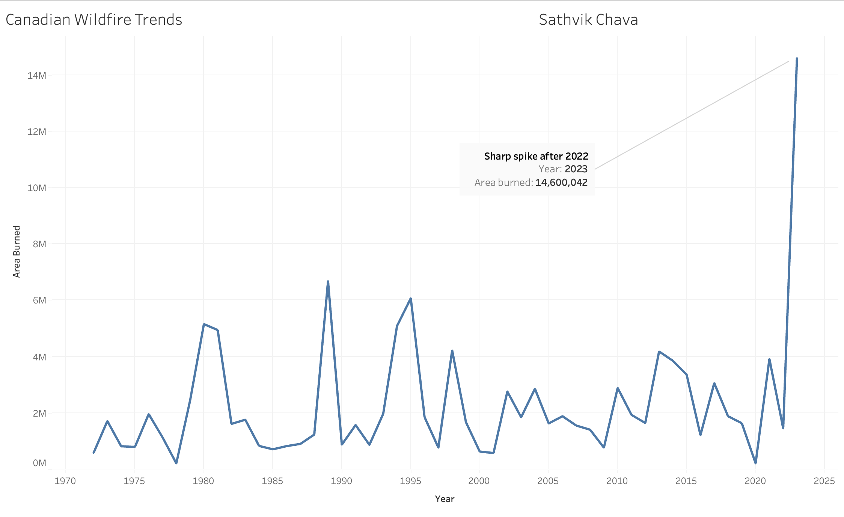
Wildfires at a Glance
The dramatic spike indicates the wildfire crisis in Canada.
There is threat to public safety.

Slide 5
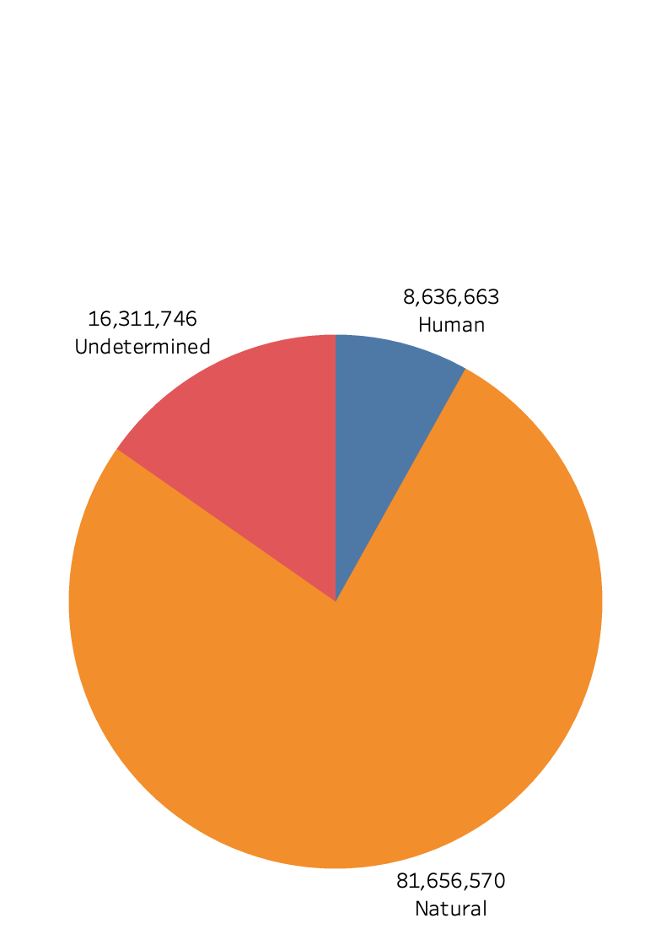
What Drives Wildfires?
Fire Cause Breakdown
Natural causes is leading contributor.
81.7 million hectares burned due to Natural causes.
16.3 million hectares remain undetermined, indicating need for investigating methods.

Slide 6
Prevention Strategies
Investment in Monitoring Wildfires and Predictive Technologies
Improving Firefighter Response
Public Awareness Campaigns
Improving Scientific Research

Slide 7
Act now, prevent bigger loss
Implement Smarter Prevention Strategies
Strengthen Firefighter skills
Relocate high-risk communities
If we don’t act, we risk: life, property and ecosystems.

Slide 8
Thank You

Slide 9
References
1. Image source: https://images.app.goo.gl/rbqEAxcwGeLUvPb7A
2. Singer-Vine, J. (2023, June 14). Data Is Plural — 2023.06.14 edition. https://www.data-is-plural.com/archive/2023-06-14-edition/

