Slide 1
Predicting Household Energy Consumption Using Time Series Forecasting
Team Name: Dynamic Neurons
Team Members:
Sathvik Chava | 11752889
Sumanjali Banjara | 11821870
David Adeyemi | 11828970
Andrew Gunason Paul | 11835138
ADTA 5560 Section 001 - Recurrent Neural Networks for Sequence Data

Slide 2
Business and Societal Relevance
Helps tackle rising energy bills
Grid demand-supply balance
Smart homes and IoT data opportunity

Slide 3
Objective
Predict appliance energy usage
Leverage past consumption and indoor/outdoor weather data
Evaluate deep learning models of this use case

Slide 4
Real Data From a Real Home
19735 records, 29 Variables
Collected every 10 mins, Over 4.5 months
Energy consumption of appliances and lights
Indoor weather data
Outdoor weather data

Slide 5
Stakeholder Benefits
Homeowners: cuts down bills, optimize usage
Utility Providers: Balance demand, reduce strain on grid
Sustainability Advisors : Lower Carbon footprint

Slide 6
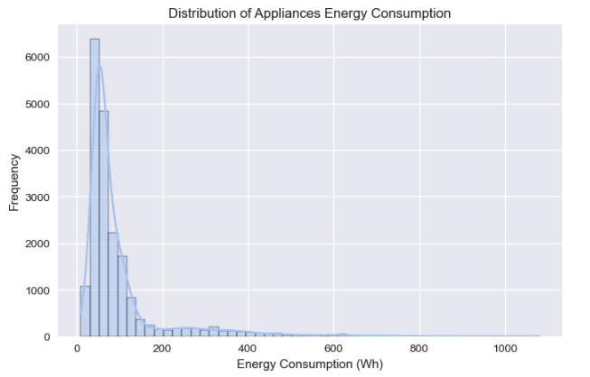
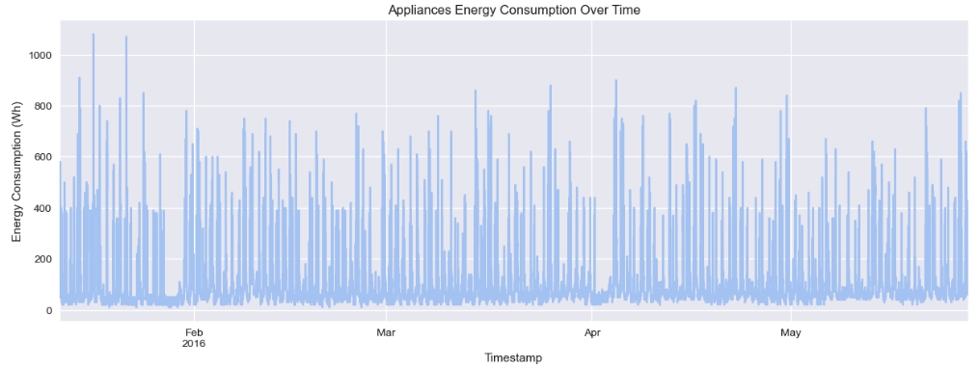
Understanding Energy Use Behavior
Daily, weekly cycles
Spikes during specific times

Slide 7
Modeling Strategy
Built 5 models and compared them
Simple Recurrent Neural Network
Bi-Recurrent Neural Network
Long-short Term Memory (LSTM)
Gated Recurrent Unit(GRU)
Encoder-Decoder

Slide 8
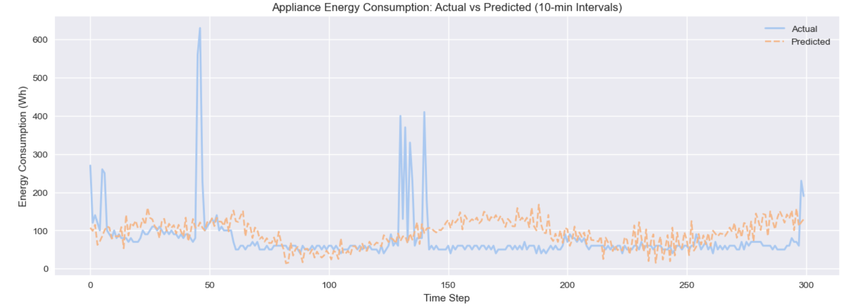
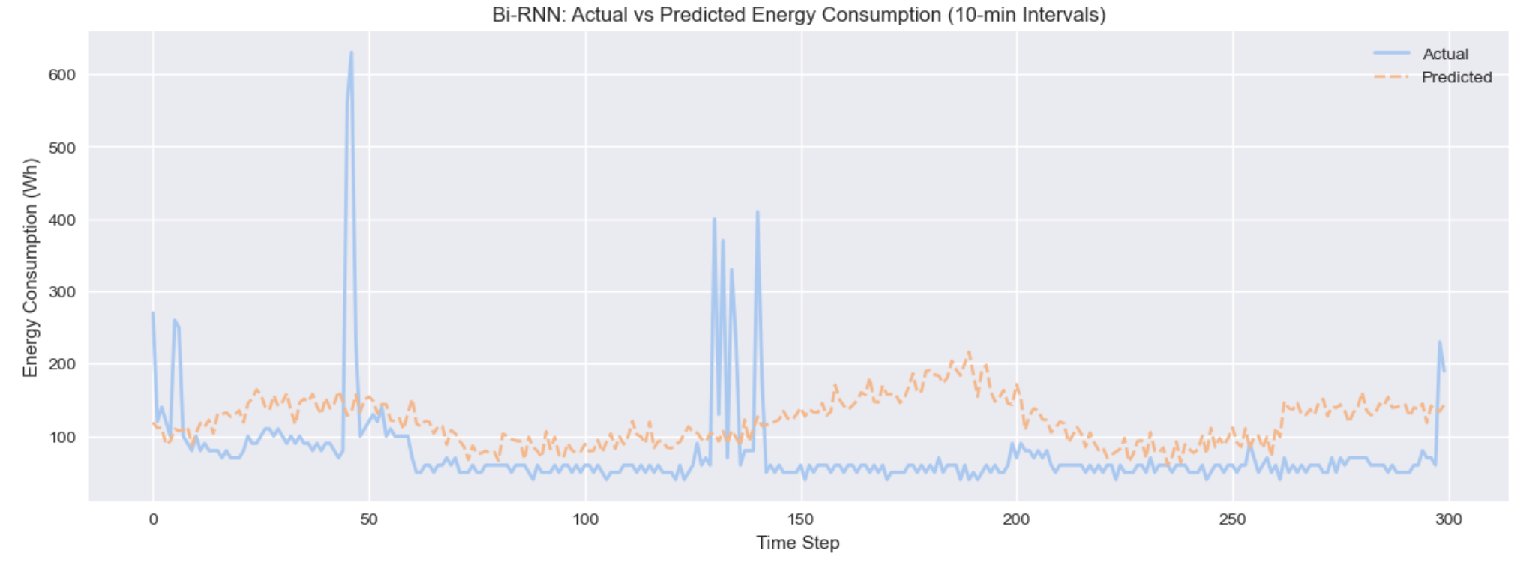
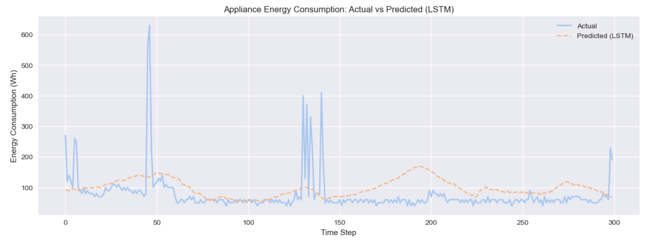
Model Performance
Simple RNN captures overall trend but underestimates spikes
Bi-RNN smooth prediction with moderate accuracy
LSTM follows general pattern, with a lag to spikes.

Slide 9
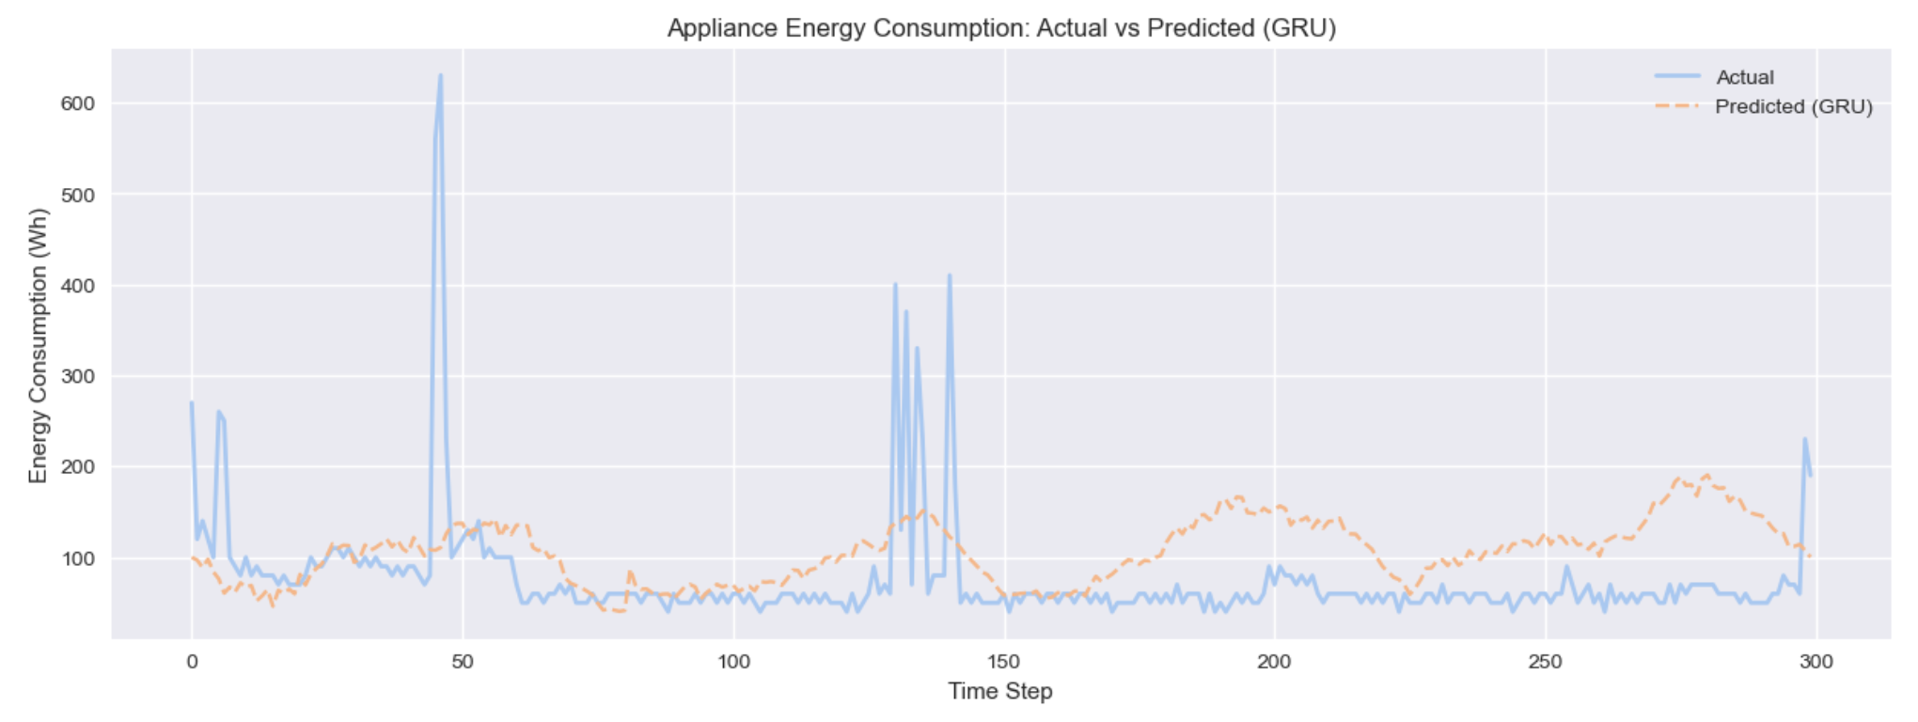
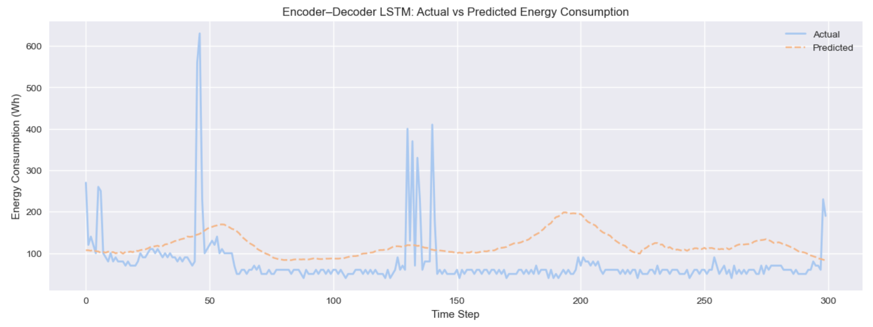
Model Performance
GRU has fewer fluctuations
Encoder-Decoder is best performer with low error rates

Slide 10
Model Comparison
The below results are an average MSE and MAE of 5 independent runs
Model | Average Test MSE | Average Test MAE
Simple RNN | 0.007563 | 0.04286
Bi-RNN | 0.007748 | 0.06103
LSTM | 0.007586 | 0.058501
GRU | 0.007902 | 0.06099
Encoder-Decoder | 0.007469 | 0.56027

Slide 11
Key Takeaways
Temporal features improves accuracy
RNNs can be employed in predicting energy usage
Encoder-Decoder is the best prediction model
Every model struggles with peaks

Slide 12
Recommendations
Adapt Encoder-decoder for energy prediction
Use prediction to optimize usage and balance demand
Use prediction to better plan the grid and supply

Slide 13
Limitations & Future Work
Only single house’s data
No human activity is captured
Adding more sensors, more houses will help to build better and accurate models

Slide 14
Thank You

