Slide 1


By
M Sahruday Reddy &
Sathvikesh Damala

Slide 2
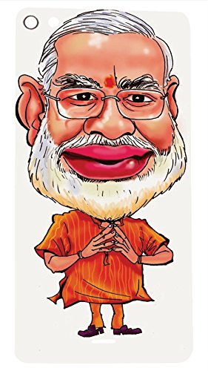

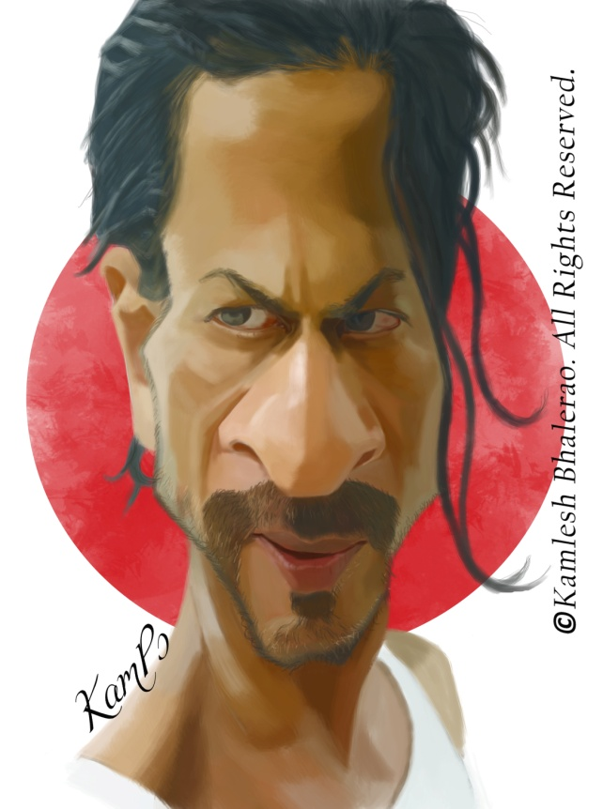

Slide 3

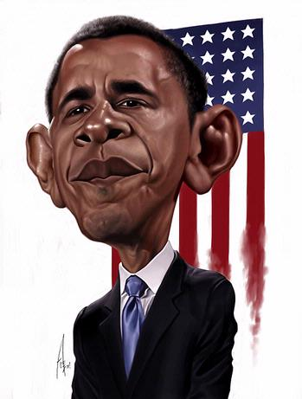
A caricature is a drawing or imitation of a particular person which exaggerates few striking characteristics of that person…..

Slide 4

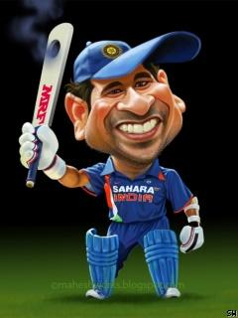
# takes the image of a person
# looks for striking characteristics
# gives a caricature
# fun for now
# helpful if modified later

Slide 5

# Can take just the input of characteristics
# Predict a persons face structure and other features
# If a person knows someone so perfectly, and hence can tell his characteristics, it would be very helpful.
# This will help in finding criminals…..
# Might look unprofessional, but caricature artists are paid a lot when they do these….!

Slide 6

# Image Warping
# Vision Cascade Object Detector which finds face features – The Viola-Jones Algorithm
# Image Transformations
# Bilateral Filtering
# Feature Points Detection and Matching

Slide 7

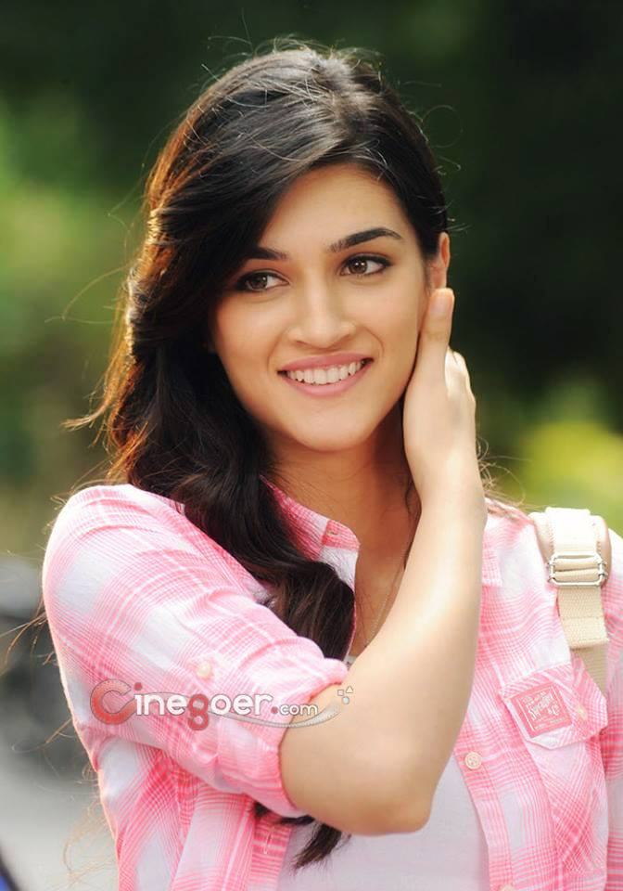
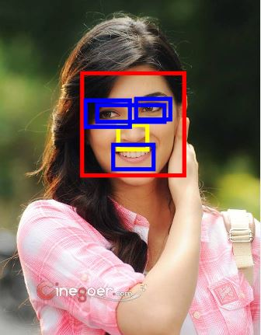
# Face Features Detection – Viola-Jones Algorithm
=====➔

Slide 8

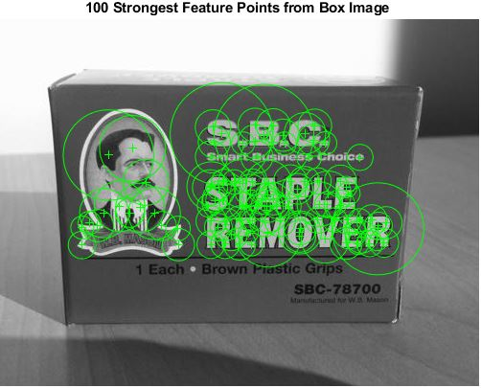
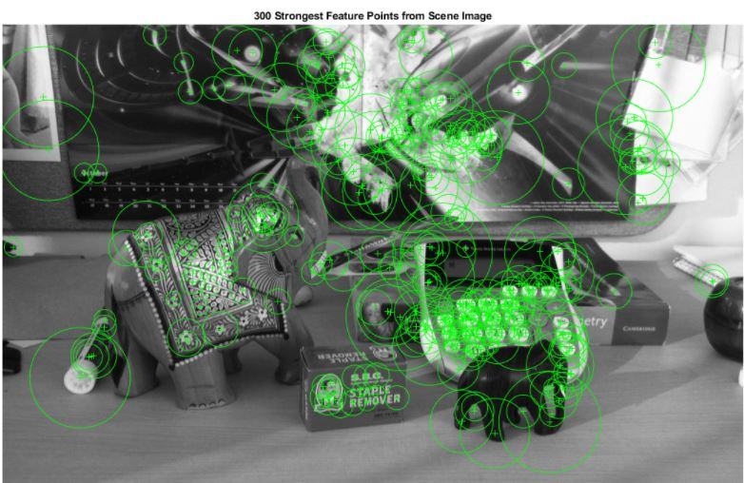

Slide 9
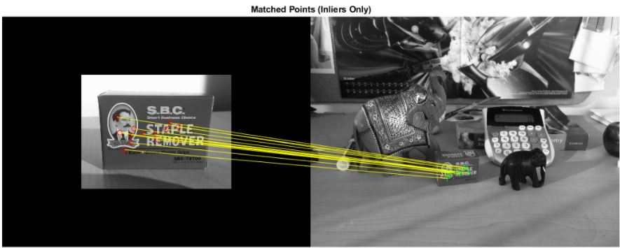

Slide 10

# The thought of spatial transformations
# 2-D spatial transformations tried and applied
# partial success as a perfect image was not obtained
# But a funny cartoonic type image was brought about

Slide 11



Slide 12
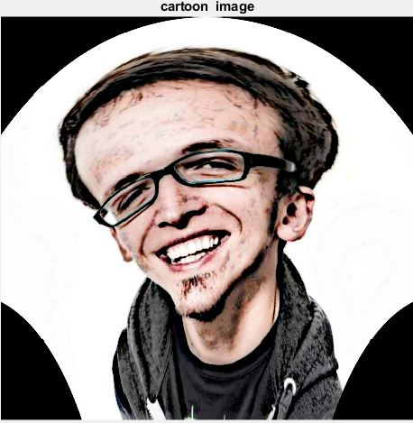

Slide 13

# The Fisher-Eye Effect
=> Effect is similar to what a fish’s eye view
=> The image is circular with details looking like plotted on the circumference
=> Basically a warp function approach

Slide 14
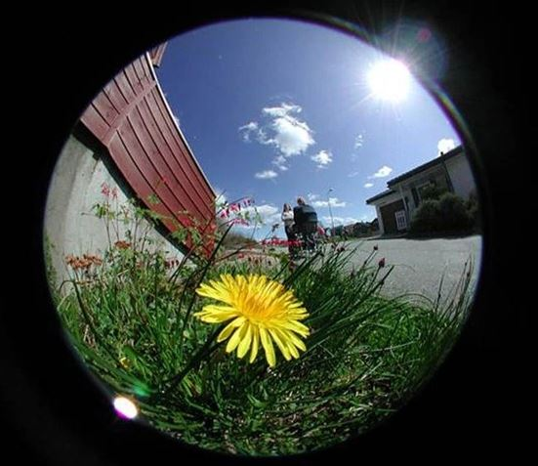

Slide 15

# The cartoonic effect
# a non-linear, edge preserving and noise reducing smoothing filter
# mainly focuses on range differences, colour intensities, depth etc.
# this preserves sharp edges
# it being a Gaussian filter, reduces noise
# gives a sketching or painting like effect

Slide 16
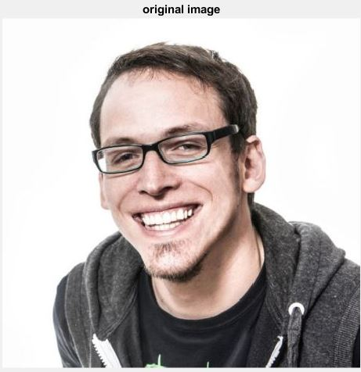
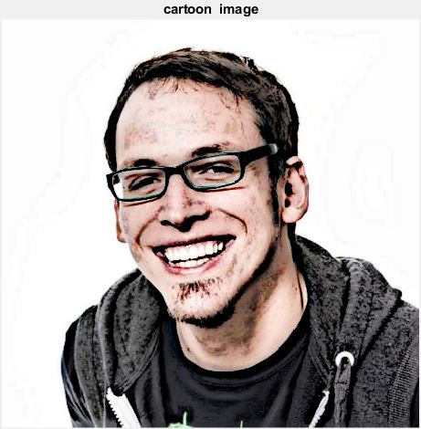

Slide 17

# The Fisher –Eye effect was combined with bilateral filtering
# Since features got adjusted, not an accurate but an approximate output was brought

Slide 18
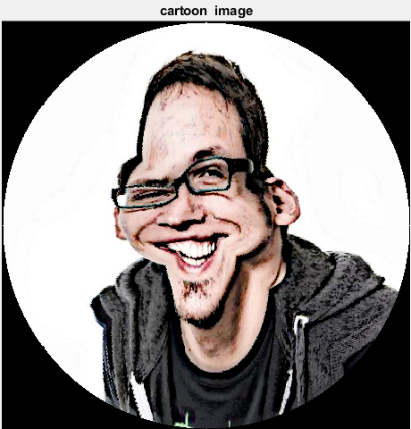

Slide 19

# Computer Vision & Image Processing
$$ MATLAB is being used
Computer Vision Course (Introduction to Computer Vision) on udacity.com
Functions, Algorithms, Computer Vision toolbox and Sample codes on in.mathworks.com and stack overflow. (source codes attached)
Digital Image Processing – 2nd Edition

Slide 20


