Slide 1
Soil Moisture,Temperature and Light Reading sensor Prototype
CS225/CS226 HARDWARE PROJECT
By Potnuru Veda Vikas (1601CS31)
Sathvikesh Damala (1601CS40)

Slide 2
INTRODUCTION:
This project is an application which gives out values like soil moisture,
humidity, temperature and light. This project is a combination of 4
different applications . The project can be utilized as to know when to water a plant and other information.

Slide 3
IDEA:
The basic idea initially was only about soil
moisture. But later it was thought to work over few other aspects of it
too. Knowing these characteristics of soil helps us in maintaining the
health of the plants.
Basic range requirements were put as thresholds

Slide 4
HARDWARE COMPONENTS USED:
ARDUINO UNO
Soil Moisture Sensor(FC-28)
Temperature Sensor(DHT11)
LDR Sensor
Jumper wires
LCD Display
LEDs

Slide 5
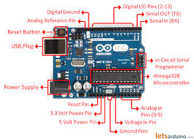
1)Arduino UNO : It is a microcontroller board based on the
ATmega328P. It has 14 digital input/output pins (of which 6 can be used
as PWM outputs), 6 analog inputs, a 16 MHz quartz crystal, a USB
connection, a power jack, an ICSP header and a reset button. It contains
everything needed to support the microcontroller; simply connect it to a
computer with a USB cable or power it with an AC-to-DC adapter or
battery to get started.

Slide 6
2)soil moisture sensor(FC-28)
The soil moisture sensor consists of two probes that are used to measure the volumetric content of water. The two probes allow the current to pass through the soil, which gives the resistance value to measure the moisture value
Working Principle :
When there is water, the soil will conduct more
electricity, which means that there will be less resistance. Dry soil
conducts electricity poorly, so when there is less water, then the soil will
conduct less electricity, which means that there will be more resistance.
This sensor can be connected in analog and digital modes

Slide 7
3)Temperature and Humidity Sensor(Dht11):
The DHT11 is a basic, ultra low-cost digital temperature and humidity sensor. It uses a capacitive humidity sensor and a thermistor to measure the surrounding air, and spits out a digital signal on the data pin (no analog input pins needed). It’s fairly simple to use, but requires careful timing to grab data. The only real downside of this sensor is you can only get new data from it once every 2 seconds, so when using our library, sensor readings can be up to 2 seconds old.

Slide 8
4)LDR Sensor:
An LDR is a component that has a (variable) resistance that changes with the light intensity that falls upon it. This allows them to be used in light sensing circuits. When the light level decreases, the resistance of the LDR increases. As this resistance increases in relation to the other Resistor, which has a fixed resistance, it causes the voltage dropped across the LDR to also increase. When this voltage is large enough (0.7V for a typical NPN Transistor), it will cause the Transistor to turn on. The value of the fixed resistor will depend on the LDR used, the transistor used and the supply voltage.

Slide 9
Pictographic Diagram:

Slide 10
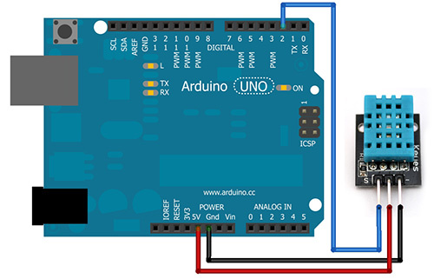
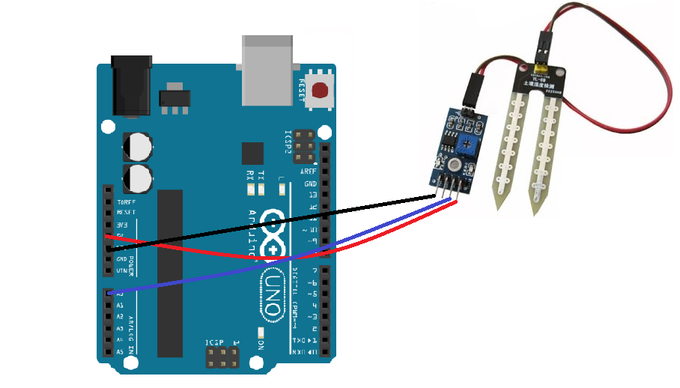
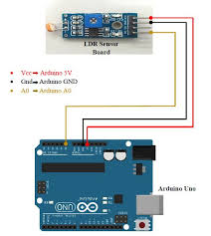

Slide 11
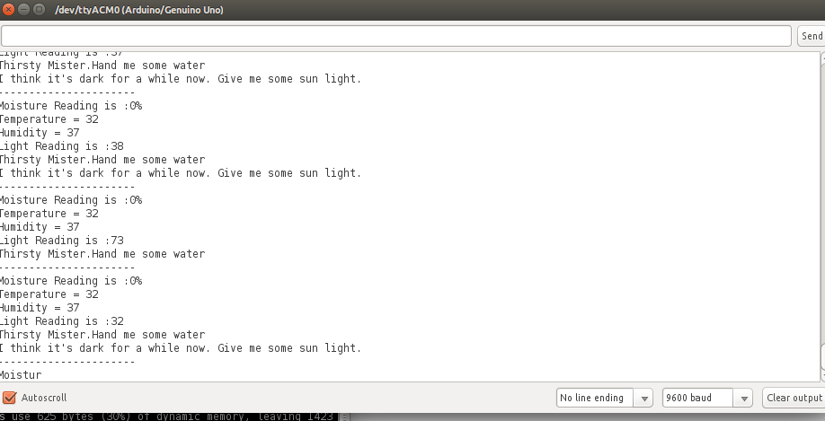
The basic output

Slide 12
Output:
1. Temperature < 19 => It’s really cold here. Can you turn the heater
on?
2. Temperature > 35 => It’s warm over here. Gimme some AC.
3. Moisture > 70 => Flooding over here. Water Out?
4. Moisture < 20 => Thirsty Mister. Hand me some water.
5. Light < 40 => I think it’s dark for a while now. Give me some
sunshine.
6. Otherwise => I’m happy right now. All cool.

Slide 13
CODE:
void interpretSituation(){
boolean tempWasGood = true;
boolean moistWasGood = true;
boolean lightWasGood = true;
// Check temperature
if (temp < 19) {
lcd.print(coolState);
Serial.println(coolState);
tempWasGood = false;
} else if (temp > 35) {
lcd.print(hotState);
Serial.println(hotState);
tempWasGood = false;
}
// Check moisture
if (moisture > 70) {
lcd.print(moistState);
Serial.println(moistState);
moistWasGood = false;
} else if (moisture < 30) {
lcd.print(dryState);
Serial.println(dryState);
moistWasGood = false; }

Slide 14
// Check light
if (light < 50) {
lcd.print(darkState);
Serial.println(darkState);
lightWasGood = false;
}
// If everything was good
if (tempWasGood && moistWasGood && lightWasGood) {
lcd.print(okState);
Serial.println(okState);
}
}
void setup() {
// put your setup code here, to run once:
Serial.begin(9600);
analogWrite(6,30);
lcd.begin(16, 2);
lcd.setCursor(0, 0);
lcd.print("hello, world!");
Serial.println("Reading From the Sensors ...");
//delay(2000); }

Slide 15
void loop() {
// put your main code here, to run repeatedly:
moisture = analogRead(A0);
moisture = map(moisture,1023,0,0,100);
// int sensorValueTemp = analogRead(A2);
Serial.print("Moisture Reading is :");
Serial.print(moisture);
Serial.println("%");
// Serial.println("Temperature Reading is :");
// Serial.println(sensorValueTemp);
int chk = DHT.read11(DHT11_PIN);
temp = DHT.temperature;
humid = DHT.humidity;
Serial.print("Temperature = ");
Serial.println(temp);
Serial.print("Humidity = ");
Serial.println(humid);
light = analogRead(A1);
light = map(light,1023,0,0,100);
Serial.print("Light Reading is :");
Serial.println(light);
lcd.autoscroll();
interpretSituation();
delay(2000);
}

Slide 16
CONCLUSION:
Based on the results this design tool based on soil moisture,temperature and light has been operating quite good to describe the exact situation of the plant
Such as dry,humid,dark,cool,hot and ok condition of
the plant on the basis on the values through the
sensors.

Slide 17
THANK YOU

