Slide 1


Member and contributions
SATHVIK GAJULA
Contributions:
Focused on implementing the baseline approach from the paper "EEG-Based Alzheimer's Disease Recognition Using Robust-PCA and LSTM Recurrent Neural Network"
Developed a clean, modular and fully working version of the Baseline model (RNN with LSTM) for Alzheimer's disease detection from EEG signals.
Improved original code structure:
  Organized code to allow flexible denoising options and PCA projection.
  Made experimental settings (window size, overlap percentage, PCA usage) easily configurable.
Identified and fixed inconsistencies between training and testing found in the authors' initial GitHub code.
Generated training logs and saved best models for better reproducibility
Z23734253
sgajula2023@fau.edu
PhD in Computer Science

Slide 2
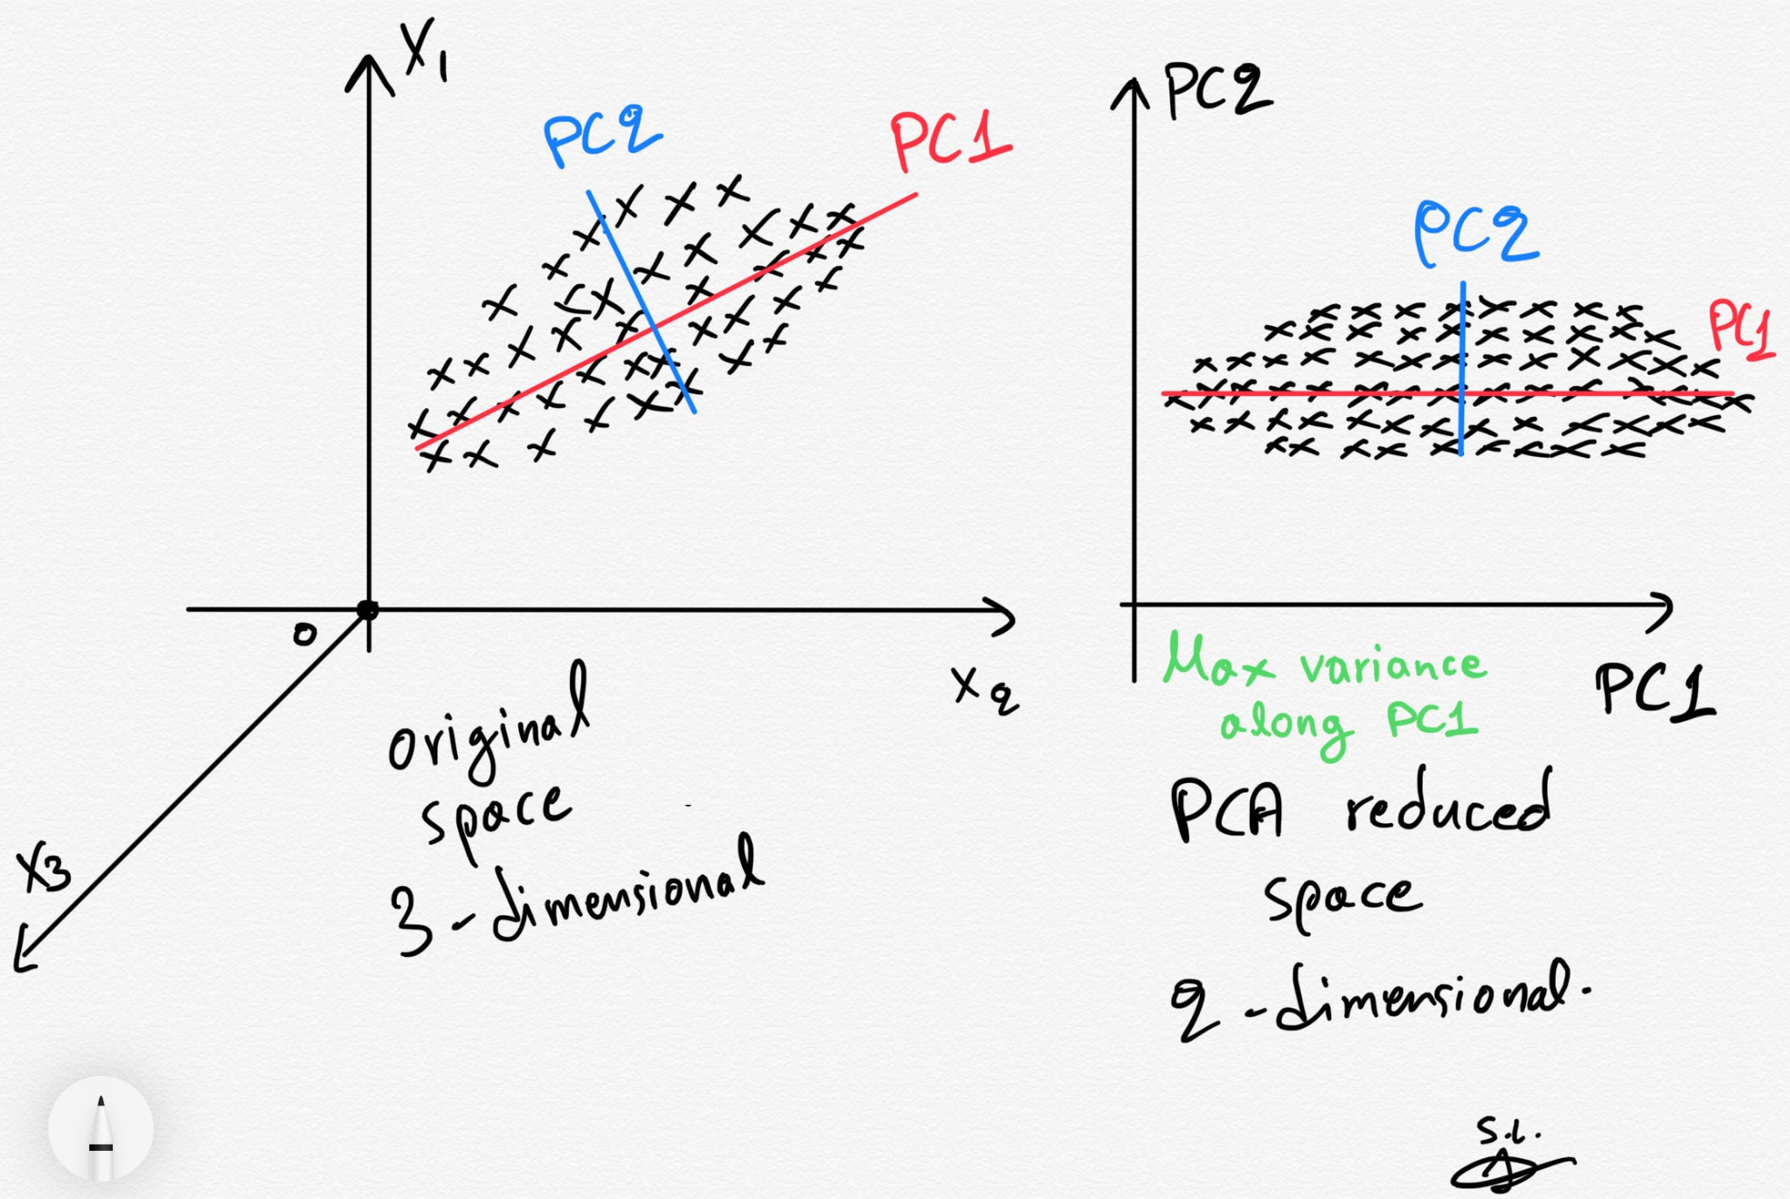
Experiment - Baseline
What did the authors use?
Dataset: EEG recordings from 15 normal (N) and 20 Alzheimer's Disease (AD) subjects .
Preprocessing:
Removal of artificial square waves (pre-start signals).
Statistical standardization (zero mean, unit variance) on each EEG channel.
Model architecture (Baseline Model):
Two LSTM layers stacked sequentially.
Dropout applied between layers to prevent overfitting.
Final dense layer (2 neurons) for binary classification (Normal vs. AD).
How did the authors design the experiment?
Input EEG signals were segmented into windows of 128, 256, 384, 512, and 640 samples.
Three overlap settings tested: 0%, 25%, and 50% overlap between consecutive windows.
Both raw EEG signals and PCA-reduced signals were used for training and testing.
10-fold cross-validation across subjects.
Denoising techniques:
None (raw EEG)
RPCA (Robust Principal Component Analysis)
MSPCA (Multi-Scale PCA)

Slide 3
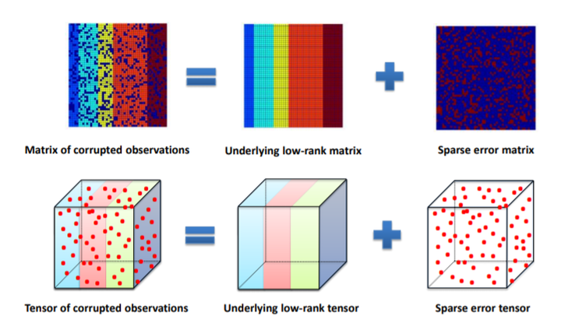
Baseline - Model implementation
RPCA
How the code from GitHub was implemented:
We started by re-implementing the baseline LSTM model described in the paper.
Python 3 and TensorFlow 2.18.0 were used for building and training the models.
Supporting libraries included NumPy, Scikit-learn, Matplotlib.
The original paper’s procedure was manually replicated from scratch.
Modifications were made to run successfully:
Preprocessing and Denoising:
Developed custom module for Robust PCA (r_pca.py)
Standardization:
Applied per-channel standardization (mean = 0, std = 1) to match the experimental setup described by the authors.
Window Overlap and Sizes:
Implemented fixed window sizes and overlaps exactly as in the paper.
Logging Improvements:
Configured training logs and evaluation results to be saved in separate files for each scenario.
Error Handling and Code Corrections:
Fixed missing argument issues (model_type, denoise_method, overlap_pct) and ensured correct logging without overwriting.

Slide 4
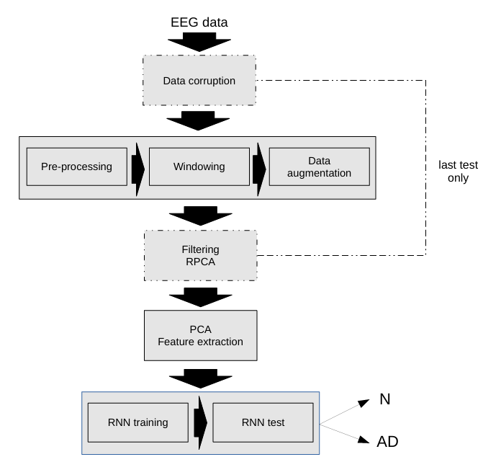
Experimental Setup & Evaluation Metrics
Experimental Setup:
Window size fixed at 256 samples and 50% overlap, based on the original paper’s best results (97.9% accuracy).
Two preprocessing settings:
  Raw EEG signals
  EEG signals denoised with RPCA.
Dimensionality reduction:
  With PCA (50 components)
  Without PCA (direct signals).
Training Configuration:
Optimizer: Adam (learning rate = 0.001)
Batch size: 32, Epochs: 20
Dropout: 0.2 (Approach 1), 0.5 (Approach 2)
Loss function: Categorical cross-entropy
Early stopping based on validation accuracy.
Evaluation Metrics:
Model performance was primarily assessed using classification accuracy, which measures the percentage of correctly classified EEG windows. Additionally, confusion matrices were generated to visualize the distribution of predictions between the Healthy and Alzheimer’s classes, providing deeper insight into model behavior.

Slide 5
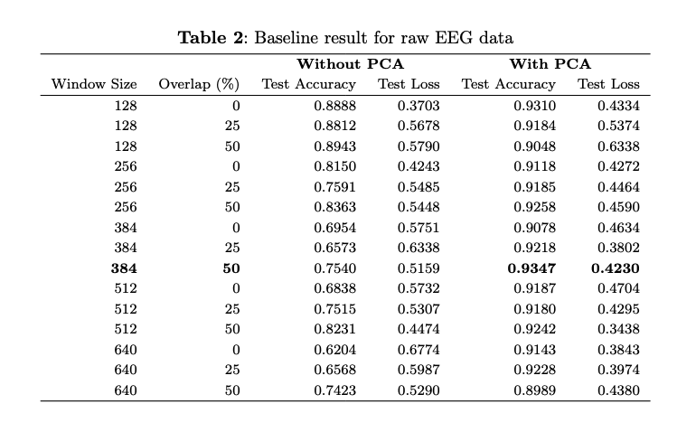
Results - Baseline
Comparison with Paper Results:
Original Study (Paper):
  Best Test Accuracy (without PCA): 79.3% (Window=128, Overlap=50%)
  Best Test Accuracy (with PCA): 97.9% (Window=256, Overlap=50%)
Our Reimplementation:
  Best Test Accuracy (without PCA): 89.4% (Window=128, Overlap=50%)
  Best Test Accuracy (with PCA): 93.5% (Window=384, Overlap=50%)
Observations:
Higher accuracy in the no-PCA setting compared to the paper.
Slightly lower accuracy in the PCA setting compared to the paper.
Best window size shifted from 256 (paper) to 384 (our result) for PCA..
Possible Reasons for Differences:
The original paper did not specify exactly which 5 subjects were used for training/testing splits.
Random weight initialization, random data shuffling and random behaviors during training can lead to variations even when using the same model structure.
Minor differences in PCA denoising, standardization or training setup could have influenced the results.
Conclusion:
Baseline implementation was successful.
Minor variations in PCA results, but overall strong and consistent model behavior.
Even though the best window size shifted to 384, we continued using 256 samples window size in other approaches to align with the original paper's settings for fair comparison

