Slide 1

Project Title - Seasonal_Agriculture_Performance
Student Name: Sathvik Reddy Koduru
College Name- East Point College of Engineering and Technology
AICTE STU ID : STU65b8f5a6d169a1706620326

Slide 2

PROBLEM STATEMENT
Agricultural activities are influenced by seasonal variations in environmental conditions, farming practices, resource availability and market conditions. As a result, agricultural performance may differ from one season to another. However, raw agricultural data does not clearly explain how agricultural performance changes across seasons or what patterns can be observed in different seasonal conditions. The problem is to analyze the given agricultural dataset and investigate seasonal differences in agricultural performance by identifying meaningful patterns, trends, relationships and variations within the available data.

Slide 3
Project Description
Seasonal Agriculture Performance Analysis is a data analytics project that analyzes agricultural activities and performance across different seasons, geographical regions, crops, farming practices, environmental conditions, resource usage, and economic factors. The project uses an agricultural dataset containing information such as rainfall, temperature, humidity, soil conditions, irrigation methods, fertilizer and pesticide usage, crop yield, production, market prices, costs, revenue, profit, water consumption, and disease/pest risk.
The project focuses on identifying how agricultural performance varies across Kharif, Rabi, and Zaid seasons and understanding the factors associated with differences in crop yield, profitability, water efficiency, and disease/pest risk. The data is first explored, cleaned, and validated to ensure reliable analysis. Exploratory data analysis and visualizations are then used to compare seasonal, crop-wise, state-wise, district-wise, and irrigation-wise performance.
Statistical techniques such as correlation analysis, ANOVA, and Chi-square testing are used to identify significant relationships and differences within the dataset. The project also investigates unusual patterns, such as farms with high yields but low profits or high water usage with low water efficiency.
The final analysis provides evidence-based insights and recommendations for seasonal planning, including crop selection, irrigation and water management, resource utilization, disease and pest management, and cost optimization. The project is implemented using Python, Pandas, NumPy, Matplotlib, Seaborn, SciPy, and Jupyter Notebook.

Slide 4

WHO ARE THE END USERS?
The primary end users of this project are farmers, agricultural planners, agricultural researchers, agronomists, and policymakers. Farmers can use the insights to support seasonal crop selection, irrigation and resource management, and improve productivity and profitability. Agricultural planners and policymakers can use the analysis to understand regional and seasonal agricultural patterns and support data-driven planning and resource allocation. Researchers and agronomists can use the findings to study relationships between environmental conditions, farming practices, crop performance, and economic outcomes.

Slide 5

Technology Used
Programming Language: Python
Libraries & Tools: Pandas, NumPy, Matplotlib, Seaborn, SciPy
Development Environment: Jupyter Notebook
Techniques: Data Cleaning, Exploratory Data Analysis (EDA), Data Visualization, Correlation Analysis, ANOVA, Chi-Square Testing, Statistical Analysis, and Data Interpretation

Slide 6
RESULTS
The analysis identified clear variations in agricultural performance across Kharif, Rabi, and Zaid seasons, as well as across different crops, states, districts, and irrigation methods. Seasonal comparisons revealed differences in crop yield, profitability, water efficiency, resource consumption, and disease/pest risk. Statistical analysis using correlation analysis, ANOVA, and Chi-square testing helped identify important relationships and differences within the dataset.
The project also identified high-performing crop-season combinations, differences in irrigation efficiency, resource-intensive farming patterns, and unusual cases such as high-yield but low-profit farms and high water usage with low water efficiency. These findings provide evidence-based insights that can support better crop selection, seasonal planning, irrigation and water management, resource utilization, disease-risk management, and cost optimization.

Slide 7
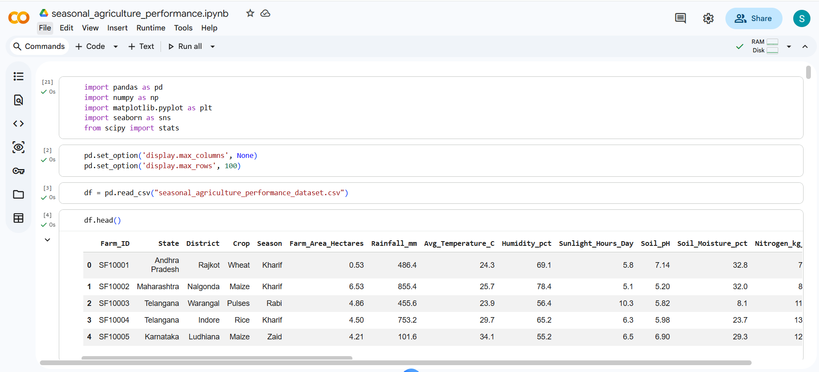
RESULTS

Slide 8
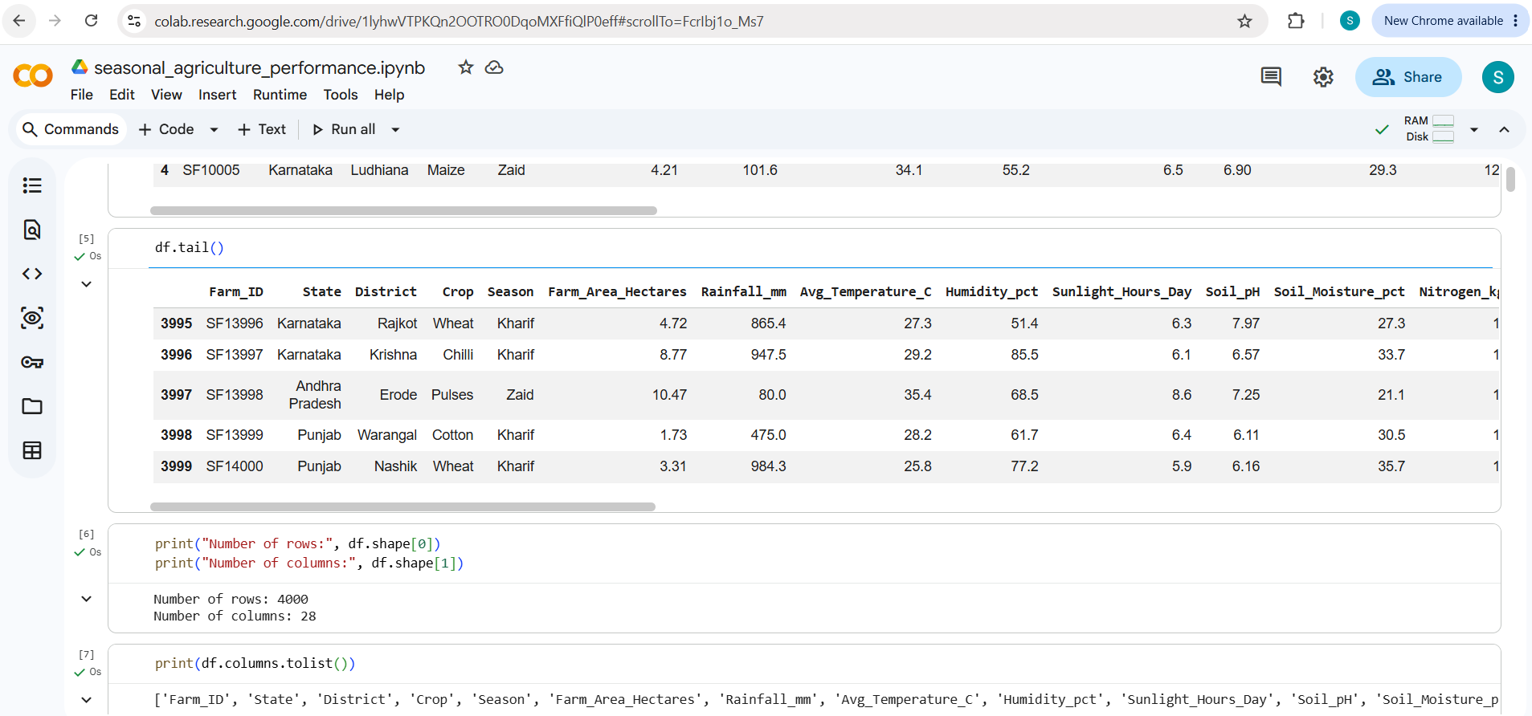
RESULTS

Slide 9
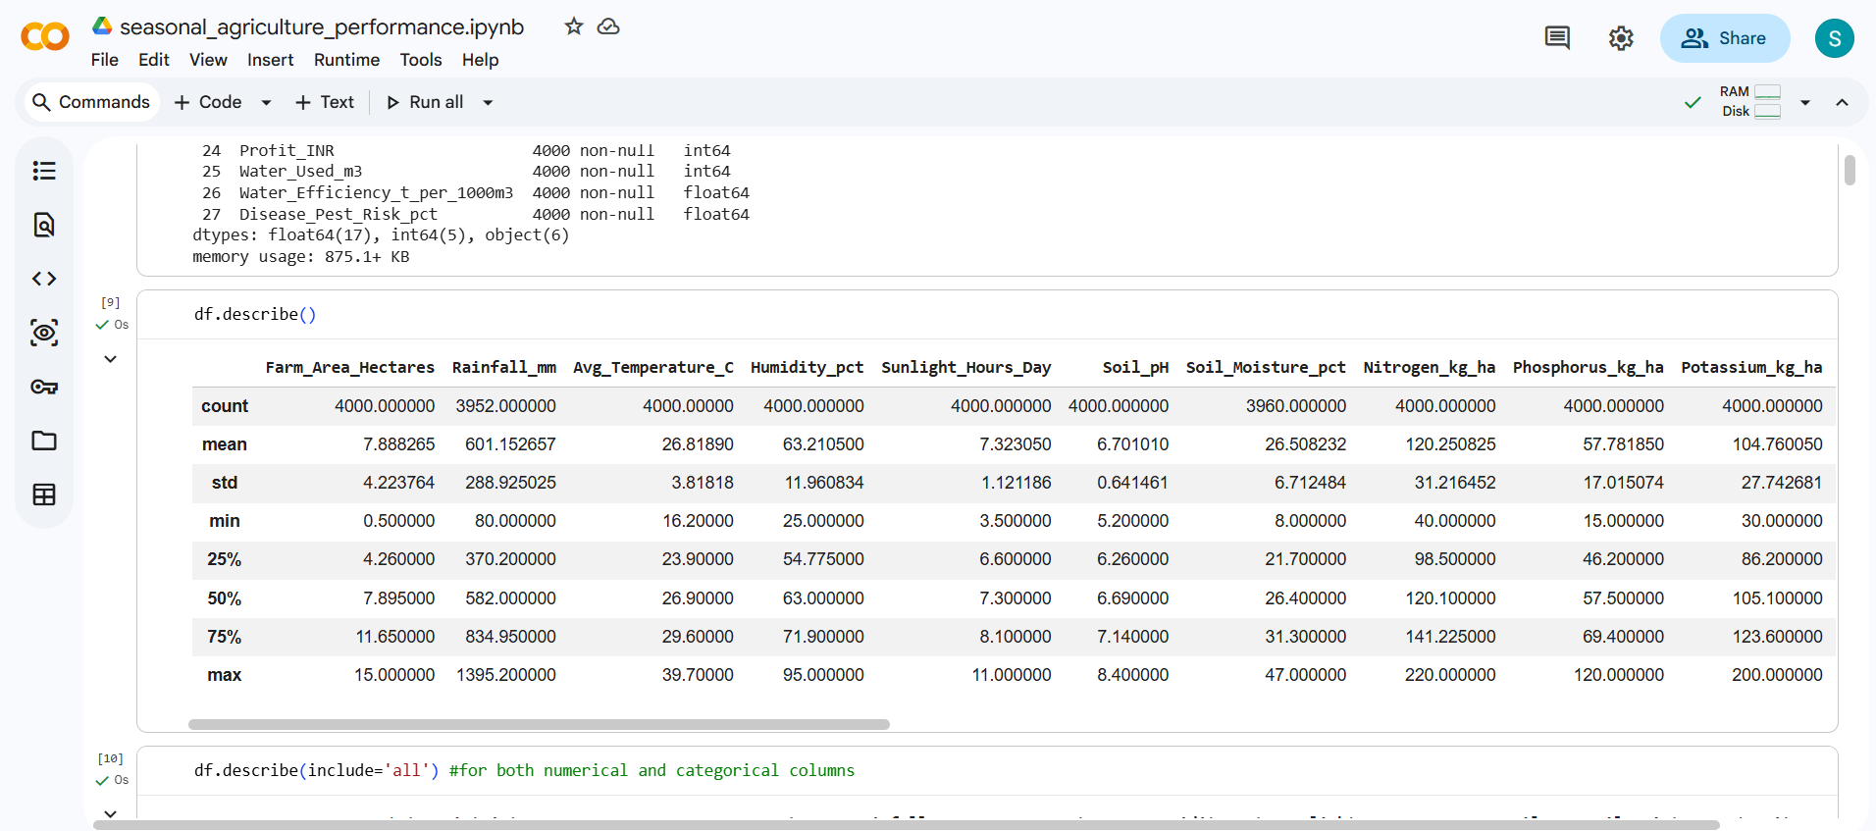
RESULTS

Slide 10
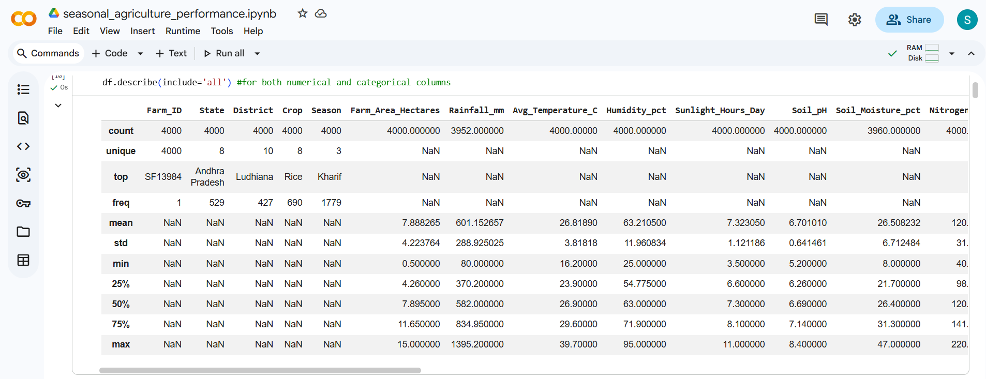
RESULTS

Slide 11
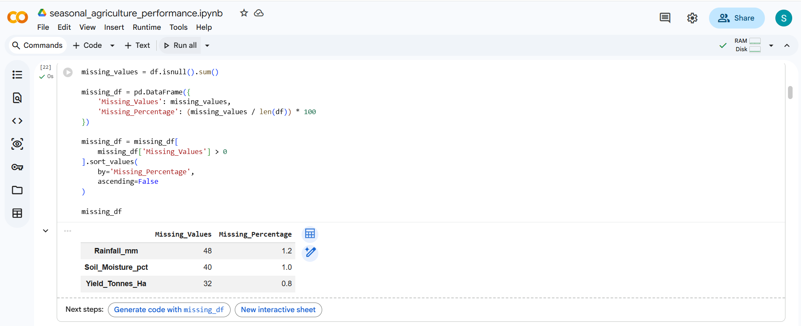
RESULTS

Slide 12
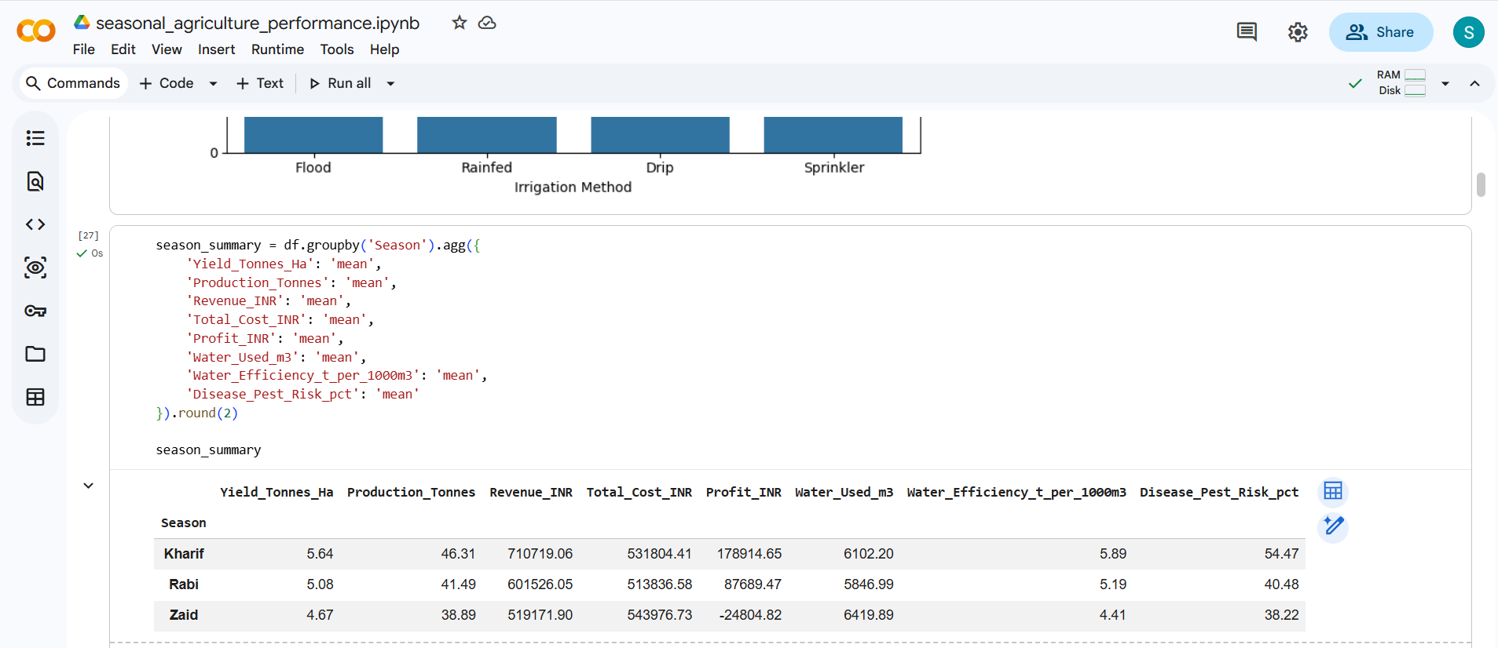
RESULTS

Slide 13
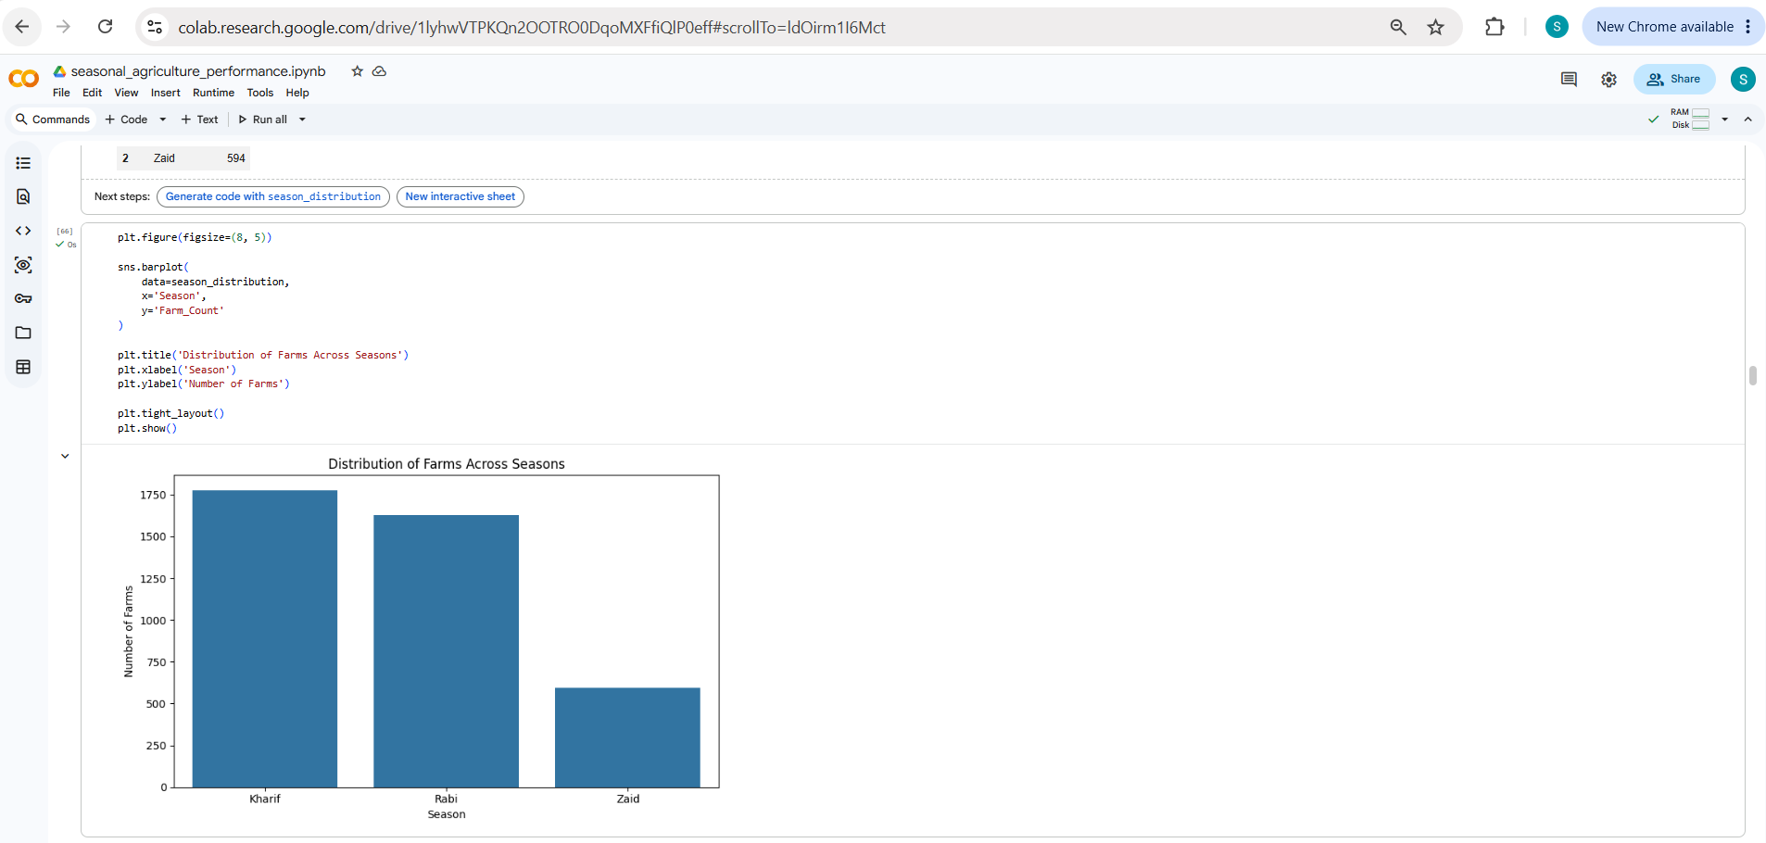
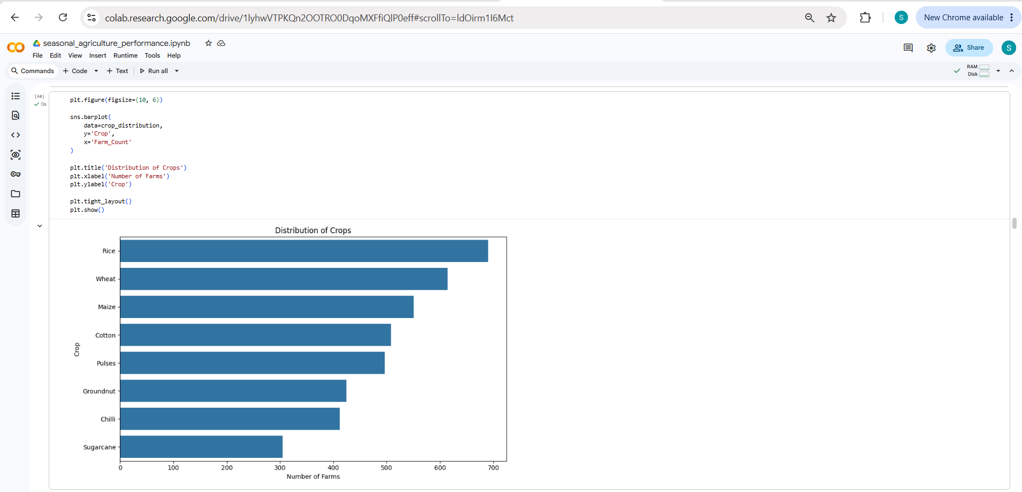
RESULTS

Slide 14
Future scope
The project can be further enhanced by developing an interactive agricultural decision-support system that provides real-time insights and recommendations to farmers and agricultural planners. Future improvements could include integrating real-time weather and rainfall data, soil and satellite data, market prices, and crop-specific information to improve the accuracy of seasonal predictions. Machine learning models could also be developed to predict crop yield, profitability, disease/pest risk, and water requirements for different crops and seasons. The system could eventually be converted into a web or mobile application with personalized recommendations based on a farm's location, crop, soil conditions, and available resources.

Slide 15
GitHub Link
https://github.com/sathvikk0124/Seasonal-Agriculture-Performance-Analysis

Slide 16

VOIS Course completion certificate -
Course name- Data Visualization

Slide 17
Thank you
.
.

