Slide 1

RISC-V Custom Instruction Multiply-Accumulate Hardware
CVR COLLEGE OF ENGINEERING
Work done by
P. Sathvik Kumar(23B81A04A3)
Under the supervision of
Dr. Siliveri Swetha
Senior Assistant Professor, ECE
CVR College of Engineering

Slide 2
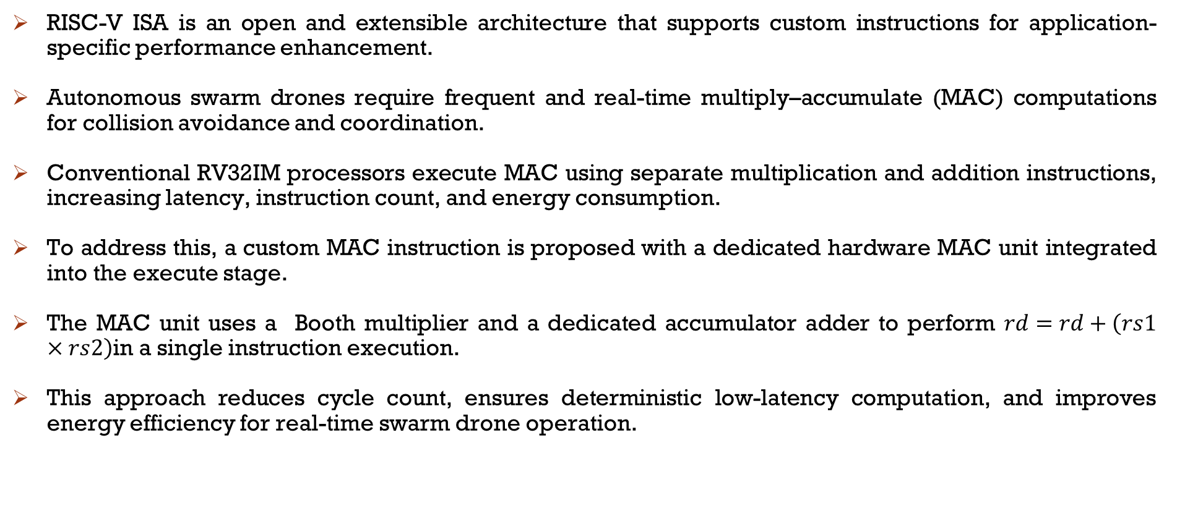
Introduction
RISC-V ISA is an open and extensible architecture that supports custom instructions for application-specific performance enhancement.
Autonomous swarm drones require frequent and real-time multiply–accumulate (MAC) computations for collision avoidance and coordination.
Conventional RV32IM processors execute MAC using separate multiplication and addition instructions, increasing latency, instruction count, and energy consumption.
To address this, a custom MAC instruction is proposed with a dedicated hardware MAC unit integrated into the execute stage.
The MAC unit uses a Booth multiplier and a dedicated accumulator adder to perform $rd=rd+\left(rs1×rs2\right)$in a single instruction execution.
This approach reduces cycle count, ensures deterministic low-latency computation, and improves energy efficiency for real-time swarm drone operation.

Slide 3
Objectives
Design and implement a 16×16-bit MAC Unit using a Radix-4 Modified Booth Multiplier and Accumulate Adder in the Execution stage for single-cycle multiply-accumulate operation.
Extend the RV32IM instruction set with a custom R-type MAC instruction using RISC-V custom-0 opcode space without breaking backward ISA compatibility.
Integrate the MAC unit into a complete 5-stage pipelined RV32IM processor (IF → ID → EX → MEM → WB) alongside the standard ALU and M-extension Multiplier/Divider Unit.
Implement pipeline hazard handling using a Hazard Detection Unit for load-use stalls and a Forwarding Unit to resolve data hazards including MAC accumulator forwarding.
Validate the complete RTL design in Verilog HDL through simulation covering MAC instruction, forwarding chains, branch resolution, and load/store operations.

Slide 4
Hardware Components Required
An FPGA (Field-Programmable Gate Array) Kit is a hardware development board used to design, prototype, and test digital circuits and embedded systems. These kits allow users to program the FPGA chip to implement custom logic circuits, processors, and embedded applications.
Power supply: Provides Power to the FPGA board

Slide 5
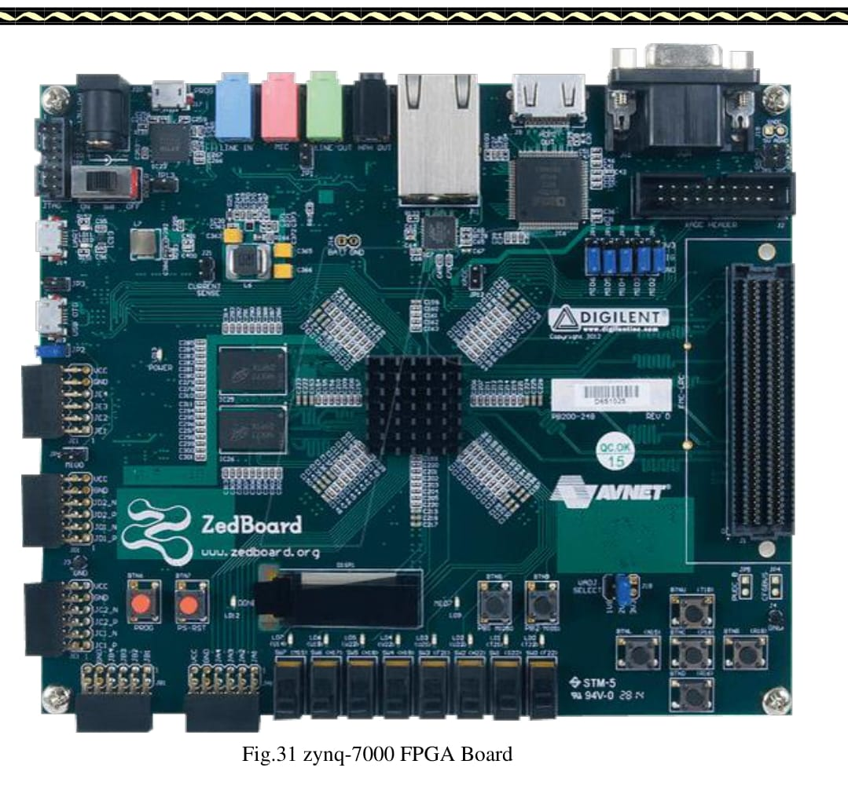
FPGA BOARD

Slide 6
Software Requirement
Xilinx Vivado is a software tool used to design digital circuits, especially for FPGA (Field-Programmable Gate Array) and SoC (System on Chip) development
Verilog HDL is used to design the RISC-V core, custom MAC unit, and modified execution datapath.
Simulate the Design : Test your Verilog code to see if the logic works correctly before implementing it on hardware.
Synthesize the Code: Convert Verilog into a form that an FPGA can understand.
Implement & Generate Bitstream : This final step prepares the design for loading onto an FPGA chip.
Debug & Analyze: Vivado has tools like waveform viewers to help you check and fix errors in your design.
Then we use the Cadence Tool for Synthesis the design code with 90nm Technology to get to know the Area , Power and Timing of the design.
We use the Genus for Synthesis.

Slide 7
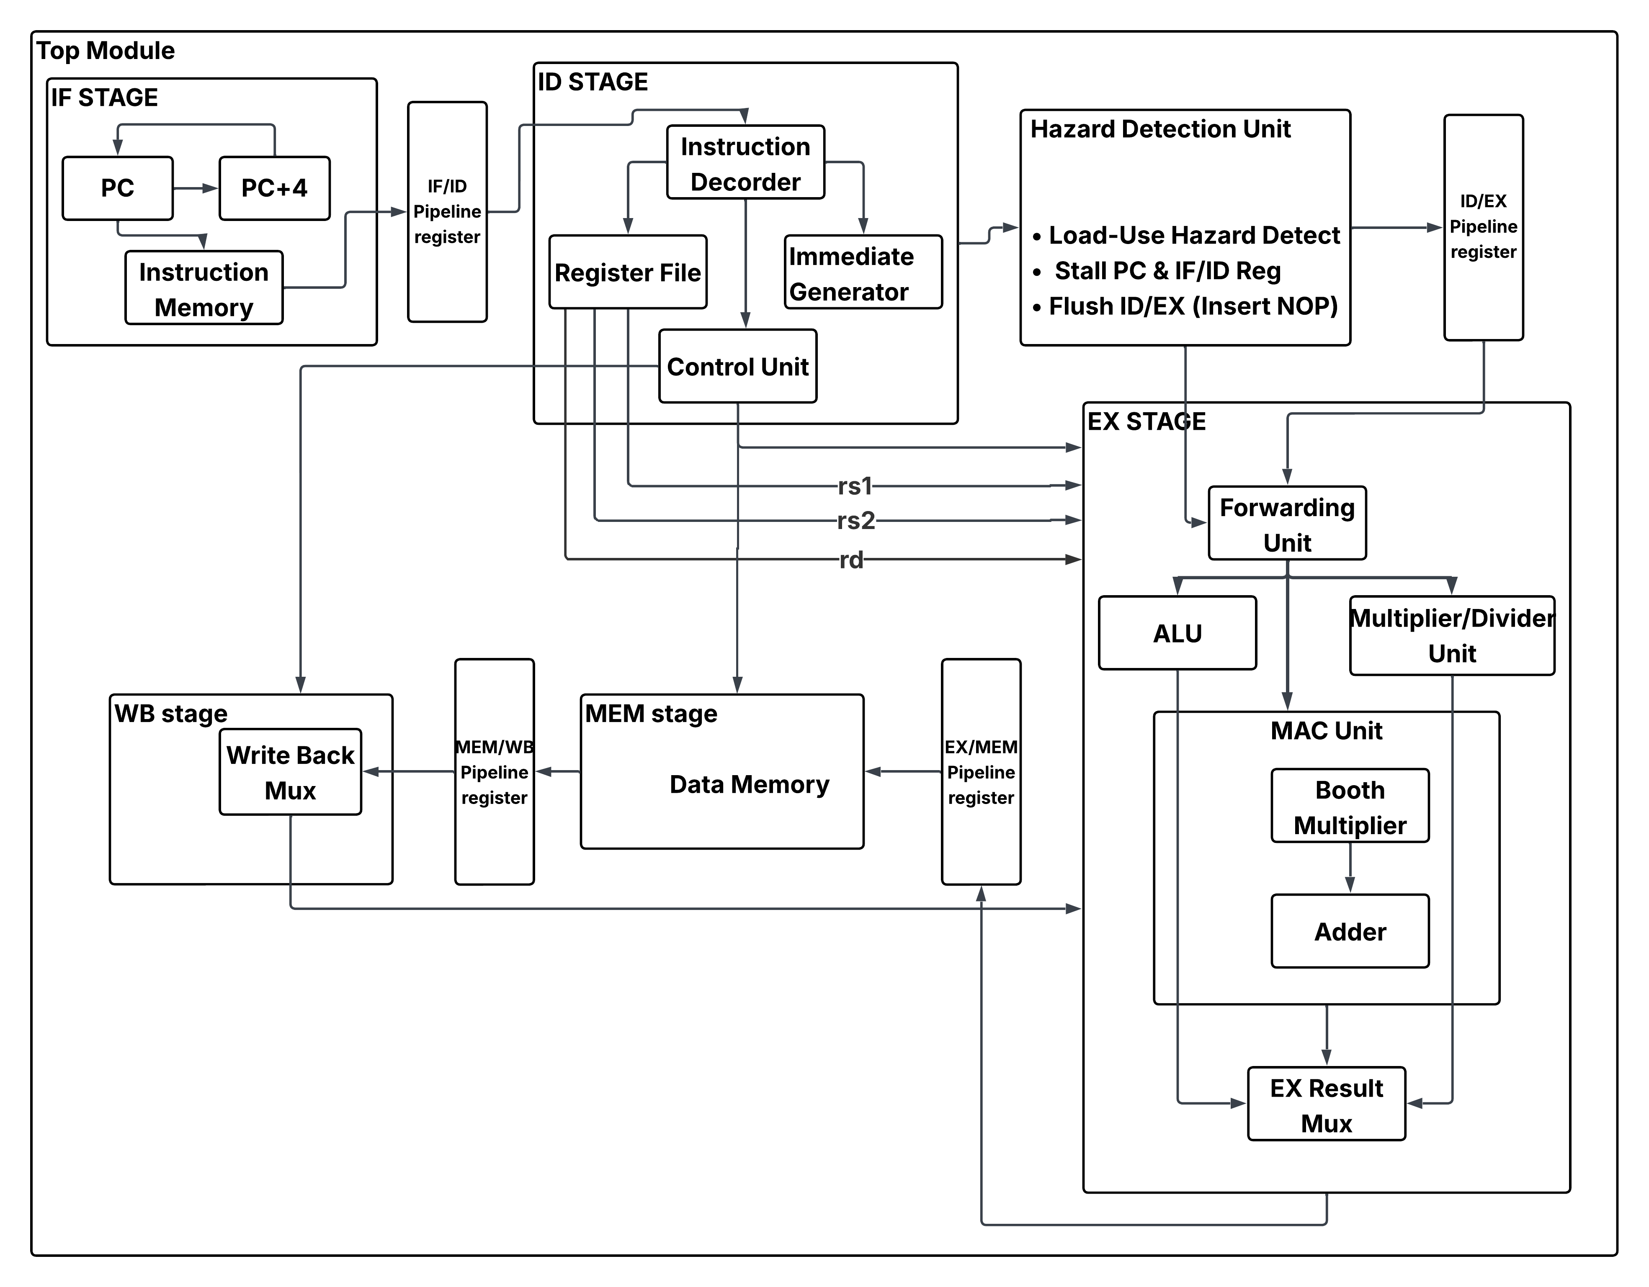
Block Diagram

Slide 8
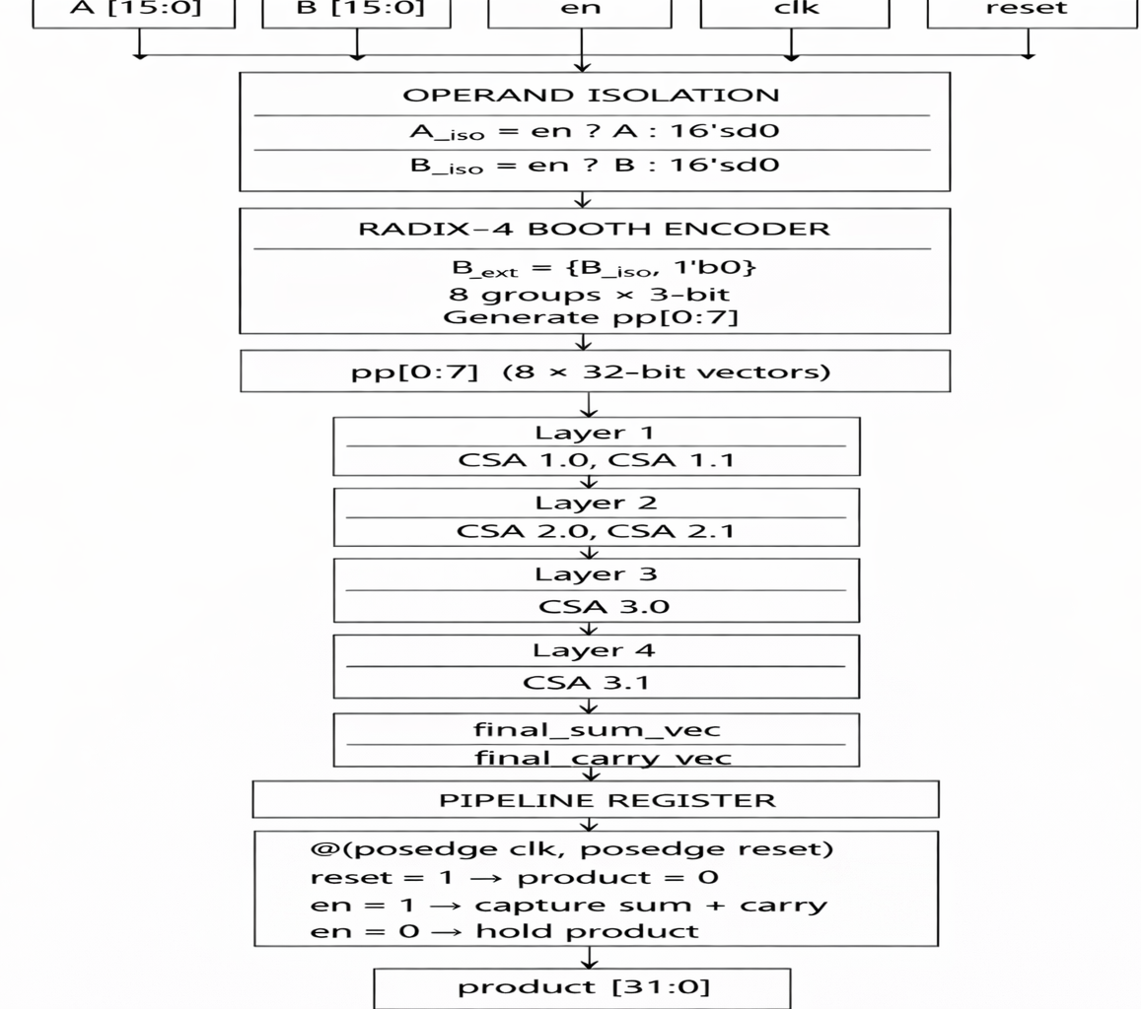
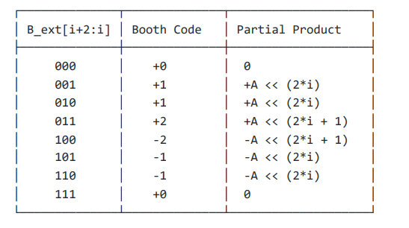
Working of Modified Booth Multiplier

Slide 9
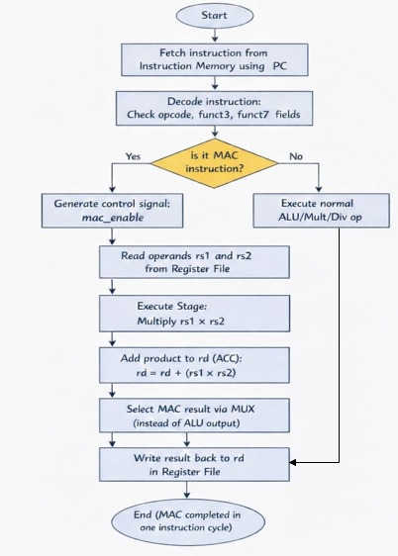
Working principle

Slide 10
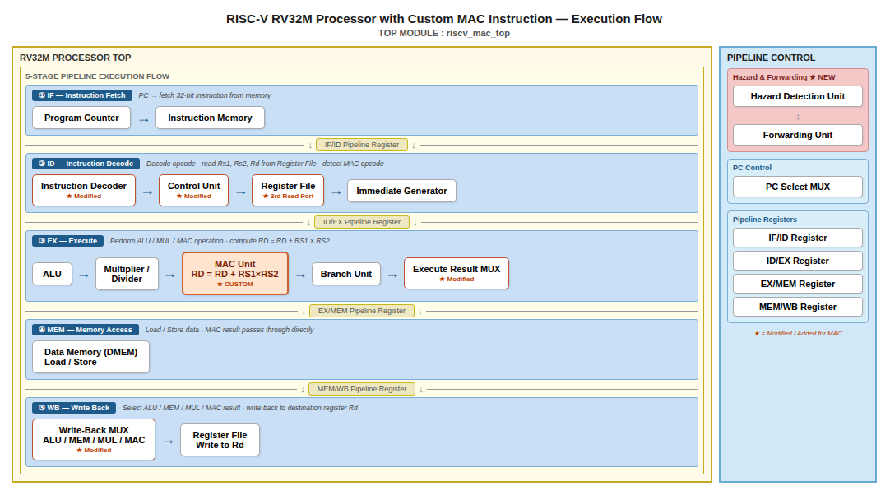

Slide 11
Comparation
Metric | Conventional Multiplication | Normal Booth Multiplier with Conventional Adder | Modified Booth Multiplier with CSA Adders | Trend / Observation
Total On-Chip Power | 37.905 W | 35.058 W | 38.575 W | Power remains high due to I/O switching.
Logic Delay (Max) | 6.456 ns | 7.340 ns | 3.741 ns | 42% improvement in logic speed with CSA.
Total Delay (Max) | 11.916 ns | 13.138 ns | 8.735 ns | CSA version is the fastest overall.
Slice LUTs | 399 | 473 | 443 | CSA is more area-efficient than "Normal Booth."
Junction Temp | 125.0°C | 125.0°C | 125.0°C | All exceed thermal limits (Critical).
Critical Path Start | A[1] | B[8]$ | en | High fanout on en is the new bottleneck.

Slide 12
MAC Unit Comparation
Feature | MAC Pure Combinational | MAC 1-Cycle (Comb. Mult + Seq. Acc) | MAC 2cycle_Fully Sequential
Total On-Chip Power | 15.75 W (Lowest) | 21.632 W | 21.53 W
Dynamic Power | 14.711 W (93%) | 20.592 W (95%) | 20.490 W (95%)
Total Delay (Max) | 51.951 ns (Slowest) | 11.255 ns | 9.511 ns (Fastest)
Logic Levels | 77 Levels | 16 Levels | 14 Levels
Slice LUTs | 523 | 522 | 532
Slice Registers | 0 | 33 | 65
Junction Temp | 125.0°C (Exceeded) | 125.0°C (Exceeded) | 125.0°C (Exceeded)
Thermal Margin | -121.7°C | -189.5°C | -188.3°C

Slide 13
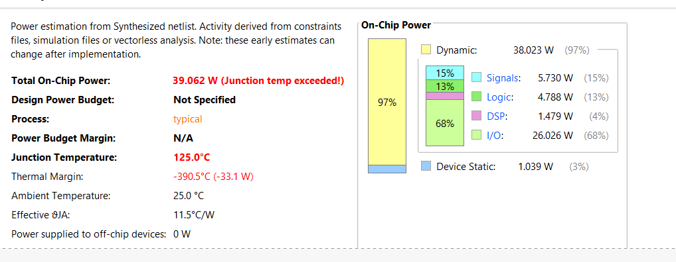
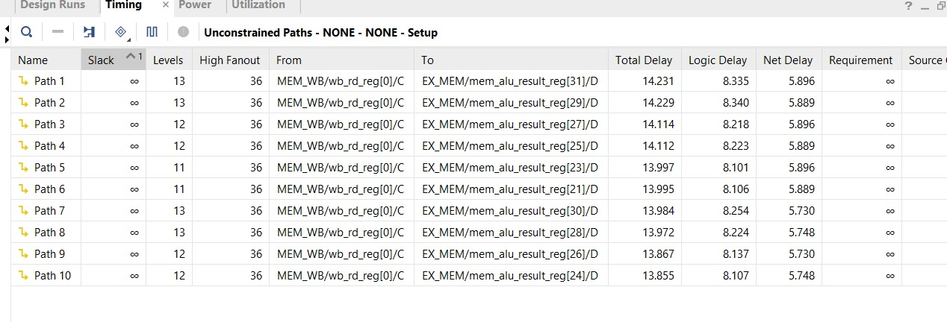
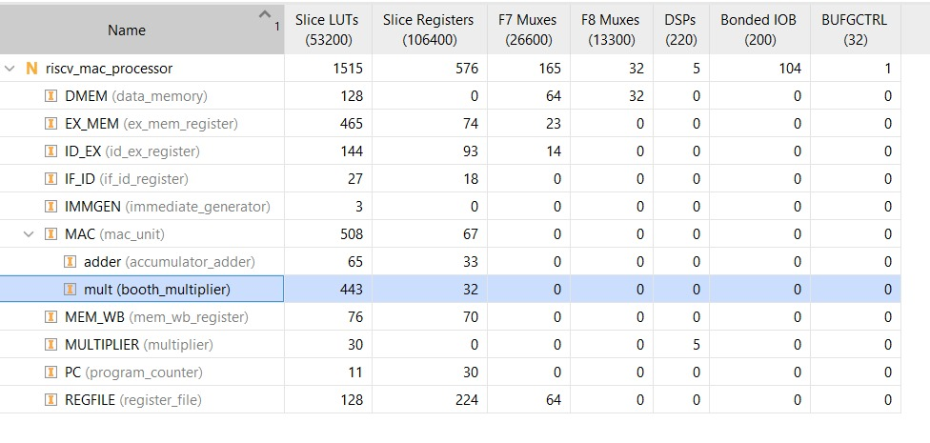
Results of RV32IM Processor integrated with MAC unit

Slide 14
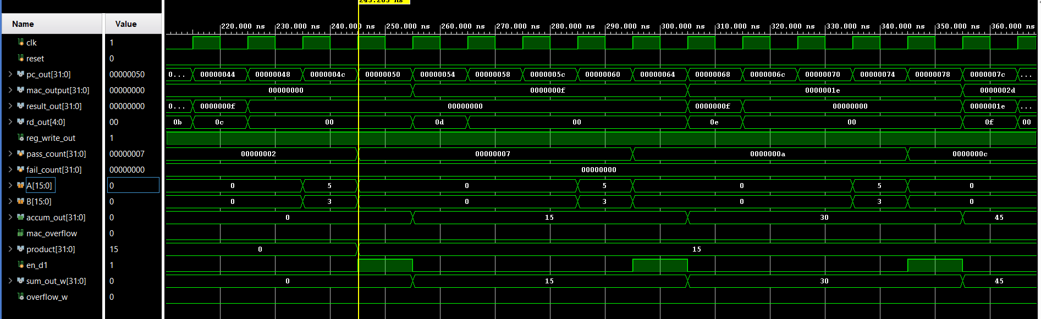
Simulation Results

Slide 15
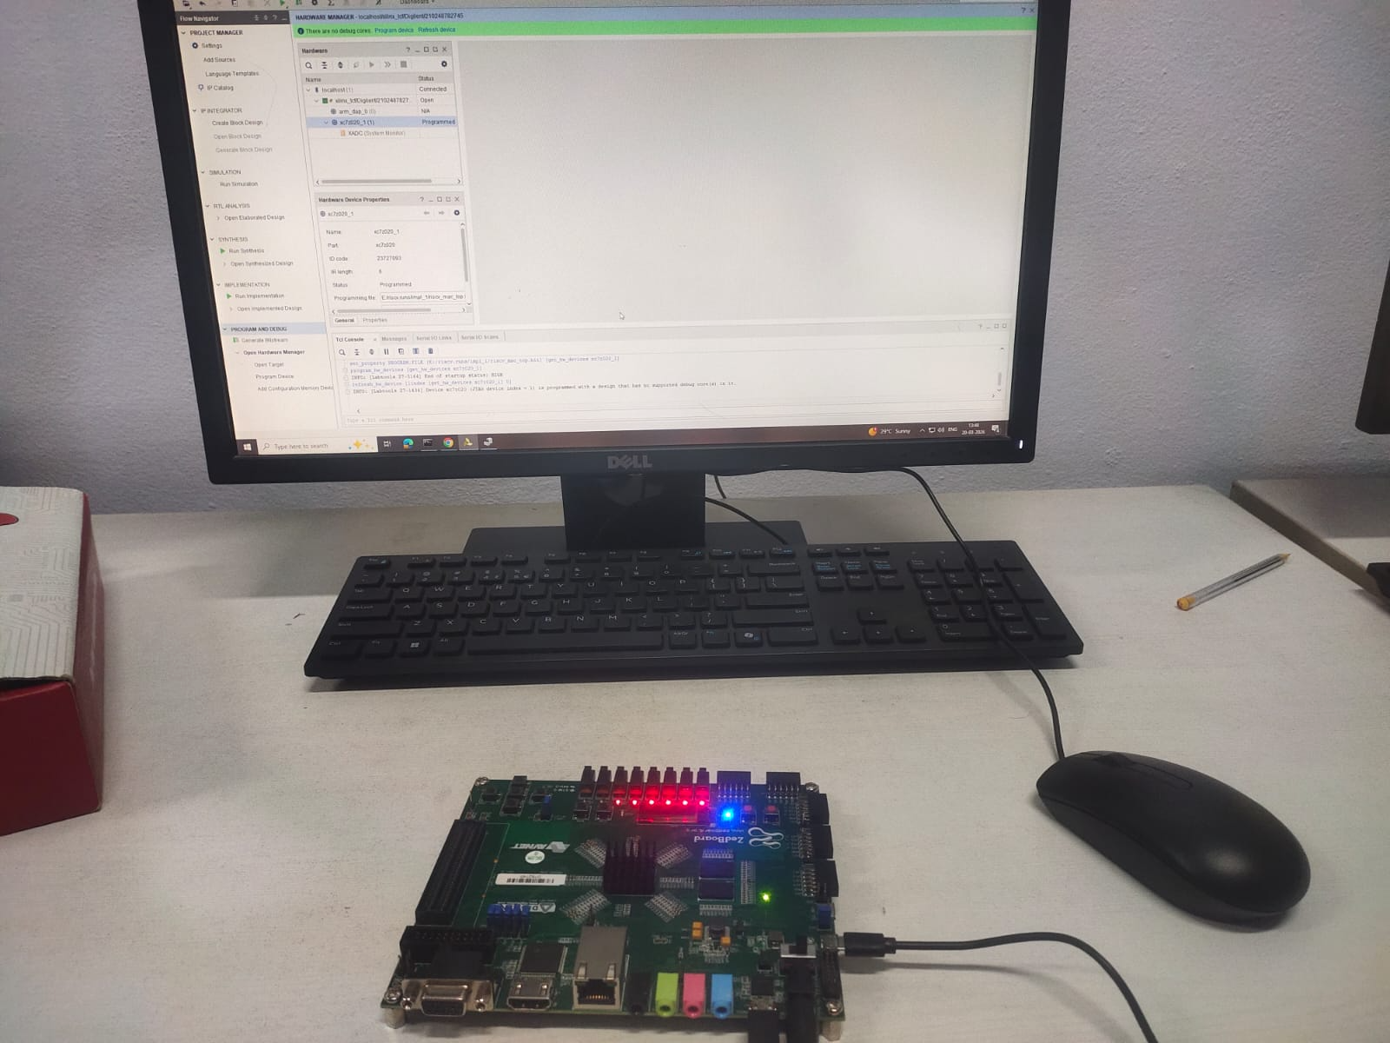
Implementation on FPGA

Slide 16
Conclusions
The proposed work focuses on extending the RISC-V processor by integrating a custom Multiply–Accumulate (MAC) instruction to improve computational efficiency.
The architecture design and integration strategy have been planned to enhance performance of autonomous swarm drone collision avoidance.
Future work involves completing RTL implementation, synthesis, and simulation to validate functionality and evaluate area, speed, and power improvements.
We successfully implemented the RV32IM processor with MAC unit integration in Xilinx Vivado tool and got required speed, power,and power.

Slide 17
References
S. N. Piske and S. O. Bajaj, “Performance-Optimized PicoRV32 Implementation with Multiply-Accumulate Custom Instructions,” International Journal of Engineering Research & Technology, vol. 14, no. 7, Jul. 2025.
V. Titopoulos et al., “Optimizing Structured-Sparse Matrix Multiplication in RISC-V Vector Processors,” arXiv preprint arXiv:2501.10189, 2025.
Booth, A. D. — "A Signed Binary Multiplication Technique" — Quarterly Journal of Mechanics and Applied Mathematics, Vol. 4, Issue 2, pp. 236–240, Oxford University Press, 1951
E. Rezunov, N. Zurstraßen, L. M. Reimann, and R. Leupers, “Automatic Microarchitecture-Aware Custom Instruction Design for RISC-V Processors,” arXiv preprint arXiv:2509.15782, 2025.
Hennessy, J. L. and Patterson, D. A. — "Computer Architecture: A Quantitative Approach" — Morgan Kaufmann Publishers, 6th Edition, 2019
Bedrij, O. J. — "Carry-Select Adder" — IRE Transactions on Electronic Computers, Vol. EC-11, No. 3, pp. 340–346, June 1962

