Slide 1
DBMS PBL · PROJECT 60
Disaster Relief Resource
and Camp Management System
MySQL database + Python application
M SHREEVENKAT SATHVIK · 25WU0101168
Semester III · CSE Panthers · Dr Sahithi
25TU03MJM0 Database Management Systems
Notes:
Hello. I am M Shreevenkat Sathvik, registration number 25WU0101168. My Project 60 is the Disaster Relief Resource and Camp Management System. I built it with a MySQL database and a small Python application for the DBMS PBL course under Dr Sahithi.

Slide 2
DBMS PBL · PROJECT 60
The problem
Which family still needs what?
Separate registers hide current needs and stock.
The system links families, assessed needs, donations and issues.
All example records in this project are fictional.
02
Notes:
During a disaster, camp registrations, item needs, donated stock, and distributions can be recorded in separate registers. That makes it hard to answer a simple question: which family still needs what? It also makes duplicate issues and stock mistakes more likely. My goal was to connect these records in one relational database so staff can see current needs and trace each issue.

Slide 3
DBMS PBL · PROJECT 60
Three review stages
1
Design
Problem, requirements, ER diagram and table mapping
2
MySQL prototype
Schema, constraints, sample data, views and queries
3
Python application
Forms, reports, validation, tests and final report
03
Notes:
The work was divided into three reviews. In Review 1, I defined the problem, users, requirements and ER diagram. In Review 2, I implemented the MySQL schema, sample data, views and a command-line prototype. In Review 3, I connected the Python web application, added forms and reports, checked the rules with integration tests, and wrote the final report. All three stages are documented in GitHub.

Slide 4
DBMS PBL · PROJECT 60
How the database is organized
Camp
Family
Person / Need
One camp has many families. One family has many people and needs.
A distribution fulfills one assessed need and records who handled it.
PK + FK + UNIQUE + CHECK support data integrity.
04
Notes:
The main tables are camps, families, persons, needs, relief items, warehouses, stock, donations, assignments and distributions. A camp has families, and each family can have many persons and needs. A need records the item, quantity, urgency and relief round. A distribution points to that need and to the active volunteer assignment. Primary and foreign keys preserve these relationships. I separated repeated facts into related tables to reach third normal form.

Slide 5
DBMS PBL · PROJECT 60
Practical innovation using basic DBMS ideas
Remaining need = assessed quantity − issued quantity
Queue: HIGH, then MEDIUM, then LOW; oldest first within each level.
Issue transaction checks need, stock and volunteer assignment.
Receipt and issue movements explain each stock balance.
05
Notes:
The first useful feature is the unmet-needs queue. The remaining quantity is calculated as assessed quantity minus the total already issued. The queue shows high urgency first and uses assessment time to break ties, so staff can explain why a need appears in that position. For every issue, a transaction checks remaining need, available stock and an active assignment. If any check fails, it rolls back. Stock movements give a traceable history.

Slide 6
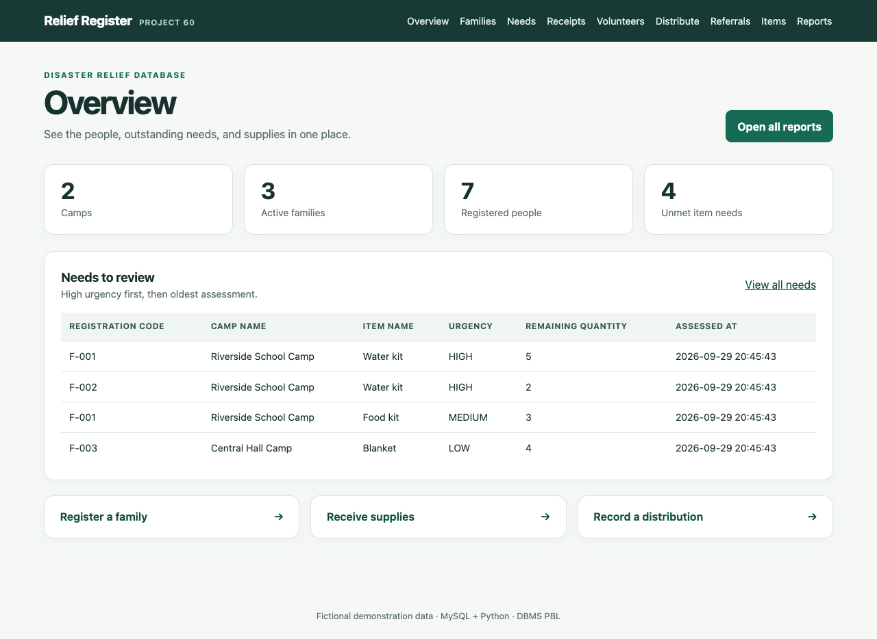
DBMS PBL · PROJECT 60
Recorded demo: unmet-needs queue
Overview
Camp and family totals
Unmet needs sorted by urgency
Open F-001 for the next step
06
Notes:
These screenshots were captured during the verified MySQL app run. On the Overview page, the top cards summarize camps, active families, registered people and unmet item needs. The queue is ordered by urgency and assessment time. Family F-001 has a water-kit need. This page is backed by a SQL view, not a manually copied list.

Slide 7
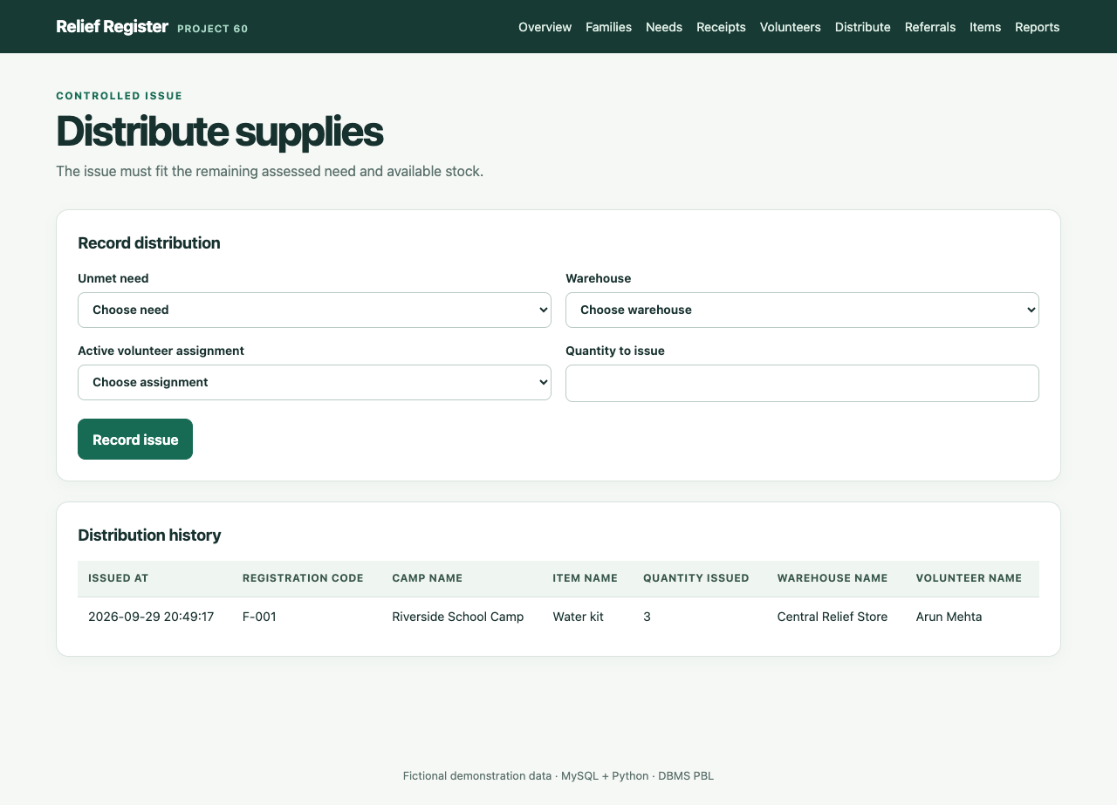
DBMS PBL · PROJECT 60
Recorded demo: issue three water kits
F-001 water kits
Need: 5 to 2
Stock: 20 to 17
Excess issue is rejected
07
Notes:
In the captured demo, I selected family F-001's water-kit need, Central Relief Store and the active volunteer assignment for Riverside School Camp. I entered quantity three and submitted. The starting assessed need was five, and stock was twenty. After the transaction, remaining need was two and stock was seventeen. The history records the issue. A further issue above the remaining quantity is rejected by the application.

Slide 8
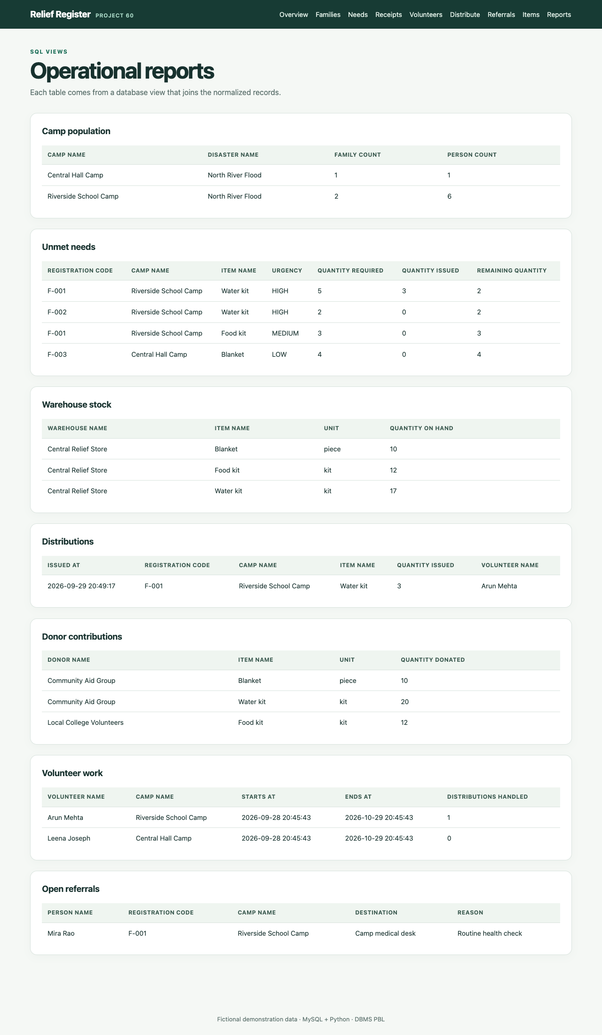
DBMS PBL · PROJECT 60
Verified reports after the issue
F-001: 2 needed · Store: 17 water kits
08
Notes:
These are the reports captured after that issue. The unmet-needs view shows F-001 required five water kits, received three, and still needs two. The warehouse stock view shows seventeen water kits. The distribution history shows the issue of three kits handled by Arun Mehta. Those reports are based on joined MySQL tables and views.

Slide 9
DBMS PBL · PROJECT 60
What the project demonstrates
8 MySQL integration tests passed
Duplicate and excess issues are rejected.
Stock reconciles with the movement history.
The app uses fictional data on a local computer.
09
Notes:
The database and app show how ordinary DBMS concepts solve a practical coordination problem. The final test run had eight passing MySQL integration tests, including duplicate and excess distribution checks, volunteer overlap, stock reconciliation and web form behavior. The project is a local educational demonstration with fictional data. Its main contribution is a clear, explainable needs queue and traceable stock movement using basic SQL and transactions. Thank you.

