Slide 1
AUTOMATED SURVEY ANALYSIS TOOL
Minor Project | Python • Streamlit • Data Analytics
A simple tool to turn customer survey responses into measurable insights.
Analyses ratings, written feedback, sentiment labels, and complaint categories.
Presents key findings through an interactive dashboard.

Slide 2
PROBLEM STATEMENT
Survey responses often contain both numerical ratings and unstructured comments.
Manually reviewing responses can make it harder to identify repeated issues.
This project automates basic calculations and keyword-based feedback grouping.

Slide 3
OBJECTIVES
Validate survey data and handle missing or invalid ratings.
Calculate average rating, rating distribution, and CSAT.
Classify feedback as Positive, Negative, Mixed, or Neutral.
Identify complaint categories and generate simple recommendations.
Display results and allow users to upload CSV data.

Slide 4
TECHNOLOGIES USED
Python — core data processing and analysis
CSV and JSON — input data and structured results
Streamlit — interactive web dashboard
Matplotlib — rating and sentiment charts
Pandas — filtered feedback CSV download

Slide 5
SYSTEM WORKFLOW
1. Upload / read survey CSV
2. Validate ratings and feedback
3. Calculate rating metrics and CSAT
4. Apply keyword-based sentiment and complaint rules
5. Save analysis results as JSON
6. Display metrics, charts, feedback, and recommendations

Slide 6
SAMPLE RESULTS
Based on the included sample dataset (9 responses)
Total responses\n9 | Valid ratings\n8
Average rating\n3.25/5 | CSAT\n50.0%

Slide 7
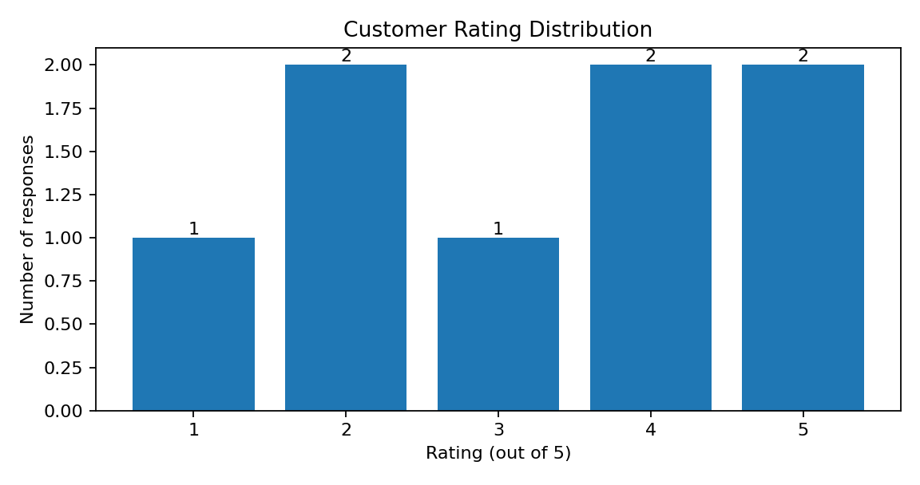
RATING DISTRIBUTION

Slide 8
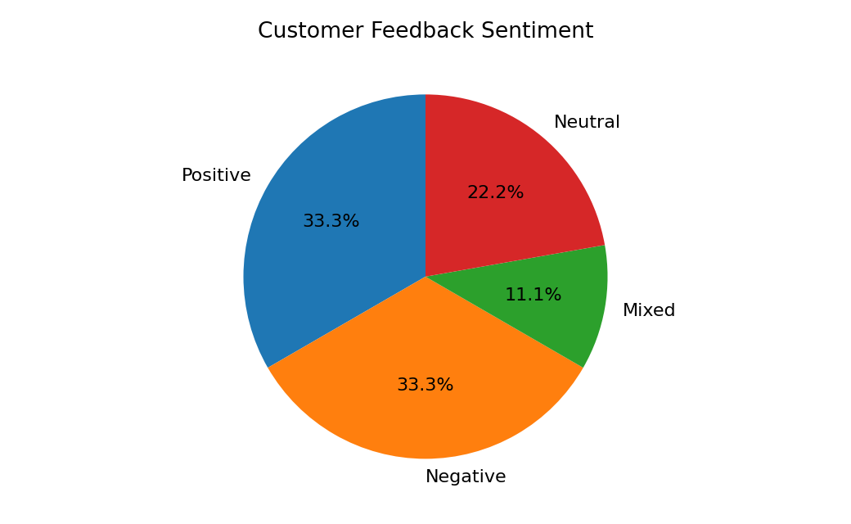
CUSTOMER FEEDBACK SENTIMENT

Slide 9
COMPLAINT ANALYSIS
Staff behaviour: 1 comment(s)
Delays and waiting: 2 comment(s)
Customer support: 1 comment(s)
Poor experience: 1 comment(s)
Most reported category: Delays and waiting.
Recommendation: Review delivery times and waiting processes.

Slide 10
LIMITATIONS
Sentiment and complaint detection use predefined keywords, not a trained AI model.
Keyword matching may miss context, sarcasm, and complex negation.
The sample dataset contains only 9 responses; results are illustrative.
A larger real-world dataset and improved text analysis can strengthen the project.

Slide 11
CONCLUSION
The project converts survey CSV data into useful customer experience metrics.
It highlights satisfaction levels, sentiment patterns, and recurring complaint areas.
The Streamlit dashboard makes the analysis easier to explore and share.
Deployment: Successfully hosted on Streamlit Community Cloud.
Future work: larger datasets, improved NLP, and expanded analytics.

