Slide 1
CUSTOMER CHURN
PREDICTION
Machine Learning Project
End-to-end prototype for churn-risk analysis and retention planning
1

Slide 2
Project Overview
Objective
Build a machine-learning prototype to estimate customer churn risk.
Dataset
440,832 cleaned customer records
56.71% churn • 43.29% non-churn
Scope
Data preparation • EDA • Feature engineering • Model comparison • Risk scoring • Business insights • Monitoring prototype
2

Slide 3
Problem Statement
Customer churn reduces recurring revenue and increases the cost of acquiring replacement customers.
The project explores whether customer profile, usage and interaction attributes can help identify customers with elevated churn risk.
Expected business use: prioritise retention outreach and investigate high-risk customer segments.
3

Slide 4
Project Objectives
• Clean and validate customer records.
• Explore churn patterns across customer attributes.
• Engineer additional model features.
• Compare Logistic Regression, Random Forest, XGBoost and LightGBM.
• Evaluate probability thresholds and illustrative business costs.
• Generate batch and new-customer predictions.
• Produce explainability and monitoring prototypes.
4

Slide 5
Technologies Used
Python
Pandas and NumPy — data preparation and feature engineering
Scikit-learn — preprocessing, model training and evaluation
XGBoost and LightGBM — boosted-tree model comparison
SHAP — model explanation
Matplotlib — charts and evaluation visuals
Joblib — model persistence
VS Code — development environment
5

Slide 6
Project Workflow
Raw customer dataset
↓
Data cleaning and validation
↓
Exploratory data analysis
↓
Feature engineering and encoding
↓
Train/test split and model comparison
↓
Threshold selection and evaluation
↓
Saved model → Batch / new-customer predictions
↓
Business insights and drift-monitoring prototype
6

Slide 7
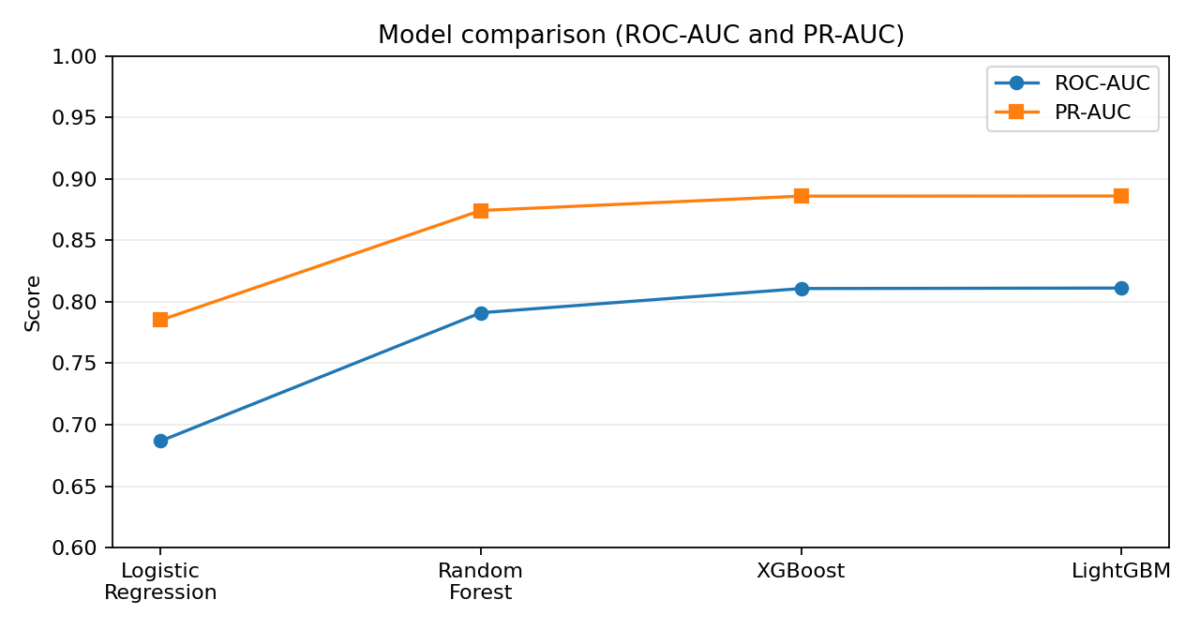
Model Comparison
Best ROC-AUC / PR-AUC:
LightGBM
Accuracy leader:
XGBoost
Current saved pipeline:
Random Forest
7

Slide 8
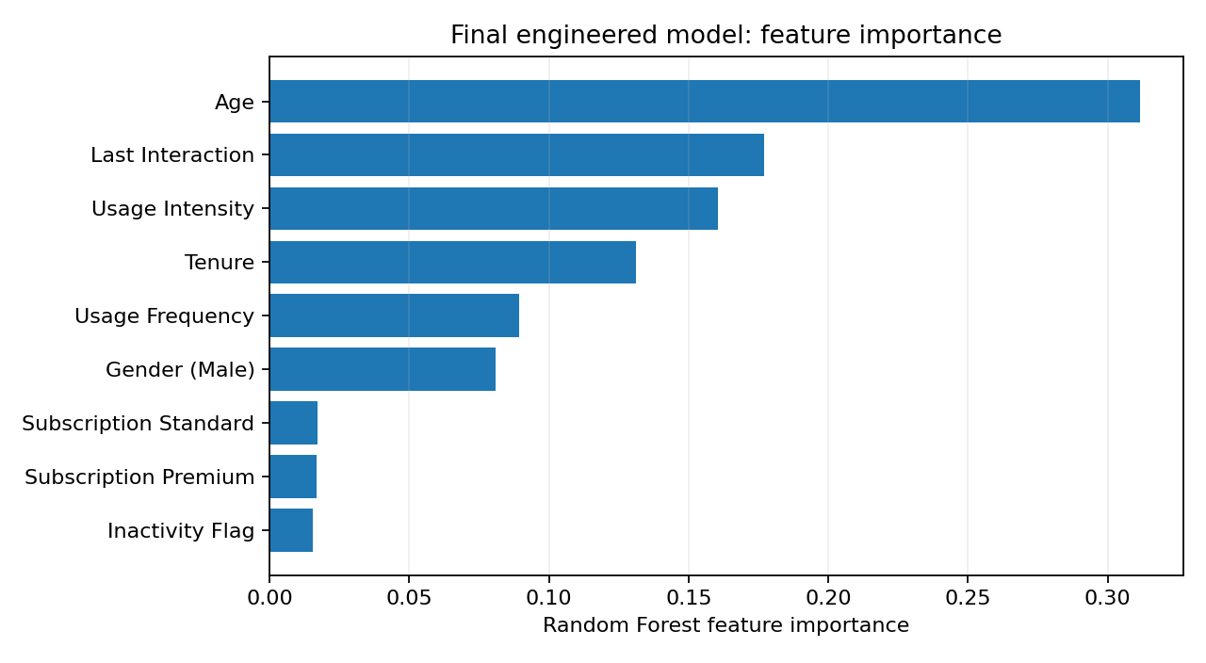
Feature Importance and Explainability
Leading Random Forest features:
1. Age
2. Last Interaction
3. Usage Intensity
4. Tenure
Approximate TreeSHAP plots were generated for 20 samples from the earlier final engineered Random Forest; they do not explain the compact deployment model.
8

Slide 9
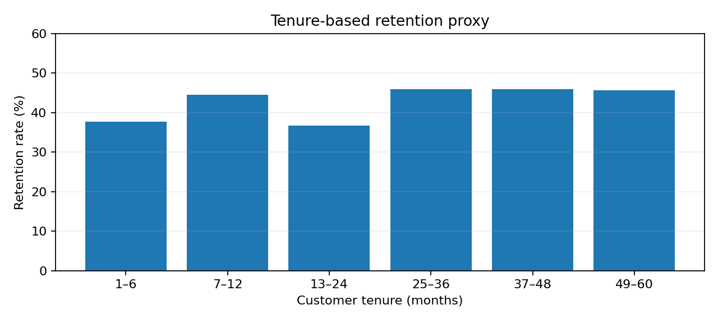
Business Insights and Retention
Observed churn patterns:
• Monthly contracts: 100%
• Payment delay 21–30 days: 100%
• Support calls 5–10: 99.08%
• Last interaction 16–30 days: 66.50%
These are dataset associations, not proven causes. Perfect-churn patterns may reflect dataset-generation rules.
9

Slide 10
Limitations and Future Deployment
Implemented prototypes
• Batch and new-customer scoring
• Drift comparison script
• Saved model bundle
Not implemented — proposed future integrations
• Airflow scheduling
• MLflow experiment tracking
• CRM / reverse ETL
• Real-time monitoring and automated retraining
Dataset limitations
No verified timestamps or censoring data; true cohort and Kaplan–Meier analysis cannot be validated. Five synthetic incoming records are only a drift-demo sample.
10

Slide 11
Conclusion
The project delivers an end-to-end customer churn prediction prototype covering data preparation, model comparison, risk scoring, explainability, business analysis and preliminary monitoring.
Model performance is promising within the available dataset, but independent real-world validation and production integrations remain future work.
Thank You
11

