Slide 1
A Seminar on Investigation and Finding A DNA Cryptography layer for Securing data in Spark Cluster
Team Details
Rettala Nikhil Goud(20EG105317)
Kadiyala Venkat Sathwik(20EG105319)
Kandula Akshaya(20EG105322)
Project Supervisor
Dr. J Balaraju
M.Tech.,Ph.D
Assistant Professor

Slide 2
Introduction
Spark is fitting for dealing with efficient in storage and analysis of data and it has certain security issues with the usage of third party security for authentication which used huge computations in all the versions of Spark. This desired method is a new security mechanism as single security instance, a SEAL (Spark E-Authentication Layer) as a secure layer which positioned above the Spark Cluster.
What is essential?
This developed protocol SEAL is providing security using fewer computations, unlike integrating a third-party authentication protocol like Kerberos. This authentication step ensures that only users possessing the correct unique DNA key, received through email, are granted access to Apache Spark for distributed data processing.

Slide 3
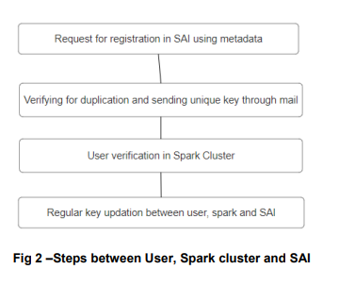
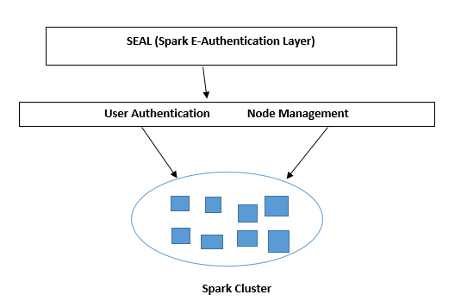
Concept Tree
SEAL using metadata
SEAL
Fig 1- Proposed Security Authentication Interface
SEAL

Slide 4
Literature (existing methods)
Author(s) | Strategies | Advantages | Disadvantages
Nan Zhang, Et al. | Kerberos Authentication | • Strong security: Kerberos is a well-established and widely used authentication protocol. • Centralized authentication: It uses a centralized Key Distribution Center (KDC) for secure authentication. | • Complexity: Setting up and maintaining a Kerberos infrastructure can be complex. • Overhead: Introduces computational overhead due to the need for ticket requests and validations.
Yong-Tae Kim Et al. | Custom Token-based Authentication | •Flexibility: Custom token-based authentication allows for a flexible and tailored solution. • Stateless: Tokens can be designed to be stateless, reducing the need for server-side storage. | •Development effort: Implementing a custom solution requires additional development effort. • Security risks: Custom solutions may have security risks if not designed and implemented correctly.
Paul J. E. Velthuis | Multi-factor Authentication (MFA) | • Enhanced security: Adds an extra layer of security through multiple authentication factors. •Compliance: Meets security compliance requirements in certain environments. | • User experience: MFA may introduce additional steps for users, impacting user experience. •Implementation complexity: Implementing and managing MFA can be complex.

Slide 5
Literature(cont..) selected strategy:
Author(s) | Method | Advantages | Disadvantages
Hwang et al | Emphasis is on maintaining the integrity and functionality of the DNA sequence, preventing false start codons, and achieving optimal embedding capacity through efficient coding and recovery techniques. | 1.High Embedding Capacity 2. False Start Prevention | 1.Complexity and Processing Overhead 2.Limited Applicability
Balaraju. J et al | Proposed a sophisticated authentication mechanism using complex DNA cryptography as an alternative to converting big data into DNA with reduced computational tasks. | 1.Innovative Security Approach 2.DNA Cryptography Solution | 1.Limited Practical Validation 2.Complex Implementation
A. Vikram et al | The method employs DNA symmetric cryptography, utilizing DNA computing to convert plain-text into a non-understandable format, providing enhanced information security and preventing unauthorized access to confidential data. | 1.Enhanced Security 2.Resistance to Conventional Attacks | 1.Complexity and Resource Intensity 2.Limited Adoption and Standardization

Slide 6
Problem Statement
Spark is a very versatile, adaptable platform for storage of data and focusing data analytics, data driven applications, however it was not begun in light of security or authorization for data. Security and controlling data are most significant fragments of any distributed platform that wants to break into the endeavor standard.
Existing method(s) disadvantages
The primary existing problem in user authentication within spark is the reliance on third-party security measures, such as Kerberos, which introduces computational overhead. The fragmented nature of security capabilities, developed independently, complicates user authentication and access control.
Users face challenges in securing their data, particularly in the absence of a unified security mechanism. The need for a single security instance for user authentication becomes apparent to address these existing authentication issues in spark.

Slide 7
Problem Illustration
Consider a scenario where multiple users attempt to access and interact with data stored in a Spark Cluster. In the current setup, the user authentication process relies on third-party security protocols, such as Kerberos. 1. Fragmented Authentication Mechanisms:
The illustration depicts different users (User A, User B, and User C) attempting to authenticate through various security mechanisms.
User A encounters authentication through Kerberos, while User B goes through a different process.
This fragmentation in authentication mechanisms complicates the overall security landscape, making it challenging to maintain a cohesive and standardized approach.
2. Computational Overhead:
Each user's authentication involves multiple computational steps and interactions with external authentication services.
This process introduces computational overhead, as illustrated by the intricate network of calculations and verifications

Slide 8
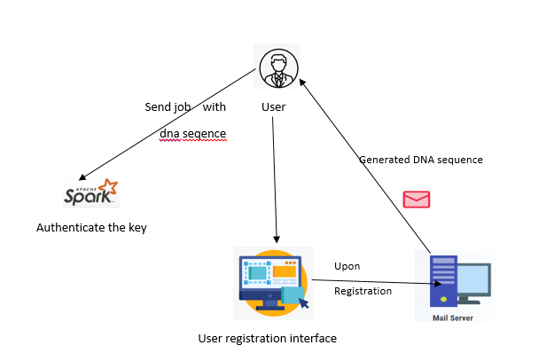
Proposed Method
The proposed project aims to develop a secure user authentication system that leverages a unique DNA sequence generated from user-provided email and username. This DNA sequence is sent to the user's email for authentication.
The Spark job serves as authentication with unique id as a argument, ensuring that only authorized users with the correct Unique key can access and contribute to the Spark cluster.

Slide 9
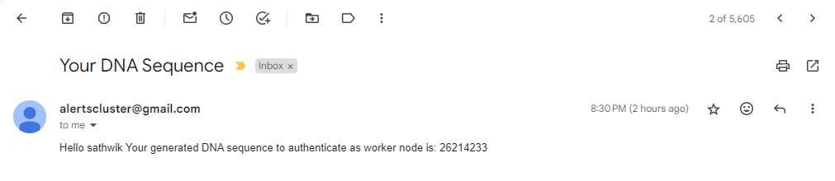
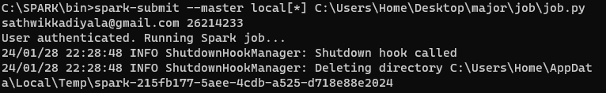
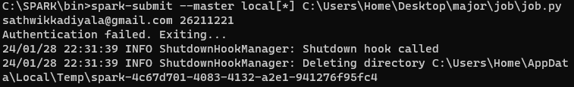
Proposed Method Illustration
Unique key sent to mail
User authenticated with corresponding key
Exiting from cluster with invalid key

Slide 10
Parameter
The total Spark Cluster security in existing model takes:
T(KA)=U[(6t)+x+y] T(KA) is the total time spent on the authentication process in the existing model.
The term U[(6t)+x+y] represents the computational factors involved in the authentication process, where 'U' is a function of various parameters.
So, the total Spark Cluster security time in the existing model is given by:
T(SC)=U[(6t)+x+y] +O(N) O(N) denotes additional overhead, possibly associated with the Spark Cluster security mechanism.
So, the total Spark Cluster security time in the developed model is given by:
T(SEAL)=U(5) +[O(N)+D] 'D' represent additional factors introduced in the developed model.

Slide 11
Experiment Environment
Software Requirements:
Operating System : Linux(Ubuntu)
Latest version of VSCode 1.60.0. Apache Spark (Latest Version) and NodeJS (Version 18.8.1).
ExpressJS (version 4.18.2) library has been included to harness its capabilities for building a robust and responsive webserver.
Nodemailer(3.0.3) module for Node.js that is used for sending emails.
Hardware Requirements:
Processor: Intel Core i5/i5-2350M CPU @2.30GHz.
RAM Capacity: 4 GB RAM or more.
System Type: 64-bit Operating System.

Slide 12
Project status
S.No | Functionality | Status (Completed /in-progress/Not started)
1 | Literature Survey | Completed
2 | Problem Definition | Completed
3 | Module Design | Completed
4 | Implementation | Completed

Slide 13
References
[1] Nan Zhang, Xiaoyu Wu, Cheng Yang, Yinghua Shen and Yingye Cheng,"A lightweight authentication and authorization solution based on Kerberos," 2016 IEEE Advanced Information Management, Communicates,Electronic and Automation Control Conference (IMCEC), Xi'an, 2016, pp.742-746,DOI:10.1109/IMCEC.2016. 7867308.
[2] Yoon-Su Jeong & Yong-Tae Kim “A token-based authentication security scheme for Hadoop distributed file system using elliptic curve cryptography” August 2015Journal of Computer Virology and Hacking Techniques 11(3) DOI:10.1007/s11416-014-0236-5
[3] Paul j. e. Velthuis, "New authentication mechanism using certificates for big data analytic tools", kth royal institute of technology school of information and communication
https://kth.divaportal.org/smash/get/diva2:1149007/FULLTEXT01.pdf

Slide 14
References
[4] Lee, S., Lee, E., Hwang, W. et al. Reversible DNA data hiding using multiple difference expansions for DNA authentication and storage. Multimed Tools Appl 77, 19499–19526 (2018). DOI:10.1007/s11042-017-5379-1
[5]Balaraju, J., & Prasada Rao, P. V. R. D. (2020b). Investigation and Finding A DNA Cryptography Layer for Securing Data in Hadoop Cluster. Int. J. Advance Soft Compu. Appl, 12, 3.
[6] A. Vikram, S. Kalaivani and G. Gopinath, "A Novel Encryption Algorithm based on DNA Cryptography," 2019 International Conference on Communication and Electronics Systems (ICCES), Coimbatore, India, 2019, pp. 1004-1009, doi: 10.1109/ICCES45898. 2019.9002399.

Slide 15
Thank you

Slide 16
Project seminar–I Evaluation
S.No | Rubrics | Marks
1 | Concept Introduction | 4
2 | Literature and Parameter | 5
3 | Problem and Problem Illustration | 8
4 | Proposed Method and Illustration | 8
Total |  | 25

