Slide 1
Simulation and Comparative Analysis of Link-State Routing and Distance Vector Routing
PEDDI SATHWIK (123003187)
Guided by
Dr. Dindayal Mahto

Slide 2
Agenda
Problem statement
Implementation design diagram
Tools used
Explanation
Analysis
Conclusion

Slide 3
Problem Statement
Routing is one of the most fundamental process in network communication. It is a process of routing the packets between multiple networks. Routing protocols are the set of defined rules used by the routers to communicate between the source and destination. These routing protocols learns the existing routes available in the network, builds the routing table and finds the efficient route for communication. It specifies how routers in the network communicate with each other to distribute the information. There are two types of routing protocols, link state and distance vector routing protocols
Here we will simulate those routing protocols with both tcp and udp i.e., with ftp and cbr traffic and compare them

Slide 4




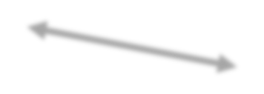

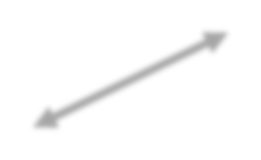







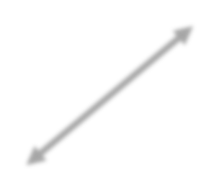



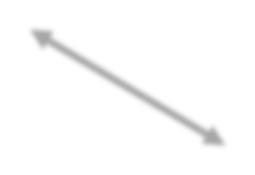

























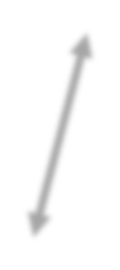



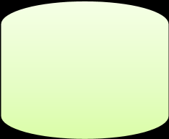





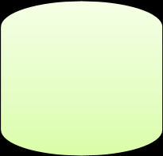



Implementation Design Diagram
Link-State routing: Distance Vector Routing:
Area 1
Routers
Area 3
Area 2
Routing
Routing
Routing
Routing
Table
Table
Table
Table
LSP Flooding
Link
Routers are periodically passing copies of their routing
tables to neighboring routers

Slide 5
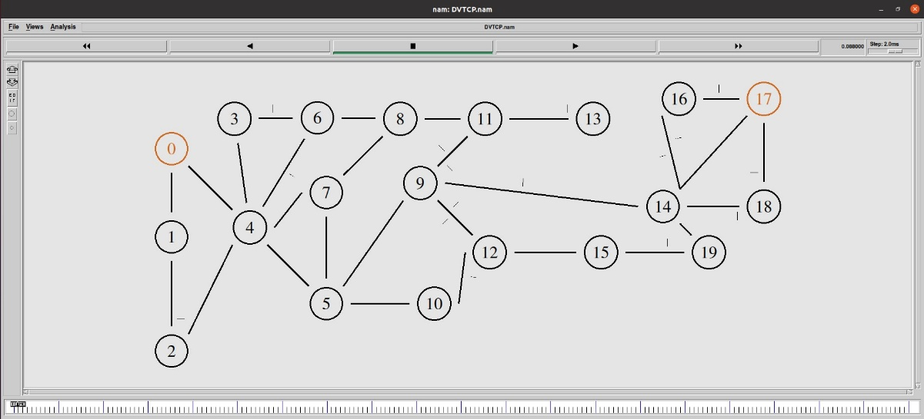
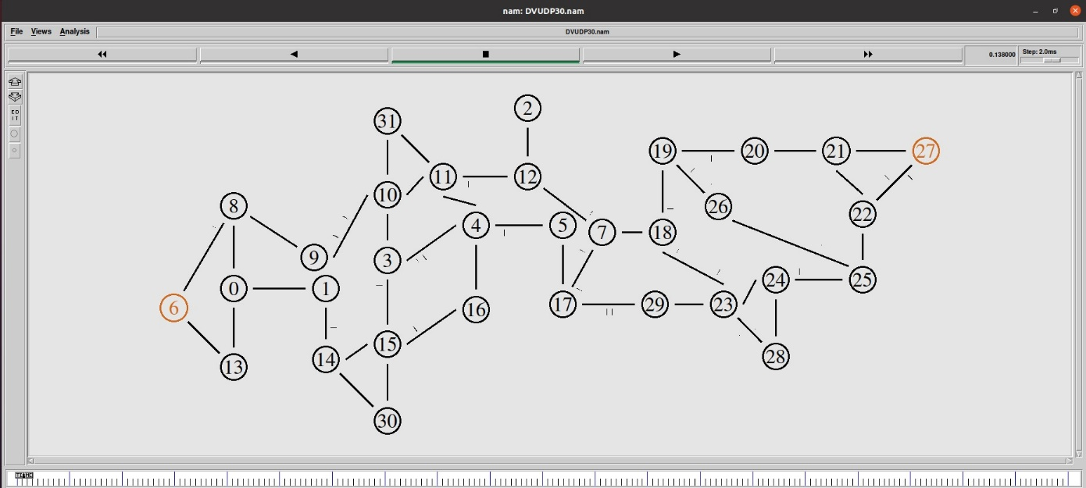
Implementation Design Diagram
20 nodes topology
30 nodes topology

Slide 6
Tools Used
NS-2 simulator
NAM tool
AWK script
Excel – for graphs

Slide 7
Explanation
Routing:
Goal: determine a “good” path through the network from source to destination -Good means usually the shortest path
Link-State routing :
In Link-State routing each node uses Djikstra’s algorithm on graph to calculate optimal routes to all nodes.
Each network periodically floods immediate reachability information to other routers.
Fast convergance,but high communication and computation overhead.
Distance Vector routing :
Each neighbour periodically exchange reachability information to its neighbours.
Minimal communication overhead , but it takes long to converge i.e., in proportion to the maximum path length.

Slide 8
Explanation
Dijkstra’s algorithm:
net topology, link costs known to all node
- accomplished via “link state broadcast”
- all nodes have same info
computes least cost paths from one node (‘source”) to all other node
- gives forwarding table for that node
iterative: after k iterations, know least cost path to k dest.’s
Notation:
c(x,y): link cost from node x to y; = ∞ if not direct neighbors
D(v): current value of cost of path from source to dest. V
p(v): predecessor node along path from source to v
N': set of nodes whose least cost path definitively known

Slide 9
Explanation
Dijkstra’s algorithm:
1 Initialization:
2 N' = {u}
3 for all nodes v
4 if v adjacent to u
5 then D(v) = c(u,v)
6 else D(v) = ∞
7
8 Loop
9 find w not in N' such that D(w) is a minimum 10 add w to N’
11 update D(v) for all v adjacent to w and not in N’ :
12 D(v) = min( D(v), D(w) + c(w,v) )
13 /* new cost to v is either old cost to v or known
14 shortest path cost to w plus cost from w to v */
15 until all nodes in N'

Slide 10
Explanation
Step
N'
D(v),p(v)
D(w),p(w)
D(x),p(x)
D(y),p(y)
D(z),p(z)
0
u
2
,u
5
,u
1
,u
∞
∞
1
ux
2
,u
4
,x
2
,x
∞
2
uxy
2
,u
3
,y
4
,y
3
uxyv
3
,y
4
,y
4
uxyvw
4
,y
5
uxyvwz
5
v
3
w
2
5
u
2
1
z
3
1
2
x
y
1

Slide 11
Explanation
Distance vector algorithm:
Based on Bellman-Ford (BF) equation (dynamic programming):
Bellman-Ford equation:
Let D_{x}(y): cost of least-cost path from x to y. Then:
D_{x}(y) = min_{v} { c_{x,v} + D_{v}(y) }
v’s estimated least-cost-path cost to y
direct cost of link from x to v
min taken over all neighbors v of x
key idea:
from time-to-time, each node sends its own distance vector estimate to neighbors
when x receives new DV estimate from any neighbor, it updates its own DV using B-F equation:
D_{x}(y) ← min_{v}{c_{x,v} + D_{v}(y)} for each node y ∊ N
under minor, natural conditions, the estimate D_{x}(y) converge to the actual least cost d_{x}(y)

Slide 12
Explanation
each node:
wait for (change in local link cost or msg from neighbor)
recompute DV estimates using DV received from neighbor
if DV to any destination has changed, notify neighbors

Slide 13
Explanation
+ D_{z}(y)}
time
D
()
costto
costto
x
x
y
z
x
y
z
x
02
7
x
0
2
3
from
from
y
y
2
0
1
D
min{
∞
∞
∞
x
(
z
)=
c
x,y
+
D
(
z),c
+
D
(
z
)
}
z
z
y
∞
∞
∞
7
1
0
=
min
{2+1,7+0}=3
D
()
costto
y
y
x
y
z
2
1
D
(
y)=min{c
x
x,y
+
D
(
y),c
x
∞
∞
y
x,z
x
z
∞
=
min
{2+0,7+1}=2
7
from
y
2
0
1
z
∞
∞
∞
D
()
x
costto
z
y
z
x
∞∞∞
from
y
∞
∞
∞
z
7
1
0

Slide 14
Explanation
D
()
costto
costto
costto
x
x
y
z
x
y
z
x
y
z
x
02
7
x
0
2
3
x
0 2
3
from
from
y
y
2
0
1
from
∞
∞
∞
y
2
0
1
z
∞
∞
∞
z
7
1
0
z
3 1
0
D
()
costto
costto
costto
y
y
x
y
z
x
y
z
x
y
z
2
1
x
∞
∞
∞
x
0 2
7
x
z
x
0 2
3
7
from
y
from
2
0
1
y
2 0
1
from
y
2 0
1
z
∞
∞
∞
z
7
1
0
z
3 1
0
costto
x
costto
costto
D
()
x
y
z
y
z
x
y
z
z
x
∞∞∞
x
0 2
7
x
0 2
3
from
from
from
y
y
2 0
1
y
2 0
1
∞
∞
∞
z
z
3 1
0
z
3 1
0
7
1
0
time

Slide 15
Explanation
Comparison of LS and DV algorithms:
message complexity:
LS: n routers, O(n^2 ) messages sent
DV: exchange between neighbors; convergence time varies
speed of convergence:
LS: O(n^2 ) algorithm, O(n^2 ) messages
• may have oscillations
DV: convergence time varies
• may have routing loops
• count-to-infinity problem

Slide 16
Explanation
robustness: what happens if router malfunctions, or is compromised?
LS:
• router can advertise incorrect link cost
• each router computes only its own table
DV:
• DV router can advertise incorrect path cost (“I have a really low cost path to everywhere”): black-holing
• each router’s table used by others: error propagate thru network

Slide 17
Analysis
For 20 nodes:

Slide 18
Analysis
For 32 nodes:

Slide 19
Conclusion
We have successfully Simulated the routing protocols in ns-2 simulator. In first scenario Link-State routing gave optimal results for throughput, Packet Delivery Ratio, Data received and less packet loss. Whereas in second scenario Distance vector routing gave slightly more optimal results.
But one of the important issue in Distance Vector routing is Count to Infinity Problem.
A routing loop is another name for count to infinity.
Routing loops usually occur when an interface goes down or when two routers send updatesto each other at the same time in Distance vecotor routing

Slide 20
Conclusion
FUTURE ENHANCEMENT
The Link-State routing protocol floods the network by loading the link state packets. It usually results in reduction in network performance. So, the future work focuses on designing an effective Link-State routing protocol which overcomes the flooding problem.
The Link-State protocol consumes more processor power. Hence the future work focuses on overcoming these problems.

