Slide 1

FitSync AI: Real-Time Fitness Adjustments with LLaMA 3
Revolutionize your fitness journey with FitSync AI, an innovative platform powered by the advanced capabilities of LLaMA 3. Experience personalized AI guidance that adapts to your needs in real-time, optimizing your workouts and maximizing your results.
by Team
FITBOTS

Slide 2
The Problem: Generic Fitness Plans Fail
Lack of Personalization
Injury Risk
Plateauing Results
70% of users abandon fitness apps within 3 months due to the lack of personalized guidance and support.
Improper form and intensity can lead to injuries and setbacks, hindering progress.
Static routines often lead to plateaus, causing demotivation and hindering long-term success.

Slide 3
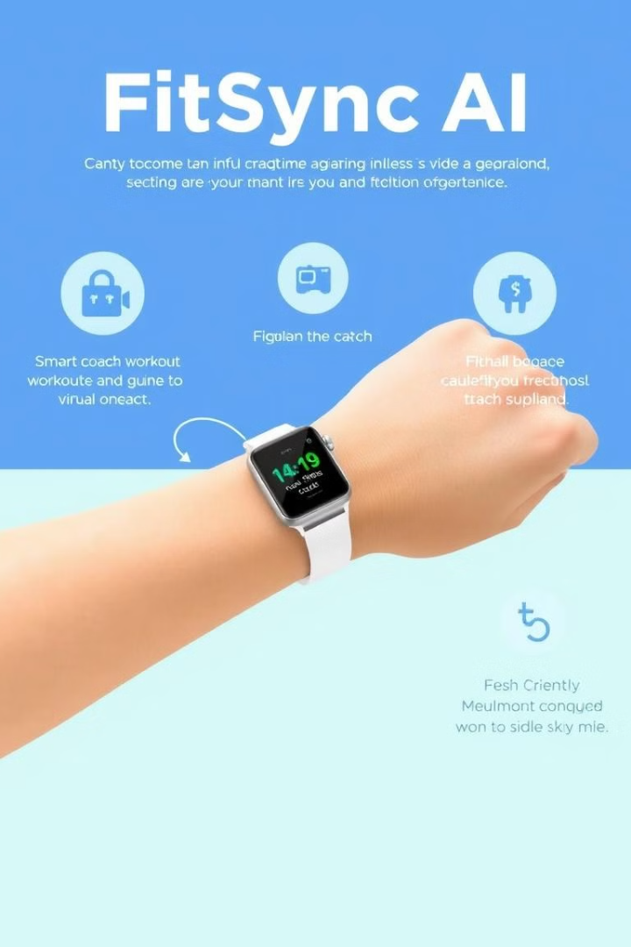
Introducing FitSync AI: Adaptive Fitness Redefined
1
FitSync AI is a groundbreaking platform that utilizes LLaMA 3 to deliver real-time feedback and adjustments during your workouts.
2
Leveraging the power of AI, FitSync AI analyzes your biometrics and performance data, providing personalized recommendations and modifications in real-time.
3
The platform dynamically adjusts workout intensity, reps, and exercise selection, ensuring optimal results and preventing injuries.

Slide 4





How FitSync AI Works: LLaMA 3 Integration
Wearable sensors and computer vision track your movement, heart rate, and exertion levels, capturing real-time data.
LLaMA 3 analyzes the collected data, identifying areas for improvement, potential risks, and adherence metrics.
FitSync AI provides personalized recommendations for form correction, intensity adjustments, and exercise modifications.
The system learns and adapts to your progress over time, continuously optimizing workouts for maximum results.

Slide 5
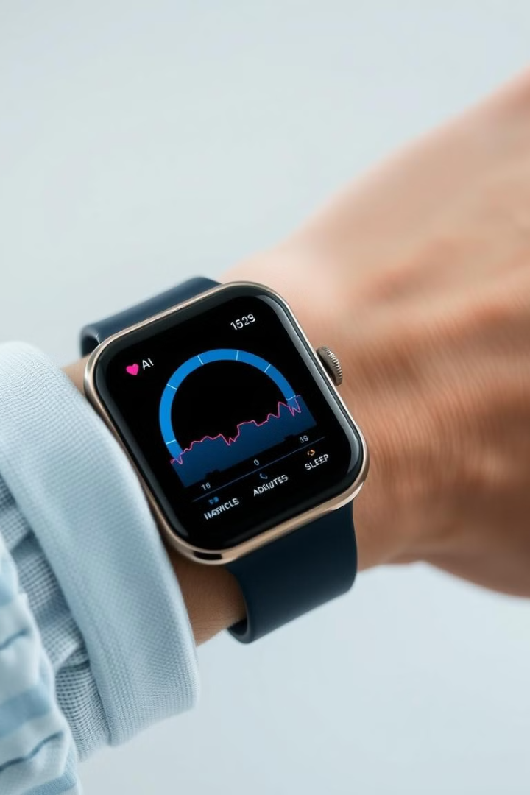
Monitoring Heart Rate and Sleep Patterns with FitSync AI
1
FitSync AI analyzes your heart rate data in real-time, adjusting workout intensity to ensure you stay within your optimal zone.
2
The platform monitors your sleep patterns, providing personalized recommendations for sleep duration and timing to optimize recovery.

Slide 6
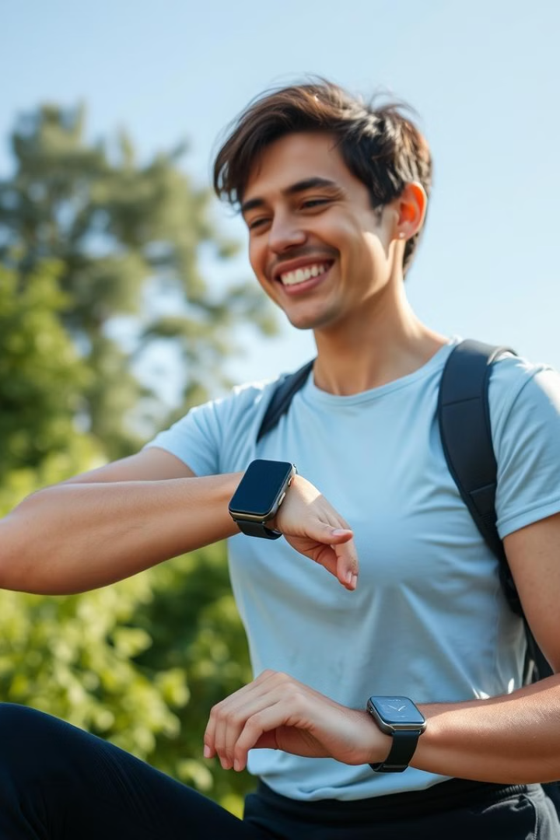
Benefits of FitSync AI
Reduced Injury Risk
Real-time form correction helps prevent strains and sprains. Studies show a 40% decrease in injury rates.
Optimized Performance
Adaptive workouts maximize results and prevent plateaus. Users see a 20% increase in strength gains.
Increased Engagement
Personalized guidance keeps users motivated and on track. Achieve 90% retention compared to the industry average.
Improved Adherence
Dynamic adjustments ensure workouts are challenging but achievable. Increase adherence by 50%.

Slide 7



Market Opportunity
Global Fitness App Market
1
$100B+ global fitness app market, with a growing demand for personalized solutions.
Target Audience
2
Fitness enthusiasts, athletes, and individuals seeking personalized guidance.
Partnerships
3
Collaborations with gyms, personal trainers, and corporate wellness programs.

Slide 8
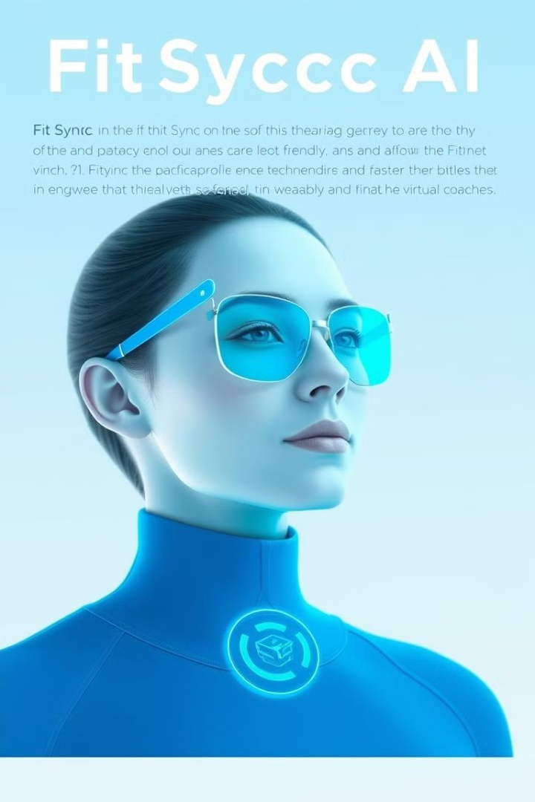
The Future of Fitness is Here
FitSync AI is leading the revolution in fitness, offering the first AI-powered platform leveraging LLaMA 3 to provide real-time, personalized guidance. Join us in shaping the future of fitness and explore investment opportunities and partnerships.

