Slide 1
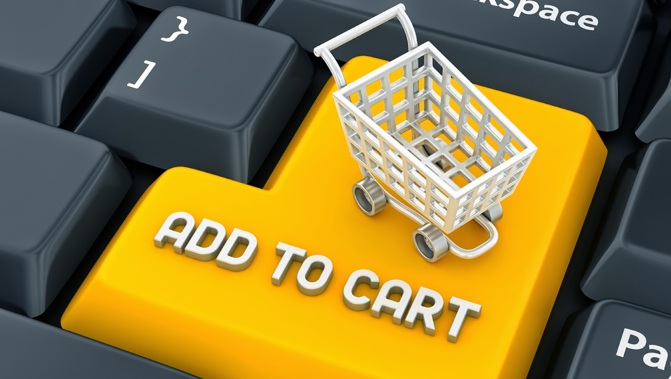
ONLINE SHOPPING PORTAL
Group: CODE BREWERS Dhrakshayani Priyanka(001381953)
Lohita Gundapaneni(001348847)
Devika Supriya Gadesuka(001084425)
Vinitha Koppula(001374627)
Online Presentation https://prezi.com/view/hYns1P1fQg5u69va9xnE/

Slide 2

Objective
In today’s fast-changing business environment, it’s extremely important to be able to respond to client needs in the most effective and timely manner.
If your customers wish to see your business online and have instant access to your products or services. In order to develop an e-commerce Database, one needs to track transactions, organize products and provide structure to the stored data and this project does this in very efficient manner.
The main purpose to a database is to store information. Have a question about a customer order? Check the database. Want to know a product price? Check the database.
By using a database, a web application can ignore the actual data and focus more on the presentation and behavior of that data. The end result is that the amount of code and logic in the web application is much smaller and easier to understand.
For example, if all products have images, then the web application just needs to ask for that data — i.e., an image — and show it as a product preview. It doesn’t care if there is one image, three images, or what the images actually are showing. The application just expects to get back an image URL, which it then displays.

Slide 3
Description
Any member can register and view available products.
Only registered member can purchase multiple products regardless of quantity.
There are three roles available: Visitor, User and Admin.
• Visitor can view available products.
• User can view and purchase products.
• An Admin has some extra privilege including all privilege of visitor and user.
Admin can add products, edit product information and add/remove product.
Admin can add user, edit user information and can remove user.
Admin can ship order to user based on order placed by sending confirmation mail

Slide 4
Entities
USER: - User is a general representation of all the user who will create an account on the website. User Id is our primary key for the user. It has multiple attributes such as DOB, Address, first name, last name etc.
SUPPLIER: - Supplier will contain the list of all the sellers who are selling the product. It will have compositional key. It will have attributes like Supplier id, product id, company name and product quantity
ADDRESS: - Address will contain the supplier address and user address. Seller address is stored in order to know from where order needs to be pick up and user address in order to know from where the product should be sent
ORDER: - Order will contain the order item and it will have attributes like order id, order quantity, product price etc
ORDER LINE: - Order line will contain the detail of the order submitted by the user. Every order will have a unique user id and other attributes like order quantity, product ID, shipping date, shipping address etc.
PRODUCT: - This will contain the detail of the product. It will have attributes like product id, brand id, quantity, description, rating id etc.
BRAND: - This will tell user the brand of the product the user is buying. It will attributes like brand id, brand name and logo
CATEGORY: - It will be used to tell the category of the product if it is clothes or accessories. Category will have attributes like category id, name, description and image.

Slide 5
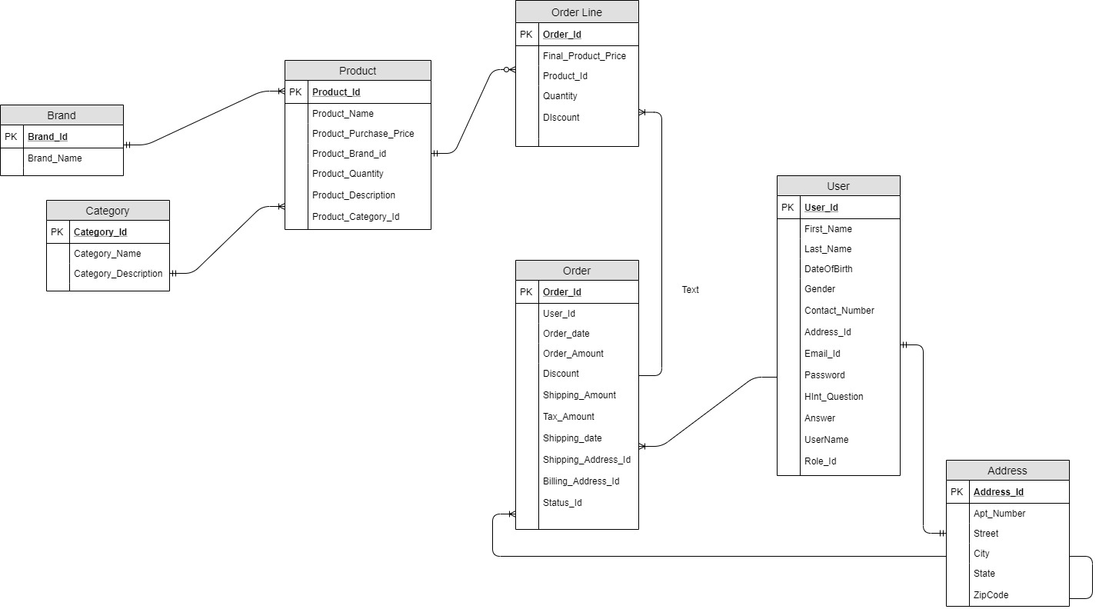
ERD

Slide 6
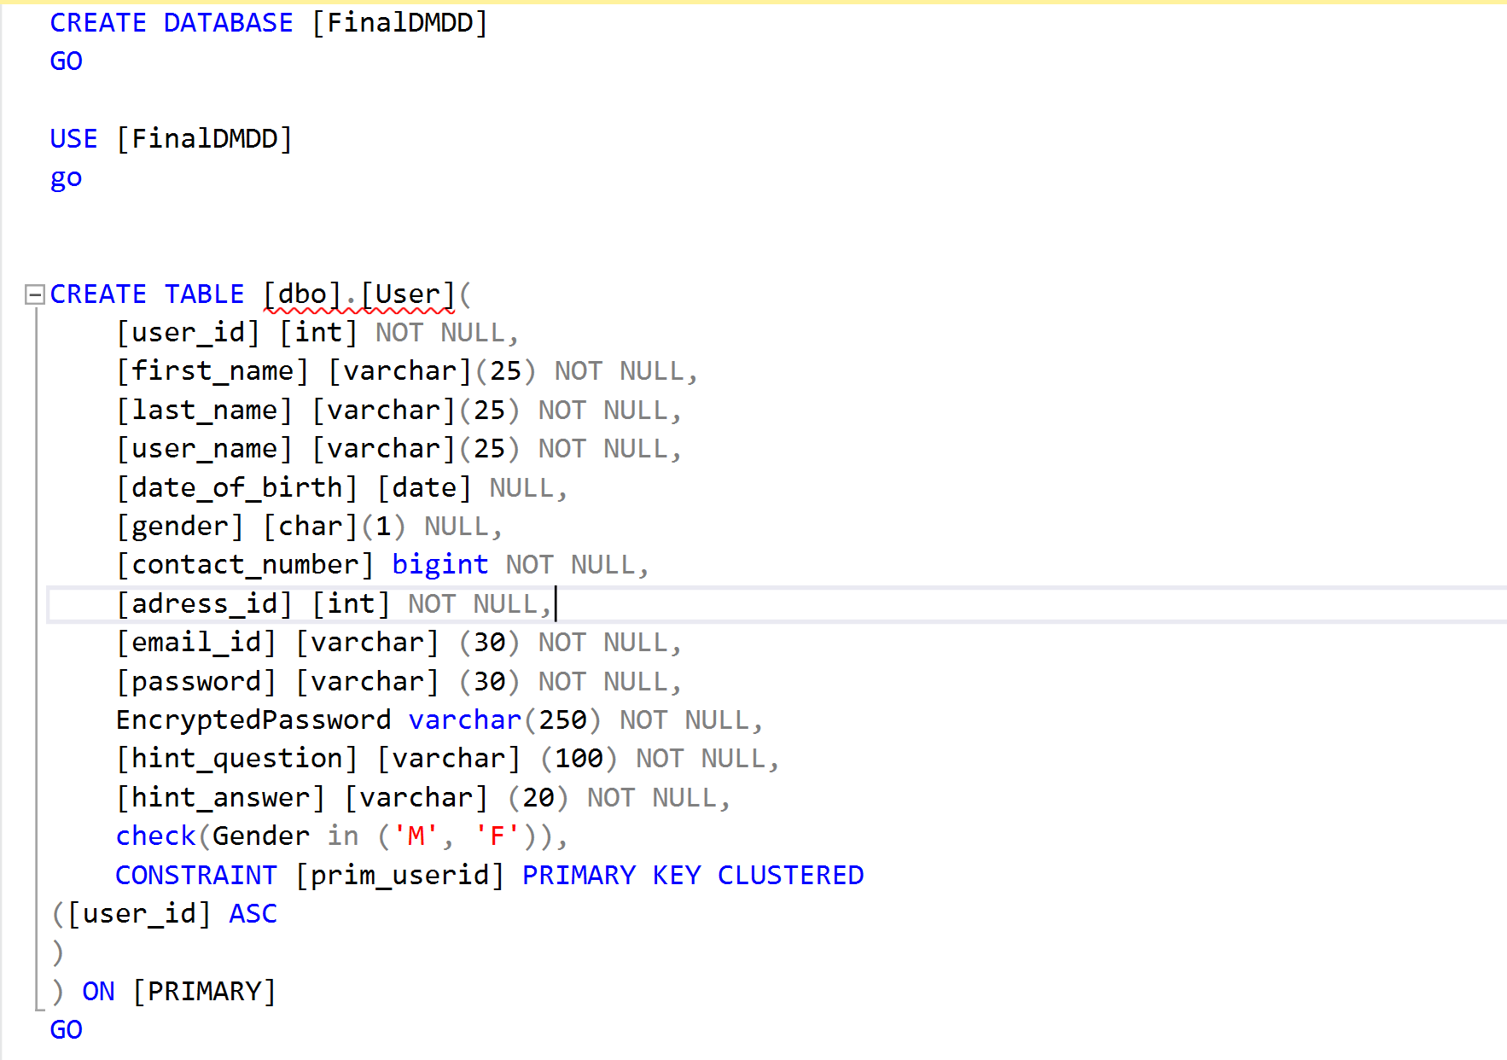
DDL

Slide 7
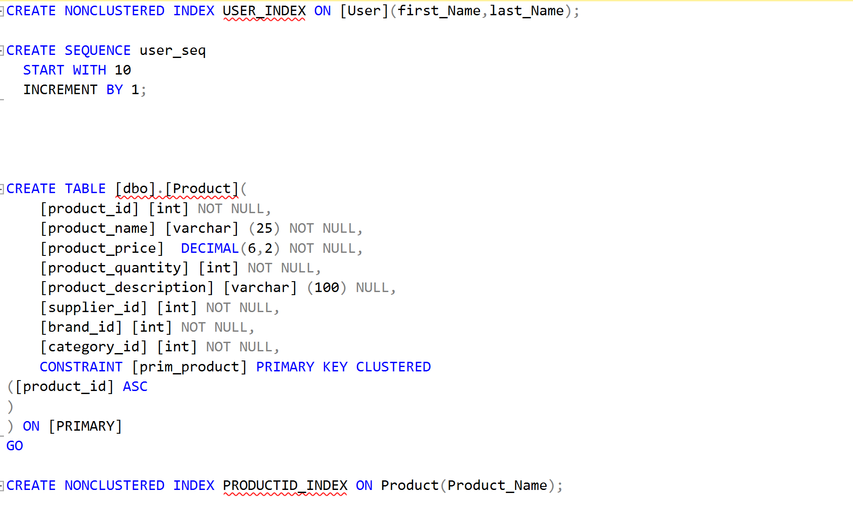
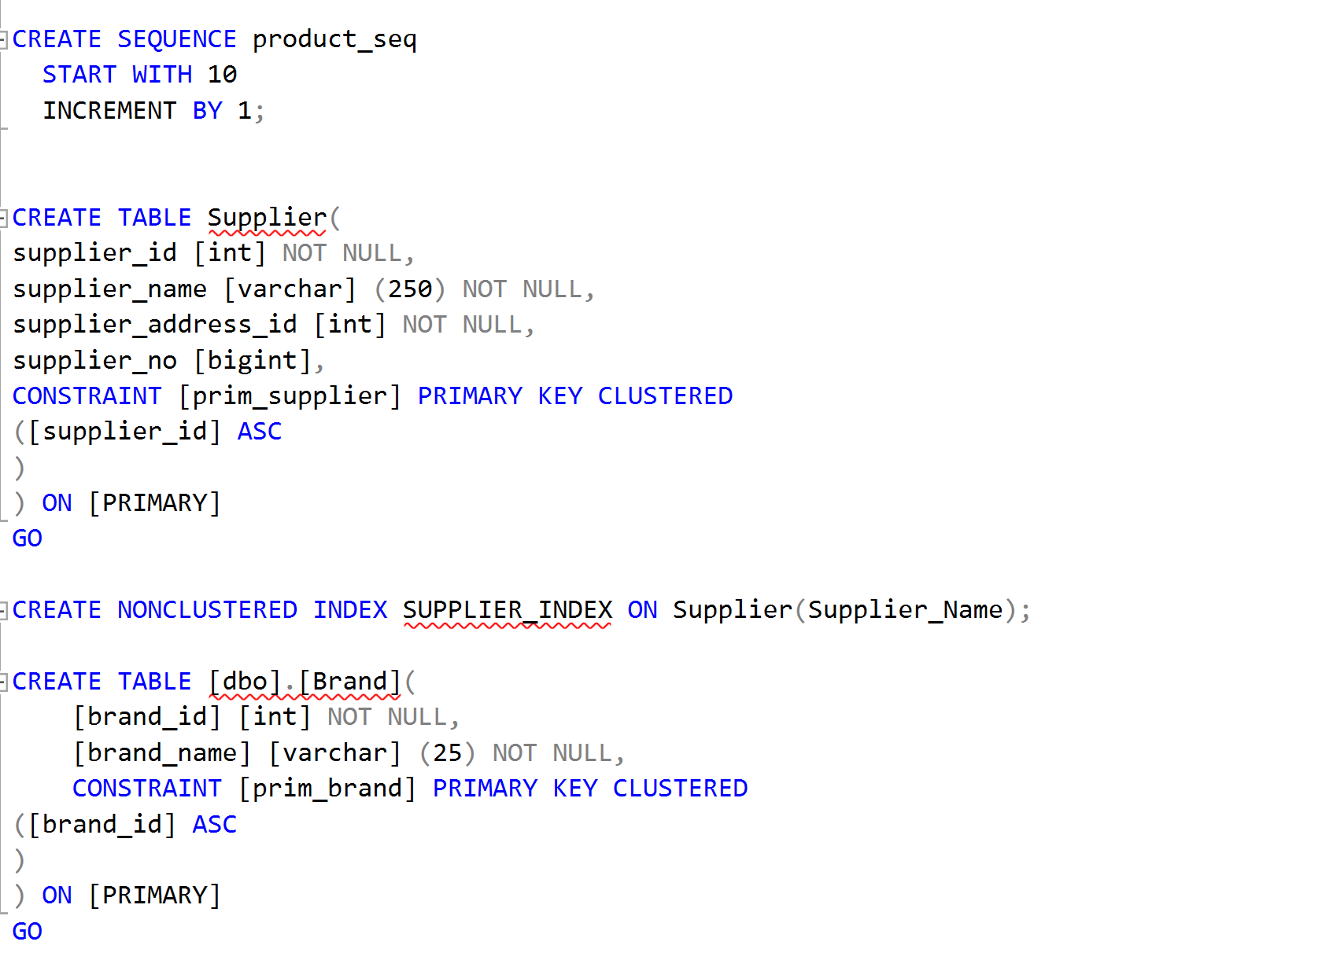

Slide 8
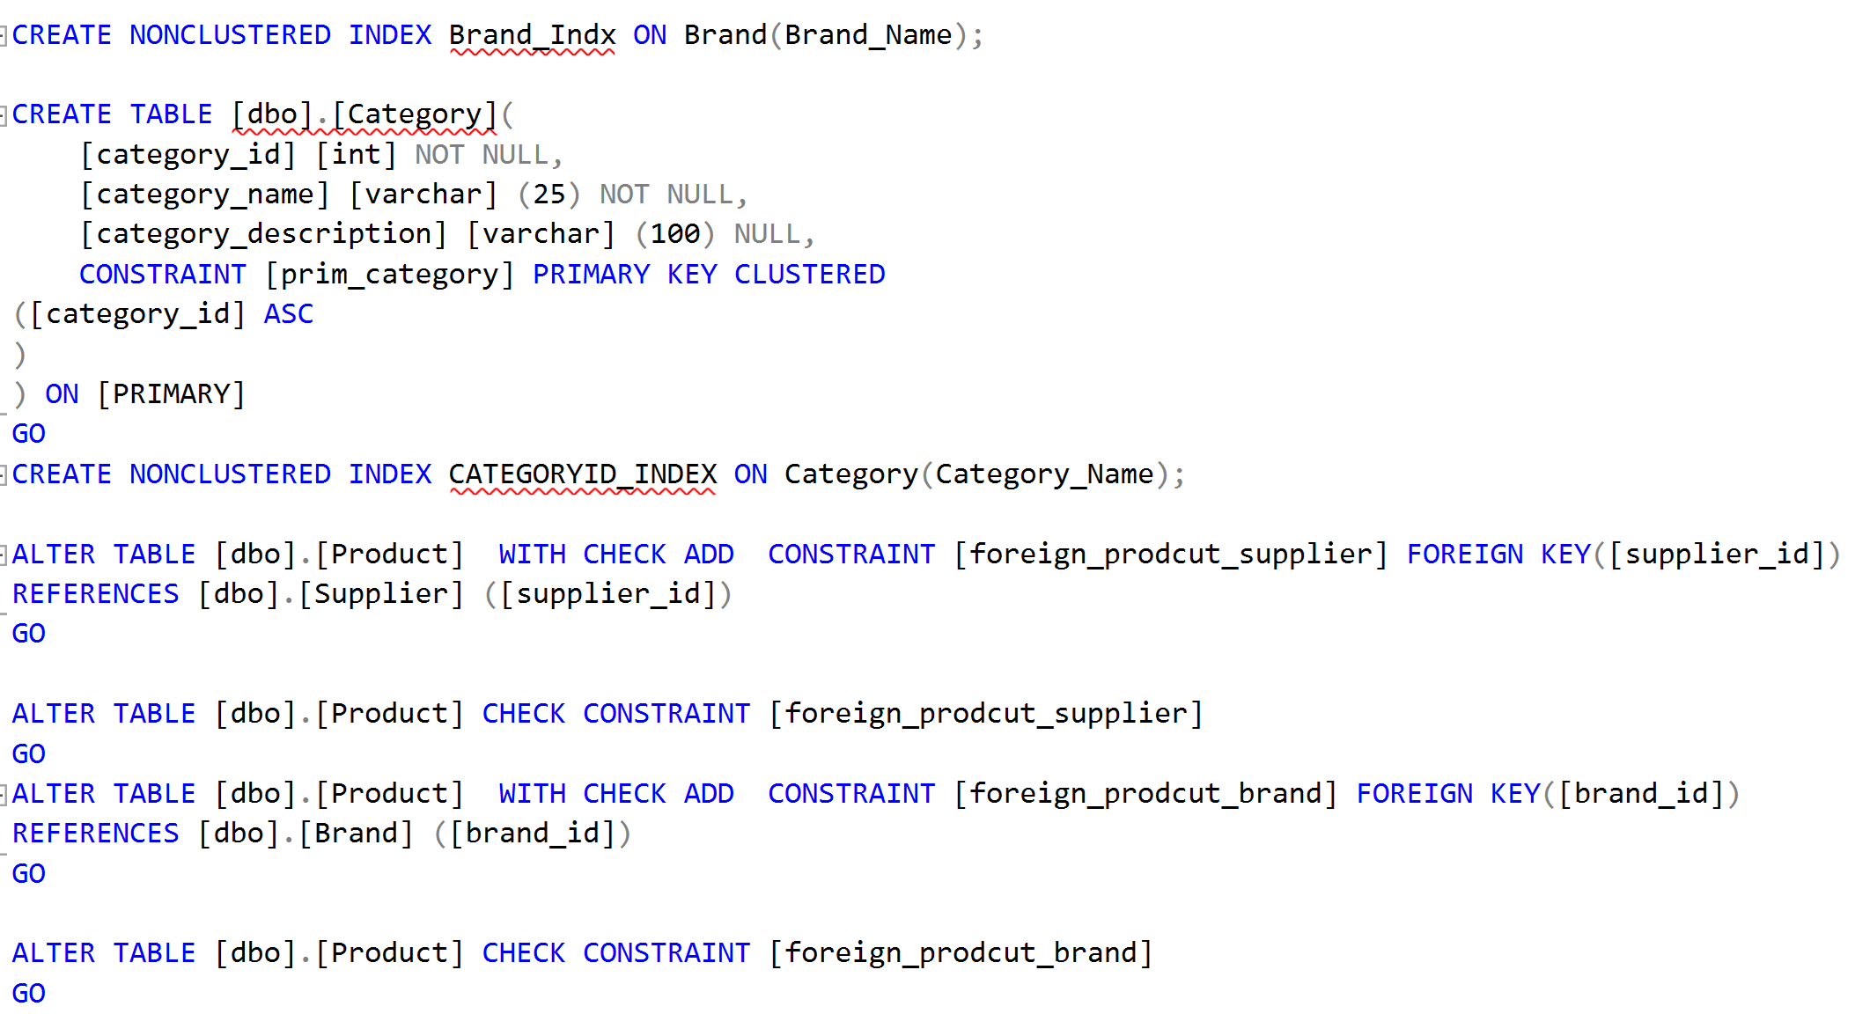
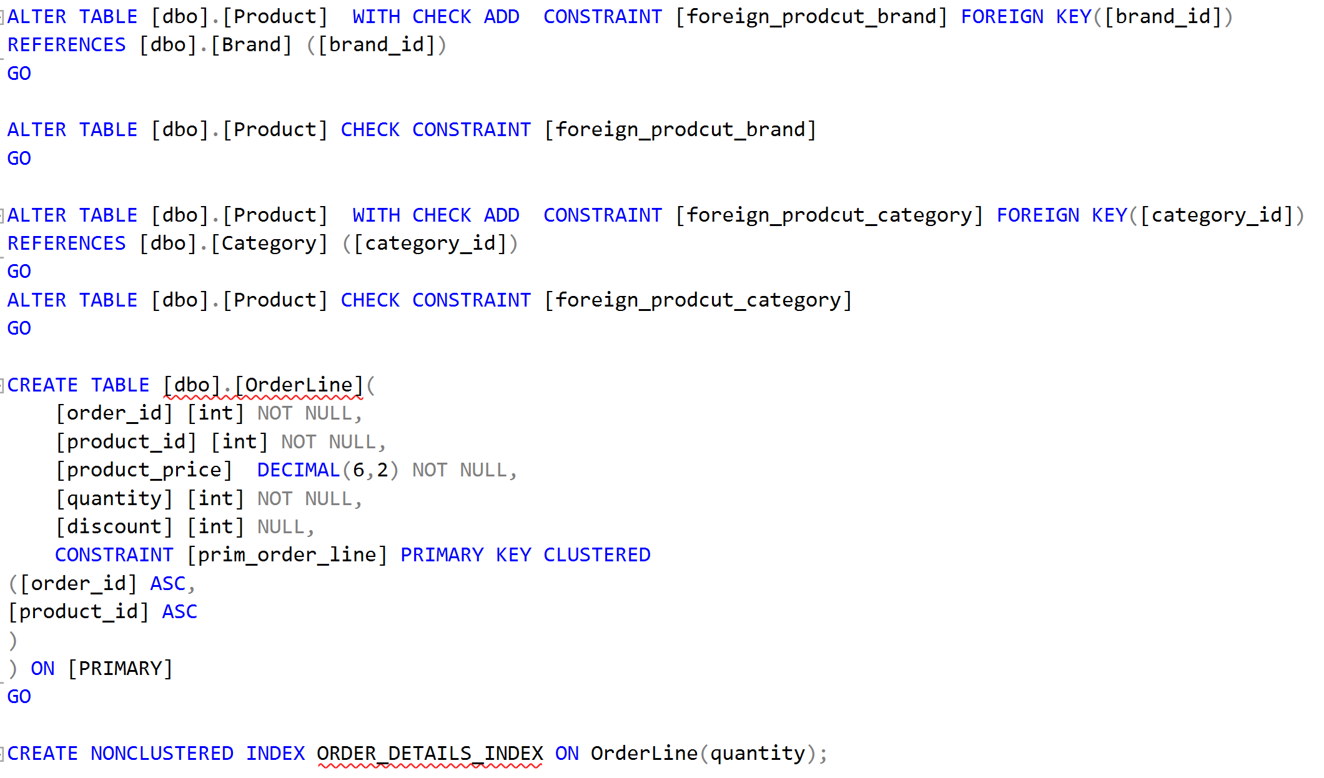

Slide 9
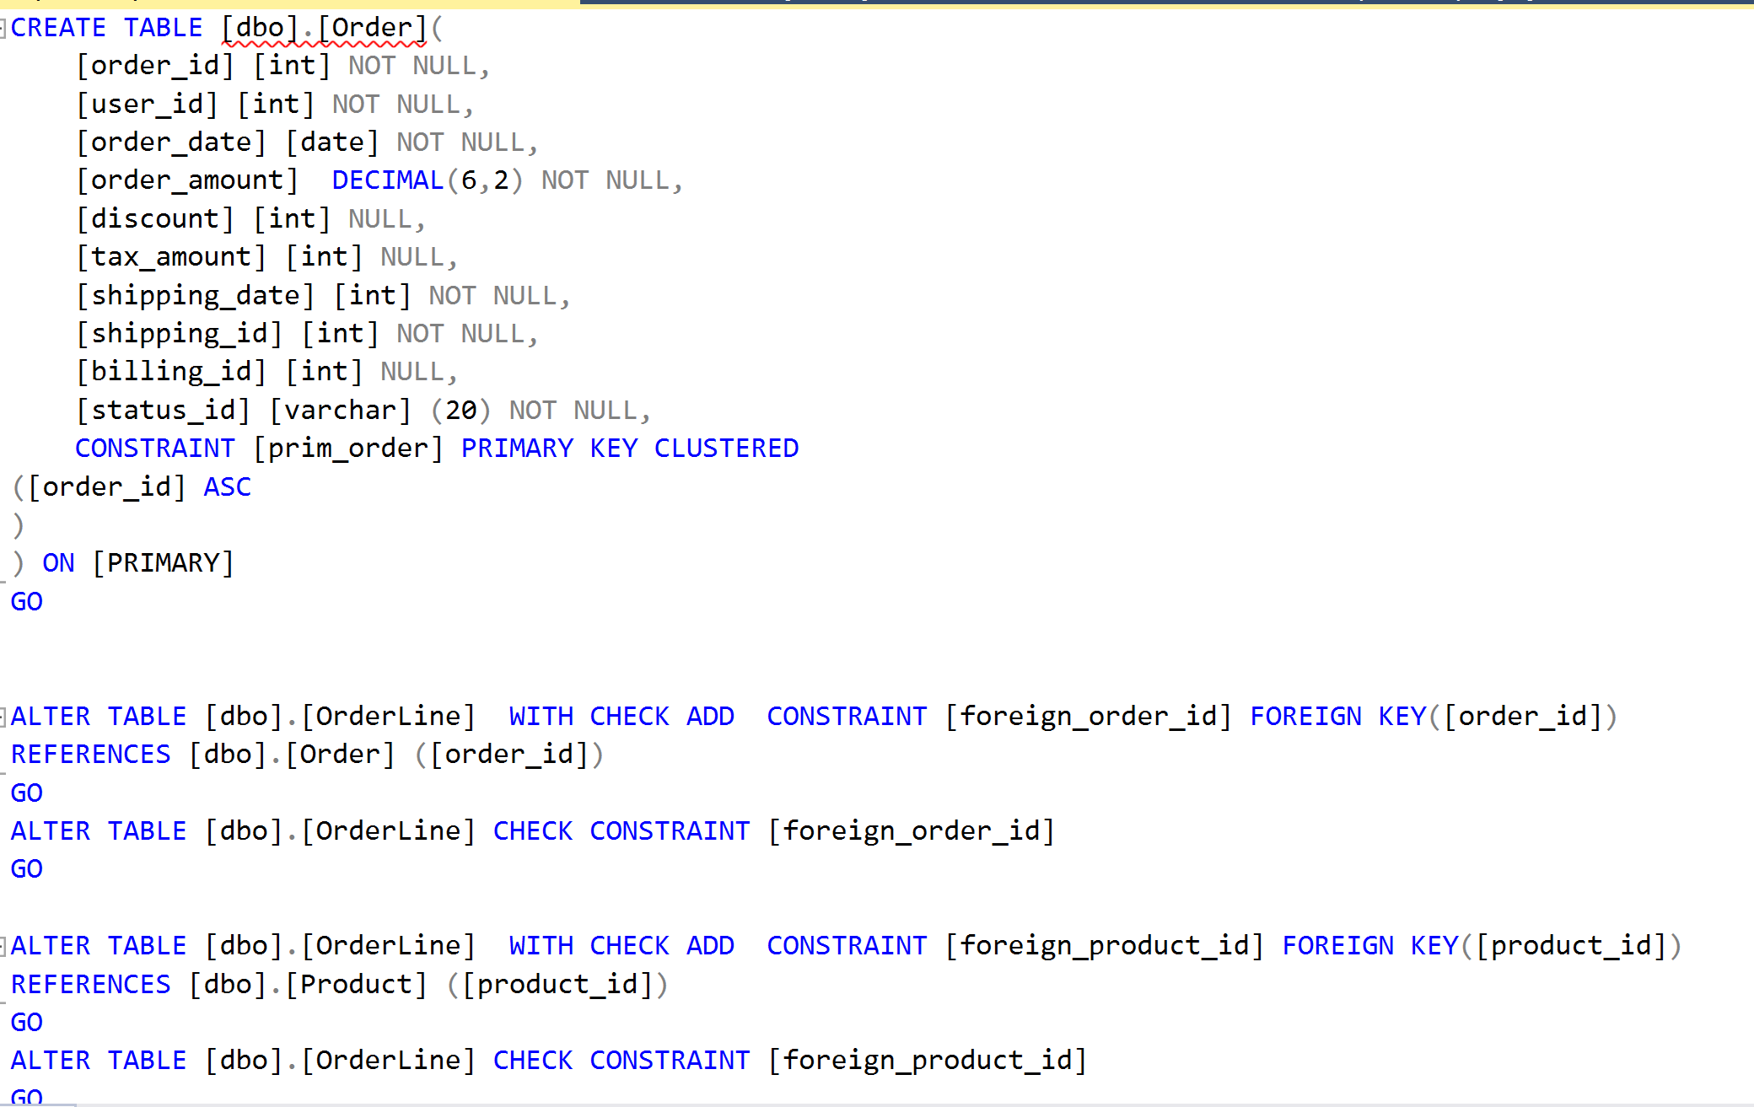
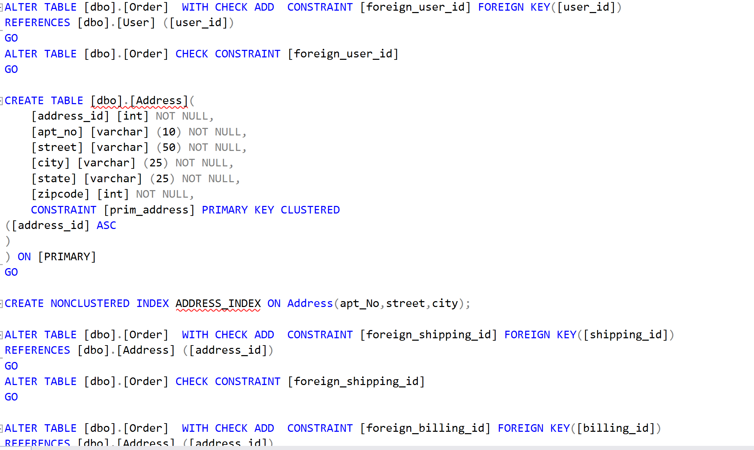
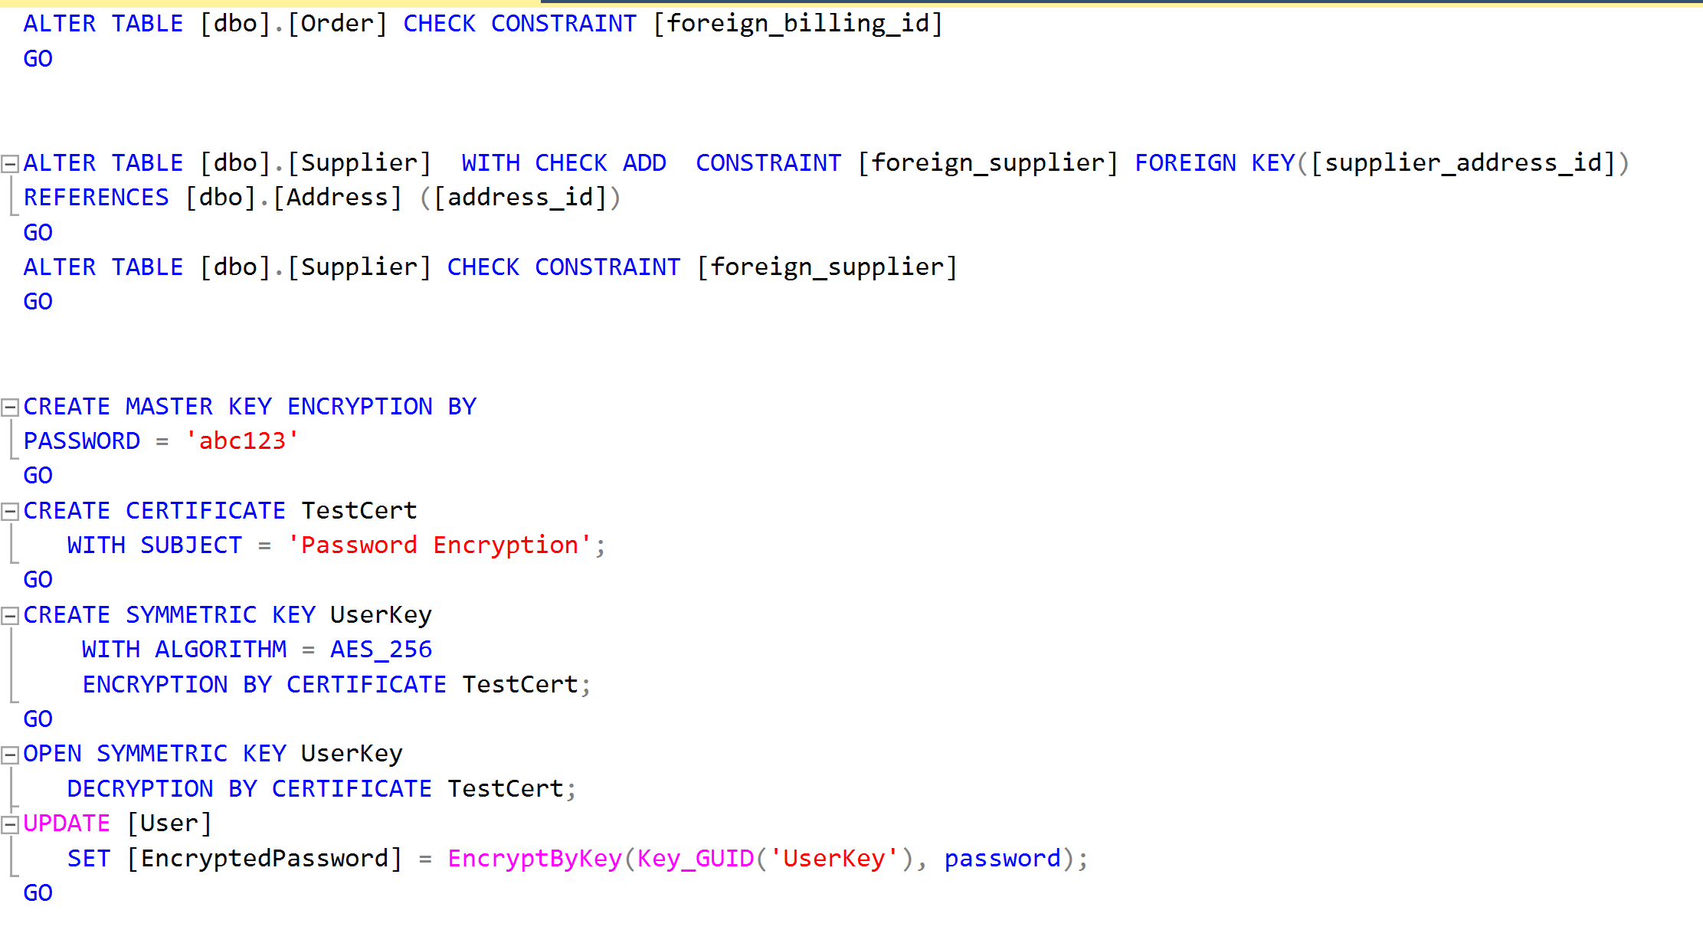

Slide 10
Encryption

Slide 11
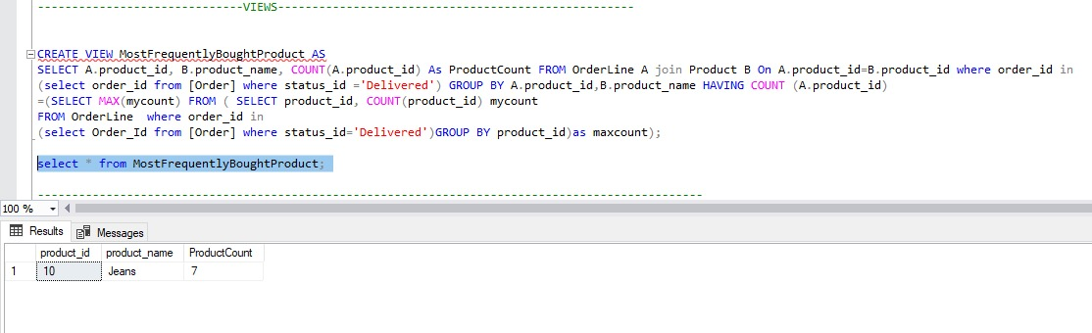
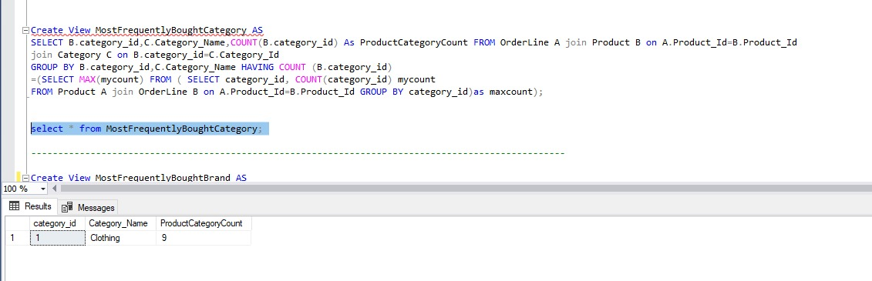
Views

Slide 12
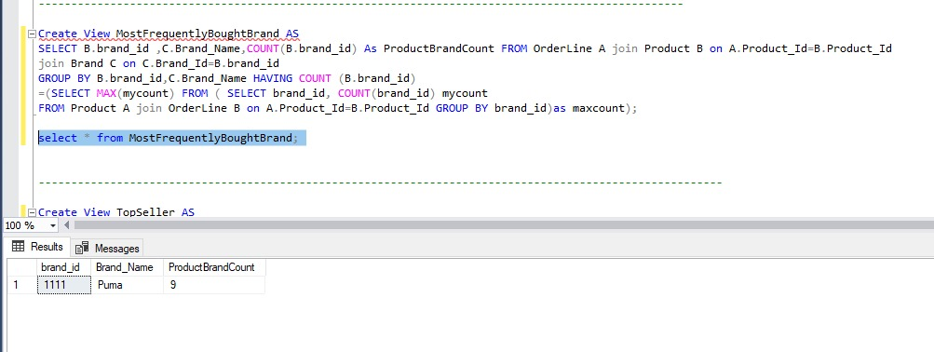
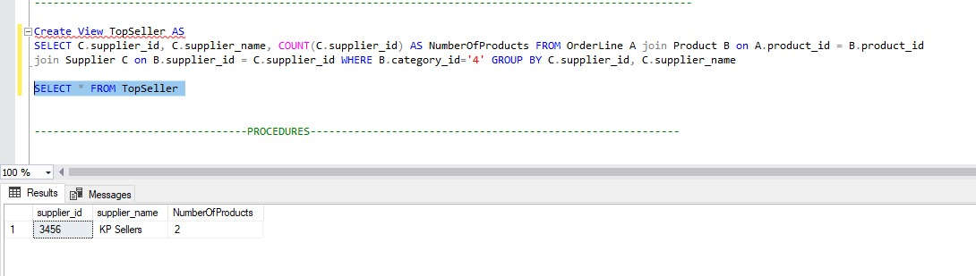

Slide 13
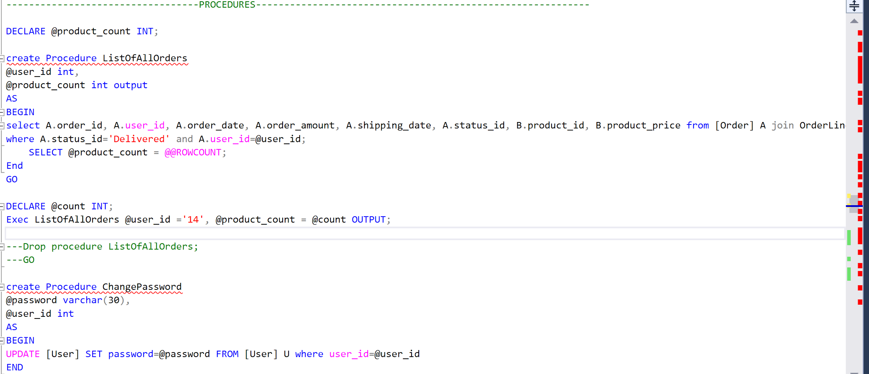
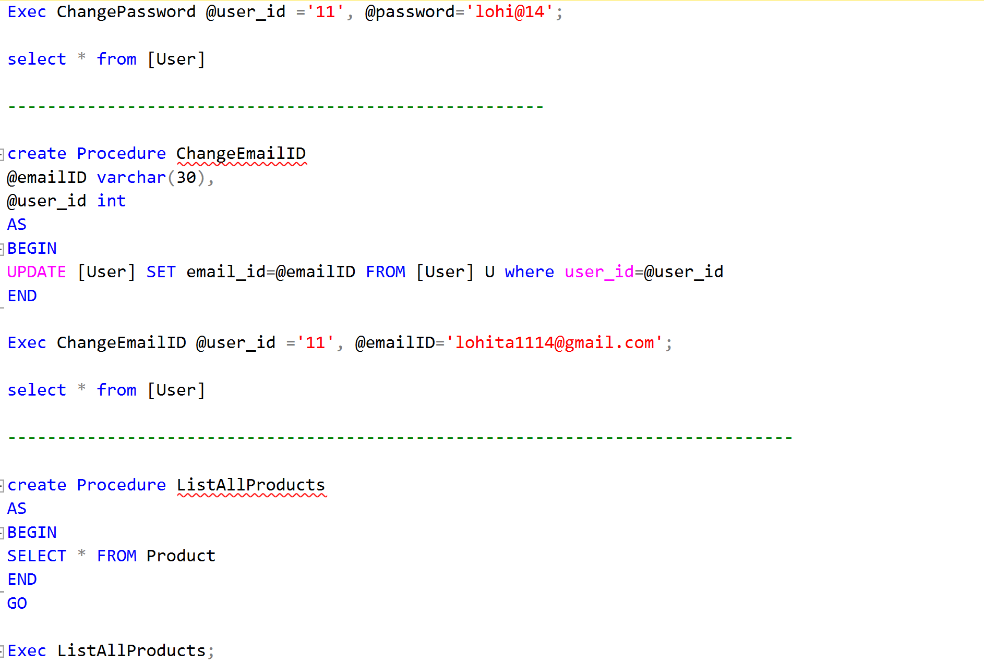
Stored Procedures

Slide 14
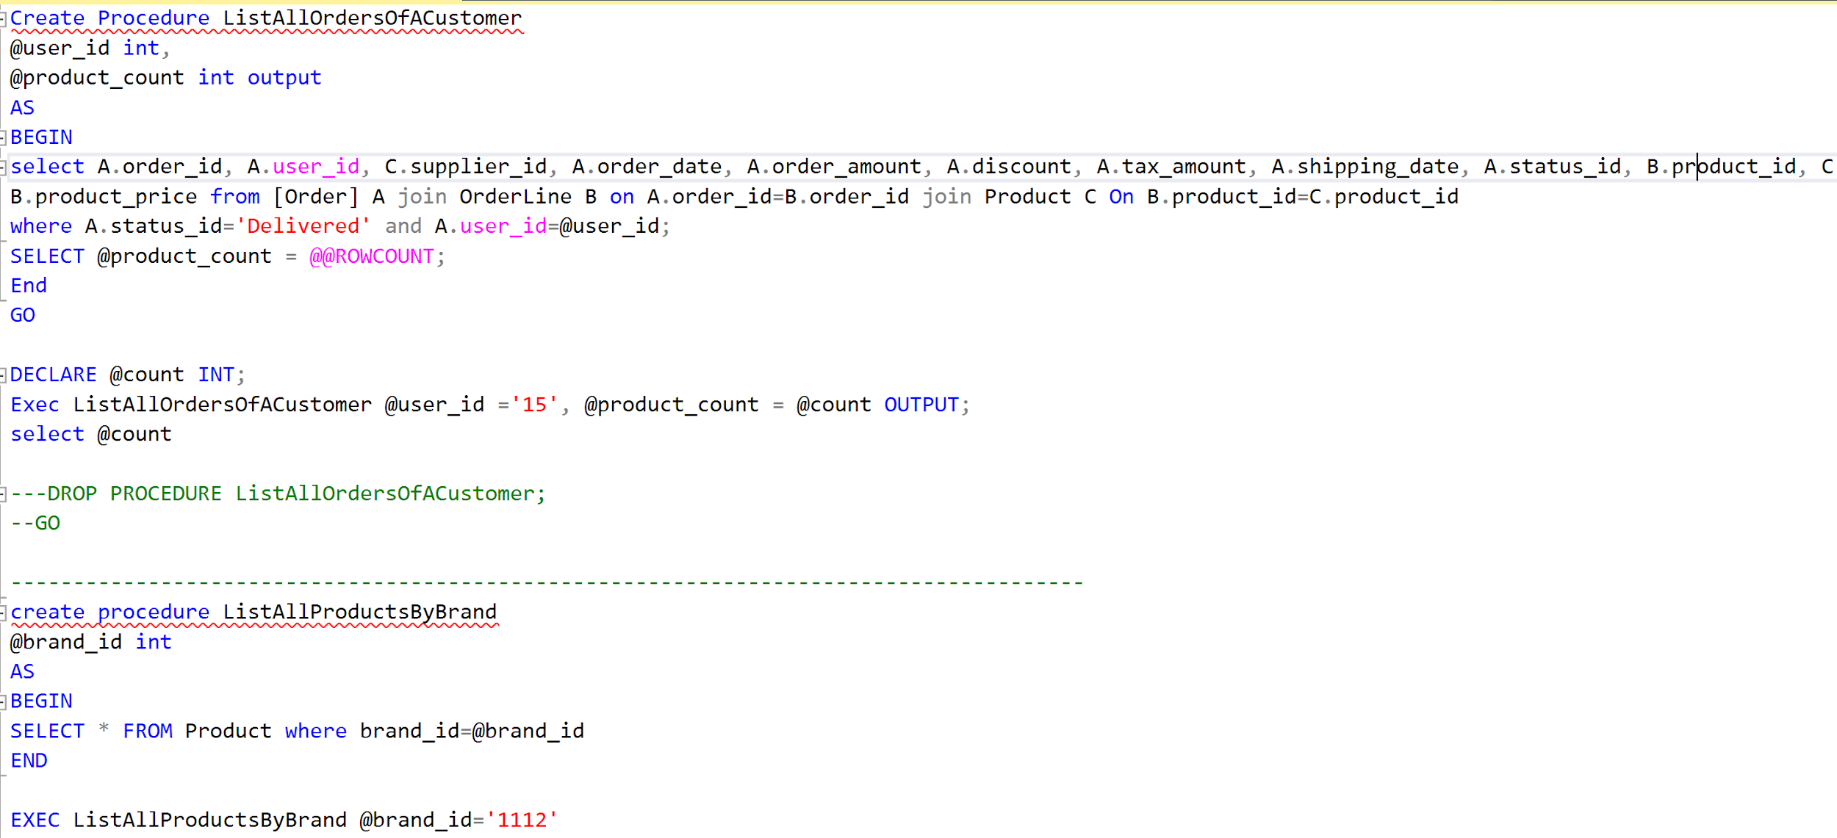
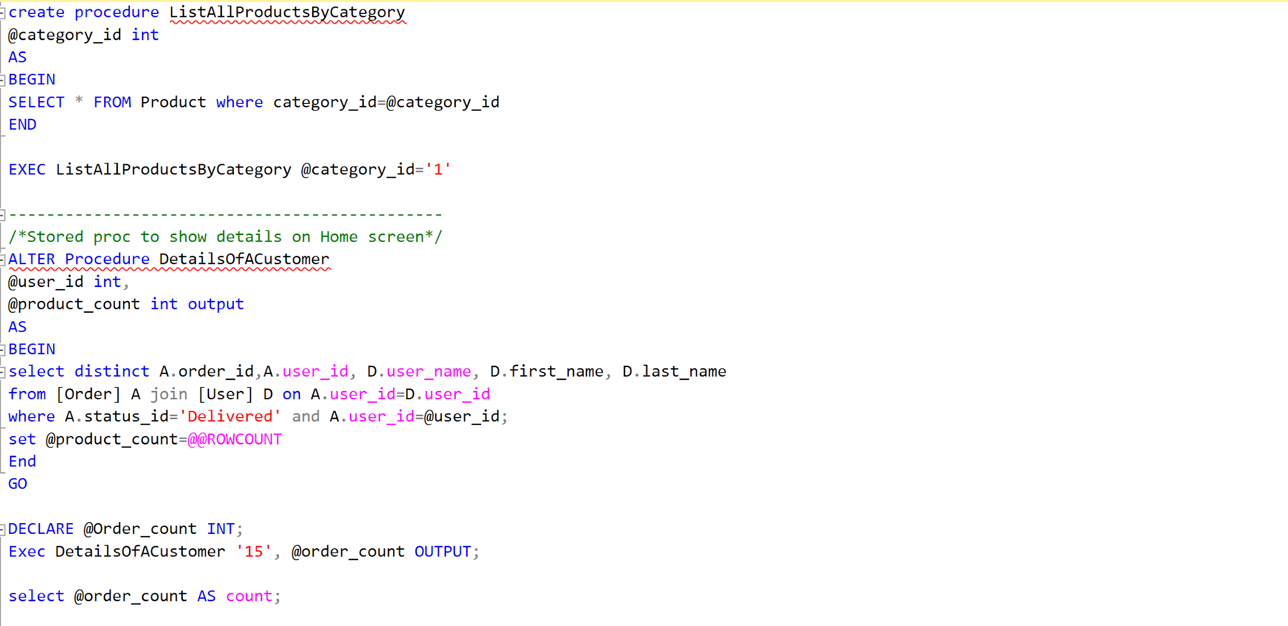

Slide 15
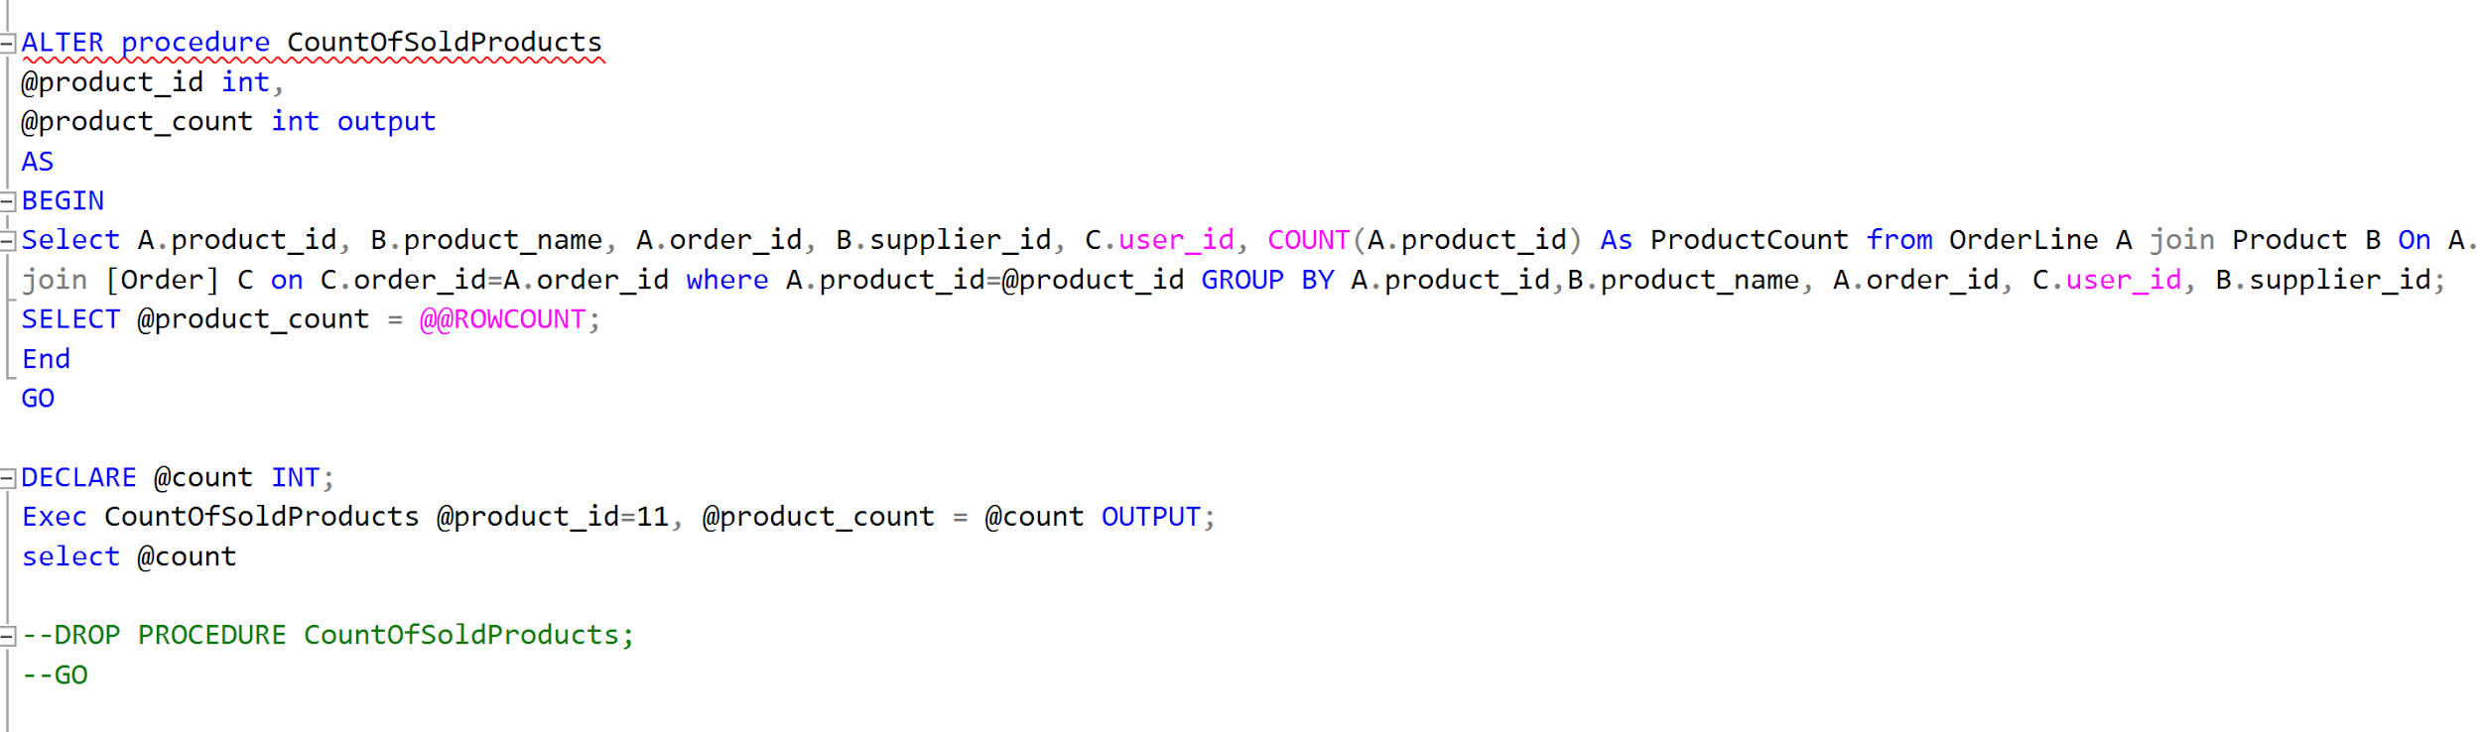

Slide 16
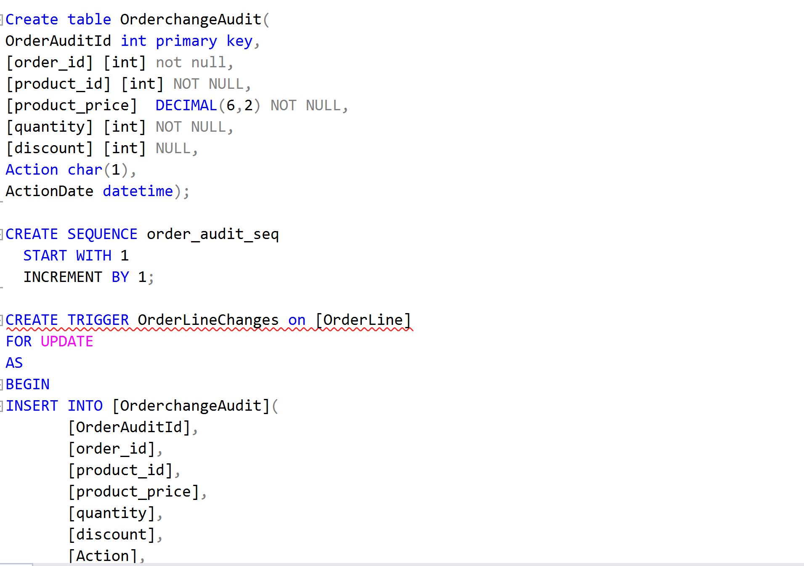
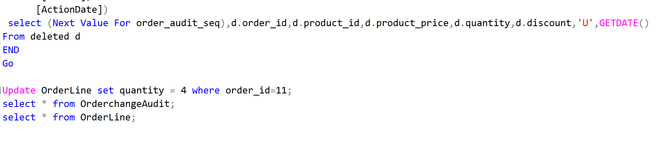
Triggers

Slide 17
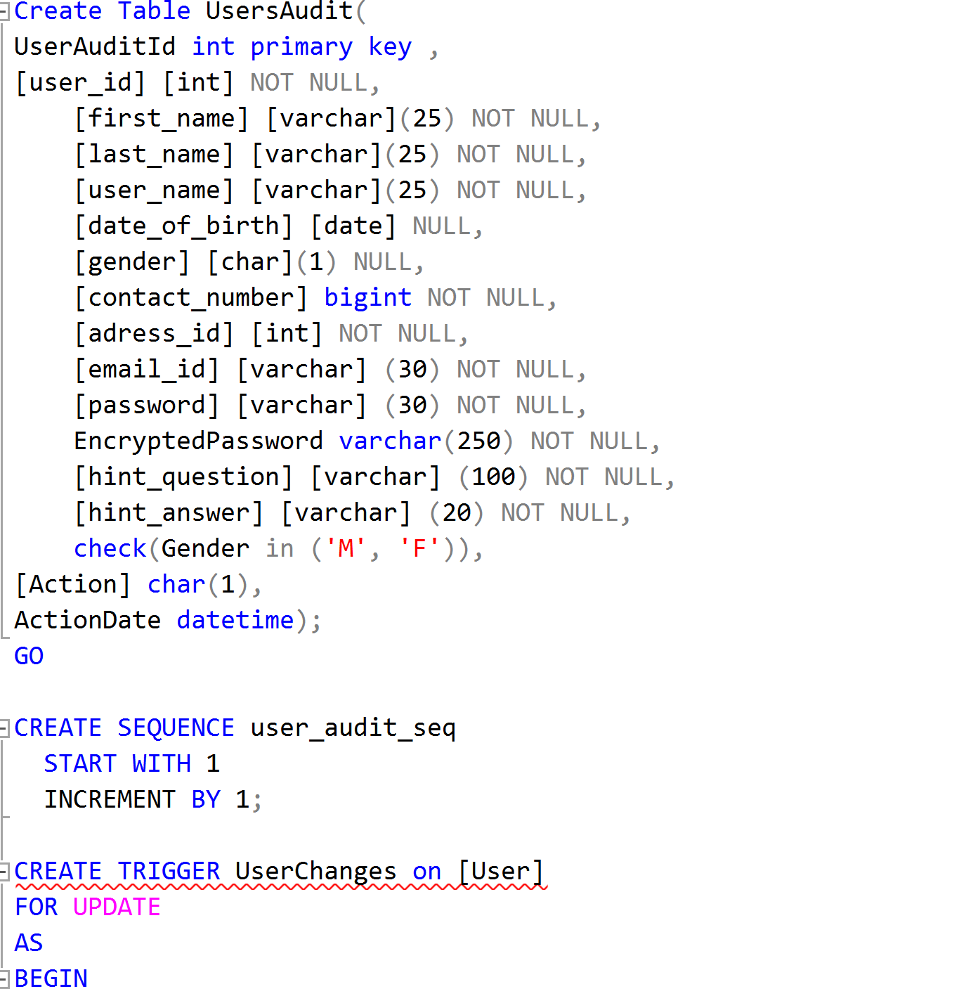
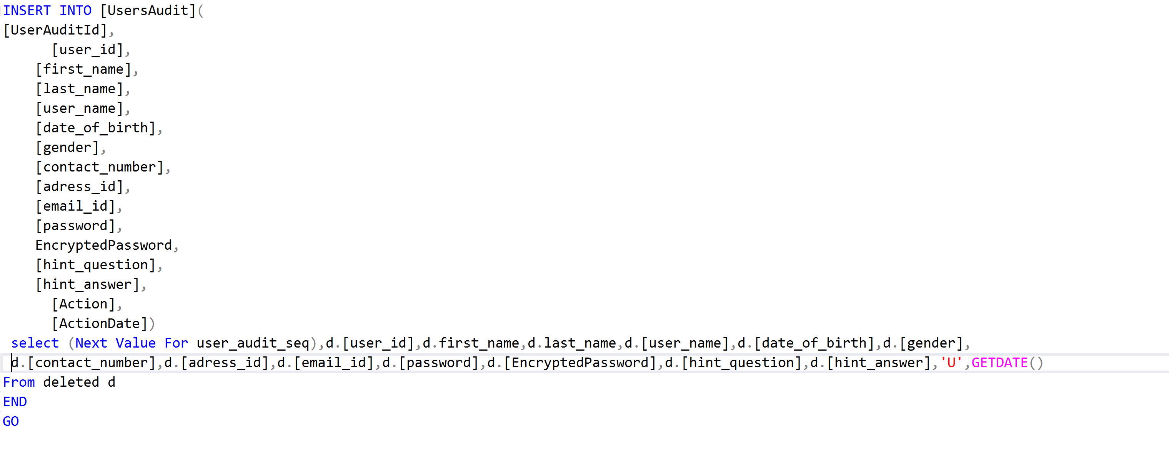

Slide 18
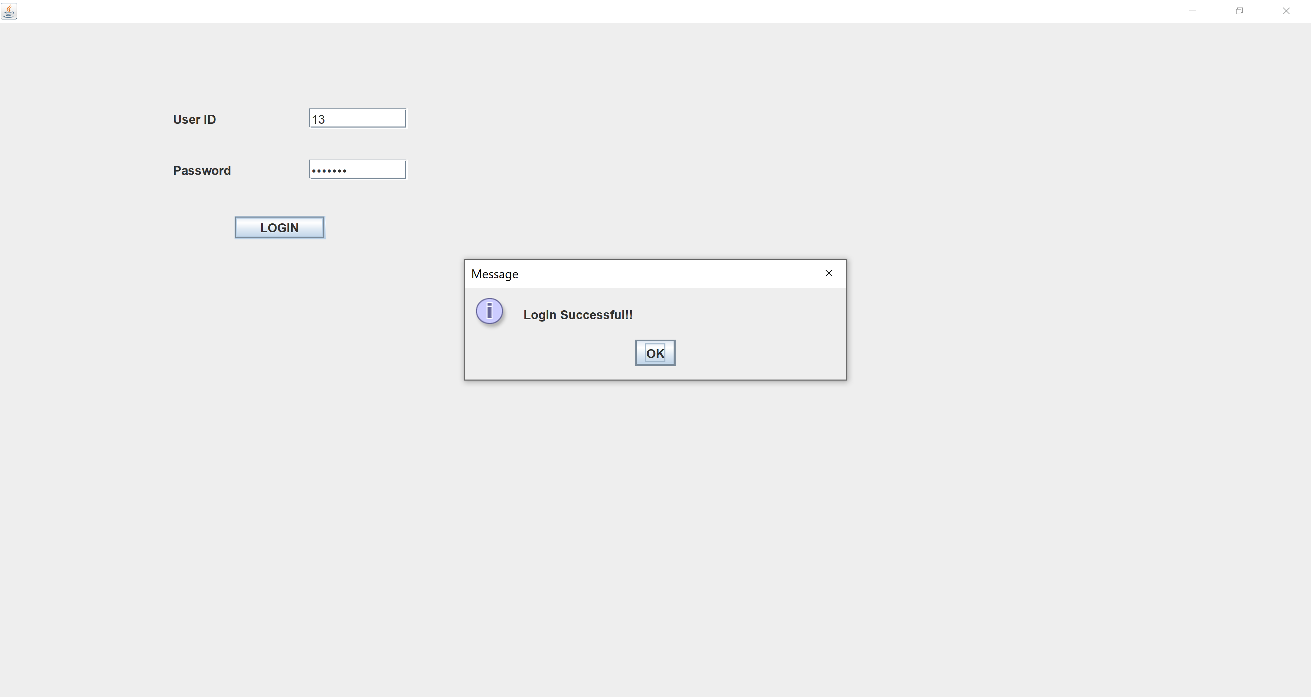
Front End: Login Page

Slide 19
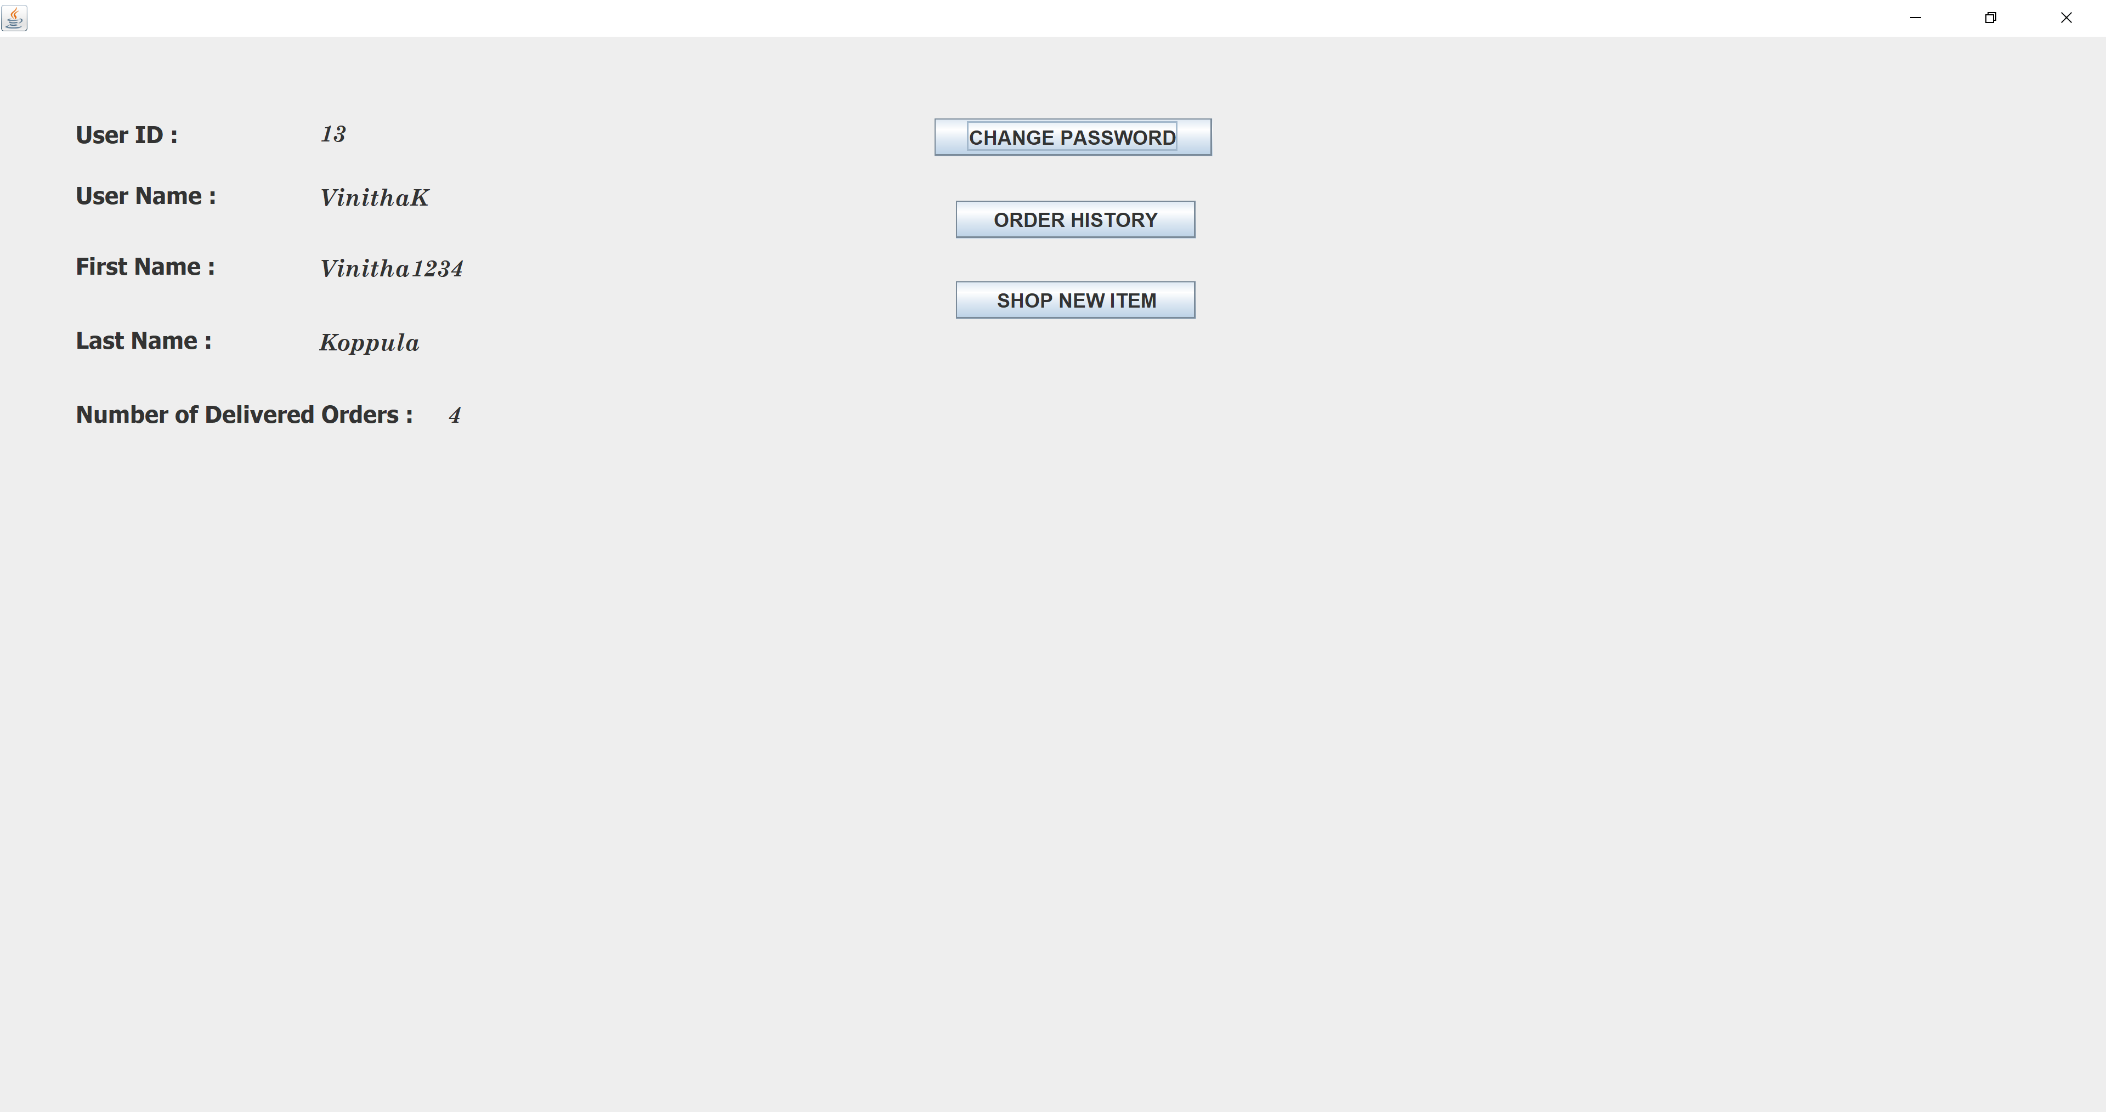
Front End: User page

Slide 20
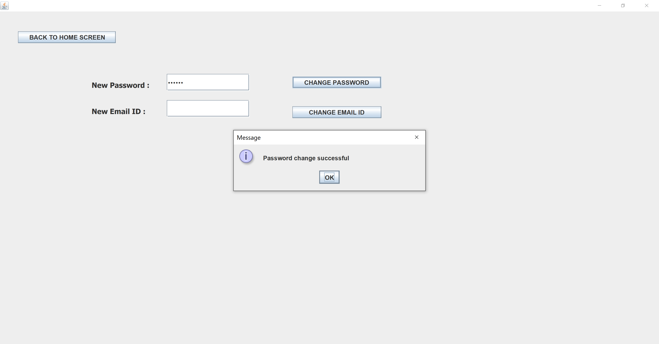
Front End: Reset Password page

Slide 21
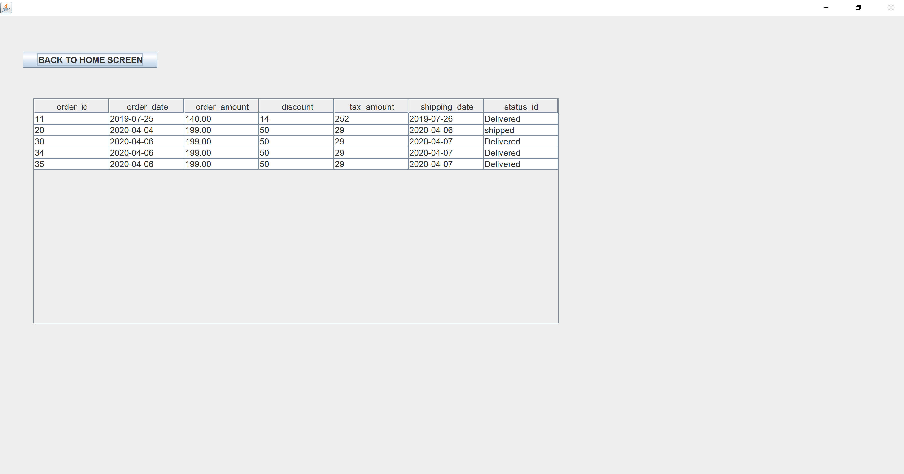
Front End: Order Details

Slide 22
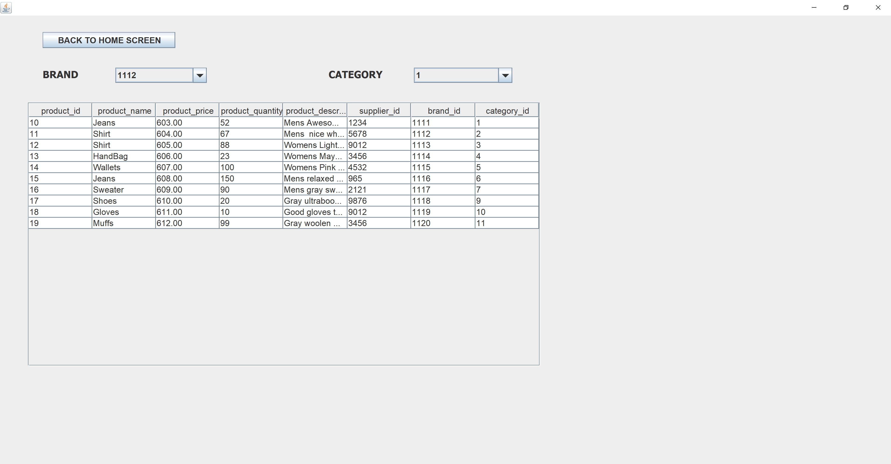
Front End: Product Details Search based on Brand and category

Slide 23
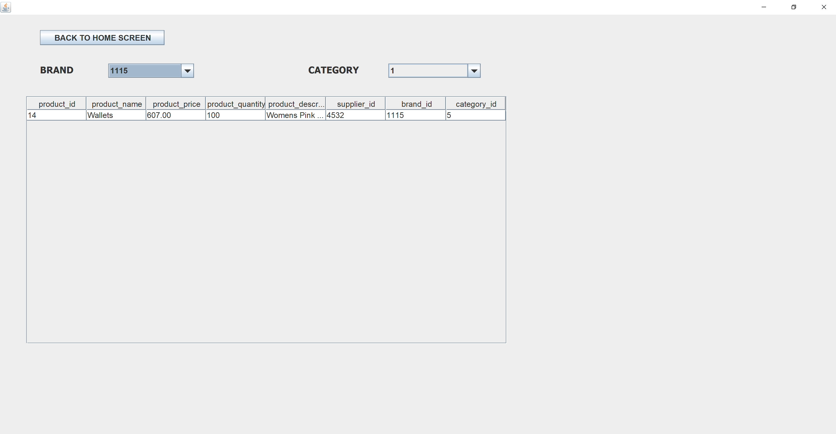
Front End: Product Search based on Brand

Slide 24
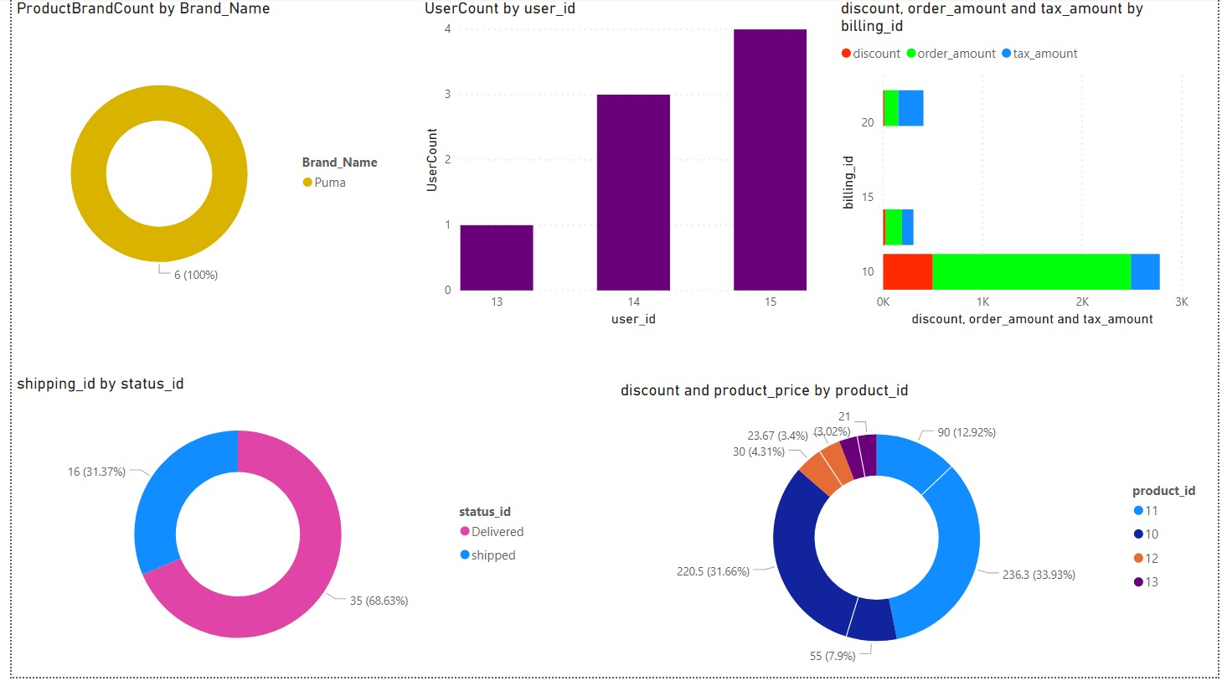
PowerBI Dashboard

Slide 25
Future Scope
The scope of the project is limited to Clothing and Accessories. Many more Product verticals can be introduced in addition to Clothing.
3-D viewing of the products can be Introduced in order to make the product view more interactive
Multiple images for a single product can be introduced in order to help consumer choose multiple Designs

Slide 26
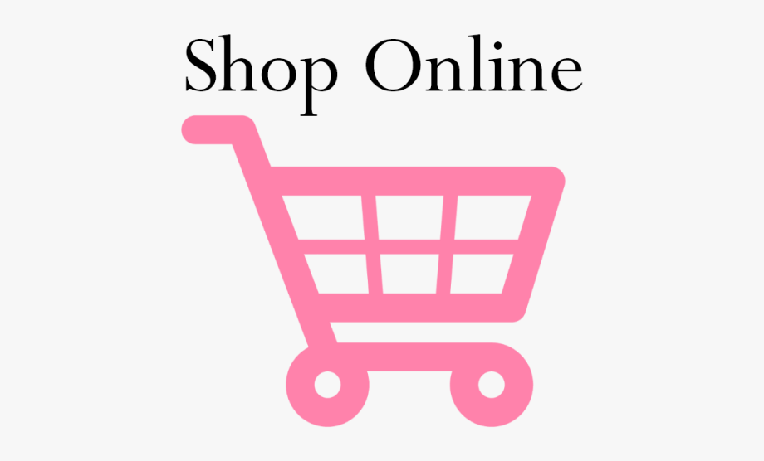
Thank you

