Slide 1

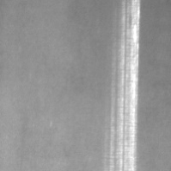
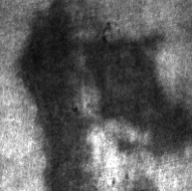
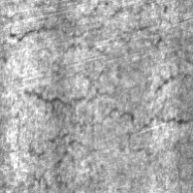
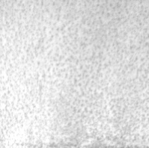
ISEM 505 · DEEP LEARNING PROJECT
Steel Surface
Defect Classification
Scratches
Patches
Transfer learning with EfficientNetB0 on the NEU-DET database:
six surface defects, classified from a single grayscale image.
Jeny George
Freddy Biayi
Sathwika Parshaboina
Crazing
Pitted Surface
Notes:
Introduce the project: a deep-learning image classifier that identifies which of six surface defects appears on a hot-rolled steel strip, built as an end-to-end pipeline in Colab.

Slide 2



01 · THE PROBLEM
Surface inspection is done by eye, one coil at a time
Human inspection is inconsistent
1,800
images
Quality inspectors judge surfaces visually, often on night shifts. Fatigue and subjectivity cause misses and disagreement.
6
defect types
The defect type drives the action
Scrap, downgrade, re-roll or adjust the line: each defect points to a different cause and a different response.
200 × 200
pixels, grayscale
What we built
A model that takes one grayscale surface image and names which of six defect types it shows, with a confidence score.
300
images per class
NEU-DET: hot-rolled steel strip surfaces, captured under controlled lighting by Northeastern University.
Steel Surface Defect Classification · ISEM 505
02
Notes:
Frame the problem in plain terms: inspection today depends on a person looking at steel, and the defect type decides what the mill does next. Our model automates that naming step.

Slide 3
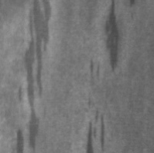
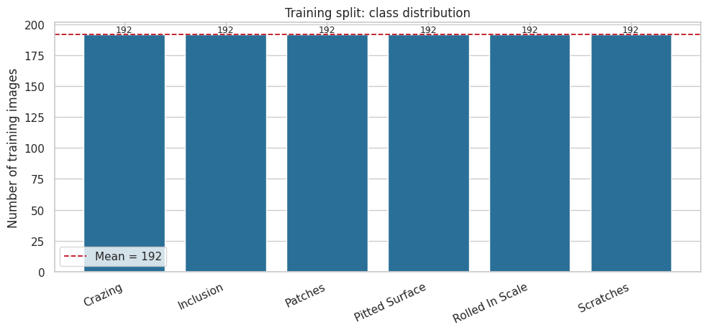
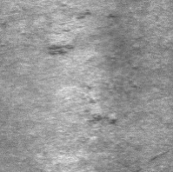

02 · THE DATA
Six defects, 300 images each, perfectly balanced
Crazing
Inclusion
Patches
Network of fine hairline cracks
Foreign material rolled into the steel
Irregular discoloured regions
Balanced by design
The imbalance ratio is exactly 1.00. No class dominates, so overall accuracy is a fair headline number here.
Pitted Surface
Rolled-In Scale
Scratches
Clusters of small cavities
Oxide scale pressed into the metal
Long, straight directional gouges
Steel Surface Defect Classification · ISEM 505
03
Notes:
Show what each defect actually looks like. Point out that crazing and rolled-in scale are both fine surface texture, and scratches can resemble inclusions. That similarity is what shows up later in the confusion matrix.

Slide 4
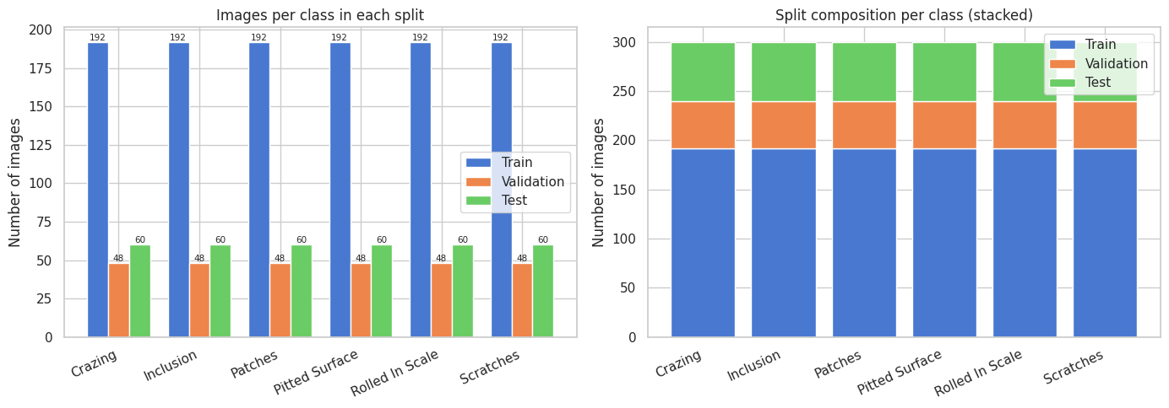


03 · SPLITS & LEAKAGE
Three splits, and a hard check that none overlap
The test set is sealed
It is used once, at the very end. Every decision about training and model choice was made on validation data only.
Two leakage checks
1,152
288
360
Filename check: no image listed in two splits
MD5 content hash: catches the same image copied under another name
Both passed, and a failure raises an error rather than a warning
Train
Validation
Test
80% of the original training folder
Early stopping and model selection
The original NEU-DET validation folder
Steel Surface Defect Classification · ISEM 505
04
Notes:
Explain the split reasoning: the set used to make decisions cannot be the set used to report results. Mention that the original download already had a validation folder, which we kept whole as our test set.

Slide 5
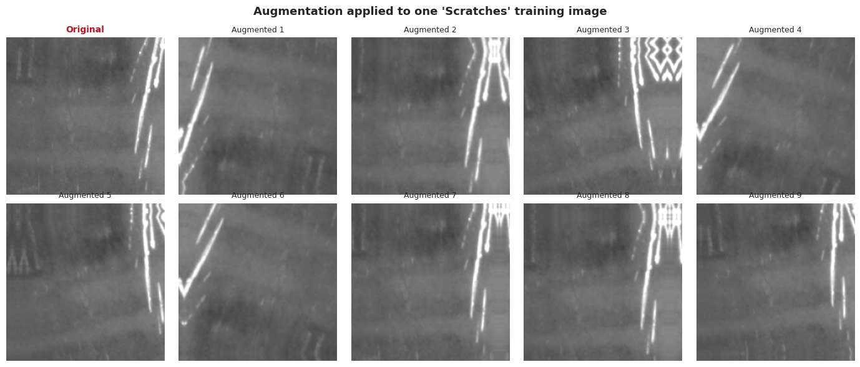



04 · PREPROCESSING
Same shape for every image, extra variety for training
Resize to 224 × 224
EfficientNetB0's native input size
Grayscale → 3 channels
The grey channel is copied so ImageNet weights still apply
One training image, augmented nine different ways. Augmentation layers live inside the model, so they are active during training and switched off automatically for validation and test.
Augmentation, training only
Flips, ±5% rotation, 10% zoom and shift, 15% contrast
Steel Surface Defect Classification · ISEM 505
05
Notes:
Preprocessing makes every input identical in shape and scale; augmentation deliberately adds variation so a small dataset does not get memorised. Stress that validation and test images are never augmented.

Slide 6



05 · THE MODEL
Transfer learning: borrow ImageNet's eyes, teach it steel
Why not train from scratch?
A CNN with millions of parameters and only a few hundred images per class memorises instantly. EfficientNetB0 has already learned edges, textures and repeating patterns from 1.2 million ImageNet photos, so we reuse that vocabulary and teach only the final decision.
STAGE 1
Feature extraction
STAGE 2
Fine-tuning
Backbone
Frozen entirely
Backbone
Top 30 of 238 layers unfrozen, BatchNorm kept frozen
Trainable
New head only: pooling, 30% dropout, 6-way softmax
Trainable
2,045,206 parameters
Learning rate
1e-3 (Adam), up to 20 epochs
Learning rate
1e-5, 100× smaller, early stop at epoch 29
Best validation
98.61% accuracy
Best validation
98.96% accuracy
Steel Surface Defect Classification · ISEM 505
06
Notes:
Explain transfer learning with the analogy of borrowing trained eyes. Stage 1 trains only the new head with the backbone frozen; stage 2 unfreezes the top layers at a much smaller learning rate so the pretrained features are refined, not destroyed.

Slide 7
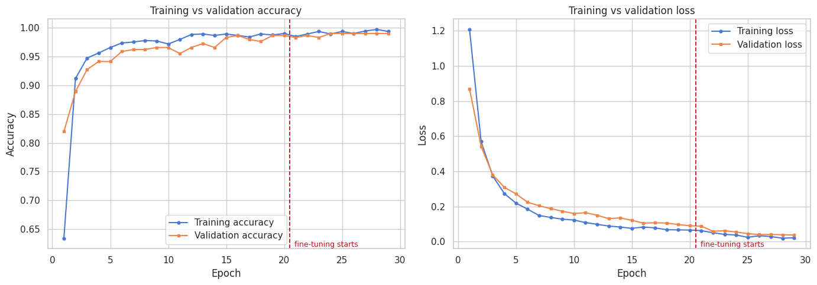

06 · TRAINING & SELECTION
Fine-tuning won, and the choice was made on validation
Candidate comparison
Scored on the validation split
Stage 1 · feature extraction
Accuracy
98.61%
Loss
0.1059
Macro F1
0.9861
Stage 2 · fine-tuned
Accuracy
98.96%
Training and validation curves stay together
Loss
0.0549
Macro F1
0.9896
Final training accuracy 99.31% against validation 98.96%, a gap of just 0.35 points. The model is generalising rather than memorising the training images.
SELECTED · fine-tuned
Steel Surface Defect Classification · ISEM 505
07
Notes:
Two candidates came out of training. Fine-tuning improved validation accuracy by 0.35 points and halved the loss, so it was selected. That decision used validation data only, leaving the test set untouched.

Slide 8
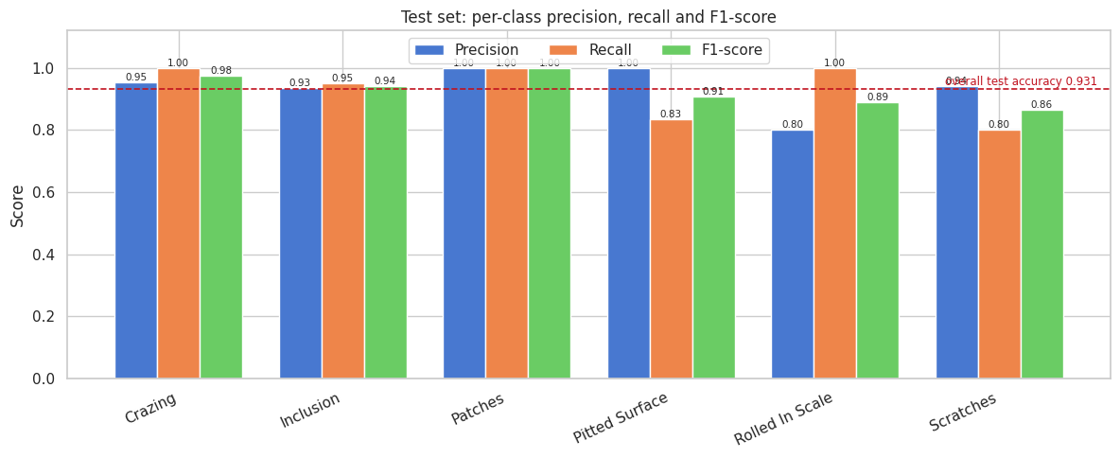


07 · FINAL TEST RESULTS
93.06% on 360 images the model had never seen
93.06%
335 / 360
0.9380
0.9301
Accuracy
Correct
Precision (macro)
F1 (macro)
The honest number
98.96%
93.06%
validation
test
A drop of 5.9 points. Validation guided every decision, so it was always the optimistic number. The test figure is the one to quote.
Steel Surface Defect Classification · ISEM 505
08
Notes:
Report the sealed-test result and be upfront about the gap: validation was consulted for early stopping and model selection, so it is biased upward. 93.06% on 360 unseen images is the honest estimate.

Slide 9
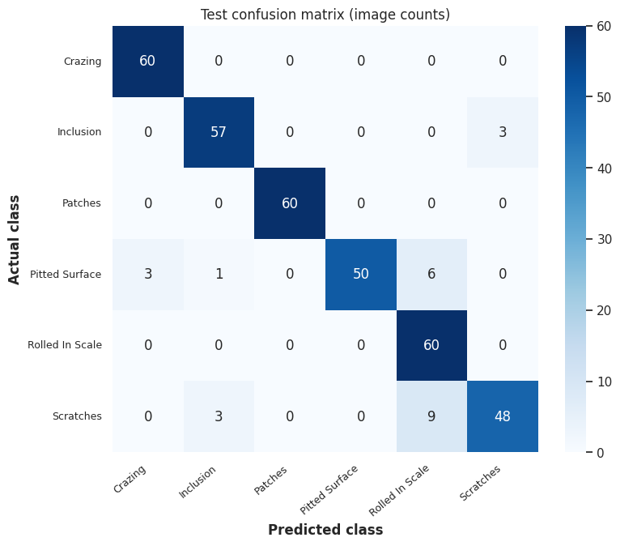

08 · WHERE IT FAILS
Three classes are perfect; scratches are the weak spot
Recall by class
Most common mix-ups
Crazing
100%
9×
Scratches → Rolled-In Scale
6×
Pitted → Rolled-In Scale
Patches
100%
3×
Scratches → Inclusion
Rolled-In Scale
100%
3×
Pitted → Crazing
3×
Inclusion → Scratches
Inclusion
95%
Pitted Surface
83%
Wrong answers are less confident
Scratches
80%
0.95 mean confidence when right, 0.65 when wrong.
Steel Surface Defect Classification · ISEM 505
09
Notes:
Accuracy hides the interesting part. Scratches and pitted surface are the weak classes, and both get confused with rolled-in scale, which is exactly what the sample images predicted. Crucially, wrong predictions carry much lower confidence, which makes a review threshold possible.

Slide 10
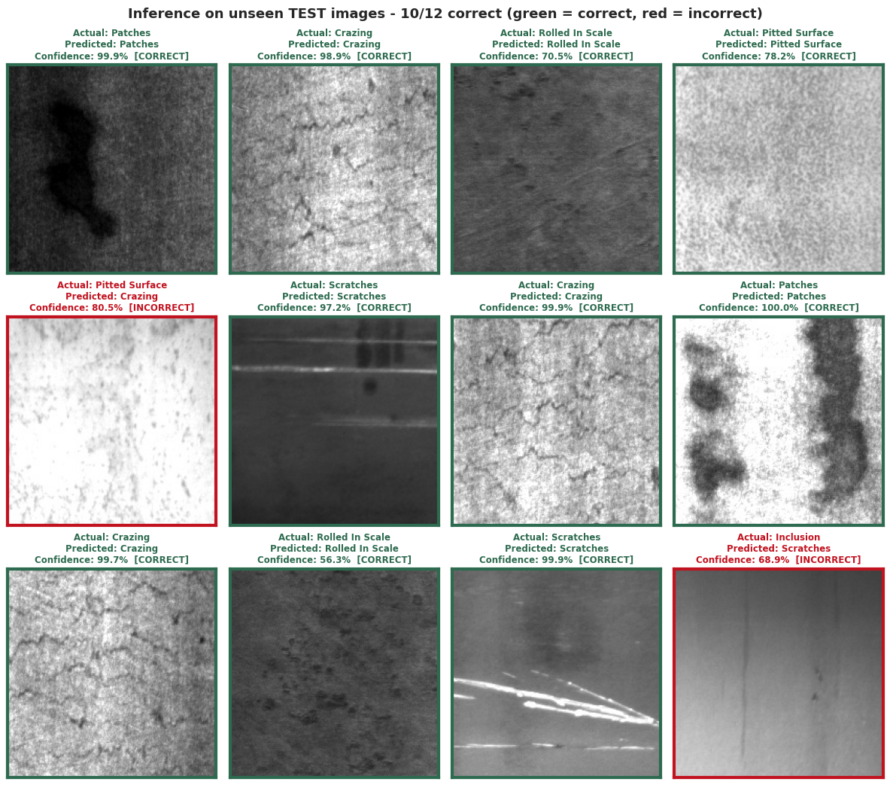


09 · FROM MODEL TO TOOL
Saved as an artifact, wrapped in a working app
One saved artifact
steel_defect_classifier.keras (32.7 MB) holds the architecture, weights and preprocessing together, plus JSON metrics, the class mapping and a split manifest.
Gradio inspection app
Reloads the saved file and serves predictions in the browser. Someone with no Python knowledge drags in an image and reads the defect and its confidence.
A review threshold, not blind trust
Below 70% confidence the app recommends manual review instead of guessing, which is how an inspection aid should behave.
Sample predictions on unseen test images
Factory camera → preprocessing → saved model → defect + confidence → quality-control action
Steel Surface Defect Classification · ISEM 505
10
Notes:
Walk from notebook to usable tool: one file holds everything needed to score an image, the Gradio app is a thin layer over it, and the confidence threshold routes uncertain images to a human instead of forcing a guess.

Slide 11
10 · WRAP-UP
What we learned, and what it would take on a real line
Transfer learning fits small datasets
Before a real mill could use it
1,800 images is far too few to train a CNN from scratch, but enough to retune one that already sees well.
NEU-DET is laboratory data: even lighting, fixed distance, cropped tightly around the defect
A working line adds vibration, oil, steam, motion blur and dust on the lens
Every image here contains a defect, so the model has never seen clean steel
Other grades, finishes and cameras would need retraining and far more images
Validation flatters, test tells the truth
98.96% became 93.06% once the sealed set was opened. Only the second number is worth reporting.
Per-class metrics beat one headline
Three defects were perfect while scratches reached 80%. The average hid both facts.
Thank you
Jeny George · Freddy Biayi · Sathwika Parshaboina
Questions?
Steel Surface Defect Classification · ISEM 505
11
Notes:
Close on the three takeaways, then the limits: this dataset is clean laboratory imagery and contains no defect-free steel, so a real deployment needs harder data, a normal class, and ongoing monitoring. Thank the audience and open for questions.

