Slide 1

Corporate Expense Management & Approval System
INFO 5707 – Final Project Presentation
Group Members Sathwika Karingu -11708107 Shreenath Jinaga-11752833 Ashwitha Kollapieni-11714415 Spoorthi Hassan-11814524 Sri Ramya Katukuri- 11788716

Slide 2

Introduction
Purpose: To streamline employee expense claims and approvals.
Relevant across HR, Finance, Admin, and Department Operations.
Implements budget controls and transparent workflows.

Slide 3

Objectives
Expense Submission Automation
Multi-Level Approval Workflow
Departmental Budget Monitoring
Vendor Management
Approval Audit Trails
Payment Processing Integration
Role-Based Access Control
Real-Time Claim Tracking
Reporting and Analytics
Support for Diverse Expense Categories

Slide 4
Scope
The system needs to process employee expense reports automatically through workflow approval functions.
The system must follow a three-stage approval sequence where Team Leads approve first and then Finance and the Director step in for final approval.
Actual expenditures can be tracked against departmental budgets using the system. Track vendors through a centralized system for every purchase submission.
Time-based status updates regarding the claim process must remain active.
Financial compliance requires systems that create complete audit trails.
The system serves multiple operational teams including HR, Finance, Admin and Department Operations.
The system will create better transparency and enhance budget control systems alongside operational efficiency.

Slide 5

Business Rules
Only employees can submit expenses for themselves.
Each report must contain at least one categorized item.
Managers can only approve reports in their department.
Claims > 10,000 need Finance and Director approval.
Budgets refresh quarterly; no over-budget entries allowed.
Payments occur only after final approval.
Vendors can be reused across multiple items.
Rejected reports cannot be resubmitted.
Admins have full audit access but can’t submit reports.
Only approved reports count toward budget analytics.

Slide 6

Entity-Relationship Diagram
Main entities:
Employee
ExpenseReport
ExpenseItem
ApprovalLog
Payment
Includes Department, Approver, and Vendor as supporting entities.
Relationships enforce report submission, itemization, and approvals.

Slide 7
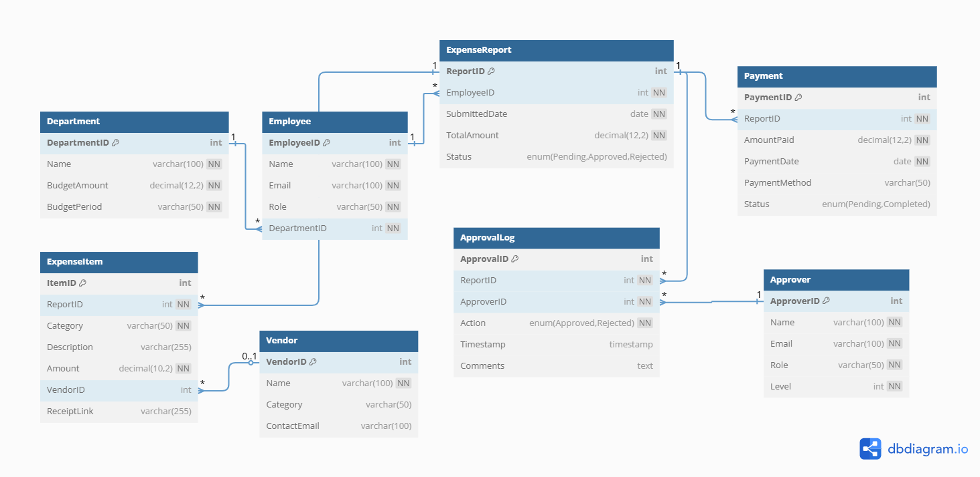
Entity-Relationship Diagram

Slide 8

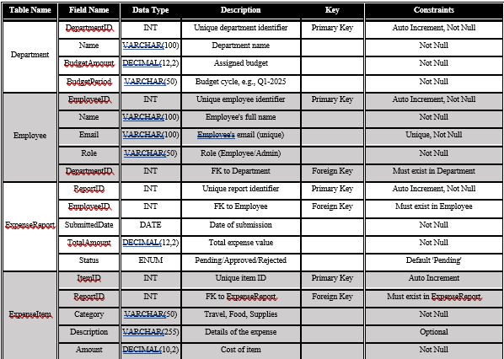
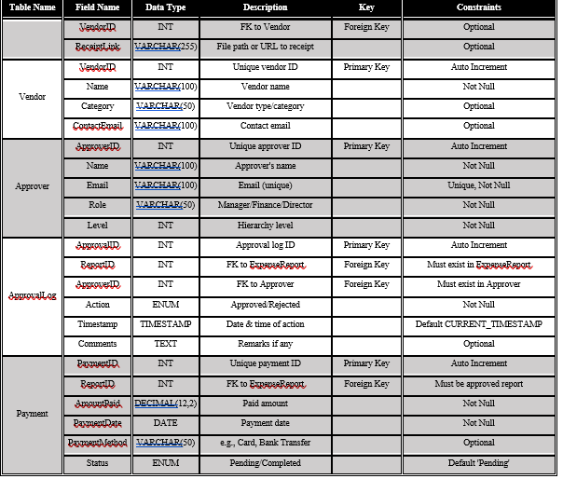
Data Dictionary Overview

Slide 9

Database Implementation
Platform: MySQL Workbench.
Tables created: 8 total (main and supporting).
Inserted data: 25+ records in core entities, 5+ in others.
Includes constraints and foreign keys.

Slide 10
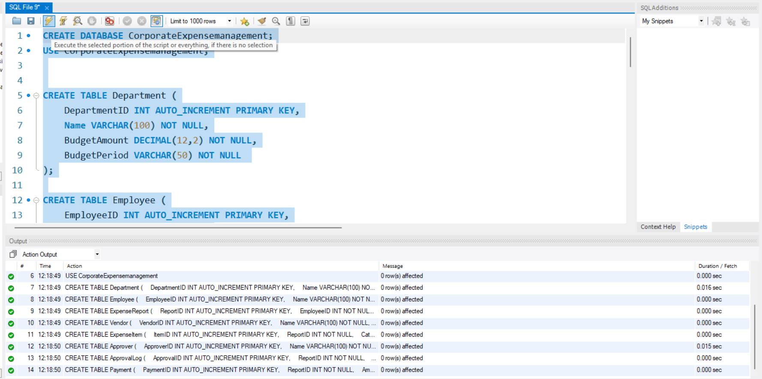
Database Implementation

Slide 11
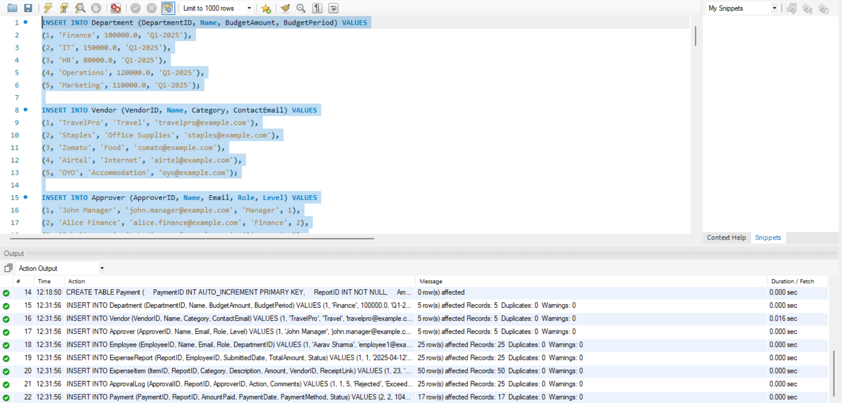
Database Implementation

Slide 12
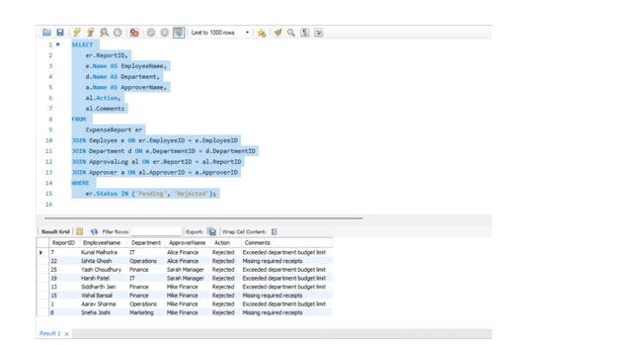
Data Retrieval Report: Query 1: Pending or Rejected Reports with Comments from Approvers

Slide 13
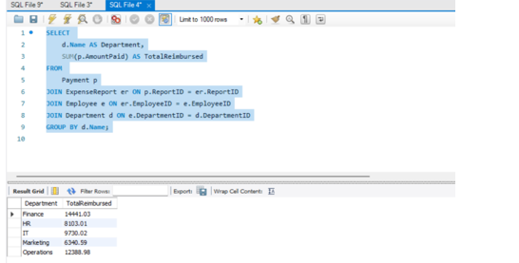
Data Retrieval Report: Query 2: Total Approved Reimbursements Paid by Department

Slide 14
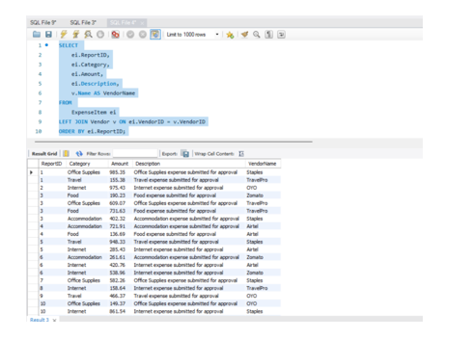
Data Retrieval Report: Query 3: Detailed Breakdown of Expense Items by Report

Slide 15
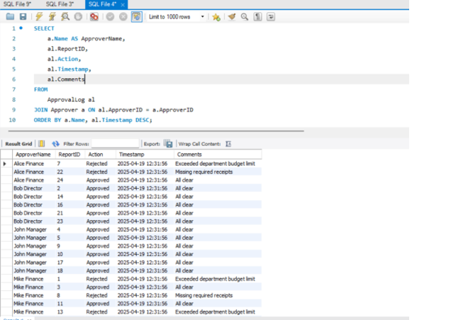
Data Retrieval Report: Query 4: Approver-wise Report Actions

Slide 16
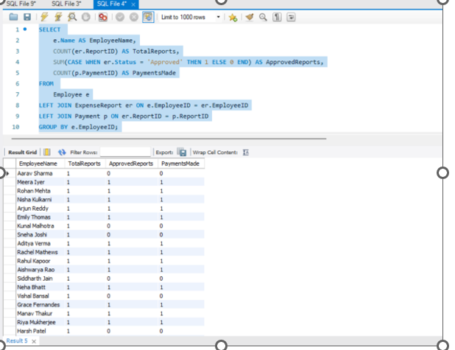
Data Retrieval Report: Query 5: Employee-wise Summary of Expense Reports and Payment Status

Slide 17

Conclusion
The Corporate Expense Management & Approval System manipulates all stages of employee expense submission through approval to monitoring processes. Business rules enforced through automation allow the system to achieve operational transparency by ensuring budget control through multiple levels of approval functionality. Business decision-making receives improved power through HR, Finance, and Department Operations because of real-time tracking alongside audit logs along with detailed analytics. The organizational financial compliance gets enhanced through this solution while manual work gets reduced by minimizing errors.(Many-to-One)

Slide 18

Thank You!
We appreciate your time and feedback.
Any questions?

