Slide 1
Artificial intelligence & machine learnning
course project
Economy of Telangana from different sectors
group :4

Slide 2
Economy of Telangana from different sectors
GROUP MEMEBERS
2003A51021
2003A51005
2003A51006
2003A51015

Slide 3
INTRODUCATION
Telangana is one of the fastest-growing states in India posing average annual growth
rate of 13.90% over the last five years. Telangana's nominal gross state domestic product for
the year 2020-21 stands at ₹12.05 lakh crore (US$170 billion). Service sector is the largest
contributor to the Telangana's economy with a share of about 65% in the year 2018-19. Growth
in services has largely been fuelled by IT services with the State holding leading position in IT
& ITeS in the country in terms of production and exports. Agriculture also form a backbone of
Telangana's Economy. Two important rivers of India, the Godavari and Krishna, flow through
the state, providing irrigation.

Slide 4
Problem statement
Telanagana is rising its economical status from year to year but we are not having an
idea regarding the sectors which gives their contribution in the economy development.we are
not even having the idea of the main sectors in Telanagana.By using machine leaning concepts
we would like to present Percentage of sectors helped in Telanagana economy.By knowing the
information we may take some further steps which helps them in increase its economy some
more .

Slide 5
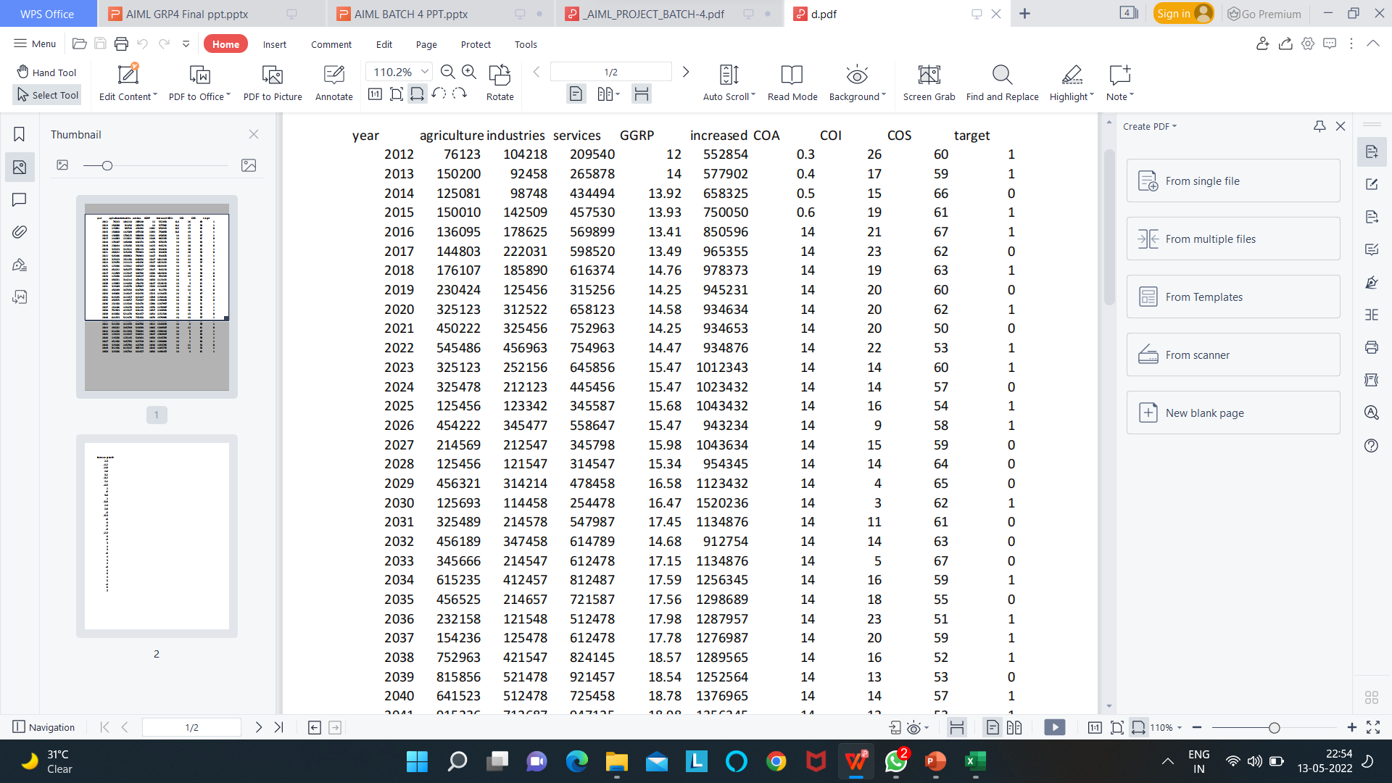
Dataset processing sample of dataset

Slide 6
Data cleaning
Steps Data cleaning is an important precursor to doing any analysis. Even with careful
surveying, there may be typos or other errors made in data collection, or there may be outliers
that, if not properly accounted for, could skew your results. Before doing any kind of analysis,
it is important to first clean the data, regardless of whether it is original field data or
administrative data. Cleaning data can be time-consuming, but putting in the effort upfront can
save a lot of time and energy down the line. Note: the first step in data processing should always
be to encrypt data that contains information that could be used to identify individuals.

Slide 7
Data visualisation
Data augmentation techniques generate different versions of a real dataset artificially
to increase its size. Computer vision and natural language processing (NLP) models use data
augmentation strategy to handle with data scarcity and insufficient data diversity.
Data augmentation algorithms can increase accuracy of machine learning models.
According to an experiment, a deep learning model after image augmentation performs better
in training loss (i.e. penalty for a bad prediction) & accuracy and validation loss & accuracy
than a deep learning model without augmentation for image classification task.

Slide 8
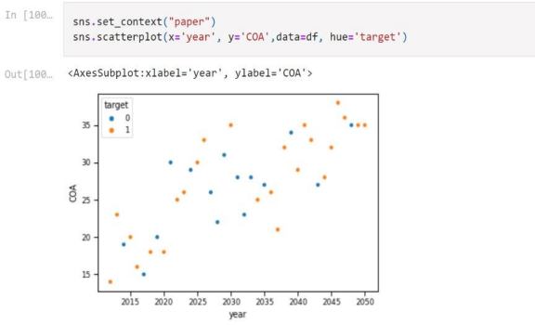
Sample of visualisation

Slide 9
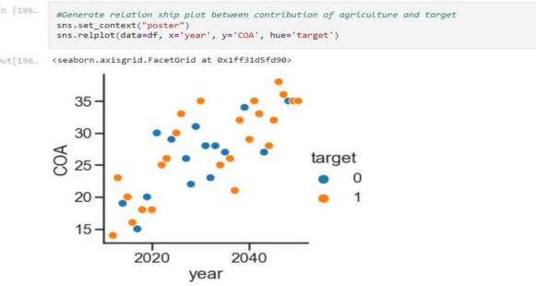

Slide 10
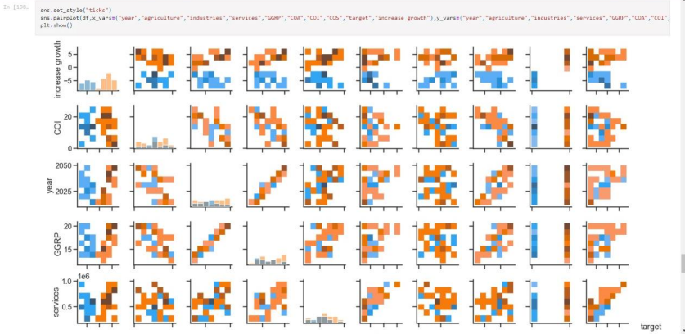

Slide 11
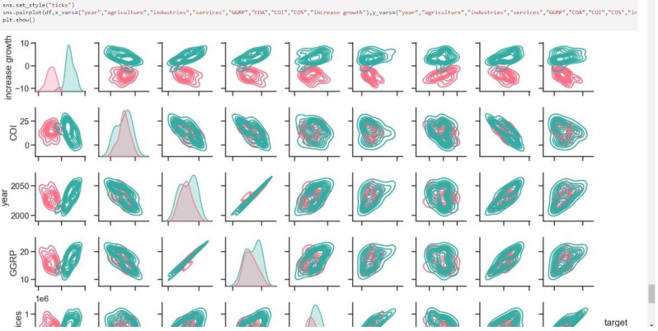

Slide 12
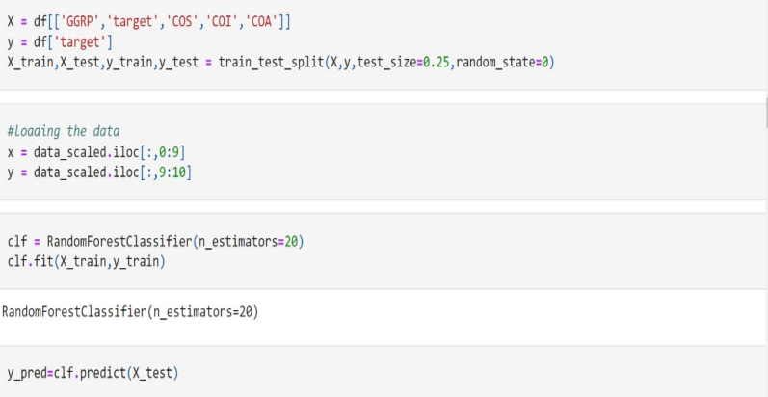
Methodology random forest

Slide 13
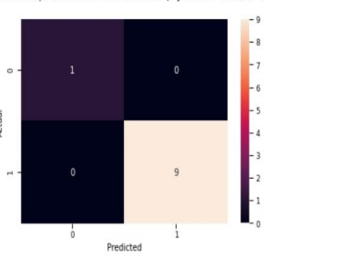

Slide 14
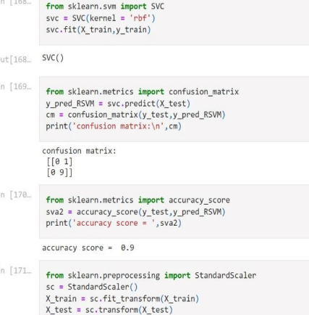
svm (rbf)

Slide 15
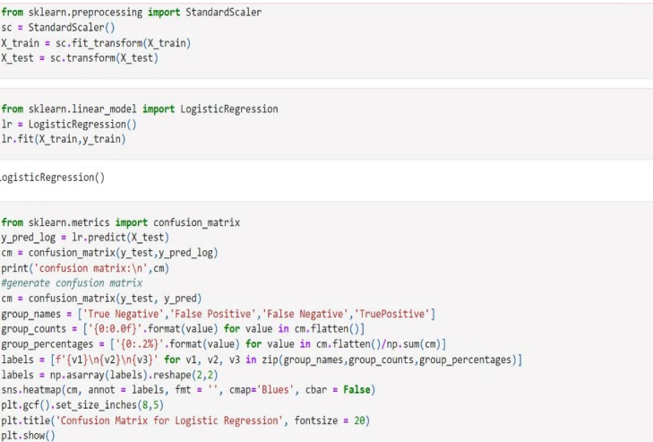
Logistic regression

Slide 16
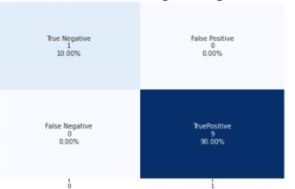

Slide 17
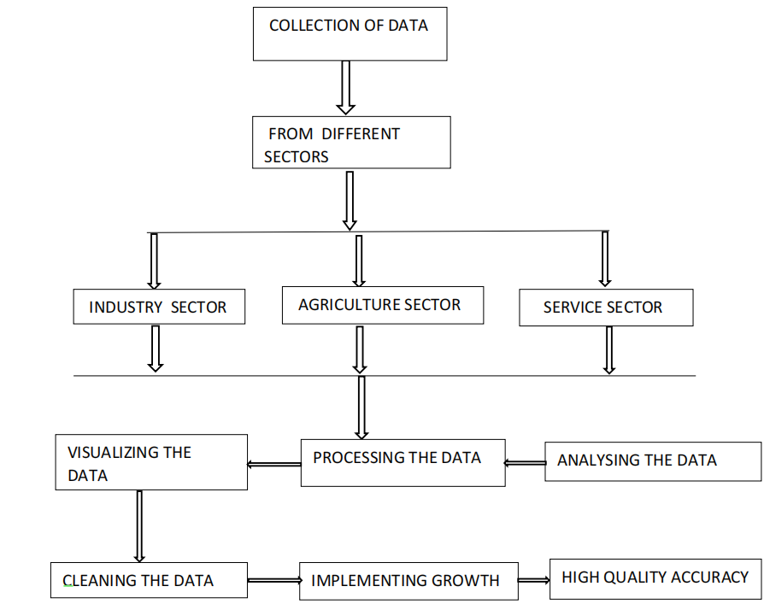
architecture

Slide 18
conclusion
The econometric exercise in this study examines the impact of AI on firm-level efficiency
in India. AI is measured as investments in software, the closest approximation to AI at the firm
level, in the absence of other direct measures on AI. We posit that AI determines firm-level
total factor productivity (TFP), a residual variable that determines aspects of growth that are
not determined by labour and capital. This setup directly follows from the argument that AI is
a General-Purpose Technology and that it plays a much broader role than ‘factors of
production’, affecting different aspects of a firm’s organizational, administrative and financial
coordination operations. Total Factor Productivity is, therefore, the most appropriate measure
to capture the effects of AI on economic growth

