Slide 1



Multi-Class Customer Category Prediction
MACHINE LEARNING PROJECT | B.TECH | A.Y. 2026-27
4 CUSTOMER CATEGORIES
Premium
Using Multinomial Logistic Regression
Regular
TEAM
K. Sathwika - 2520090210
A. Sanjana Reddy - 2520090159
Budget
GUIDE
Dr. Lakshmi Prasanna Yeluri
Asst. Professor, Professor-in-charge
Occasional
DEPARTMENT / SECTION
Dept. of CS&IT | Section: [Add section]
[Add college / university name]
Notes:
Introduce the project title, the team (K. Sathwika and A. Sanjana Reddy), the guide (Dr. Lakshmi Prasanna Yeluri) and the four customer categories the model predicts.

Slide 2



Introduction
2
Background
Domain overview
Why it is needed
Customers differ in age, income, purchase frequency and spending habits.
Grouping them into categories drives personalised marketing.
Machine Learning: supervised multi-class classification.
Multinomial Logistic Regression gives a probability for every category.
Manual methods and binary classifiers cannot handle many categories.
An automated, interpretable model enables targeted campaigns.
Notes:
E-commerce customers behave differently. Grouping them into categories enables personalisation. Multinomial logistic regression is a supervised multi-class method that outputs a probability per category.

Slide 3

Problem Statement
3
Limitations / challenges
Manual segmentation is slow, subjective, not scalable
Binary methods cannot represent many classes
Raw data: missing values, mixed scales
Existing problem
Customers must be assigned to one of several categories, but traditional methods rely on manual analysis or simple binary classification.
Who is affected
Businesses: poor targeting, wasted budget
Customers: irrelevant offers
Notes:
Customers must be placed into one of several categories, but manual analysis and binary classification fall short. Both businesses and customers are affected.

Slide 4



Motivation
4
Why this project
Customer categorisation is a practical, high-impact use of ML, and multinomial logistic regression is a clear, interpretable method for it.
Real-world need
Online retailers must identify customer types quickly to personalise offers, recommendations and services.
Industry motivation
Segmentation and personalisation raise sales and satisfaction; interpretable models explain why a customer was placed in a category.
Notes:
Customer categorisation is a practical, high-impact ML task and interpretable models are preferred in business settings.

Slide 5
Objectives
5
MAIN OBJECTIVE
Build a multinomial logistic regression model that accurately predicts a customer's category from demographic, purchasing and transaction data.
1
2
3
4
5
Collect and prepare data (clean, encode, scale)
Train a multinomial logistic regression model
Evaluate: accuracy, precision, recall, F1, matrix
Find features that influence each category
Save the model with Joblib and serve predictions
Notes:
The main objective is to build a multinomial logistic regression model that predicts customer category. Five specific objectives support it.

Slide 6

Existing System
6
WHAT EXISTS TODAY
WHERE IT FALLS SHORT
Cannot predict more than two categories directly
Current approach
Manual analysis, fixed business rules or simple binary classification.
Time-consuming, subjective, hard to scale
Existing technologies
Spreadsheets, rule-based filters
Binary logistic regression
Basic statistical reports
Little automated preprocessing, weak personalisation
Notes:
Existing approaches rely on manual grouping, rules and binary classifiers, which are slow and cannot predict many categories.

Slide 7


Proposed System
7
Multi-class in one model
Outputs a probability for every category
Automated preprocessing
Cleaning, imputing, encoding, scaling
Proposed solution
A machine learning system that preprocesses customer data and uses multinomial logistic regression to predict the most probable customer category.
Fast and interpretable
Feature coefficients explain each category
Business ready
Data-driven categories for targeted marketing
Notes:
The proposed system preprocesses data automatically and uses one multinomial logistic regression model to predict the most probable category.

Slide 8
System Architecture / Block Diagram
8
Input
Processing
Model
Output
Customer CSV
Age, gender, income
Frequency, spend
Preferences
Cleaning
Missing values
Encoding
Scaling
Train/test split
Multinomial Logistic Regression
Softmax over 4 classes
scikit-learn
Predicted category
Class probabilities
Metrics, confusion matrix
Notes:
Data flows from the customer CSV through preprocessing and the multinomial model to the predicted category and evaluation outputs.

Slide 9
Methodology / Workflow
9
Collect customer CSV dataset
Explore data (EDA)
Clean data, fix missing values
1
2
3
Encode categorical features
Scale numerical features
Split into train and test sets
4
5
6
Train the multinomial model
Evaluate: accuracy, F1, matrix
Save with Joblib and predict
7
8
9
Notes:
Nine-step pipeline: Data, Preprocess, Split, Train, Evaluate, Save model, Predict.

Slide 10






Technology Stack
10
LANGUAGE
FRAMEWORKS / IDE
LIBRARIES
Python 3.x
Flask, VS Code or Jupyter
NumPy, Pandas, Matplotlib, Seaborn, scikit-learn, Joblib
FRONTEND
DATA STORE
PLATFORM
HTML, CSS, JavaScript
CSV dataset and Joblib model file
Windows 10/11 or Linux; no cloud needed
Notes:
Python with scikit-learn for modelling, Flask for the backend, and a simple HTML/CSS/JavaScript frontend.

Slide 11








System Modules / Components
11
User Interface
Data Collection
Preprocessing
Core ML
Web forms and tabs
Loads customer CSV
Impute, encode, scale
Multinomial regression
Storage
Prediction
Visualization
Validation
CSV data, .joblib model
Category + probabilities
Charts and metrics
Input checks, upload limit
Notes:
Eight modules from the user interface to input validation.

Slide 12
Implementation
12
1
Load the CSV with Pandas
train_model.py
clf = LogisticRegression(
solver="lbfgs", max_iter=2000)
model = Pipeline([("pre", pre),
("clf", clf)])
model.fit(X_train, y_train)
y_pred = model.predict(X_test)
print(accuracy_score(y_test, y_pred))
joblib.dump(model, "model.joblib")
2
Impute, encode and scale features
3
Split data 80/20 (stratified)
4
Train the multinomial model
5
Predict and compute metrics
6
Save with Joblib; serve via Flask
Notes:
Key steps: load data, preprocess inside a pipeline, split, train, evaluate, save and serve through Flask. Solver lbfgs fits a true multinomial (softmax) model for more than two classes.

Slide 13
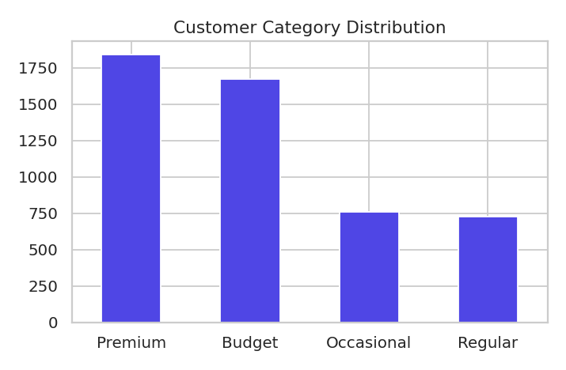
Dataset / Input Data
13
5,000
13
4
~2%
records (synthetic CSV)
columns
customer categories
missing values
Features
Preprocessing
Age, gender, income, membership, purchase frequency, order value, annual spend, recency, spending score, discount %, product preference. Target: customer category.
Median / mode imputation
One-hot encoding
Standard scaling
80/20 stratified split
Category distribution
Notes:
5,000 synthetic customer records with 13 columns and four categories; about 2 percent of some values were left missing to demonstrate imputation.

Slide 14
Algorithm / Model
14
P( class k | x ) = exp( wk . x + bk ) / sum over j of exp( wj . x + bj )
Input features
Linear score per class
Softmax
Highest probability wins
Why it was selected
Important parameters
Built for multi-class problems, gives class probabilities, interpretable and efficient.
solver = lbfgs, C = 1.0
max_iter = 2000
test split 20%, seed 42
Notes:
Multinomial logistic regression computes a linear score per class, applies softmax to get probabilities and picks the highest.

Slide 15
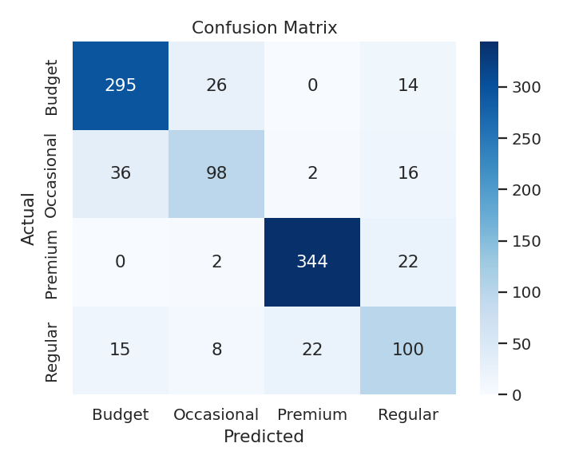
Results
15
83.7%
83.6%
83.7%
83.6%
Accuracy
Precision
Recall
F1-score
Notes:
Test accuracy 83.7 percent. Per-class F1: Premium 0.93, Budget 0.87, Regular 0.67, Occasional 0.69. The model outperforms the Decision Tree (76.1 percent) and KNN (78.0 percent) baselines on this dataset.

Slide 16
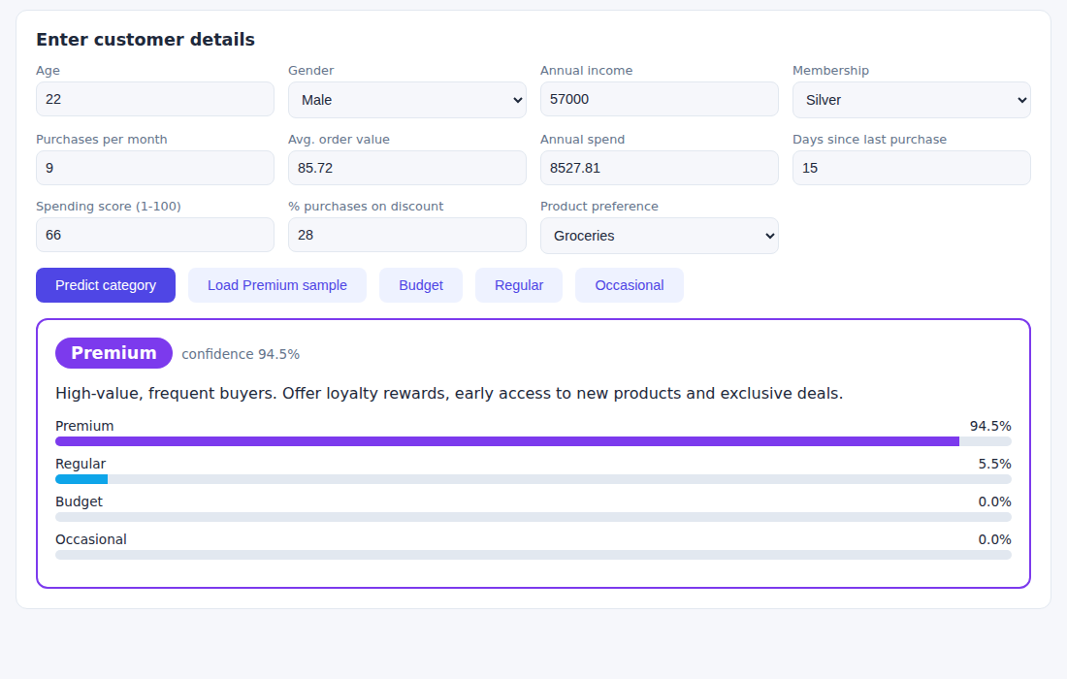
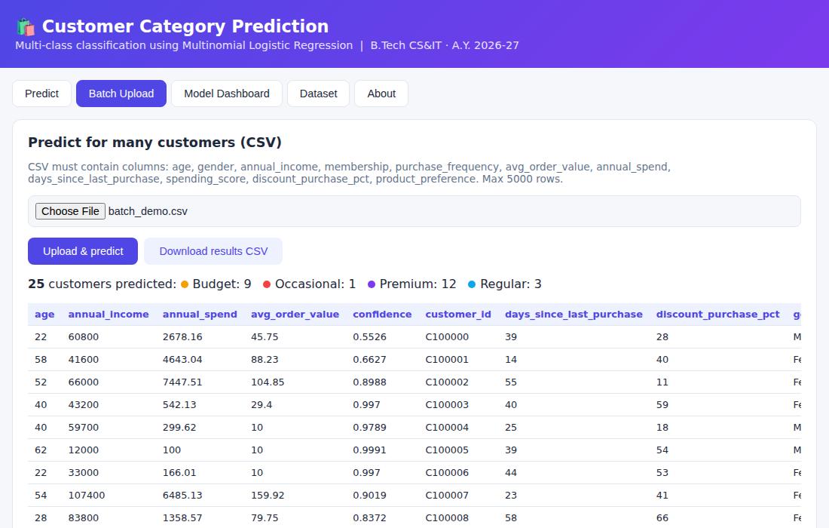
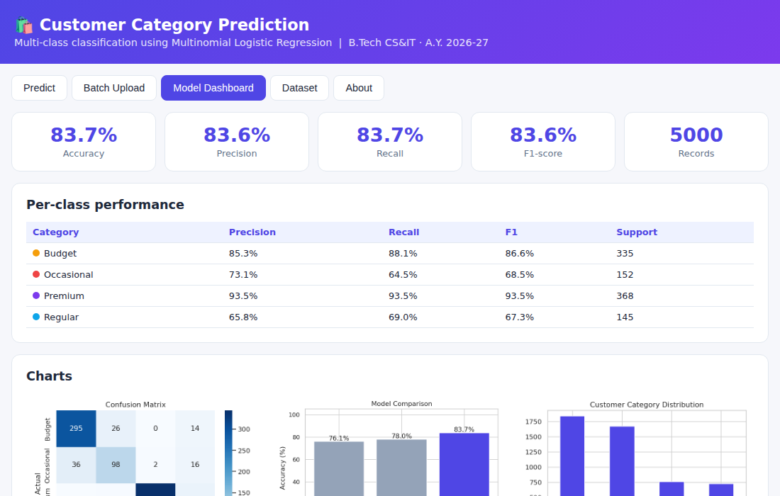
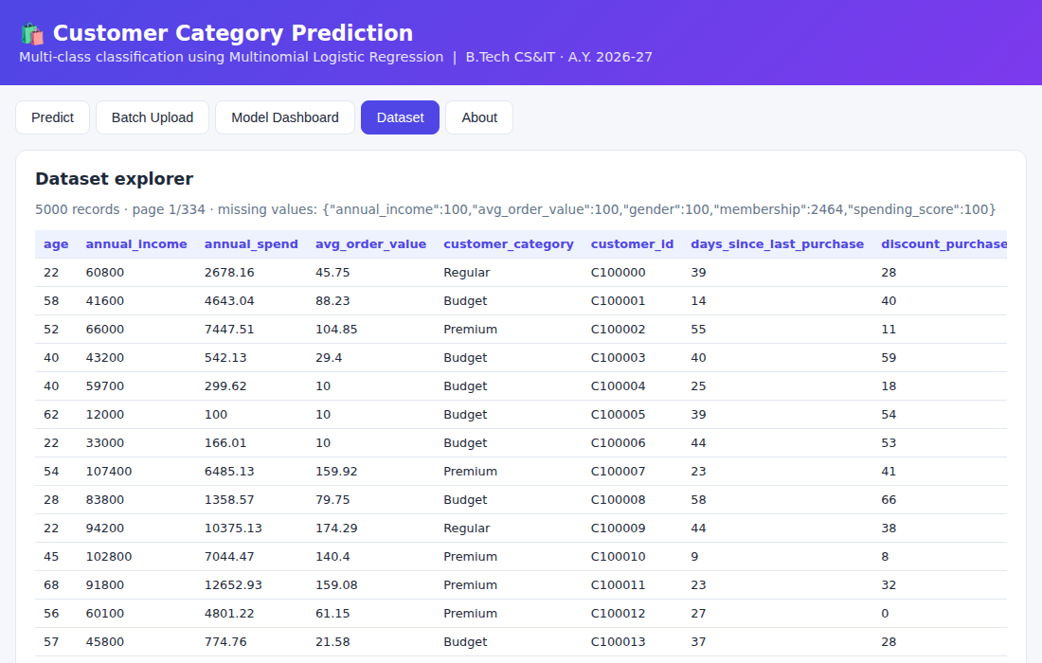
Screenshots / Demo
16
Demo flow
1
Enter details or load a sample
2
Click Predict category
Predict: category + probabilities
Batch CSV upload
3
Upload a CSV for batch results
4
Open the dashboard for metrics
Model dashboard
Dataset explorer
Notes:
Web application screens: prediction with probabilities, batch CSV upload, model dashboard, dataset explorer.

Slide 17





Advantages
17
Multi-class in one model
Interpretable
Fast and scalable
Predicts all four categories at once
Coefficients show feature influence
Quick training and prediction
Class probabilities
Automated and consistent
Confidence for every decision
Replaces slow, subjective manual grouping
Notes:
Key strengths of the proposed approach.

Slide 18



Applications
18
Targeted marketing
Personalised campaigns and recommendations
TARGET USERS / INDUSTRIES
E-commerce
Customer relationship management
Retention and service by category
Retail
Banking
Sales forecasting
Resource allocation per segment
Telecom
Marketing analytics
Notes:
Applications in marketing, CRM and sales planning across several industries.

Slide 19

Limitations
19
Linear assumption
Data dependent
Assumes a linear relationship between features and class log-odds
Performance depends on data quality and size; results here use synthetic data
Complex patterns
Labelled data needed
May underperform on non-linear patterns and imbalanced classes
Requires predefined, labelled customer categories
Notes:
Honest limitations: linear assumption, data dependence (results come from synthetic data), non-linear patterns and need for labelled data.

Slide 20



Future Scope
20
Better models
More features
Deployment and scale
Random Forest, SVM, XGBoost, neural networks
Feature selection, hyperparameter tuning
Handle class imbalance
Streamlit / Flask dashboards
Real-time prediction
User authentication
Cloud API
E-commerce platform integration
Larger real-world datasets
Notes:
Better models, richer features and cloud deployment are the next steps.

Slide 21



Conclusion
21
ACHIEVED
A multinomial logistic regression model classifies customers into four categories from demographic and purchasing data.
Thank you
KEY OUTCOME
An efficient, interpretable and reliable solution: 83.7% test accuracy.
Questions?
CONTRIBUTION
Supports data-driven targeting, better satisfaction and improved e-commerce sales.
K. Sathwika
A. Sanjana Reddy
Notes:
Summarise: model built, interpretable and effective with 83.7 percent accuracy, supports data-driven marketing. Thank the audience and invite questions.

