Slide 1


FINGER PRINT BASED ATTENDANCE
SYSTEM
Team name:HSN9
Names: K.Harshitha.
N.Sathwika.
G.Navyateja.

Slide 2
ABSTRACT
Attendance systems are commonly used systems to mark the presence in offices and schools.
From manually marking the attendance in attendance registers to using high-tech applications and biometric systems, these systems have improved significantly.
In this project, we used fingerprint Module and Arduino to take and keep attendance data and records.
By using fingerprint sensor, the system will become more secure for the users.

Slide 3
Project Description:
In this fingerprint attendance system circuit, we used Fingerprint Sensor module to authenticate a true person or employee by taking their finger input in the system.
Besides enroll key is used to download attendance data over serial monitor.
A secure and effective identity management system plays an important role in the successful deployment of an attendance management system.

Slide 4
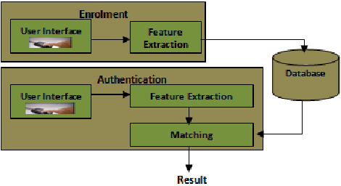
BLOCK DIAGRAM:

Slide 5
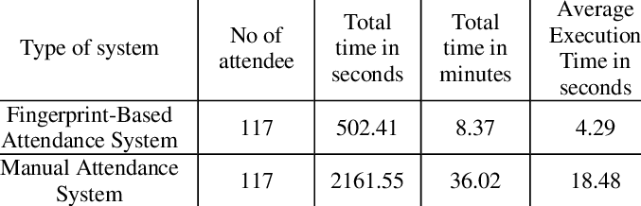
Tabular column:

Slide 6
Required Components:
Fingerprint sensor
Connecting wires
16x2 LCD
Bread Board
RTC Module
Node MCU

Slide 7
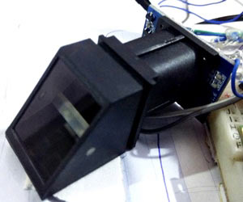
FINGER PRINT SENSOR:

Slide 8
ADVANTAGES:
It is used for security purpose.
It is used for monitoring the person.
There will be only one fingerprint for a person, it even differ for twins.
Speed accuracy is high i.e., responses in seconds.

Slide 9
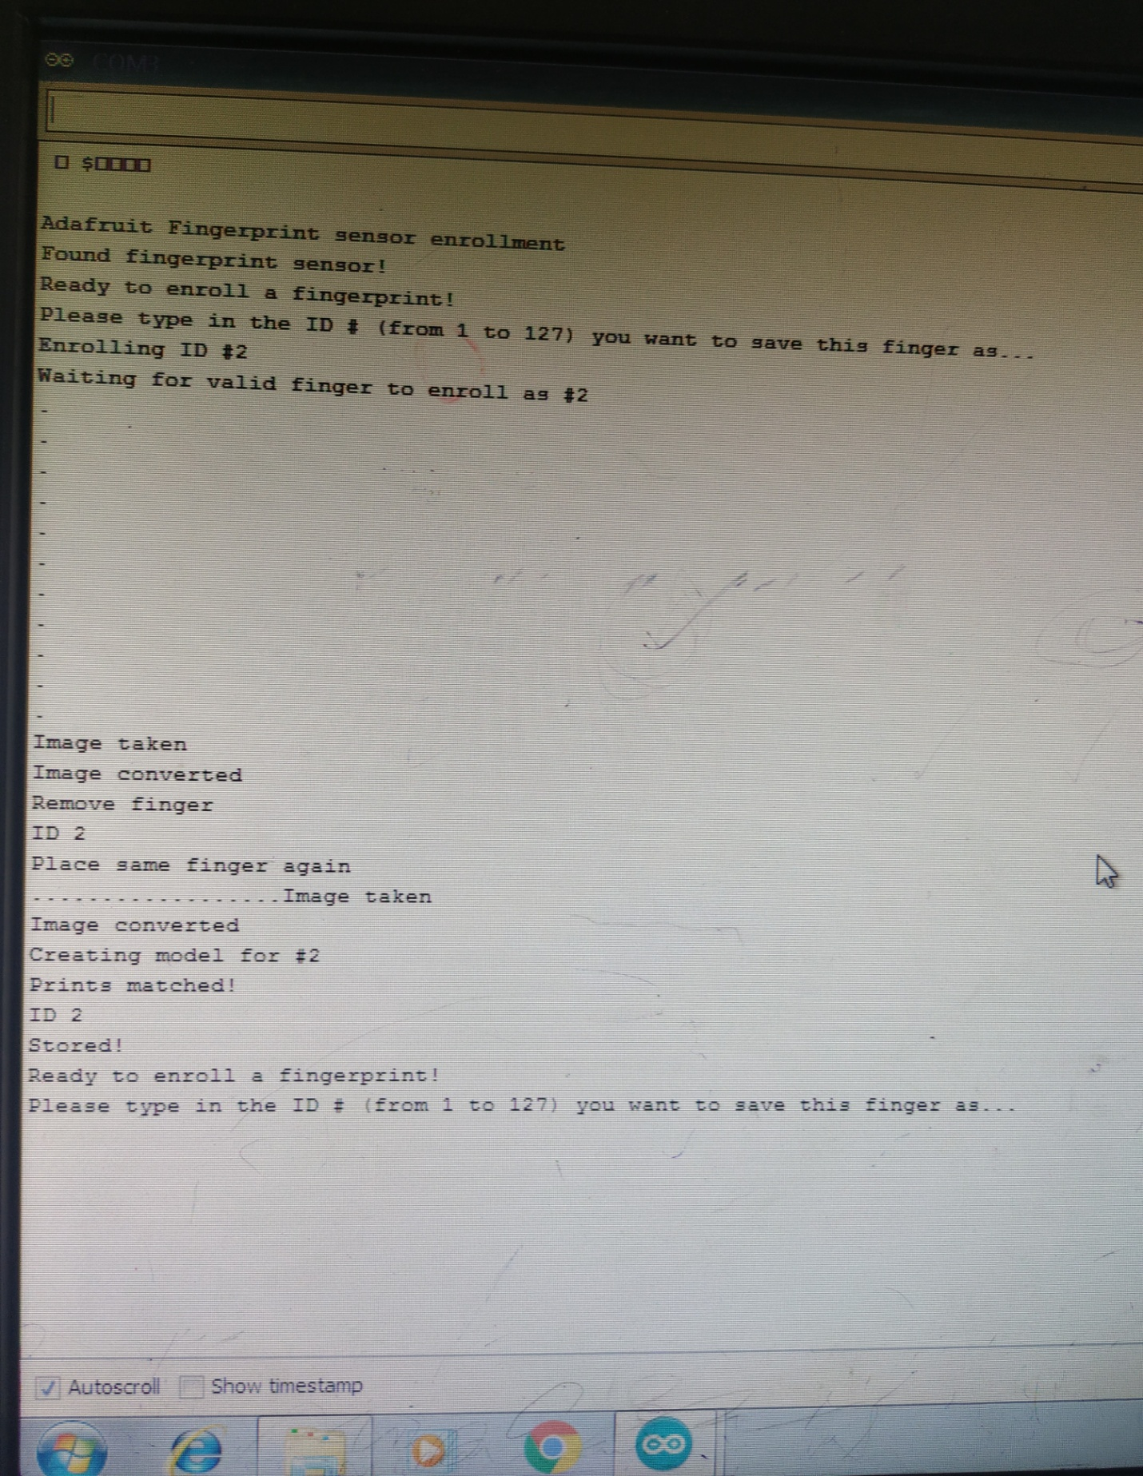
OUT PUT:

Slide 10
CONCLUSION:
The system extract the local characteristic of a fingerprint which is minutiae points in template based.
The developed system is very helpful in saving valuable time of students and lecturers, paper and generating report at required time.
The system can record the clock in and clock out time of students

Slide 11


