Slide 1
College Majors From an Economical Perspective
Sathwik Kesappragada
June 2nd, 2020

Slide 2
Importance of Analysis
The overarching question is to see
“which college majors are the most economically viable”
and get interesting Statistics on various degrees. We believe this is an interesting question because college is expensive and will continue to be more expensive in the coming years; more people accruing copious amounts of Student Loan debt. College has become a financial investment for most people and we want to see what degrees will give us the best return on investment.

Slide 3
Objectives and/or Questions of Interest
Difference between STEM and Non-STEM majors
Difference within STEM majors
All data is from American Community Survey, 2010-2012 Public Use Microdata Series.
https://www.census.gov/programs-surveys/acs/data/pums.html

Slide 4
Project Proposal Questions
What are the best and worst degrees for men and women respectively?
Salary difference between STEM majors and NON-STEM majors
What majors attract the most by gender ~ major preference ?
How much a salary gap is there between men and women for some majors?
How do different categories of majors stack up against each other like engineering majors to science to math to arts ?
What majors are the most popular college degrees?
What is the salary gap between graduates and non-graduates?
Unemployment rates respective to the major

Slide 5
Difference between STEM and Non-STEM major
What falls under STEM and Non-STEM
Top 5 median salaries by major
Lowest Unemployment rates
5 Most popular majors
Frequency Comparison
Logistic Regression
Nearest Centroid (NC) Classifier

Slide 6

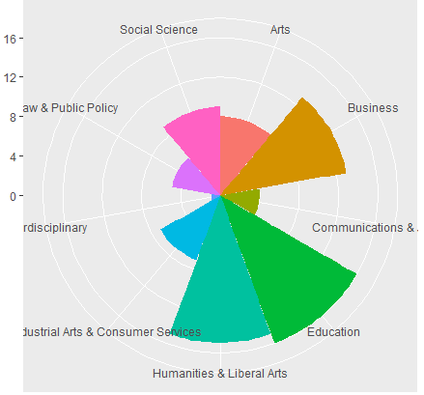
STEM vs Non-STEM (pt.1)
Subdivisions
First step involves filtering the data to classify between STEM and non-STEM
STEM consists of Health, Physical Sciences, Agriculture & Resources, etc
Non-STEM consists of Business, Education, Arts, etc

Slide 7
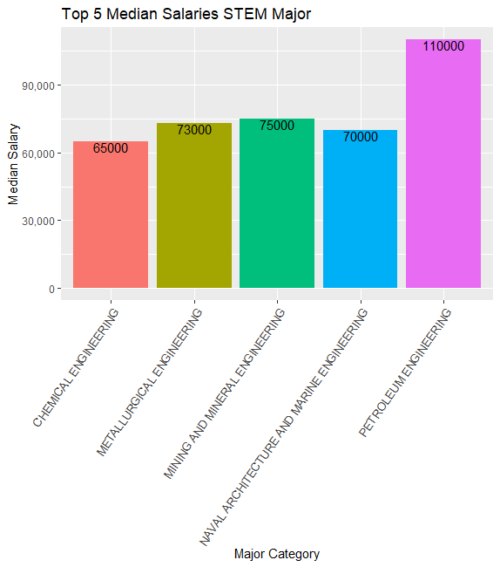
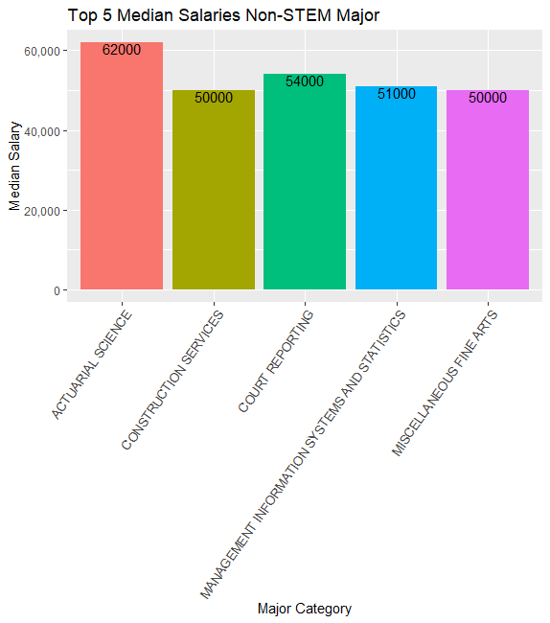
STEM vs Non-STEM(pt.2)
Median Salaries
These are the top 5 highest paying majors
STEM: Petroleum Engineering
Non-STEM: Actuarial Science

Slide 8
STEM vs Non-STEM pt.3
Most Popular Majors
Lowest Unemployment Rates by Major
.
Botany (0.00) | Educational Administration and Supervision (0.00)
Mathematics & Computer Science (0.00) | Military Technologies (0.00)
Soil Science (0.00) | Court Reporting (0.011)
Engineering Mechanics Physics and Science (0.006) | Mathematics Teacher Education (0.016)
Petroleum Engineering (0.018) | Electrical, Mechanical, and Precision Technologies (0.029)
Biology | Business Management and Administration
Nursing | General Business
Computer Science | Communications
Mechanical Engineering | Marketing & Research
Electrical Engineering | Accounting

Slide 9
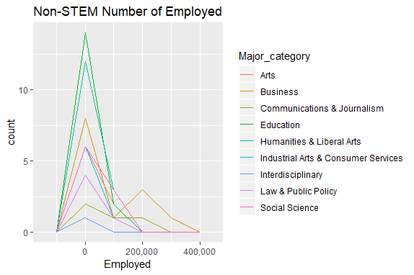
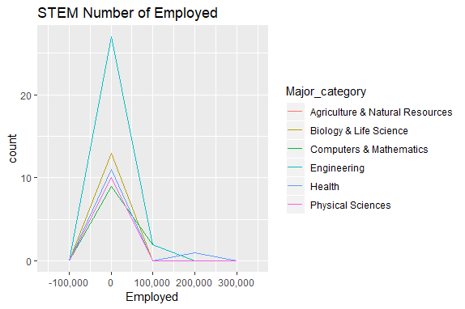
STEM vs Non-STEM pt.4
Number Employed
STEM: Engineering, Biology, Health
Non-STEM: Business, Social Science, Education

Slide 10

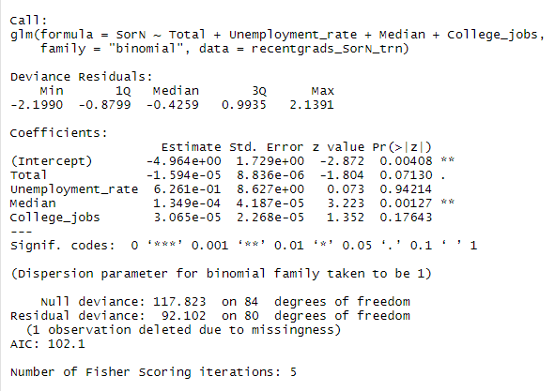
Logistic Regression & Model
For College_jobs and Unemployment_rate:
p-values are 0.176 and 0.942 respectively. As a result, the number with jobs requiring a college degree and unemployment rate are NOT significant predictors for STEM vs NONSTEM preference,
For Median Salary and Total:
p-values are 0.001 and 0.071, respectively, and are significantly less than 0.10, which indicates that Median Salary and Total popularity of majors contributes to the prediction of joining STEM or NONSTEM.
Model = logOdds(Major_category -> STEM) = -4.964+ 0.0001349 *Median Salary

Slide 11
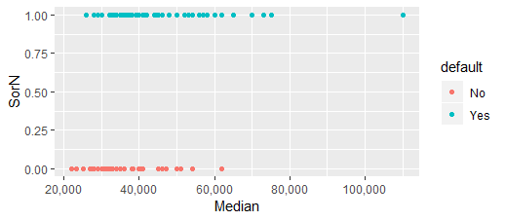
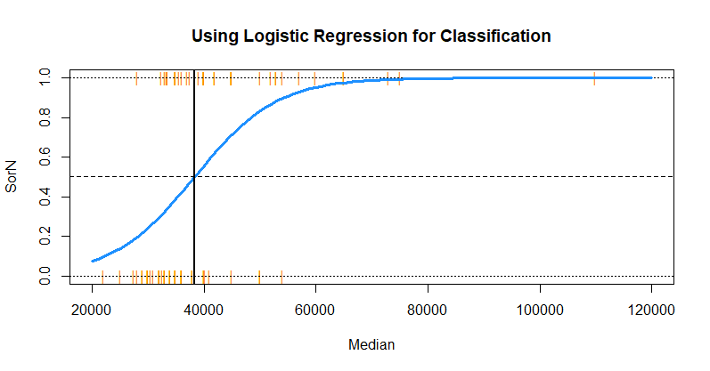
Logistic Regression : STEM v NONSTEM
The blue “curve” is the predicted probabilities given by the fitted logistic regression.
Orange lines represent Majors
The solid vertical black line represents the decision boundary
Could spot all majors and range in salary for STEM and NONSTEM

Slide 12
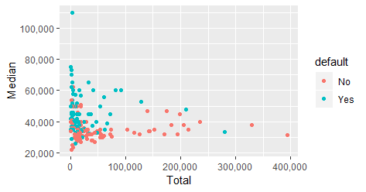
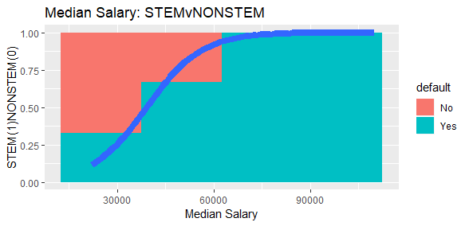
STEM vs NonSTEM
No gaps
Median Salary Range: 20,000-120,000
STEM has a bigger range in salaries
Estimates the conditional probability of STEM vs NonSTEM | Median Salary

Slide 13
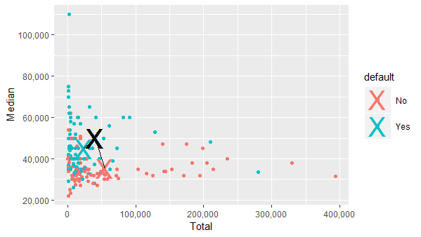
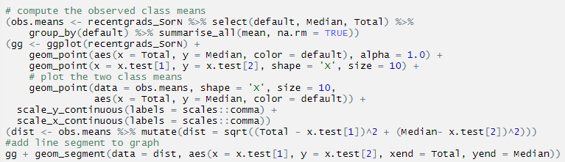

Nearest Centroid (NC) classifier
Provides mean difference classifier
Computed the distance from the class mean to the test point
Line Segment

Slide 14
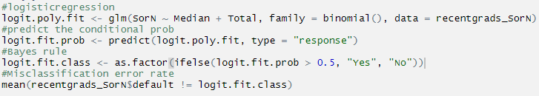
Logistic Regression - Misclassification Rate
Misclassification Rate = 0.2947977
The percentage of training and testing examples misclassified from a given data set.

Slide 15
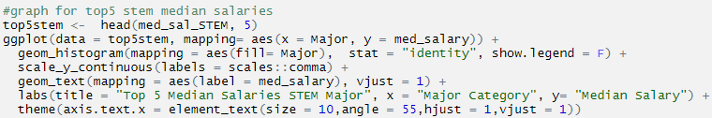
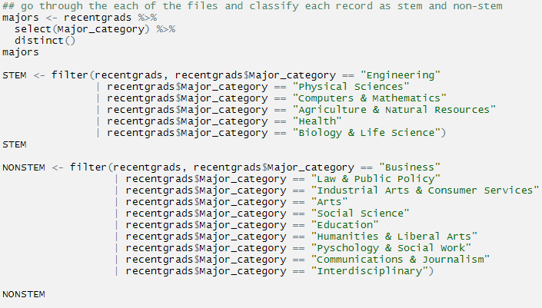
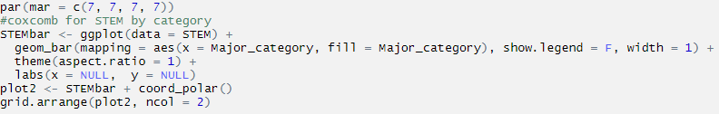
R Code

Slide 16
Difference within STEM major
STEM vs STEM

Slide 17
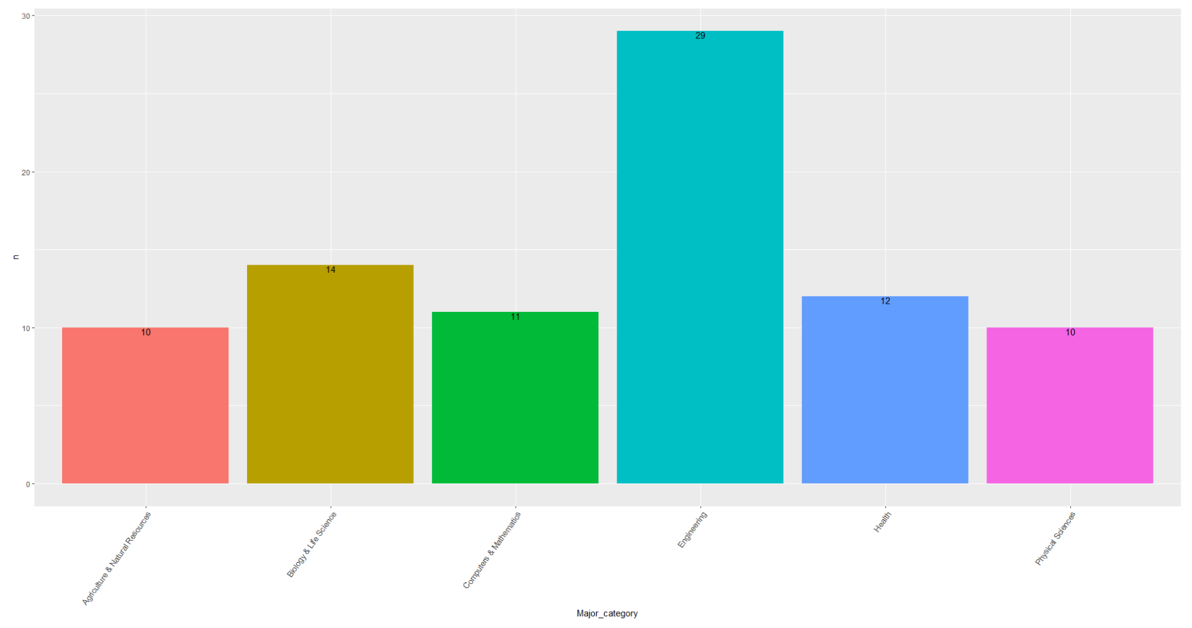
Differences Within Stem Majors (pt.1)
Amount of Stem Majors by each Category
Out of the 6 major stem categories, the one with the most diversity in majors is engineering.
The major categories with the least diversity in majors is Agriculture & Natural Resources and Physical Sciences.

Slide 18
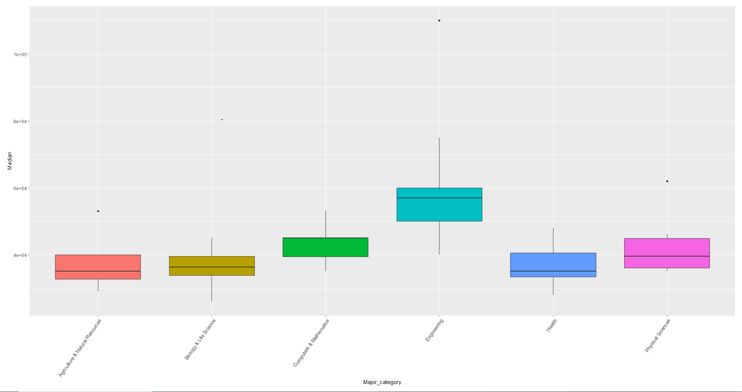
Differences Within Stem Majors (pt.2)
Boxplot of Median Salary of 6 Major Categories
From the boxplot, the highest median salary among the 6 major categories is engineering.
The lowest median salary is Agriculture and Natural Sciences.

Slide 19
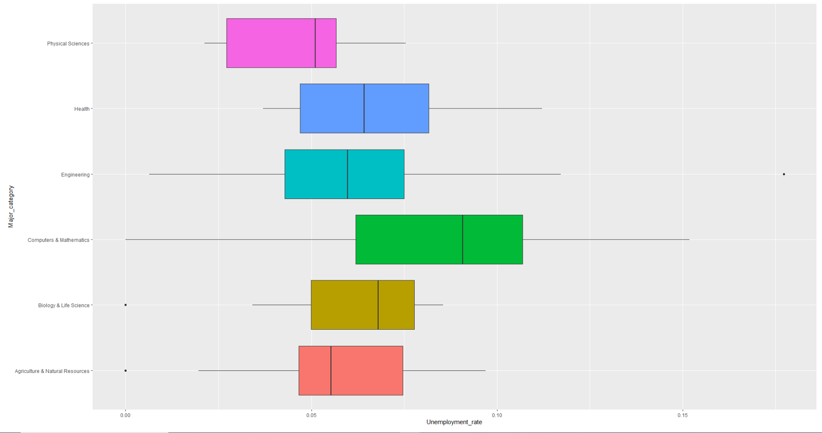
Differences Within Stem Majors (pt.3)
Boxplot of Unemployment Rate
Highest unemployment rate variance among 6 major categories is Computer & Mathematics.
Highest overall unemployment rate among 6 major categories is also Computers and Mathematics.

Slide 20

R Code: Within Stem Majors

Slide 21
Conclusion
STEM vs. Non-STEM majors:
Top 5 STEM major median salaries is much greater than that of Top 5 Non-STEM major
Median Salary and Popularity of majors are significant predictors for preference
Within STEM majors:
Major category with the highest median salary: Engineering
Computer & Mathematics has the biggest diversity in unemployment rates

