Slide 1
Evidence Synthesis Using LLMs for Climate Change Adaptation Analysis
Team: E
Sathwik kuchana
Mallika
priyadarshini

Slide 2
Motivation & Prior Work
Climate adaptation research is growing rapidly, demanding faster and scalable evidence synthesis.
Manual reviews are slow, inconsistent, and resource-intensive.
LLMs like LLaMA offer automation potential for extracting structured evidence from literature.
Prior work tested GPT-4o on the GAMI (Food Security) dataset:
High accuracy in country identification (88% precision, 90% recall).
Weaker performance in stakeholder (F1: 0.54) and depth classification (F1: 0.22).
These limitations highlight the need for domain-specific fine-tuning.
Our work builds on this by fine-tuning LLaMA 3B using annotated scientific evidence from GAMI.

Slide 3
Objective and Research Question
Objective: Utilize Llama model to extract structured climate adaptation evidence from scientific documents.
Research Question: How effectively can a fine-tuned LLM perform domain-specific evidence synthesis at scale?

Slide 4
Dataset Overview – GAMI Food Sector
Source: Global Adaptation Mapping Initiative (GAMI) – Food Security Focus Group.
Total: 551 peer-reviewed scientific articles focused on agricultural adaptation.
Training Set: 440 articles | Test Set: 111 articles.
We got preprocessed dataset which is Parsed using LlamaParse → Markdown: captured text, tables, flowcharts, graphs (images excluded).
Structured format enabled accurate chunking and metadata alignment for downstream modeling tasks.

Slide 5
Data Preprocessing - Chunking
Chunked each document into segments of 300 words to balance context and computational limits.
Simple sliding window technique without semantic segmentation used.
Generated over 4000+ text chunks for indexing and retrieval.

Slide 6
Data Preprocessing - Embedding
Used 'all-MiniLM-L6-v2' model from Sentence Transformers.
Embedded each chunk into 384-dimensional dense vectors.
This allowed semantically meaningful retrieval during inference using vector similarities
Trained on 1B+ sentence pairs with contrastive learning.
Chosen for:
Strong performance with low compute
Fast inference
Compatible with CPU-based deployments
Lightweight (22M parameters)

Slide 7
Building FAISS Index
Created FAISS index to enable fast approximate nearest neighbor search.
Each document maintained a separate embedding retrieval mapping.
Reduced computational overhead during chunk retrieval by narrowing search to file-specific chunks.

Slide 8
Retrieval Strategy
For a given query and file, retrieved top-3 contextually relevant chunks.
Distance computed in embedding space using L2 norm.
Ensured model received only document-relevant information, mimicking human context recall.

Slide 9
Dummy Dataset - Purpose
Before fine-tuning on real scientific data, trained the model on a dummy dataset.
Purpose: Ensure the model understands and outputs structured responses.
Dummy data mimicked the desired output format with simple, consistent examples.

Slide 10
Dummy Dataset Creation
Generated 10 synthetic examples covering country, stakeholder identification, and depth of adaptation.
Each example aligned with real-world adaptation response expectations.
Saved in Parquet format for compatibility with fine-tuning workflows.

Slide 11
Dummy Dataset Results
Post dummy fine-tuning evaluation:
Country Accuracy: 32% - Basic location extraction learned.
Stakeholder Accuracy: 0% - No significant stakeholder identification learned.
Depth Accuracy: 13% - Minimal understanding of adaptation depth.
Conclusion: Dummy phase succeeded in teaching response structure but not semantic extraction.

Slide 12
Fine-Tuning Configuration
Model: LLaMA 3B fine-tuned using PEFT (Parameter-Efficient Fine-Tuning) with Unsloth.
LoRA Config: r=16, lora_alpha=16, lora_dropout=0, use_gradient_checkpointing='unsloth'.
Target Modules: q_proj, k_proj, v_proj, o_proj, gate_proj, up_proj, down_proj.
Training Args: epochs=10, batch_size=4, learning_rate=2e-4, bf16=True, warmup_steps=100.
Optimizer: adamw_8bit for memory-efficient training.
PEFT enables fine-tuning with fewer trainable parameters, reducing compute cost.
Unsloth allows 2x larger batch sizes, uses 30% less VRAM, and supports long context windows.

Slide 13
Real Dataset Fine-Tuning
Fine-tuned Llama 3.2 3B on real annotated GAMI data.
Training with 5 contexts provided per document to maximize evidence exposure.
Supervised Fine-Tuning (SFT) performed for 10 epochs initially.

Slide 14
Test Set Design
Evaluation contexts included:
Context 1, 2, 3, 5, and 8.
Allowed testing model's ability to generalize across varying levels of evidence richness.

Slide 15
Evaluation Metric - Exact Match
Developed custom exact match evaluation strategy:
- Country names compared after normalization.
- Stakeholders compared using multi-value overlap handling (||| separator).
- Depth assessed with strict classification match.
Ensured field-specific performance measurement.

Slide 16
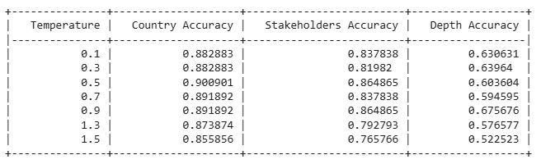
Results Summary Table
Accuracy over multiple temperatures (0.1 to 1.5) measured.
Peak performance typically observed between 0.5 and 0.7 temperatures.
Country extraction consistently achieved >88% accuracy.

Slide 17
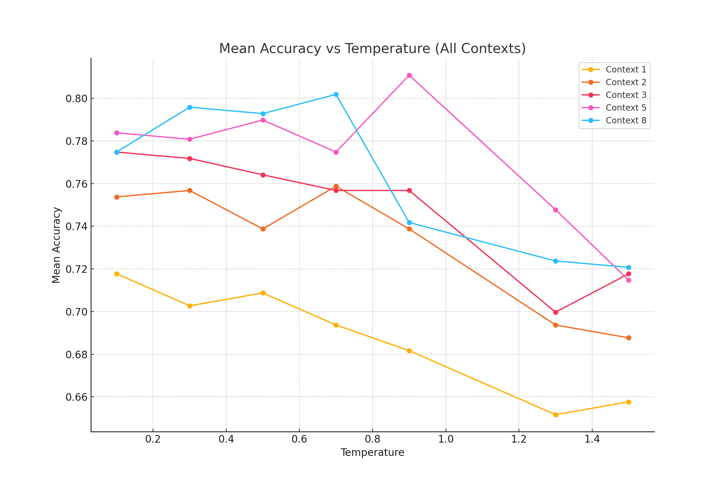
Mean Accuracy vs Temperature (All Contexts)

Slide 18
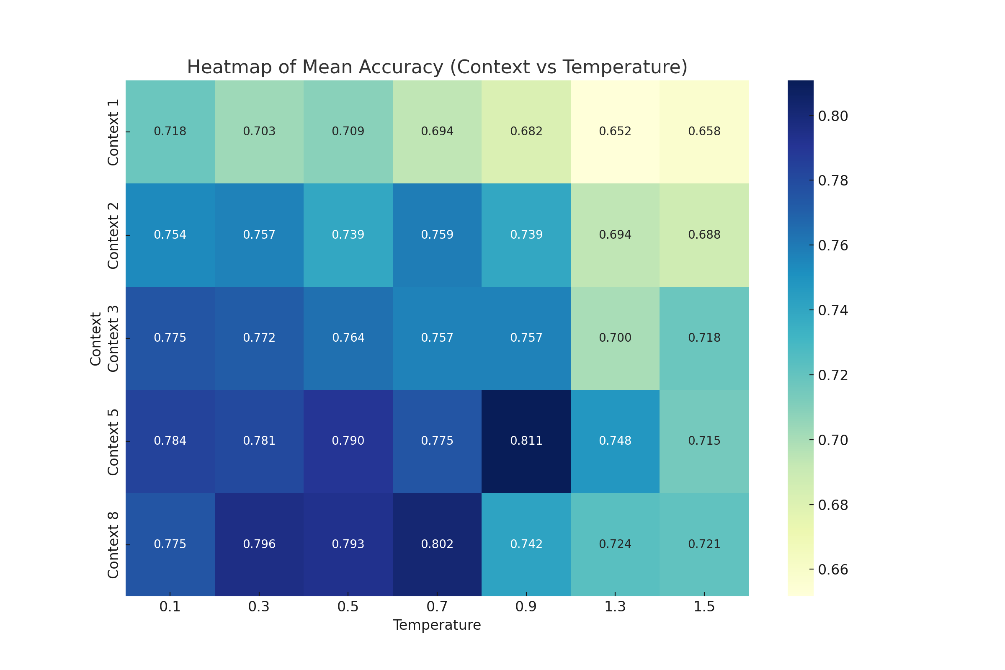
Heatmap Analysis

Slide 19
Key Executive Insights:
Moderate Temperature (0.5 - 0.7) yields the best mean accuracy across all contexts.
Contexts with richer retrievals (5, 8) achieve consistently higher extraction accuracies.
Context 1 and 2 show weaker performance, but slightly improve at moderate temperatures.
Extremely low (0.1) or high (1.5) temperatures lead to reduced accuracy (either rigid or hallucinating).
Mean Accuracy trends show temperature tuning is critical for optimal model behavior.
Retrieval strategy and context density significantly influence evidence extraction quality.
Practical setting: Temperature 0.5 + Top-5 contexts recommended for future deployments.

Slide 20
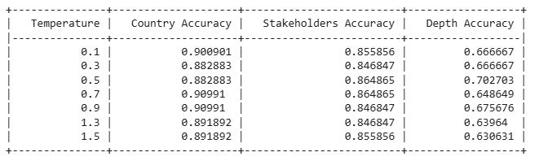
Extended Training - 20 Epochs
Model further fine-tuned for 20 epochs on full 5-context data.
Resulted in slight improvements in stakeholder and depth field extraction accuracies.
Demonstrated benefit of additional supervised exposure.

Slide 21
Key Observations and Challenges
Country identification relatively easy for LLMs.
Stakeholder extraction harder due to diverse textual representations.
Depth classification highly subjective, leading to accuracy challenges.
Parsing inconsistencies in scientific literature complicated training.

Slide 22
Practical Applications and Future Work
Deploy semi-automated evidence synthesis for climate policy development.
Expand model fine-tuning across health and water sectors.
Introduce uncertainty quantification in model responses.
Pave path for human-in-the-loop systematic evidence reviews.
Build next-gen AI systems for scientific literature intelligence.

Slide 23
Conclusion
Demonstrated that LLMs like Llama 3.2 3B, when fine-tuned appropriately, can significantly assist systematic climate evidence synthesis.
Accelerates research timelines, reduces manual effort, and increases accessibility of scientific findings.
A promising foundation for scaling evidence-based decision support in climate adaptation fields.

