Slide 1
SMS Spam Detection Using NLP

Slide 2
Introduction
Introduction to the project.
Objective: Build a model to classify SMS messages as spam or ham (not spam).
Tools used: Python, Pandas, Plotly, NLTK, Scikit-learn, TensorFlow.

Slide 3
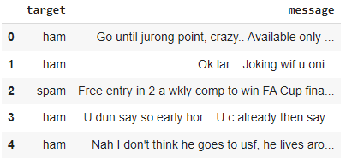
Data Loading and Initial Exploration
Steps:
Load the data using Pandas.
Drop any columns with missing values.
Rename columns for better understanding (target and message).

Slide 4
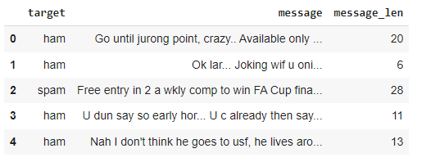
Data Overview
Display the basic information about the dataset.
Check for null values.
Add a new column to calculate the length of each message.

Slide 5
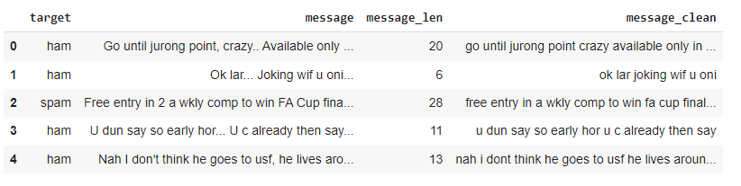
Text Cleaning
Importance of Text Cleaning in NLP
Enhanced Data Quality
Reduced Model Bias and Overfitting
Steps involved:
Convert text to lowercase.
Remove text in square brackets.
Remove links, punctuation, and words containing numbers.

Slide 6
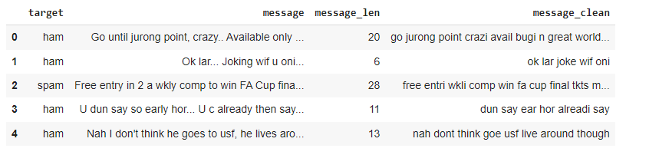
Stopwords Removal and Stemming
Stopwords and their impact on text analysis.
Use NLTK to remove stopwords from the messages.
Explain stemming and its role in reducing words to their root form.
Applied stemming to the cleaned text.

Slide 7
Label Encoding
Encoding categorical labels into numeric format.
Used Scikit-learn's LabelEncoder to transform the target labels (ham and spam) into numeric values.

Slide 8
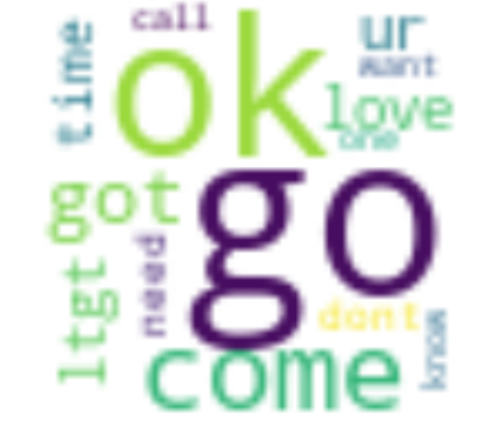
Word Cloud Visualization
word clouds are used to highlight the most frequent words in ham (non-spam) and spam messages:
Creating Word Clouds:
Interpreting the Word Clouds:

Slide 9
Train-Test Split and Vectorization
Used train_test_split function to split dataset into train and test .75% training and 25% testing
Used CountVectorizer to convert text data into numerical format (document-term matrix).
Fit the vectorizer on the training data and transform both training and testing sets.
Training samples | 4179
Testing samples | 1393

Slide 10
Model Training and Evaluation
Models used: Naive Bayes and XGBoost.
Training Process:The training set (document-term matrix) along with the corresponding labels (spam or ham) is used to train the chosen machine learning model.
Model Evaluation: After training, the model's performance is evaluated using the testing set.
Model | Test accuracy
Navies Bayes | 0.97
XG Boost | 0.96

Slide 11
LSTM Model Evaluation
LSTM
F1-score: 0.28571428571428575
Precision: 0.2
Recall: 0.5

Slide 12
Conclusion
we have achieved highest test accuracy for Navies Bayes which is 97%
we focused on achieving a robust spam detection system with a balanced performance suitable
Future Work
Exploring other NLP techniques, optimizing hyperparameters, and deploying the model as a web application.

