Slide 1

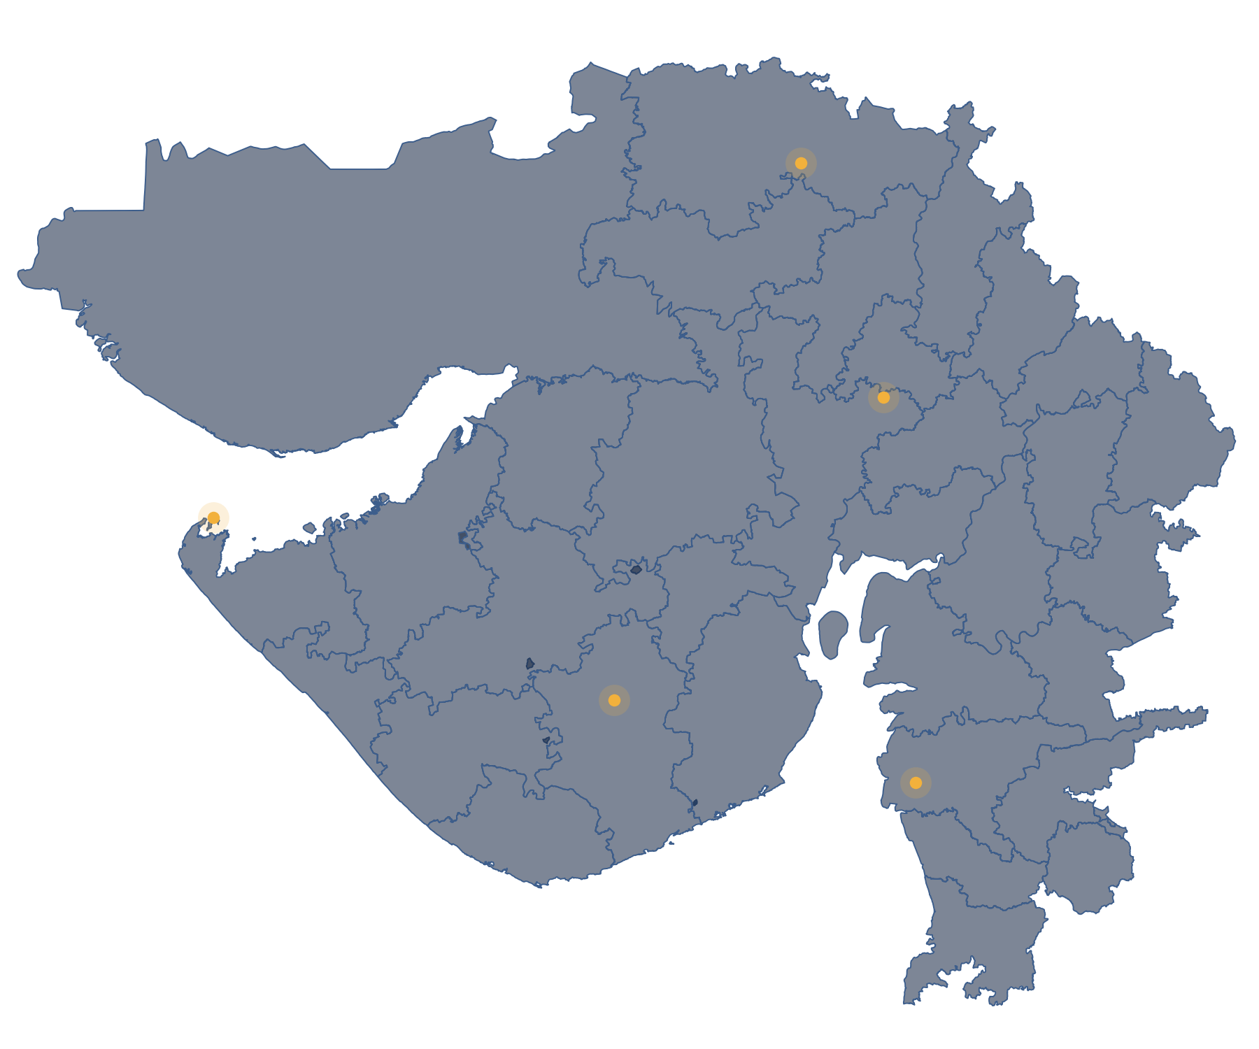
M.SC. AGRICULTURE ANALYTICS · GROUP PROJECT
Comparative evaluation of
Temperature-based solar
radiation models using
global performance indicator
Evaluation of 16 Temperature-Based Solar Radiation Models Across Stations and Seasons
PRESENTED BY
Gayatri
Shreya
Yaswanthi
Het
Gopal
Sathwik
5 IMD stations · 2002–2023 analysis window · 16 models · 5 periods
Notes:
Title slide. Project title, the six group members and the scope in one line: 5 IMD stations, 2002–2023 analysis window, 16 models, 5 periods.
Speakers are not assigned in the deck; the 18 content slides (2–19) can be shared three per person.

Slide 2







BACKGROUND & PROBLEM
Solar radiation drives agriculture — yet it is rarely measured
Energy input
Direct Rs measurement
Global solar radiation (Rs) is the energy that drives photosynthesis and crop growth.
pyranometers are costly and sparse
Evapotranspiration
Temperature is everywhere
Rs is a key input to reference evapotranspiration (FAO-56) and irrigation planning.
daily Tmax and Tmin are routinely recorded
Solar resource
Estimate Rs from temperature
Rs data also support solar-energy assessment.
empirical models + extraterrestrial Ra
Why it matters here Temperature-based models need only data that IMD stations already record — but each model was fitted elsewhere, so its reliability in Gujarat is unknown.
Comparative evaluation of temperature-based solar radiation models using global performance indicator
02
Notes:
WHAT THIS SLIDE MEANS
Why we need to estimate Rs at all, and why temperature-based models are the practical route.
SAY
• Rs controls crop growth and evapotranspiration — FAO-56 reference ET needs it.
• Pyranometer networks are sparse; temperature is recorded almost everywhere.
• So published models estimate Rs from Tmax, Tmin and extraterrestrial radiation Ra (computed from latitude and date).
LIKELY QUESTION
Why not use satellite radiation products directly? — They are an option (future scope); this project tests models that run on station data alone.
TRANSITION
"But these models come from other regions — which brings us to the research gap."

Slide 3



RESEARCH GAP & QUESTION
A model fitted elsewhere may not suit Gujarat
01
02
03
Developed elsewhere
Performance may vary
Compare, don’t assume
Each of the 16 equations was fitted with coefficients from a different region and dataset.
Accuracy can differ between locations and between seasons — especially the monsoon.
A like-for-like evaluation, with one ranking framework, is needed before choosing a model.
RESEARCH QUESTION
Where only daily temperature and sunshine records exist, which temperature-based model best estimates daily Rs — and does the answer change with season and place?
Comparative evaluation of temperature-based solar radiation models using global performance indicator
03
Notes:
WHAT THIS SLIDE MEANS
The gap: published coefficients are not local, so performance across places and seasons must be tested side by side.
SAY
• The 16 models come from different authors and regions (paper Table 2, Karale et al. 2026).
• We expect performance to depend on location and season — we test this, we do not assume it.
• One common framework (four metrics + GPI) makes the comparison fair.
LIKELY QUESTION
Did you re-fit the coefficients? — No. Coefficients are used exactly as printed; local calibration is future scope.
TRANSITION
"From this question we set seven concrete objectives."

Slide 4
OBJECTIVES
PROJECT OBJECTIVES
01
02
03
04
16
5
5
4
Evaluate 16 published temperature-based Rs models
Analyse Annual + Winter + Pre-Monsoon + Monsoon + Post-Monsoon
Assess all 5 IMD stations; only the 3 meeting reference-data/QC criteria are ranked.
Calculate RMSE, MAE, MBE and R²
05
06
07
GPI
Top-3
S × T
Construct the Global Performance Indicator
Identify Top-3 models for each ranked cell
Compare station × season patterns
Comparative evaluation of temperature-based solar radiation models using global performance indicator
04
Notes:
WHAT THIS SLIDE MEANS
The project scope as seven numbered objectives.
SAY
• 01–03 define the scope: 16 published models, five periods (Annual + four IMD seasons: Winter Jan–Feb, Pre-Monsoon Mar–May, Monsoon Jun–Sep, Post-Monsoon Oct–Dec), five IMD stations.
• 04–06 define the scoring: four metrics, combined into GPI, ranked to a Top-3 for every ranked station × period cell.
• 07 is the synthesis: how the ranking changes between stations and between seasons.
LIKELY QUESTION
Why these five stations? — They are the IMD stations available to the group; all five were assessed, three could be ranked.
TRANSITION
"Next: the study area and the five stations."

Slide 5
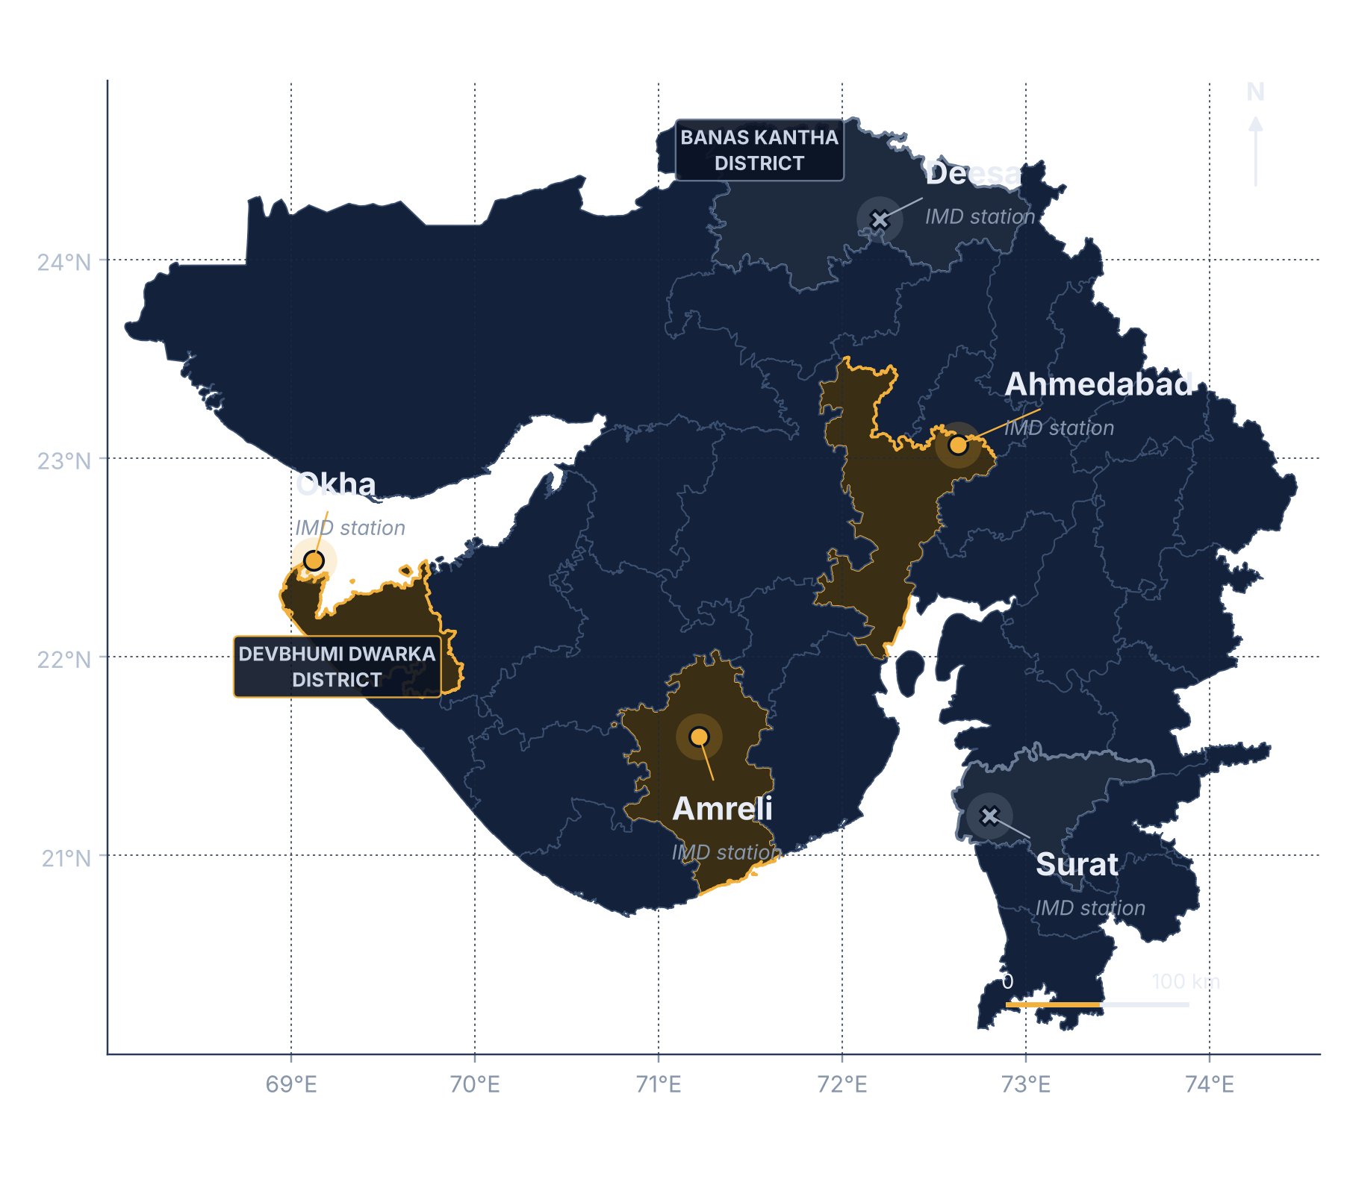
STUDY AREA & STATIONS
Five IMD stations across Gujarat
Ahmedabad station
23.07°N · 72.63°E
RANKED
Ahmedabad district
Amreli station
21.60°N · 71.22°E
RANKED
Amreli district
Okha station
22.48°N · 69.12°E
RANKED
↳ in Devbhumi Dwarka district
Surat station
21.20°N · 72.80°E
NOT RANKED
Surat district
Deesa station
24.20°N · 72.20°E
NOT RANKED
↳ in Banas Kantha district
Markers = station points. Shaded polygons = the host district of each station (shown for location context).
● ranked station ✕ not-ranked station ■ host district boundary
Comparative evaluation of temperature-based solar radiation models using global performance indicator
Lat: IMD normals (engine/config.py) · lon: NASA POWER request points
05
Notes:
WHAT THIS SLIDE MEANS
Where the five stations are, and which three could be ranked.
SAY
• Each marker is a station point; the shaded polygon is only the district that station sits in.
• Okha is a station in Devbhumi Dwarka district; Deesa is a station in Banas Kantha district.
• Ahmedabad, Amreli and Okha are ranked; Surat and Deesa are not ranked because their sunshine reference data failed QC (slide 16).
LIKELY QUESTION
Where do the coordinates come from? — Latitudes are the IMD Climatological Normals values used in the engine; longitudes are the NASA POWER request points for each station.
TRANSITION
"Next: what data each station provides, and what we compare the models against."

Slide 6


DATA SOURCES & REFERENCE
What goes in, and what the models are compared against
MODELS USE
IMD PRIMARY REFERENCE
Tmax, Tmin → 16 models
Rs = (0.25 + 0.50·n/N)·Ra
IMD daily records
Ra and day length N from latitude and date (FAO-56)
Tmax maximum temperature, °C
Tmin minimum temperature, °C
n bright sunshine hours
Sunshine-based standard used by the paper. It is an estimate — not measured pyranometer radiation.
IMD REFERENCE USES
n → Ångström–Prescott Rs
2002 – 2023
analysis window · 22 years
NASA POWER
Used as satellite evidence for the sunshine-record quality check and for a side comparison. It is NOT the ranking reference.
supplementary only
Comparative evaluation of temperature-based solar radiation models using global performance indicator
README §3–4 · engine/solar_geometry.py
06
Notes:
WHAT THIS SLIDE MEANS
Two data paths: temperatures feed the models, sunshine hours feed the reference. NASA POWER only checks data quality.
SAY
• The IMD files are the only input the notebook reads; the analysis window is 2002–2023 (next slide).
• The reference Rs is Ångström–Prescott with a = 0.25, b = 0.50 (paper Eq. 5), using Ra and N from FAO-56 geometry.
• NASA POWER satellite data were used to check whether each station-year of sunshine is trustworthy — not to rank models.
LIKELY QUESTION
Why not use NASA POWER as the reference? — The paper method uses the sunshine-based reference. As a supplementary test, NASA as reference keeps 10 of 15 Top-3 sets unchanged.
TRANSITION
"Next: which years are actually analysed, and the five evaluation periods."

Slide 7
DATA PERIOD & SEASONAL FRAMEWORK
Source record ≠ analysis window ≠ usable days
ANALYSIS WINDOW 2002 – 2023
WHICH YEARS ARE USED, PER STATION
A
SOURCE DATA AVAILABLE
Ahmedabad
8,013 days
1985 – 2025
IMD daily files · Surat from 1990 · Deesa from 2012
Amreli
5,437 days
Okha
7,040 days
B
ANALYSIS WINDOW
2002 – 2023
Surat
0 · not ranked
22 years · 8,035 days · same period as Karale et al. (2026)
Deesa
0 · not ranked
C
USABLE RANKING DATA
1985
1990
2000
2010
2020
2025
20,490 days
source record
years used for ranking
analysis window (all stations)
pass every QC rule · 3 stations ranked · Surat, Deesa 0
FIVE EVALUATION PERIODS
Annual
Winter
Pre-Monsoon
Monsoon
Post-Monsoon
IMD seasons used in the paper. Every model is ranked separately in each period: 3 stations × 5 periods = 15 ranked cells.
Jan – Dec
Jan – Feb
Mar – May
Jun – Sep
Oct – Dec
Comparative evaluation of temperature-based solar radiation models using global performance indicator
data/raw_imd · engine/config.py · daily_predictions.csv
07
Notes:
WHAT THIS SLIDE MEANS
Three different time spans are easy to confuse. A = what the IMD files contain; B = the window we analyse; C = the days that actually enter the ranking.
SAY
• A — Source: the IMD files run 1985–2025 for Ahmedabad, Amreli and Okha; Surat starts in 1990, Deesa only in 2012.
• B — Analysis window: 2002–2023 for every station (22 years, 8,035 calendar days) — the same period as Karale et al. (2026), so our results are comparable with the paper. Records before 2002 and after 2023 are not analysed.
• C — Usable: a day enters the ranking only if it passes every QC rule (next slides). Ahmedabad uses all 22 years (8,013 days); Amreli 15 of 22 years (2003–2011, 2013–2017, 2023; 5,437 days); Okha 2002–2021 (7,040 days); Surat and Deesa 0 — 20,490 usable days in total.
• Five periods: Annual (Jan–Dec), Winter (Jan–Feb), Pre-Monsoon (Mar–May), Monsoon (Jun–Sep), Post-Monsoon (Oct–Dec). Every model is ranked separately in each → 3 stations × 5 periods = 15 ranked cells.
LIKELY QUESTION
Why does the data go back to 1985 but the analysis start in 2002? — We follow the paper's 2002–2023 window for comparability; the extra years exist in the files but are outside the study design.
TRANSITION
"With the data and periods fixed, here is the full workflow."

Slide 8



METHODOLOGY WORKFLOW
From raw IMD data to a station × season comparison
01
02
03
04
05
Raw IMD data
QC
Solar geometry
Ångström–Prescott reference
16 models
Tmax · Tmin · n
inclusion rules
Ra, N (FAO-56)
(0.25 + 0.50·n/N)·Ra
M1 – M16
10
09
08
07
06
Station × season comparison
Top-3
Ranking
GPI
Metrics
3 stations × 5 periods
per ranked cell
highest GPI = rank 1
one score per model
RMSE · MAE · MBE · R²
Steps 06–09 are repeated for every station × period cell · 15 ranked cells = 3 usable stations × 5 periods
Comparative evaluation of temperature-based solar radiation models using global performance indicator
code/solar_radiation_analysis_FINAL.ipynb · engine/pipeline.py
08
Notes:
WHAT THIS SLIDE MEANS
The whole method on one slide, read left-to-right on top, then right-to-left below; later slides zoom into each box.
SAY
• 01–04: raw IMD data → QC → solar geometry (Ra, N) → Ångström–Prescott reference Rs.
• 05–06: all 16 models run on the same valid days and are scored with four metrics against that reference.
• 07–10: GPI → ranking (highest GPI = rank 1) → Top-3 → comparison across stations and seasons.
LIKELY QUESTION
Is anything calibrated or gap-filled? — No. Published coefficients only; nothing filled, clipped or recalibrated.
TRANSITION
"Next: the quality-control rules that decide which days are used."

Slide 9
QUALITY CONTROL & INCLUSION RULES
A day counts only if every rule passes
ΔT > 0
0 ≤ n ≤ N
Sunshine-year check
QC ACROSS 5 STATIONS → RANKING ON 3 USABLE STATIONS
Tmax and Tmin valid; Tmax − Tmin positive
sunshine hours within day length
station-year agrees with satellite cloudiness
Usable ranking days
Ahmedabad 8,013 · Okha 7,040 · Amreli 5,437
Surat 0 · Deesa 0
GROUP-ADDED QC
16 finite estimates
≥ 30 days
Nothing altered
UPLOAD WORKFLOW · DASHBOARD
all models give a finite value
minimum valid days per station × period
no filling · no clipping · no recalibration
Satellite check cannot run; years with < 200 sunshine values are flagged. Same day-level rules apply.
Group-added step The sunshine-year check (vs NASA POWER cloudiness: < 200 valid days, same-day r < 0.30, or a better fit when time-shifted) is our addition — not in the paper. Every decision: results/qc_report.csv.
Comparative evaluation of temperature-based solar radiation models using global performance indicator
README §4, §8 · results/qc_report.csv
09
Notes:
WHAT THIS SLIDE MEANS
The inclusion rules. QC was run on all five stations; only three produced usable ranking days.
SAY
• ΔT > 0 because √ΔT and ln ΔT are undefined otherwise; n > N is physically impossible, so those days are excluded, not clipped.
• The sunshine-year check (amber) is a group-added step, not in the paper; it is what removed every Surat and Deesa year.
• Result: Ahmedabad 8,013, Okha 7,040, Amreli 5,437 usable days; Surat and Deesa 0. Uploaded files cannot run the satellite check; the dashboard flags weak years instead.
LIKELY QUESTION
Is the sunshine check part of the paper? — No, it is our addition. Without it, 11 of 15 Top-3 sets stay the same, but date-shifted records would then be used as the reference.
TRANSITION
"Once the valid days are fixed, all 16 models are run on them."

Slide 10
THE 16 MODELS
Five model families by temperature formulation
A
√ΔT / Hargreaves
B
Power / Log ΔT
C
Linear / Polynomial ΔT
D
Temperature Ratio
E
Tmax / Tmin / Mean T
M1
M6
M15
M3
M5
M9
M2*
M4
M11
M16*
M7
M8*
M12
M10
M13
M14
COEFFICIENTS
COEFFICIENTS
COEFFICIENTS
COEFFICIENTS
COEFFICIENTS
(a + b√ΔT)·Ra
a·ΔT^{b}·Ra
(a + bΔT + cΔT²)·Ra
(a + b·Tmax/Tmin)·Ra
(a + b·Tmax + c·Tmin)·Ra
a
b
a
b
a
b
c
a
b
a
b
c
M1
0
0.16
M3
0.3124
0.2942
M4
0.7730
−0.0296
0.0016
M7
0.2889
0.1562
M13
0.206590
0.026851
−0.024184
M6
0.3040
0.1008
(a + b ln ΔT)·Ra
M11
0.4610
0.0029
0
(a + b·Θ)·Ra *
(a + b·T)·Ra
M15
0.236
0.106
a
b
M16*
0.4023
−0.0433
0.00185
a
b
a
b
M5
0.2063
0.1801
3.6 × (a + bΔT)
M8*
1.7217
−1.691
M14
0.85235
−0.00997
M9
0.15
0.28
a
b
(a + b·Tmin/Tmax)·Ra
a + b·Ra + c·T
M2*
1.29
0.3626
a
b
a
b
c
M12
0.5290
0.0516
M10
−4.46
0.477
−0.226
* Used conventions: M2 ×3.6 (kWh→MJ; no Ra) · M8 Θ = Tmin/Tmax (paper leaves Θ undefined) · M16 used as printed (no √ΔT). All coefficients as printed · ΔT = Tmax − Tmin · T = mean temperature · units: MJ m⁻² d⁻¹.
Comparative evaluation of temperature-based solar radiation models using global performance indicator
Karale et al. (2026) Table 2 · engine/models.py · results/model_registry.csv
10
Notes:
WHAT THIS SLIDE MEANS
All 16 models in five families (A–E) by the temperature term they use. Families are the headline; coefficients are shown underneath, exactly as printed.
SAY
• A √ΔT (Hargreaves type): M1, M6, M15 · B power/log ΔT: M3, M5, M9 · C linear/polynomial ΔT: M2, M4, M11, M16 · D temperature ratio: M7, M8, M12 · E Tmax/Tmin/mean T: M10, M13, M14.
• Most models scale Ra; M2 has no Ra term and M10 is additive. Rows write each model in a shared general form — e.g. M1 = 0.16·√ΔT·Ra, i.e. a = 0, b = 0.16.
• * marks three model-form conventions used in the final analysis: M2 ×3.6, M8 Θ = Tmin/Tmax and M16 as printed. The family grouping is our presentation aid, not the paper’s.
LIKELY QUESTION
Where do the equations come from? — Paper Table 2; implemented in engine/models.py and listed in results/model_registry.csv.
TRANSITION
"To compare these 16 models we need a scoring system — four metrics."

Slide 11
EVALUATION METRICS
Four scores per model, per cell
RMSE
MAE
MBE
R²
√ mean(P − O)²
mean |P − O|
mean (P − O)
1 − SSE/SST
Typical error size; penalises large errors
Average error size
Systematic bias · + over, − under
Variation explained; not clipped at zero — can be negative
RMSE ↓ better
MAE ↓ better
MBE: signed
R² ↑ better
ROLE IN GPI
ROLE IN GPI
ROLE IN GPI
ROLE IN GPI
α = +1
α = +1
α = +1 (signed)
α = −1
P = model estimate O = Ångström–Prescott reference Rs · computed on daily values within each station × period. R² is not clipped at 0 — it is negative in 180 of the 240 model × cell results.
Comparative evaluation of temperature-based solar radiation models using global performance indicator
Paper Table 3 · engine/metrics.py
11
Notes:
WHAT THIS SLIDE MEANS
How each model is scored before ranking. The α row shows how each metric enters the GPI on the next slide.
SAY
• RMSE and MAE measure error size; RMSE punishes large misses more.
• MBE keeps its sign: positive = overestimate, negative = underestimate — signed use is a project assumption (E).
• R² = 1 − SSE/SST, the paper’s formula; it can be negative when a model is worse than the mean of the reference.
LIKELY QUESTION
Why can R² be negative? — With 1 − SSE/SST, a model whose squared error exceeds the variance of the reference gets R² < 0. Okha’s best annual model has R² = −0.08.
TRANSITION
"Next: how these four metrics become one score — the GPI."

Slide 12
GLOBAL PERFORMANCE INDICATOR
Four metrics → one score → one ranking
1
2
3
4
5
6
Metrics
Min–max 0–1
Median comparison
α direction
Summation
Ranking
RMSE, MAE, MBE, R² for all 16 models
y = (x − min)/(max − min)
median(y) − y
−1 for R²; +1 others
GPI = Σ α(median − y)
highest GPI = rank 1
WORKED EXAMPLE Ahmedabad · Annual · M1
Equal ±1 contributions
Not arbitrary weights. Positive GPI indicates performance above the median on balance across the included indicators.
Signed MBE
The most negative bias scales to 0 and scores best on MBE — assumption E.
metric
α
median y
M1 y
contribution
R²
−1
0.924
1.000
+0.076
RMSE
+1
0.162
0.000
+0.162
MAE
+1
0.130
0.000
+0.130
MBE
+1
0.659
0.592
+0.068
GPI = 0.436 → rank 1 of 16
Comparative evaluation of temperature-based solar radiation models using global performance indicator
Paper §2.3.1 (Despotovic et al. 2015) · engine/gpi.py · annual_gpi.csv
12
Notes:
WHAT THIS SLIDE MEANS
GPI turns four metrics into one number per model, within one station and one period.
SAY
• Each metric is min–max scaled to 0–1 across the 16 models, then compared with the median model.
• α = −1 for R² (higher is better), +1 for RMSE, MAE and MBE; contributions are summed with equal ±1 signs — no weighting, no tuning.
• Worked example: Ahmedabad Annual M1 gets 0.436 → rank 1 of 16.
LIKELY QUESTION
What does a negative GPI mean? — Worse than the median model on balance. Also expect: why signed MBE? — the paper uses it; |MBE| is our sensitivity test (slide 18).
TRANSITION
"Applying GPI to the annual data gives these Top-3 models."

Slide 13
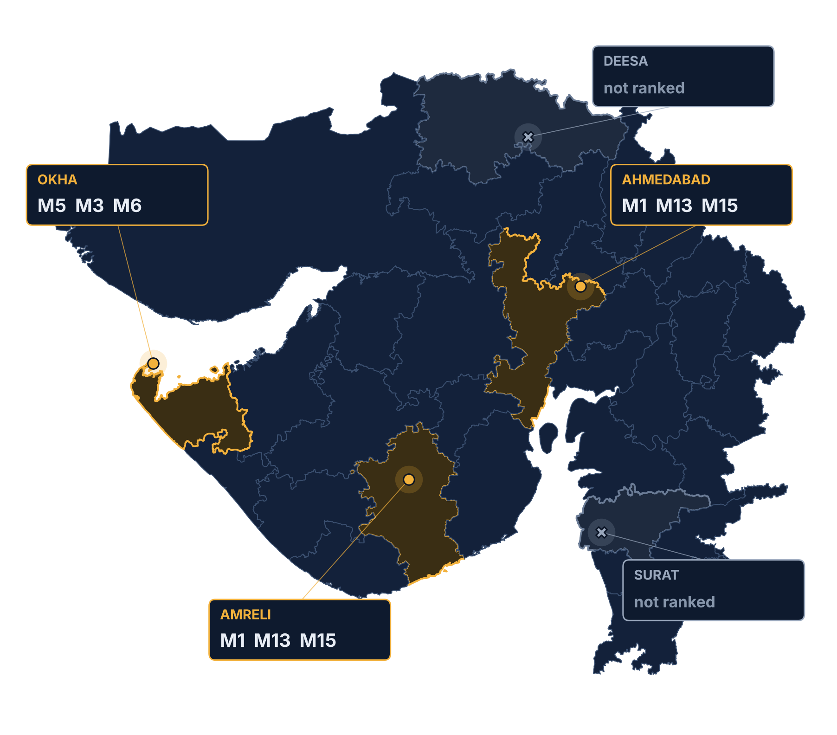
ANNUAL RESULTS
Annual Top-3 by station
AHMEDABAD
RANK-1
M1
M13
R² 0.54
→
→
M15
RMSE 3.32
#1 · GPI 0.44
#2 · GPI 0.33
#3 · GPI 0.30
AMRELI
RANK-1
M1
M13
R² 0.33
→
→
M15
RMSE 3.67
#1 · GPI 0.28
#2 · GPI 0.22
#3 · GPI 0.21
OKHA
RANK-1
M5
M3
R² -0.08
→
→
M6
RMSE 4.83
#1 · GPI 0.15
#2 · GPI 0.13
#3 · GPI 0.11
Note Okha’s best annual model still has R² = −0.08.
Comparative evaluation of temperature-based solar radiation models using global performance indicator
results/final/top_3_models.csv · RMSE in MJ m⁻² d⁻¹
13
Notes:
WHAT THIS SLIDE MEANS
Annual ranking at the three usable stations.
SAY
• Ahmedabad and Amreli have the same annual Top-3: M1 → M13 → M15.
• Okha’s annual Top-3 is completely different: M5 → M3 → M6.
• Okha’s rank-1 model has R² = −0.08 — even the best model there explains less variance than the reference mean. Surat and Deesa are not ranked.
LIKELY QUESTION
Why is Okha different? — The project did not test causes; we report the difference without attributing it (no causal claim).
TRANSITION
"Annual results hide seasonal changes — next, the five periods."

Slide 14
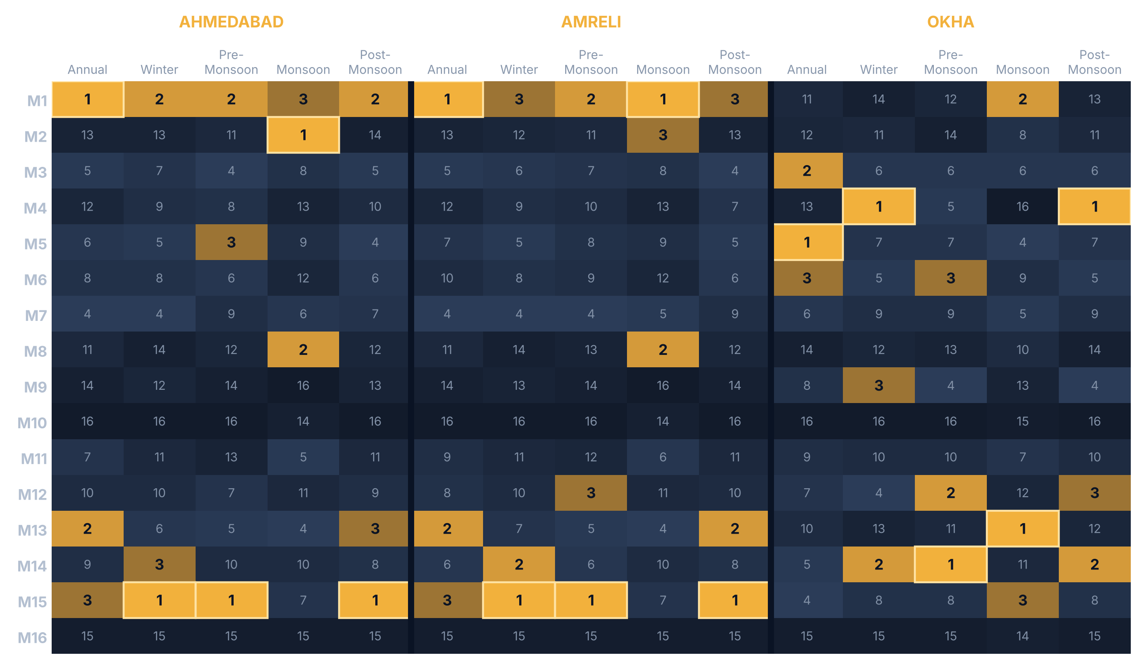
SEASONAL RESULTS
The Top-3 changes with the season
M15 leads 6 station-season cells
Ranks #1 in Winter, Pre-Monsoon and Post-Monsoon at Ahmedabad and Amreli.
Monsoon brings in M2 / M8
Both enter the Top-3 at Ahmedabad and Amreli — in the Monsoon only.
Okha · always different
No two Okha periods share the same Top-3.
M10 · M16 weakest
Ranks 14–16 in every ranked cell.
■ Top-3 □ rank 1 · numbers = GPI rank (1 = best)
Winter Jan–Feb · Pre-Monsoon Mar–May · Monsoon Jun–Sep · Post-Monsoon Oct–Dec
Comparative evaluation of temperature-based solar radiation models using global performance indicator
results/final/model_ranking.csv
14
Notes:
WHAT THIS SLIDE MEANS
Each column is one station × period cell; the number is the model’s GPI rank there. Gold cells are the Top-3.
SAY
• Read across a row to see how one model’s rank moves between seasons and stations.
• M15 is rank 1 in Winter, Pre-Monsoon and Post-Monsoon at both Ahmedabad and Amreli — but not in the Monsoon.
• In the Monsoon, M2 and M8 join the Top-3 at Ahmedabad and Amreli; Okha has a different Top-3 in every period.
LIKELY QUESTION
Is any model best everywhere? — No. M10 and M16 are consistently weakest (ranks 14–16), but no model is rank 1 in every cell.
TRANSITION
"Next: how often each model reaches the Top-3."

Slide 15
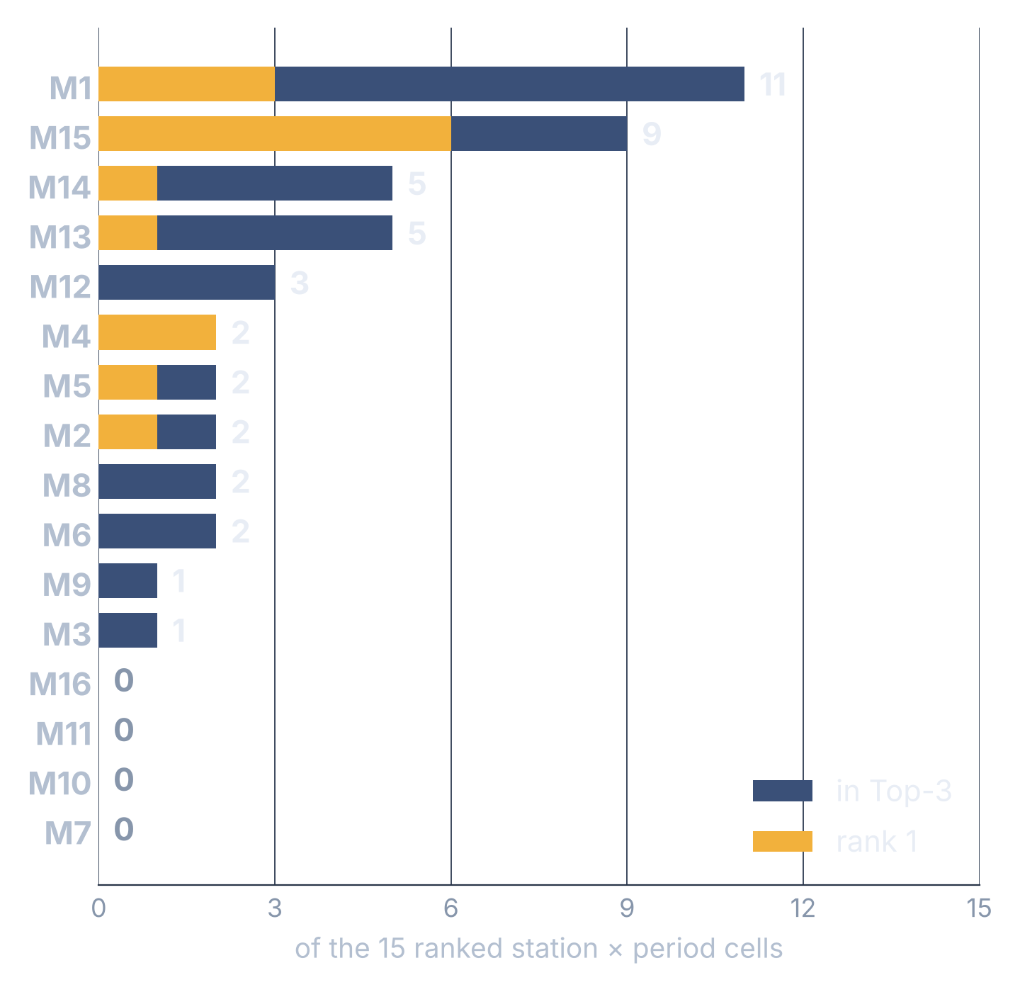
TOP-3 MODEL ANALYSIS
How often does each model reach the Top-3?
11/15
M1 in the Top-3
most frequent model
6
rank-1 positions for M15
most rank-1 wins
7
different models take rank 1
no single winner
12/16
models reach the Top-3 at least once
0
Top-3 places: M7, M10, M11, M16
Comparative evaluation of temperature-based solar radiation models using global performance indicator
15 cells = 3 stations × 5 periods · model_cross_district_summary.csv
15
Notes:
WHAT THIS SLIDE MEANS
Across all 15 ranked cells, how often each model is in the Top-3 (grey bar) and at rank 1 (gold).
SAY
• M1 is in the Top-3 in 11 of 15 cells — the most consistent — but rank 1 only 3 times.
• M15 has the most rank-1 positions (6). Seven different models take rank 1 overall.
• 12 of 16 models reach the Top-3 at least once; M7, M10, M11 and M16 never do.
LIKELY QUESTION
So should Gujarat use M1? — Only conditionally: the best model depends on station and season, and on assumptions D and E.
TRANSITION
"Why only 15 cells, not 25? Because two stations failed data quality."

Slide 16
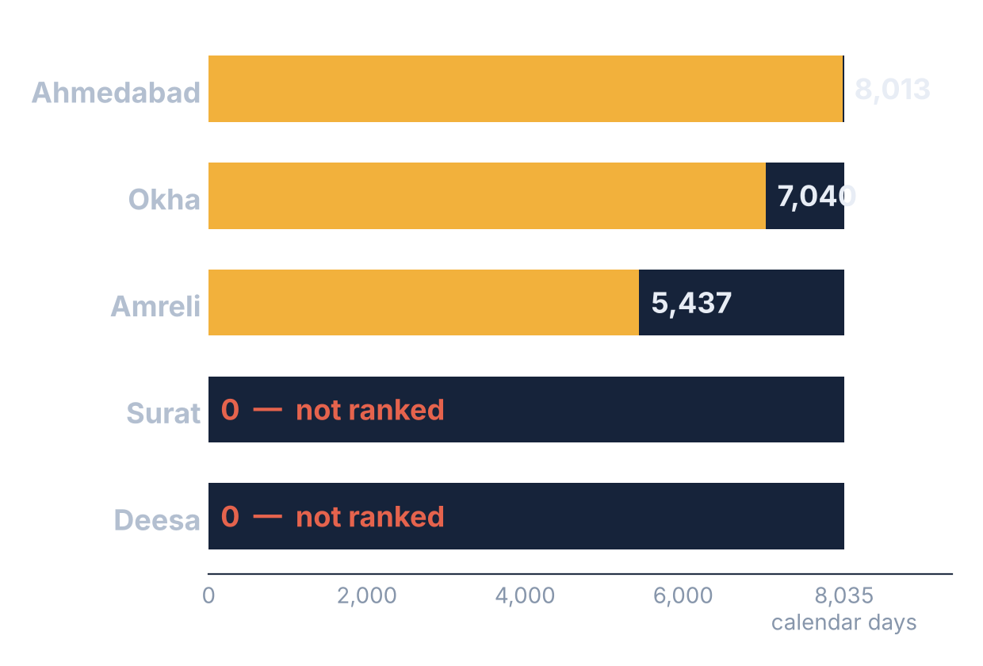
DATA QUALITY & STATION EXCLUSIONS
Reference-data exclusions — not model failures
Conclusion Surat and Deesa were excluded because the reference data failed QC — not because the models failed.
USABLE RANKING DAYS (2002–2023)
ISSUE
SURAT
DEESA
Missing observations
22 % of calendar days absent (1,806 of 8,035)
Data start only in 2012 (3,660 of 8,035 days absent)
Insufficient valid sunshine
17 years with < 200 valid sunshine days
—
Temporal / date shift
2002 fits satellite best when shifted ~10 days
Every year fits only when shifted 50–75 days
Consequence
0 usable ranking days
0 usable ranking days
Comparative evaluation of temperature-based solar radiation models using global performance indicator
README §8 · results/qc_report.csv
16
Notes:
WHAT THIS SLIDE MEANS
Why the ranking covers three stations. The models were not the problem — the sunshine-based reference data at Surat and Deesa failed QC.
SAY
• Usable days: Ahmedabad 8,013, Okha 7,040, Amreli 5,437; Surat and Deesa 0 (out of 8,035 calendar days, 2002–2023).
• Surat: 22% of days absent (1,806 of 8,035), 17 years with fewer than 200 valid sunshine days, and 2002 best matched satellite cloudiness after a ~10-day shift.
• Deesa: no record before 2012, and every year from 2012 only matches satellite cloudiness after a 50–75 day shift — consistent with mis-dated sunshine records.
LIKELY QUESTION
Could you correct the shift and use Deesa? — That would mean altering the data; the project rule is no filling or correcting, so Deesa stays unranked.
TRANSITION
"All of this — and the ranking itself — can be explored in our dashboard."

Slide 17

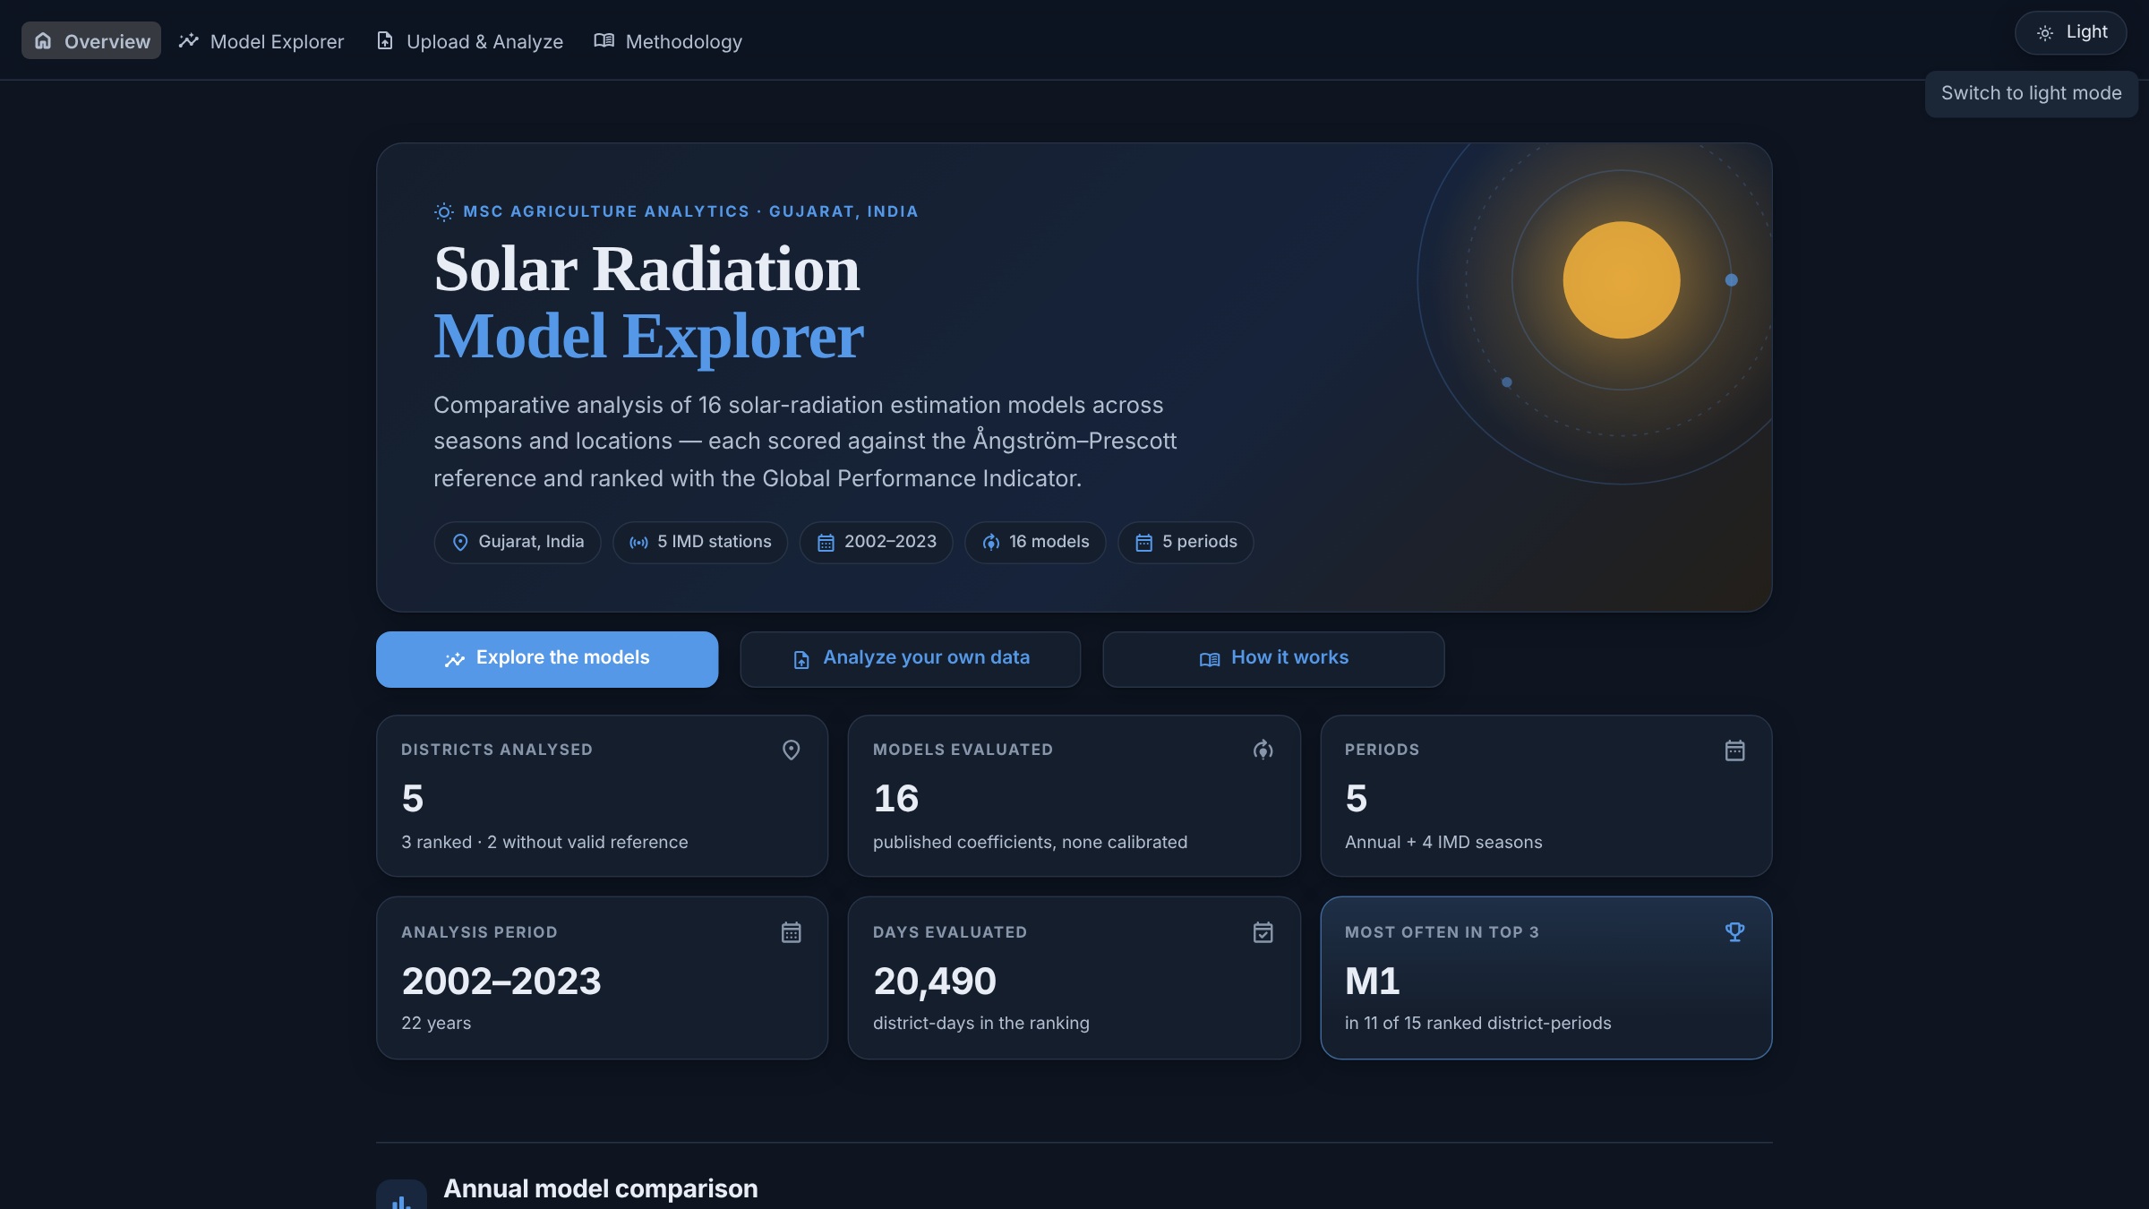
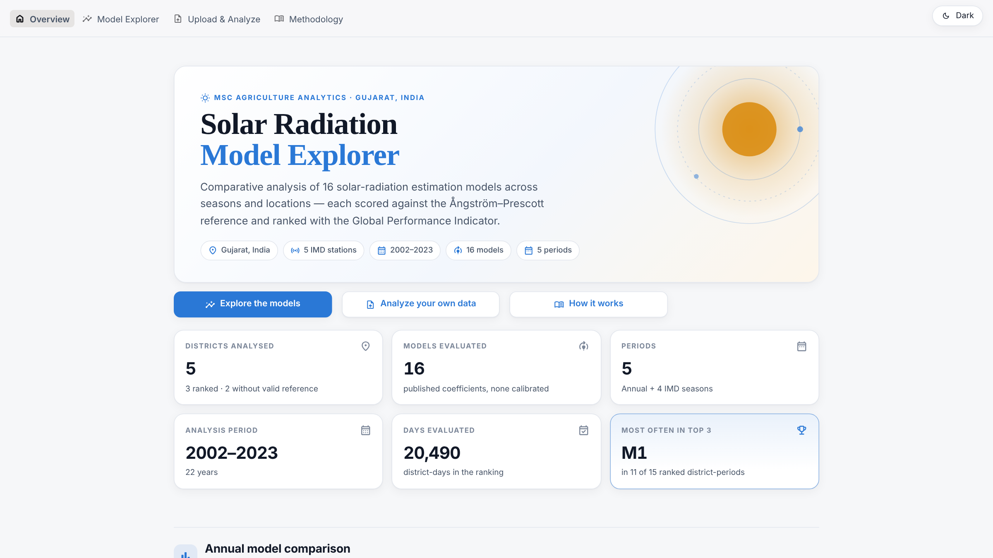
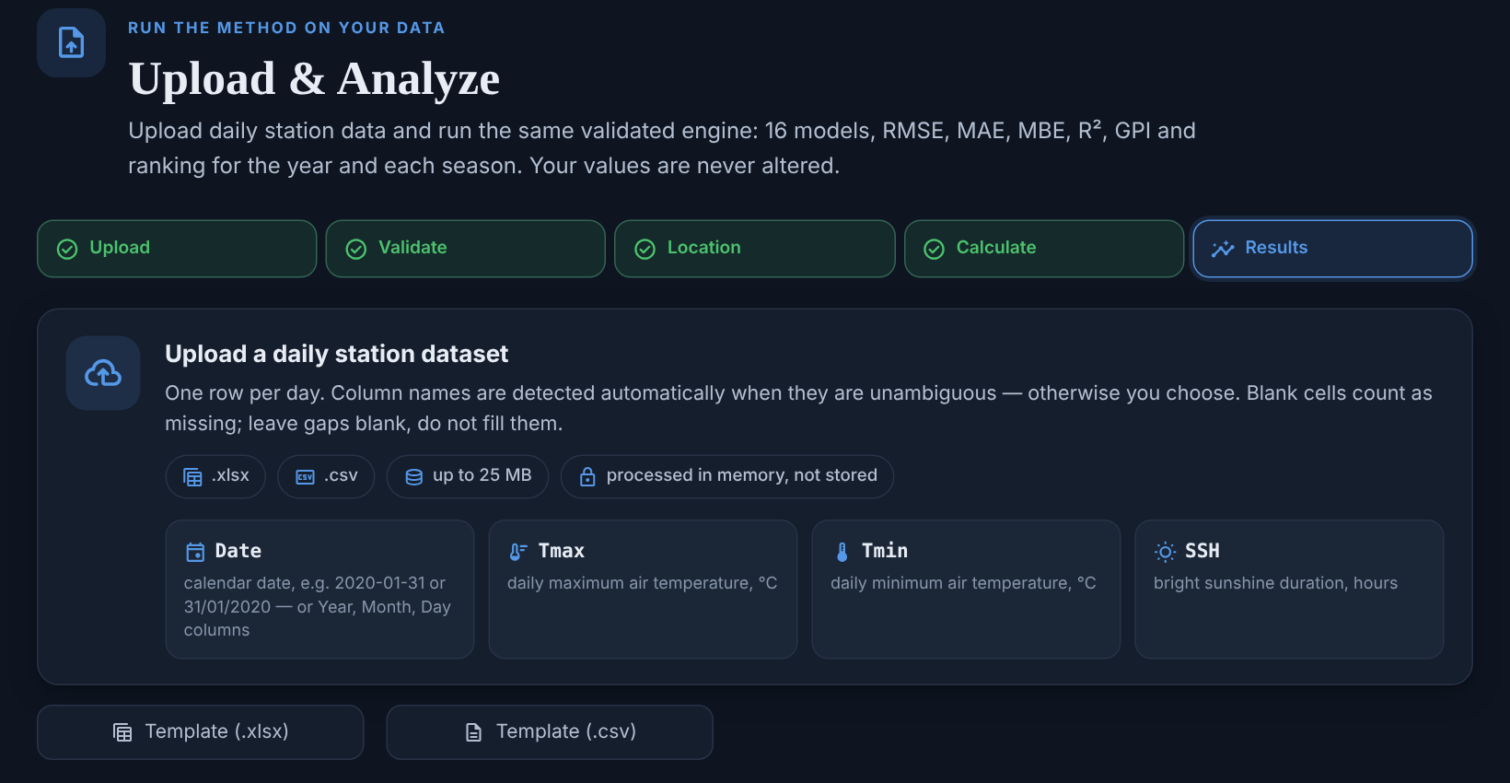
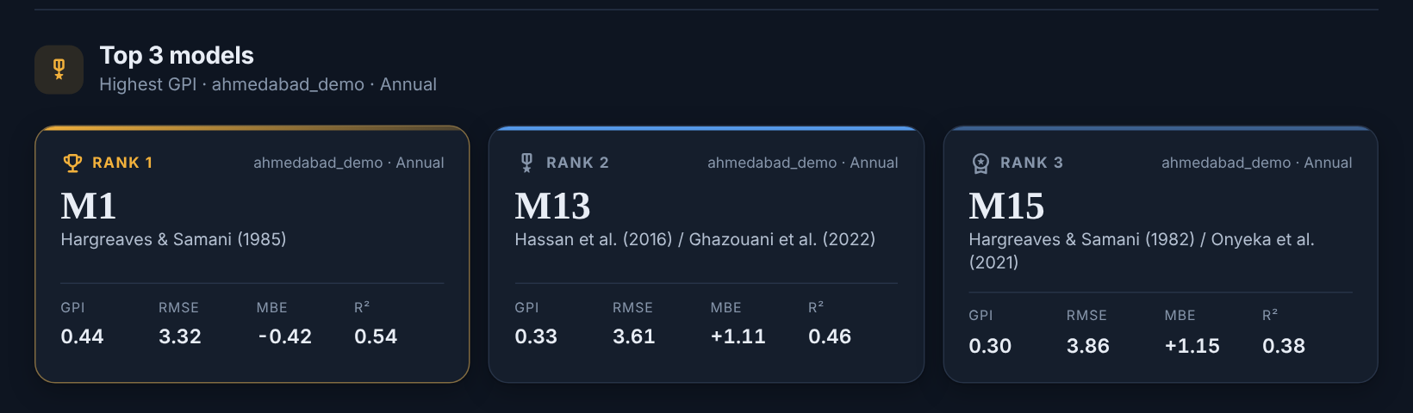
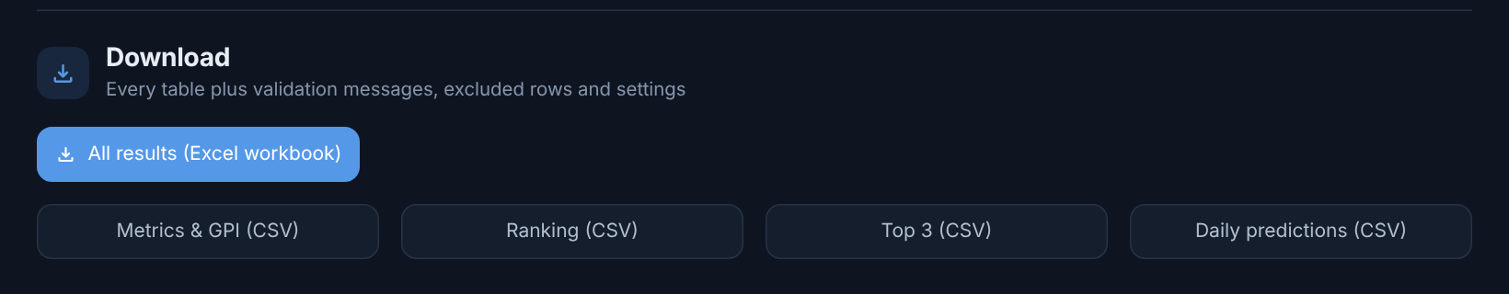
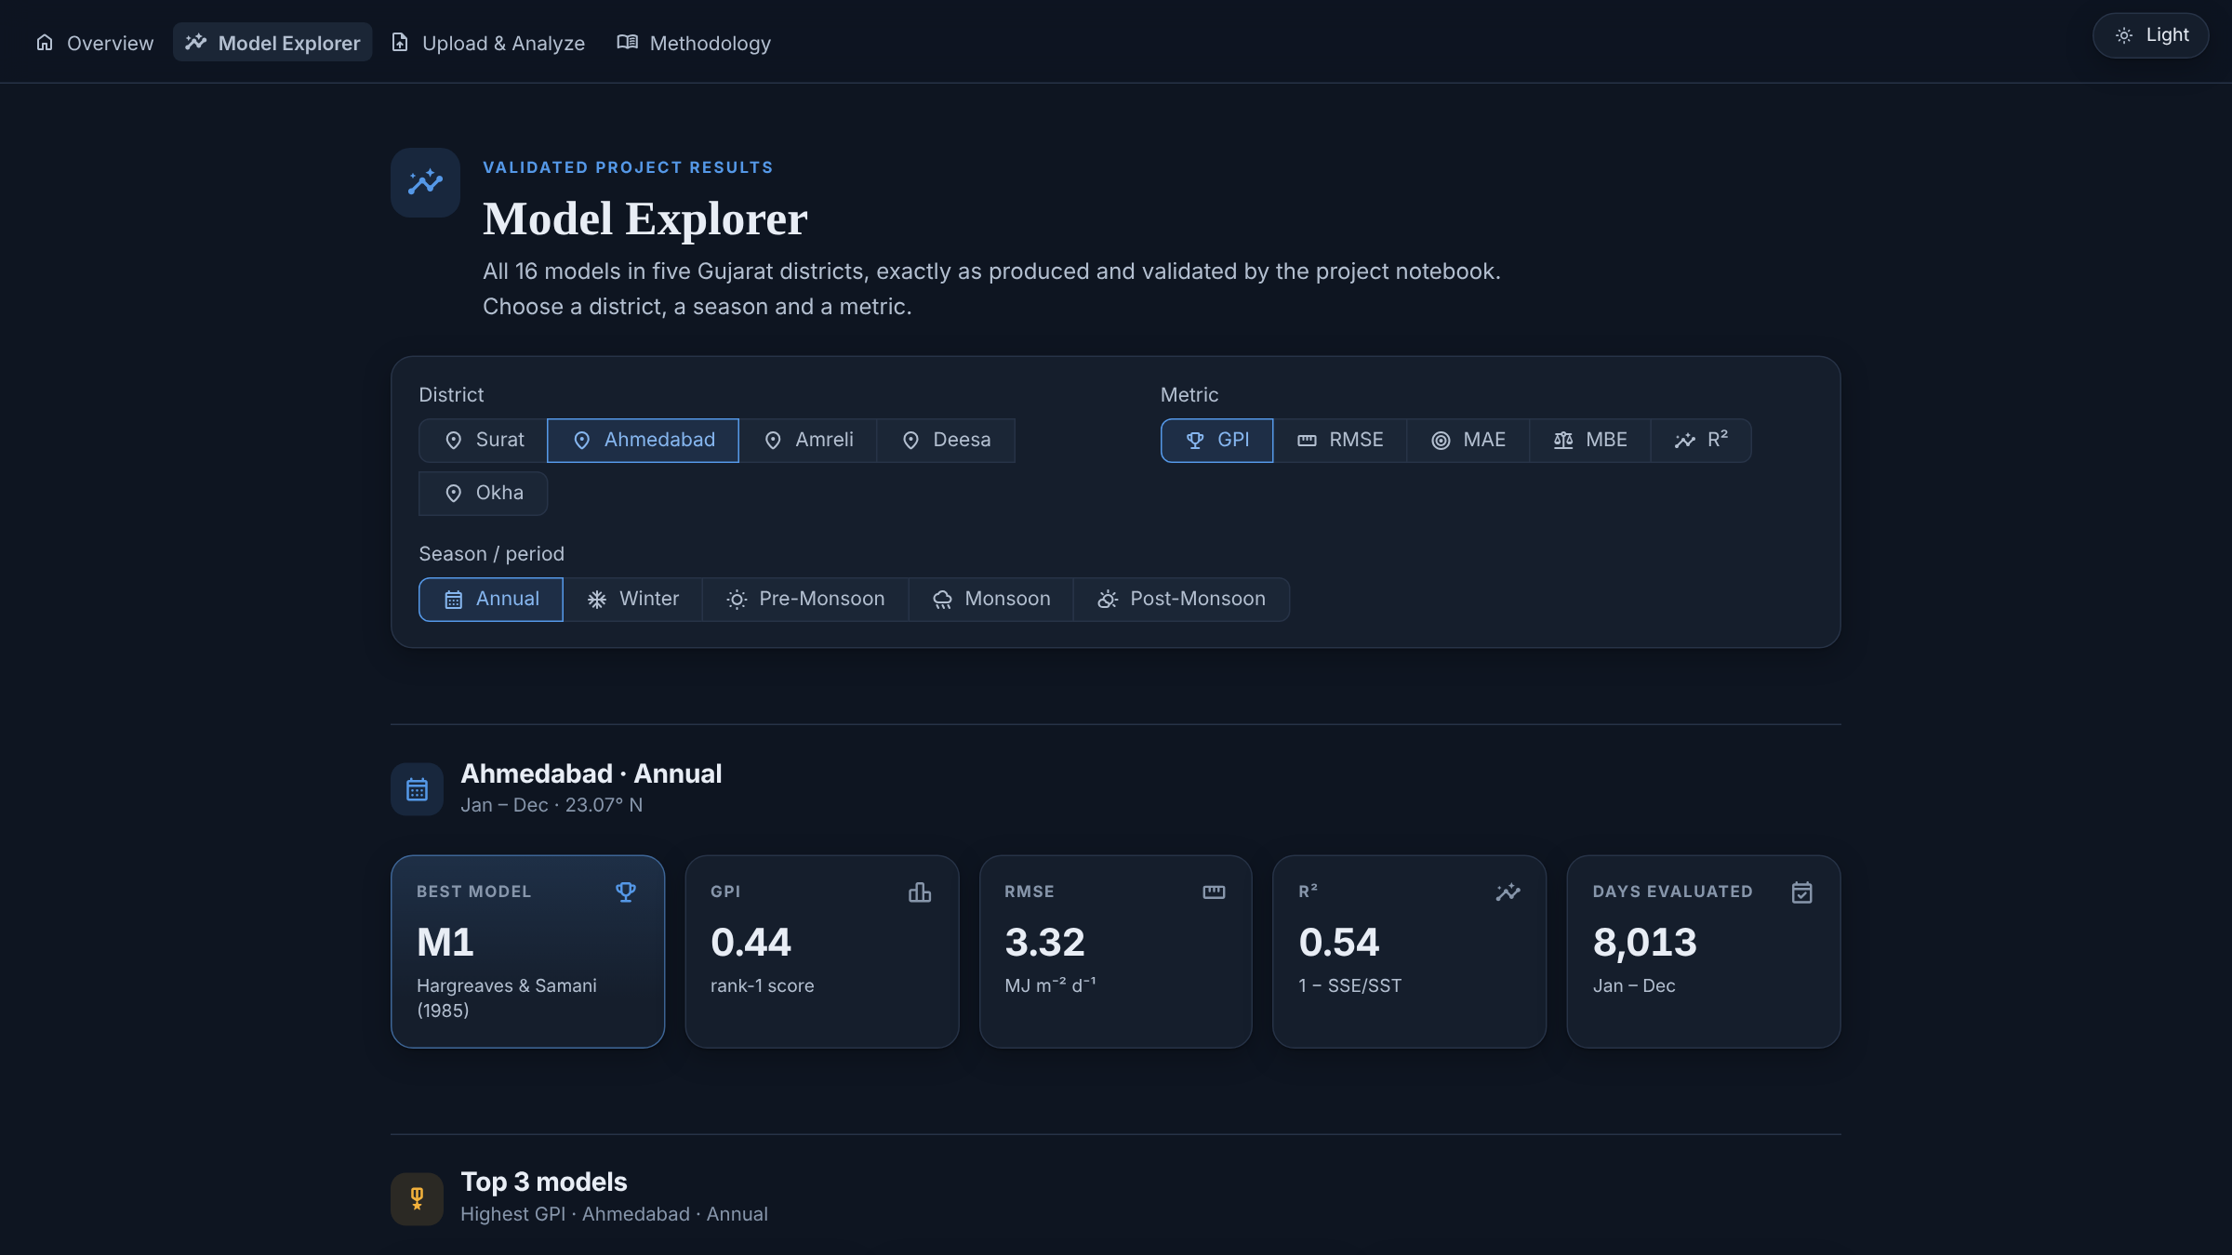
INTERACTIVE DASHBOARD
Solar Radiation Model Explorer
LIGHT / DARK MODE
UPLOAD & ANALYZE analyse your own station file
Overview · dark
Excel / CSV upload
16-model analysis
5-period results
Downloadable outputs
Overview · light
1 · upload a daily station file
1
Upload Excel / CSV
5
Run 16 models
2
Column check
6
Metrics → GPI
3
Same QC rules
7
Top-3 · 5 periods
4
Enter latitude
8
Download results
2 · results: Top-3 for each period
3 · download
Model Explorer
Model Explorer
all validated results by station, period and metric
Test: Ahmedabad file → M1, M13, M15 · 8,013 days = validated result
Comparative evaluation of temperature-based solar radiation models using global performance indicator
Screenshots: current dashboard build, run locally
17
Notes:
WHAT THIS SLIDE MEANS
The dashboard is a research tool, not only a viewer: anyone can upload a compatible station file and run the same 16-model, 5-period analysis.
SAY
• Pages: Overview, Model Explorer (all validated results), Upload & Analyze, Methodology; light and dark themes.
• Upload: daily .xlsx/.csv with Date, Tmax, Tmin, SSH → column check (auto-matched only when unambiguous) → same QC rules (gaps never filled) → latitude → 16 models → metrics → GPI → Top-3 for 5 periods.
• Outputs download as one Excel workbook or separate CSVs. Test: uploading the Ahmedabad file returned M1 (GPI 0.44), M13, M15 on 8,013 days — the validated annual result.
LIKELY QUESTION
Is the upload analysis identical to the project analysis? — Same engine and day-level rules; the NASA sunshine-year check cannot run on uploads, so years with < 200 sunshine values are flagged instead.
TRANSITION
"Before the conclusions: the assumptions behind the ranking."

Slide 18
ASSUMPTIONS, SENSITIVITY & LIMITATIONS
METHODOLOGICAL ASSUMPTIONS, SENSITIVITY & LIMITATIONS
MODEL-FORM CONVENTIONS USED
RANKING SENSITIVITY
A
M2 × 3.6 printed result read as kWh → MJ
Top-3 sets unchanged (of 15) when the alternative is used
D
R² → Pearson r²
4/15
B
M8 Θ = Tmin/Tmax Θ is not defined in the paper
E
MBE → |MBE|
4/15
C
M16 printed form used without √ΔT, as printed
A
M2 → as printed (no ×3.6)
13/15
METRIC / GPI CONVENTIONS USED
C
M16 → original √ΔT form
15/15
D
R² = 1 − SSE/SST paper formula; paper’s printed values behave like r²
B
M8 → other Θ reading
not tested — no quantified result
E
Signed MBE in GPI as in the paper; |MBE| tested as alternative
LIMITATIONS
Reference is estimated
sunshine-derived Rs, not measured pyranometer Rs
QC is a group addition
sunshine-year check is not in the paper
No direct reproduction
none of the five stations is in the paper
Comparative evaluation of temperature-based solar radiation models using global performance indicator
README §7–8 · results/validation_checks.csv
18
Notes:
WHAT THIS SLIDE MEANS
The final analysis uses five methodological assumptions and conventions. This slide states each one and shows how alternatives change the ranking.
SAY
• Model-form: A M2 ×3.6, B M8 Θ = Tmin/Tmax, C M16 printed form. Metric/GPI: D R² = 1 − SSE/SST, E signed MBE.
• Sensitivity (Top-3 sets unchanged of 15): D → r²: 4/15; E → |MBE|: 4/15; A → M2 as printed: 13/15; C → M16 with √ΔT: 15/15. B was not tested, so no number is claimed.
• Limitations: the reference is sunshine-derived (not pyranometer Rs), the sunshine-year QC is our addition, and none of our five stations is in the paper.
LIKELY QUESTION
Why keep signed MBE? — It follows the paper; the paper’s own Table 4 shows no dominance violations with signed MBE (one with |MBE|), so |MBE| is reported as a sensitivity test.
TRANSITION
"With these caveats in mind, here is what we conclude."

Slide 19
KEY FINDINGS & CONCLUSIONS
Conclusion: no model is best everywhere
01
02
03
04
05
7
0
6
2/5
4/15
models take rank 1
models shared across all 3 stations
station-season cells with M15 at #1
stations unusable
Top-3 sets unchanged
No universal best model
Location matters
Season matters
Data quality sets scope
Rankings are conditional
No single model ranked first across all station × season cells.
Ahmedabad & Amreli share M1, M13 and M15; Okha has a different annual Top-3.
Winter, Pre-Monsoon and Post-Monsoon at Ahmedabad and Amreli.
Surat and Deesa: reference data failed QC.
…when the R² or the MBE convention is changed.
FUTURE SCOPE (PROPOSED)
Test alternatives
Pyranometer Rs
More stations
Local calibration
Upload QC
Satellite Rs
The full workflow stays reusable through the upload-enabled dashboard.
R² / MBE conventions
measured reference
clean sunshine records
re-fit coefficients
satellite sunshine check
compare products
Comparative evaluation of temperature-based solar radiation models using global performance indicator
19
Notes:
WHAT THIS SLIDE MEANS
The five findings, each backed by a number, and what should come next.
SAY
• No universal model: seven different models reach rank 1 across the 15 ranked cells (Top-3 among 16 models).
• Location and season both change the answer — Okha shares none of the annual Top-3 of Ahmedabad and Amreli (M1, M13, M15); M15 is rank 1 in 6 station-season cells (Winter, Pre-Monsoon, Post-Monsoon at Ahmedabad and Amreli).
• Data quality set the scope: 2 of 5 stations could not be ranked. Only 4 of 15 Top-3 sets stay the same if the R² or MBE convention changes, so the rankings are conditional on assumptions D and E.
• Future scope (proposed): settle the R² / MBE conventions, use measured pyranometer radiation, add stations with clean sunshine records, calibrate locally, add a satellite sunshine check for uploads, compare with satellite Rs products.
LIKELY QUESTION
Which finding is most robust? — "No single model ranks first everywhere" holds in the primary results; the specific Top-3 sets depend on the R² and MBE conventions.
TRANSITION
"Thank you — we are happy to take questions."

Slide 20


Thank You
Questions & Discussion
Yashwanthi · Sathwik · Het · Gopal · Shreya · Gayatri
LIVE DASHBOARD
https://temperature-based-solar-radiation-models.streamlit.app/
Notes:
Thank-You / Q&A slide (last slide). The Live Dashboard QR code and clickable URL open https://temperature-based-solar-radiation-models.streamlit.app/

