Slide 1

Project Title - Seasonal Agriculture Performance Analysis
Student Name : Sathya C
College Name : St. Joseph’s College of Engineering and Technology
AICTE STU ID : STU6898cebe798d31754844862

Slide 2

PROBLEM STATEMENT
Agricultural activities are influenced by seasonal variations in environmental conditions, farming practices, resource availability and market conditions. As a result, agricultural performance may differ from one season to another. However, raw agricultural data does not clearly explain how agricultural performance changes across seasons or what patterns can be observed in different seasonal conditions. The problem is to analyze the given agricultural dataset and investigate seasonal differences in agricultural performance by identifying meaningful patterns, trends, relationships and variations within the available data.

Slide 3
PROJECT DESCRIPTION
This project analyzes agricultural performance across different seasons.
It compares Kharif, Rabi and Zaid seasons.
The analysis focuses on yield, production, water usage, revenue, cost and profit.
It also studies environmental factors like rainfall and temperature.
The goal is to identify seasonal patterns and useful insights.

Slide 4

WHO ARE THE END USERS?
Farmers – To choose suitable crops and seasons.
Government Departments – For agricultural planning and resource management.
Agricultural Consultants – To provide better farming advice.
Agribusiness Companies – To understand production and market trends.
Researchers & Students – For agricultural research and analysis.

Slide 5

TECHNOLOGY USED
Python – Main programming language.
Pandas – Data cleaning and analysis.
NumPy – Numerical calculations.
Matplotlib – Creating charts.
Seaborn – Data visualization.
Jupyter Notebook / VS Code – Development environment.

Slide 6
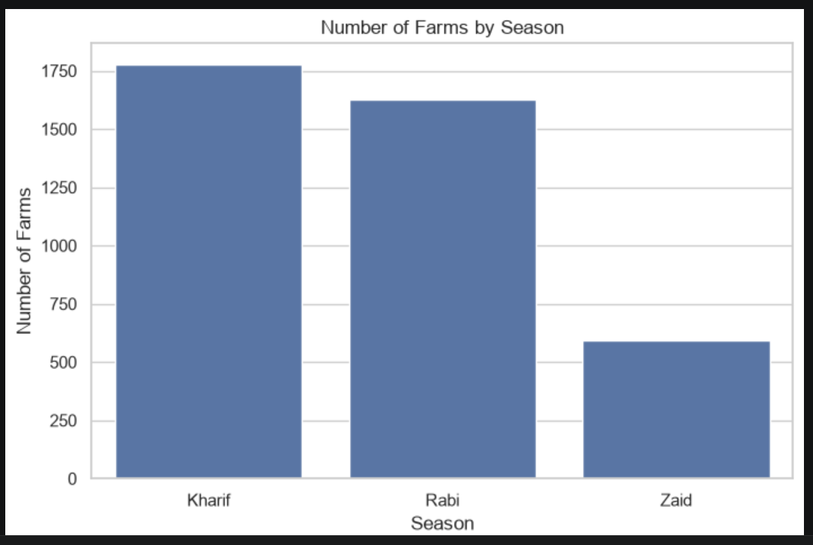
RESULTS

Slide 7
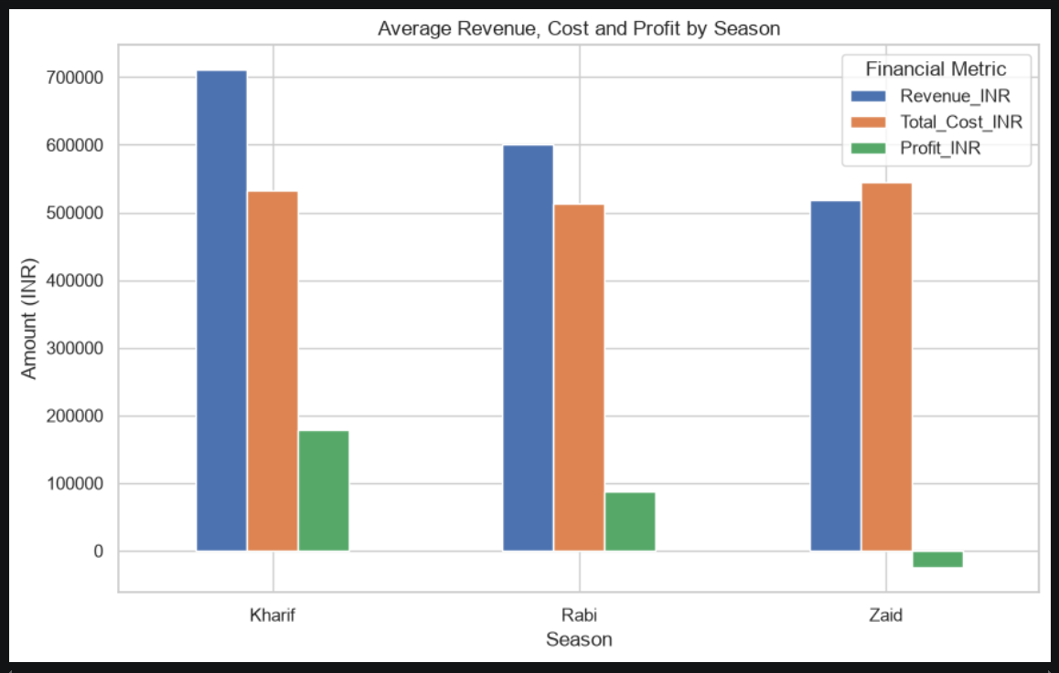
RESULTS

Slide 8
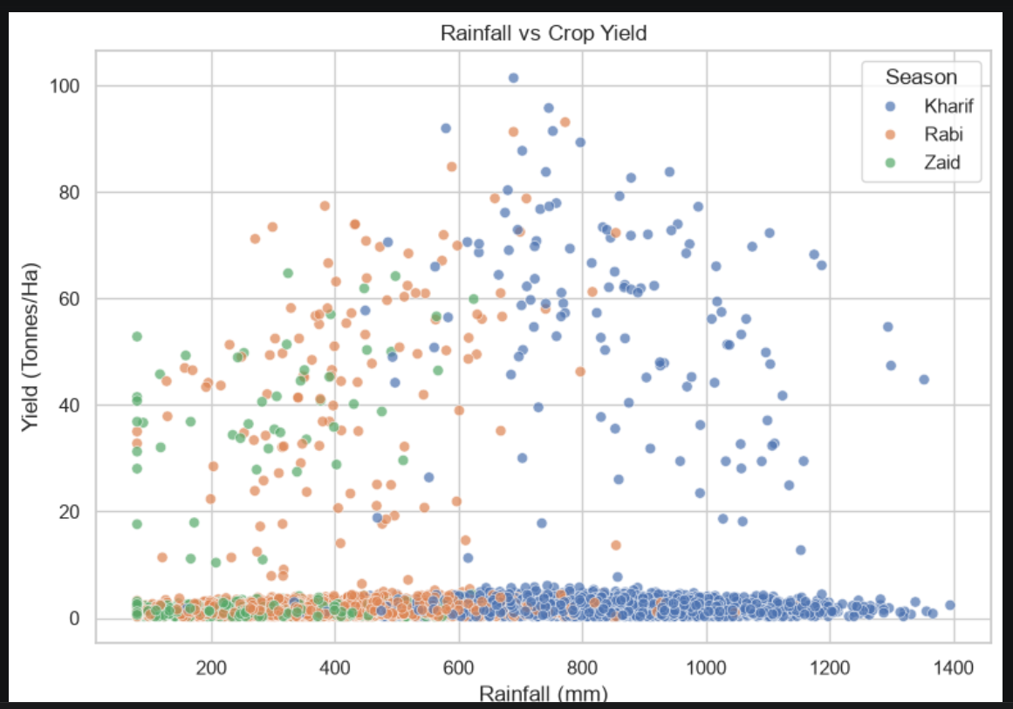
RESULTS

Slide 9
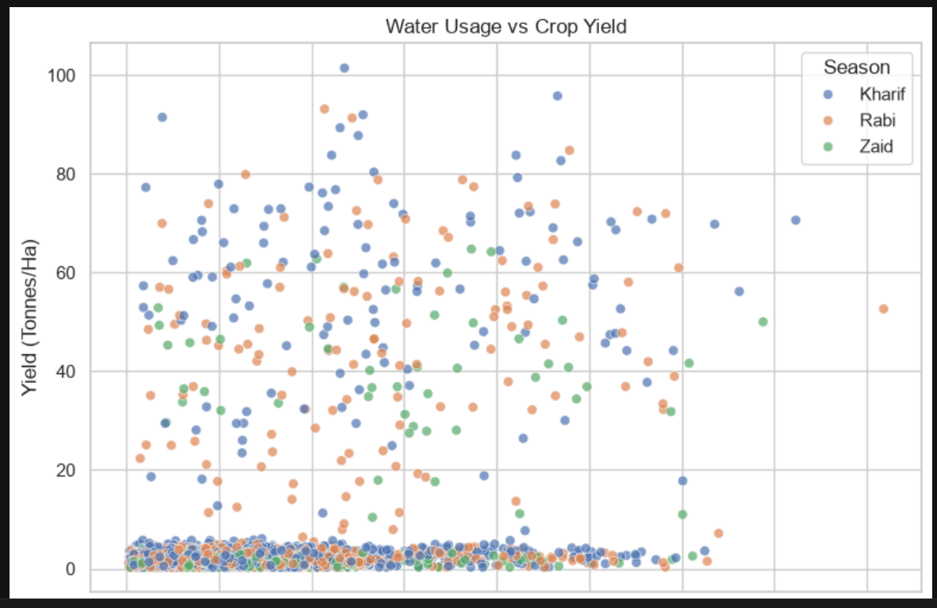
RESULTS

Slide 10
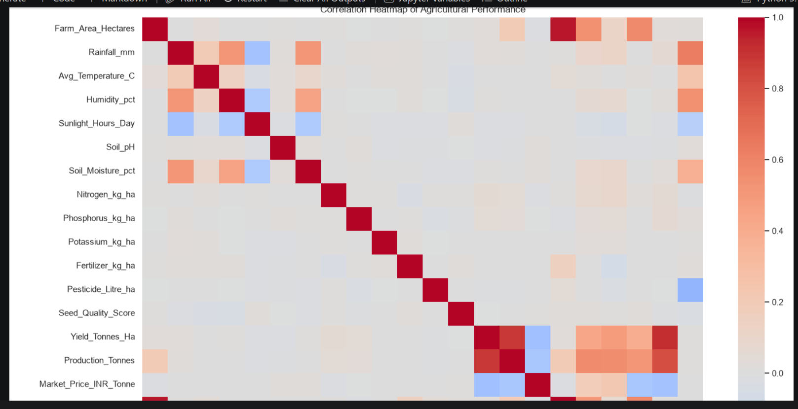
RESULTS

Slide 11
FUTURE SCOPE
Use Machine Learning to predict crop yield.
Predict future profit and production.
Integrate real-time weather data.
Use IoT sensors for soil and water monitoring.
Create an interactive Power BI dashboard.
Develop a smart farming application.

Slide 12
GitHub Link
https://github.com/sathya-555/Seasonal-Agriculture-Performance-Analysis.git

Slide 13
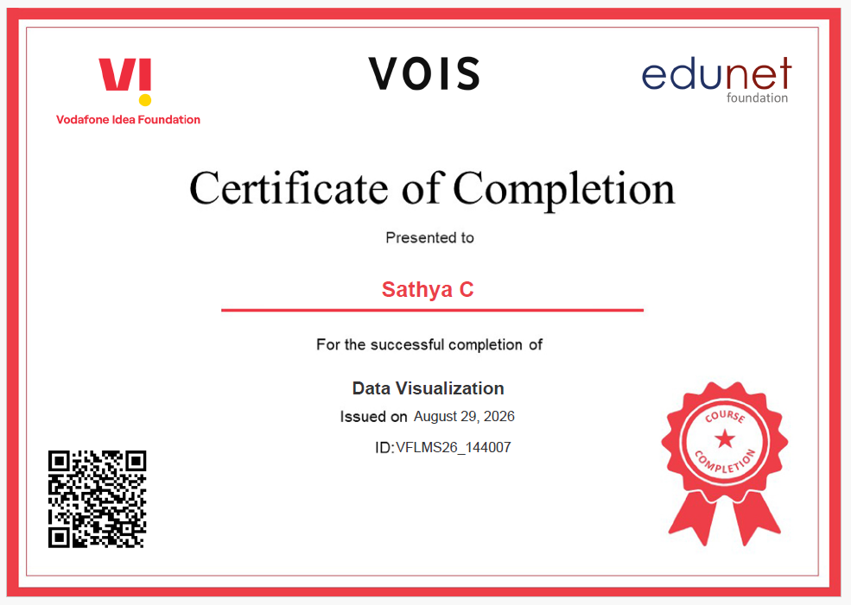
VOIS Course completion certificate - Course name- Data Visualization

Slide 14
Thank you
.
.

