Slide 1








“” - empty
null
HTTP Request
Controller
Model
Service
Repository
HTTP Response
Client
yyyy-MM-dd
HH:mm
Presentation
Layer
Business
Layer
Persistence
Layer
Database
Layer

Slide 2
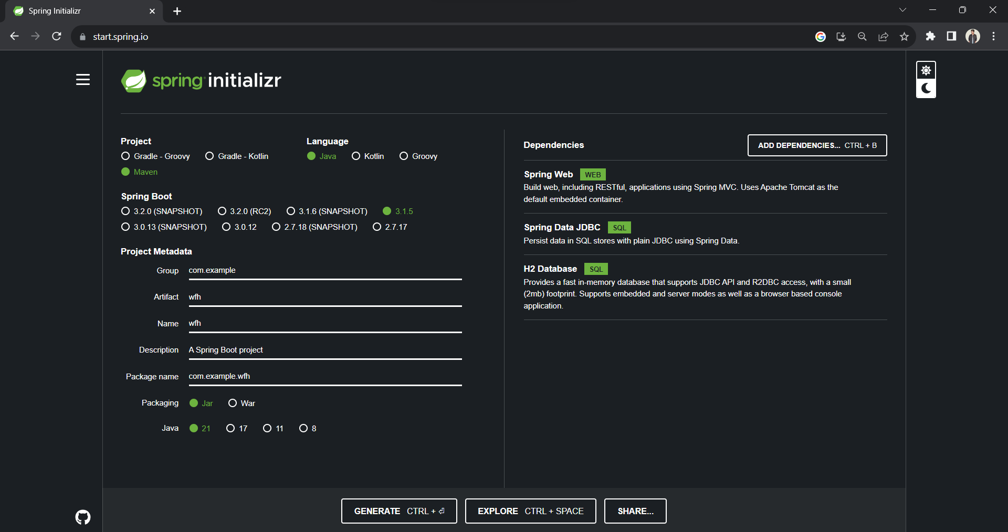

Slide 3
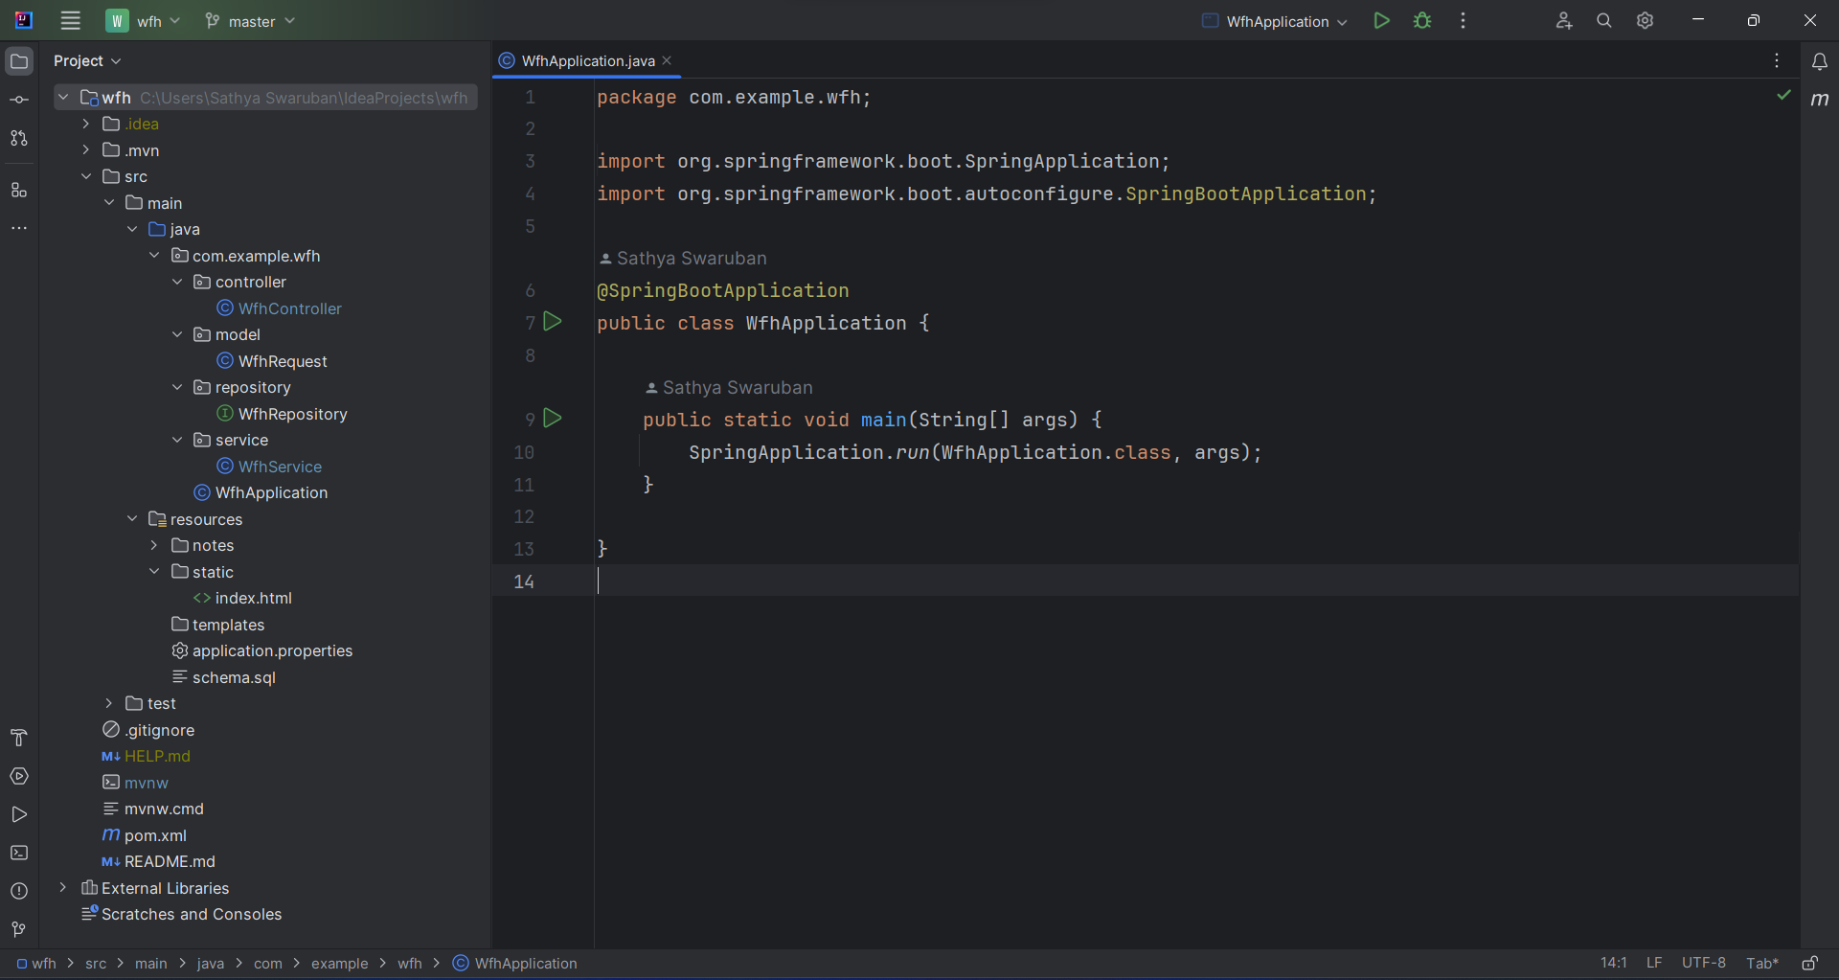

Slide 4
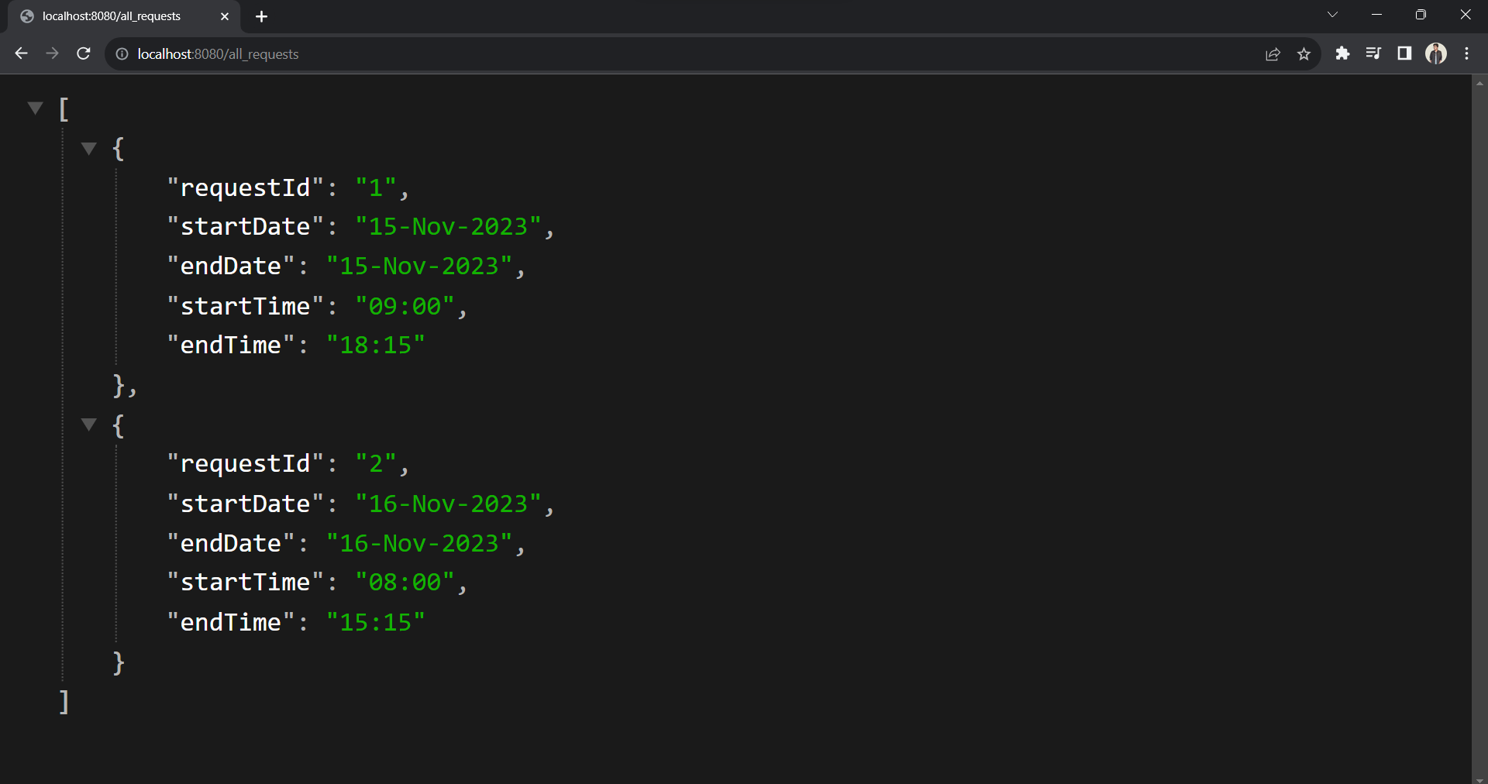
http://localhost:8080/all_requests

Slide 5
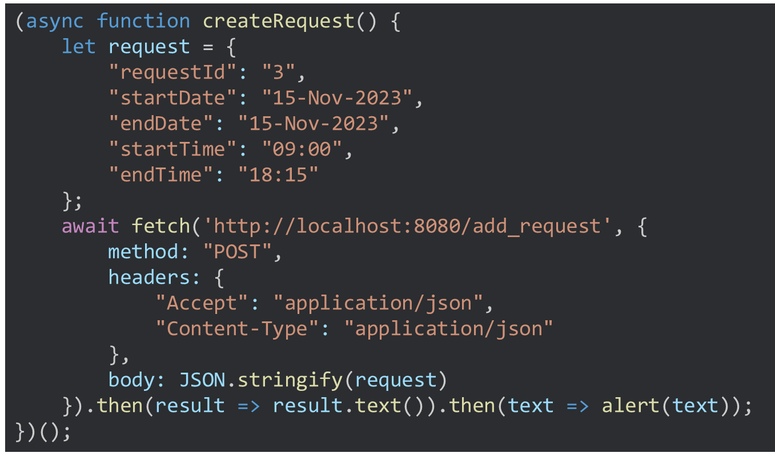

Slide 6
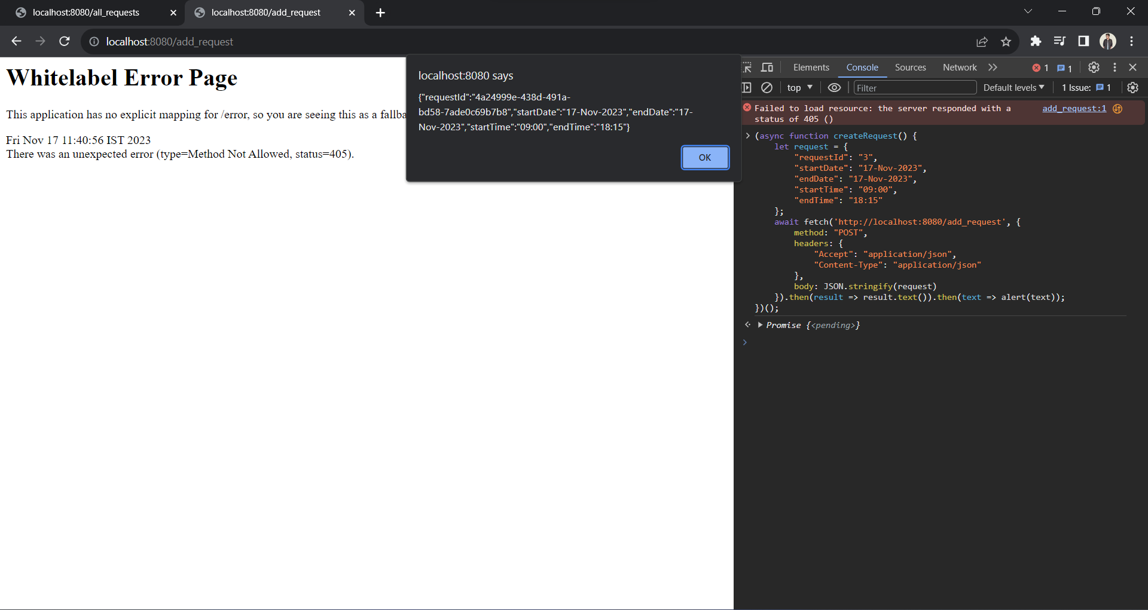
http://localhost:8080/add_request

Slide 7
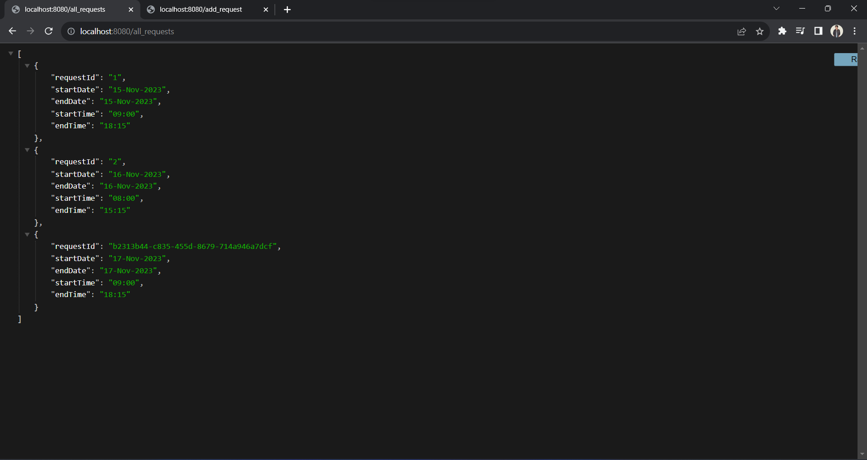
http://localhost:8080/all_requests

Slide 8
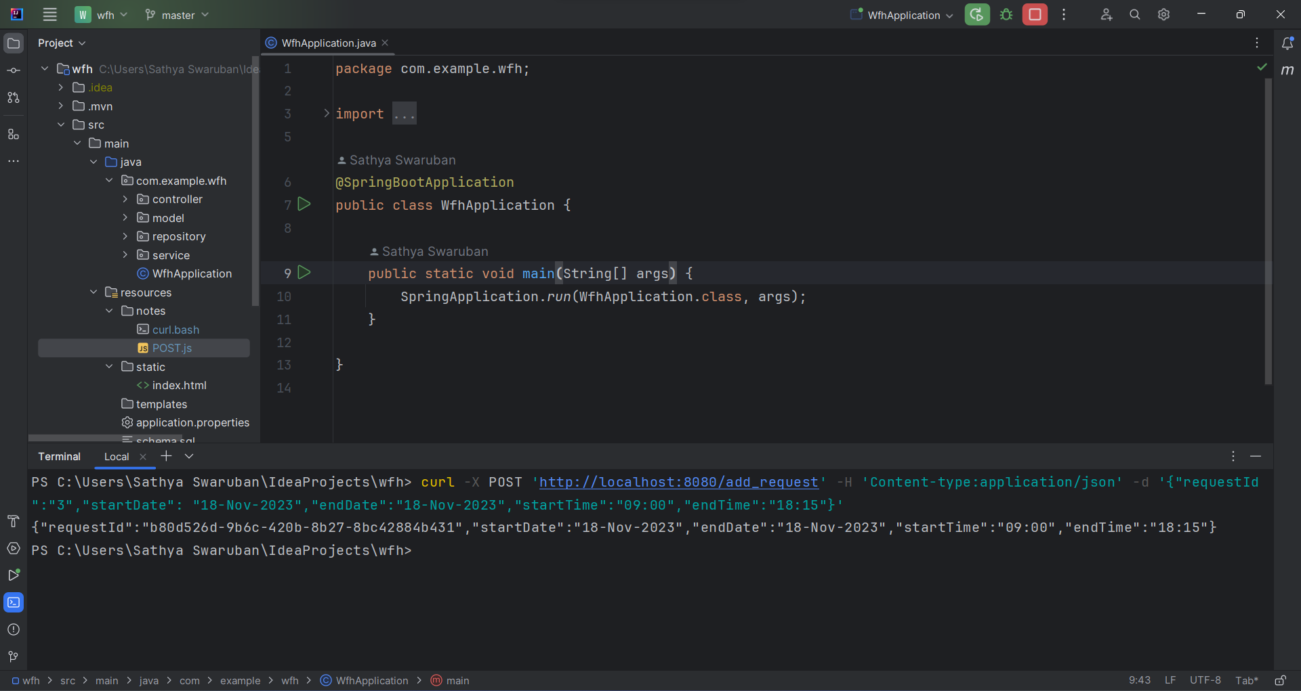

Slide 9
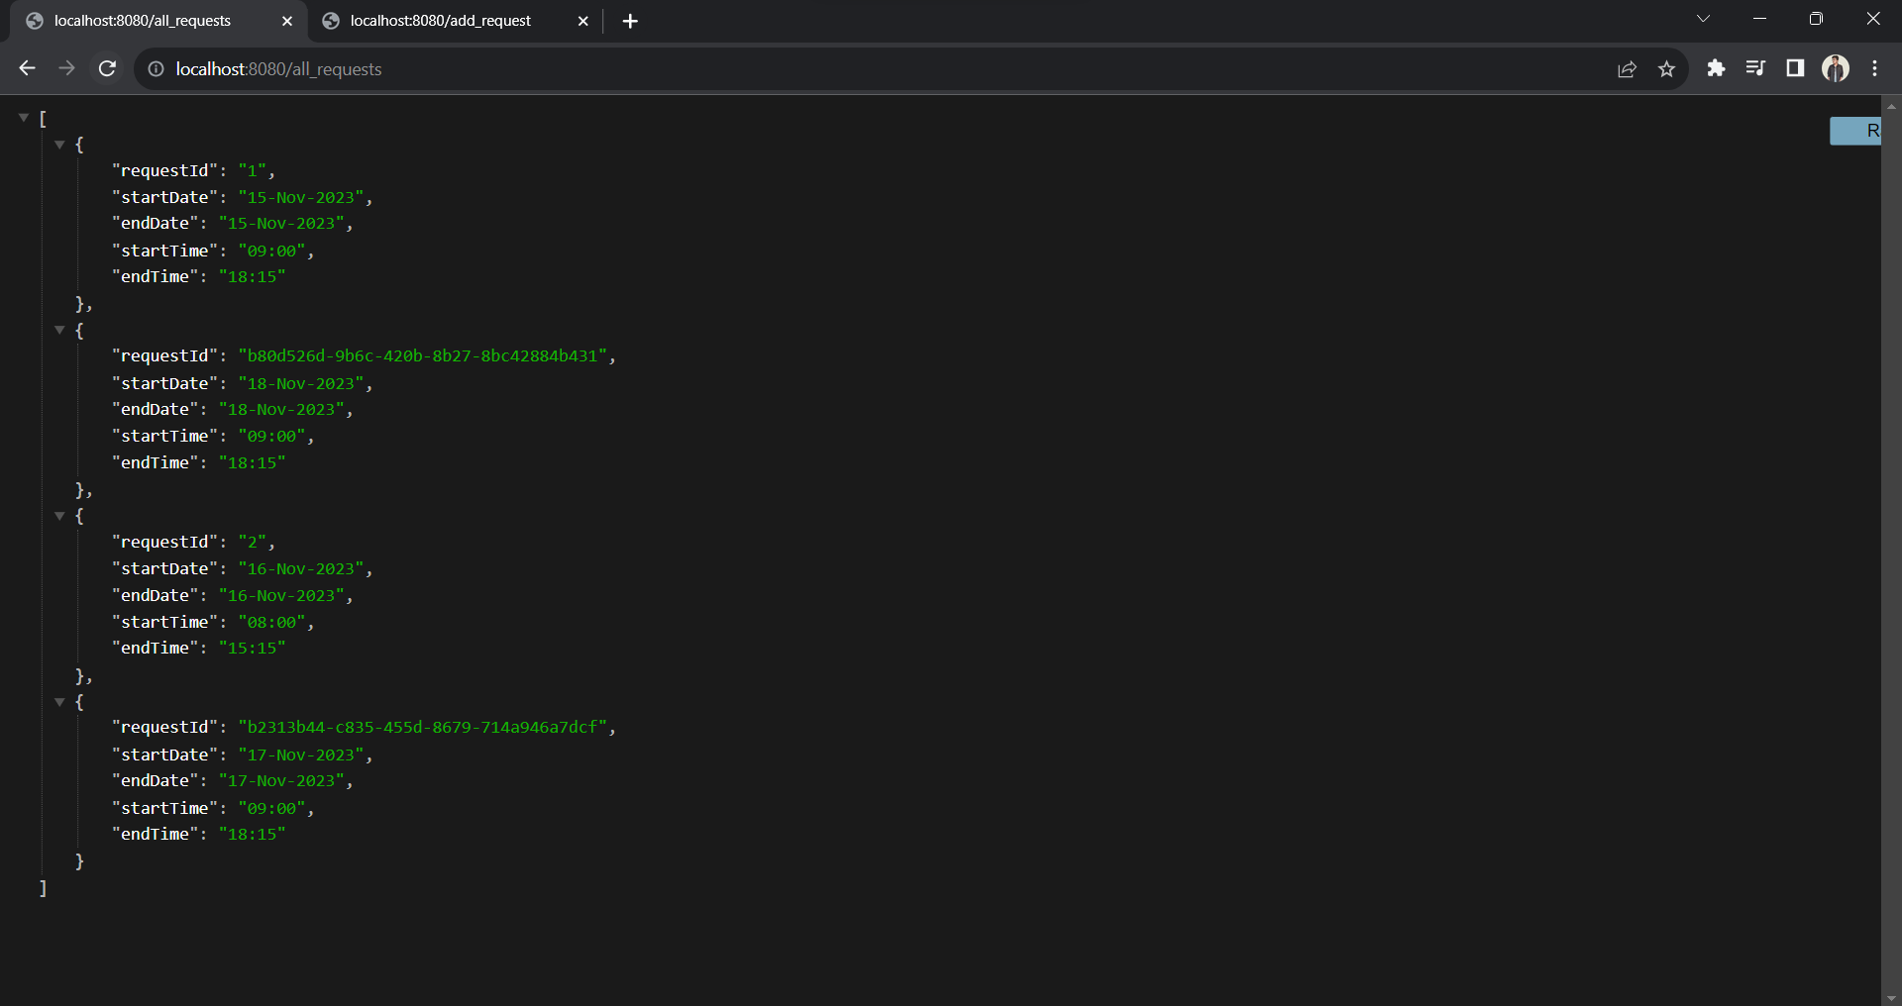
http://localhost:8080/all_requests

Slide 10
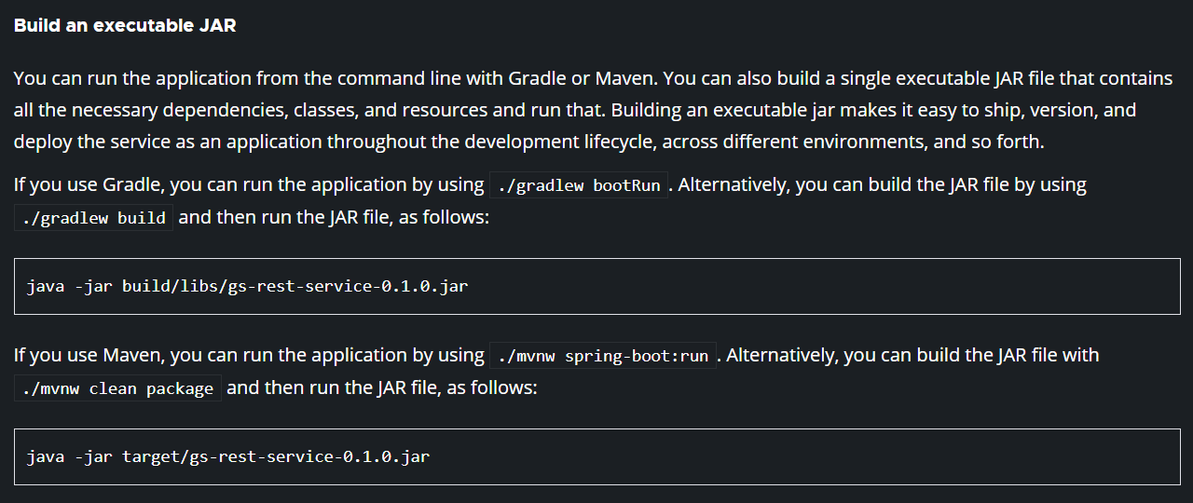

Slide 11
Add GitHub link of the source code
HTTP response status codes

Slide 12
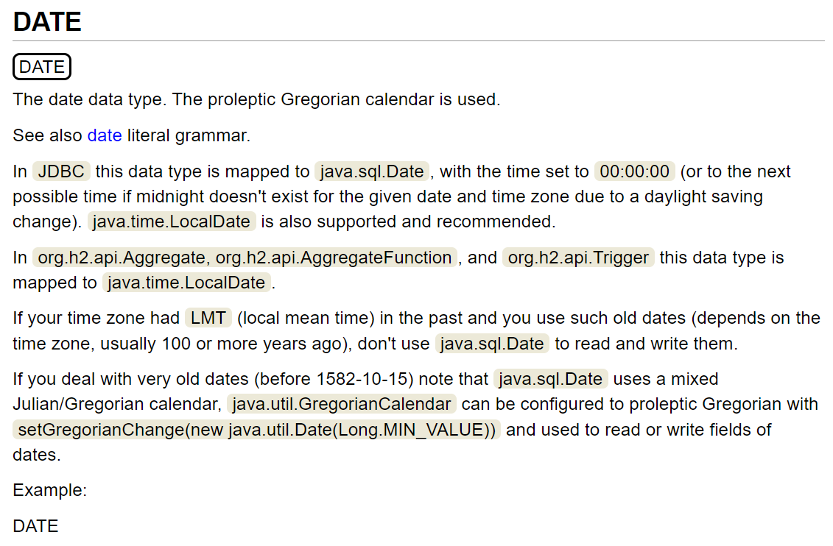

Slide 13
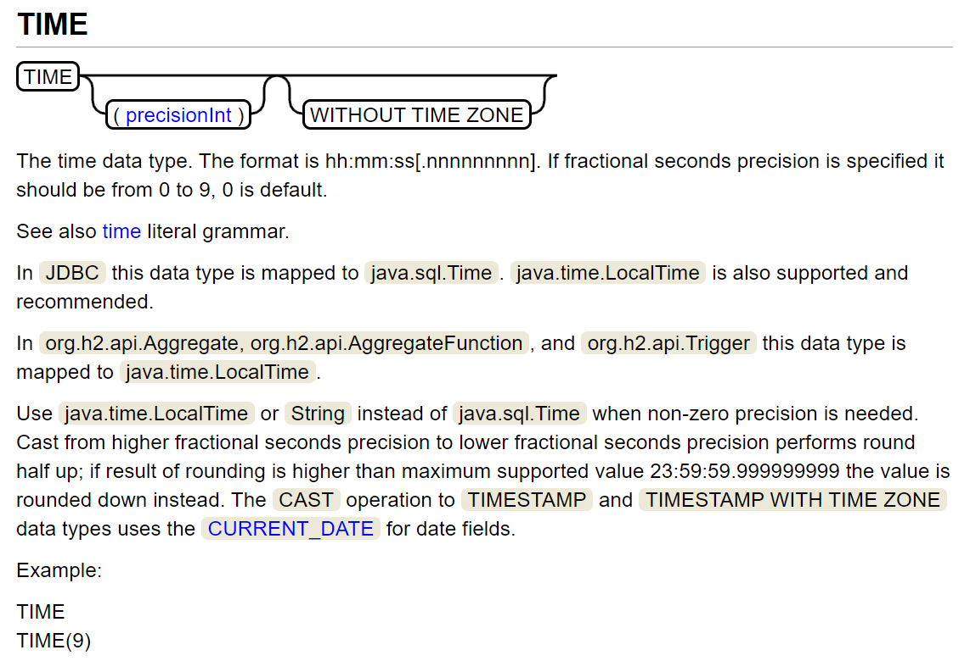

Slide 14


