Slide 1
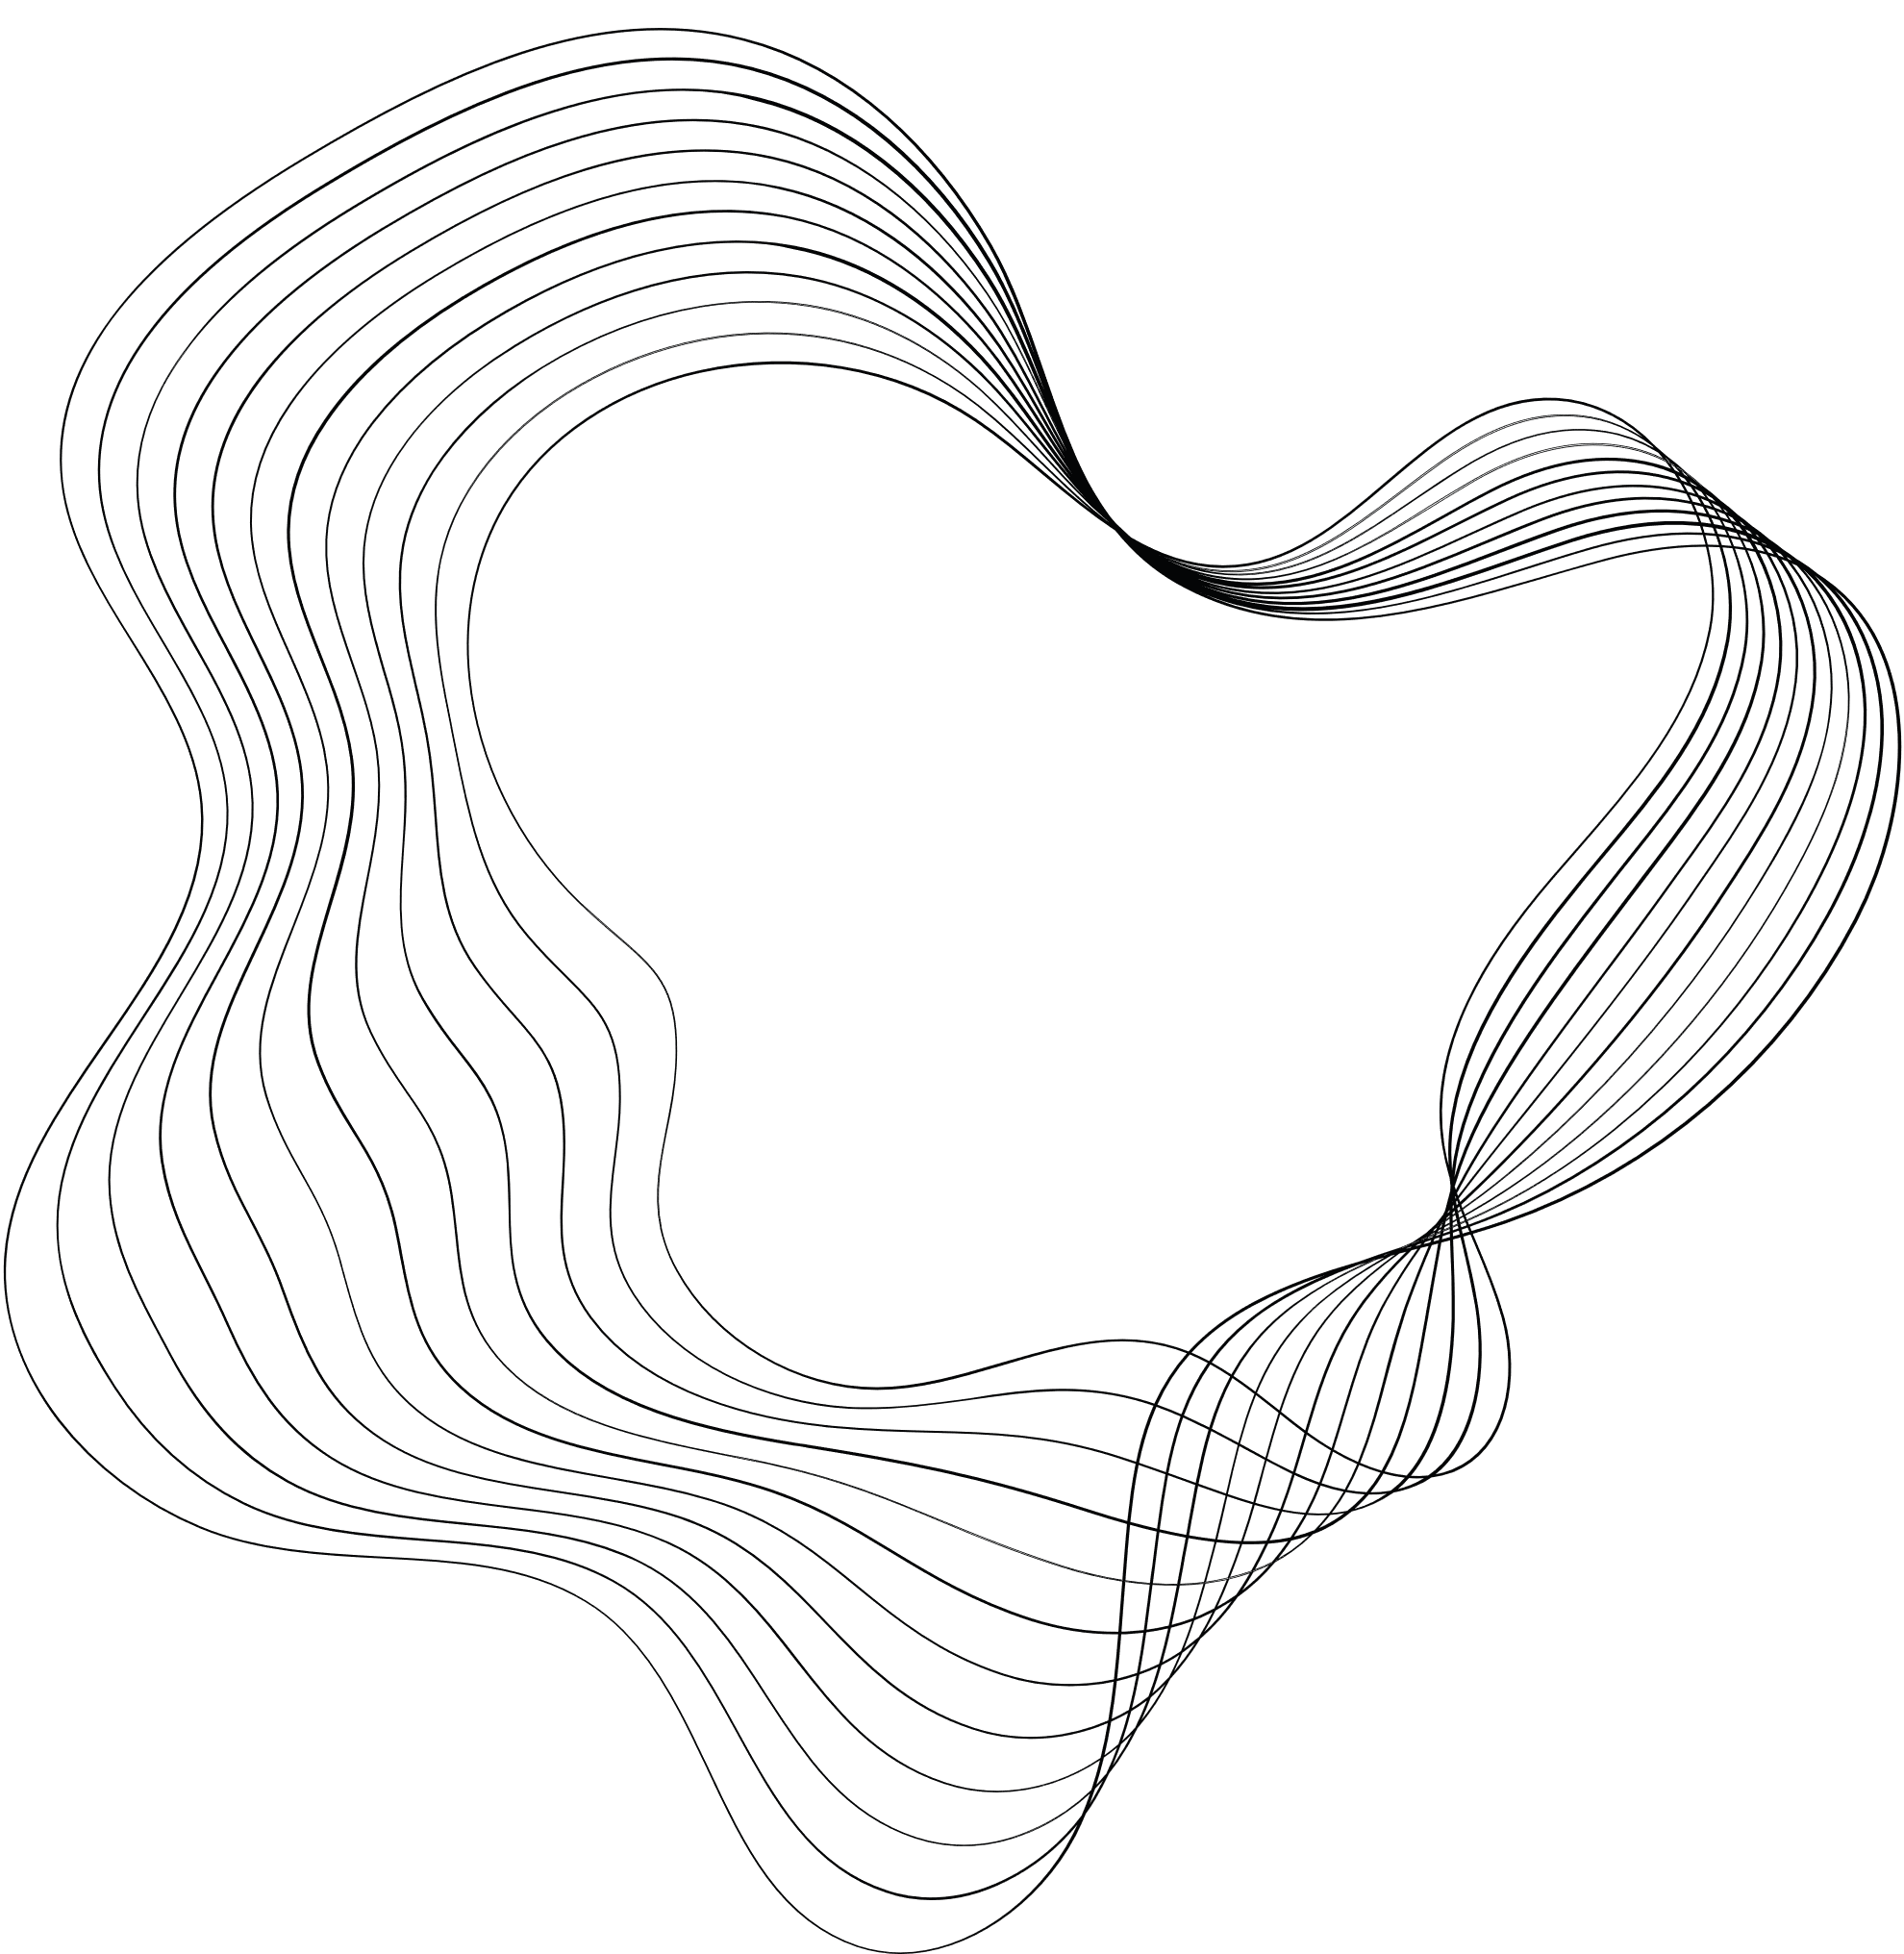


WILDFIRE
DETECTION

Slide 2

CONTENT
01
ABSTRACT
02
INTRODUCTION
03
LITERATURE SURVEY
04
MOTIVATION
05
PROBLEM STATEMENT
06
METHODOLOGY AND HARDWARE REQUIREMENT
07
EXPECTED OUTCOME
08
REFERENCES

Slide 3

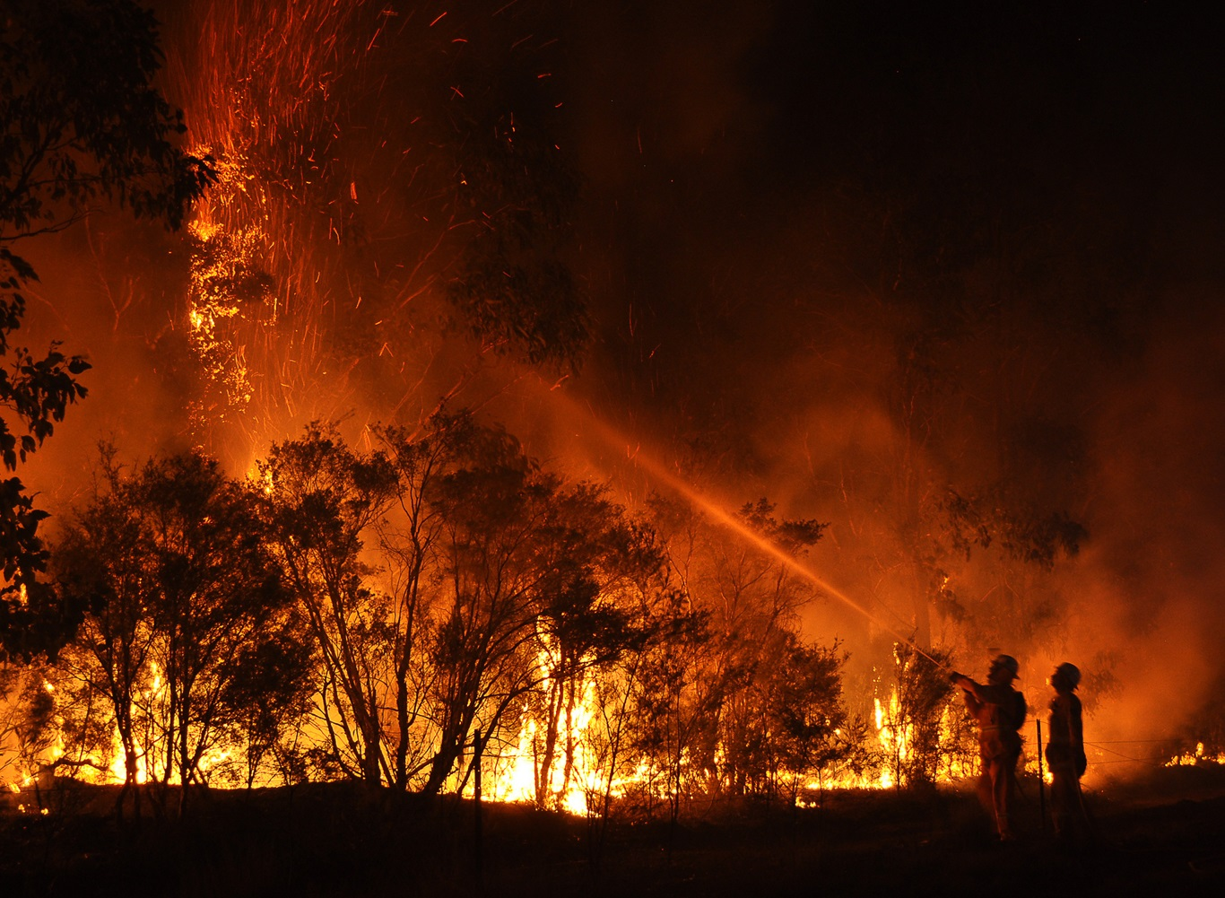
ABSTRACT
Wildfires, made worse by climate change and human activities, have emerged as a formidable challenge to global ecosystems, infrastructure, and human safety. Traditional wildfire detection mechanisms, while effective, are often made worse due to high costs and latency. This study investigates the efficacy of Artificial Intelligence (AI), particularly Convolutional Neural Networks (CNNs), in tandem with multi-resolution satellite imagery, as a novel approach for prompt and efficient wildfire detection. Our findings demonstrate that AI-powered models, when trained with high-resolution satellite data, can significantly enhance the speed and accuracy of wildfire detection, offering a promising alternative to traditional methods.
Index Terms - Wildfires, AI, Convolutional Neural Networks, image processing, satellite imagery

Slide 4


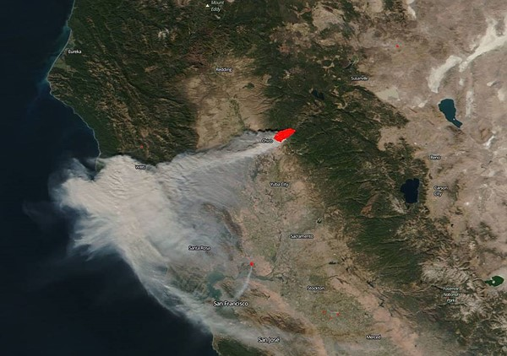
INTRODUCTION
Assessing the risk of wildfires over the entire globe can be crucial in avoiding harm to wildlife, economy, properties and humans. This is known to be a challenging task. Here, a machine learning model is trained on a dataset composed of remote sensing data variables such as topography, vegetation and weather. The model is able to assess the risk of fire with a spatial resolution of 1000m/pixel. It achieves optimal results compared to other state-of-the-art architectures. Most of the variables in the dataset are found to be critical for the task, while few were disregarded. Particular focus has been given to collecting data across a variety of landscapes. Specifically, samples from Africa, Australia, Asia, Europe, South America and the US are included. This research shows the potential for deploying global wildfire risk assessment applications.

Slide 5
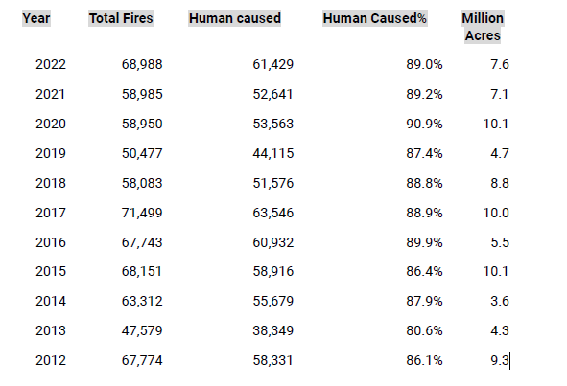
LITERATURE SURVEY
SOURCE :- https://www.nifc.gov/fire-information/statistics

Slide 6



MOTIVATION
Enhance Early Detection
Improve Accessibility
Advance Prediction Models
Develop a system that leverages real-time data to improve the early detection of wildfires, enabling faster and more accurate responses.
Create user-friendly tools that can be easily utilized by non-experts, ensuring widespread adoption and use in high-risk areas.
Integrate advanced machine learning techniques with up-to-date environmental data to refine and enhance wildfire prediction models, reducing the gap between predictions and actual wildfire behavior.

Slide 7



WHAT’S THE DIFFERENCE
Mission
Despite advancements in wildfire prediction and management, a significant gap exists in the integration of real-time data for dynamic response strategies
Current models often lack the ability to update predictions swiftly as conditions change
Vision
Additionally, there's a need for more user-friendly tools that can be easily deployed by non-experts in high-risk areas
Addressing these gaps can significantly enhance the effectiveness of wildfire mitigation efforts.

Slide 8
PROBLEM STATEMENT
The increasing frequency and severity of wildfires pose significant threats to ecosystems, economies, and human safety.
Current prediction and management models struggle to integrate real-time data, limiting their effectiveness in dynamic situations.
Additionally, existing tools are often complex and inaccessible to non-experts in high-risk areas.
This project aims to address these issues by developing an intuitive, real-time data-driven wildfire prediction and management system.

Slide 9


METHODOLOGY
01
02
03
04
Data Collection
Data Preprocessing
Model Development
Model Evaluation
Data collected form
Nasa’s EOSDIS
MODIS fires were detected using MODIS
ISRO's Geoportal
Clean and preprocess the data to ensure quality and consistency, including normalization and augmentation of image data.
Choose an Convolutional neural network architecture for image-based data analysis.
Evaluate the model's performance using metrics such as accuracy, precision, recall, and F1 score

Slide 10
05
06
07
User Interface Development
Integration and Deployment
Tools and Libraries
Develop an intuitive user interface using Streamlit to allow non-experts to interact with the model.
Include functionalities for real-time data input.
Integrate the trained model with the user interface.
Deploy the application on a suitable platform, ensuring it can handle real-time data processing and visualization.
Python
torch, torchvision, torchinfo, pathlib, tqdm, streamlit, pillow, matplotlib

Slide 11
SOFTWARE AND HARDWARE REQUIREMENT
SOFTWARE
HARDWARE
Torch
Torchvision
Torchinfo
Streamlit
Pillow
Matplotlib
Windows 10 or more
GPU: NVIDIA GTX 1080 Ti
RAM: 16GB DDR4
Storage: 500GB SSD

Slide 12
EXPECTED OUTCOME
Image Classification
Model Validation
Users can upload their own satellite images for classification. The model will predict whether the uploaded images depict wildfire-prone areas or not. This feature enables users to apply the model to real-world scenarios.
The second page offers a set of validation images that users can use to test the model's performance. This is a valuable resource for understanding how well the model classifies wildfire-prone areas and can be used for demonstration and educational purposes.

Slide 13
TEAM
HEMA P
AKSHAY BT
SATHYAPRAMODA D PURNAIAH
KIRAN YARASHI
KIRAN YARASHI
HEMAN
SATHYA

Slide 14

REFERENCES
https://www.nifc.gov/fire-information/statistics
Forest survey of INDIA
Indian Geo-platform of ISRO
https://www.cnn.com/2018/11/09/us/california-wildfires-superlatives-wcx/index.html
NASA Earth Observing System Data and Information System (EOSDIS).
https://www.mathworks.com/discovery/convolutional-neural-network-matlab.html

