Slide 1

DEPARTMENT OF ARTIFICIAL INTELLIGENCE
20AM6203 - DESIGN PROJECT - 2
Batch - 12
Presented By
Guided By
JEROME CHRISTOPHER J -
NUEMON KUMAR K R
SATHYA PRAKASH A
811722001019
- 811722001037
- 811722001044
Mr. R. ROSHAN JOSHUA,
Assistant Professor / AI

Slide 2
Go-with-the-Flow:
Motion-Controllable Video Diffusion Models Using Real-Time Warped Noise

Slide 3
OBJECTIVE
To develop a motion-controllable video generation framework based on diffusion models that leverages real-time warped noise to achieve temporally consistent and visually coherent video outputs, enabling fine-grained user control over motion trajectories and dynamics in synthesized videos.

Slide 4
EXISTING SYSTEM
The existing systems for video generation using diffusion models primarily focus on frame-by-frame synthesis or apply simple temporal conditioning methods, which often result in motion inconsistencies and visual flickering between frames.
Demerits
Incorporate optical flow
Motion priors to enhance temporal coherence
They are computationally intensive and not suitable for interactive

Slide 5
PROPOSED SYSTEM
The proposed system introduces a novel video generation framework that enables real-time, motion-controllable synthesis using diffusion models enhanced with warped noise guidance.
Merits
It enables users to interactively manipulate motion paths
It ideal for applications in video editing
It used in animation and creative content creation.

Slide 6
LITERATURE SURVEY
S.NO | TITLE | AUTHOR | YEAR | TECHNIQUES USED | DEMERITS
1 | Denoising Diffusion Probabilistic Models | Ho, J., Jain, A., & Abbeel, P. | 2022 | Diffusion model | While effective is not generating high- quality visuals.
2 | Score-based Generative Models | Song, Y., & Ermon, S. | 2022 | Proposed score- based models | Computationally intensive.
3 | Learning to Generate Video from Still Images | Bansal, M., & Jampani, V. | 2023 | Used motion interpolation | Limited flexibility.

Slide 7
LITERATURE SURVEY
S.NO | TITLE | AUTHOR | YEAR | TECHNIQUES USED | DEMERITS
4 | Improved Diffusion Models for Video Generation | Nichol, A. Q., & Dhariwal, P. | 2023 | Diffusion models | Not optimized for motion control.
5 | Motion Transfer for Video Editing. | Motion Transfer for Video Editing | 2023 | transferring motion | Complex motion transfer.

Slide 8
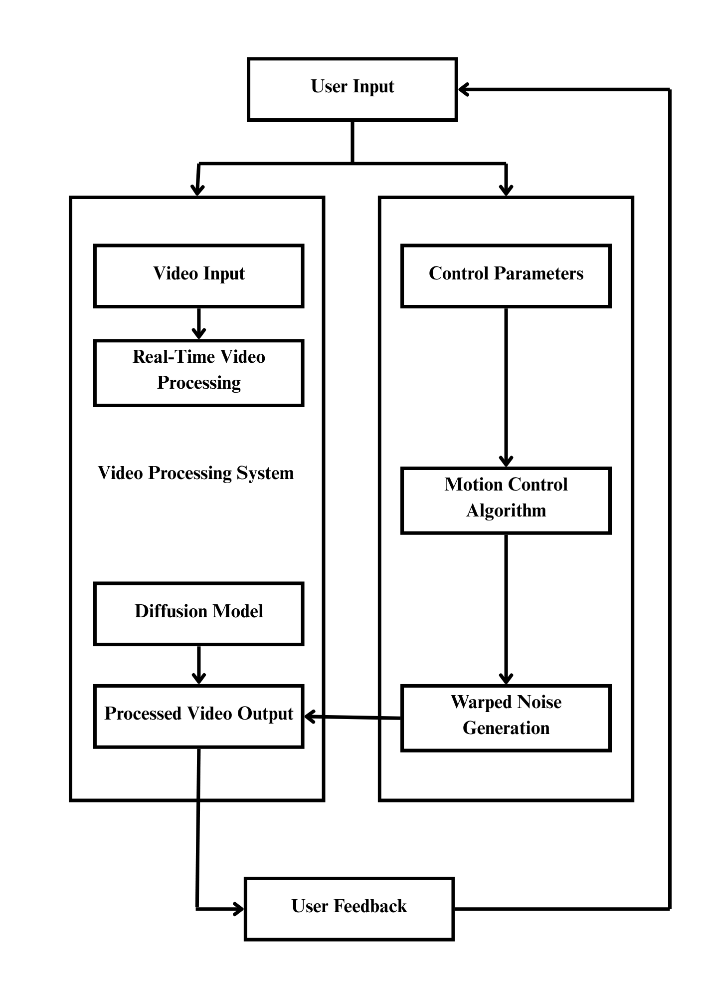
DATA FLOW DIAGRAM

Slide 9
SYSTEM SPECIFICATIONS
Processor: Intel i7/i9 or AMD Ryzen 7/9
RAM: Minimum 16 GB
GPU: NVIDIA RTX 3060 or higher
Storage: SSD with at least 500 GB free space
Operating System: Ubuntu 20.04+ / Windows 10 or 11
SOFTWARE SPECIFICATIONS
Programming Language: Python 3.9+
Deep Learning Framework: PyTorch(v1.13+)
CUDA Toolkit: v11.7
Code Editor: VS Code/ PyCharm
Environment Management: Anaconda

Slide 10
MODULES
Training Module
Noise Warping Module
Diffusion Module
Motion Control Module
Execution Module

Slide 11
TRAINING MODULE
Description:
To fine-tune or train a video diffusion model capable of generating realistic motion-controllable animations from static images, based on prompts.
This module establishes the context and motion information that will guide the
video generation.
Technique:
Text-to-Video
Motion Path Encoding

Slide 12
Key Components:
Dataset: Video datasets with motion direction labels (e.g., DAVIS, UCF-101).
Preprocessing: Frame extraction, image-caption pairing, and prompt engineering (e.g., "person running forward").
Model Architecture:
Use StableDiffusion, VideoDiffusion, or AnimateDiff as a base.
Add a Motion Token Injection Layer or Temporal Attention Layer.
Loss Functions:
Frame consistency loss (spatial + temporal)
Text-image alignment loss (CLIP-based)
Tools:
Diffusers
Transformers
Pytorch-lightning
Xformers

Slide 13
NOISE WARPING MODULE
Description:
The Noise Warping Module is responsible for embedding motion information into Gaussian noise. This process allows the generation of temporally consistent videos by adapting the noise at each time step based on the user-defined motion trajectory.
Technique:
Warping Noise Fields
Real-time Adaptation

Slide 14
Key Concepts:
Latent Noise Map: The starting random noise that gets denoised into an image/video.
Warping Strategy:
Apply directional shift (e.g., roll or translation in X/Y).
Modulate noise intensity based on motion token (e.g., forward, backward).
Temporal Consistency: Use warped noise as a base for all future frames to keep coherence.
Implementation Ideas:
np.roll(noise, shift=1, axis=1) for horizontal "forward" motion
Frame-to-frame noise interpolation using linear or sinusoidal curves

Slide 15
DIFFUSION MODULE
Description:
This module acts as the brain of the system, where intelligent decision-making transforms noisy, warped inputs into sharp, realistic video frames with smooth transitions.
Mechanism Behind the Scenes:
Operates on reverse diffusion — refining video frames through multiple
denoising cycles.
Uses temporally-aware networks (e.g., 3D U-Nets or Transformer-based
layers) to ensure frames are not only sharp but consistent over time.
Learns complex mappings from noise to motion-driven video sequences.

Slide 16
Submodules:
Denoising U-Net: Iteratively predicts and refines the clean image.
Scheduler: Controls the timestep-based sampling (e.g., DDIM, DDPMScheduler).
Prompt Conditioning: Uses text encoders (like CLIP or T5) for prompt guidance.

Slide 17
MOTION CONTROL MODULE
Description:
Coordinates the full pipeline from user input to final animated GIF output.
Working Process:
Receives motion cues (e.g., drawn paths or flow vectors) and embeds them into
the generation process.
Applies motion injection techniques at each denoising step to steer object
movement.
Modifies frame transitions dynamically based on real-time control signals.

Slide 18
Functions:
Prompt Parser: Extracts intent from natural language prompts (e.g., "replace cat with dog")
Motion Controller: Maps direction to noise warp logic (forward → +X, backward → -X)
Object Controller: Triggers replacement via inpaintingTriggers removal via segmentation or rembg
Extensions:
Integrate ControlNet to enforce skeletal/flow control.
Include facial landmarks for animation of faces or animals.

Slide 19
EXECUTION MODULE
Description:
Coordinates the full pipeline from user input to final animated GIF output.
Workflow in Action:
Assembles frames into a video stream with the desired frame rate and resolution.
Performs optional enhancements such as motion smoothing or upscaling.
Handles encoding and format conversion for compatibility across devices.

Slide 20
Key Deliverables
Final output as a playable, high-quality video file (MP4, AVI, etc.).
Real-time preview support for user validation.
Optional hooks for downstream editing or post-processing.

Slide 21
ADVANTAGES
Fine-grained motion control
Temporal consistency
Real-time responsiveness
Generalizability to diverse scenes
High-quality, realistic video output

Slide 22
APPLICATIONS
Video editing and animation
Virtual reality (VR) and augmented reality (AR)
Game development
Creative content generation
Robotics simulation

Slide 23
CONCLUSION
The "Go-with-the-Flow" method advances video diffusion models by introducing real-time warped noise based on optical flow fields, allowing for effective motion control.
This technique improves video consistency, enhances quality, and provides real-
time manipulation of generated content.
By maintaining high fidelity in pixel-wise generation and offering motion control capabilities, it opens up new possibilities for applications in digital media, animation, and video editing.

Slide 24
REFERENECES
1. Kangxue Yin, et al. (2023) – Go-with-the-Flow, arXiv:2306.00961
Jonathan Ho, et al. (2022) – DDPM, arXiv:2006.11239
Yang Song, et al. (2021) – Score-Based
arXiv:2011.13456
Generative
Modeling,
4. HuggingFace Diffusers Library(2021)

Slide 25
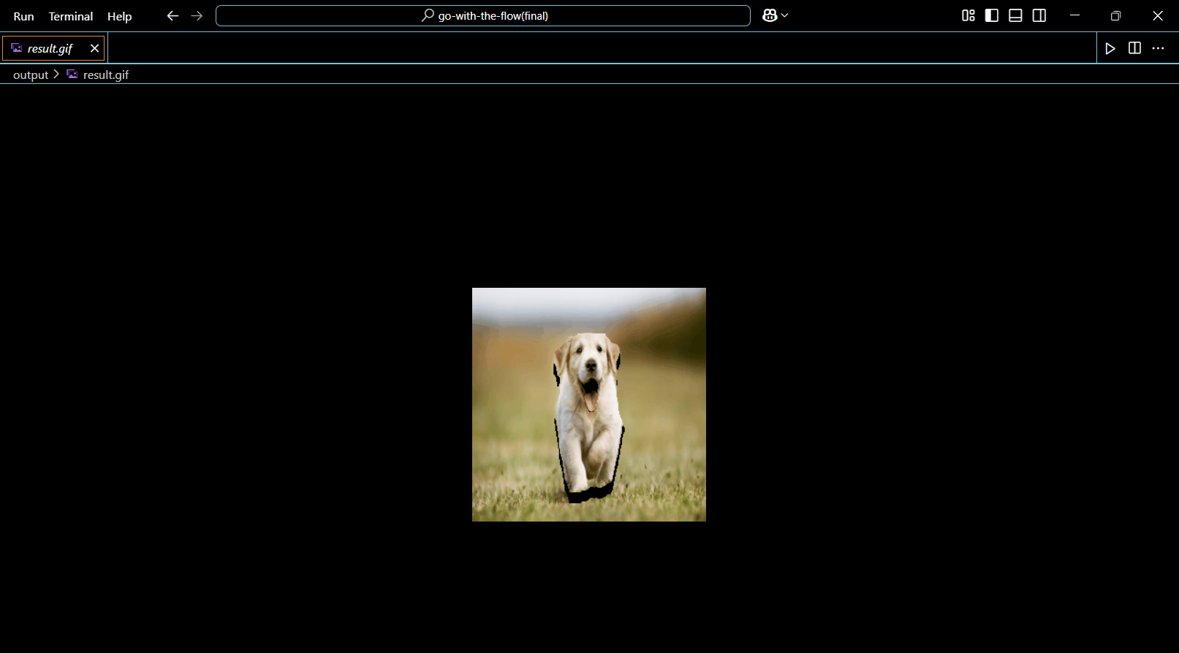
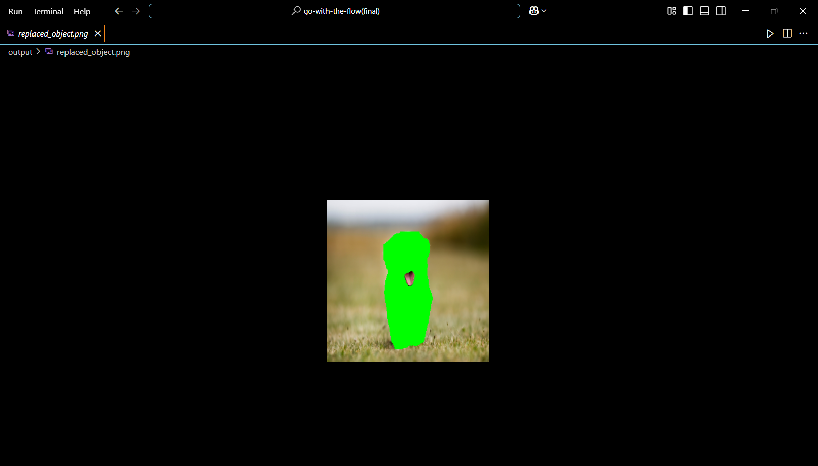
SCREENSHOTS
GIF Object Replacement

Slide 26
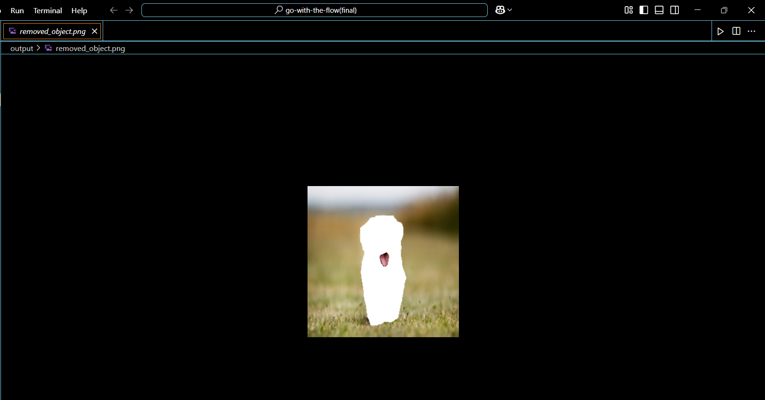
SCREENSHOTS
Object Removable

Slide 27
THANK YOU

