Slide 1
SAP USR02 User Analysis
AI-Assisted ABAP Development
Case Study using Watsonx.ai

Slide 2
Business Requirement
Obtain list of users with validity dates
Track failed logon attempts
Capture last logon date and time
Focus on active users from SAP table USR02

Slide 3
AI-Based Solution
Watsonx.ai (llama-3-3-70b-instruct) was used to generate and enhance ABAP code.
Generated object-oriented ABAP codeResolved syntax errorsAdded user group and additional fieldsCreated interactive report with SU01 navigation on double-click

Slide 4
Benefits & Productivity Gains
Reduced manual development effort. Estimated development time reduced from 5-6 hours to 30-40 minutes. Improved requirement understanding and stakeholder communication. Supported timely project execution

Slide 5
Implementation and Governance
AI-generated solution refined and executed in SAP ABAP editorTechnical specifications prepared using IBM Consulting AdvantageAll AI-generated outputs reviewed before useRisks addressed: incorrect responses, bias, and data privacy concernsHuman judgment applied throughout

Slide 6
start
Error handling
Watsonx ai prompt to generate code to display the list of active users
Watsonx ai prompt to correct the code
yes
Watsonx ai prompt to correct the code
Watsonx ai prompt generate code using OOPS and to have additional fields and an interactive report
Yes
All requirements met
No
Execute the report to get the list of users

Slide 7
AI coding in ABAP using Watson.ai

Slide 8
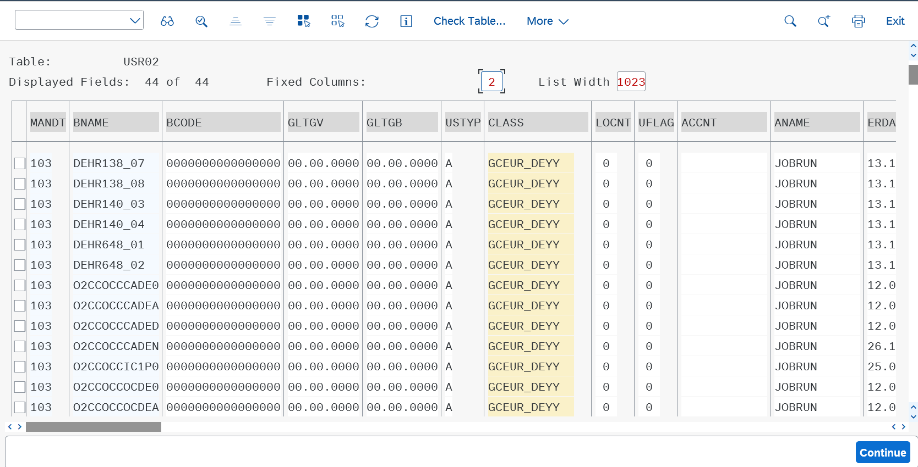
Output from Table

Slide 9
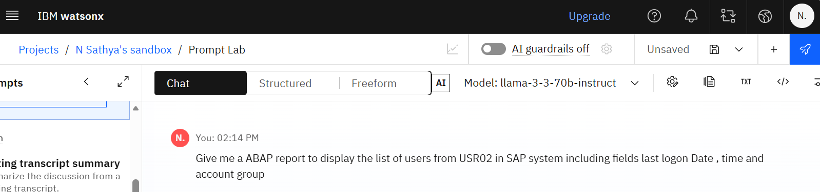
The Problem statement

Slide 10
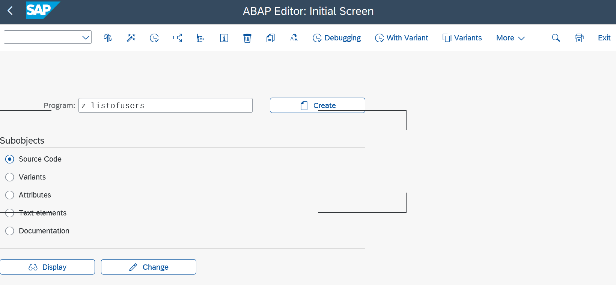
Create a report in ABAP editor

Slide 11
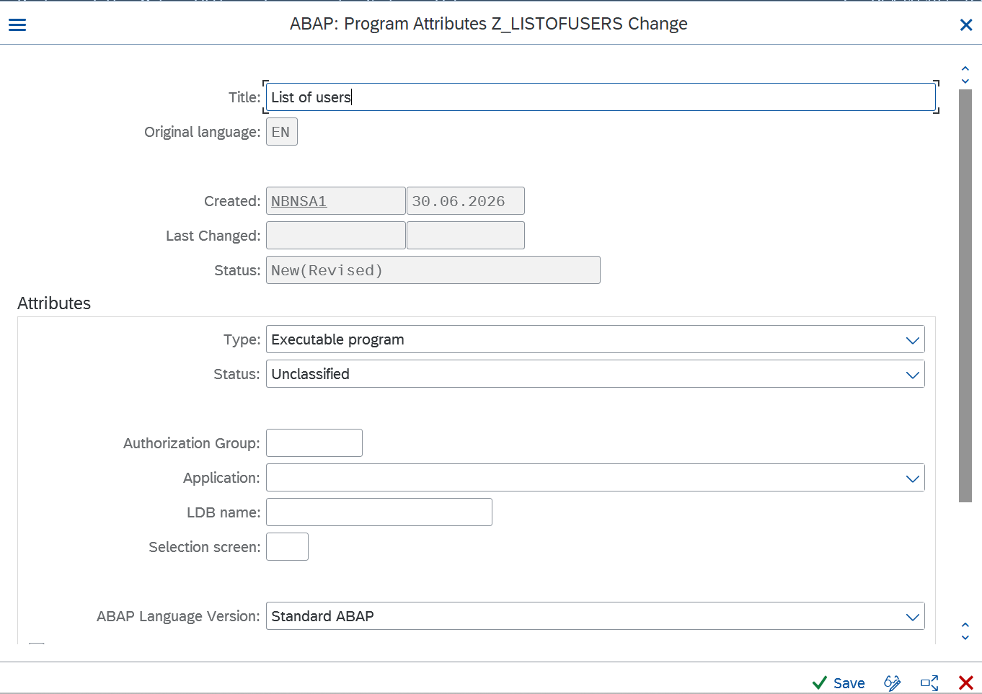

Slide 12
REPORT zuser_list.
TYPES: BEGIN OF ty_user,
bname TYPE usr02-bname, "Username
gltgb TYPE usr02-gltgb, "Last Logon Date
gltgs TYPE usr02-gltgs, "Last Logon Time
class TYPE usr02-class, "Account Group
END OF ty_user.
DATA: lt_users TYPE TABLE OF ty_user.
SELECT bname gltgb gltgs class FROM usr02 INTO TABLE lt_users.
WRITE: / 'Username', 20 'Last Logon Date', 40 'Last Logon Time', 60 'Account Group'.
ULINE.
LOOP AT lt_users INTO DATA(ls_user).
WRITE: / ls_user-bname, 20 ls_user-gltgb, 40 ls_user-gltgs, 60 ls_user-class.
ENDLOOP.

Slide 13
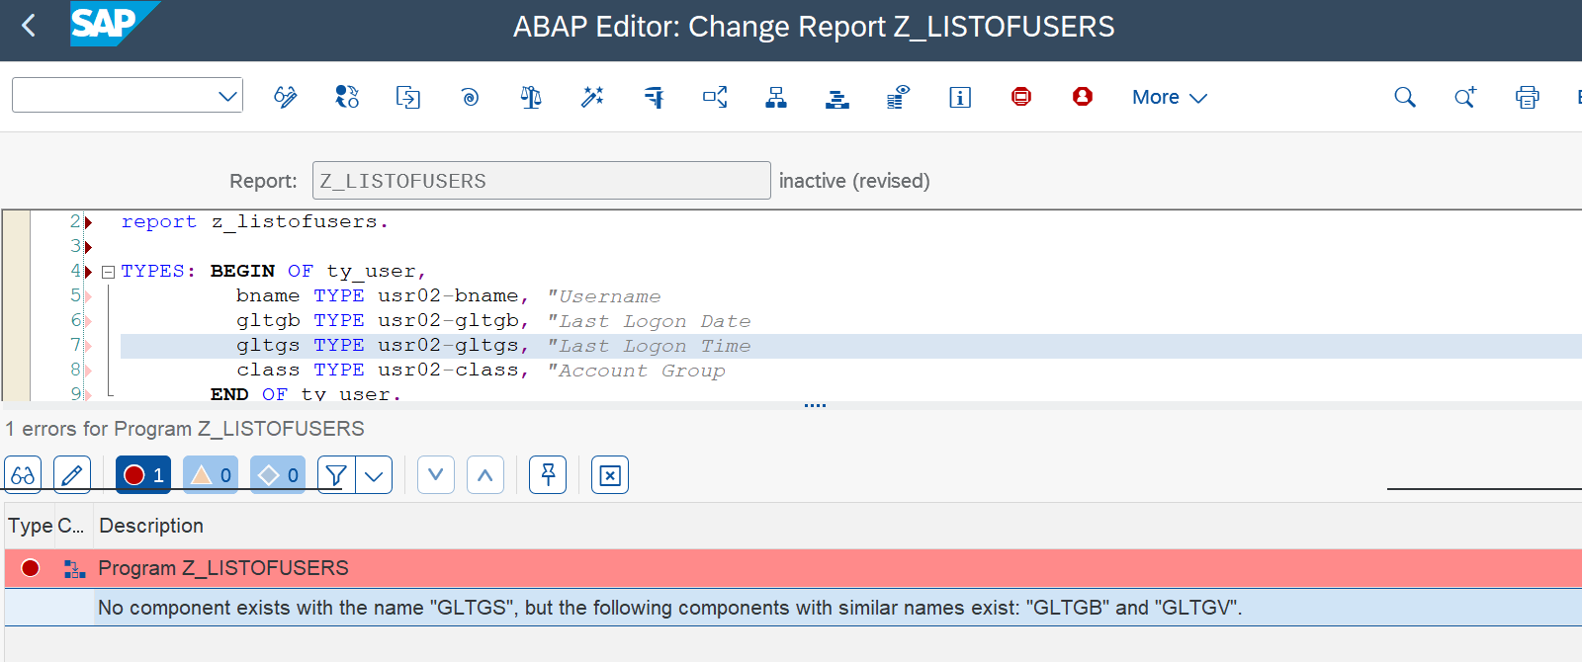
Errors in the code while performing syntax check

Slide 14
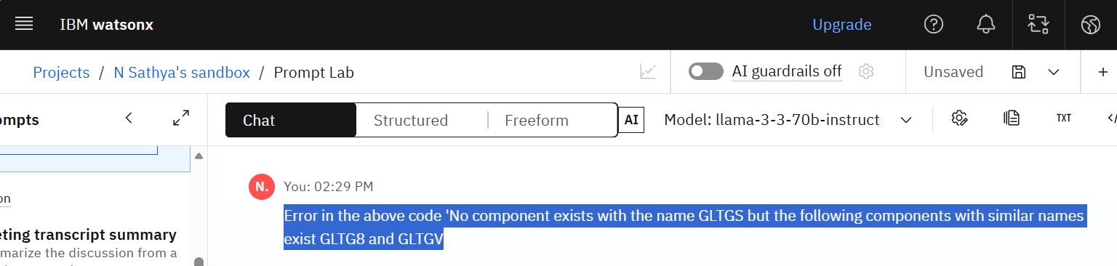
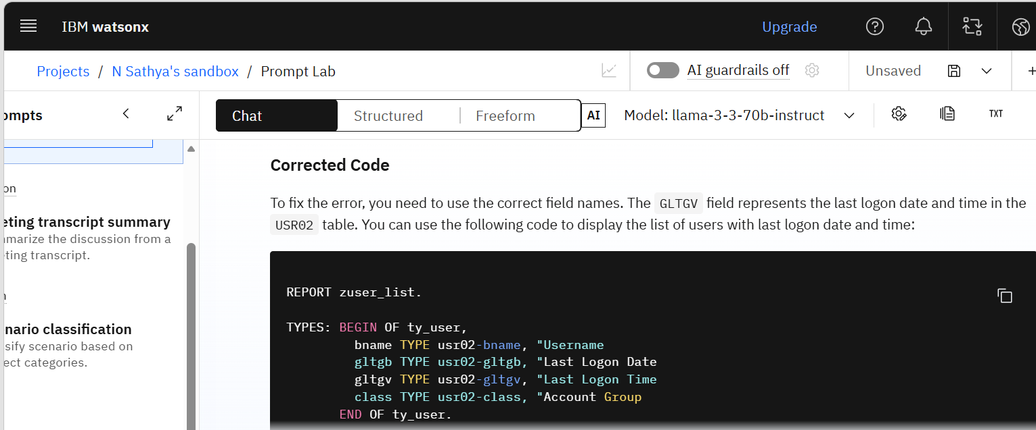
Giving the errors to Watsonx.ai

Slide 15
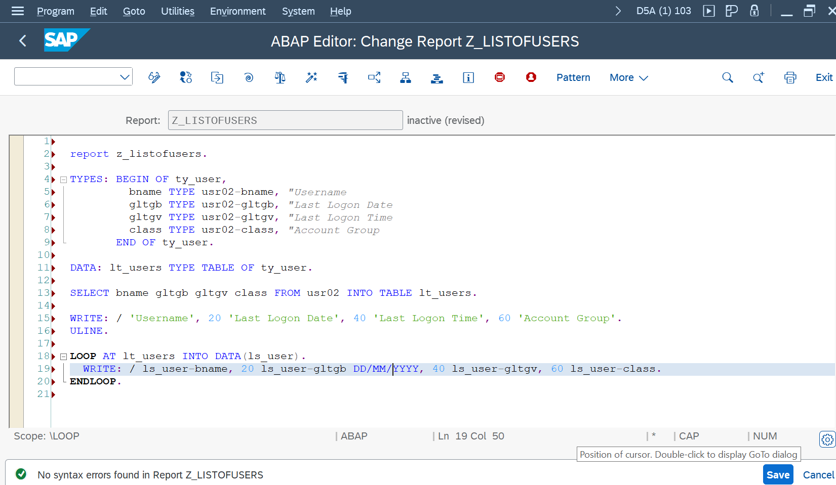
No syntax error in the code

Slide 16

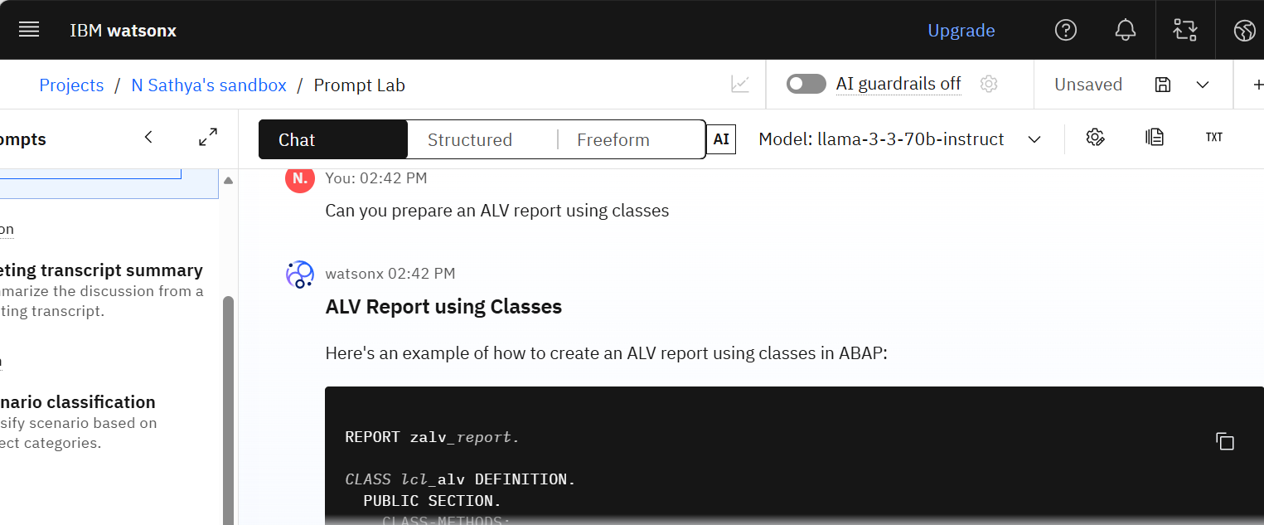
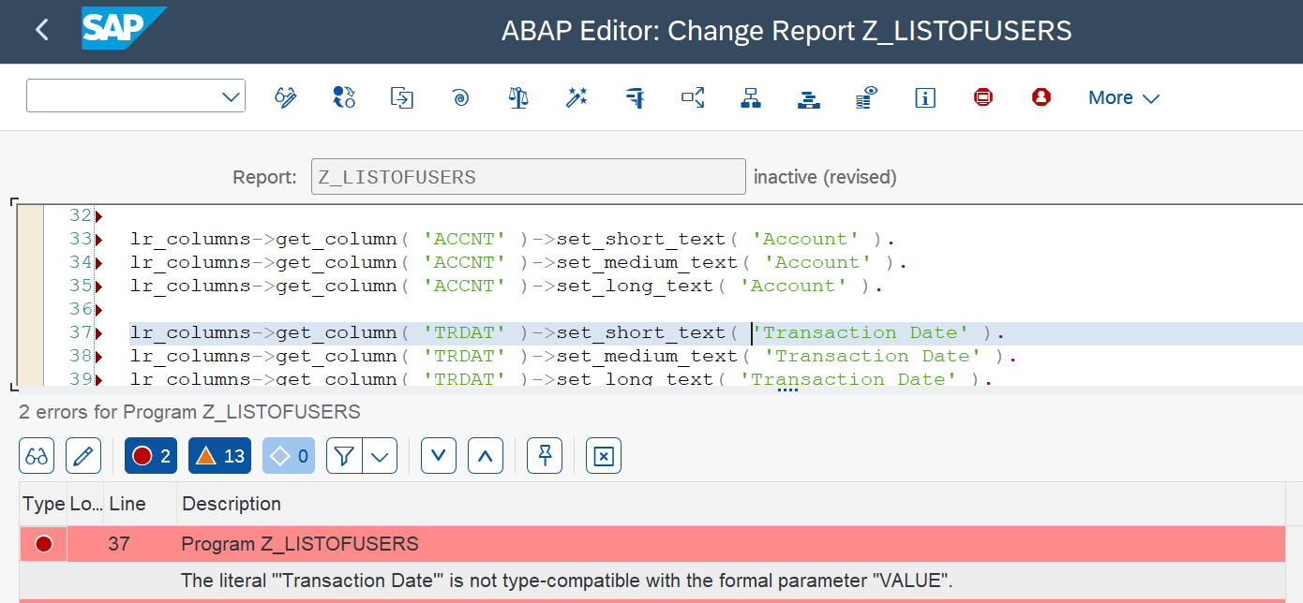
To enhance the code using Watsonx.ai

Slide 17
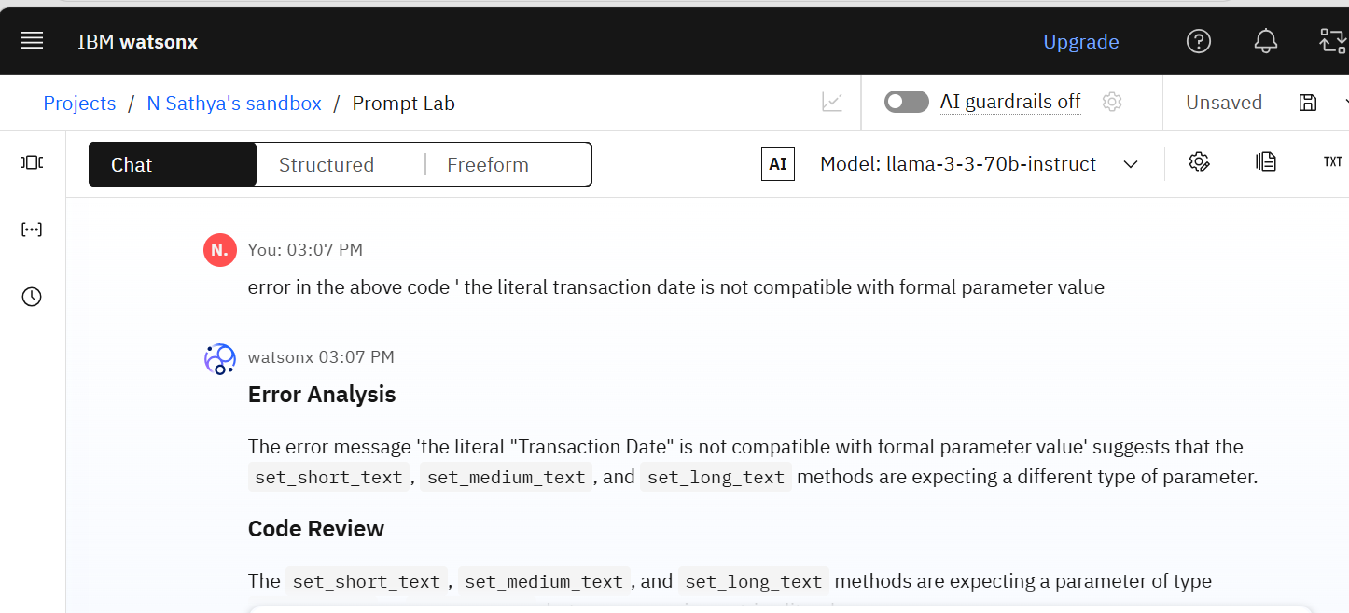
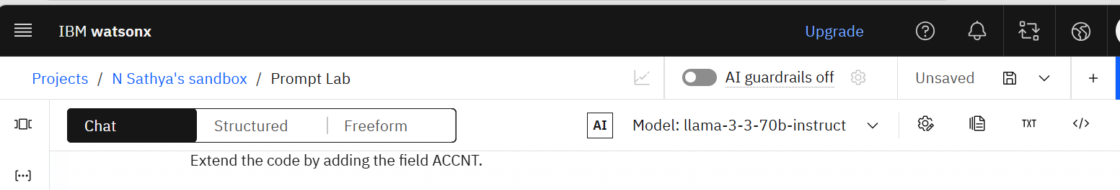
Error given as input in Watsonx in

Slide 18
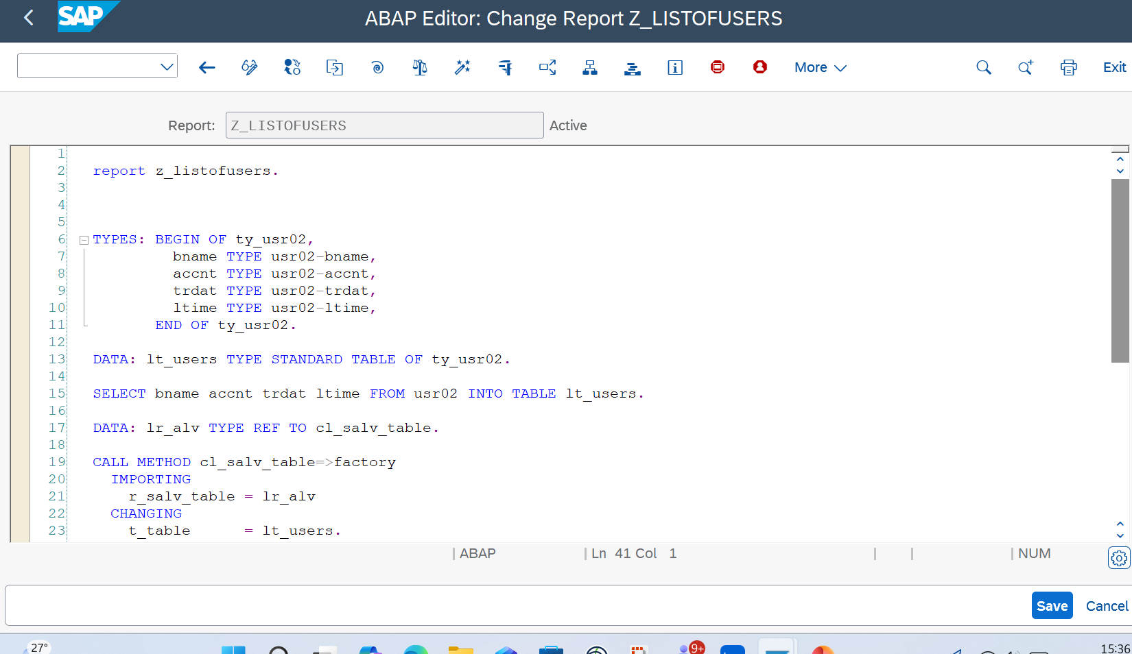
No syntax errors

Slide 19
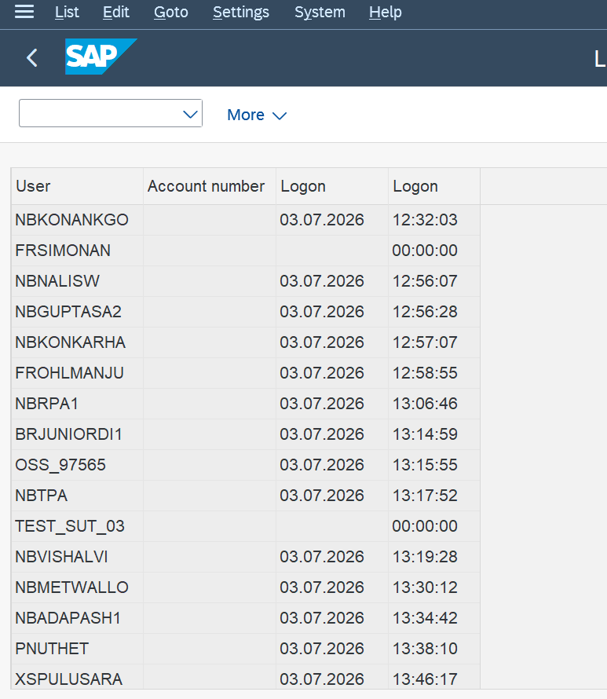
Output form the report

