Slide 1
Winter 2027-28 measles readiness
Recommendation: fund option B, the MMR catch-up for those born 2008 to 2012
It is the only option that brings measles' reproduction number for the winter below one: 0.9 with it, against 1.3 with no catch-up and 1.3 under each of the other options.
Without it, one case in the region would on average start a chain that keeps growing through the winter.
Decision for the executive management team, 21 July 2027
Fund option B for delivery from September to November 2027 through the school immunisation team, further education colleges and GP letters (EUR 438,000 in the options paper).
Regional Immunisation Office, Oriel Health Region
1 / 5

Slide 2
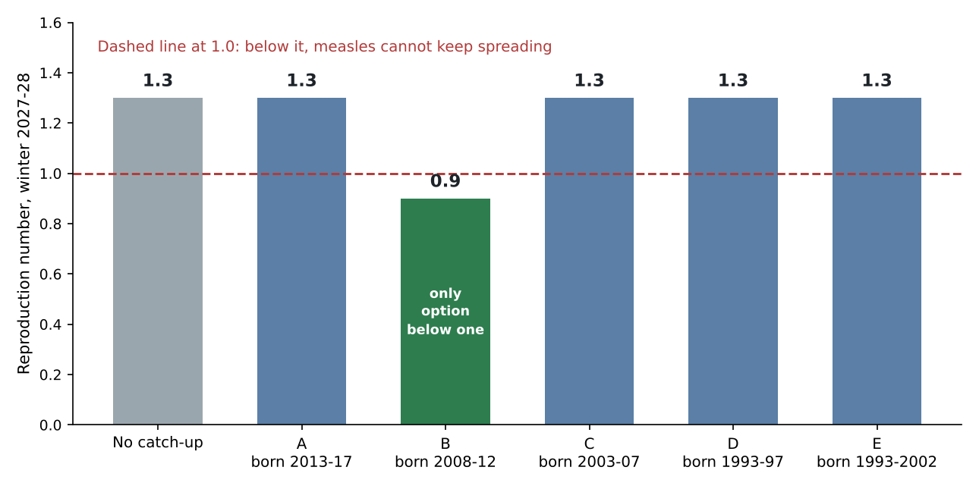
Only option B brings the winter reproduction number below one
Dominant eigenvalue of the next-generation matrix: National Social Contact Survey 2023 term-time diaries, national immunity profile May 2027, projection at 1 January 2028, scaled to R0 15 (PS-07 3.2).
2 / 5

Slide 3
Why the 15 to 19-year-olds decide it
The region is 95.2 per cent immune, above the 93.3 per cent that R0 15 needs, so on the average no catch-up looks needed (0.7).
All the contact survey's diaries together give 0.9, but two thirds were kept in July and August with the schools closed. The winter runs in term.
In the May diaries, kept in term, more than half of the contacts of 15 to 19-year-olds are with others of that age; in the summer diaries, under a fifth.
The cohort born 2008 to 2012, whose uptake fell in the 2010-12 vaccine scare, is 15 to 19 on 1 January 2028 and 11.2 per cent susceptible, against 4.8 per cent across the region. In term, chains of infection run inside that group, so only option B takes the reproduction number below one; D and E reach the least immune adults and the most people and leave it at 1.3.
National Social Contact Survey 2023 public use file; national immunity profile, May 2027
3 / 5

Slide 4
What each option involves
Option | On the register, living in the region | No valid MMR dose | Exactly one valid dose | Confirmed cases since 2019 | Of which imported
A (born 2013 to 2017) | 35,346 | 3,545 | 4,720 | 9 | 2
B (born 2008 to 2012) | 33,217 | 4,286 | 6,091 | 10 | 2
C (born 2003 to 2007) | 29,398 | 2,857 | 3,960 | 11 | 3
D (born 1993 to 1997) | 30,625 | 4,971 | 7,302 | 10 | 3
E (born 1993 to 2002) | 57,865 | 8,526 | 11,793 | 16 | 5
Register at 30 June 2027; valid doses under the national guidelines (12.5). Cases with rash onset from 1 January 2019 to 30 June 2027. Option E includes option D's birth years.
Regional immunisation register extract of 3 July 2027; notifiable disease system extract of 6 July 2027
4 / 5

Slide 5
Method and sources
PS-07 section 3: the reproduction number below one throughout the winter, December to February, with R0 15 over the winter; population and immunity on 1 January 2028 from the national profile; each option counted for the people the options paper expects it to make immune.
Next-generation matrix: contacts per day by age band from the survey's term-time diaries (2 to 26 May 2023) times each band's susceptible share, scaled so a wholly susceptible region gives 15; the reproduction number is its dominant eigenvalue, which has to stay below one through the term weeks of the winter (PS-07 3.1).
Register: addresses in Northern Ireland are outside the region; local health office codes read in the scheme in force when recorded; events through the merge table; GP return lines replaced or withdrawn removed; doses counted under guidelines 12.5.
Cases: notifiable disease system extract of 6 July 2027; the 2019 outbreak's back-entered records and cases notified twice counted once.
PS-07 Measles winter planning standard, version 3.0; options paper of 9 June 2027
5 / 5

