Slide 1
Four of the seven commercial uses meet the coverage test
Commercial Fleet Safety Programme: the uses covered from 1 July 2027
Briefing ahead of the notice to operators, due by 15 January 2027
Thomas Moyer, Policy Adviser

Slide 2
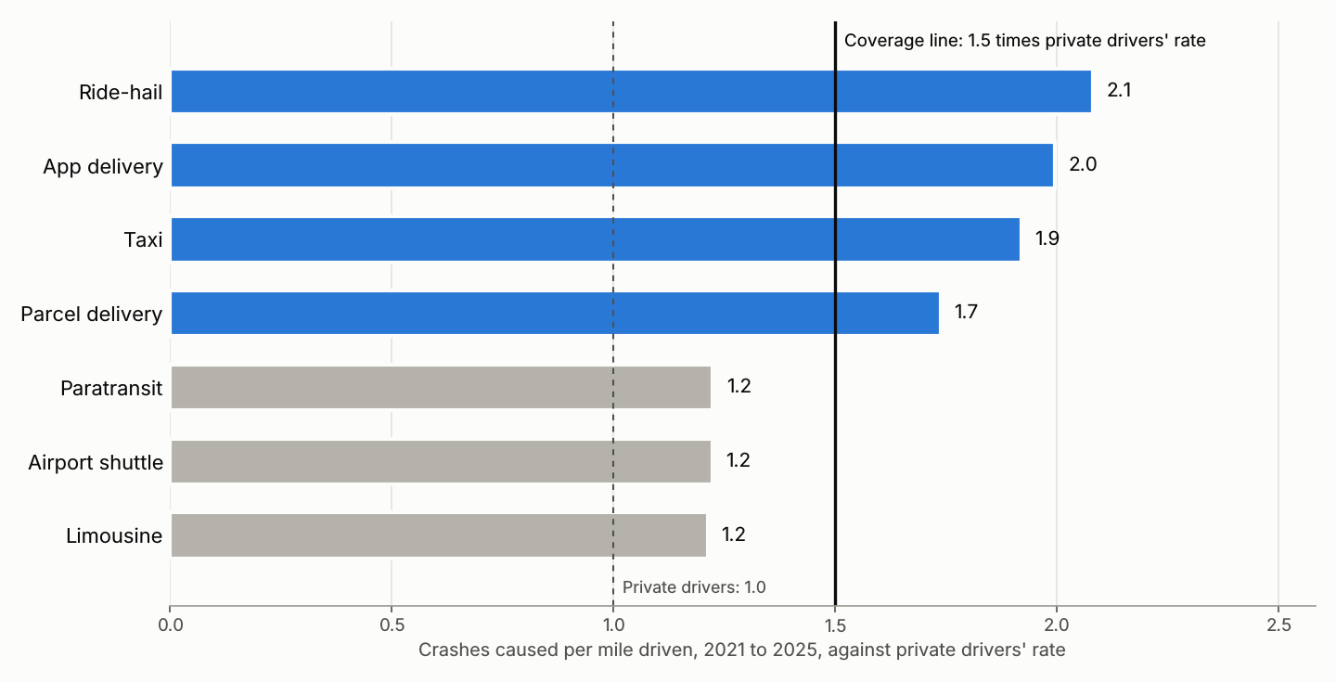
Taxicabs, ride-hail, parcel delivery and app-based delivery cause crashes at 1.5 times private drivers' rate per mile or more
Crashes between moving vehicles, 2021 to 2025 (state crash records extract); miles by road class, day type and hour (Department of Transportation).
2

Slide 3
No record counts the miles each use drives, so the crash reports measure them
A vehicle struck by an at-fault driver is a draw from the traffic around it, so a use's share of the vehicles struck on a class of road in a given hour is its share of the miles driven there.
Crashes per mile are far from even: they run highest on urban arterials at night, so the struck vehicles over-represent the uses that work those streets and hours.
The Department's miles for each road class, day type and hour are shared out by the vehicles struck there, and each use's shares add up to its miles.
Closest to the line: Parcel delivery at 1.7 times private drivers' rate, covered; paratransit, airport shuttles and limousines all under 1.3, not covered.
Use | Crashes caused | Miles (millions) | Per 100 million miles | Against private
Ride-hail | 6,762 | 1,787 | 378.3 | 2.1
App delivery | 3,282 | 905 | 362.6 | 2.0
Taxi | 1,564 | 448 | 348.8 | 1.9
Parcel delivery | 3,317 | 1,050 | 315.8 | 1.7
Paratransit | 865 | 389 | 222.4 | 1.2
Airport shuttle | 648 | 292 | 222.1 | 1.2
Limousine | 558 | 253 | 220.3 | 1.2
Private drivers | 91,211 | 50,194 | 181.7 | 1.0
Miles by stratum: fleet_safety_programme_2027.xlsx, sheet Miles by stratum.
3

Slide 4
Ride-hail drivers caused the crashes that killed or seriously injured the most people, and cost the most
Use, 2021 to 2025 | People killed or seriously injured | Cost (USD millions)
Taxi | 74 | 505.9
Ride-hail | 402 | 1,979.6
Limousine | 45 | 242.4
Airport shuttle | 63 | 299.5
Paratransit | 55 | 279.5
Parcel delivery | 109 | 641.9
App delivery | 136 | 699.9
Every crash of any kind in which a driver of the use was recorded at fault; deaths within 30 days; the Department's 2025 crash unit costs.
4

Slide 5
What the operators are told by 15 January
Covered from 1 July 2027: taxicabs, ride-hail, parcel delivery and app-based delivery.
Not covered: limousines, airport shuttles and paratransit.
Operators of the covered uses fit telematics to every vehicle they run in the use and enrol its drivers in coaching. The test is run again every three years on the latest five years of crashes.
Coverage rule, adopted 14 October 2026 (Resolution 2026-41).
5

