Slide 1
Eight pads go into the 2027 zero-emission controller conversion
Pads whose intermittent-vent controllers vented more than 0.5 t of methane in 2026, as reported under MRS-03 (methane reduction plan, section 3)
Pad | Surface location | Methane 2026 (t)
Kakwa 3-9 | 03-09-063-05W6 | 0.95
Kakwa 11-22 | 11-22-063-05W6 | 0.86
Kakwa 14-16 | 14-16-063-05W6 | 0.75
Kakwa 6-27 | 06-27-063-05W6 | 0.74
Elmworth 10-11 | 10-11-070-09W6 | 0.71
Kakwa 16-23 | 16-23-064-04W6 | 0.70
Elmworth 7-2 | 07-02-070-11W6 | 0.64
Kakwa 1-14 | 01-14-064-04W6 | 0.62
The order
One order for the conversion kits, placed with the supplier by 15 February 2027, fixes this list.
Installs run from May, after spring break-up, to the end of September.
The other 18 pads keep their controllers until the 2028 programme; the highest of them, Elmworth 14-24, vented 0.41 t.
Source: Larchmere 2026 source-level inventory under MRS-03 Revision 4 (larchmere_source_inventory_2026.xlsx, Annex B pads). Methane Reduction, 24 January 2027.
1

Slide 2
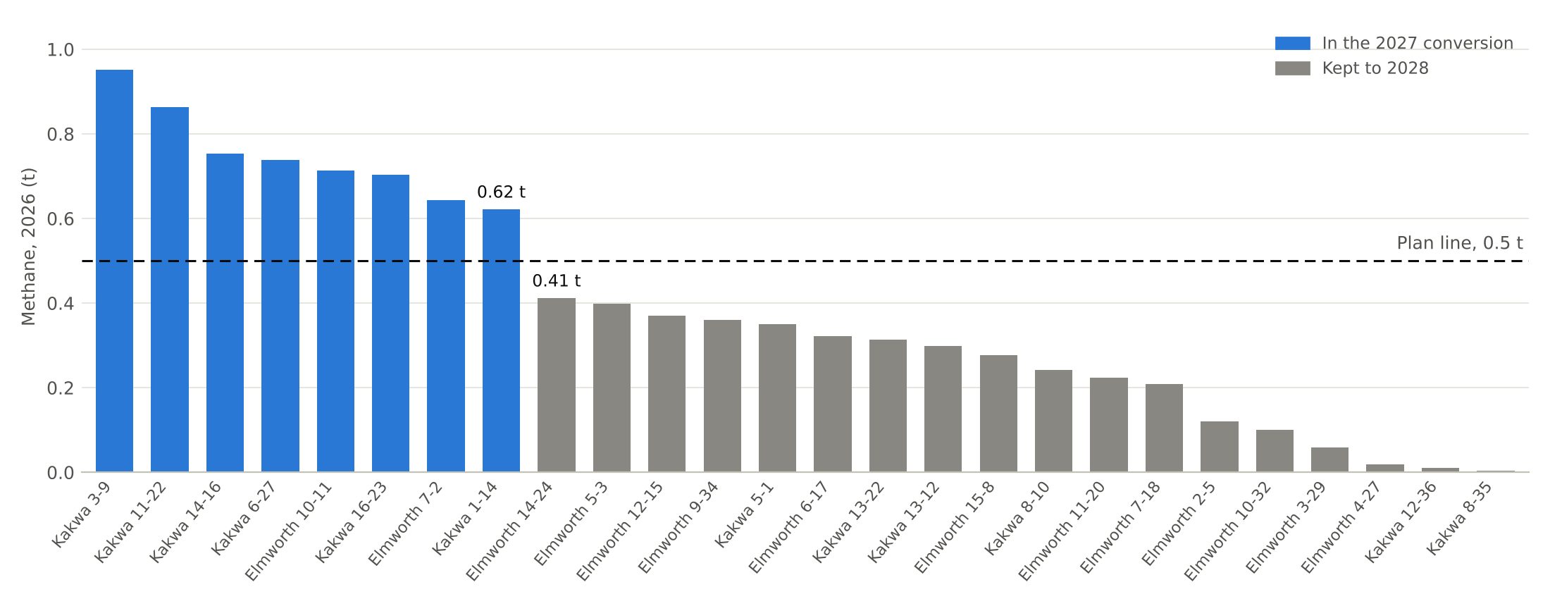
The line falls between Kakwa 1-14 at 0.62 t and Elmworth 14-24 at 0.41 t
Every pad's 2026 methane from its intermittent-vent controllers, highest first, against the plan's 0.5 t line
Source: Larchmere 2026 source-level inventory under MRS-03 Revision 4 (larchmere_source_inventory_2026.xlsx, Annex B pads). Methane Reduction, 24 January 2027.
2

