Slide 1
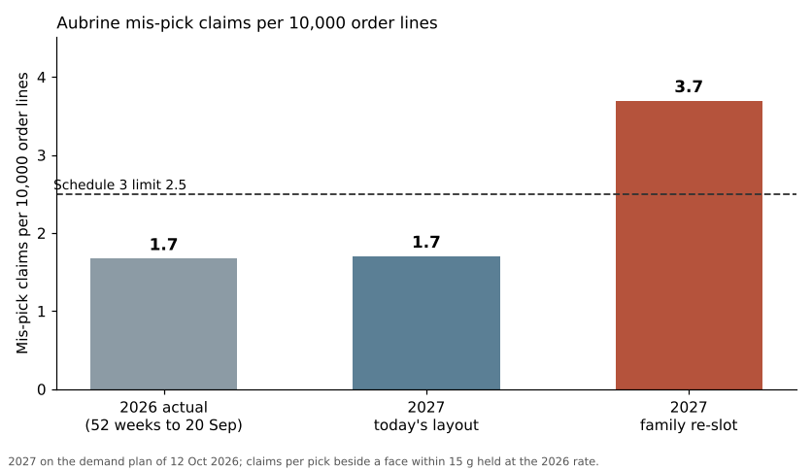
Hold the family re-slot as drawn: 3.7 claims per 10,000 lines in 2027 against the limit of 2.5
About 3,800 mis-pick claims on 2027's lines under the re-slot; today's layout stays at 1.7 per 10,000.
Parcels are check-weighed to 15 g: a wrong item gets through only when it weighs within 15 g of the one ordered.
The re-slot puts each line's shades side by side: 34.5% of 2027 picks would sit beside such a face, against 15.6% now.
Source: Aubrine claims register and Uphall WMS exports to 20 September 2026; slotting plan approved 14 October 2026; Schedule 3 of the fulfilment agreement; PB-SOP-02. 1

