Slide 1
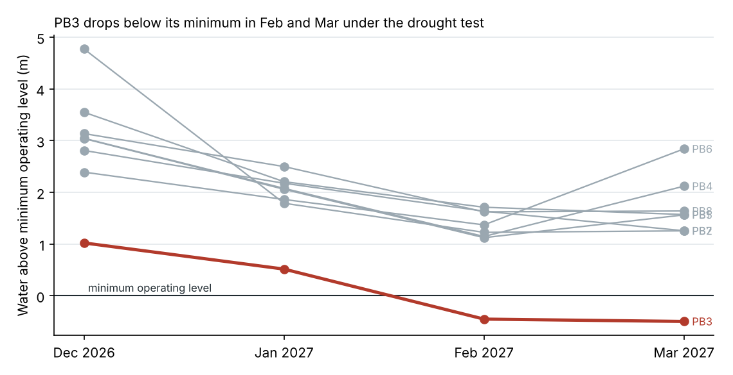
The 2026-27 bore plan fails the drought test at PB3 in February and March
With PB9 taking 4.40 ML/d from December, PB3's lowest level reaches 35.5 m below measuring point in February and March against a minimum operating level of 35.0 m.
PB9 sits in the same gravel channel as PB3: its October test drew PB3 down by about 0.66 m for each ML/d it pumped, 3.0 m at the planned take. PB4, closer on the map, moved 0.5 m.
Every other bore, PB9 included, stays above its minimum in all four months.
Ask: do not adopt the plan as drafted; bring back a revision that takes PB3 or PB9 down in February and March (SWS-03 section 5).
Site drought committee, 6 November 2026. Source: SCADA daily log 2014-2026, MRC MB1, PB9 test logger, summer bore plan (28 Oct).

Slide 2
Lowest level in each month under the design drought (m bmp, nearest 0.5 m)
Bore | Dec 2026 | Jan 2027 | Feb 2027 | Mar 2027 | Minimum
PB1 | 28.0 | 29.5 | 30.0 | 30.0 | 31.6
PB2 | 28.5 | 31.5 | 32.0 | 32.0 | 33.2
PB3 | 34.0 | 34.5 | 35.5 * | 35.5 * | 35.0
PB4 | 33.0 | 34.0 | 35.0 | 34.0 | 36.1
PB5 | 29.5 | 30.5 | 31.5 | 31.0 | 32.6
PB6 | 29.5 | 30.0 | 30.5 | 29.0 | 31.9
PB7 | 28.5 | 29.0 | 29.5 | 30.0 | 31.2
PB8 | 26.5 | 27.0 | 28.0 | 28.0 | 29.6
PB9 | holds in every month |  |  |  | 38.0
* below minimum operating level. Takes as the 28 October plan; aquifer at MB1's December 2019 to March 2020 levels.

